Slide 1

North Korean Missile testing data analysis (1984 – 2023)
YJ Kim (DAI #5)

Slide 2

Decision maker’s interest
Current DPRK missile testing capacities and capabilities
Historical progression of DPRK missile testing
Shifts in missile launching activities under different regimes
Analyzing DPRK military & economy trends
Ultimate Objective
Feed into strategic decision making process
Source:
https://www.reuters.com/world/asia-pacific/north-korea-fires-ballistic-missile-south-korea-military
Notes:
The ultimate goal would be gathering relevant information and driving it to the decision-making process.

Slide 3
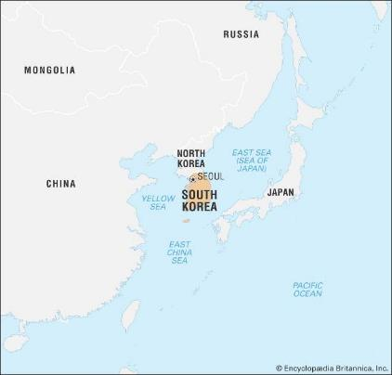
Agenda
Overview of DPRK missile facility locations
Number of missile tests by timeline with historical events
Number of successes and failures by facility names
DPRK missile traveled distance expansions by timeline
DPRK missile landing location groups
Source: https://www.britannica.com/place/South-Korea

Slide 4
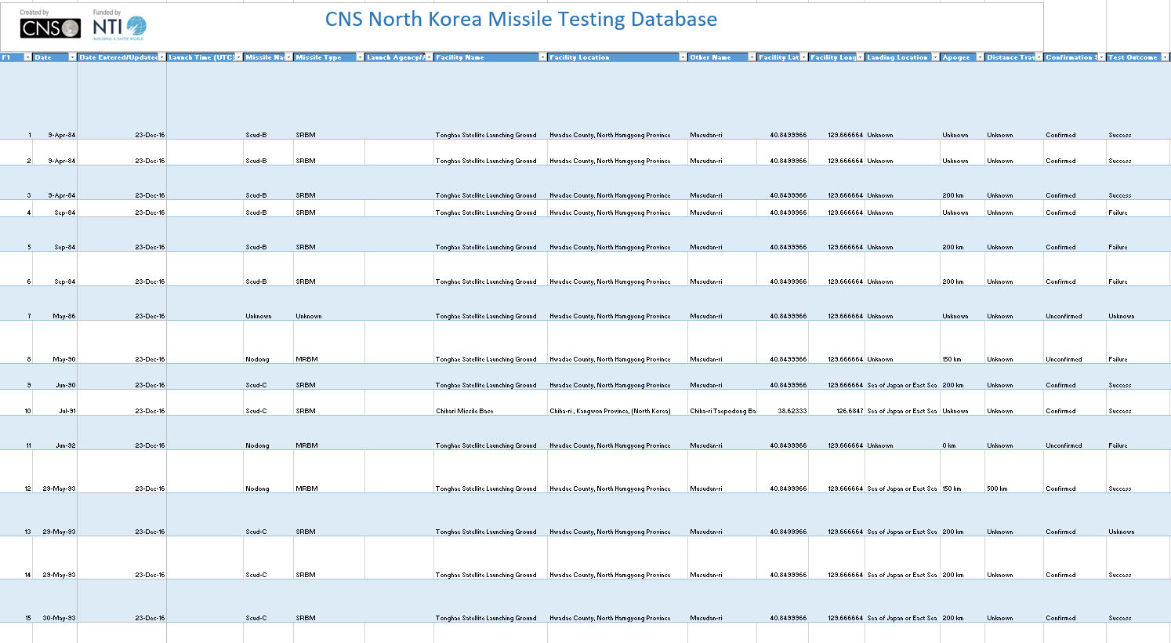
Data of interest
Data of interest
Facility names
Facility locations (Lat/Lon)
Test dates
Travel Distance
Landing locations
Test outcomes
(245 rows × 20 columns)

Slide 5
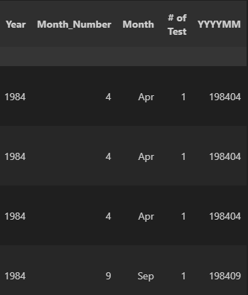
Data cleaning process
New columns
Changed ‘str’ values to ‘int’ or ‘float’
- Example: (km) values in the distance column
Replaced ‘Unknown’ values to ‘NaN’
Created new columns with given data
- Example: ‘Year’, ‘YYYYMM’ from dates column
Considered but actions not taken
- duplicating data
(Screen captured from VScode)
Notes:
Distort or misreport

Slide 6
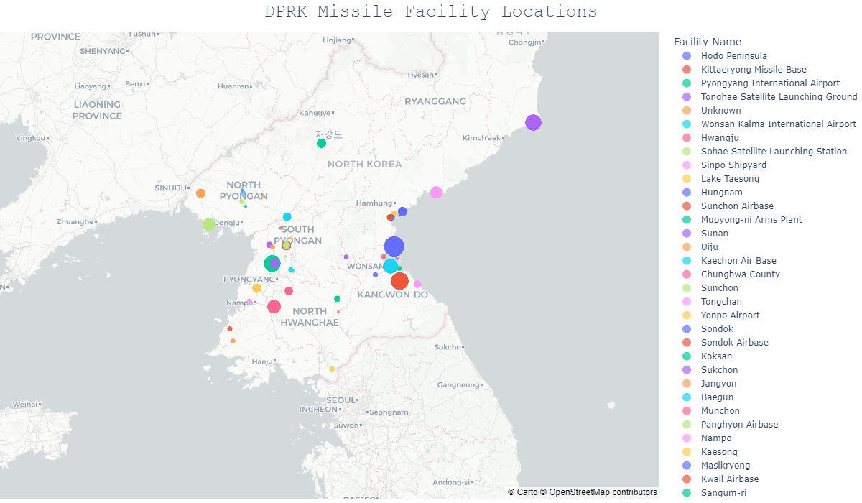
Notes:
Highlight
The distance from the borderline to capital of South Korea.
Equivalent size of Mississippi

Slide 7
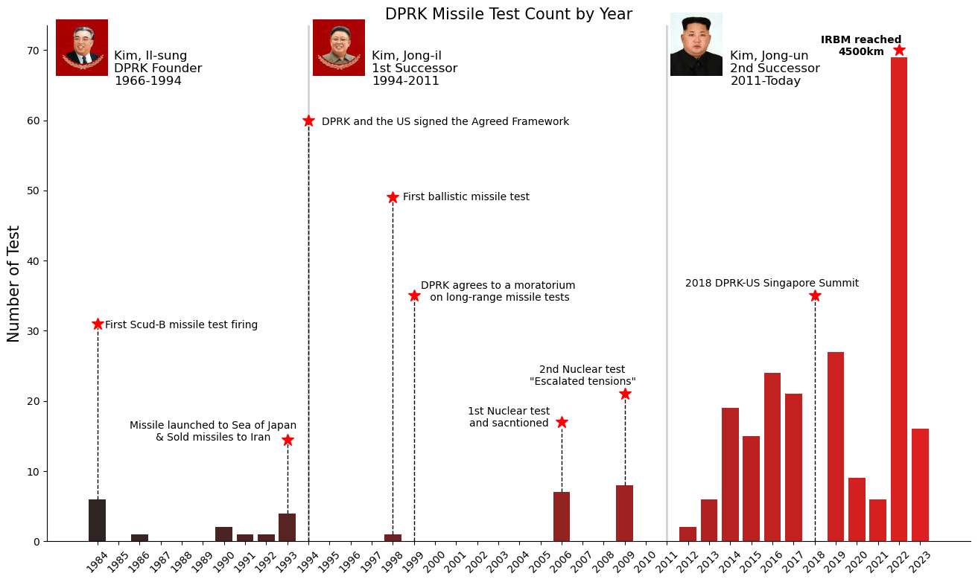

Slide 8
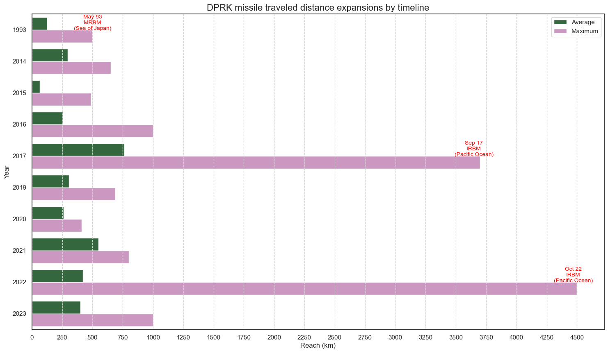

Slide 9
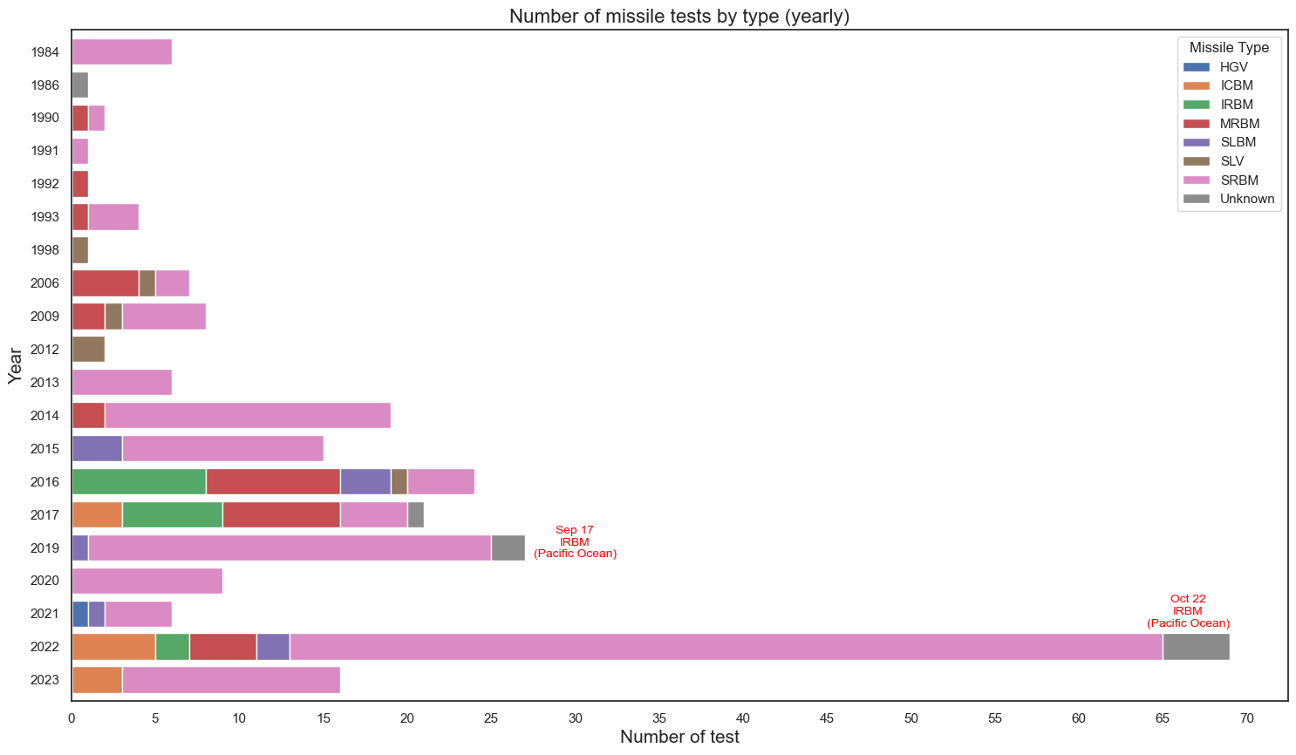

Slide 10
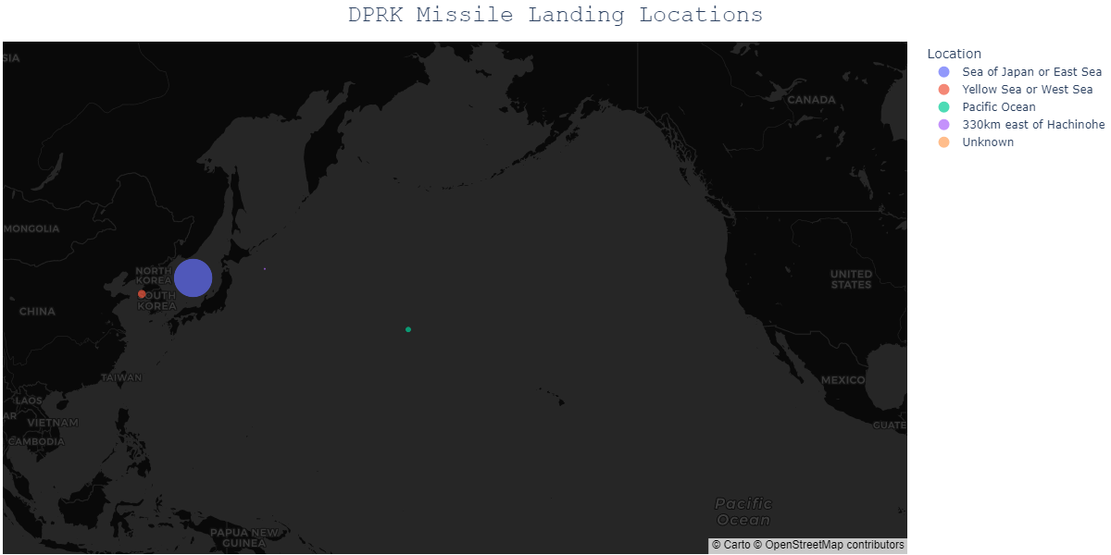

Slide 11
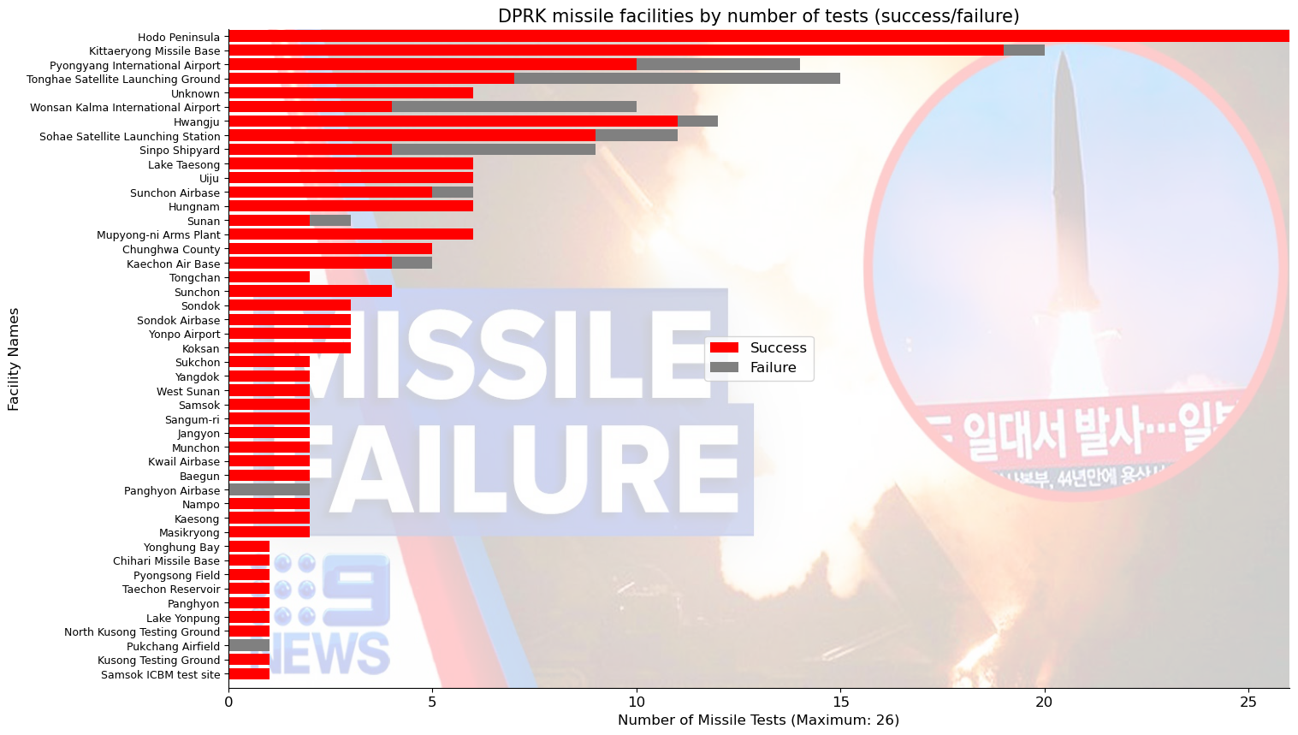
Notes:
Assets management aspects

Slide 12

Future data projects
Cross-reference with different classification dataset
Correlation between economic situation and missile tests
Find DPRK ‘internal’ information releases regarding tests
Analyze political imprisonment data and missile capabilities
Exploit target audiences &
Induce desired behavior

Slide 13

Contact, GitHub & dataset information
Contact
YJ Kim: princetonlaw@pm.com
GitHub repository:
https://github.com/mesege1/dprk_missile_stats
Data source:
https://www.nti.org/analysis/articles/cns-north-korea-missile-test-database/

