Slide 1

North Korean Missile testing data analysis (1984 – 2023)
YJ Kim (DAI #5)

Slide 2
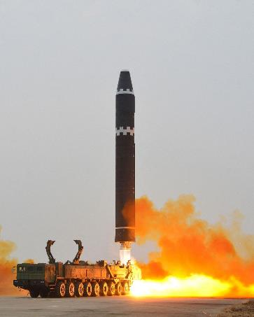
Decision maker’s Interest
Current DPRK missile testing capacities and capabilities
Historical progression of DPRK missile testing
Shifts in missile launching activities under different regimes
Analyzing DPRK military & political tactics
Ultimate Objective
Strategic defense decision making process
Source:
https://www.reuters.com/world/asia-pacific/north-korea-fires-ballistic-missile-south-korea-military
Notes:
The ultimate goal would be gathering relevant information and driving it to the decision-making process.

Slide 3
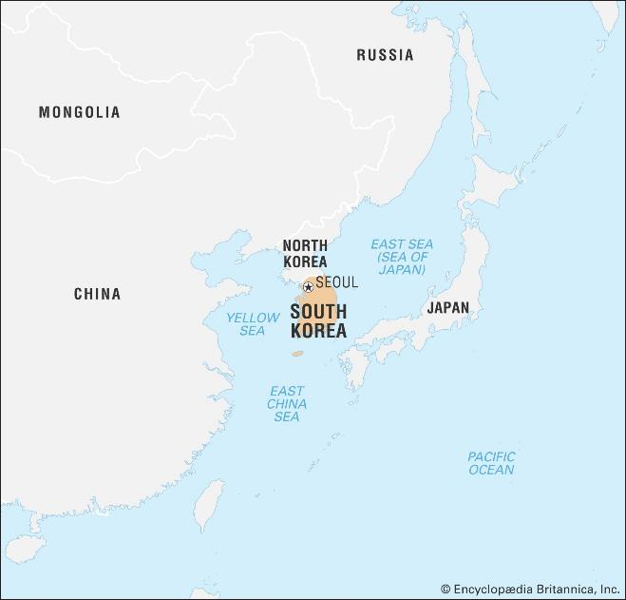
Agenda
Overview of DPRK missile facility locations
Number of missile tests by timeline with historical events
Number of successes and failures by facility names
DPRK missile traveled distance expansions by timeline
DPRK missile landing location groups
Source: https://www.britannica.com/place/South-Korea

Slide 4
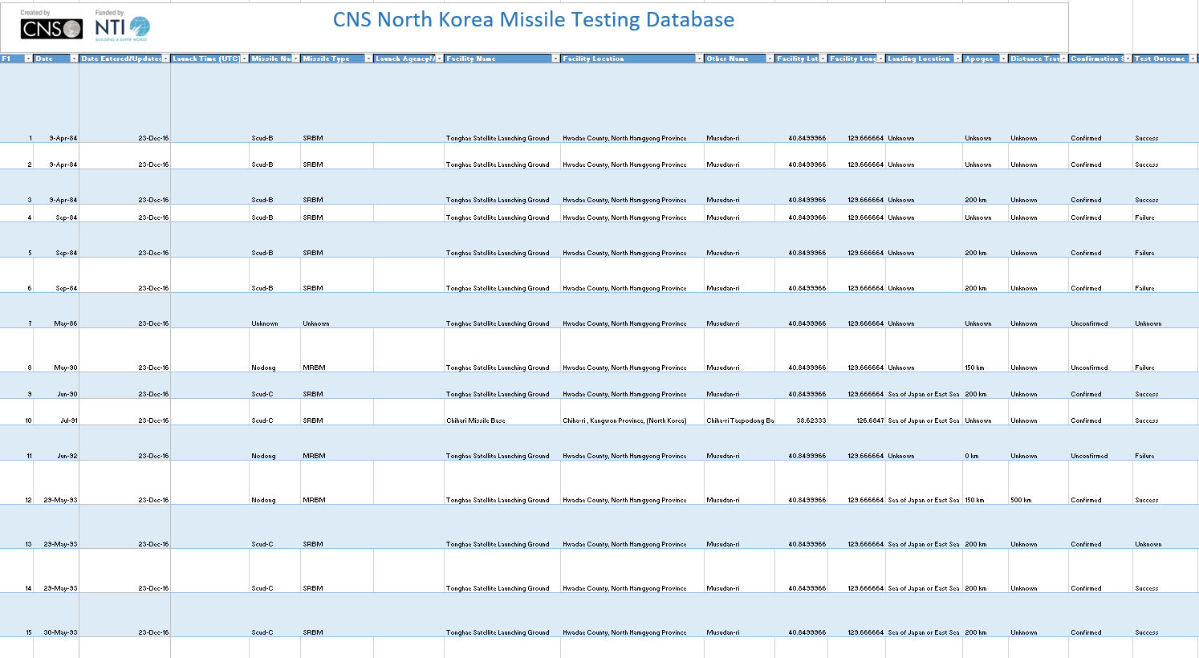
Data of interest
Data of interest
Facility names
Facility locations (Lat/Lon)
Dates
Distance
Landing locations
Test outcomes
(245 rows × 20 columns)

Slide 5
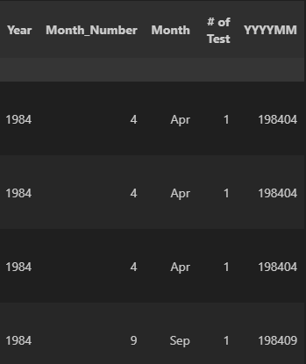
Data cleaning process
Changed ‘str’ values to ‘int’ or ‘float’
- Example: Distance data and km format
Replaced ‘Unknown’ values to ‘NaN’
Created new columns for applying functions
- Example: ‘Year’, ‘Month_Number’, ‘YYYYMM’
New column that gives values for each row
Consideration
- duplicated data
(Screen captured from Vscode)

Slide 6
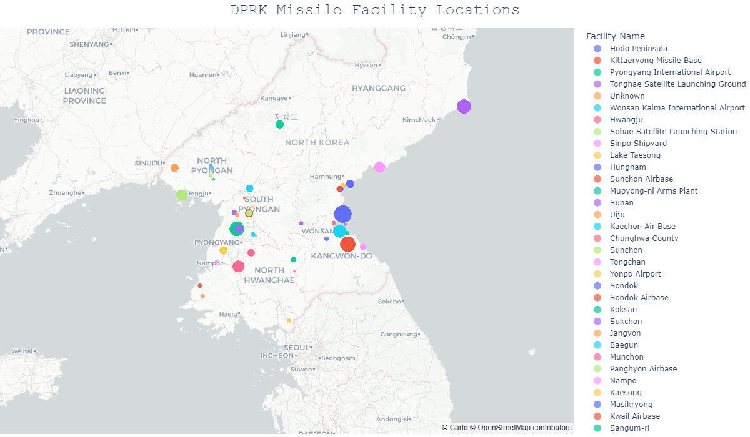
Notes:
Highlight
The distance from the borderline to capital of South Korea.
Equivalent size of Mississippi

Slide 7
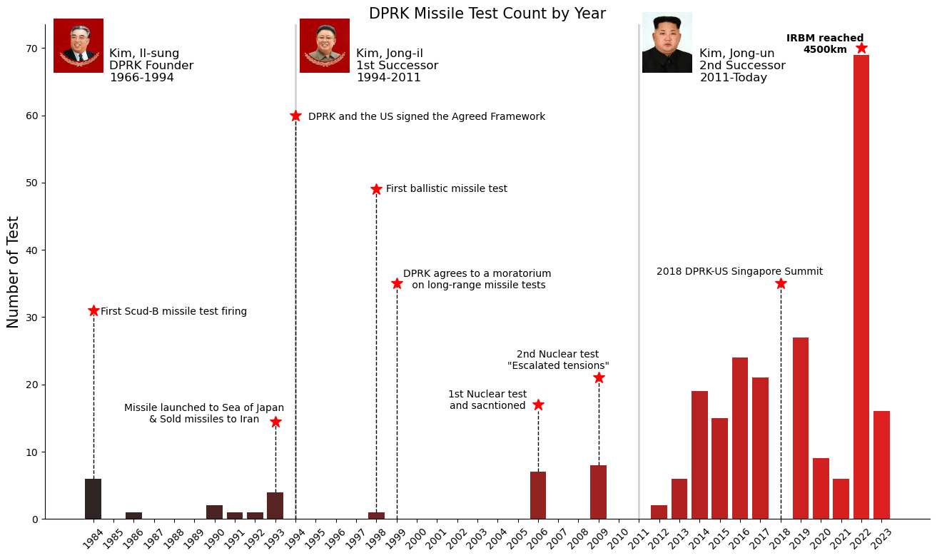

Slide 8
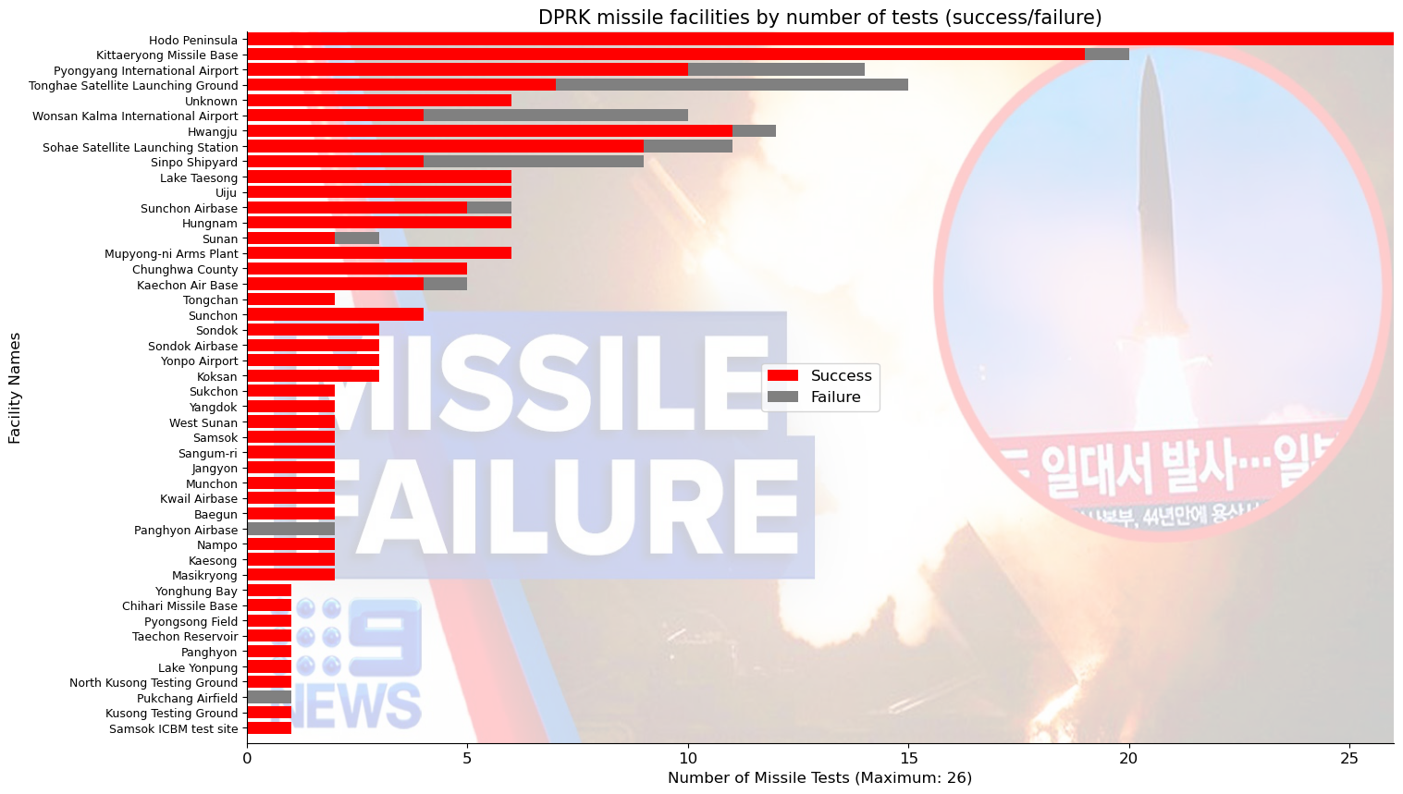
Notes:
Assets management aspects

