Slide 1
GALVANIZE DAI#5
THE NEXT CALIPHATE: PREDICTION FROM THE GWOT DATABASE
Measuring the impact of education level on
violent extremist activities in developing countries
YJ Kim

Slide 2

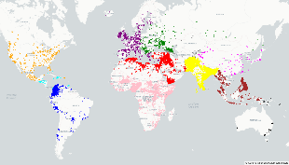
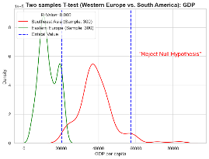


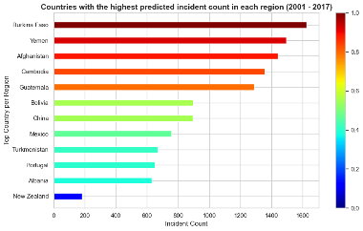
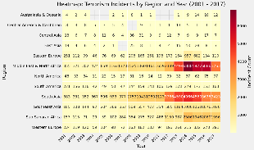
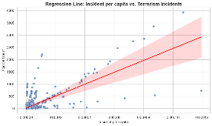
Overview
What is GWOT?
A global counterterrorism ‘military’ campaign initiated by the United States after 9/11 attack.
Why it matters?
Global terrorism is far from ending, and many unforeseen threat exists globally. Prediction is important.
About the data
The primary data: 'Global Terrorism Database' (2001 – 2017).
Supplementary data: 'Mean Education Level' and 'GDP per capita.'
Analysis Methodology
Gather data
Apply a model
& predict outcomes
Exploratory analysis
Hypothesis test
& build a model

Slide 3
02.
EXPLORATORY DATA ANALYSIS EXAMINE AND EXPLORE THE DATASET

Slide 4
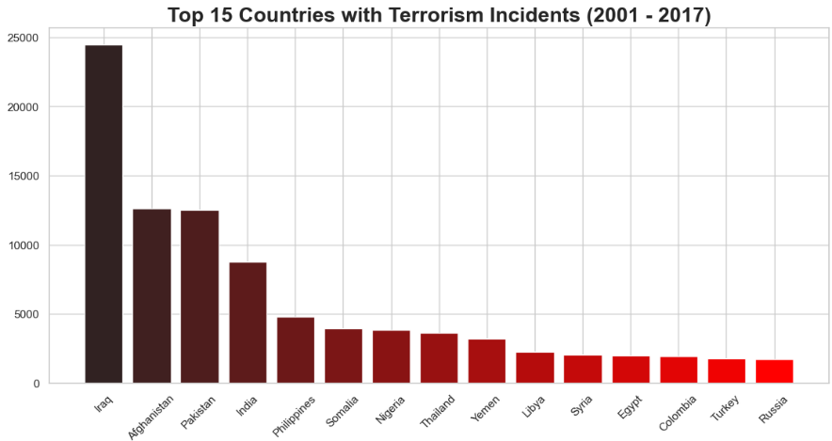
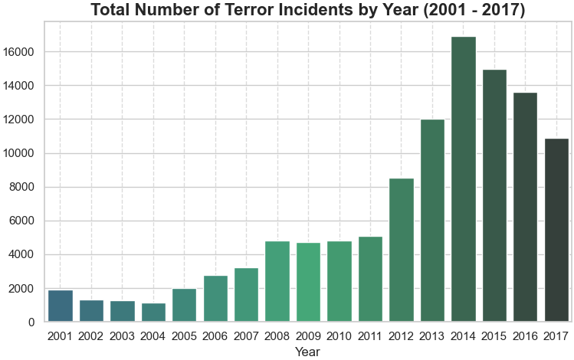
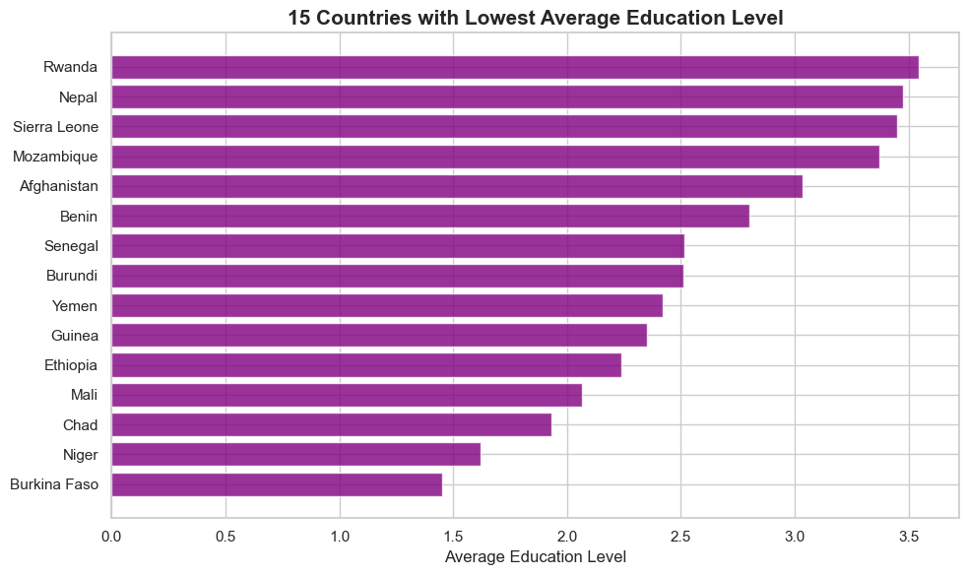
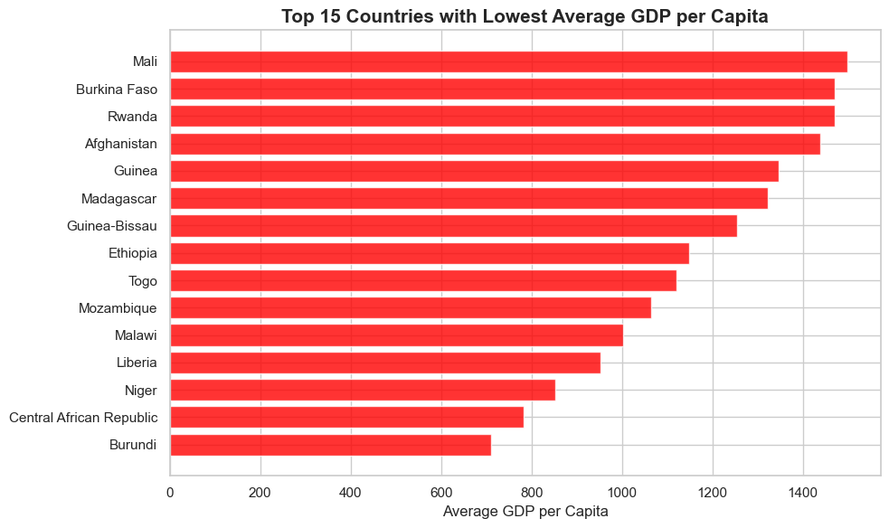
GWOT designated countries
Emergence of ISIS
9 countries repeated from low education and GDP per capita: Education level and GDP relate (Assumption)

Slide 5
03.
HYPOTHESIS TESTING
DOES THE EDUCATION AFFECT PARTICIPATION IN TERRORISM?

Slide 6

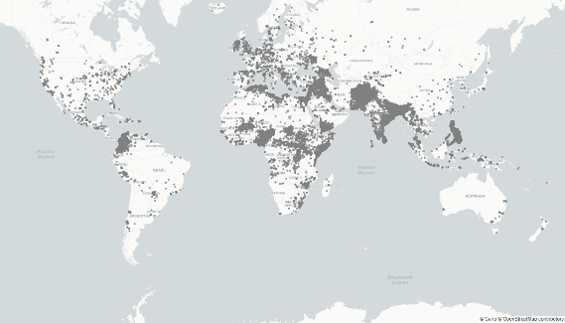
Null and Alternative Hypotheses
Null Hypothesis (H0)
Lack of education in developing countries has no significant relationship with participation in violent extremist activities.
Alternative Hypothesis (H1)
Lack of education in developing countries significantly relates to participation in violent extremist activities.
Test Objectives
Determine whether the model is statistically significant and impacts the terrorism incident.
Sampling methods
Input
Statistical Test
Input
output
Group by regions
High/Low incident countries
Answer

Slide 7
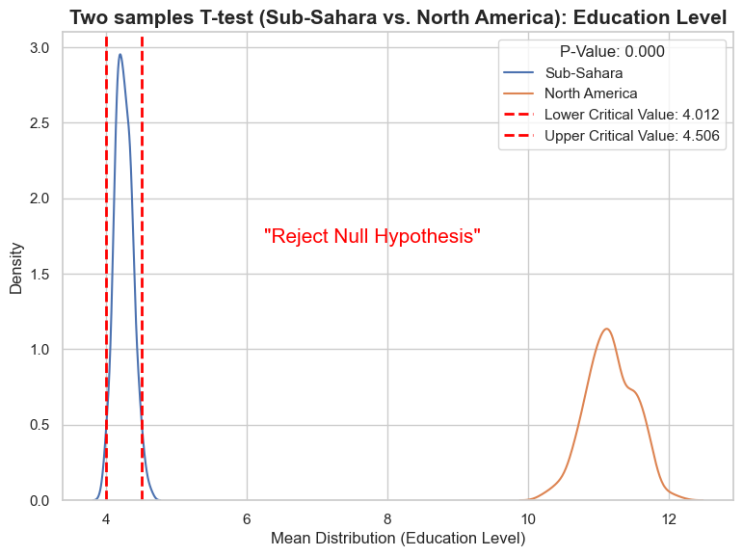
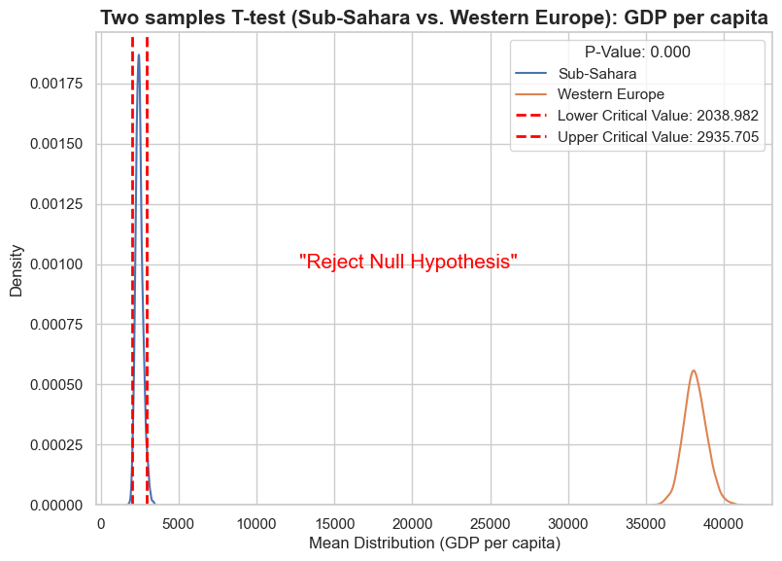
Hypothesis testing: Education and GDP per capita by region
Null Hypothesis (H0)
Lack of education in developing countries has no significant relationship with participation in violent extremist activities.
Alternative Hypothesis (H1)
Lack of education in developing countries significantly relates to participation in violent extremist activities.

Slide 8
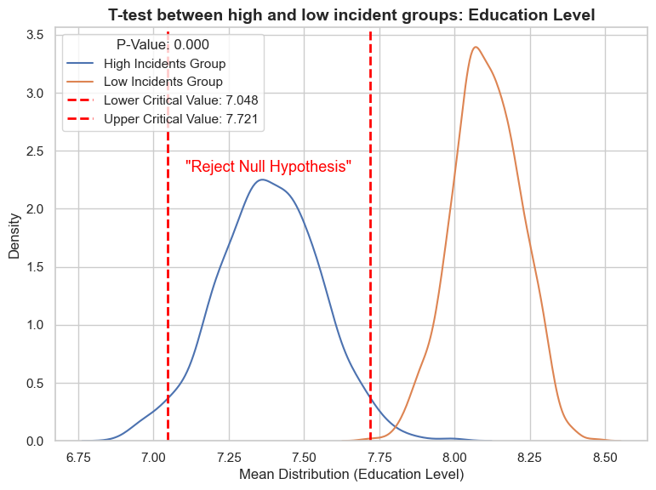
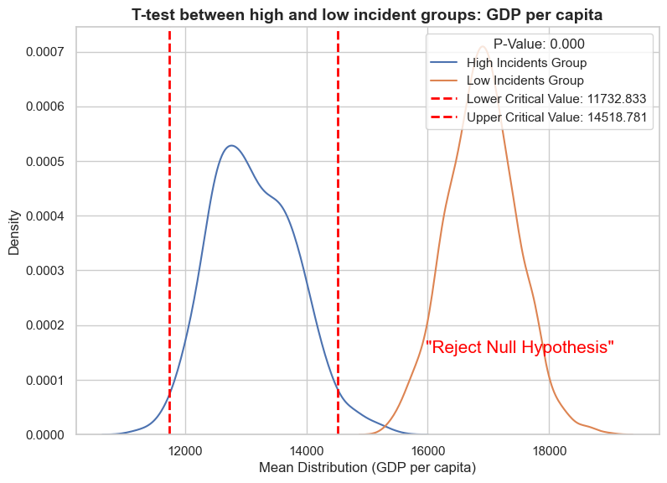
Hypothesis testing: High & Low incident groups (Median:23)
Null Hypothesis (H0)
Lack of education in developing countries has no significant relationship with participation in violent extremist activities.
Alternative Hypothesis (H1)
Lack of education in developing countries significantly relates to participation in violent extremist activities.

Slide 9
04.
REGRESSION ANALYSIS
CREATE A PREDICTIVE MODEL

Slide 10
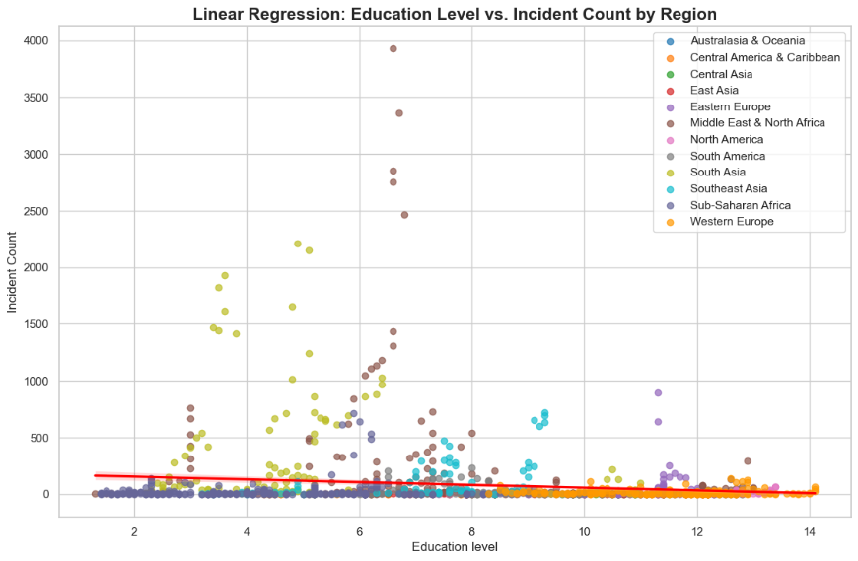
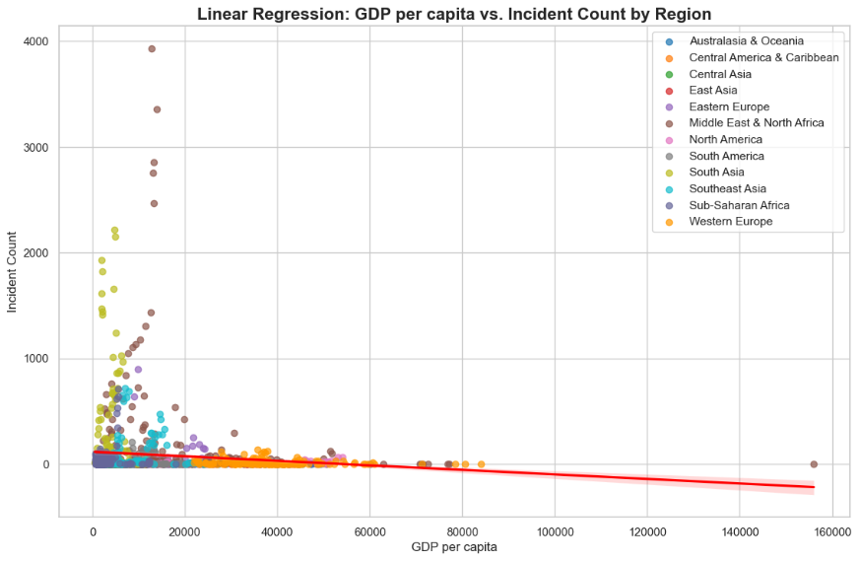
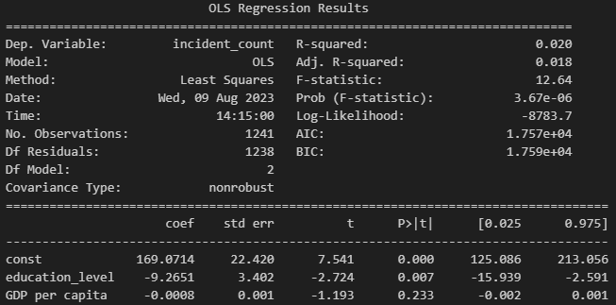
Regression line
Regression line
Education level = statistically significant but weak influence on terrorism incidents
GDP per capita = ‘not’ statistically significant
When combined, still significant
Additional variables would explain the ‘incident’ better
High F-statistic
Low Prob(F-statistic)
P-value

Slide 11
05.
PREDICTION
COUNTRIES WITH THE HIGHEST POSSIBILITIES

Slide 12
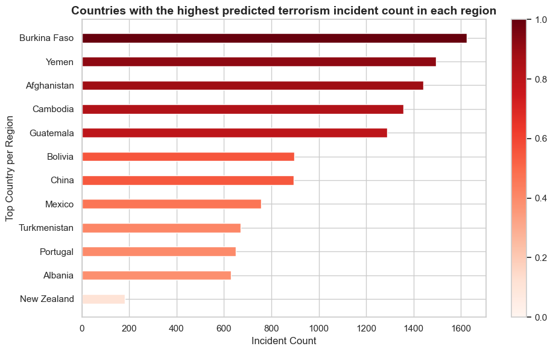
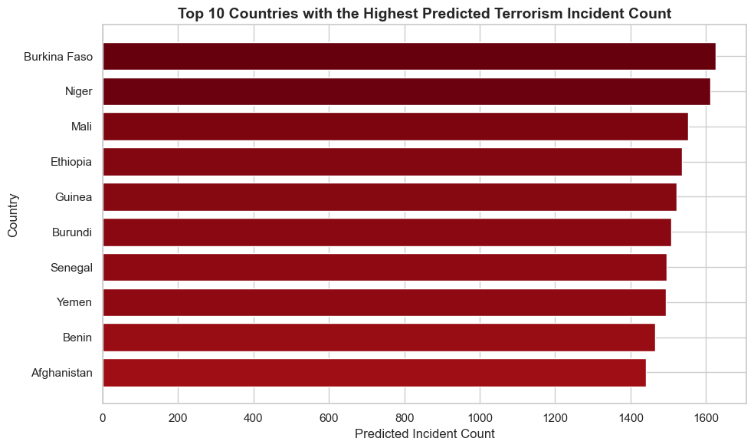
Conclusion
Sub-Saharan African countries are seemingly the most prone to terrorism activities, according to the model.
But
Many other social factors contribute to violent extremism.
This project only reviewed correlations between education level, GDP per capita.
Not an absolute projection.

Slide 13
06.
FUTURE DATA PROJECTS
HOW TO CHANGE CONDITIONS?

Slide 14

Future data of interests
Child Labor Statistics
Not in Education, Employment or Training (NEET)
Child Opportunity Index
Social Media Accessibility Index
Why?
“Counter terrorism framework”
Step 1. Identify correlation
Step 2. Identify causation
Step 3. Change conditions
Step 4. Influence
(Children in Syrian Al-hol refugee camp, source: https://www.the-sun.com/news/2411749/al-hawl-children-isis-fighters-video-shamima-begum/)

Slide 15
Contact, GitHub & data information
Contact
YJ Kim: princetonlaw@pm.me
GitHub repository
https://github.com/mesege1/globalterrorism
Data sources
Global Terrorism Database (https://www.start.umd.edu/gtd/)
The World Bank (https://data.worldbank.org/indicator/NY.GDP.PCAP.CD)
Our World in Data (https://ourworldindata.org/)

