Slide 1

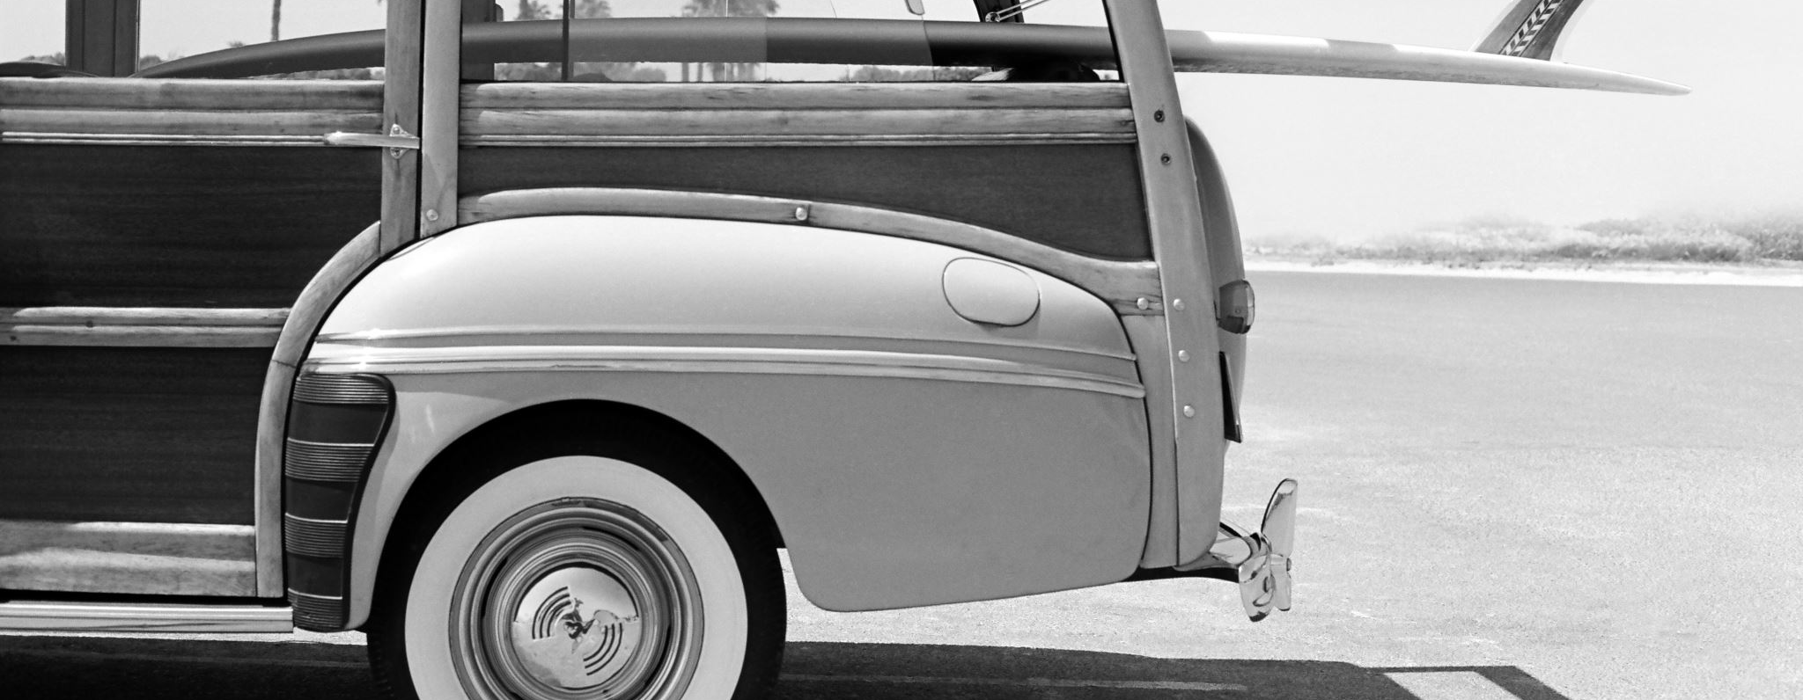


Cars: 1970-1982
Exploration of the relationship between MPG and vehicle weight
Authors: LTM, YJ, Ashton, Ben

Slide 2
Null and Alternate Hypotheses
Null: There is no significant change in MPG in relation to a given vehicle’s weight
Alternate: MPG increases/decreases by weight of vehicle
Two-tail

Slide 3
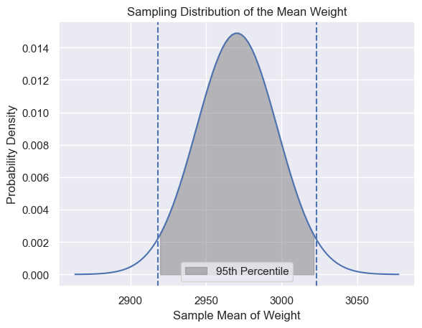
95th Percentile of Weight

Slide 4
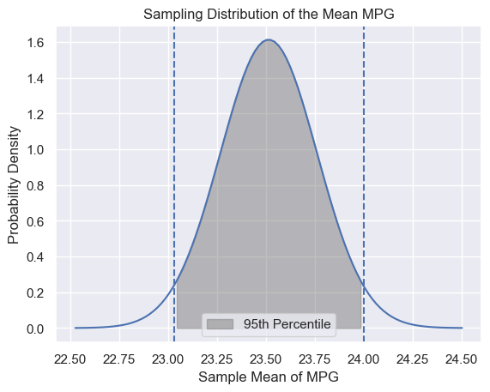
95th Percentile of MPG

Slide 5
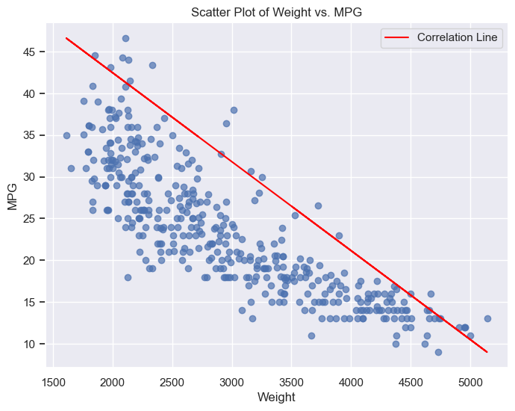
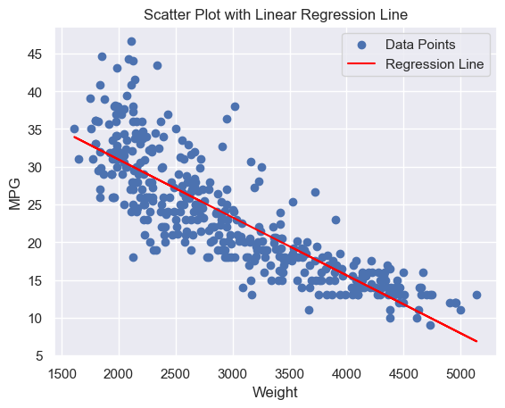
Correlation: Inverse relationship between MPG and weight
z

Slide 6
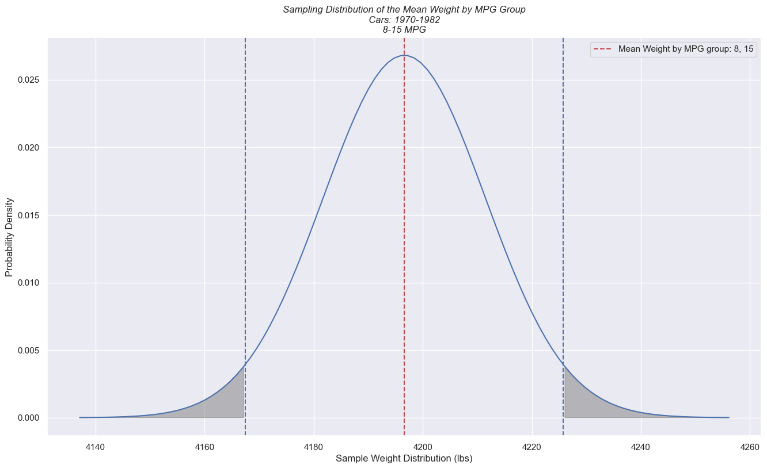
Initial Sample Distribution

Slide 7
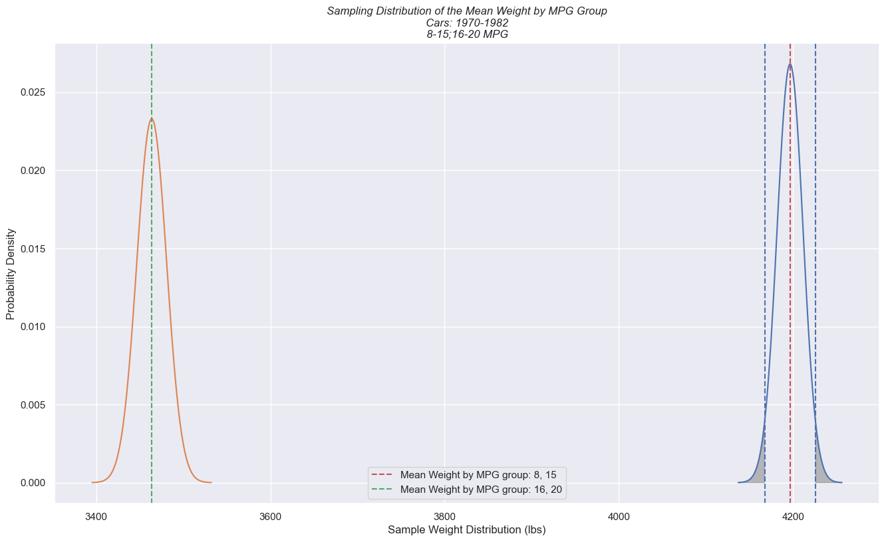
Two Sample Distributions Showing Rejection of Null Hypothesis

Slide 8
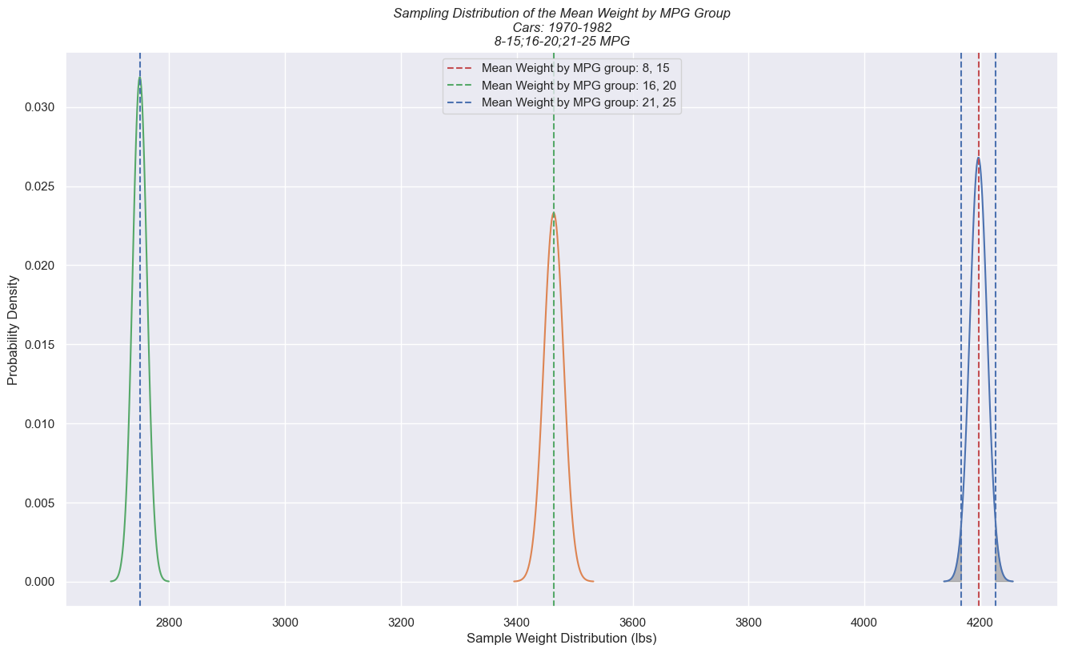
Three Sample Distributions Confirming Further Rejection of Null Hypothesis

Slide 9
Conclusion
The Null hypothesis was rejected based on the data
MPG does increase/decreases by weight of vehicle
As the weight of a vehicle increases the MPG decreases

Slide 10
Repository location
https://github.com/mesege1/stats_case_study

