Slide 1
Feature Engineering san Francisco crime dataset
Mohamad Bagheri Esfe
Fall 2017

Slide 2
Use case
Data scientists sometimes need to create new features to fit a better model to the dataset
Feature Engineering helps them to use domain knowledge of the data to create features that make machine learning algorithms work.

Slide 3
Methodology
Adding new features by parsing or aggregating the current features: Street or Intersection
Using External datasets : Weather
External Data + aggregation: Day or Night
After creating the feature matrix run a generic ML model and sort the feature base on importance.

Slide 4
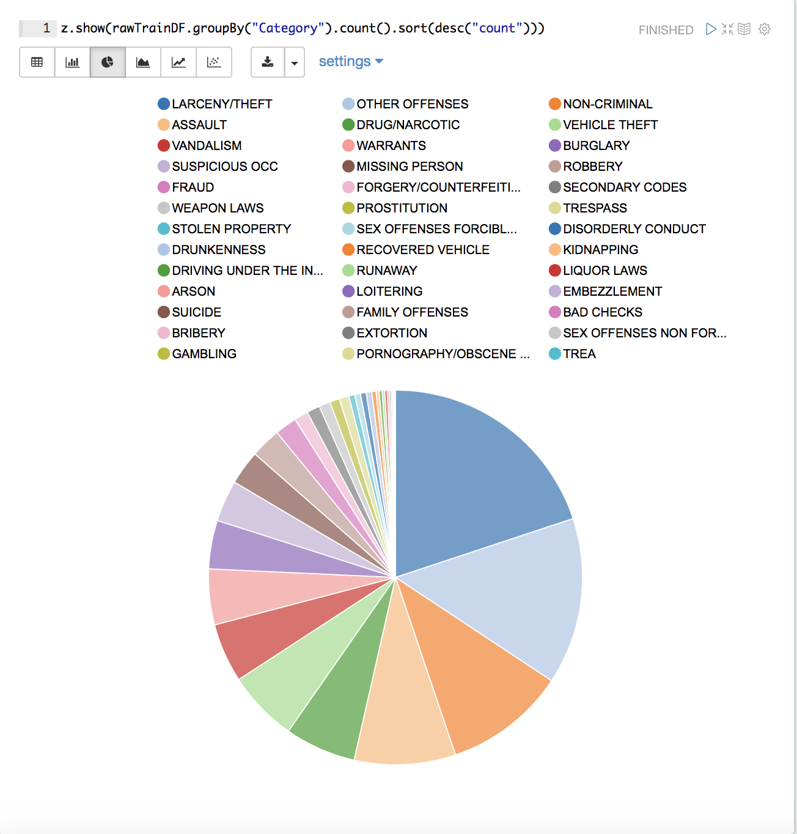
Data Source
SF crime dataset : 300 mb
9 Features , target is Category of the crime

Slide 5
Time Related Features
The existing time fields are Timestamp and Weekday.
Year Weekend
Month
Hour of Day
+ Sunset/Sunrise API (https://sunrise-sunset.org/api)
Day or Night

Slide 6
Weather Feature
API: wunderground.com

Slide 7
Address and Neighborhood
Intersection → OAK ST / LAGUNA ST
Street → OAK ST
Neighborhood: Is (lat,long) inside the neighborhood polygon?

Slide 8
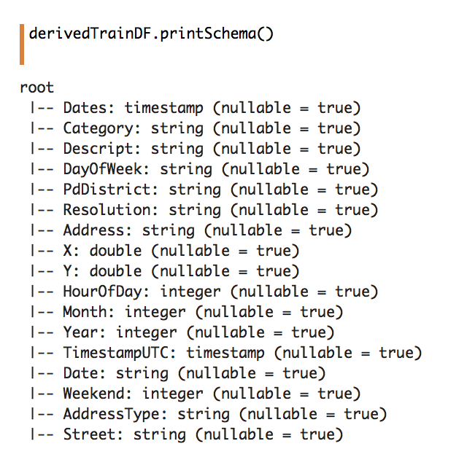
Fit a random forest
The next step is the to run a random forest model and get the coefficients.

Slide 9
Scala
Dataset can be considered as Big Data so I used Spark!
Writing UDFs using match/case

Slide 10
Acceptance Criteria
Feature Engineering is the starting point for the modeling. The output of this process is the list of features ordered by their correlation score with the target.
To check the validity of the process we can create the correlation matrix for the features and compare it with the result of feature engineering.

Slide 11
Goals
Derive features from the dataset by aggregating the current features and also by using external data
Create User Defined Functions to generate these features – this enables us to reuse these functions for other projects

