Slide 1

Customer Accounts and Transaction System
By Mesfin Kebede

Slide 2
Tools & Technologies
Backend: Suitable backend framework
Frontend: HTML, CSS, php, python (libraries/frameworks).
Database: SQLite.
Version Control: Git.

Slide 3
Objective
Develop a comprehensive system that facilitates customer account management, transactions, and employee activities in a banking scenario.

Slide 4

CATS: Account Management
In the banking system, Customers manage their accounts and perform transactions. Employees assist with account operations, might also act as customers, and oversee bank functions. The Bank/ATM system facilitates autonomous transactions and manages all banking activities, ensuring seamless coordination between customers and employees.
Account Management
Customer Management
Transaction Management
Card Management
Employee and Branch Management

Slide 5
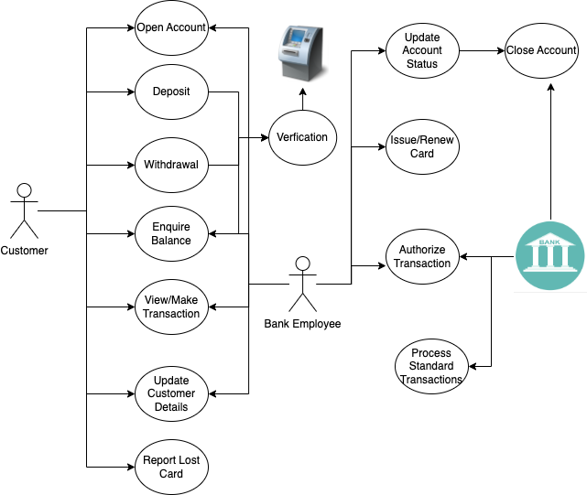
Use Case Diagram

Slide 6
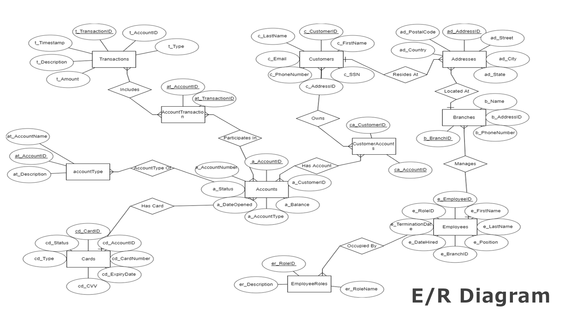

Slide 7
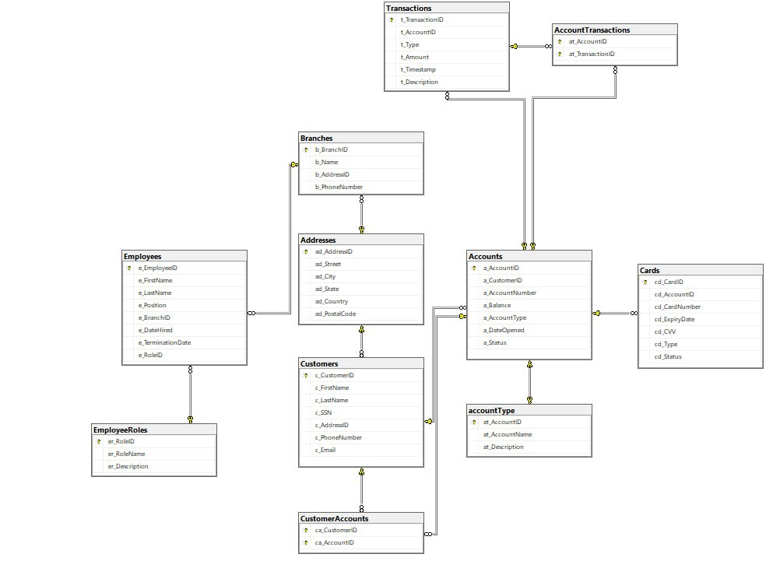
Relational Schema

Slide 8
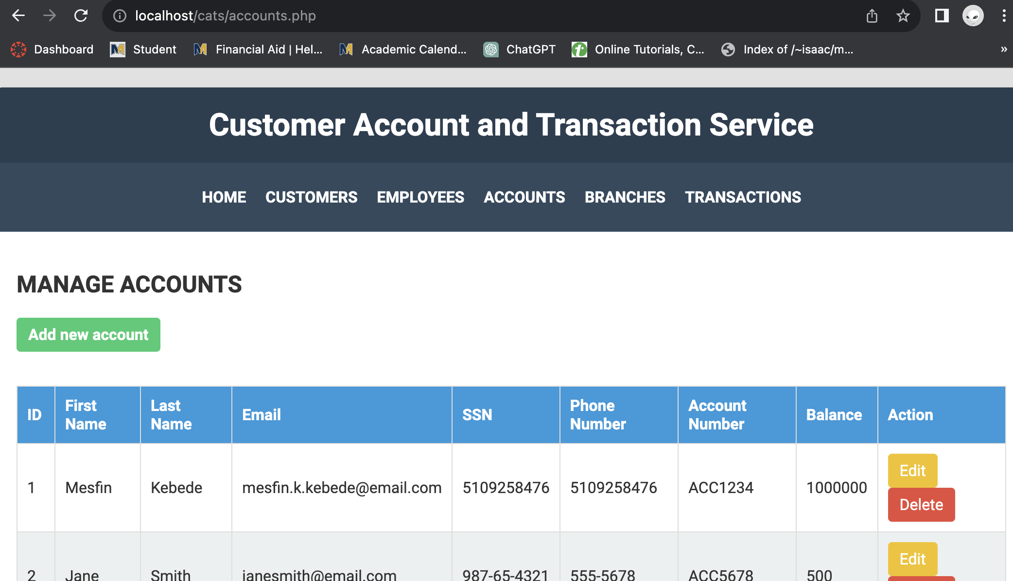

Slide 9
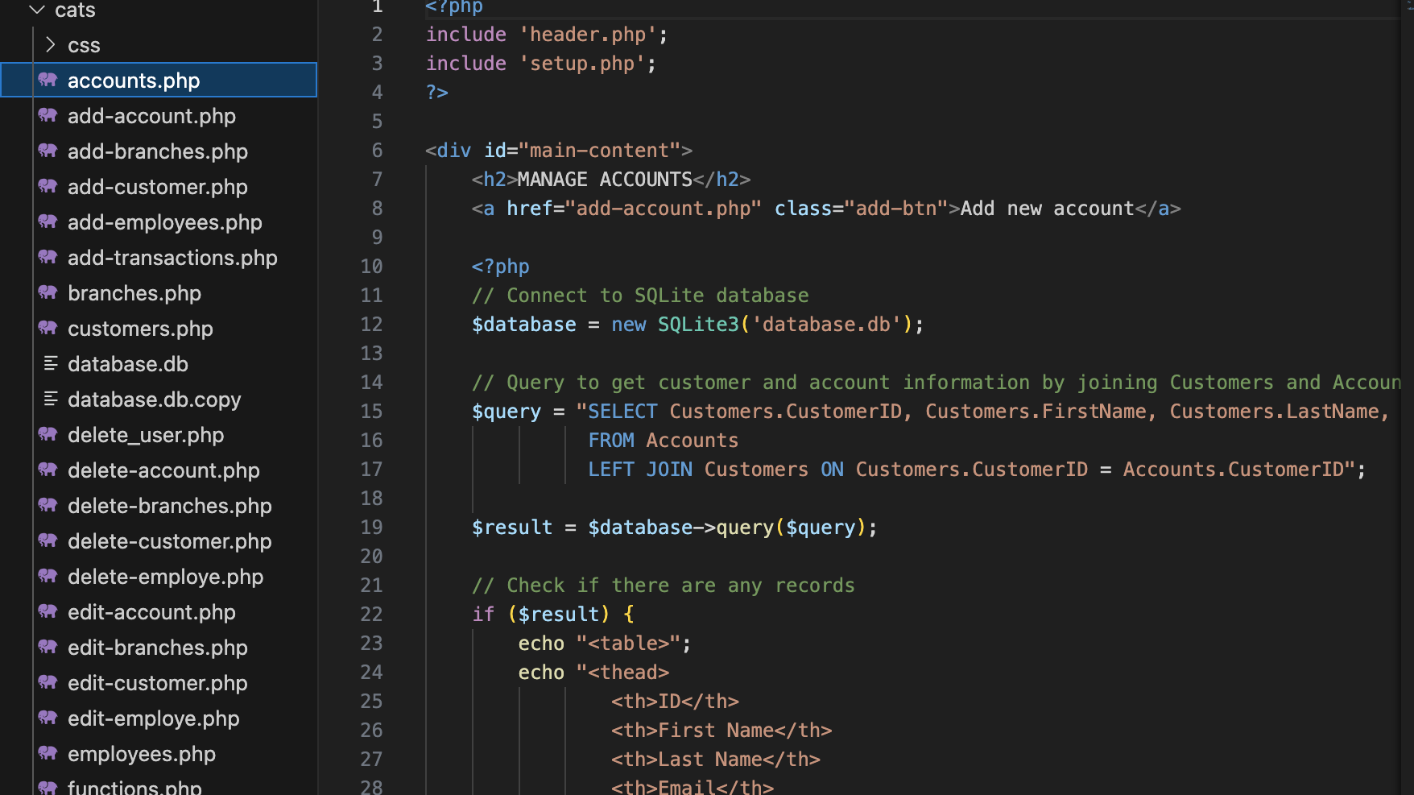

Slide 10
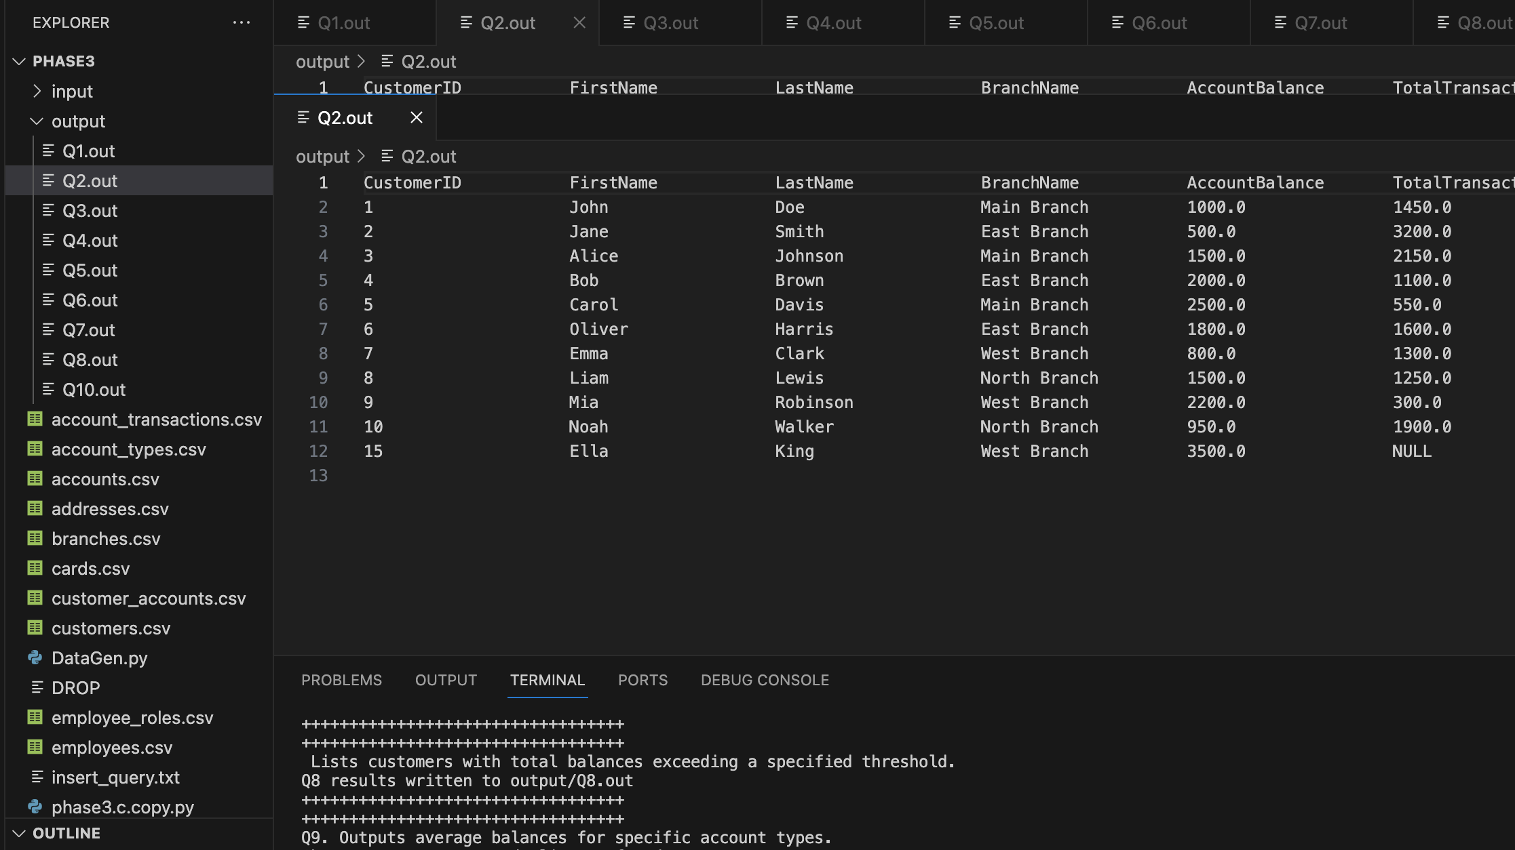

Slide 11
