Slide 1

Capstone Project: Detecting Fraud in PaySim Dataset Author: Mesfin K GitHub: https://github.com/mesfin-k/capstone-two
Slide 1 of 18
Notes:
Good morning/afternoon, everyone. [Pause – 2 sec] Imagine a world where digital transactions are fast and convenient, but fraud lurks beneath, costing billions. [Emphasize] Today, I'll share the story of Sentinel, my capstone project using AI to detect fraud in mobile money transactions. [Pause] We'll journey from raw data to a powerful detection system. Let's begin. [Look at audience]

Slide 2
Agenda
1. Project Overview: The Challenge 2. Data Wrangling: Taming the Data 3. Exploratory Data Analysis (EDA) 4. Preprocessing: Preparing for Modeling 5. Modeling & Evaluation 6. Key Insights & Results 7. Conclusion & Recommendations 8. Q&A
Slide 2 of 18
Notes:
Here’s our roadmap. [Pause] We'll start with the challenge, then wrangle the messy data, uncover hidden patterns through EDA, prepare for modeling, test and evaluate models, reflect on key insights, and finish with recommendations. [Pause – 1 sec] A complete journey, step by step.

Slide 3
Project Overview - The Challenge
Problem: Fraud in mobile money costs billions. Objectives: High recall, focus on TRANSFER & CASH_OUT. Dataset: Synthetic, 6.3M records. Approach: CRISP-DM, Python, Scikit-learn, XGBoost.
Slide 3 of 18
Notes:
Fraud in mobile money is like a shark in an ocean of safe transactions. [Pause – 2 sec] Rare, but dangerous. Our goal: [Emphasize] catch as many sharks as possible without slowing down the ocean. PaySim gives us a realistic testbed with millions of simulated transactions. [Look at audience]

Slide 4
Data Wrangling - Notebook 1
Steps: - Load raw data - Filter relevant types - Drop unnecessary columns - Handle data quality (zeros, outliers) - Verify balance consistency - Save processed data
Slide 4 of 18
Notes:
Every story begins with chaos. [Pause – 1 sec] Raw data was huge and messy. We trimmed it to TRANSFER and CASH_OUT, removed noise, fixed zeros and outliers, and checked balances for consistency. [Emphasize] The result: a clean dataset where fraud patterns start to show. [Pause]

Slide 5
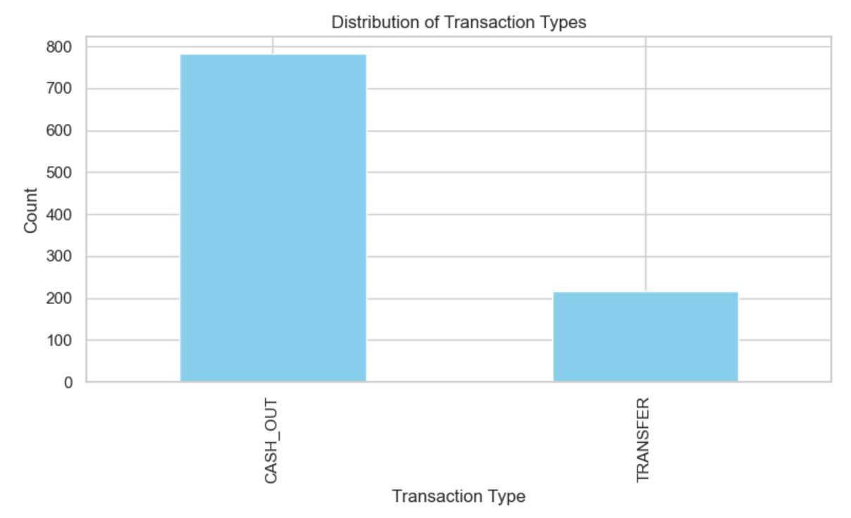
EDA - Part 1
Checks: - Shape, types, stats - Severe class imbalance (~0.1% fraud) - Feature distributions (skew, outliers) - Count plots for transaction types
Slide 5 of 18
Notes:
EDA is our detective work. [Pause] First clue: class imbalance. Fraud was less than 0.1%. [Emphasize] That’s like finding one needle in a thousand haystacks. Feature distributions revealed skew and extreme outliers. Transaction type counts confirmed TRANSFER and CASH_OUT dominate. [Pause – 2 sec]

Slide 6
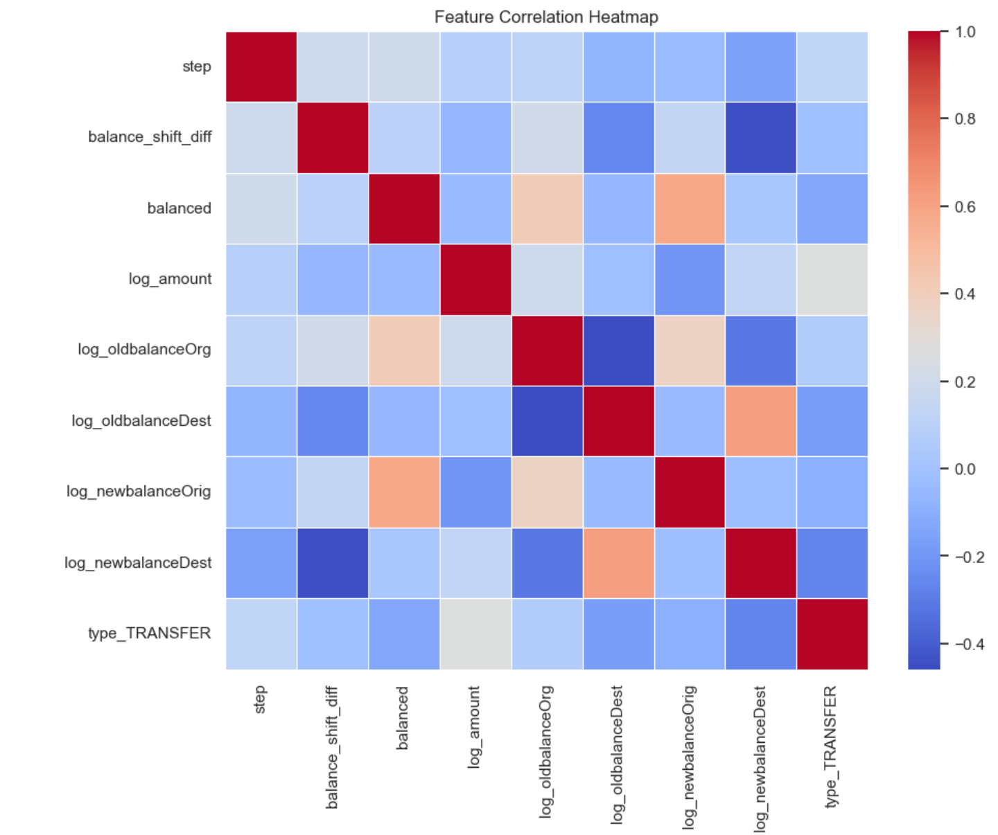
EDA - Part 2
Slide 6 of 18
Notes:
Next, relationships. [Pause] Correlation heatmaps showed balances strongly linked to fraud.

Slide 7
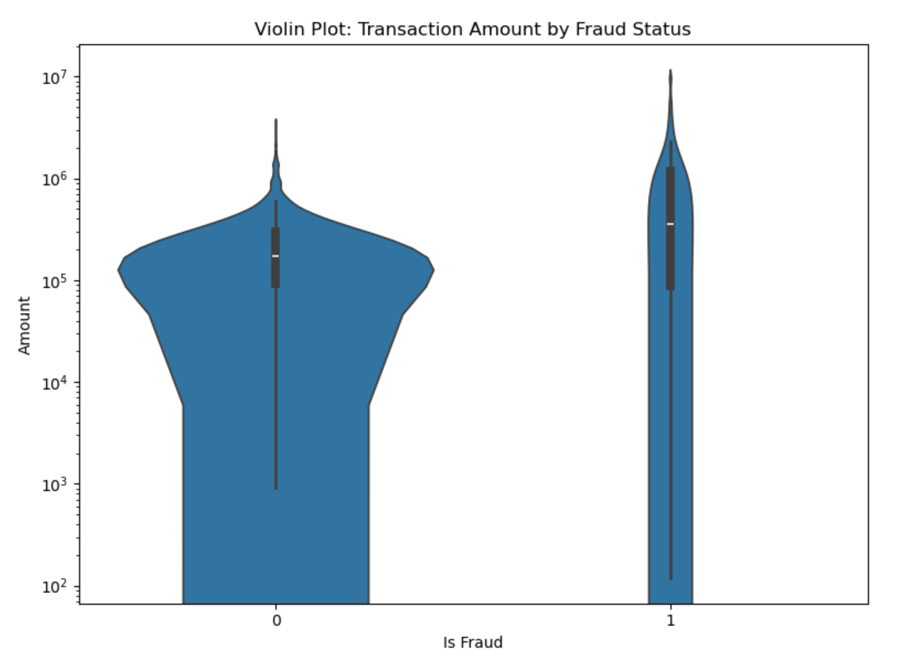
EDA - Part 2
Slide 6 of 18
Notes:
Next, Violin plots revealed fraud concentrated at high transaction amounts.

Slide 8
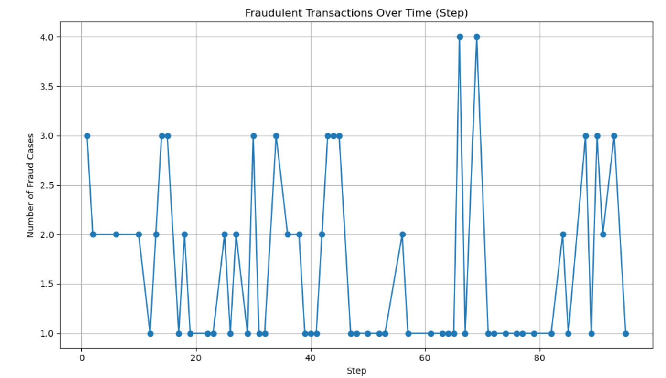
EDA - Part 2
Slide 6 of 18
Notes:
Next, time series showed fraud scattered without obvious peaks. [Emphasize] Fraud hides in the data, but leaves subtle fingerprints. [Pause]

Slide 9
EDA - Key Insights
Key Takeaways: - Handle imbalance with SMOTE - Engineer balance deltas - Fraud hidden in balance inconsistencies
Slide 7 of 18
Notes:
EDA gave us three key lessons. [Pause] One, imbalance is severe—SMOTE will help. Two, engineered features like balance deltas carry fraud signals. Three, inconsistencies in balances are red flags. [Emphasize] These insights guided all preprocessing and modeling steps.

Slide 10
Preprocessing
Steps: - Drop unnecessary columns - Feature engineering: balance diffs, logs - Encode categorical type - Scale numericals - Stratified train-test split
Slide 8 of 18
Notes:
With insights in hand, we prepared the data. [Pause] Dropped leakage-prone fields, engineered new features, encoded transaction types, scaled continuous features, and stratified splits to keep fraud representation realistic. [Look at audience] This gave us a fair, balanced starting point.

Slide 11
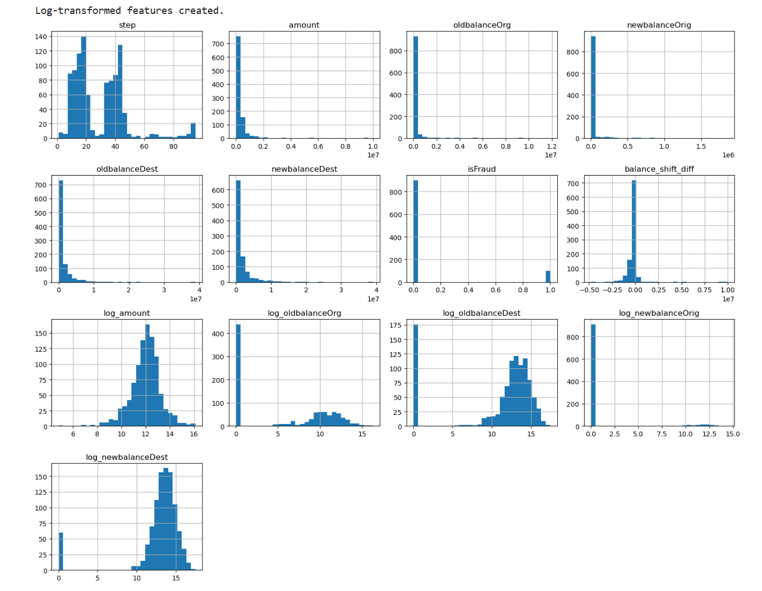
Preprocessing Visuals
Slide 9 of 18
Notes:
Visual checks mattered. [Pause] Log transformations normalized skewed features, making them model-friendly.

Slide 12
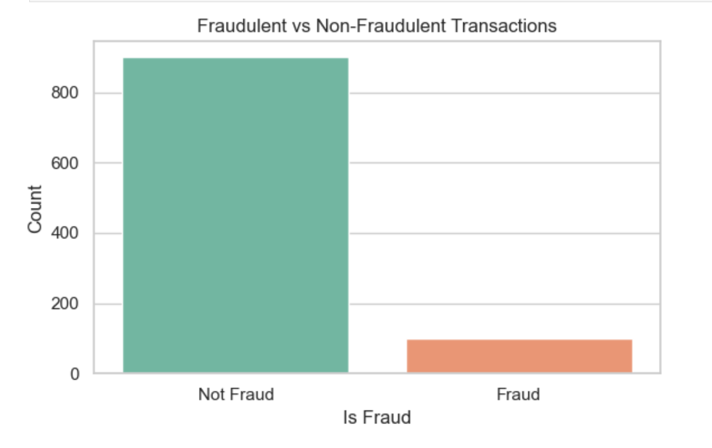
Preprocessing Visuals
Slide 9 of 18
Notes:
Fraud vs non-fraud splits confirmed stratified sampling worked. [Emphasize] The stage was now set for modeling. [Pause – 1 sec]

Slide 13
Modeling Setup
Steps: - Encode type - Feature selection (safe set) - Temporal split - Scale features
Slide 10 of 18
Notes:
Modeling setup was designed for realism. [Pause] We used temporal splits to mimic deployment, ensuring no future data leaked. Safe feature sets avoided shortcuts. Scaling guaranteed fair treatment across models. [Emphasize] This was not just technical, but ethical design. [Pause]

Slide 14
Modeling - SMOTE & Baseline
Steps: - Baseline recall check - Apply SMOTE if needed - Models: Logistic Regression, Random Forest, XGBoost
Slide 11 of 18
Notes:
Before sophisticated models, we checked baselines. [Pause] If recall was too low, we applied SMOTE to resample fraud cases. [Emphasize] Catching fraud mattered more than overall accuracy. Then, we deployed three models: Logistic Regression, Random Forest, and XGBoost. [Pause – 1 sec]

Slide 15
Logistic Regression Results
Confusion Matrix: High recall, balanced precision. Report: Fraud recall ~92%.
Slide 12 of 18
Notes:
Logistic Regression was simple but effective. [Pause] Fraud recall hit ~92%, with strong balance between catching fraud and avoiding false alarms. [Emphasize] Sometimes simplicity is powerful. [Pause – 1 sec]

Slide 16
Random Forest Results
Confusion Matrix: Strong precision, high recall. Report: Fraud recall ~92-100%.
Slide 13 of 18
Notes:
Random Forest excelled. [Pause – 2 sec] Its ensemble trees captured nonlinearities, pushing fraud recall as high as 100% in some cases. [Emphasize] A reliable, business-friendly choice. [Look at audience]
We’re detecting fraud in mobile money. The data are highly imbalanced, so we focus on recall and F1. We engineered balance-consistency features and applied SMOTE. Comparing three models, Random Forest with SMOTE gave the best balance of recall, F1, and AUC. It’s straightforward to deploy as an API with monitoring and periodic retraining.

Slide 17
XGBoost Results
Confusion Matrix: Balanced results. Feature Importances: balances strongest. Threshold tuning improved recall.
Slide 14 of 18
Notes:
XGBoost proved the heavyweight. [Pause] By tuning thresholds, we boosted fraud recall while managing precision. [Emphasize] Feature importance confirmed: balances were the most powerful fraud indicators. [Pause – 2 sec] This was Sentinel at full strength.

Slide 18
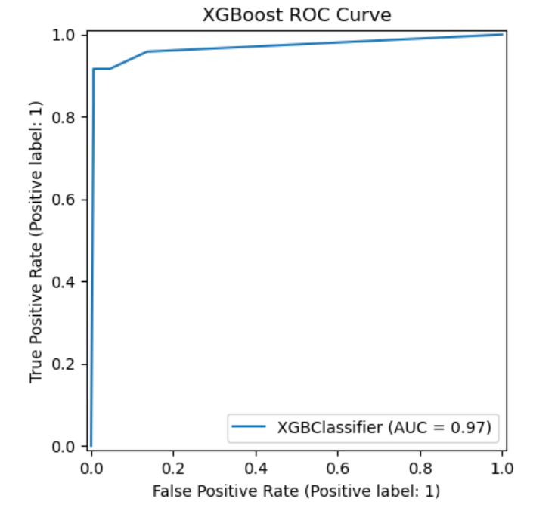
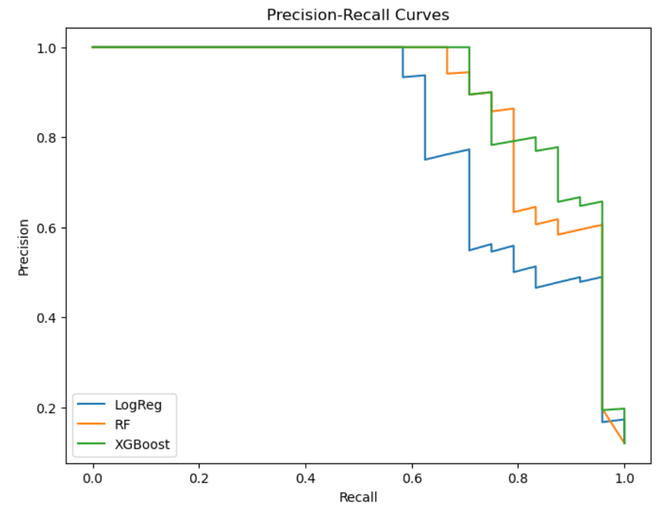
Results Comparison
Summary: - Logistic Regression: reliable - Random Forest: strong performer - XGBoost: best after tuning
Slide 15 of 18
Notes:
Comparing results, each model had strengths. Logistic Regression: reliable. Random Forest: robust with high recall. XGBoost: best overall, especially with tuning. [Pause] ROC and precision-recall curves showed Sentinel could catch fraud without overwhelming false positives. [Emphasize] Business value confirmed.

Slide 19
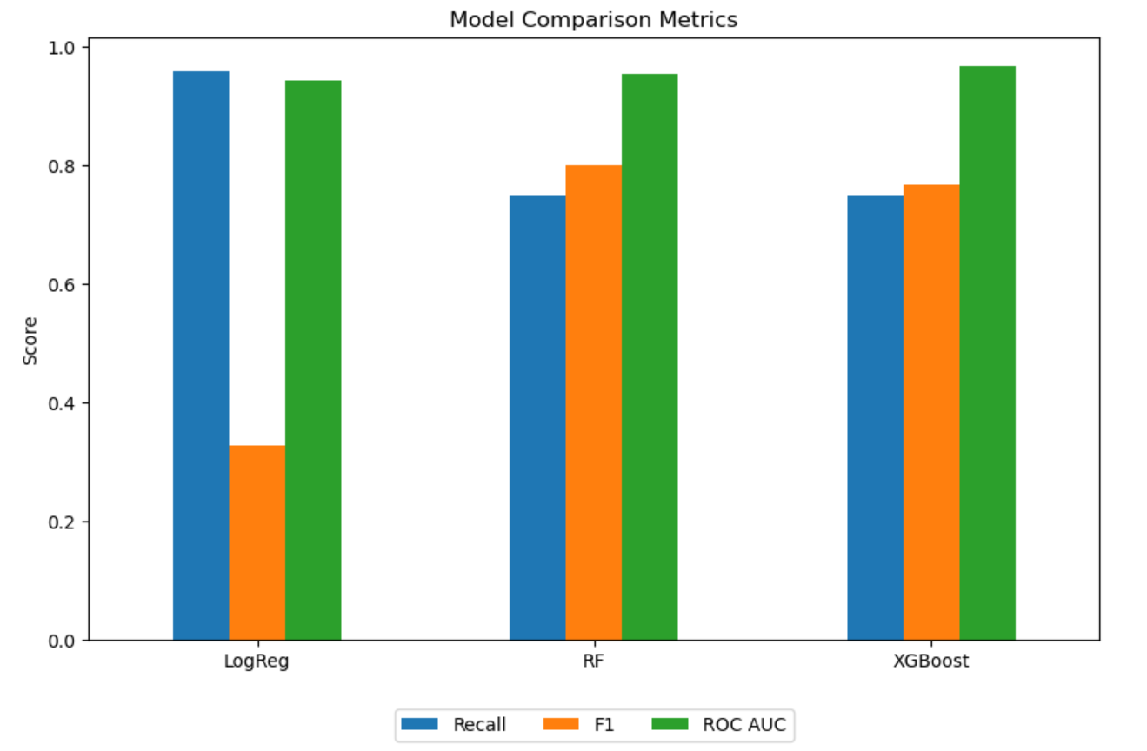
Results Comparison
Summary:
Slide 15 of 18
Notes:
“This chart compares three models: Logistic Regression, Random Forest, and XGBoost.”
“Logistic Regression has the highest recall at around 95%, which means it detects nearly all fraud cases. However, its F1 score is very low — showing it generates many false positives.”
Logistic Regression is recall-heavy but noisy. XGBoost is strong on AUC, but SMOTE trades precision for recall. Random Forest consistently improves recall and F1 under SMOTE, reaching AUC ≈ 0.98. That’s why I recommend RF + SMOTE with threshold tuning for production.

Slide 20
Lessons Learned
1. Balances are most important features. 2. Temporal split prevents leakage. 3. SMOTE can help but needs care. 4. High recall achieved.
Slide 16 of 18
Notes:
Four lessons emerged. [Pause] First, balances dominate fraud signals. Second, temporal splits prevent leakage. Third, SMOTE helps but must be applied cautiously. Fourth, high recall—over 92%—is possible. [Emphasize] These lessons guide future deployments.

Slide 21
Conclusions & Recommendations
Sentinel is robust. Deploy as API. Retrain quarterly. Enhance with ensembles. Potential savings: 80-90% loss reduction.
Slide 17 of 18
Notes:
From chaos to clarity. [Pause – 2 sec] Sentinel is not just a model; it’s a roadmap for fraud detection. Deploy as an API, retrain quarterly, enhance with ensembles. [Emphasize] The result: up to 90% reduction in fraud losses. [Look at audience] The impact is real.

Slide 22
Q&A
Thank you! Questions? GitHub: https://github.com/mesfin-k/capstone-two
Slide 18 of 18
Notes:
Thank you for following this journey. [Pause] I welcome your questions and feedback. [Look at audience] Let’s discuss how Sentinel can evolve further.

