Slide 1
IKT200- Introduction to Intelligent Systems (Autumn ‘20)

Slide 2
Gebremariam Assres
Associate Professor at Kristiania University College, Norway
Research Fellow at Brunel University London, UK
Lead Technical Consultant at SaaS Systems, Ethiopia
Assistant Professor at Aksum University, Ethiopia
Lecturer at Mekele University, Ethiopia
Graduate Assistant at Mekele University, Ethiopia
Since 2019
3 years
1 year
7 years
4 Year
4 Year
BSc, MSc in Computer Science
PhD in IT (software engineering)
I teach various Computer Science courses at the bachelor and masters levels- including Mobile Computing and IoT, Information Risk and Security, Intelligent systems, and Security in Mobile Applications.
Research in Internet of Things, Mulsemedia, Mobile Applications, Software architecture, E-Learning, Information security, workflow design, BPR, and related.
Email: Gebremariam.Assres@Kristiania.no

Slide 3
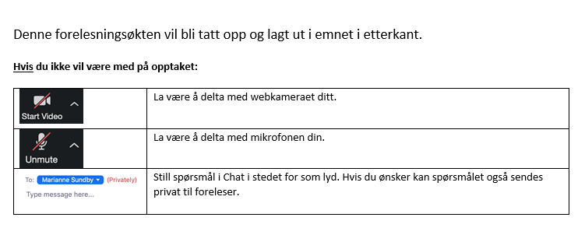
Live Zoom Sessions
This is not the normal situation in learning ... so, we must help each other towards achieving the learning objectives.
Notes:
This lecture will be recorded and published on Canvas afterwards.
If you do not want to be recorded:
Turn off your web camera
Turn off your microphone
Pose questions in Chat instead of asking. You may also send questions directly to the lecturer's e-mail.
(This is due to the GDPR.)

Slide 4

Experiences & Expectations
About yourself, your experiences in Intelligent Systems, IoT mentimeter.com
Experiences & Expectations- Please reflect on your thoughts in groups.
Notes:
Scientific, Technical, Standards, etc.

Slide 5
Today's themes
Study guide, Introduction
Activities- discussion via mentimeter, and in groups
Pre-recorded Lecture- Mobile Application (In)security
Assignment 1

Slide 6
Study Guide

Slide 7
Course Objectives
Provide knowledge of business models, ecosystems and technologies used in intelligent systems.
Enable students acquire knowledge about sensors, steering behaviour, networks, infrastructure and applications.
Give skills in evaluation and selection of appropriate technologies/sensors.
The students will discuss ethical considerations within the field.

Slide 8
Learning outcomes
Knowledge- the student:
  has knowledge about intelligent systems
  has knowledge about Internet of Things- sensors, actuators and controllers
  has knowledge about artificial intelligence- agents, finite state machines, expert systems and path finding algorithms such as A*
  has knowledge of important rules and regulations within the field
  has knowledge of the process for manufacturing solutions within intelligent systems including identification of user groups, disclosure of requirements, design, development, testing, production setting and maintenance / further development
Skills- the student:
  can explain what objects can be included in the Internet of Things
  can apply artificial intelligence based on finite state machines, expert systems and search algorithms
  can carry out a systematic and documented comparison of technologies and systems
  can understand how intelligent systems can be linked to a businesses
Competence- the student:
  can reflect on ethical issues related to intelligent systems

Slide 9
Course plan
Start Thursday, August 20th from 09.15 to 13.00
Assignment hand-out: Wednesday, December 2nd?
Assignment hand-in: Friday, December 4th?
Weekly
M
T
W
T
F

Slide 10
Lectures and activities
Week | Topic | Activity | Readings
34 | Introduction, Motivation- Intelligent systems; Sensors, Actuators, Controllers | Live Zoom- discussion, group activities; lecture, assignments | Textbook, Chapter 1
35 | Agents, Finite State Machines, Design principles for connected devices | Live Zoom- discussion, group activities; lecture, assignments | Textbook, Chapter 2
36 | Rule-based ("expert") systems Turing and Eliza, Internet Principles, Beacon technology | Live Zoom- discussion, group activities; lecture, assignments | Textbook, Chapter 3
37 | Overview of prototyping, Pathfinding (part 0) | Live Zoom- discussion, group activities; lecture, assignments | Textbook, Chapter 4
38 | Prototyping Embedded Devices, Pathfinding (part 1) | Live Zoom- discussion, group activities; lecture, assignments | Textbook, Chapter 5
39 | Guest lecture : robotics | Live Zoom (TBA)- lecture and discussion
40 | Prototyping the Physical Design, Pathfinding (part 2) | Live Zoom- discussion, group activities; lecture, assignments | Textbook, Chapter 6

Slide 11
Lectures and activities …
Week | Topic | Activity | Readings
41 | Steering Behaviors, Prototyping Online Components | Live Zoom- discussion, group activities; lecture, assignments | Textbook, Chapter 7
42 | Techniques for Writing Embedded Code, Business models | Live Zoom- discussion, group activities; lecture, assignments | Textbook, Chapters 8 & 9
43 | Guest lecture with workshop in machine learning | Live Zoom (TBA)- lecture and discussion
44 | Moving to Manufacture, Ethics | Live Zoom- discussion, group activities; lecture, assignments | Textbook, Chapters 10 & 11
45 | Exam assignment, course summary, wrap-up | Summary, questions, feedback

Slide 12
Assessment
Exam type- Individual written home assignment
Duration- 48 hours
Grading scale- Norwegian grading system (A-F)
Weighting- 100 % of the overall grade

Slide 13
Readings
Books:
Greengard, Samuel. The internet of things. MIT press, 2015.
McEwen, A., & Cassimally, H. (2013). Designing the internet of things. John Wiley & Sons.
Millington, Ian, and John Funge. Artificial intelligence for games. CRC Press, 2009.
Russell, S., & Norvig, P. (2010). Artificial intelligence: a modern approach.
Articles:
Belk, R. (2020). Ethical issues in service robotics and artificial intelligence. The Service Industries Journal, 1-17.
Sikder, A. K., Acar, A., Aksu, H., Uluagac, A. S., Akkaya, K., & Conti, M. (2018, January). IoT-enabled smart lighting systems for smart cities. In 2018 IEEE 8th Annual Computing and Communication Workshop and Conference (CCWC) (pp. 639-645). IEEE.

Slide 14
Introduction

Slide 15


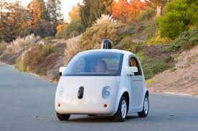



Introduction …
Intelligent systems in the automotive industry
Driving:
Driver assist
Driverless Automobiles
Goal: Safety
Car Manufacturing:
Robots are driving optimization and the rethinking of processes and production in innovative new ways.
Cloud Services:
Predictive Maintenance
Individualized Marketing
Goal: Data
Driver Monitoring:
Detecting driver behavior- identification, recognition, monitoring and control.
Google, Tesla, and Toyota- Investment in intelligent systems
How self-driving cars work- An example from Googles self-driving cars
However, artificial intelligence is very much more than the car industry!
Car Insurance:
Speeds up the process of filing claims when accidents do occur.
Source: https://igniteoutsourcing.com/automotive/artificial-intelligence-in-automotive-industry/

Slide 16

Introduction …

Slide 17
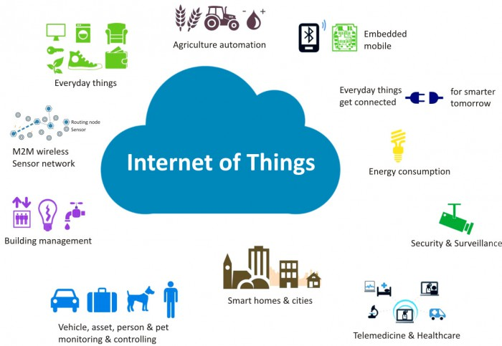
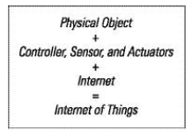
Introduction …

Slide 18
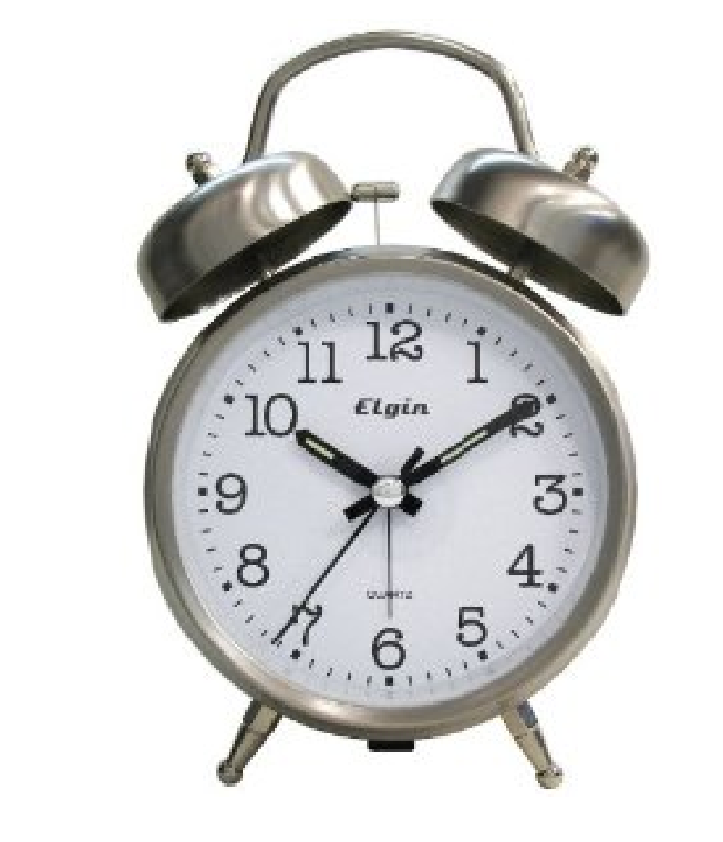
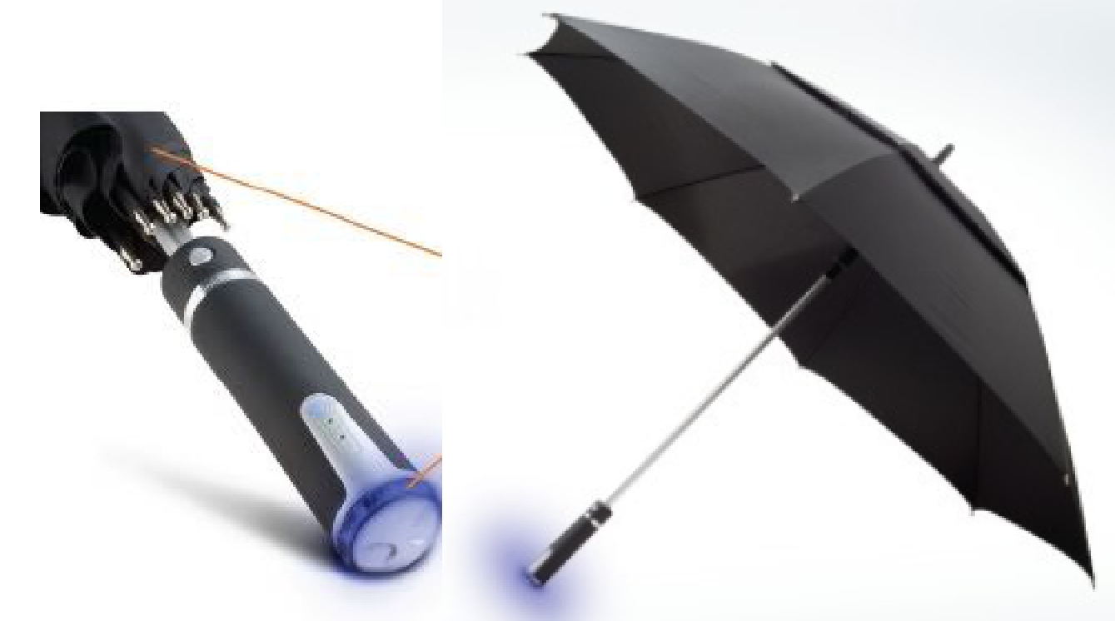
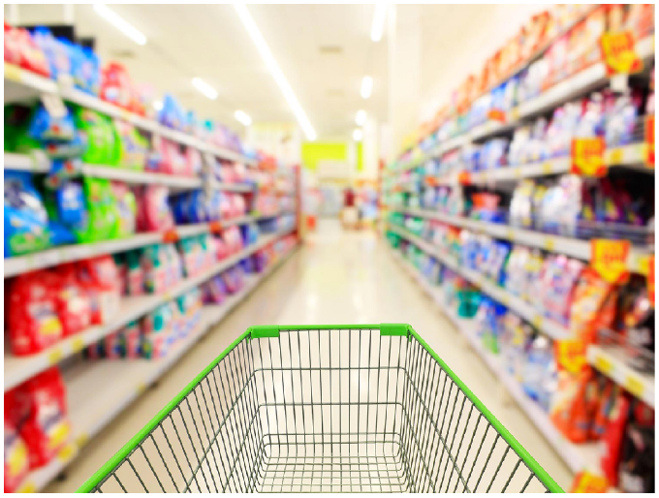
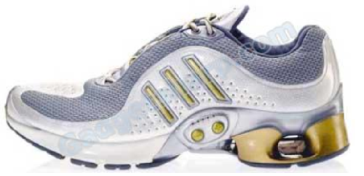

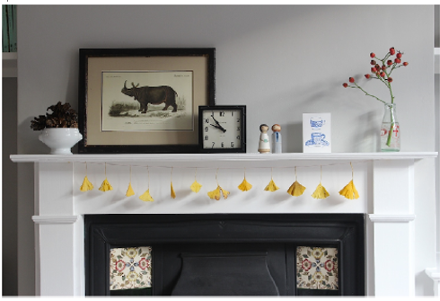
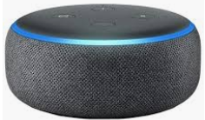
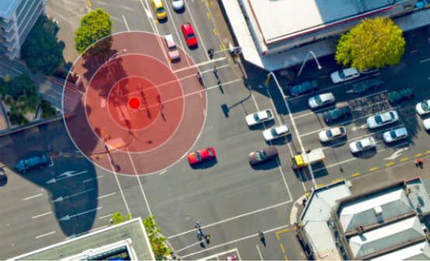
In shops
Introduction …
Clock notices delayed train
Weather forecast enabled umbrella
Shoe pedometer
blinking light reminds you it’s time to take your tablets
mantelpiece at home: an ornament with dial notices
Smart speakers
display at a bus stop- expected time vs real-time

Slide 19
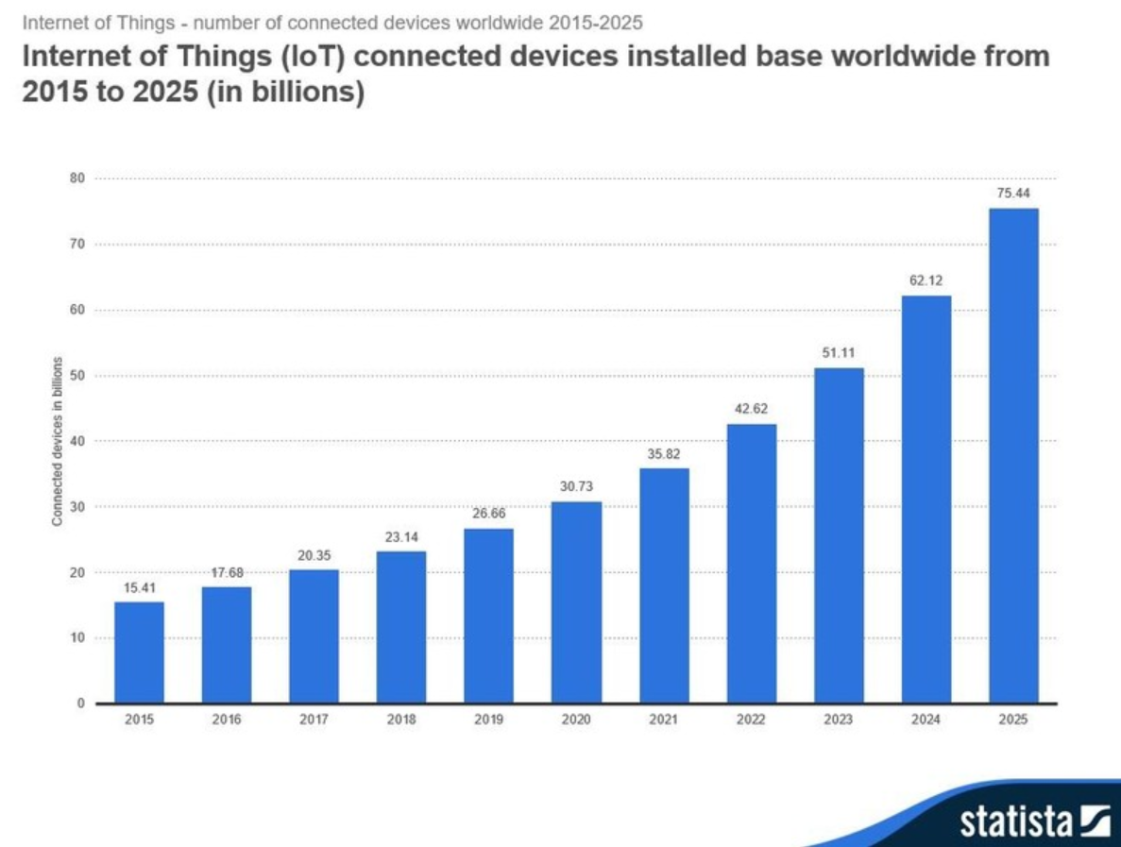
Introduction …

Slide 20
Mentimeter discussion points
What is Intelligent Systems? Any suggestions from you ...
Using so much technology has also a downside. What challenges do you see in Intelligent Systems?
Select the discipline (s) that you understand better or you are most familiar with- AI, Intelligent Systems, IoT, Robotics, Data Science
Select example (s) of Intelligent Systems in a smart house- bulb, speaker, fridge

Slide 21
Group discussion
What makes a system intelligent?
Why do we need intelligent systems?
Discuss on the notion of Internet of Things on your own perspectives.
What do you know about Alexa, Siri or other similar systems?

Slide 22
Next time
Main topics:
  Artificial intelligence: Agents & finite state machines.
  IoT: Design principles for connected devices.

