Slide 1
Today’s topics
Mobile security
Countermeasures
Technical controls
Security principles

Slide 2
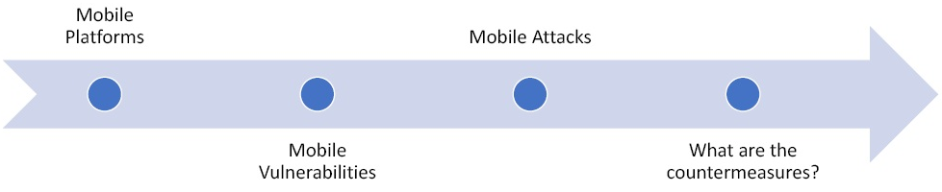
Mobile security countermeasures
Mobile security countermeasures are actions, devices, procedures, techniques, or other measures that reduce the vulnerability of an information system.
Notes:
https://csrc.nist.gov/glossary/term/countermeasures
Platforms:
Android – It is the biggest and by far most popular. So it is also the biggest target.
iOS – The next biggest platform is Apple’s iOS. It seems to be more secure than Android.
Windows – Windows Mobile which is now known as Windows 10. Its market share is reducing day by day.
BlackBerry – It is not used much nowadays.
What are Mobile Vulnerabilities?
Operating System – The first vulnerability is actually found in the Operating System. There are specific vulnerabilities in each OS that bad actors exploit to gain access or implant malware, etc.
Apps / App Stores – There are a few rogue app stores that hackers have put out into the market from people download malicious apps.
Malware – There are malwares that are specifically written for mobile platforms and perform activities like blocking device, data stealing, send SMS or spoof email, etc.
“Jail Breaking” – It is also known as routing. In the attacker try to get access to the actual OS.
Privacy – Mobile device is a personal property and if it gets compromised in any form it is a big privacy mobile vulnerability.
Physical Theft – Because of the size and portability property of a mobile device, it can be easily stolen and the whole device is automatically compromised.
What are Mobile Attacks?
Malware
Virus
Trojan Apps
OS Modification
Data Loss
App Vulnerabilities – They can leak data and privacy.
MITM – Man in the middle attack is a very real threat for mobile devices. One can sniff passwords, credential, steal cookies, etc. and all the attacks that are there for web application hold true for mobiles also.
Theft
Privacy
App Modification
Geo Location
MITM
Example of countermeasures
Mobile device management (MDM)
Lock devices
IMEI blocking
Physical security
“Find my Phone”

Slide 3
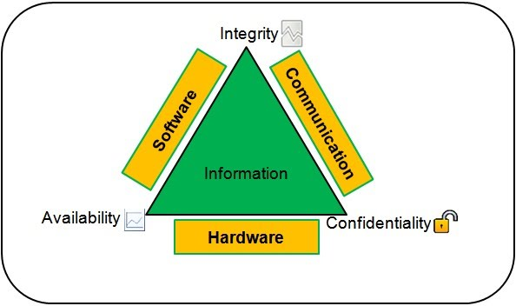
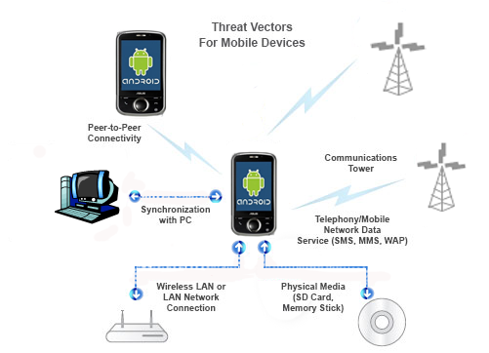
Countermeasures …
Countermeasures are prescribed to meet the security requirements or goals(i.e., confidentiality, integrity, and availability) specified for the mobile platform and other systems it gets connected to.
Notes:
https://sites.google.com/site/mobilesecuritylabware/home/fundamental-concepts-security-ethics
Mobile threats can be categorized into two main segments: Malicious activity by attackers and Vulnerabilities.
Malicious Activity by Attackers:
1. Activity Monitoring and Data Retrieval
2. Unauthorized dialing, SMS, and Payments
3. Unauthorized Network Connectivity (Exfiltration or Command & Control)
4. UI Impersonation
5. System Modification (Rootkit, APN Proxy Config)
6. Logic or Time bomb
Vulnerabilities
1. Sensitive Data Leakage (Inadvertent or Side Channel)
2. Unsafe Sensitive Data Storage
3. Unsafe Sensitive Data Transmission
4. Hardcoded Password/Keys

Slide 4
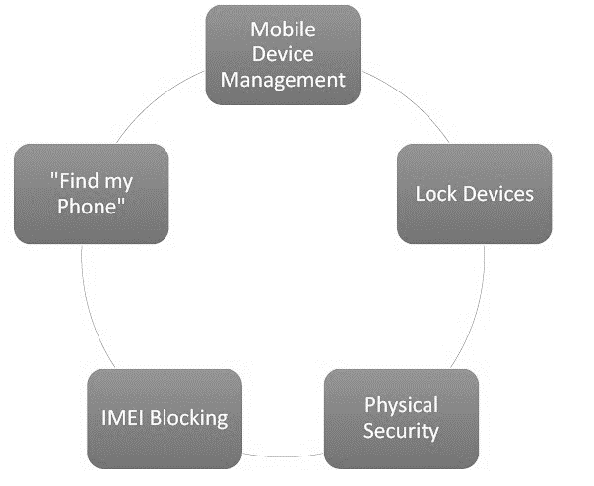
Countermeasures …
Example of countermeasures
Mobile device management (MDM)
Lock devices
IMEI blocking
Physical security
“Find my Phone”
Notes:
https://gotowebsecurity.com/ethical-hacking-course-mobile-attacks-theory/
Details on this is provided in next slides.

Slide 5
Countermeasures …
Example of countermeasures …
Mobile device management- use software and hardware to control mobile access to an organization's data and services.
Lock devices- use PIN code, and lock pattern- as it is better than leaving open.
Physical security- is vital as the device is always with the person and has entire digital identity of the owner which can prove to be very unsafe if lost or stolen.
“Find my Phone”- is an app in many mobile platforms (e.g., Android) where one can register the device, talk to back-end service and get real time info about the device.

Slide 6
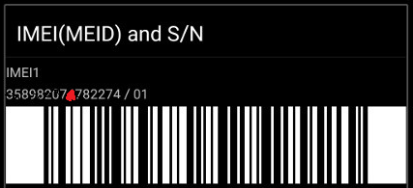
Countermeasures …
Example of countermeasures … IMEI Blocking
  IMEI (International Mobile Equipment Identity) is a 15 digits unique ID or serial number that all mobile phones have.
  It is found on the silver sticker on the back of your phone, under the battery pack, or on the box your phone came in OR it can be found by dialing *#06#.
  IMEI Blocking- enables one to ask the ISP to block, if a device gets lost or stolen.

Slide 7
Mobile Security Technical Controls
Passwords, passphrases and biometrics:
  Protect your device with proper handling of password credentials (password or passphrase) and enable auto-lock.
  Choose the strongest alphanumeric password that your device can support.
  Good passwords are short, easy to remember (15-character).
  Use capital letter, a number, a substituted word, a misspelt word and a special.
  Example of such password is “Back2dafewture!”.
  Modern mobile devices have biometric locks to provide more secure access control and are a supplementary or alternate control.

Slide 8
Technical Controls …
Encryption:
  It is a method of converting information into secret code that hides its true meaning.
  The converted secret code is called ciphertext.
  The science of encrypting and decrypting information is called cryptography.
  Cryptography enables secure communication under adversarial behavior.
  Categories of cryptography:
  Symmetric key cryptography relies on a shared key between two parties.
  Asymmetric key cryptography uses a public-private key pair where one key is used to encrypt and the other to decrypt.
  Has function (one-way cryptography has no key since the plaintext is not recoverable from the ciphertext.
Notes:
One purpose of a hash function in cryptography is to take a plaintext input and generate a hashed value output of a specific size in a way that can't be reversed.
A cryptographic hash function is an algorithm that takes an arbitrary amount of data input—a credential—and produces a fixed-size output of enciphered text called a hash value, or just “hash.” That enciphered text can then be stored instead of the password itself, and later used to verify the user.

Slide 9
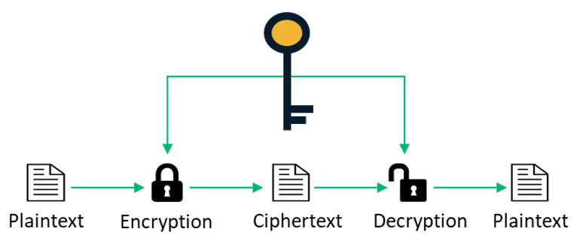
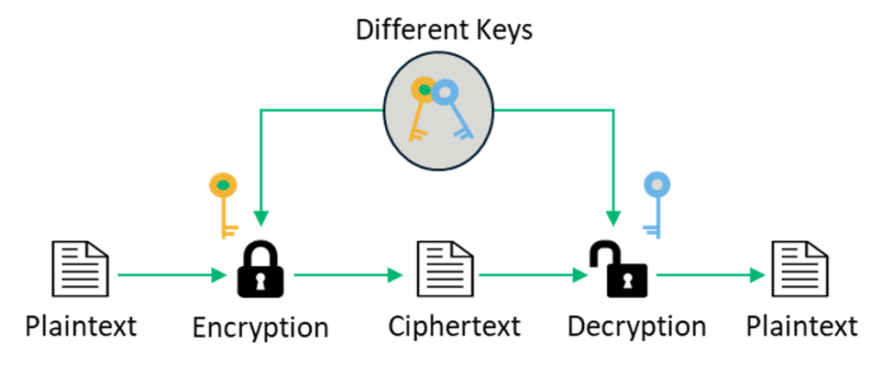
Technical Controls …
Notes:
https://sectigostore.com/blog/5-differences-between-symmetric-vs-asymmetryic-encryption/
Symmetric key encryption is a way for you to encrypt a message so that only you and your intended recipient can read it. It's one type of data encryption, but it's not the only one. There's also another type of encryption that's close in name but is different in terms of what it does: asymmetric encryption. Some examples of symmetric encryption algorithms include:
AES (Advanced Encryption Standard)
DES (Data Encryption Standard)
IDEA (International Data Encryption Algorithm)
Blowfish (Drop-in replacement for DES or IDEA)
RC4 (Rivest Cipher 4)
RC5 (Rivest Cipher 5)
RC6 (Rivest Cipher 6)
Asymmetric encryption is used in key exchange, email security, Web security, and other encryption systems that require key exchange over the public network. Two keys (public and private), private key cannot be derived for the public, so the public key can be freely distributed without confidentially being compromised. Examples of asymmetric encryption include:
. Rivest Shamir Adleman (RSA)
. Digital Signature Standard (DSS), which incorporates the Digital Signature Algorithm (DSA) Elliptical Curve Cryptography (ECC)

Slide 10
Technical Controls …
Code encryption:
  Enables to maintain system integrity by providing a facility to detect code integrity violation (e.g., helps to protect reverse engineering attack).
  Protects mobile users from information theft or privacy violation.
  An encrypted code is decrypted on the device before loading for execution.
Data encryption:
  User data is stored both locally and in the cloud.
  Most mobile operating systems provide some form of full-disk encryption solution.
  Cloud storage enables to back up and provide multiple-device support with synchronization.

Slide 11
Technical Controls …
  Types of data stored in the cloud:
Contacts list, browser bookmarks, chat logs
Settings and logs- system and application specific
Apps, content, automated support, documentation, etc.
Passwords, Photos, Game progress
Data encryption in cloud:
Key generation process happens on the client device.
The key is encrypted with user-supplied input and the data is encrypted using this key.
Only the encryption key and the encrypted data are ever stored in the cloud.
The data is decrypted only after bringing it back to the device.

Slide 12
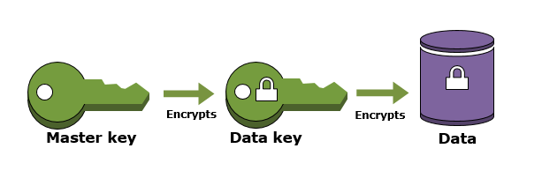
Technical Controls …
Encryption key management:
It describes how cryptographic keys are generated, protected, managed, and distributed.
In most cases, the key generation seed is the unique device identifier (UID) of mobile device.
This UID cannot be seen or extracted by anyone including the device manufacturer.
Master key:
Master key is used to encrypt key stores or other keys including the data-encrypting key.
User-supplied variable is utilized to encrypt the master key.
For example, a master key can be created using UID as input.

Slide 13

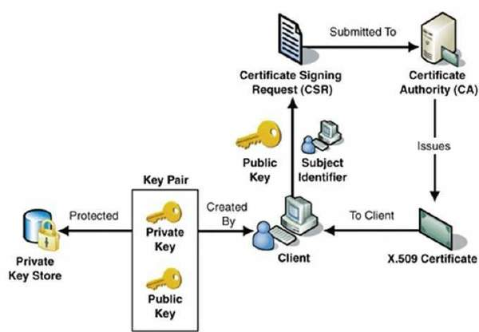
Technical Controls …
Public Key Infrastructure (PKI):
It is a PKC based encryption framework that protects communications between a server (a website) and client (users).
It works by using two different cryptographic keys: a public key and a private key.
PKI infrastructure

Slide 14
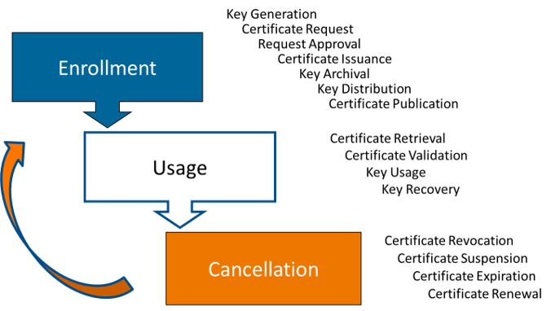
Technical Controls …
PKI key management:
PKI issues certificate and performs listing of certificates on a Certificate Request List (CRL), in response to a current request.
New keys are issued at regular intervals, such as every year or two, to reduce the exposure from keys that have been unknowingly compromised.
PKI should restore the keys to the user in case they forget the passwords that protect their private keys or lose the keys through a disk crash or virus attack.
When employees leave the company, the network manager retains the keys in order to access previously encrypted files and email messages.

Slide 15
Technical Controls …
Application of PKI :
Data encryption for confidentiality:
Use key pairs to encrypt messages and files for secure e-mail and messaging.
Encryption for authenticating people, applications and services, and for access control:
Browsers and Web servers use certificates for authentication(and confidentiality) and for applications like online banking and shopping.
Digital signatures to provide non-repudiation (accountability) and verify data integrity.
Use digital signatures to verify the source and integrity of the content of code and files.

Slide 16
Technical Controls …
Virtual Private Network (VPN):
VPN is commonly used by mobile workers who are unable to guarantee secure connection and yet might need to access an organization’s resources.
A properly configured VPN prevents attackers from intercepting and modifying traffic, while allowing approved access to internal resources.
VPN’s security utility can be enhanced by deploying multistep or multifactor authentication.
Types of VPN:
IPsec VPNs is used for point-to-point connections when network endpoints are known and fixed.
SSL VPNs provide secure access through a web browser and are commonly used by remote workers.
Mobile VPNs provide mobile devices with secure access to network resources and applications on a network while moving from one physical location to another.

Slide 17
Technical Controls …
User training:
User training is even more important than technical controls.
An educated user on a device with poor security is safer than an uneducated user on a device with "strong" security.
Avoid jailbreaking and rooting:
Avoid removing hardware restrictions (e.g., rooting on Android, and jailbreaking on Apple) on your mobile device in order to install unapproved third-party apps or features.
This can weaken built-in security protections, leaving your phone susceptible to malware.
Patching:
  Patching is the process by which software flaws are fixed and features improved.
  It should be noted that jailbreaking/rooting destroys the possibility of protection using patches.

Slide 18
Technical Controls …
Remote track and wipe:
  Remote track and wipe aims to mitigate the risk of device theft or loss.
  Most modern smartphone and tablet platforms have remote wiping and tracking built into the operating system.
Antivirus and Antimalware:
  Antivirus solutions are helpful controls against common malware types.
  New mobile solutions use behavioral analytics and signaling back to a remote cloud server to analyze malware.
Transmission security:
  Majority of smartphones can use multiple network mechanisms.
  For example, Wi-Fi, Bluetooth, provider network (3G, 4G, CDMA, GSM, LTE, etc.), etc.
  It is advisable to disable wireless access when not in use to prevent unauthorized access to the device.

Slide 19
Technical Controls …
Mobile usage control:
  Usage control will allow users to turn off features with the aim to limit security attacks.
  For example, features for downloading videos or images, texting, premium call numbers, overseas calls, and Internet access.
  Content filtering controls can block certain websites to allow safer mobile browsing on the Internet.
  Location and monitoring settings can help a user to limit sharing of private info publicly.
  Control access to SIM cards and removable storage such as SD card and internal storage.
  When replacing old mobile device with a new one, it is important to consider deleting all personal information from SIM, removable storage, and internal storage.

Slide 20
Mobile Security Principles
Security principles
High-level principles to provide a structure for safer use thereby minimize the security risk of mobile devices:
Principles for mobile device end-users.
Principles for mobile application software developers.

Slide 21
Principles …
Principles for mobile device end-users:
  Lock the mobile device- ensure the use of strong passphrases and never write down and store within the device.
  Accept and install the updates (unless it is a fake security update).
  Keep the operating system fully updated to the latest version available from the vendor.
  If the vendor ceased supporting operating system updates, upgrade the device.
  Ensure software updates, in general, for all applications.
  Keep a clean machine by removing old, unused apps.
  Protect personal information by storing the least amount possible on devices.
  Wipe the data on the mobile device before disposing it.
  Sync or backup your mobile device to avoid the risk of lost or stolen devices.
  Stay safe behind bars (do not jailbreak or root the device) and install apps from primary distribution sources only- use Apple Store, Google Play, etc.
  Educate yourself on best practices regarding mobile devices.
  Use malware detection software which predicts and stops mobile attacks .
  Use privacy apps to explain all access to the data that installed apps require.
  Avoid questionable apps and be aware of apps that want to access your data.
  Only attach your mobile device to a trusted computer.
  When charging mobile devices, only connect to a trusted computer.

Slide 22
Principles …
Principles for mobile application developers:
  The architecture should be flexible and robust enough to support devices, apps, and any back-end infrastructure and associated networks.
  Developers should undertake mobile security awareness training.
  Building security and privacy into every phase of development.
  Ensure that sensitive data is protected in transit.
  Ensure security and privacy by design like locking down the security and privacy settings of mobile apps by default.

Slide 23
Class activities:
Individual participation 1: Discussion questions via Mentimeter
Group activity: List of activities to be provided
Individual participation 2: Questions via Kahoot with from previous week
Working on Quiz From Week37
NB: Additional information about the activities yet to be provided in separate document.

Slide 24
Topics for next week
Secure REST based communication in mobile apps
Threat modeling

