Slide 1
Today’s topics
Mobile security organizational perspective
Practitioner’s perspective
End-user perspective
Class activities

Slide 2
Practitioner’s perspective
Perspectives of the practitioners
Sociological aspects of the increase in the use of mobile devices as the world transforms rapidly in a move toward mobile ubiquity.
Challenges surrounding mobile device security for practitioners highlighting the key risks for individuals.
The key mobile security concerns for organizations interacting with a digital native workforce who rely on these mobile devices.
Insights on various threats, risks, mitigations, mobile security strategies, privacy as well as forensics.
Implementation of suggested steps to secure mobile devices.

Slide 3
Practitioner’s perspective …
Security challenges in today’s businesses
Mobile devices became user programmable and support third-party software.
So, study extends to security of such third-party software and associated privacy risks.
Moreover, the business is increasingly likely to be a mobile enterprise.
This is performed using technology, systems, and processes that are designed and built to support mobility.
Work is no longer a place we "go“, instead it's something we do.
However, the proliferation of mobile applications in the workplace is a serious and expanding threat to both security and privacy.

Slide 4
Practitioner’s perspective …
Strict follow-up to relevant mobile device security principles
Principles for end-users and developers (see previous lectures)
Principles for organizations
Thereby build trust between individuals and organizations: apps shall access organizational data responsibly, secure data storage on mobile device and secure data transmission by ISP.

Slide 5
Practitioner’s perspective …
Principles for organizational mobile device security:
  Embed security in corporate: governance, risk and compliance strategy.
  Establish security governance on the mobile devices. E.g., deliberate decision to impose or not to impose security measures on mobile devices.
  Perform regular software testing such as runtime interpretation of code for errors.
  Perform regular security audits on mobile apps.
  Check device defaults like what services are open, authentication defaults for Wi-Fi or mobile hotspots, etc.

Slide 6
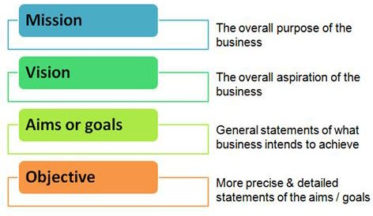
Practitioner’s perspective …
Embed security in corporate governance … outcomes
Strategic alignment
Risk management
Business process assurance
Value delivery
Resource management
Performance measurement

Slide 7
Practitioner’s perspective …
Embed security in corporate governance … Apply ERM
Enterprise risk management (ERM) is a set of methods and processes used by organizations to manage risks and seize opportunities for achieving objectives.
Enables to align risk appetite and strategy and enhance risk response decisions.
E.g., COSO ERM- stands for Committee of Sponsoring Organizations of the Treadway Commission (initially to combat fraud in the US).
COSO ERM is a framework with eight components and four categories of objectives.
The COCO principle: “Good risk management and internal control are necessary for long term success of all organizations.”

Slide 8
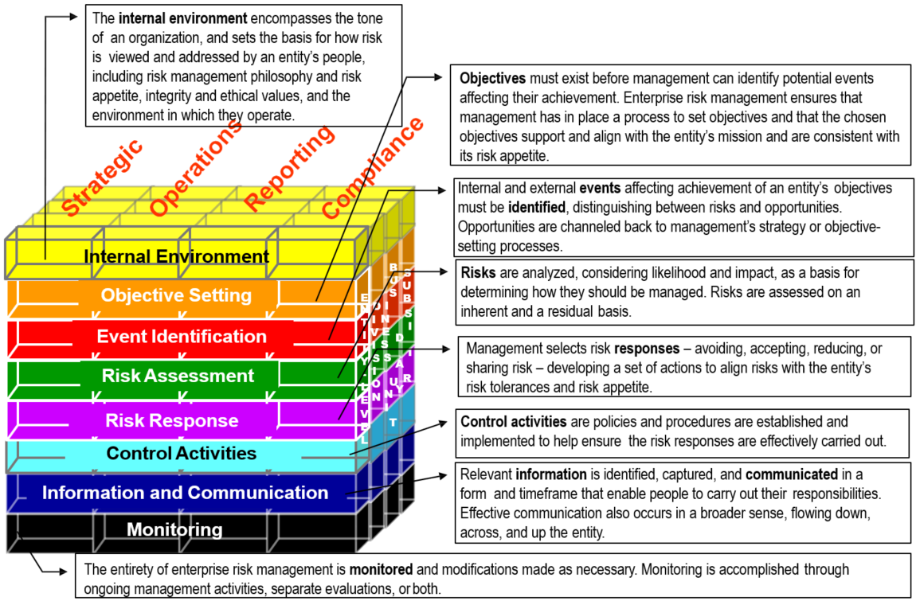
Practitioner’s perspective …
Notes:
Entity-level
Division
Business unit
Subsidiary (sub unit)

Slide 9
Practitioner’s perspective …
Some of the key risks for individuals to be aware of are:
Information exposure risks of keeping highly sensitive data on mobile devices
Privacy implications of technological capabilities that mobile devices provide
Impact of the mobile device being lost or stolen and lack of implementing encryption
More people having a mobile device means the device is a target that can be exploited.
The risk of mobile data exposure is extended by the remote-control capability to spy.

Slide 10
Practitioner’s perspective …
Some of the key concerns for organizations are:
Have suitable strategies in place for securing mobile devices.
Shift the focus to data-centric models rather than system or device-centric models.
MDM control isn't a universal cure and products vary with functionality and approach.
Protection of data through encryption and testing a mobile app before it goes live.
Privacy and identity management.
Security awareness training on mobile devices for staff.
Maintain digital trust with customers.
Consider BYOD programs and implications for organizational policy relating to integration within the organization.

Slide 11
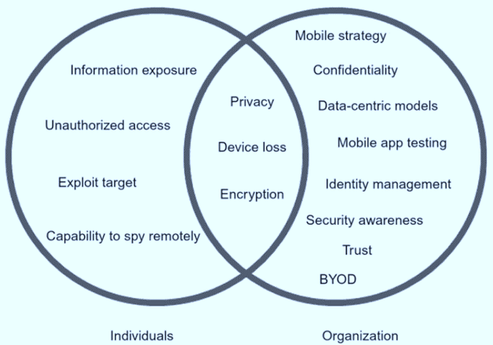
Practitioner’s perspective …
The mobile device overlap

Slide 12
End-user perspective
Impact of Internet and mobile adoption
With the commercialization and widespread usage of the Internet there is a sharp increase in daily Internet surfing.
Growing adoption rate of mobile and portable devices witnessed in the developing economies (global South).
Thus, there is increasing mobile security concern as more and more activities are migrating from PC to a mobile platform.

Slide 13
End-user perspective …
Investment on security
Multinational corporations have invested on cyber and mobile security, and they have relatively matured (especially internal network) security.
However, small and medium scale firms usually have fragmented investment in cyber and mobile security due to inherent financial constraints.

Slide 14
End-user perspective …
Impact of end user security awareness
The security situation for individual Internet and mobile end users is even more serious due to proliferation of personalized portable devices.
Individuals are reluctant to invest in security software for their different mobile devices.
Generally, end users are unaware of the potential vulnerability to uninvited third parties who might access those devices.
This results on the Internet and mobile end users being the weakest link on the mobile security chain.
Notes:
Portable Devices means electronic devices to include, but not limited to: smart phones, tablets, flash memory devices (e.g. USB flash drives, personal media players), portable hard disks, and laptop/notebook/netbook computers if those computers may be transported outside of a Secured Area.
personalization technology encompasses the variety of software tools that collect, store, and manage customer data in order to orchestrate individualized experiences.

Slide 15
End-user perspective …
In defense of the impact of human factor on security:
How would we expect our colleagues to react if we were to describe them personally like this?
What are the other links in this chain and how secure are they really?
What breach trajectory must be created before a human being can become a weak link?
Has the human-factor been automated out of the system in question?
Am I blaming the victim of a crime?
Am I treating end users fairly and transparently?
Why are we pushing such a negative vision of human capability?
Who exactly are we serving with such a message?
Notes:
Article: Mc Mahon, C. (2020). In defense of the human factor. Frontiers in Psychology, 11, 1390.
Focus: Impact of human factor on security
The author ended-up with an assignment for the reader to ask questions when they encounter the “human being is the weakest link” trope.
How would we expect our colleagues to react if we were to describe them personally like this?
What are the other links in this chain and how secure are they really?
What breach trajectory must be created before a human being can become a weak link?
Has the human been automated out of the system in question?
Am I blaming the victim of a crime?
Am I treating end users fairly and transparently?
Why are we pushing such a negative vision of human capability?
Who exactly are we serving with such a message?

Slide 16
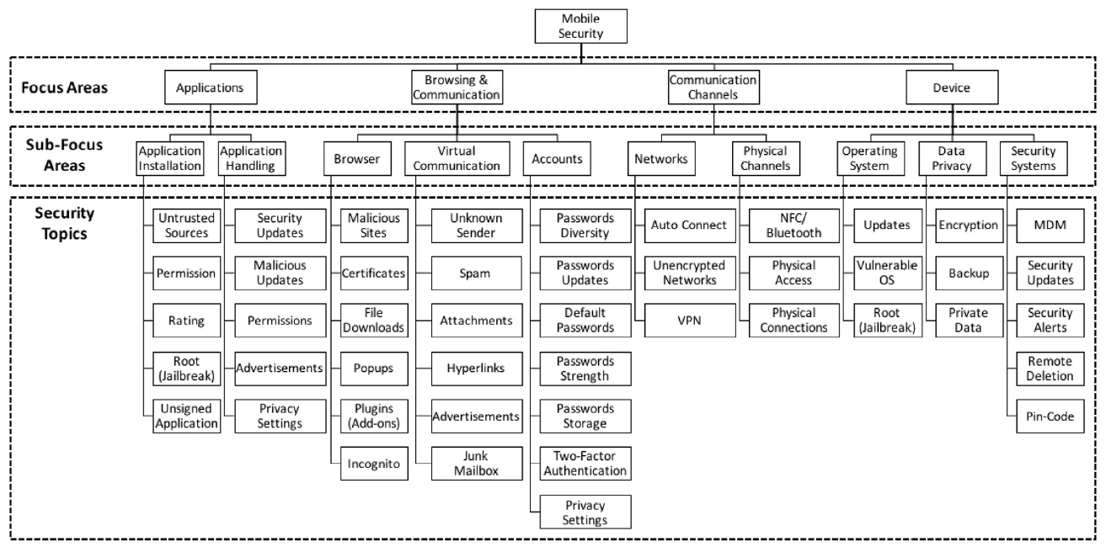
End-user perspective …
Technological elements associated with mobile users’ security awareness

Slide 17
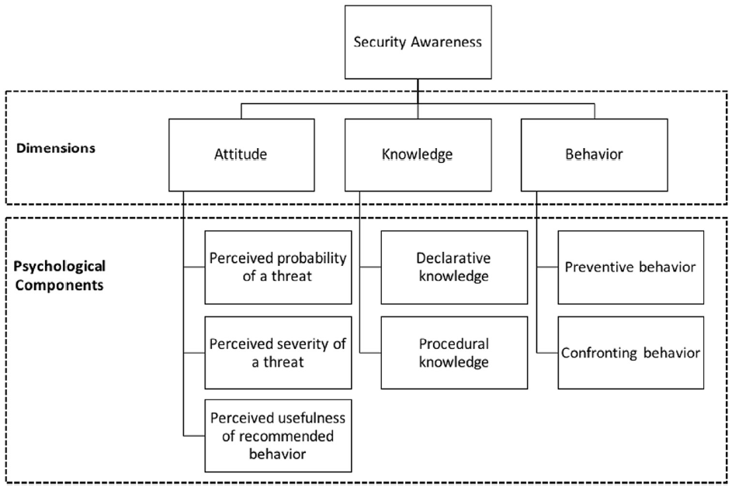
End-user perspective …
Taxonomy of mobile users’ security awareness

Slide 18
Class activities:
Individual participation 1: Discussion questions via Mentimeter (Week38)
Group activity: List of tasks to be provided
Individual participation 2: Questions via Kahoot with from ” Week39”
Working on Quiz From previous “Week38”
Work on “Obligatory assignment 1“
NB: Additional information about the activities yet to be provided in separate document.

Slide 19
Next topics
OWASP mobile security risks, standards, and testing guide

