Slide 1

CNIT 128
Hacking Mobile Devices
9. Writing Secure Android Apps
Updated 4-14-2021

Slide 2
Common Vulnerabilities
Code injection
Logic flaws
Insecure storage
Application configuration
Insecure communication
Logging

Slide 3
Topics
Principle of Least Exposure
Essential Security Mechanisms
Advanced Security Mechanisms
Slowing Down a Reverse Engineer

Slide 4
Principle of Least Exposure

Slide 5
Minimizing Attack Surface
Find all entry points
  Code exposed to inputs from outside sources
Remove unnecessary entry points
Perform security checks at necessary entry points

Slide 6
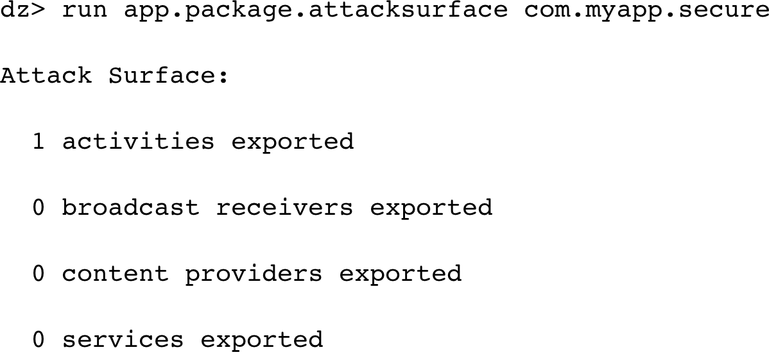
App Components
Don't export more components than required
The safest case is shown below
  Most apps require some integration with other apps

Slide 7
Data Storage
Avoid storing unnecessary data
  Such as passwords!
Private directory is protected somewhat by the sandboxing
SD card is less protected

Slide 8
Untrusted Sources
Inputs from SD card, Internet, Wi-Fi, Bluetooth, etc.
Verify authenticity with signature, encryption, or some other validation
Be careful loading classes or running executables from untrusted locations
Cryptographic protections are the best

Slide 9
Minimal Permissions
Request the fewest permissions needed for your app
This is safer, and also avoids worrying careful users
Avoid risky permissions
  INSTALL_PACKAGES
  Using powerful shared users such as
android.uid.system

Slide 10
Bundling Files in the APK
APK can contain extra files by accident
  May contain SSH credentials or other secrets

Slide 11
Essential Security Mechanisms

Slide 12
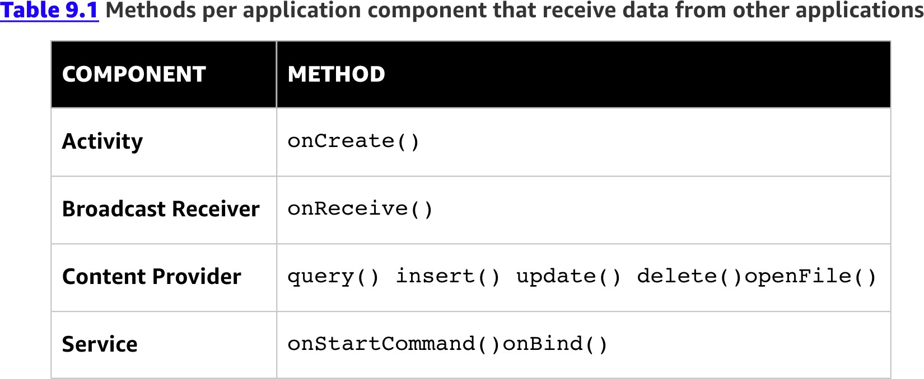
Review Entry Points
Trace these functions

Slide 13
Permission Protection
Exported components should be limited with permissions
  Only available to apps with the same signature
If you really want to offer a component for public use
  Great care is required in the implementation

Slide 14
Securing Activities

Slide 15
Task Manager Snooping
Remove your app from the recent app list
  To avoid exposing private information on that image
Put this code in OnCreate() to show a blank screen in the list
getWindow().addFlags(WindowManager.LayoutParams.FLAG_SE CURE);
Set this attribute in an activity to remove it entirely from the list
intent.addFlags(Intent.FLAG_ACTIVITY_EXCLUDE_ FROM_RECENTS);

Slide 16
Tapjacking
Prevent touches from being sent through elements with this attribute:
android:filterTouchesWhenObscured="true"
Or by using this method:
view.setFilterTouchesWhenObscured(true);

Slide 17
Dictionary
Disable additions to the dictionary to keep passwords and other secrets out
Add this attribute to an EditText box:
android:inputType="textVisiblePassword"

Slide 18
Fragment Attacks
Fragments are small UI elements that customize activities
  But fragment injection vulnerabilities were found
Since Android 4.4, fragments are blocked by default
Use this code to allow a whitelist of fragments:
@Override
protected boolean isValidFragment(String fragmentName) { String[] validFragments =
{"com.myapp.pref.frag1", "com.myapp.pref.frag2"};
Arrays.asList(validFragments).
return
contains(fragmentName);
}

Slide 19
Secure Trust Boundaries
Make sure there's no way to open an authenticated activity from unauthenticated areas of the app
One way: implement an app-wide authentication variable

Slide 20
Masking Password Displays
Add this attribute to an EditText box:
android:inputType="textPassword"

Slide 21
Browsable Activities
Can be used directly from a web browser
High-value targets for attackers
Avoid using BROWSABLE
If you use it, consider all possible intents that could cause actions in your app

Slide 22
Securing Content Providers

Slide 23
Default Export Behavior
Prior to API 17, content providers were exported by default
To prevent this, put this code in the manifest:
<provider android:name=".ContentProvider"
android:authorities="com.myapp.ContentProvider" android:exported="false" >
</provider>

Slide 24
SQL Injection
Use prepared statements, like this:
String[] userInput = new String[] {"book", "wiley"};
Cursor c = database.rawQuery("SELECT * FROM Products WHERE type=?
AND brand=?", userInput);

Slide 25
Directory Traversal
The getCanonicalPath() method removes .. characters and provides the absolute path to a file
The code on the next page uses this to limit paths to the /files/ subdirectory of the app's private data directory

Slide 26
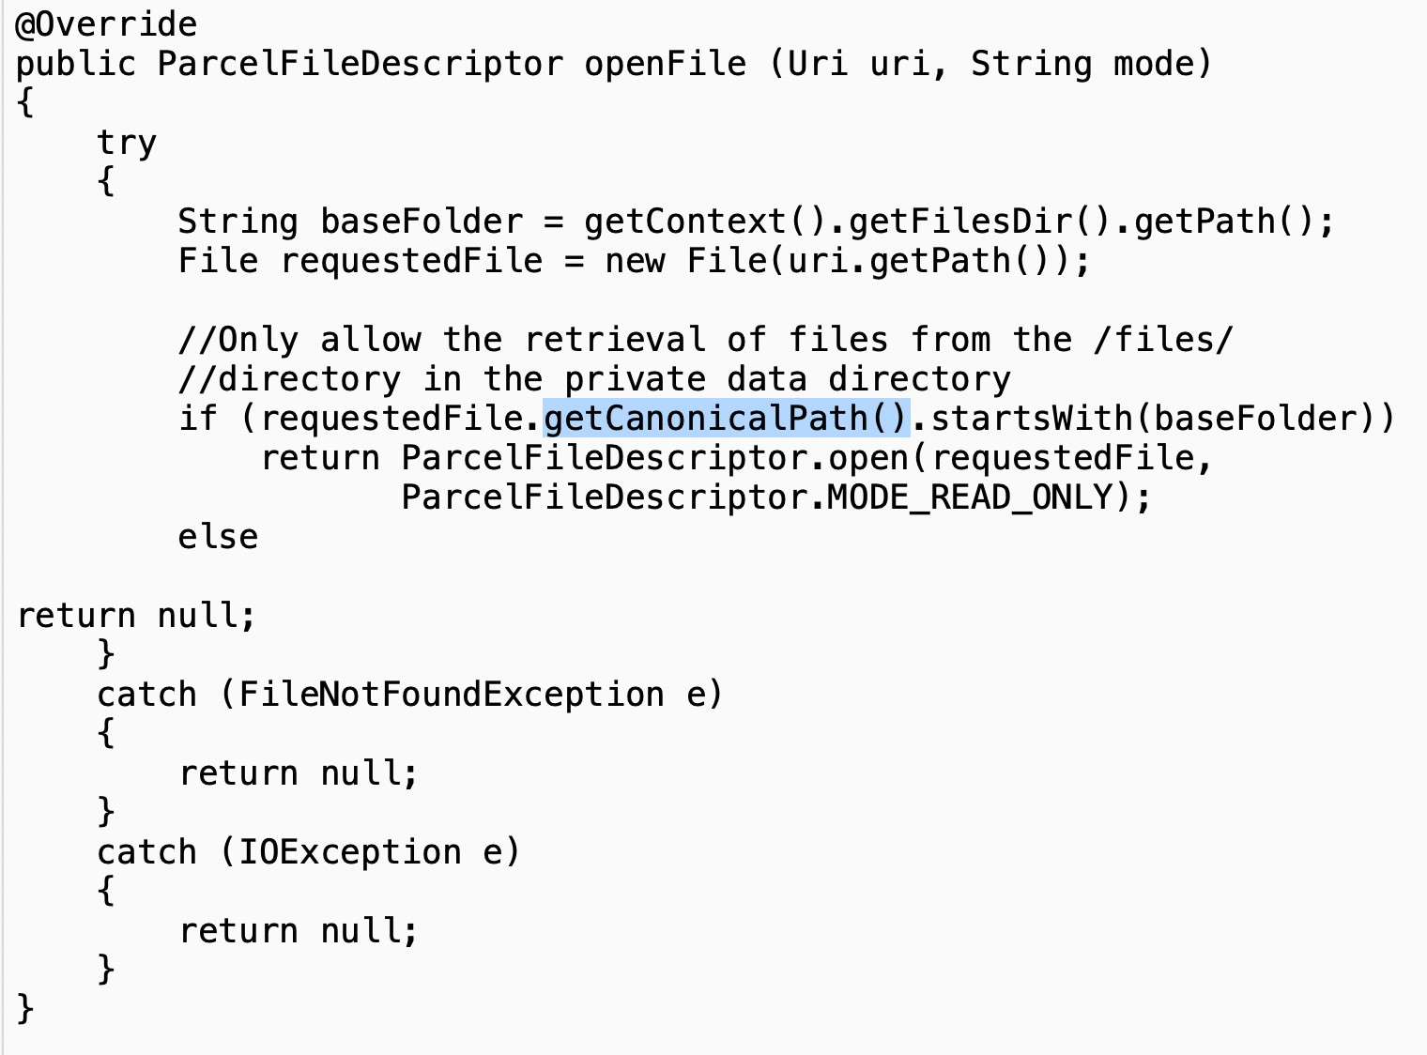

Slide 27
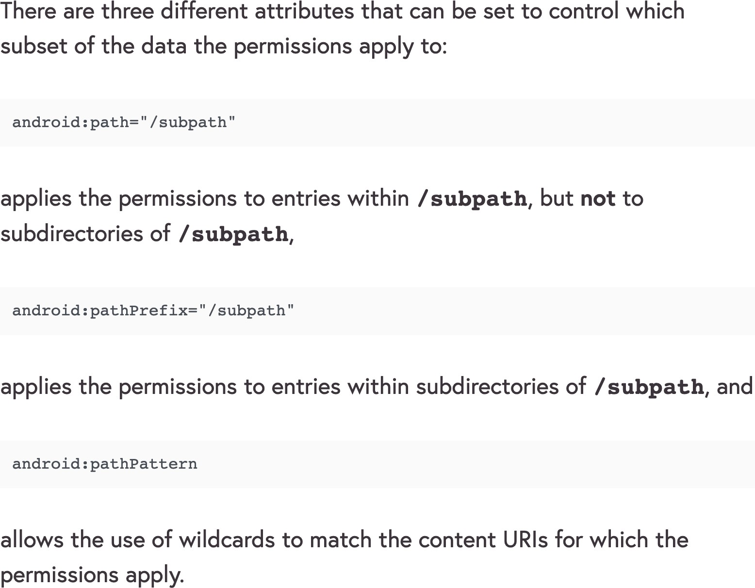
Pattern Matching
Pattern- matching checks may fail for variations of the path
Link Ch 9a

Slide 28
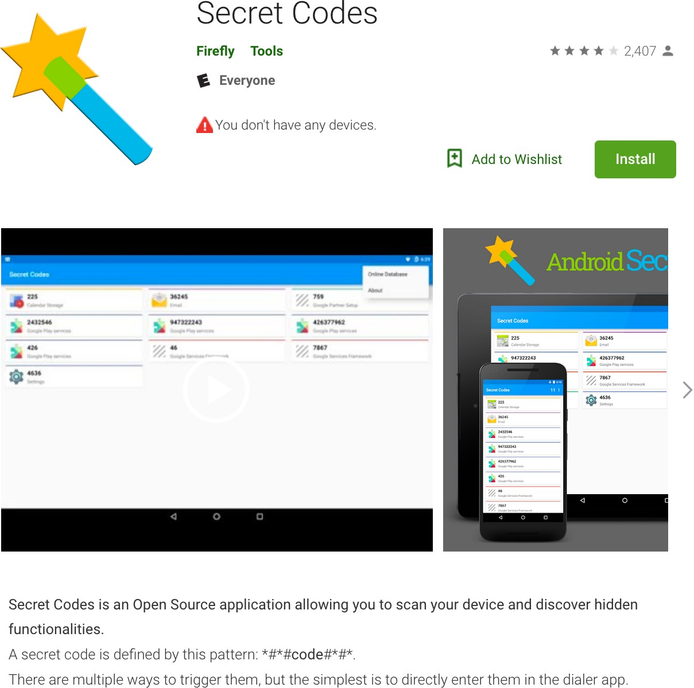
Securing Broadcast Receivers
Secret codes are easily enumerated using apps on the Play Store
Don't trust them

Slide 29
Storing Files Securely

Slide 30
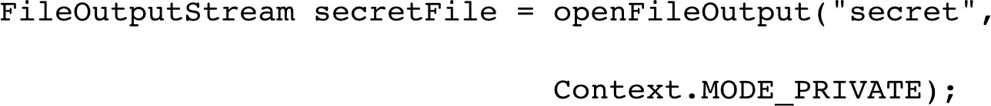
Creating Files and Folders Securely
Explicitly set permissions

Slide 31
Encryption
Use AES for symmetric encryption, avoid ECB
Use RSA-2048 for asymmetric encryption
Password hashing advice in textbook is wrong
  You need salting and stretching; better to avoid doing it yourself

Slide 32
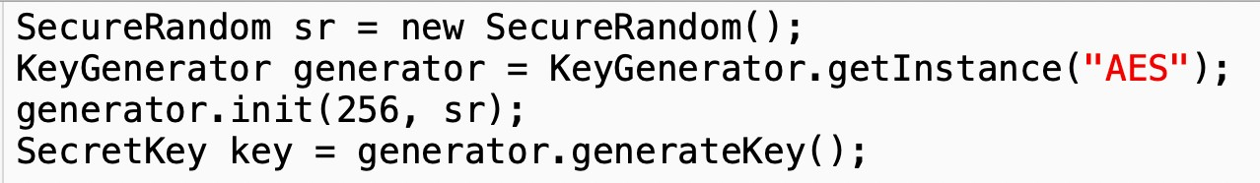
Random Numbers
Random() produces the same series of numbers each time it's run from the same seed
SecureRandom is better
Java provides methods to seed it from a source of entropy

Slide 33
Random()
import java.util.Random; class Main {
public static void main(String[] args) {
// create instance of Random class Random rand = new Random(1);
// Generate random integers in range 0 to 999 int rand_int1 = rand.nextInt(1000);
int rand_int2 = rand.nextInt(1000);
// Print random integers System.out.println("Random Integers: "+rand_int1); System.out.println("Random Integers: "+rand_int2);
}
}

Slide 34
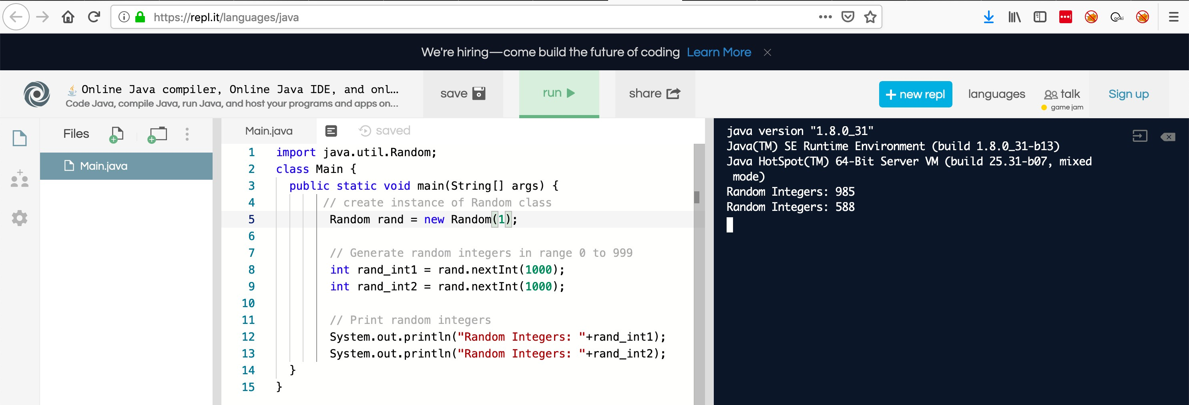
Online Java Tester
replit.com
Every run produces the same numbers

Slide 35
Key Generation
PBKDF2 uses many rounds of hashing to derive a key from a password
Key should be stored in Android Keystore

Slide 36
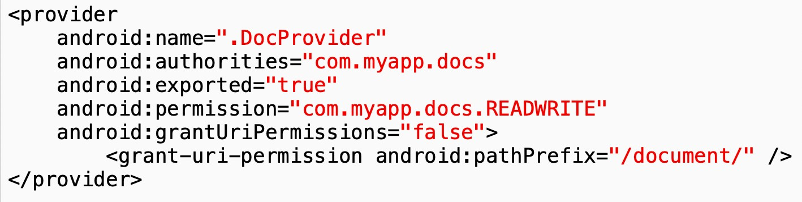
Exposing Files
To allow specified other apps to see a file
Those apps need com.myapp.docs.READWITE
permission
They can only access the /document/ folder

Slide 37
Secure Communications

Slide 38
HTTPS
HTTP is very unsafe
HTTPS is much better, but depends on trusted Certificate Authorities (CAs)
Certificate pinning makes HTTPS even more secure
  Requiring a specific certificate or CA

Slide 39
Local Communications
Transferring data from one app to another
Android API is the best method
  Activities with intent-filters
  In more recent Android versions
    ChooserTargets, Shortcuts, direct share targets
Using network sockets or the clipboard is less safe

Slide 40
Securing WebViews

Slide 41
WebView
Lets you display a Web page in an activity
Often leads to security problems
If loaded over HTTP, subject to interception and modification
More recommendations at
  https://www.checkmarx.com/blog/android- webview-secure-coding-practices/

Slide 42
Configuring the Android Manifest

Slide 43
Backups and Debugging
If android:allowBackup is false, an attacker can't back up files with physical access to the device
android:debuggable allows debugging

Slide 44
API Version Targeting
minSdkVersion should be as large as possible
Lower values remove new security fixes
Values below 17 export content providers by default

Slide 45
Android 9
Targeting SDK 28+ gives you
  DNS over TLS
  Network TLS by default
    Cleartext traffic must be explicitly set
  Separate WebView directories for each process
    Can't steal cookies

Slide 46
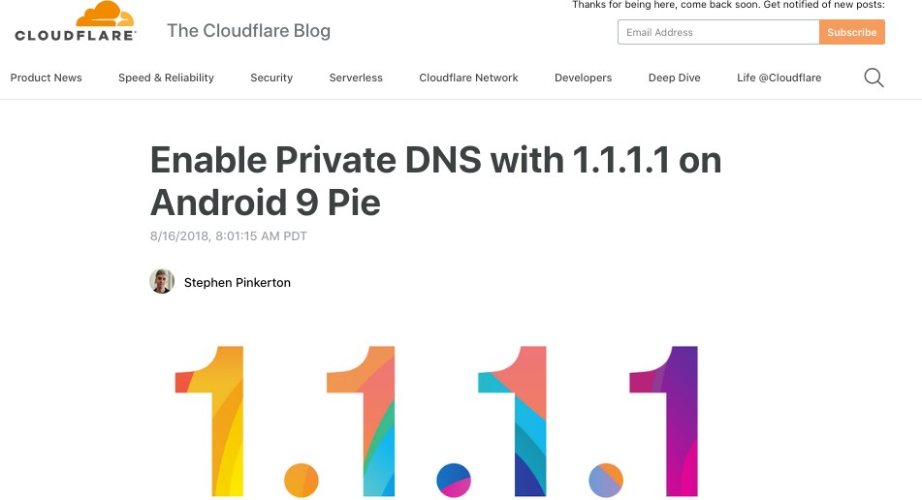
•
https://blog.cloudflare.com/enable-private-dns-with-1-1-1-1-on-android-9-pie/

Slide 47
Logging
Should be disabled in release builds
Use a centralized logging class
  So it can be easily disabled
ProGuard can remove logging code

Slide 48
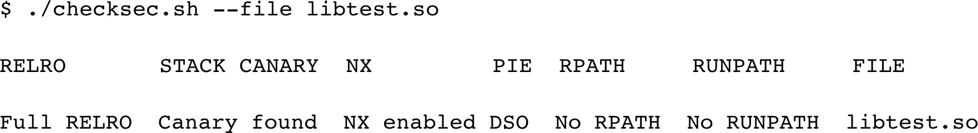
Native Code
Notoriously difficult to secure
Limit its exposure to the outside world
Enable exploit mitigations
  Use latest NDK version

Slide 49
Exploit Mitigations
RELRO: Relocation Read-Only
  Prevents GOT rewrites
RPATH / RUNPATH
  Allows attacker to load modified libraries from a user-controlled path
Link Ch 9f

Slide 50
Advanced Security Mechanisms

Slide 51
Protection Level Downgrade
A malicious app can define a permission first with an insecure protection level
So your app inherits that level
Your app can check to make sure the protection levels are intact at each entry point

Slide 52
Protecting Non-Exported Components
Attacker with root permissions can interact with them
You can add a request token to prevent that
  Randomly generated
  Stored in a static variable in memory
  Intents must have this token to run

Slide 53
Slowing Down a Reverse Engineer

Slide 54
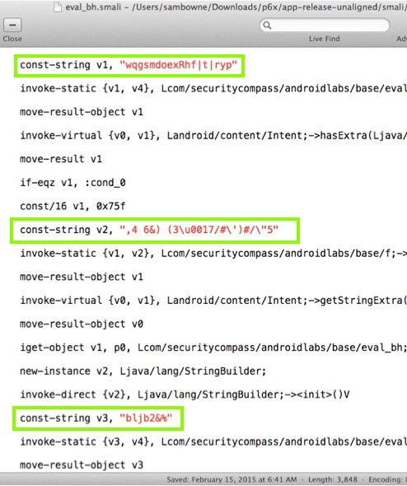
Obfuscation
ProGuard -- free but very ineffective
DexGuard -- paid version of ProGuard
Dash-O is good but expensive ($3000)
Arxan is another

Slide 55
Root Detection
Search for su
See if default.prop allows ADB shell to run as root
See if adbd is running as root
Look for packages with names like
  SuperSU or Superuser

Slide 56
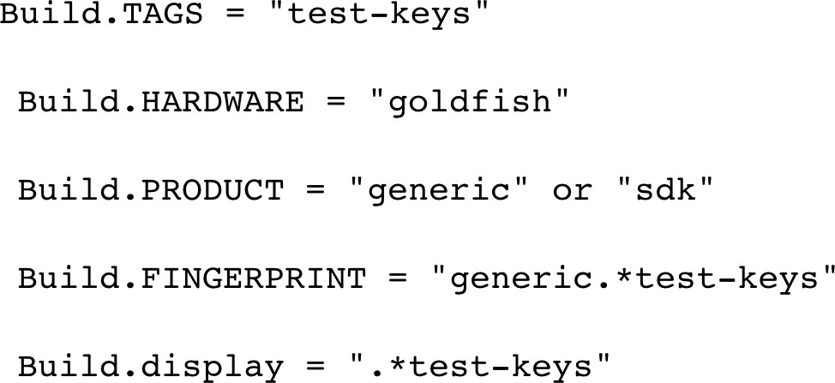
Emulator Detection
Check for emulator build properties

Slide 57
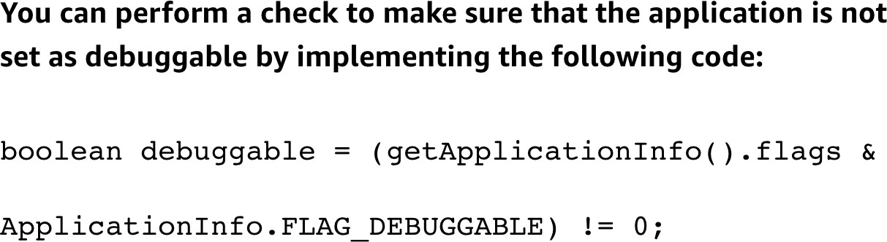
Debugger Detection
Attacker may have modified your app or the environment to allow debugging

Slide 58
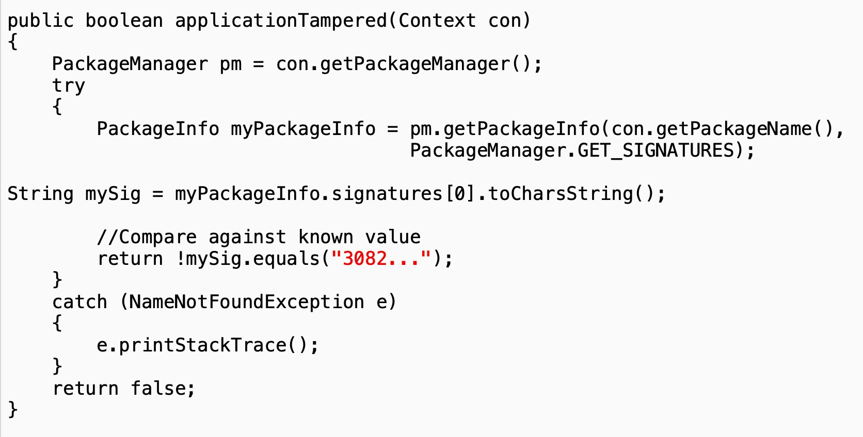
Tamper Detection
Check signature

Slide 59


