Slide 1
Security issues in Android Applications
Understanding Android Apps
Android security model
Reverse-engineering
Exposing vulnerabilities and attacking App components

Slide 2

Introduction
Android is an open source and Linux-based operating system for mobile devices.
It is developed by the Open Handset Alliance (OHA) which is led by Google.

Slide 3
Introduction …
The first commercial version, Android 1.0, was released in 2008.
Android 4.1 (Jelly Bean) was released in 2012 with improved user interface.
Source code for Android is available under free/open source software licenses.
Google publishes most of the code under the Apache License and Linux kernel GNU General Public License.

Slide 4
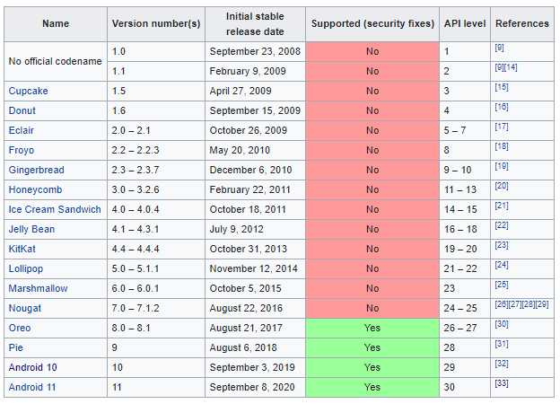
Android versions
Features of the different Android versions- current transition from version 10 to 14
Android 13 was also released on August 15, 2022

Slide 5
Main features of Android
Intuitive user interface
Connectivity (e.g. Wi-Fi)
Storage (e.g. SQLite)
Media support (e.g. MPEG-4)
Messaging (e.g. SMS)
Web browser
Multi-touch
Multi-tasking
Resizable widgets

Slide 6
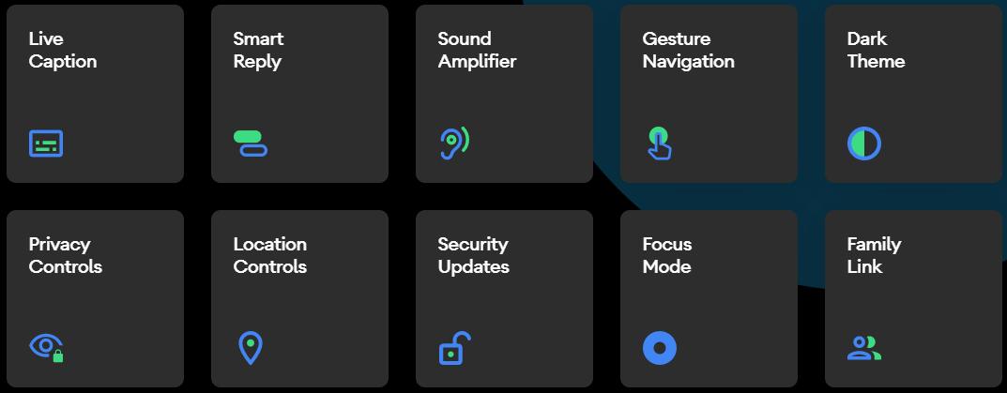

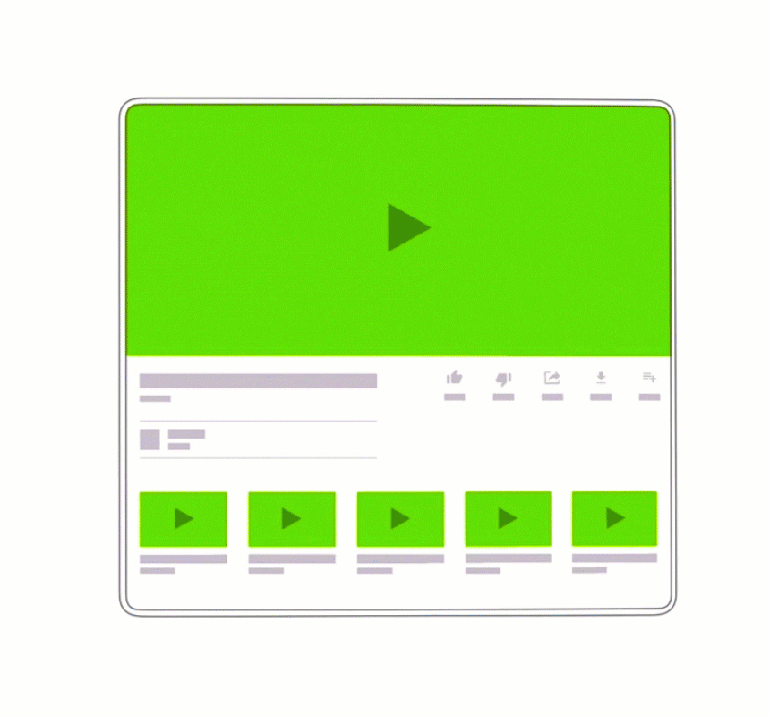
New features of versions 10/11/12
foldable

Slide 7
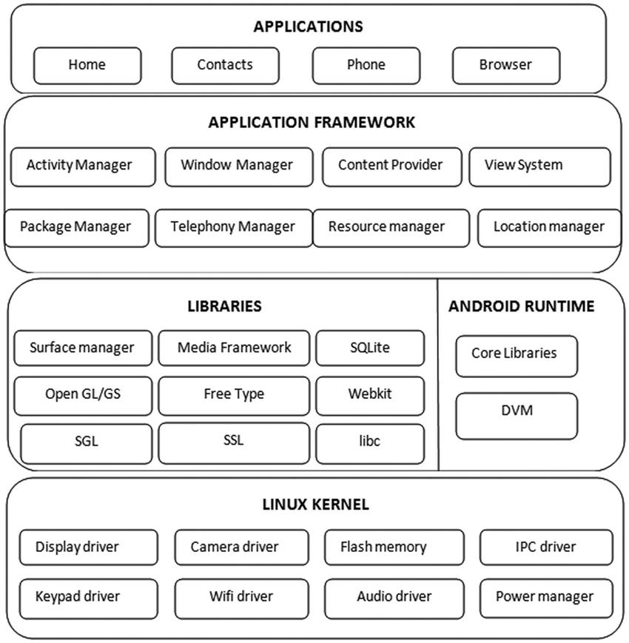
Application architecture
Android OS has two distinct features:
  modified Linux kernel (Android kernel)
  application virtual machine that runs Java-like Apps.
  gap between mainline Linux kernel and Android kernel varied over the years.
In Linux, applications that are started by a user are run under that user’s context.
  Thus, it relies on a user’s not installing malicious software on their computers …
  as there is no protection against accessing files that are owned by same user …
In contrast to Linux, however, each App installed on Android is assigned its own unique identifier:
  user identifier (UID) and group identifier (GID).
Dalvik Virtual Machine (DVM) is specifically designed for Android platform and is unique.
The main reason for the existence of DVM is to run on processor and memory limited hardware.
  So, DVM is lighter than the normal JVM.
The code that runs on DVM is written and compiled to Java classes and converted into a single DEX file.
Android Apps are distributed in the form of a zipped archive APK files which stands for Android Package.

Slide 8
Android App Components
Activities- visual screens of an application with which users interact. For example, when you launch an application, you see its main activity.
Services- non-graphical components that provide the facility to perform tasks that are long running in the background.
Broadcast receivers- non-graphical components that allow an application to register for certain system or application events.
Content providers- the data storehouses of an application that provides a standard way to retrieve, modify, and delete data - SQLite.

Slide 9
Android APK folder structure
  /Assets - allows the developer to place files in this directory that they would like bundled with the App.
  /Res - contains all the App activity layouts, images used, and any other files that the developer would like accessed from code in a structured way.
  /Lib - contains any native libraries that are bundled within the App- loaded by the application according to the detected CPU architecture- like x86, ARM, MIPS.
  /META-INF - this folder contains the certificate of the App and files that hold an inventory list of all included files in the zip archive and their hashes.
  /classes.dex - this is the executable file containing the Dalvik bytecode of the application. It is the actual code that will run on the Dalvik Virtual Machine.
  /AndroidManifest.xml - the manifest file containing all configuration information about the application and defined security parameters.
  /Resources.asrc - resources can be compiled into this file instead of being put into the res folder- contains any application strings.

Slide 10
Android SDK tools
Android Apps are usually developed in Java language using Android Software Development Kit (SDK)- requires downloading the Android SDK.
Exploit the Android Developer Tools package → integrated development environment (IDE) and all the tools.
Whether you plan to use an emulator or physical device, the Android SDK provides many tools that are essential for Android hacking.
Emulator is among the Android SDK tools which provide root access by default.
However, emulators do not use hardware like USB, headset, Wi-Fi, Bluetooth, real phone calls, NFC, SD card, etc.
At the lowest levels of operation, an emulator is not an exact replica of how Android runs on a real device.
Real Android devices do not provide root access by default. However, significant testing/hacking can be performed without having root access on an Android device.

Slide 11
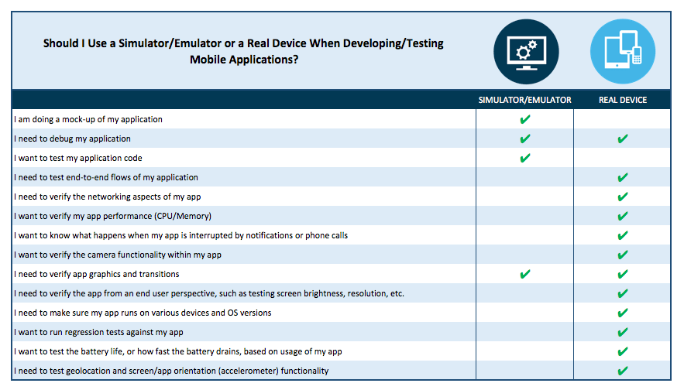
Android SDK tools …
https://mobilelabsinc.com/blog/simulators-vs-emulators

Slide 12
Android SDK tools …
adb is used to explore devices/emulators- install apps, run shell, read logs, forward ports, show devices, push file to, etc.
drozer is Android pen testing tool that finds vulnerabilities in apps or devices and provides exploits, useful payloads.
aapt (Android Asset Packaging Tool) is used to packages assets into binary and converts binary to readable text to perform reverse-engineering.

Slide 13
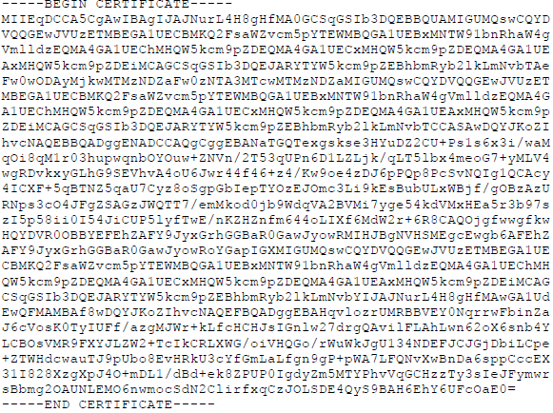
Android security model
The foundation of the Android app security model is that no two apps running on the same device should be able to access each other’s data without authorization.
They should also not be able to affect the operation of the other app adversely or without appropriate consent which is the basis of an application sandbox.
An app would need to know if another app is authorized to perform an action, hence application’s identity is important.
Code signing is done on Android package through digital certificates where the private key is only held by developers to prove identity of an app’s author thereby get trust.
Tools: $keytool –genkey, $jarsigner … application.apk alias_name- also use in Windows command ssh-keygen -t rsa

Slide 14
Android security model …
App certificates are not verified by the Android operating system in any way and do not need to be issued by a certain Certificate Authority (CA) like other platforms.
The signing certificate is checked only when the application gets installed and if the certificate subsequently expires, the application will still run as normal.
Google recommends that signing certificates be created with a validity period of 25 years or longer to support seamless updates to your application.
A number of vulnerabilities have been discovered in the way that the validation of signatures is performed on APK files.
Android employs a fine-grained privilege model for applications to request permission to access resources.

Slide 15
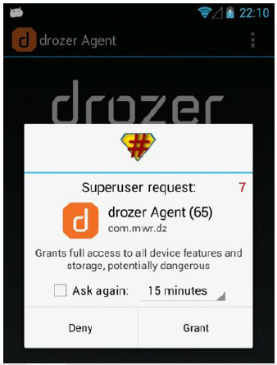
Android security model …
In drozer, permissions that have been requested can be accessed using
dz> run app.package.info -a com.android.browser.
File system (full disk) encryption (FDE) is when the entire drive are encrypted- available on Android since version 3.0 (Honeycomb).
FDE serves as protection against stolen or lost disks- it uses dm-crypt module in kernel to encrypt and decrypt data on the block device layer (see video here).
Android does not allow Apps to run tasks as a root user (super user permission) which led researchers to find ways to obtain root on Android devices, hence rooting.
A typical objective of rooting a device is to put the su command in a directory on the PATH (e.g., /system/bin or /system/xbin).
An example of a prompt from the SuperSU application

Slide 16
Reverse-engineering Apps
Reverse-engineering is the process of gaining a deep understanding of a finished product.
In Android, first, find the package of a target App:
$adb shell pm list packages | grep app-name
To pull the App off the device you need to find the APK path:
$adb shell pm path package-name
To reverse engineer an App from Play Store, you need to install it on your device or get APK by sending package name to the sites.
A DEX (dalvik executable) is an executable file saved in a format that contains compiled code written for Android.
DEX files can be disassembled into human-readable assembly from adb shell:
$dexdump -d /path/to/classes.dex

Slide 17
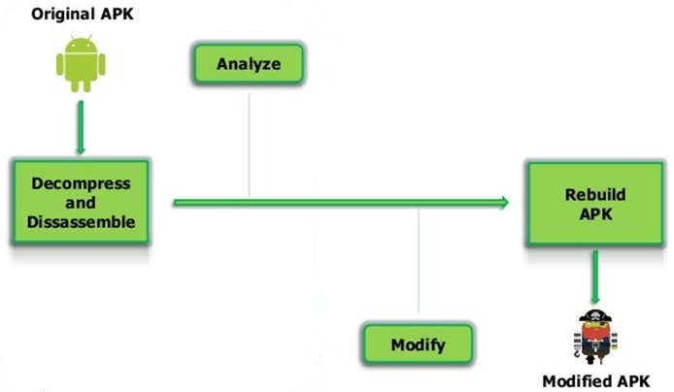
Reverse-engineering Apps …
Apktool is used to reverse-engineer an entire Android package back for modification.
IDA is another popular disassembler used by reverse engineers all around the world.
Application analysis workflow in Android:

Slide 18
Exposing vulnerabilities
App components to consider are App container, communications and Internet server.
Exported components (APIs) App can be found and exposed by inspecting its manifest using the below drozer command:
            dz> run app.package.attacksurface com.android.browser
            Attack Surface:
            6 activities exported
            4 broadcast receivers exported
            1 content providers exported
            0 services exported
The root and system users can exert control over installed Apps and can interact with components even when they are not exported.
Whether an App exports a component in its manifest or not, it is relevant only when the calling App is another non-system App.

Slide 19
Exposing vulnerabilities … attack scenario
An installed malicious App defines a set of known permission names from legitimate App with a protection level of normal.
User installs legitimate App, and OS sees that one of the permissions is already defined. This leads the OS to ignore the protection level and stick to the known parameters defined by the malicious App.
The permission now has a downgraded protection level of normal instead of more secure value (e.g., signature). Android does not know any difference even if the permission of the legitimate App was defined with signature.
The malicious App can interact with the no-longer protected legitimate App components defined with the downgraded permission.

Slide 20
Attacking App components
Attacking an app over the Android IPC system involves finding all the exported components of the App and attempting to use it in a way that was not intended.
For activities, broadcast receivers, and services, this means you must examine all the code that handles intents from other Apps.
In Android, an intent is a data object that loosely defines a task to be performed and it can be matched against intent filters based on its action, data, and category.
Common Android vulnerabilities can be showcased using Apps like Sieve, password manager App.
After installing it, you can find the package name of Sieve by using dz> run app.package.list -f Sieve
Examine exported App components of Sieve in its manifest using tools like drozer.

Slide 21
Attacking App components …
Insecure storage:
The sandbox provides segregation of Apps’ data mainly based on file/folder ownership and permissions, i.e., each file and folder belongs to an owner and a group.
However, the owner/group of a file can be changed as the root user using a tools such as chown and chmod.
Insecure communication:
Apps are often designed to make use of HTTP/HTTPS in order to easily integrate into existing infrastructure to send and receive information from services on the Internet.
However, native apps are often less secure than web browsers which may also make use of other communication protocols.
Thus, communication flaws of Apps can be misused to attack the device.

Slide 22
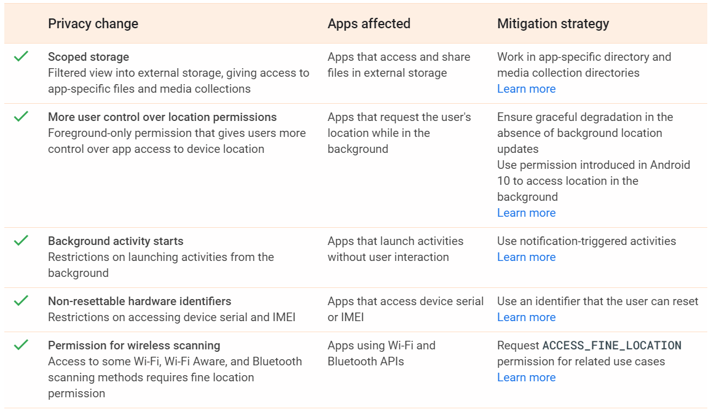
Top Privacy Changes in Android 10

Slide 23
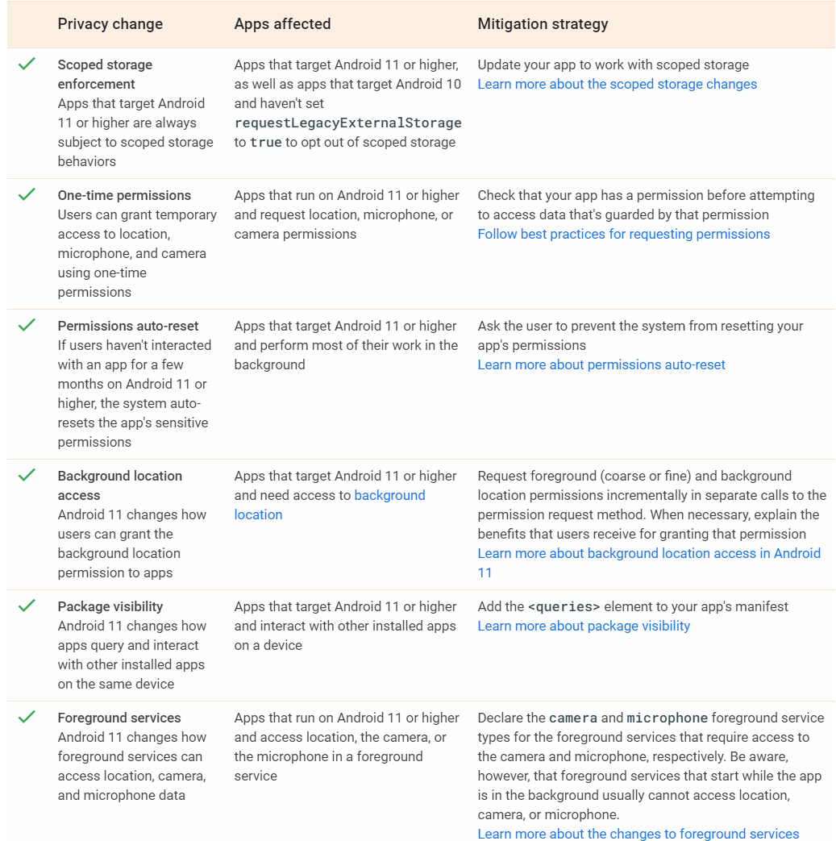
Top Privacy Changes in Android 11

Slide 24
Demo
To set up drozer use the following tools:

Slide 25
Demo …
Install drozer-agent software from adb
>adb –s device install path/drozer-agent-2.3.4.apk
>adb -s device install path/sieve.apk
>adb uninstall com.mwr.example.sieve
Starting the drozer agent runs on port 31415
Port forward to establish the communication between the Drozer Client and Agent:
>adb forward tcp:31415 tcp:31415
Finally, launch the application and press the bottom "ON“. And connect to it:
drozer console connect
To find installed app's package name
dz> run app.package.list -f Sieve
To get Manifest of the app
dz> run app.package.manifest com.mwr.example.sieve
To explore the attack surface of the App
dz> run app.package.attacksurface com.mwr.example.sieve
Examine exported activities- permissions
dz> run app.activity.info -a com.mwr.example.sieve
dz> run app.package.info -a com.android.chrome
More information on basic drozer commands can be found in link 1 and link 2.
Notes:
https://gist.github.com/Pulimet/5013acf2cd5b28e55036c82c91bd56d8
https://gist.github.com/sridhareaswaran/516c8412956115c0df10f519f5ff296d
https://android.magicer.xyz/tools/help/shell.html
https://developer.android.com/studio/releases/platform-tools
Drozer:
https://github.com/FSecureLABS/drozer/issues/358
Start an app :
adb shell
>am start -n com.package.name/com.package.name.ActivityName

Slide 26
Class activities:
Class activities:
Individual participation 1: Discussion questions via Mentimeter (Week42)
Individual participation 2: Questions via Kahoot (Week42)
Group activity: List of activities to be provided
Work on “Obligatory assignment 2“
NB: Additional information about the activities yet to be provided in separate document.
Individual participation 1: Discussion questions via Mentimeter (Week42)
Individual participation 2: Questions via Kahoot (Week42)
Group activity: List of activities to be provided
Work on “Obligatory assignment 2“
NB: Additional information about the activities yet to be provided in separate document.

Slide 27
Next topics
Exploiting vulnerabilities and writing Secure Android Apps

