Slide 1

Lecture themes
IKT200- revision of learning content

Slide 2
Agents
When we talk about entities in artificial intelligence, we use the term agents.
An agent observes (through sensors) and acts (through actuators) toward an environment to achieve one (or more) goals.

Slide 3
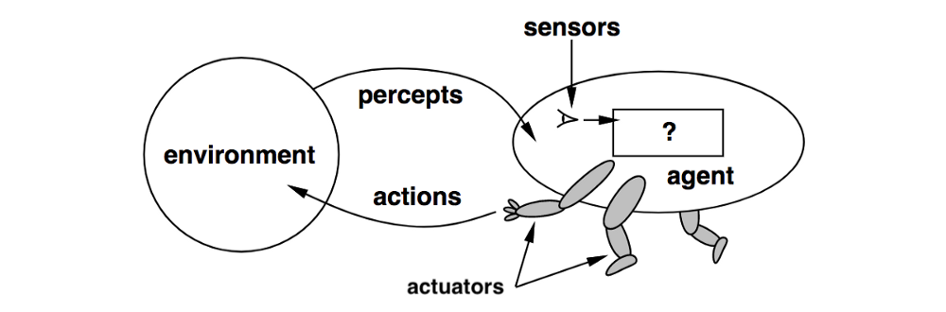
Agents …

Slide 4
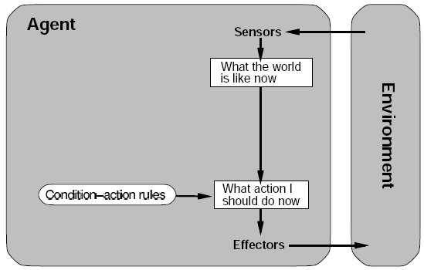
Agents - complexity
Simple agents include the type of reflex act. E.g., "thermostat" logic.

Slide 5
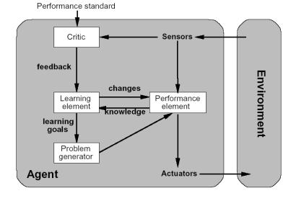
Agents – complexity …
Advanced agents learn overtime, using complicated logic. E.g., Machine Learning.

Slide 6
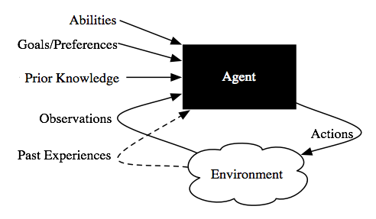
Agents – complexity …

Slide 7
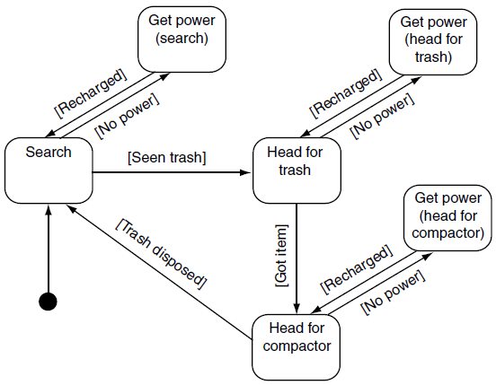
Agents- models
Active State Generates. E.g., in electric sweeper robot, a recharge state that override (have higher priority than) other states.

Slide 8
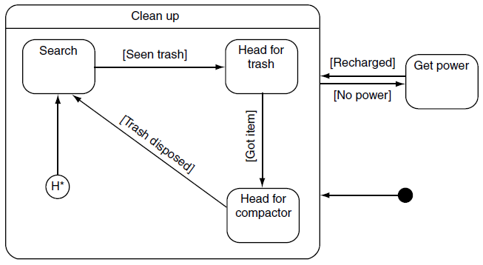
Agents- models …
Hierarchical finite state machine (HFSM). Hierarchical FSM is a situation in which one or more FSMs exist inside other FSMs.

Slide 9
Agents- models …
(Child-)States Compete is another model to handle transitions between states. It works as described below:
  All states (or a subset of states) are asked about their relevance to becoming an active state.
  Based on the feedback from each, the active state is selected.
ROOT
Search
Head for trash
Head for compactor
Get power

Slide 10
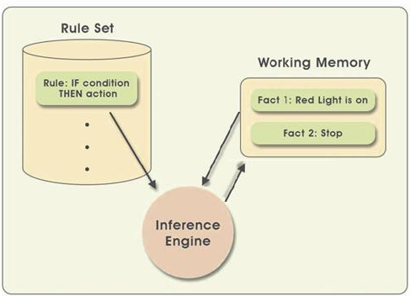
Rule-based systems
Rule-based (expert) system:

Slide 11
Rule-based systems …
There are two ways an inference engine can work:
Data-driven inference (also called forward chaining inference).
  Well suited when we know all the input.
  Widely used in Game AI (computer games usually have all input available).
Goal-driven inference (also called backward chaining inference).
  Well suited when we only know some (or no) input.
  Widely used in systems that diagnose, troubleshoot, or similar.

Slide 12
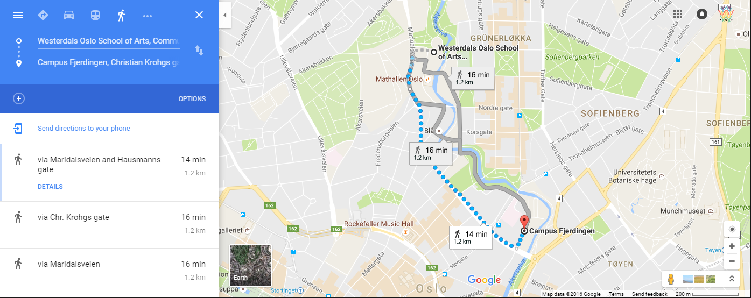
Pathfinding
Pathfinding is the plotting of shortest route between two points using a computer program.
  Path-node definition, path finding (searching), path following

Slide 13
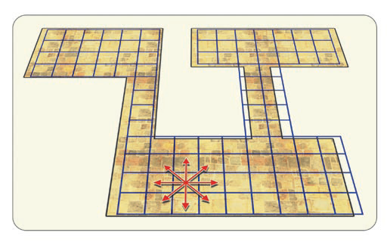
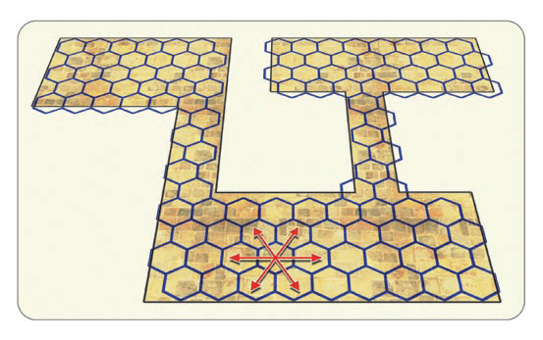
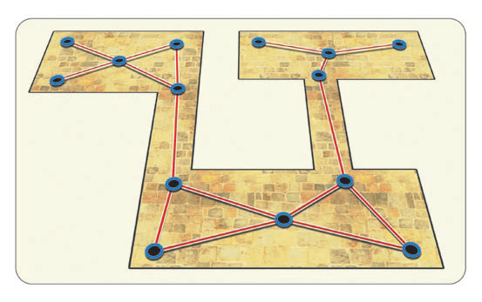
Pathfinding …
Path Node Definition
  In order for the machine to work with pathfinding, we must have defined points that can be moved to.
  The points are defined via. e.g., Grid, hexgrid or custom points.

Slide 14
Pathfinding …
Algorithms
  Depth first search
  Breadth first search
  Dijkstra's shortest path algorithm
  Best first search
  A* search
  https://clementmihailescu.github.io/Pathfinding-Visualizer/#

Slide 15
Steering behaviors
Steering behaviors are used to organically manage the movement of an AI agent.
We have many types of steering behaviors:
  Seek & Flee, Pursue & Evade, Arrive, Wander
  Wall Avoidance, Obstacle Avoidance, Interpose
  Hide, Path following, Offset pursuit
  https://mugen87.github.io/yuka/examples/

Slide 16
Online components
Internet of Things- sensors, actuators and controllers.
  Sensor: Receives real-world input.
  Actuator: Provides feedback to the real world.
  Controller: The data device that controls it all.

Slide 17
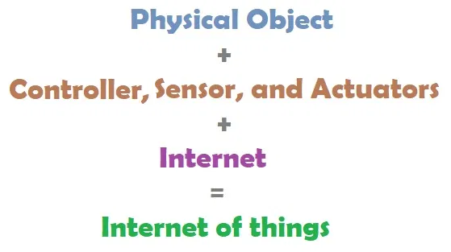
Online components …

Slide 18
Online components …
Communication with third party systems
There are several options to obtain information from third party systems.
Using API, or scraping can be performed:
  By parsing their data (such as html or text), or
  By recognizing characters in screenshots (screen-scraping).
  Check the permission the website owner / program allow you to do.

Slide 19
Physical prototyping
Intelligent systems always have a software component that tells what the system should do.
Often they also consist of two physical elements:
  A "thing" that we want to make smart.
  Electronics to handle the code above.

Slide 20
Physical prototyping …
If you build solutions that contain these two physical elements, prototyping is an important part of the process!
What are the benefits of prototyping before production?
  Sooner or later you will encounter a problem in your design.
  So it is much better to change one prototype than to recall x series-produced units!

Slide 21
Prototyping vs production
When moving from prototype to production, you often switch to cheaper variant components to keep the cost per unit low.
E.g., one may replace Arduino unit with an AVR chip (same as the one in the Arduino) plus other individual parts you need.
3D printing may be replaced by the cheaper injection molding variant.
The software is often easier to move from prototype to production but dependent on choice of tools and languages.

Slide 22
Open source vs Closed source
In its simplest form, "open" source vs. "closed" source is about two things:
  Your rights to the code you created (your "Intellectual property").
  Other people's rights to freely modify and reuse your code.
Often you see benefits on both sides :
  As developers, we want the opportunity to look at, learn from and modify existing code and solutions.
  At the same time, we want to protect what we have created ourselves.

Slide 23
Electronic components
The simplest form of input/output is digital- so it has state 1 or 0. e.g., a switch can be on or off; an LED may light or not; etc.
Often one wants more conditions than the two extremes- for example, you want to operate an engine at speeds other than "off" and "full speed".
Then you need converters between analog and digital signals:
  Analogue-to-digital converter (ADC) for input/sensors.
  Digital-to-analogue converter (DAC) for output/actuators.

Slide 24
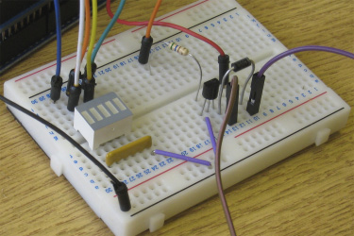
Wiring board/PCB
To connect the electronics, it's easy to start with a breadboard.

Slide 25
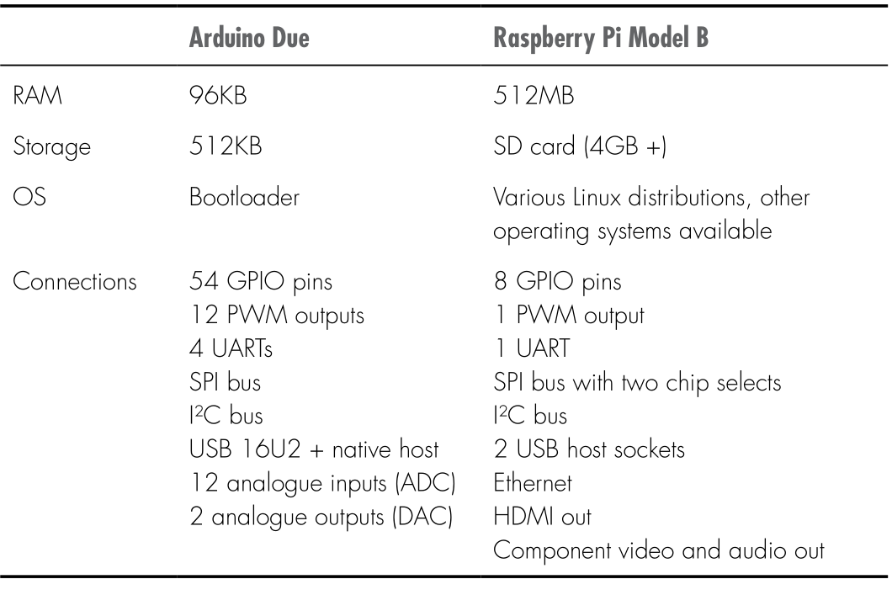
Microcontroller
For example, Arduino is MUCH weaker than the Raspberry Pi, but can often be easier to work with!

Slide 26
Prototyping
Before we build the physical thing, we must have a plan for what it will look like! It means:
  Write down notes on a whiteboard or block.
  Maybe build a mock-up.
For a mock-up, one might consider old-school methods.
  To make prototypes faster- as the time for example in 3D printing is usually measured in hours.

Slide 27
Prototyping …
Play dough- suitable for rapid form testing but not so suitable for longer handling.
Epoxy putty- is reminiscent of model clay but becomes rock hard over an hour.
  Can be polished, painted, etc- well suited for lasting mockups.
LEGO/kits- Meccano or similar solutions allow us to create mockups having moving parts and which are reusable.
Papp- cheap and easy to work with and parts can later be used as templates for laser cutting of wooden boards, etc.

Slide 28
3D-printing
3D printing is a form of additive production:
  It starts with nothing and builds something together.
One of the great advantages of 3D printing is that you can make parts like continuous rings or joints.

Slide 29
CNC milling
CNC milling is reminiscent of 3D printing, but is a subtractive production
  Starting with a subject and removes unwanted parts- like a sculptor works.
Since it is much easier to cut than assemble, CNC cutters can work with far more materials than 3D printers :
  Steel, wax, plastic, wood and aluminium are among the common materials.

Slide 30
Efficiency and battery capacity
In code context, efficiency and battery capacity are usually closely linked- if the code is effective, it also uses less battery.
Readability of code surpasses performance, but though we can save a lot by optimizing small bits: in which case we do!
Replace polling for updates with an event-based system.

Slide 31
Debugging
Without access to a modern debugger, you have to depend on logging system to send text messages about the state of the code:
  Log about the amount of remaining RAM every now and then.
  Log messages of type. "Has reached code line X".
  Write the log to an SD card, to another machine on the web, etc.
Challenges with logging :
  can cause the system to run slower and some times miss bugs.
  If your system crashes, you may not be able to write your error log.

Slide 32
Business model
A business model is the basis for going from prototyping to production
  It is the solution for how a business firm survives.
The business model should provide answers to the following key questions :
  What should we deliver?
  Who are the customers?
  Who are partners and who are competitors?
  How should we sell?
  How should we deliver?
  How should we get paid?
  How should we make a profit?

Slide 33
Mass production
A lot to think about before launching the mass production:
  Run the mass production yourself or outsource the job
  Certifications for safe goods? (trademark, etc.)
  Outlets
  Packing
  Freight

Slide 34

Ethics
The pessimist might say that technology:
  Distances us from old traditions.
  Removes jobs.
  Is intrusive, and enslaves us (Facebook and MMORPGs)
  Makes us slower and more unhealthy.
Rather, the optimist says that technology:
  Is new and exciting.
  Is progression (and implied: improvement).
  Saves life and makes the world better.
  Make us happier and healthier.

Slide 35
Ethics …

Slide 36
Privacy
There have been major changes in digital comm. in our time:
  What we do in the real world is shared with the virtual world, at about the same time: Facebook, Twitter, ...
There are changes to what was previously viewed as privacy
  Everything you write online can be seen anywhere …
  From what you ate to breakfast, professional blog posts, to whom you hang out in the evenings, etc.

Slide 37
Privacy ...
Modern devices and IoT solutions store lots of metadata about us.
  For example, pictures taken with the mobile camera :
  They often contain GPS coordinates
  Devices automatically upload training track to Facebook, etc.
  If one wants to monitor you, it now gets relatively easy mapping- e.g., burglars checking Facebook.

Slide 38
Guest lectures
Machine learning
Robotics

Slide 39
Discussion points
What are your favourite topics from the course? Why?
Which topics did you like the least? Why?

Slide 40
Good luck with your exams!

