Slide 1
Significance of Intermediate Code Generation
Course: Compiler Design
Student Name: YARED MESFIN
Student ID: 1411368

Slide 2


Introduction
💻 Compiler Design translates high level programs into machine code
🔗 Intermediate Code Generation connects the front end and back end of a compiler
⚙️ It converts programs into a machine independent form called IR
🚀 IR makes compilers portable and easier to optimize
📘 This presentation explains the concept types and importance of IR

Slide 3
What is Intermediate Code Generation?
Intermediate Code Generation is a compiler phase
Converts high level source code into an intermediate representation
intermediate representation is:
  Easier to analyze
  Easier to optimize
  Independent of machine architecture

Slide 4
Why Intermediate Code is Used
Enhances portability
Facilitates retargeting
Enables optimization
Simplifies compiler design
Machine independent intermediate code is the key reason modern compilers are portable.

Slide 5
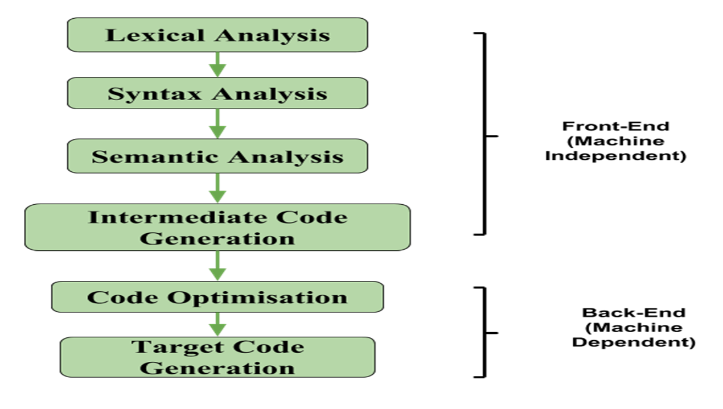
Role in Compiler Phases

Slide 6
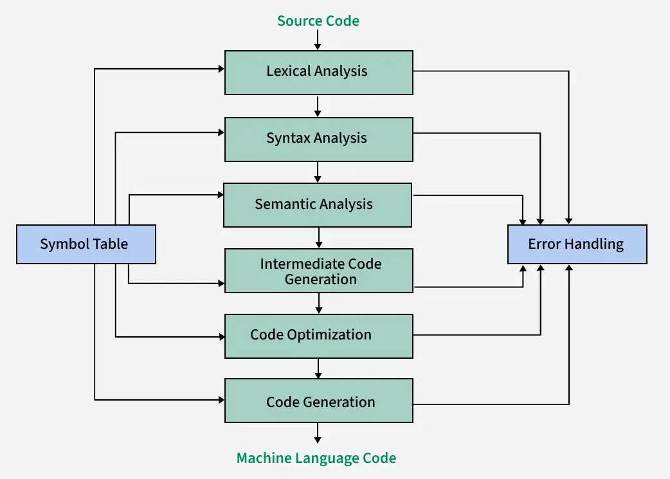
Position in Compiler Phases

Slide 7
Types of Intermediate Code
Graphical IRs
• AST
• DAG(Directed Acyclic Graph)
• Control Flow Graph
Linear IRs
• Postfix
• Three Address Code

Slide 8
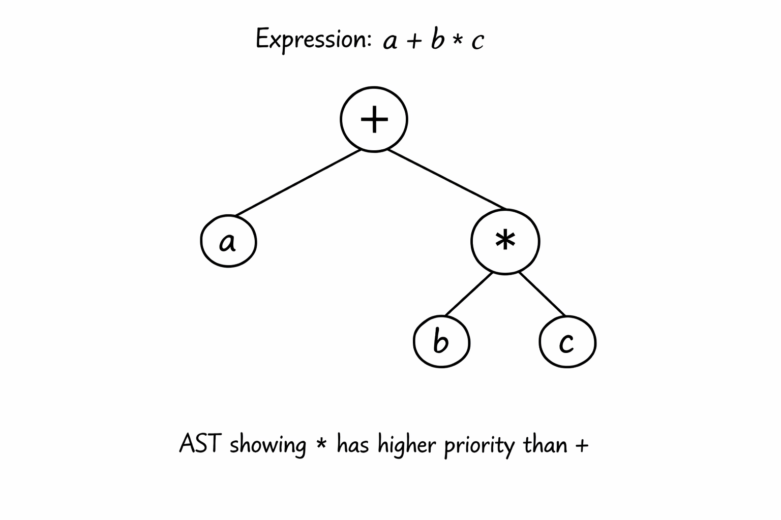
📊 Graphical IRs
Graphical IRs use graphs or trees to represent program structure and control flow.
🌳 AST (Abstract Syntax Tree)
• Shows the hierarchical structure of a program
• Removes unnecessary grammar symbols from the parse tree
• Easy to analyze semantic meaning

Slide 9
📊 Graphical IRs
🔗 DAG (Directed Acyclic Graph)
• Optimized form of AST
• Eliminates common sub expressions
• Reduces repeated computations
Example:
a = b * c + b * c
b * c is computed once in DAG

Slide 10
📊 Graphical IRs
🔀 Control Flow Graph (CFG)
• Represents flow of control in a program
• Nodes = basic blocks
• Edges = control paths (if, else, loops)
Example:
Used to represent if-else and while statements

Slide 11
🧮 Linear IRs
Linear IRs represent code as a sequence of instructtions.
📌 Postfix Notation
• Operators come after operands
• Easy to evaluate using a stack
Example:
Infix: (A + B) * C
Postfix: A B + C *

Slide 12
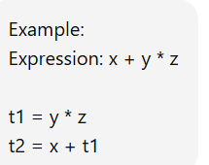
🧮 Linear IRs
⚙️ Three Address Code (TAC)
• Each instruction has at most three operands
• Uses temporary variables
• Close to machine code → easy to optimize
Representations of TAC
- Quadruples
-Triples
-Indirect Triples

Slide 13
Applications & Importance
Used in optimization
Used in retargetable compilers
Used in modern compilers

Slide 14
Case Study Java Compiler & Bytecode
How Intermediate Code is Used in Java
The Java compiler does not directly generate machine code.
Instead it translates Java source code into Bytecode, which is a form of intermediate code.
Bytecode is:
  Platform independent
  Executed by the Java Virtual Machine (JVM)

Slide 15
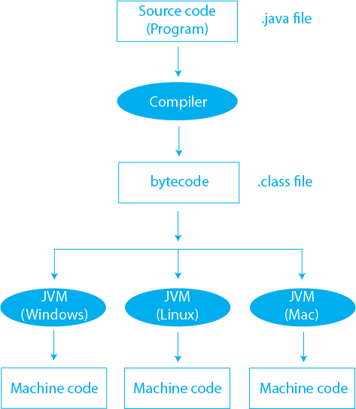
Java Compilation Process

Slide 16
Role of Intermediate Code Generation
Translation: Converts source code to intermediate representation
Portability: Same intermediate representation can work on multiple machines
Optimization: Improves performance before final code generation

Slide 17
Why Not Generate Machine Code Directly?
If machine code is generated directly:
For n machines, need n compilers
Need n optimizers
With intermediate code:
Only one optimizer
Multiple code generators for different machines

Slide 18
Advantages
Easier to implement
Facilitates code optimization
Platform independent
Code reuse
Easier debugging

Slide 19
Disadvantages
Increased compilation time
Additional memory usage
Increased compiler complexity
Slight performance overhead

Slide 20
Conclusion
• Intermediate Code Generation bridges the front end and back end of a compiler 💻
• Produces machine independent code (IR) for portability and optimization 🌍🚀
• Graphical IRs (AST, DAG, CFG) and Linear IRs (Postfix, Three-Address Code) simplify analysis and code generation ⚙️
• Helps reduce redundancy, improve performance, and ease compiler design

Slide 21
References
Techniques, and Aha et al., Compilers: Principles, Techniques & Tools
Course PDF Notes
Online compiler resources
Compiler Design Lecture Notes

