Slide 1
Significance of Intermediate Code Generation
Course: Compiler Design
Student Name: YARED MESFIN
Student ID: 1411368

Slide 2
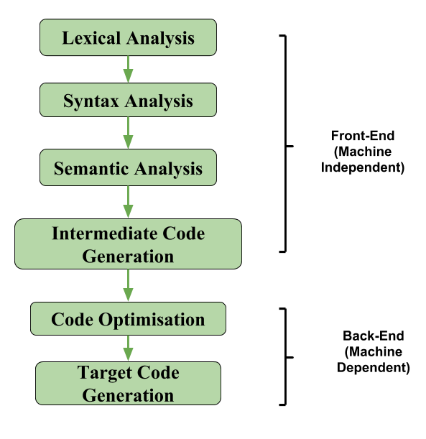
Introduction
the analysis synthesis model of a compiler:
  Front End → Translates source code into intermediate code
  Back End → Converts intermediate code into target machine code
Intermediate code acts as a bridge between high-level language and machine code

Slide 3
What is Intermediate Code Generation?
Intermediate Code Generation is a compiler phase
Converts high level source code into an intermediate representation
intermediate representation is:
  Easier to analyze
  Easier to optimize
  Independent of machine architecture

Slide 4
Why Intermediate Code is Used
Enhances portability
Facilitates retargeting
Enables optimization
Simplifies compiler design
Machine independent intermediate code is the key reason modern compilers are portable.

Slide 5
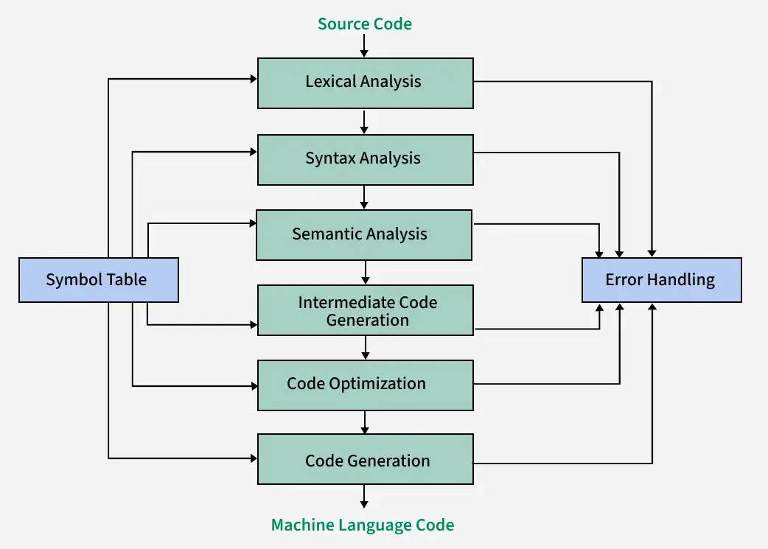
Position in Compiler Phases

Slide 6
Case Study Java Compiler & Bytecode
How Intermediate Code is Used in Java
The Java compiler (javac) does not directly generate machine code.
Instead it translates Java source code into Bytecode, which is a form of intermediate code.
Bytecode is:
  Platform independent
  Executed by the Java Virtual Machine (JVM)

Slide 7
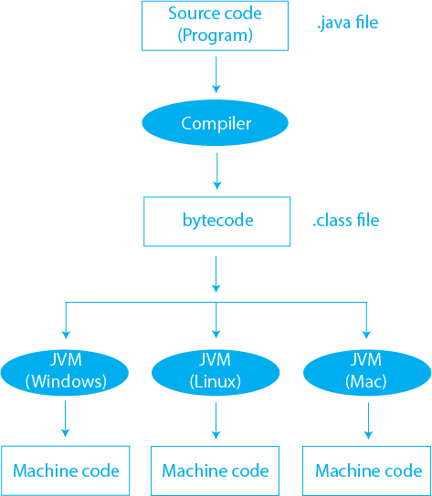
Java Compilation Process

Slide 8
Benefits of Machine Independent Intermediate Code
Portability is enhanced
Only one optimizer is required
Compiler need not be rewritten for every new machine
Easy to adapt compiler to different architectures

Slide 9
Role of Intermediate Code Generation
Translation: Converts source code to intermediate representation
Portability: Same intermediate representation can work on multiple machines
Optimization: Improves performance before final code generation

Slide 10
Why Not Generate Machine Code Directly?
If machine code is generated directly:
For n machines, need n compilers
Need n optimizers
With intermediate code:
Only one optimizer
Multiple code generators for different machines

Slide 11
Types of Intermediate Code
Language-dependent
Example: Java Bytecode
Language-independent
Example: Three-Address Code

Slide 12
Common Intermediate Code Representations
Postfix Notation
Three Address Code
Syntax Tree

Slide 13
Postfix Notation
Also known as reverse Polish notation or suffix notation.
In the infix notation, the operator is placed between operands, e.g., a + b. Postfix notation positions the operator at the right end as in ab +.
For any postfix expressions e1 and e2 with a binary operator (+) , applying the operator yields e1e2+.
Postfix notation eliminates the need for parentheses, as the operator's position and arity allow unambiguous expression decoding.
In postfix notation, the operator consistently follows the operand.
Example 1: The postfix representation of the expression (a + b) * c is : ab + c *
Example 2: The postfix representation of the expression (a - b) * (c + d) + (a - b) is : ab - cd + *ab -+

Slide 14
Three-Address Code (TAC)
A three address statement involves a maximum of three references, consisting of two for operands and one for the result.
A sequence of three address statements collectively forms a three address code.
The typical form of a three address statement is expressed as x = y op z, where x, y, and z represent memory addresses.
Each variable (x, y, z) in a three address statement is associated with a specific memory location
Example: The three address code for the expression a + b * c + d : T1 = b * c T2 = a + T1 T3 = T2 + d; T 1 , T2 , T3 are temporary variables.

Slide 15
There are 3 ways to represent a Three Address Code in compiler design
1.Quadruples
2.Triples
3.Indirect Triples

Slide 16
Syntax Tree
A syntax tree serves as a condensed representation of a parse tree.
The operator and keyword nodes present in the parse tree undergo a relocation process to become part of their respective parent nodes in the syntax tree. the internal nodes are operators and child nodes are operands.
Creating a syntax tree involves strategically placing parentheses within the expression. This technique contributes to a more intuitive representation, making it easier to discern the sequence in which operands should be processed.
The syntax tree not only condenses the parse tree but also offers an improved visual representation of the program's syntactic structure,

Slide 17
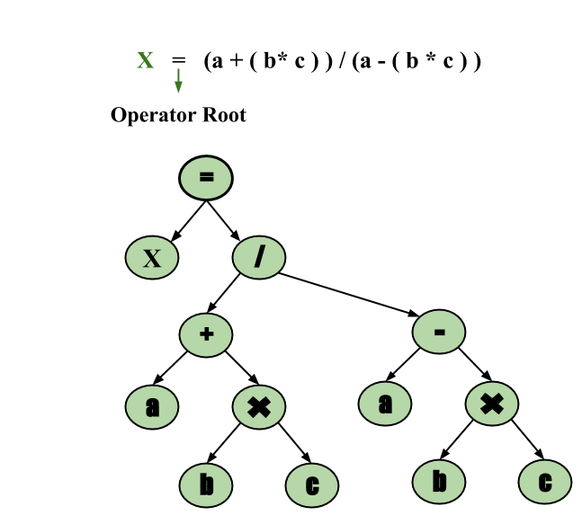
Example of Syntax Tree
Example: x = (a + b * c) / (a - b * c)

Slide 18
Advantages
Easier to implement
Facilitates code optimization
Platform independent
Code reuse
Easier debugging

Slide 19
Disadvantages
Increased compilation time
Additional memory usage
Increased compiler complexity
Slight performance overhead

Slide 20
Conclusion
Intermediate Code Generation is a important step in compiler design that simplifies the translation of high level programming languages into machine code. By creating an intermediate representation compilers can analyze and optimize code more effectively ensuring that programs run efficiently on various hardware. This approach enhances portability and allows for improvements in performance. Overall Intermediate Code Generation plays a key role in making programming easier and more efficient for developers

Slide 21
References
Aho, Lam, Sethi Ullman Compilers: Principles, Techniques, and Tools
GeeksforGeeks Intermediate Code Generation
Compiler Design Lecture Notes

