Slide 1


LIFECYCLE
01
HUMAIN Future AI Builders Hackathon
HUMAIN
Lifecycle
Autonomous Enterprise AI
Turning incoming employment contracts into verified
onboarding preparation through autonomous AI.
CHALLENGE 3
Autonomous Enterprise
Notes:
HUMAIN Lifecycle is an existing local hackathon prototype. Its goal is to prepare onboarding from an incoming authorized contract and verify the resulting records. Final HR decisions remain with people. All product examples in this deck use synthetic employee data.
Sources: README.md; docs/HACKATHON_DEMO.md; docs/UI_DESIGN_SYSTEM.md

Slide 2

LIFECYCLE
02
The enterprise onboarding problem
A single employment contract creates work across disconnected teams.
01
Manual contract review
02
Disconnected HR and IT
03
Policy inconsistencies
Read documents and re-enter the same employee facts.
Coordinate handoffs across separate requests and inboxes.
Check each contract against the right approved rules.
04
Repetitive administration
05
Limited workflow visibility
06
Deadline monitoring
Create profiles, tasks and welcome messages by hand.
Find out what ran, what failed and who must act next.
Track contract, Iqama and work-permit dates.
The coordination burden continues until someone verifies the outcome.
Notes:
This slide describes the business process targeted by the prototype. These are qualitative workflow challenges, not survey findings or measured cost estimates. The project connects intake, policy checks, HR task preparation, communications and evidence in one workflow.
Sources: docs/WORKFLOWS.md; backend/app/onboarding.py; backend/app/journeys.py

Slide 3
LIFECYCLE
03
Our solution: verified onboarding preparation
HUMAIN Lifecycle connects an AI-native employee lifecycle workspace to durable HR workflows.
BUSINESS OBJECTIVE
Understand
Coordinate
“Prepare onboarding
from this contract and
verify the result.”
Interpret the objective
Select authorized tools
Verify
Execute
HUMAIN Chat
Inspect saved evidence
Persist the work
Local Qwen3.5:4b orchestrator
Autonomous preparation
Human approval of identity, employment terms and official Qiwa actions
Notes:
HUMAIN Chat interprets the user objective and invokes registered typed tools. Python owns permission checks, policy gates and durable side effects. Verification checks persisted records. Automation setup can be verified while three human HR tasks remain pending and IT requests remain simulated.
Sources: backend/app/agent.py; backend/app/journeys.py; backend/app/onboarding.py; docs/JOURNEY_LIVE_EVALUATION.json

Slide 4
LIFECYCLE
04
HUMAIN Chat & specialized capabilities
A local language model coordinates typed tools and backend services.
HUMAIN Chat
Qwen3.5:4b in host Ollama
Contract
Intelligence
Policy
Validation
Onboarding
Automation
Compliance
Monitoring
Communications
Audit &
Verification
Extract source facts
Check activated rules
Create records & tasks
Find upcoming dates
Send approved templates
Inspect durable evidence
Coordinated AI-enabled tools and backend capabilities
These capabilities do not represent six independent language models.
Notes:
The registry includes extract_contract, validate_contract, start_onboarding_journey, get_company_policies, create_onboarding, get_expiring_documents, send_authorized_email and get_audit_history. Contract table parsing and policy comparisons use deterministic code where appropriate. This is one locally hosted model coordinating tools, not six independent LLM agents.
Sources: backend/app/agent.py REGISTRY; backend/app/documents.py; backend/app/journeys.py; backend/app/email_agent.py

Slide 5
LIFECYCLE
05
Technical architecture
Local AI inference with server-enforced permissions and a persistent system of record.
React + TypeScript + Vite
Ollama / Qwen3.5:4b
Browser UI and streamed chat responses
Host-local AI planning and structured extraction
Authentication and permissions
FastAPI + Python + SQLAlchemy
Tool calling, policy gates and workflow orchestration
SMTP / Mailpit
PostgreSQL 17 in Docker
Approved real SMTP or local sandbox capture
Employee records, workflow state and durable audit evidence
Runtime AI uses local Ollama inference. The implementation does not call the OpenAI API.
Notes:
Vite proxies local /api requests to FastAPI. The backend validates typed requests, checks permissions, orchestrates tool calls and owns transactions. PostgreSQL 17 is authoritative and uses a persistent named Docker volume. Ollama runs on the Windows host. Email uses either Mailpit sandbox capture or explicitly configured and authorized SMTP. Qwen has no arbitrary SQL, shell or SMTP credential access. The independent test database uses a separate Docker service.
Sources: docs/ARCHITECTURE.md; backend/app/main.py; backend/app/security.py; backend/app/database/models.py; backend/app/ollama.py; docker-compose.yml

Slide 6
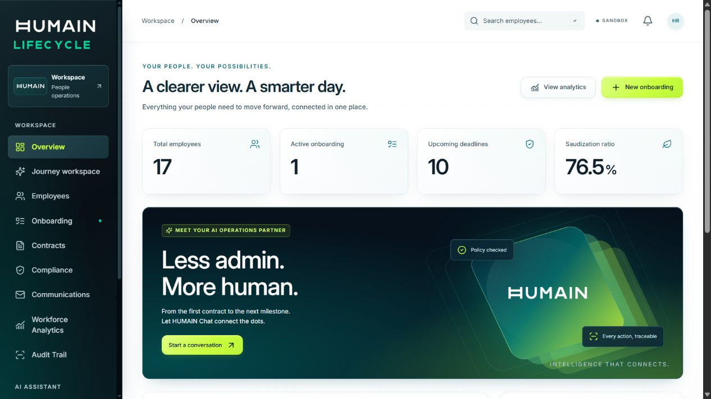
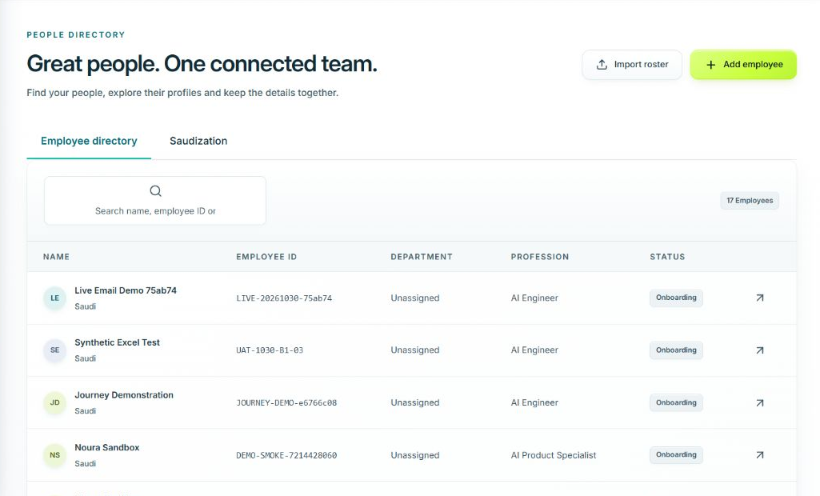
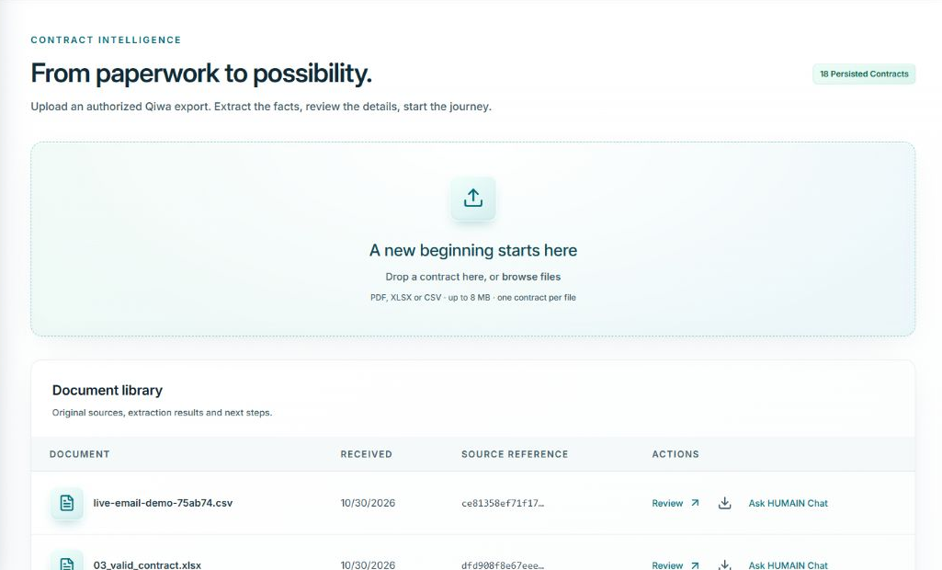
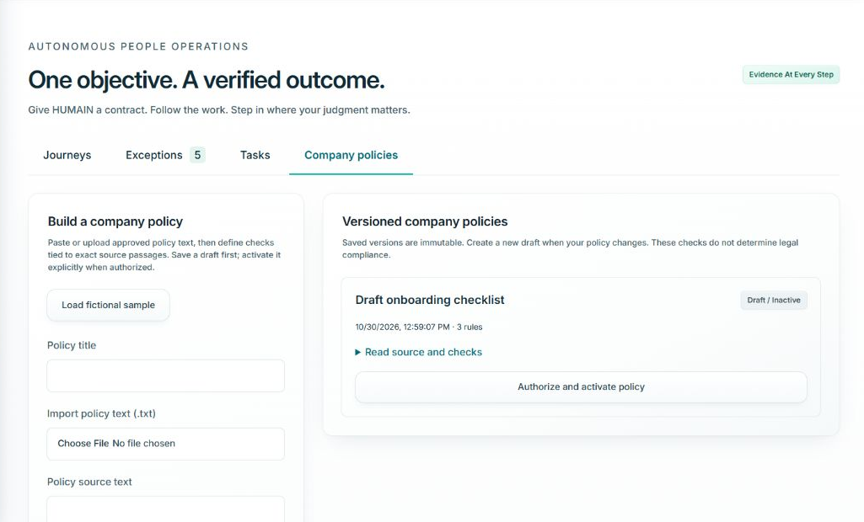
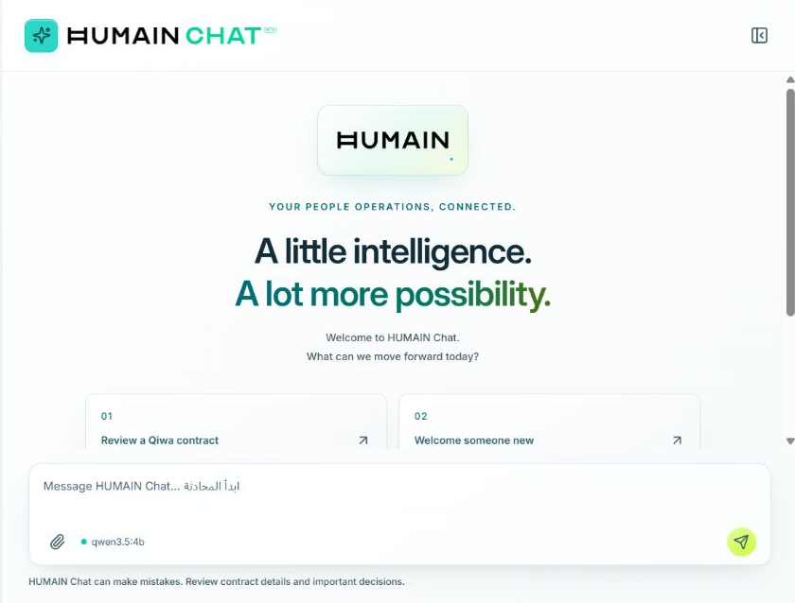
LIFECYCLE
06
Real product implementation
Five views from the running application, using synthetic workspace records.
01 Executive dashboard
02 Employee management
03 Contract intake
04 Policy management
05 HUMAIN Chat
Workforce counts, deadlines and recorded activity
Notes:
All five screenshots were captured from the running local application for this deck on 31 October 2026 Riyadh time. The employee data is synthetic. Policy management shows an existing inactive draft, not an approved corporate policy. Cropped thumbnails preserve the original UI pixels. The source folder includes the full captures. Counts represent the capture moment and may change as the app runs.
Sources: submission/presentation_assets/dashboard.png; submission/presentation_assets/employees.png; submission/presentation_assets/contracts.png; submission/presentation_assets/policies.png; submission/presentation_assets/chat.png

Slide 7
LIFECYCLE
07
End-to-end autonomous workflow
One contract becomes a persisted objective with evidence and reviewable exceptions.
01
Incoming contract
02
Extraction
03
Validation
PDF text, XLSX or CSV
Map facts from the source
Check required fields and dates
06
Employee & contract records
05
HUMAIN Chat orchestration
04
Activated company policy
Commit durable HR records
Coordinate authorized actions
Apply only when selected
07
Five onboarding tasks
08
Authorized email
09
Verified automation evidence
3 human HR + 2 simulated IT
Template and recipient controls
Records, outcomes and audit
Exception path: missing facts or policy findings pause execution for authorized review, then resume.
Notes:
The diagram groups responsibilities rather than prescribing the exact sequence of LLM calls. The objective is persisted in a journey. Policy validation applies only when the user selects an activated policy. The recorded 37.036-second example used contract fact validation without an activated policy. Unresolved policy findings block creation and communication until an authorized review or recorded exception resolves them. HR remains responsible for official Qiwa approval. IT tasks are simulated requests only.
Sources: backend/app/journeys.py PLAN and policy_gate; backend/app/onboarding.py; backend/app/email_agent.py; docs/JOURNEY_LIVE_EVALUATION.json; tmp/pdfs/journey.json

Slide 8
LIFECYCLE
08
Testing & recorded results
Reproducible checks and one recorded live demonstration.
LATEST RECORDED TEST RUN
ONE RECORDED LIVE RUN
101
37.036 s
automated tests passed
Full agent request, including Qwen overhead
81 backend 3 frontend unit 17 browser
2.074 s
Lint, type checking, production build
and migration checks passed
Core workflow execution
Automation setup verified
5 tasks
3 human pending + 2 simulated IT
SMTP accepted
0 new attempts on retry
Single demonstration, not an average or success rate. SMTP acceptance does not prove inbox delivery.
Automated test run: 30 Oct 2026. Live-run timings are separate recorded measurements.
Notes:
The latest full check on 30 October 2026 in docs/SYSTEM_CHECK_2026-10-30.md records 101 passing tests: 81 backend, 3 frontend unit and 17 browser tests, supported by backend-results.xml and browser-results.json. The single saved primary-database journey records 37.036 seconds total, 2074 milliseconds core workflow execution, five tasks, three pending human HR tasks, two simulated IT requests, verified automation setup and SMTP acceptance. An explicit retry produced no new SMTP attempts. The timings are separate recorded measurements, not averages or a benchmark, and there is no measured human baseline. Inbox delivery is unconfirmed for this historical journey. A separate later demo has independently confirmed Gmail receipt, but that is not attributed to this timed example.
Sources: docs/JOURNEY_LIVE_EVALUATION.json; docs/SYSTEM_CHECK_2026-10-30.md; docs/backend-results.xml; docs/browser-results.json

Slide 9
LIFECYCLE
09
Innovation, business value & limitations
A working prototype with explicit boundaries and inspectable outcomes.
WHAT THE PROTOTYPE CONTRIBUTES
CURRENT LIMITATIONS
Business objectives drive tool orchestration
Scanned PDF OCR is unavailable
Locally hosted AI inference
External IT provisioning remains simulated
Policy-aware execution with review gates
Human HR approvals remain necessary
Durable workflows that resume
Held-out task accuracy and time savings
have not yet been established
Duplicate prevention across retries
Human oversight for consequential decisions
The prototype is not production-ready
Transparent records and audit evidence
FUTURE WORK
OCR support, real IT connectors, broader held-out evaluation and measured manual baselines
Notes:
Business value here is the implemented ability to coordinate preparation, enforce policy and authorization, avoid duplicate effects and expose evidence. No quantified savings or official compliance outcome is claimed. PDF extraction currently depends on extractable document text and has no scanned-document OCR. IT provisioning is simulated. Future OCR, external task/IT connectors, broader unseen test sets and measured manual baselines are proposals, not implemented features. This is a local hackathon prototype rather than a production-ready service.
Sources: backend/app/documents.py; backend/app/journeys.py; backend/app/onboarding.py; docs/SECURITY.md; docs/HACKATHON_DEMO.md

Slide 10
LIFECYCLE
10
Conclusion & demo
Challenge 3: Autonomous Enterprise
An incoming contract.
Verified preparation.
Human judgment
retained.
Verified evidence
Employee record
630421cd-afe3-449e-bed0-25f1135feb8b
Contract record
fadcab75-1404-4a03-b501-e4967b9c60db
Internal tasks created
5
Human tasks remaining
3
IT requests
2 simulated · no accounts provisioned
Welcome email
SMTP accepted · inbox unverified
Automation setup
Verified
HUMAIN Lifecycle prepares onboarding
and escalates exceptions that require
human judgment.
Automation setup does not mean the employee is ready. Human checks and real IT provisioning remain separate.
Source fingerprint: 0032ea3f51f651c96ca53237907781cb637491c0359afba63c620a2c0ce96e78
DEMO
Contract intake / Journey & tasks / Email receipt / Audit
Notes:
The evidence panel faithfully recreates the original Verified evidence layout as sharp editable text, with the same labels, actual record IDs, results, warning and full source fingerprint. It is a transcription, not a screenshot. The original screenshot and underlying recorded values remain in presentation_assets. SMTP acceptance does not establish inbox delivery for this timed example. Human approvals and real IT provisioning remain separate. The Contract intake link opens the local app.
Sources: docs/JOURNEY_LIVE_EVALUATION.json; submission/presentation_assets/recorded-journey-evidence.json; submission/presentation_assets/journey-evidence.png

