Slide 1

Distributed Reactive Synthesis
Supervised by Prof. Purandar Bhaduri
Mesharya M Choudhary (190101053)
Bhuvan Aggarwal (190101025)

Slide 2
Table of contents
01
02
03
04
Introduction
Rational Verification
Assume Guarantee Synthesis
Future Work

Slide 3
Introduction

Slide 4
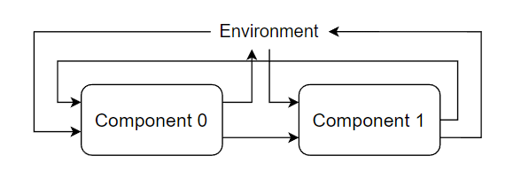
What is a distributed reactive system?
Distributed System = Multiple components + Environment (interacting together)
Each component has input, output variables and a goal (local specification)
System evolves in rounds and continues infinitely
Evolution is synchronous

Slide 5
What is a distributed reactive system?
In each synchronous round, each component with help of its controller,
takes input from other components and the environment
produces output
A controller is a finite state machine (FSM) with input/output
Mealy Machine, or,
Moore Machine
S1
O1
Input
S2
O2
Input
Output
Component with controller as Moore machine

Slide 6
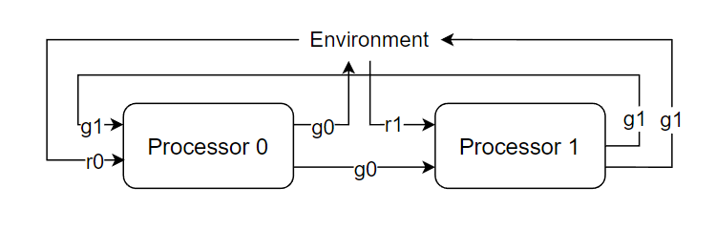
What is a distributed reactive system?
Local Specification of a component, can be represented as
Linear Temporal Logic (LTL)
Automata, etc.
Local specification of processor 0 can be
Whenever request r0 comes, grant g0 should be given eventually
And, if request r0 is pending, r0 should not be raised again

Slide 7
What is distributed reactive synthesis?
Find a strategy to choose outputs for component based on history of past inputs and outputs.
Strategy should help component in achieving its goal
The problem is that distributed reactive synthesis is undecidable
Thus, all methods to solve it are incomplete.

Slide 8
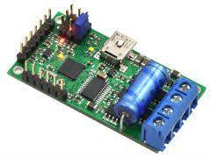
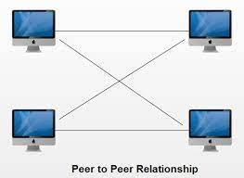
Why distributed reactive synthesis?
Applications in
Synthesizing hardware circuits
Device drivers
Controllers for robots
Communication Protocol
Peer to Peer Network
Distributed Shared Bus
Eliminates the manual work needed to synthesize controllers

Slide 9
Approaches to Distributed Synthesis
Assume- Guarantee Synthesis
1.
Rational Verification
2.

Slide 10
Rational Verification

Slide 11
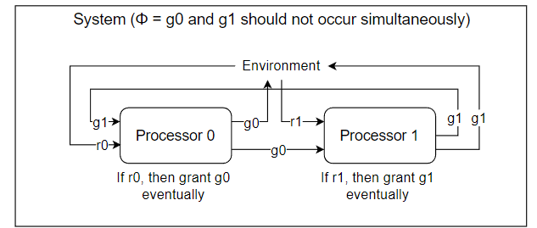
What is Rational Verification?
Check whether a temporal logic formula φ (overall goal) satisfied by the multi-agent system.
Each agent has their own goals and preferences.
Only interested in the runs which are generated by rational behaviour of agents.
Rational behaviour means that the agent try behave in such a manner that the runs generated are more preferable for them.

Slide 12
Agents are non deterministic i.e. at every step they have multiple choices of actions.
A strategy for an agent resolves its non determinism.
Maps history of the system to an action of the agent
The set of strategies of each agent forms a strategy profile.
A unique run of the system is induced by the strategy profile.

Slide 13
What does it mean to satisfy φ ?
A multi-agent system is said to satisfy φ if there exists a strategy profile which generates a run that satisfies φ.
We are only interested in strategy profiles that form a Nash equilibrium.
A strategy profile is said to be a Nash equilibrium if none of the agents have any incentive to unilaterally change their strategy.
Any strategy profile which is not a Nash equilibrium will not be rational since an agent can deviate for its benefit.

Slide 14
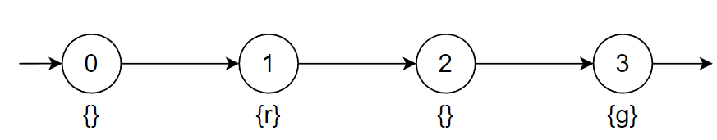
How are goals expressed?
We use Linear Temporal Logic (LTL) to express the goals
It is satisfied by infinite words over the valuations of propositional variables
Extension of Propositional Logic with X (next) and U (until) operators
Formed by combination of propositional variables, logical operators and U, X.
Other operators such as G (always) and F (eventually) can be defined using U,X and logical operators
!g U r

Slide 15
LTL Operators
Xφ means φ holds for the next time step. Ex:- (X r)
ψUφ means that φ must eventually be true at some time step and ψ must hold for all time steps before that instant. Ex:- (!g U r)
Gφ means φ holds for the current time step as well as all future time steps. Ex:- G (r-> X g)
Fφ means φ holds for some time step starting from the current one.Ex:- (r-> F g)

Slide 16
When does LTL formula hold for system?
LTL formula holds for the system if the infinite word generated over the valuations of the variables of the system satisfies the formula.
Agents have have their own goals as well apart from the overall system specification.
Due to this they prefer some runs over the other and each agent tries to play a strategy which yields them the most preferable run.
This can be modelled as infinite games on finite graphs.

Slide 17
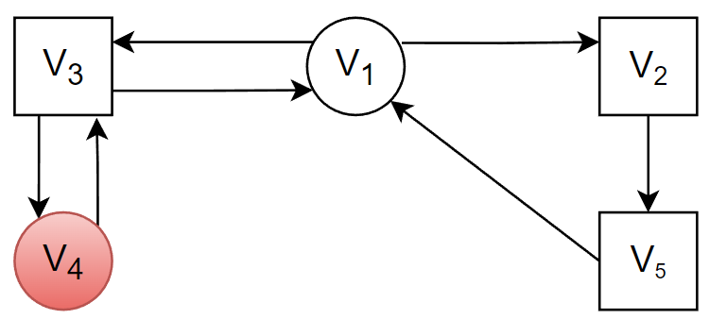
Infinite Game on Graphs
Game starts at V1
V1,V4 are controlled by player 1
V2,V3,V5 are controlled by player 2
If the objective of player 1 was to avoid entering the unsafe state V4 (safety objective) then they would prefer the strategy profile where each time V1 is visited they move to V2. This prevents player 1 from ever entering V4.

Slide 18
Equilibrium Verification Environment(EVE)
We are interested in strategy profiles which are Nash equilibrium as well as satisfy the overall specification of the system.
We use EVE to model the distributed systems and find such strategy profiles.
EVE works by first converting the model to Concurrent Game Structure
A Concurrent Game Structure is a graph where at each node every player decides some action and based on the tuple of those actions transitions to the next node are determined.
Next EVE converts the CGS to a two player game as discussed above but with parity objective and then solves it.

Slide 19
Peer to Peer Network
Two components A and B which can be either in download state (da,db) )or upload state (ua,ub).
Component A can successfully download only when it is in download state and B is in upload state at the same time step and similarly for B.
Component A wants to download successfully infinitely often thus its specification is G F (da and ub), similarly for B it is G F (db and ua).
The overall specification of the system is true i.e. all behaviours are allowed given they are rational.

Slide 20
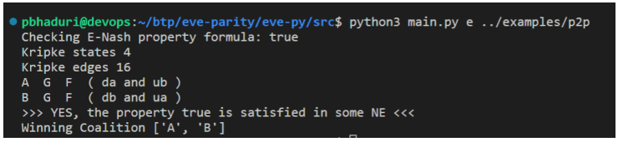
Peer to Peer Network
The tool outputs that the overall specification true is satisfied in some strategy profile which is in Nash Equilibrium.
It also tells that there exist some strategy profile such that the overall specification is satisfied and the goals of both A and B are fulfilled.

Slide 21
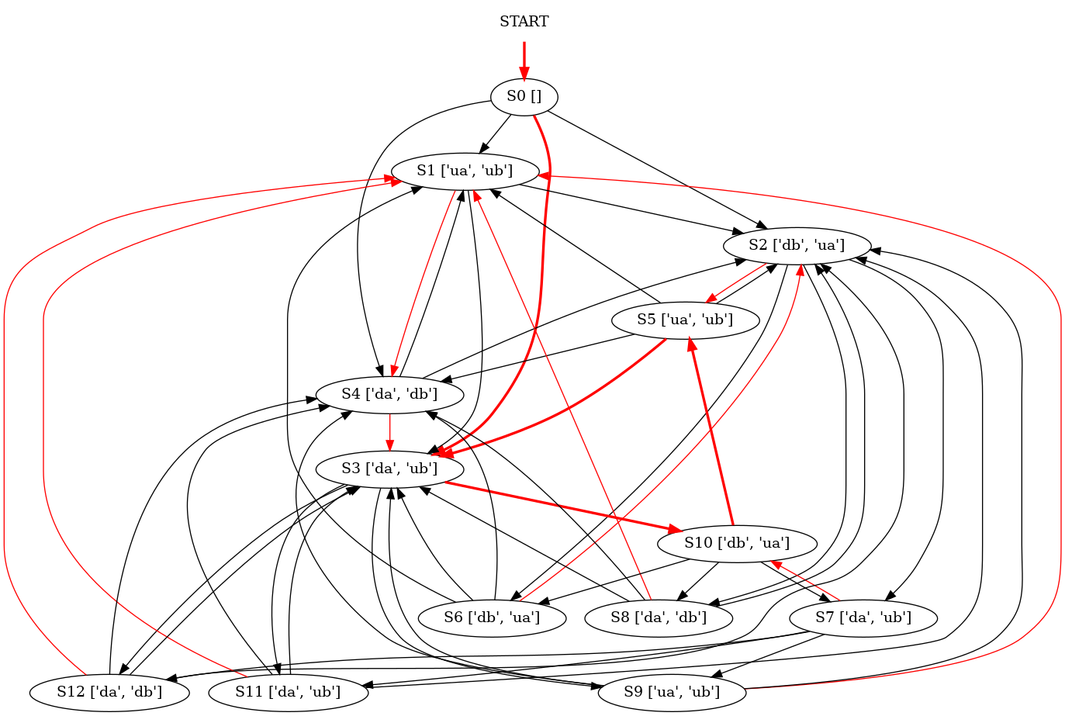

Slide 22
Peer to Peer Network
The above graph output by EVE represents the concurrent game structure.
At each node we have to fix an outgoing edge and these sets of transitions for the strategy profile.
We start from state s0 and following the edges marked in red infinitely we can see that local specification/goal of both components is satisfied.
Thus this is a winning strategy for them and they have no incentive to deviate from it.

Slide 23
Assume Guarantee Synthesis

Slide 24
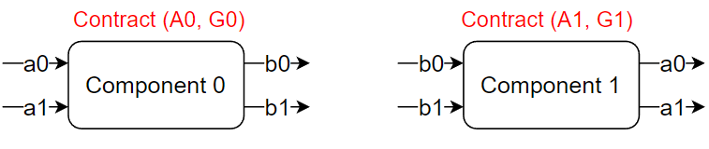
Assume-Guarantee Contract
Each component may not be able to satisfy their goal by itself
Requires some kind of guarantee by other components
Each component has a contract (A,G), where,
A = is the assumption the component makes about system
G = is the guarantee the component provides over its own output variables

Slide 25
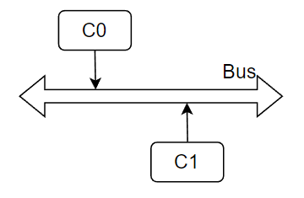
Example - Distributed Shared Bus
C0 and C1 can write packets to the bus at any time step
Packet collision occurs if both components write simultaneously
Goal of each component - To send the specified number of packets in a specified time limit.

Slide 26
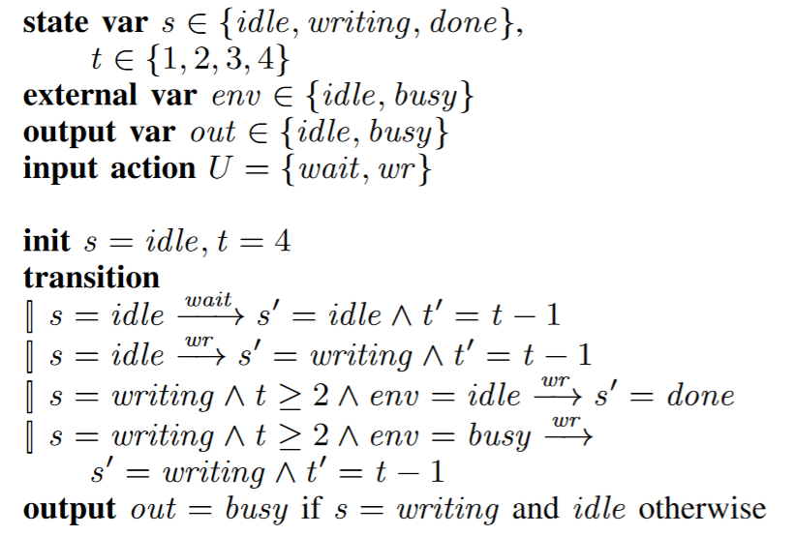
Example - Distributed Shared Bus
Figure: Description of a component in guarded command language with deadline as 4 time units.

Slide 27
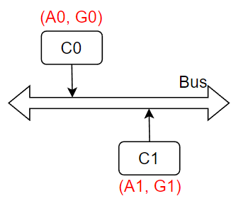
Example - Distributed Shared Bus
Say, C0 and C1 both want to send 1 packet within 4 time steps
Some different assumptions C0 can take are:
Assume arbitrary environment: Not helpful, as C1 send packet at each step.
Assume environment fulfills its specification: Knowing that C1 would send 1 packet once within 4 time steps, still does not help.
Assume C1 sends only at odd time steps: Sufficient for Co to fulfill its goal.

Slide 28
Agnes
Agnes - Assume-Guarantee NEgotiation for distributed Synthesis
A tool for automatically calculating assume-guarantee contracts
Negotiation:
Iterative algorithm
Initializes assumption and guarantees to true
Refines contracts at each iteration

Slide 29
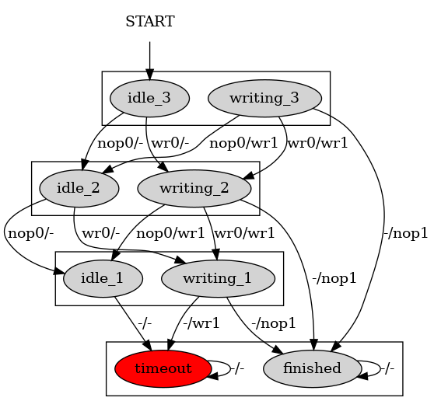
Distributed Shared Bus - Agnes
Component C0
Send 1 packet
Within a deadline of 3 time steps
Component C1
Send 2 packets
Within a deadline of 4 time steps
Specification of Component C0

Slide 30
Distributed Shared Bus - Agnes
Specification of C0 shown in the figure
State represents the current action and time left
idle_3 indicates C0 is not writing and 3 time units are left
A transition nop0/wr1 indicates that
C0 has decided to no operation in next cycle
Environment, i.e. C1, writes in next step
timeout (shown in red color) is the unsafe state
Similar construct for C1
Specification of Component C0

Slide 31
Distributed Shared Bus - Agnes
Distributed System
Verdict: Winning for both !
Agnes
C0
C1
(A0,G0)
(A1,G1)

Slide 32
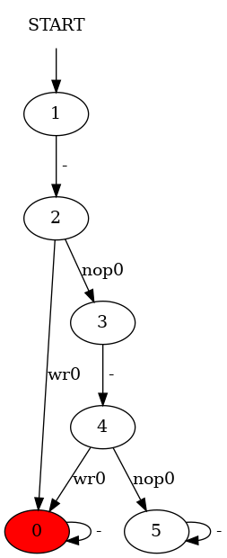
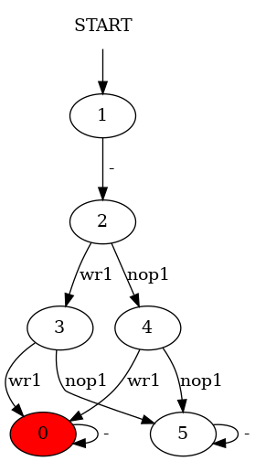
Guarantee 0
Guarantee 1
Writing in 2nd and 4th time step is invalid
Writing in 3rd time step is invalid
G0=A1=(nop₀+wr₀).(nop₀).(nop₀+wr₀).(nop₀).(nop₀+wr₀)^{ω}
G1=A0=(nop₁+wr₁).(nop₁+wr₁).(nop₁).(nop₁+wr₁)^{ω}

Slide 33
Negotiation Algorithm
Initialize the assumptions and guarantees
Component C0
Component C1
Φ0 = F ( finished₀)
A0 = (nop₁+wr₁)^{ω}
G0 = (nop₀+wr₀)^{ω}
Φ1 = F ( finished₁)
A1 = (nop₀+wr₀)^{ω}
G1 = (nop₁+wr₁)^{ω}
Can C0 fulfill its specification and guarantee with the current assumption?
No

Slide 34
Negotiation Algorithm
Component C0
Component C1
Φ0 = F ( finished₀)
A0 = (nop₁+wr₁).(nop₁+wr₁).(nop₁).(nop₁+wr₁)^{ω}
G0 = (nop₀+wr₀)^{ω}
Φ1 = F ( finished₁)
A1 = (nop₀+wr₀)^{ω}
G1 = (nop₁+wr₁).(nop₁+wr₁).(nop₁).(nop₁+wr₁)^{ω}
Refine the assumption. The new assumption would be a subset of the previous assumption

Slide 35
Negotiation Algorithm
Component C0
Component C1
Φ0 = F ( finished₀)
A0 = (nop₁+wr₁).(nop₁+wr₁).(nop₁).(nop₁+wr₁)^{ω}
G0 = (nop₀+wr₀)^{ω}
Φ1 = F ( finished₁)
A1 = (nop₀+wr₀)^{ω}
G1 = (nop₁+wr₁).(nop₁+wr₁).(nop₁).(nop₁+wr₁)^{ω}
Can C1 fulfill its specification and guarantee with the current assumption?
No

Slide 36
Negotiation Algorithm
Component C0
Component C1
Φ0 = F ( finished₀)
A0 = (nop₁+wr₁).(nop₁+wr₁).(nop₁).(nop₁+wr₁)^{ω}
G0 = (nop₀+wr₀).(nop₀).(nop₀+wr₀).(nop₀).(nop₀+wr₀)^{ω}
Φ1 = F ( finished₁)
A1 = (nop₀+wr₀).(nop₀).(nop₀+wr₀).(nop₀).(nop₀+wr₀)^{ω}
G1 = (nop₁+wr₁).(nop₁+wr₁).(nop₁).(nop₁+wr₁)^{ω}
Refine the assumption.

Slide 37
Negotiation Algorithm
Component C0
Component C1
Φ0 = F ( finished₀)
A0 = (nop₁+wr₁).(nop₁+wr₁).(nop₁).(nop₁+wr₁)^{ω}
G0 = (nop₀+wr₀).(nop₀).(nop₀+wr₀).(nop₀).(nop₀+wr₀)^{ω}
Φ1 = F ( finished₁)
A1 = (nop₀+wr₀).(nop₀).(nop₀+wr₀).(nop₀).(nop₀+wr₀)^{ω}
G1 = (nop₁+wr₁).(nop₁+wr₁).(nop₁).(nop₁+wr₁)^{ω}
Can C0 fulfill its specification and guarantee with the current assumption?
Can C1 fulfill its specification and guarantee with the current assumption?
Yes
Yes
Successfully found the assume-guarantee pairs !

Slide 38
Agnes - Limitations
The algorithm is necessarily incomplete, because distributed synthesis is undecidable.
There are still some limitations
Agnes only accepts two component systems
It accepts only safety specifications
In general, there is more than one way to restrict the assumptions in each round. But we randomly choose one.
Thus, backtracking can be used.

Slide 39
Future Work
Look at more complicated examples and check whether synthesizing them is feasible with either approach.
Look at more tools for distributed synthesis.
Particularly examples from Distributed Systems such as:-
Distributed Mutual Exclusion
Distributed Deadlock Detection
Consensus and Agreement etc.
Our aim is to check if we can derive any of the existing algorithms for such problems using our approaches.

Slide 40
Acknowledgement
We would like to express our gratitude to our mentor Prof. Purandar Bhaduri for giving us the opportunity to explore Distributed Reactive Synthesis.

Slide 41
Thank You!

