Slide 1

Distributed Reactive Synthesis using Assume-Guarantee Reasoning and Games
Supervised by Prof. Purandar Bhaduri
Mesharya M Choudhary (190101053)
Bhuvan Aggarwal (190101025)

Slide 2
Goal
To verify distributed algorithms
&
explore the possibility of deriving distributed algorithms using Distributed Synthesis

Slide 3
Contents
Goal
Preliminary work
PRALINE
STV+AGR
MCMAS
Why EVE ?
Experimentation
Conclusion and Future Work
Citations

Slide 4
Preliminary Work

Slide 5
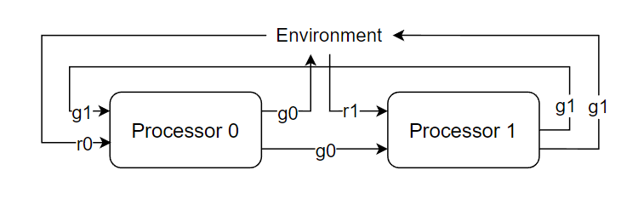
What is a distributed reactive system?
Distributed System = Multiple components + Environment (interacting together)
Each component has input, output variables and a goal (local specification)
System evolves in rounds and continues infinitely
Evolution is synchronous
Goal can be represented in:
Linear Temporal Logic (LTL)
Automata, etc.

Slide 6
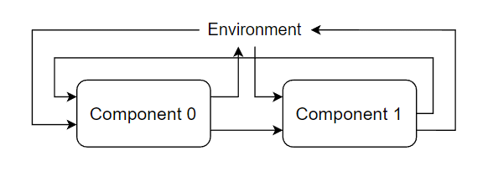
What is distributed reactive synthesis?
Find a strategy profile. Strategy profile is the set of strategies for all components.
Strategy tells the component how to react.
Strategy with memory: Strategy based on history of past inputs and outputs
Memoryless Strategy: Based only on current state.
Strategy should help component in achieving its goal
The problem is that distributed reactive synthesis is undecidable [3]
Thus, all methods to solve it are incomplete.

Slide 7
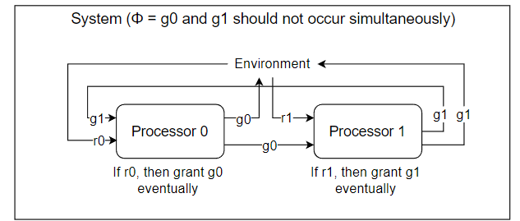
Rational Verification
Check whether a temporal logic formula φ (overall goal/property) satisfied by the multi-agent system.
Each agent has their own goals and preferences.
Only interested in the runs which are generated by rational behaviour of agents.
Rational behaviour means that the agent try behave in such a manner that the runs generated are more preferable for them.

Slide 8
Assume Guarantee Synthesis
Each component may not be able to satisfy their goal by itself
So, they make assumptions about behaviour of others while providing some guarantees on their behaviours[2].
Assume Guarantee Synthesis tries to synthesize these compatible assumptions and guarantees

Slide 9
Tools Explored Previously
Agnes Tool (Assume Guarantee Synthesis)
EVE Tool (Rational Verification)
A tool for automatically calculating assumptions and guarantees[2].
Limitations:-
Agnes only accepts two component systems
It accepts only safety and deterministic buchi specifications
A tool for finding strategy profiles which are Nash equilibrium and satisfy the overall specification[4].
Each component has their local goal which they try to satisfy.
There are some limitations:-
.The witness generated by EVE contains all Nash Equilibria but not all paths in the witness are Nash Equilibria
Thus, one has to manually extract the strategy using the witness by choosing the correct path.

Slide 10
PRALINE

Slide 11
Nash Equilibria Synthesis
PRALINE [5] is a tool that computes Nash equilibria in concurrent games over graphs.
In concurrent games at each state the joint action tuple of the agents determines the next state.
A payoff function payoff_i is associated with each player p_i.
The payoff function is a mapping of state to integers.
Goal of a player is to maximise the limit superior of its payoff function.

Slide 12
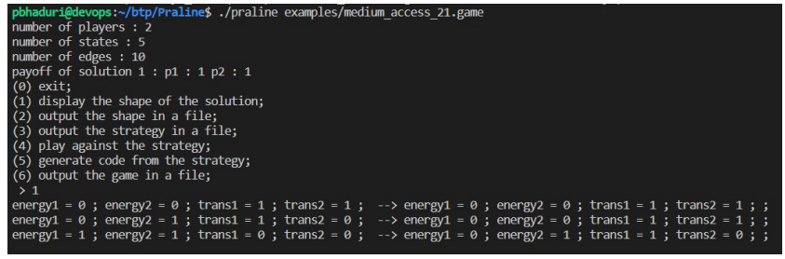
Example
We consider the medium access example provided with the tool.
Two components, C0 and C1. Both have to send packets over shared medium.
Packets are dropped when sent at the same time.
Maximise number of packets sent within limited number of attempts.
Goal is to maximise the number of packets successfully sent.

Slide 13
Limitations
The tool doesn’t accept LTL specification rather the payoff function itself is supposed to be provided in the form of closed form expression.
It is not possible to express every LTL specification as a closed form expression.

Slide 14
STV+AGR

Slide 15
Strategy Synthesis and Verification using Assume Guarantee Reasoning
STV+AGR [6] is a tool which allows model checking of relevant properties in asynchronous multi agent systems through assume guarantee reasoning.
Assume Guarantee Reasoning works by breaking down the overall goal into local goals for individual components and finding individual strategies
The individual strategies are used to obtain the joint strategy to achieve the overall goal.
The goal to be satisfied is expressed as ATL (Alternating-time Temporal Logic).
For example ATL formula, << Agent1>> F p states that Agent1 has a strategy to ensure that property p holds sometime in the future.

Slide 16
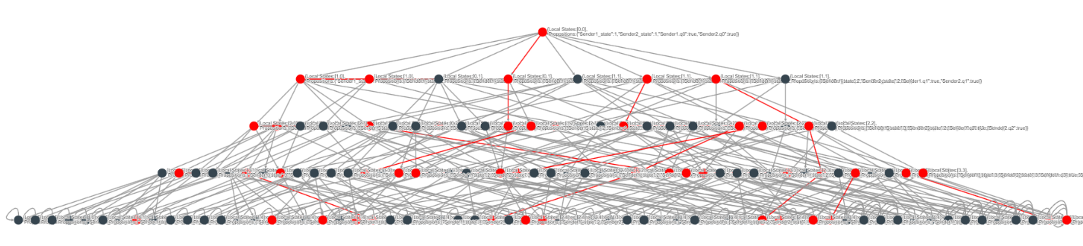
Example
We consider the distributed shared bus [2] example where two components try to send a packet.
If both of them try to send a packet simultaneously then they are not able to.
We encoded the states such that each component got 3 chances.
The formula to be satisfied was set to <<Sender1,Sender2>> F(Sender1_state = sent & Sender2_state = sent).

Slide 17
Limitations
This tool is for asynchronous models only. We cannot model synchronous systems with this tool.
Thus the strategy produced above is for a distorted version of the distributed bus problem where the actions of both senders don’t happen simultaneously.
The tool sometimes throws error on some of the ATL formulas. For a concrete example, a formula like << Peer1>> GF(Download2 = 1) throws ’Unknown Formula’ error even though the formula << Peer1>> FG(Download2 = 1) with G and F LTL operators interchanged works perfectly fine.

Slide 18
MCMAS

Slide 19
Model Checker for Verification of Multi Agent Systems
MCMAS [7] is a model checking tool which takes input MAS (Multi Agent System) in ISPL(Interpreted Systems Programming Language) format
It accepts ATL, LTL formulas and produces counterexamples for false formulae and witnesses (example over which the formula holds) for true formulae.
We consider the distributed bus example [2] where there are two senders each with the aim of sending a single packet within 4 time steps.
The property to be verified is << Sender1,Sender2>> F((Sender1.state = done)&(Sender2.state = done)).

Slide 20
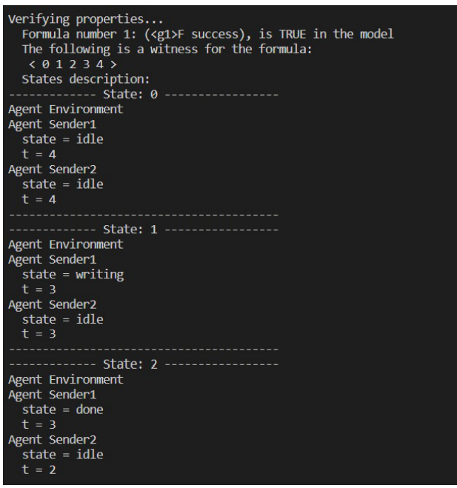
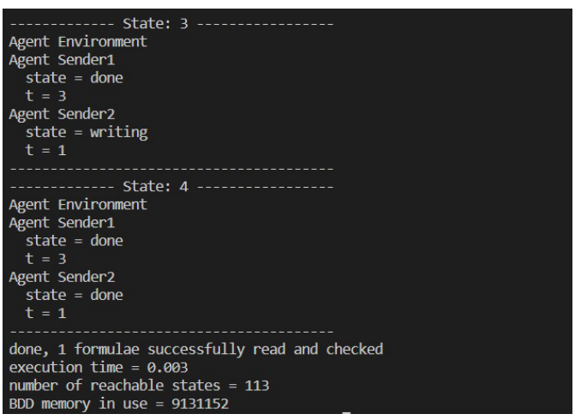
Example

Slide 21
Limitations
The tool only produces a witness satisfying the formula but figuring out the winning strategy just from the witness isn’t always possible.

Slide 22
Why EVE ?

Slide 23
Why EVE ?
We chose EVE (uses Rational Verification) for further experimentation.
Why EVE?
EVE accepts goals in LTL which is the most common logic to express temporal logic [9]
Provides the winning coalition according to Nash equilibrium
Generates witness graph containing all Nash equilibrium.
We were able to setup communication with the author of EVE.
Limitations
The witness graph also has paths which are not Nash equilibrium
Only finds memoryless strategies
Unable to model algorithm which contains sequence numbers or counters. Allows only boolean variables.

Slide 24
Experimentation

Slide 25
Experiment - 1
Szymanski's Algorithm

Slide 26
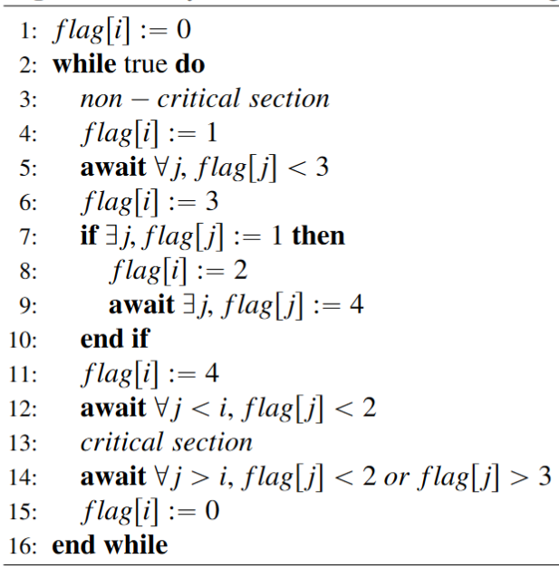
Szymanski's Algorithm
Szymanski's algorithm[10] is a solution to mutual exclusion problem.
Each process has its flag variable. Only the corresponding process writes it.
Flag can take values from 0 to 4
Complete algorithm for process_i is described here.

Slide 27
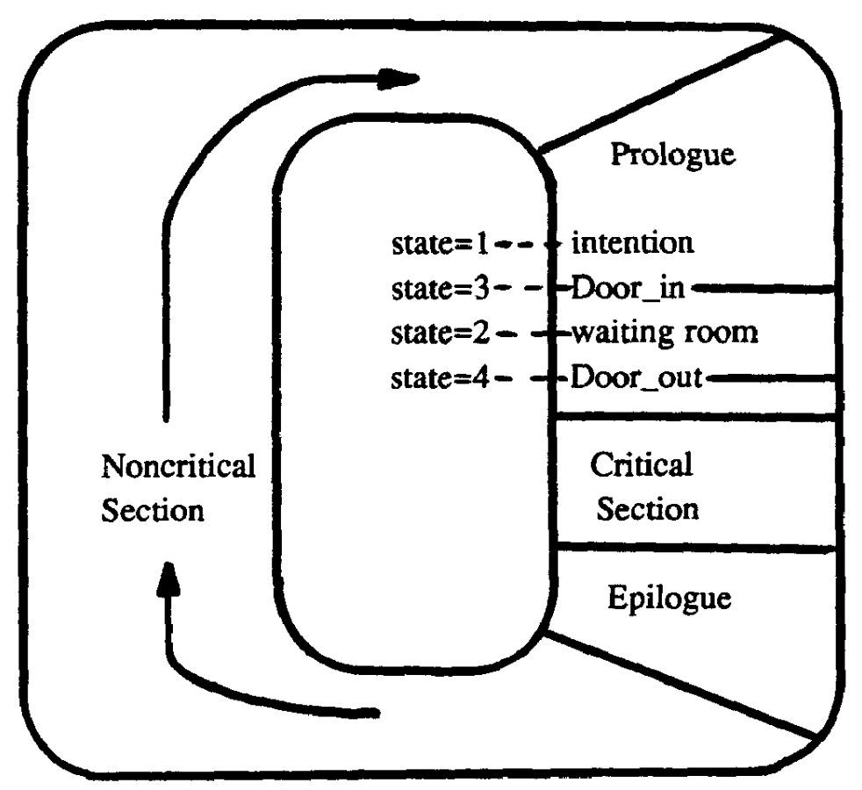
Intuition
Intuition for the algorithm.
The algorithm models a waiting room with entry and exit doors.
All of the process which want to enter critical section at roughly same time enter the waiting room.
The last of them closes the entry, and opens the exit.
Then process enter critical section one at a time.
The last process to access critical section closes exit and reopens the entry for next batch of processes.

Slide 28
Implementation and Verification
We implemented algorithm for 3 processes.
Verification of mutual exclusion.
Goal of each process = Its critical section is accessed infinitely often
Check Property of system = Is mutual exclusion is satisfied?
EVE outputs that the property of system is satisfied in all Nash equilibria.
Verification of liveness
Goal of each process = Its critical section is accessed infinitely often
Check Property of system = Does each process accesses critical section infinitely often?
EVE outputs that the property of system is satisfied in all Nash equilibria.
Thus, Szymanski algorithm satisfies mutual exclusion as well as liveness for 3 processes.

Slide 29
Experiment - 2
Simpson's 4-slot Algorithm

Slide 30
Simpson's 4-slot Algorithm
This algorithm implements a wait-free atomic register using safe registers.
Safe register:
If read is not concurrent with write - reads latest value.
If read is concurrent with write - returns arbitrary value.
Atomic register:
If read is not concurrent with write - reads latest value.
If read is concurrent with a write, or series of writes - the behavior is consistent with them occurring in some serial order.

Slide 31
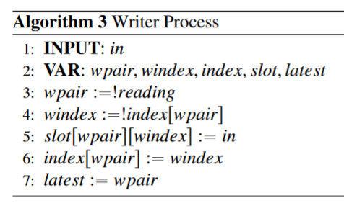
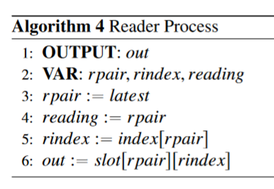
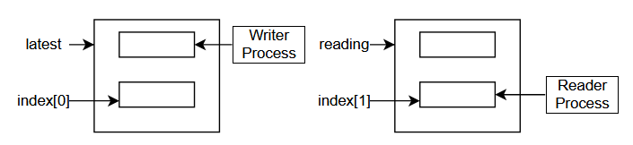
Simpson's 4-slot Algorithm
A snapshot while execution
latest=0, reading = 1, index = [1,1]

Slide 32
Simpson's 4-slot Algorithm
The statements from writer and reader to interleave or overlap arbitrarily.
Thus, we allow the processes to take arbitrary time in the execution of each statement.
Also the slot and control registers, are only assumed to be safe.
Thus, we make sure if simultaneous read/write happens on same variable, read can return arbitrary value. (E.g. Writer statement 3 and Reader statement 4)
With EVE, we were able to find that all the reads/writes are non-interfering.

Slide 33
Experiment - 3
Mutual Exclusion and Peterson’s Algorithm

Slide 34
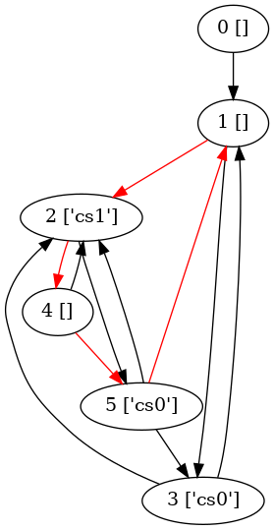
Simple Mutual Exclusion
Two processes - Process 0 and Process 1.
Process 0 has only 1 variable
cs_0: denoting when process is in critical section
The goal of Process 0 is to satisfy mutual exclusion and liveness
G !(cs_0 and cs_1) and (G F cs_0)
There exists a Nash equilibrium path shown in red i.e. round-robin algorithm
Output witness graph

Slide 35
Round Robin
Round robin cannot be implemented without memory
So, we add a turn variable.
But EVE does not support shared variables
Add turn_0 and turn_1 instead, where turn_0 = 1 - turn_1
The output is shown on next page

Slide 36
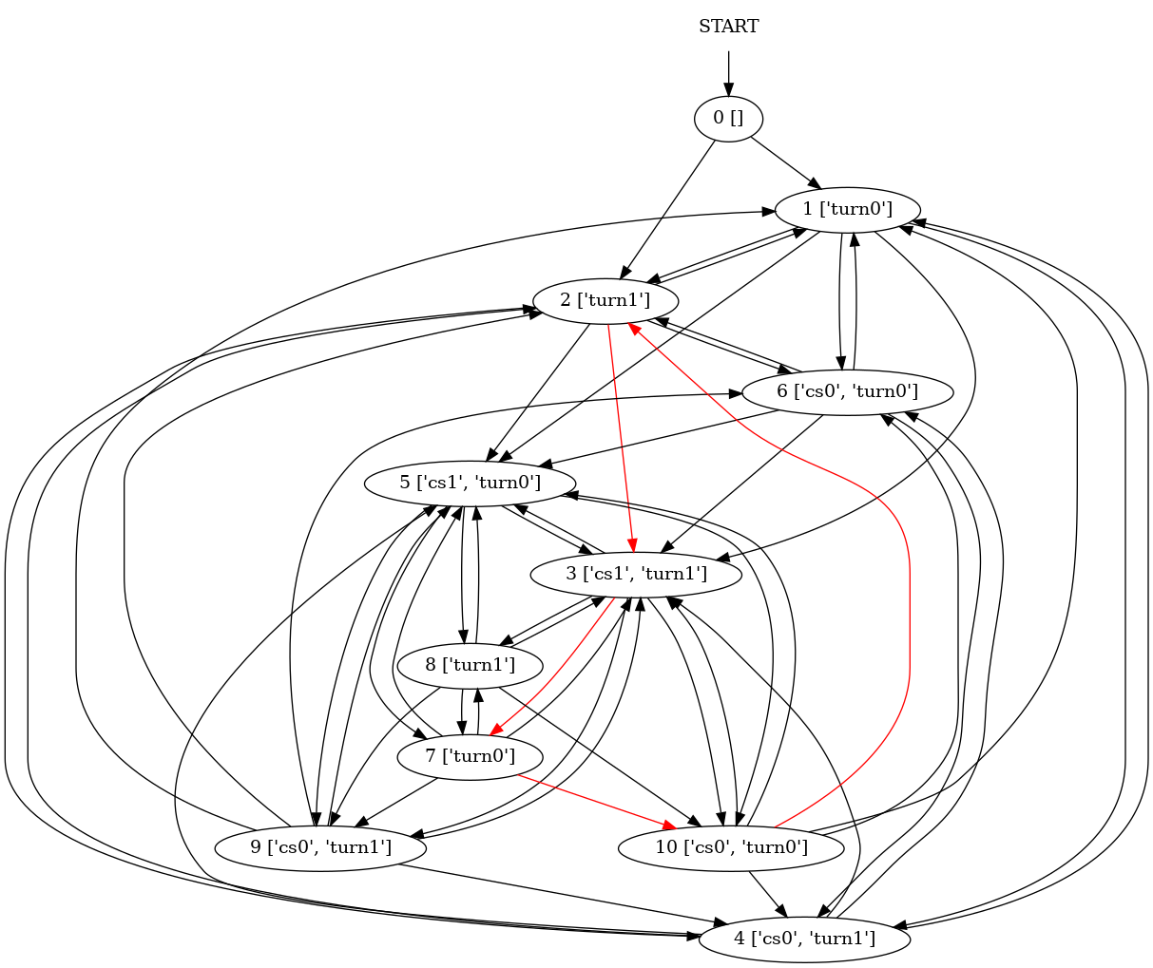
Round Robin

Slide 37
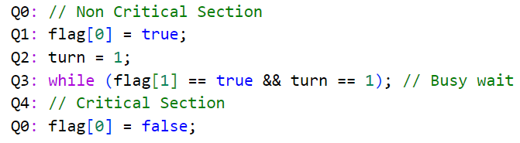
Peterson’s Algorithm
Round robin algorithm can be implemented using single 'turn' variable.
But a process cannot go to critical section twice, even if other process does not want to go to critical section.
To introduce this feature we can introduce a flag variable, to show the intention.
Peterson's algorithm does the same thing described above.
We implement the basic skeleton of the algorithm
Each executing statement maps to the Process states (Q0,Q1,Q2,Q3,Q4)

Slide 38
Using Verification to derive the algorithm
To partially derive the algorithm.
Tried different possible assignments in Q0, Q1, Q2
Only the correct value assignments returned winning coalition of Process 0 and Process 1, under the property of mutual exclusion.

Slide 39
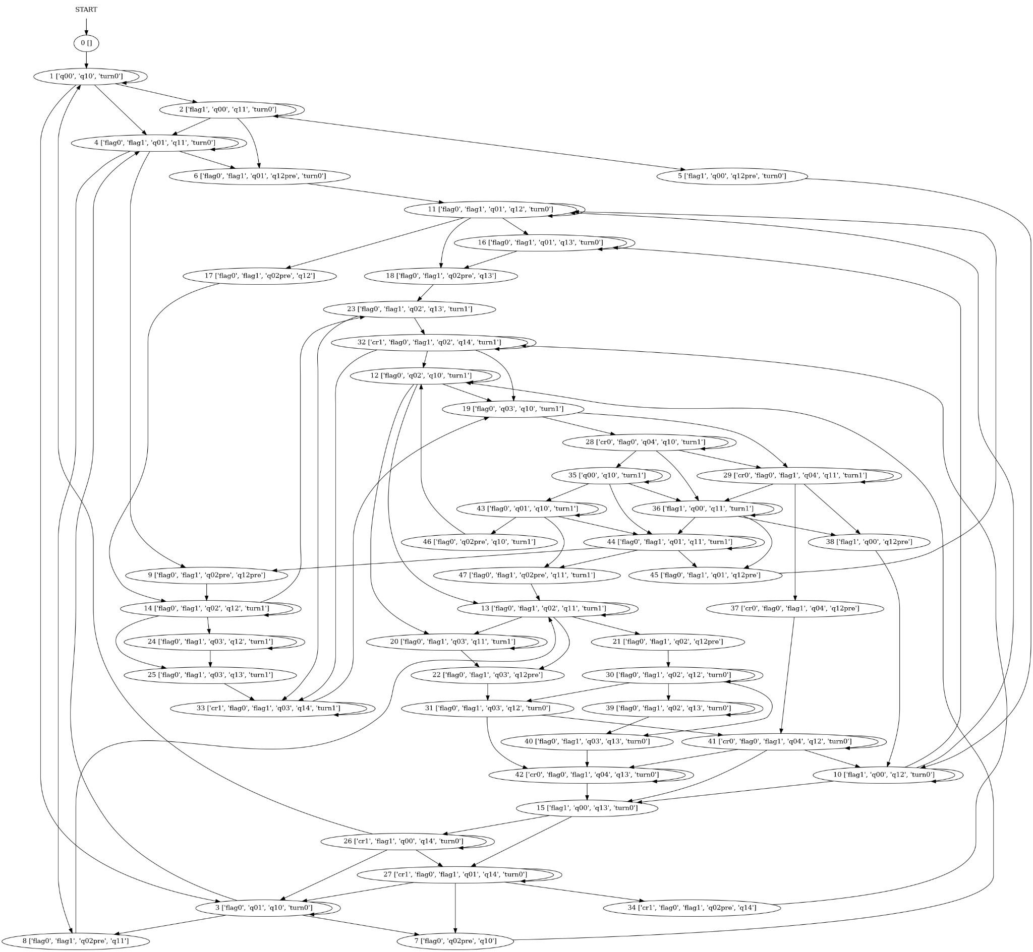
Witness graph for correct implementation
Output witness graph of implementation of Peterson's Algorithm.
* Follow this link to view full scale resolution image.

Slide 40
Using synthesis to derive the algorithm
We also set the statements Q0, Q1, Q2 to allow all possible behaviours.
But the graph returned was huge with around 360 states making it impossible to manually analyse.

Slide 41
Conclusion and Future Work

Slide 42
Conclusion
The problem of deriving algorithms in a human comprehensible format via strategy profile obtained from distributed synthesis is difficult.
The underlying algorithm of EVE is 2EXPTIME-complete [2,4] so execution of even slightly complicated examples took several hours and sometimes didn’t terminate
Requires conversion of automata to algorithm.
An alternative for this is to utilize verification and try out the possible combinations of statements and find the correct algorithm satisfying the specification via brute force as discussed previously.
If in future EVE like tool is built, whose output graph only shows paths with Nash equilibrium, the output may directly be utilised by computer to implement the algorithm.

Slide 43
Citations

Slide 44
Citations
Alessandro Abate, Julian Gutierrez, Lewis Hammond, Paul Harrenstein, Marta Kwiatkowska, Muhammad Najib, Giuseppe Perelli, Thomas Steeples, and Michael Wooldridge. Rational verification: game-theoretic verification of multi-agent systems. Applied Intelligence, 51(9):6569–6584, 2021.
Rupak Majumdar, Kaushik Mallik, Anne-Kathrin Schmuck, and Damien Zufferey. Assume– guarantee distributed synthesis. IEEE Transactions on Computer-Aided Design of Integrated Circuits and Systems, 39(11):3215–3226, 2020
Amir Pneuli and Roni Rosner. Distributed reactive systems are hard to synthesize. In Proceedings [1990] 31st Annual Symposium on Foundations of Computer Science, pages 746– 757. IEEE, 1990.
Julian Gutierrez, Muhammad Najib, Giuseppe Perelli, and Michael Wooldridge. Eve: A tool for temporal equilibrium analysis. In International Symposium on Automated Technology for Verification and Analysis, pages 551–557. Springer, 2018.
Brenguier, R. (2013). PRALINE: A Tool for Computing Nash Equilibria in Concurrent Games. In: Sharygina, N., Veith, H. (eds) Computer Aided Verification. CAV 2013. Lecture Notes in Computer Science, vol 8044. Springer, Berlin, Heidelberg. https://doi.org/10.1007/978- 3-642-39799-8_63.
Damian Kurpiewski, Łukasz Mikulski, Wojciech Jamroga. STV+AGR: Towards Practical Verification of Strategic Ability Using Assume-Guarantee Reasoning. arXiv:2203.01033 [cs.MA]
Lomuscio, A., Qu, H. Raimondi, F. MCMAS: an open-source model checker for the verification of multi-agent systems. Int J Softw Tools Technol Transfer 19, 9–30 (2017). https://doi.org/10.1007/s10009-015-0378-x
Pnueli A, Rosner R (1989) On the synthesis of an asynchronous reactive module. In: Proceedings of the Sixteenth International Colloquium on Automata, Languages, and Programs
A. Pnueli, “The temporal logic of programs,” in FOCS, pp. 46–57, 1977
Szymanski, B.K.: A simple solution to Lamport’s concurrent programming problem with linear wait. In: Lenfant, J. (ed.) Proceedings of 2nd International Conference on Supercomputing, ICS 1988, Saint Malo, France, 4–8 July 1988, pp. 621–626. ACM (1988). https://doi.org/10.1145/55364.55425

Slide 45
Acknowledgement
We would like to express our gratitude to our mentor Prof. Purandar Bhaduri for giving us the opportunity to explore Distributed Reactive Synthesis using Assume-Guarantee Reasoning and Games.

Slide 46
Thank You!

