Slide 1

File System Interface in xv6(Linux)
CS 344: Operating Systems Lab
Mesharya M Choudhary 190101053

Slide 2
xv6 differences with linux
Following are two features of file system which are present in linux but not in xv6:-
The linux inode has doubly indirect and triply indirect blocks also whereas the xv6 inode has only direct blocks and singly indirect block.
The linux file system provides support for symbolic links(symlink) which are basically a type of file which point to another file on the computer while default implementation of xv6 doesn’t support it.The command for creating a symlink is ln -s <path to file> <path of the link>

Slide 3
Extending inode
🤔
Following are the important files that we modify:-
fs.h- The value of NDIRECT is set to 10.We are sacrificing two direct blocks to create space for a doubly indirect block and a triply indirect block and set the value of MAXFILE (from approx 70KB)to NDIRECT+NINDIRECT+(NINDIRECT)²+(NINDIRECT)³ = 2113674 disk blocks(1 disk block is 512B so approx 1GB) as NINDIRECT=512/4=128

Slide 4
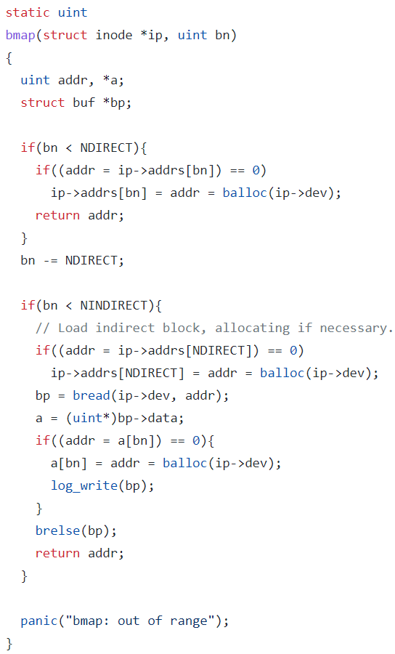
Extending inode
fs.c-
This is the default implementation of the bmap function with direct and singly indirect blocks
The bmap function returns the disk block address of the bnth block of the inode

Slide 5
Extending inode
bn-=NINDIRECT
if(bn<NINDIRECT*NINDIRECT){ if((addr=ip->addrs[NDIRECT+1])==0){
addr=ip->addrs[NDIRECT+1]=balloc(ip->dev)
bp=bread(ip->dev,addr)
a=(uint*)bp->data
if(addr=a[bn/(NINDIRECT)]==0){
addr=a[bn/NINDIRECT]=balloc(ip->dev)
log_write(bp)
}
Pseudocode for doubly indirect case

Slide 6
Extending inode
brelse(bp)
bp=bread(ip->dev,addr)
a=(uint*)bp->data
if((addr=a[bn%NINDIRECT])==0){
addr=a[bn%NINDIRECT]=balloc(ip->dev)
log_write(bp)
}
brelse(bp)
return addr
}
We can similarly write the code for triply indirect case.

Slide 7
Example - Suppose we want to map the block number 139
0-9
10 Direct
Singly Indirect
Doubly Indirect
Triply Indirect
0th Direct(138)
1st Direct(139)
….
127th Direct(265)
128 Direct
10-137
138-16521
138-265
0th Singly Indirect
1st Singly Indirect
…..
127th Singly Indirect
16522
-
2113673
266-393
128 Direct
16394-
16521
128 Direct

Slide 8
Adding symlink
🤔
Following are the relevant files that we modify:-
stat.h - We add a new file type for symlinks so we add the macro T_SYMLINK.
sysfile.c - We modify the relevant files corresponding to addition of a new system call and add the definition for sys_symlink system call which is responsible for creating an inode for the given path and storing the target so that we can establish a logical link between two files.
int sys_symlink(void){
char path[MAXLEN],target[MAXLEN]
if(argstr(0,target,MAXLEN)<0 || argstr(1,path,MAXLEN){
return -1
Pseudocode for sys_symlink
Check if arguments are read correctly

Slide 9
symlink system call
}
struct inode* ip=create(path,T_SYMLINK,0,0)
int len=strlen(target)
writei(ip,len,0,sizeof(int))
writei(ip,target,sizeof(int),len+1)
return 0
}
We are creating an inode for the symlink file named path and we are storing the target filename in the data block of the inode

Slide 10
open system call
We also make some changes to the sys_open function so that we can trace to
target file by using the symlink file.Following is the pseudocode for the snippet that is to be inserted in the sys_open function at the beginning:-
int sys_open(void){
….
while(ip->type==T_SYMLINK){
readi(ip,len,0,sizeof(int))
readi(ip,target,sizeof(int),len+1)
if((ip=namei(target))==0){
return -1
}
}
…. }
Once this while loop finishes execution we will have reached our target file so we can continue with the rest of the sys_open code implemented by default

Slide 11
create function
Also since we are adding a new file type we must also handle the creation of such files.For this we modify the create function by adding the given snippet
static struct inode* create
(char*path,short type,short major,short
minor){
…..
if((ip=dirlookup(dp,name,0))!=0){
if(type==T_SYMLINK){
return ip
}
}
….
}
We check whether the current directory already has a symlink file with the same name, if this is the case we return its inode or otherwise we proceed as usual with the rest of the code creating a new inode and return it.

