Slide 1



Introduction to
Shape with image background

Slide 2
Not supported shape

Slide 3
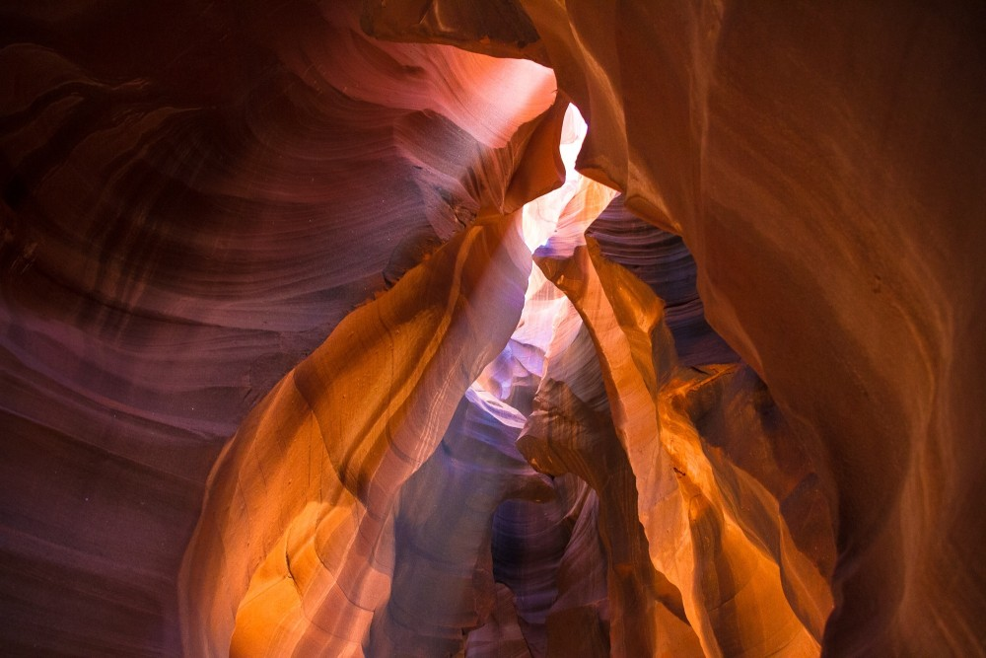
What is PPTXjs?
jQuery plugin
Written in javascript
Representing a presentation
Supports writing to html
jQuery plugin
Written in javascript
Representing a presentation
Supports writing to html

Slide 4
What's the point?
Generate slide decks
Represent business data
Show a family slide show
...
Export these to HTML formats
Presentation 2007 slides
Serialized
כמה דברים בעברית
עוד דברים בעברית
ועוד
Not yet 100% support yet
…..

Slide 5

Need more info?
Check the project site on GitHub: https://github.com/meshesha/PPTX2HTML
shape

Slide 6
Custom Table
No. | First Name | LastName | ID Num.
1 | Tady | meshesha | 56456455
2 | Shlono | Lewi | 64564456
4 | Tio | Dros | 123456789
5 | Ezxra | Wendde | 010202029
6 | Dawit | Zeru | 534534534
7 | Aaaaa Bbbbbb cccccccc

Slide 7
Theme Table
No. | Tady | meshesha | 56456455
1 | Shlono | Lewi | 64564456
2 | Tio | Dros | 123456789
4 | Eszra | Wendde | 010202029
5 | Ddawit | Zesru | 534534534
6 | AAAAAAAAA BBBBBBBBBBB CCCCCCCCC DDDDDDDD
7 | Tady | meshesha | 56456455

Slide 8
fdsf
HIIIIII
vvv

Slide 9


Slide 10



IMAGE BULLET
IMAGE BULLET
IMAGE BULLET
Bullets-1
Bullets-1
Bullets-1
Bullets-1
Bullets-1
Bullets-1
IMAGE BULLET-1
IMAGE BULLET -2
IMAGE BULLET -3

Slide 11
SmartArt Diagram
ABC
abc
DEF
def
GHI
ghi

