Slide 1
Air Quality monitoring
Exhausted carbon, humidity, and traffic
Solomon Chen

Slide 2

Why?

Slide 3
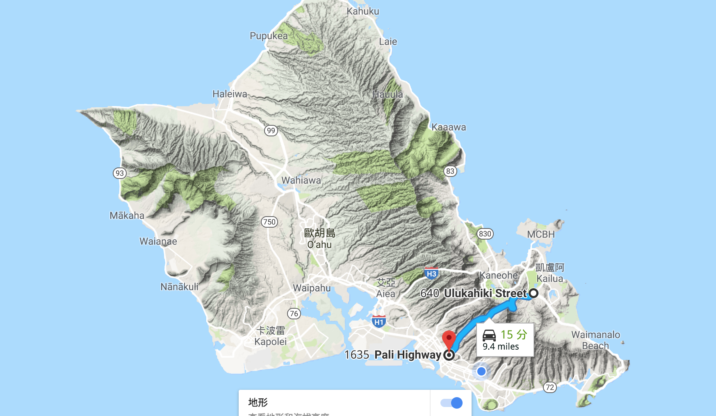
Where?

Slide 4
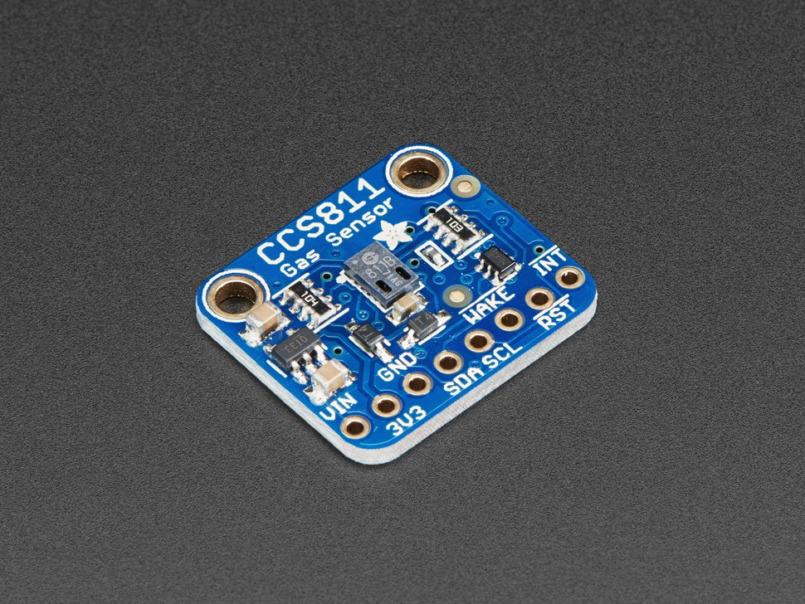
What to be monitored?
Temperature
Humidity
CO/CO2
Maybe nitrogen oxide

Slide 5
How?
There are two options:
Sensors on my car!
Driving on pali at different time on Pali to comepare exhausted carbon concentration in different traffic condition. Quantify traffic condition using box model and my residence time.
2. Stationary sensor package
Install sensor packages at selected sites (not as exciting tho…)

