Slide 1
UNIVERSITY PROJECT · 2024
Academic Integrity
Verification System
Blockchain-Based Academic Record Verification
[Your Name] · [University Name] · 2024

Slide 2
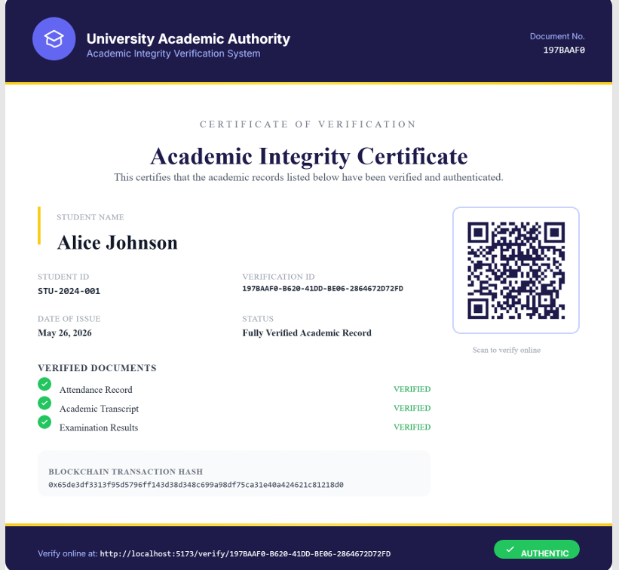
THE PROBLEM
The Problem We Are Solving
[Screenshot — Example of
paper certificate / fraud case]
01
Universities still rely on paper certificates that are easy to forge — no digital trail, no verification layer.
02
Employers and institutions have no fast, reliable way to
verify a candidate's academic records.
03
Transcripts and results can be tampered with after printing, leaving no trace of manipulation.

Slide 3
THE CONTEXT
Why Academic Fraud Is a Real Issue
Certificate fraud costs institutions millions annually. A 2024 study found that 1 in 8 employers encountered a fake academic credential. Without a tamper-proof system, universities have no reliable way to protect the integrity of their graduates.
1 in 8
Millions
No standard
employers found a fake
academic credential
lost annually by institutions
due to certificate fraud
verification process exists
across universities today

Slide 4
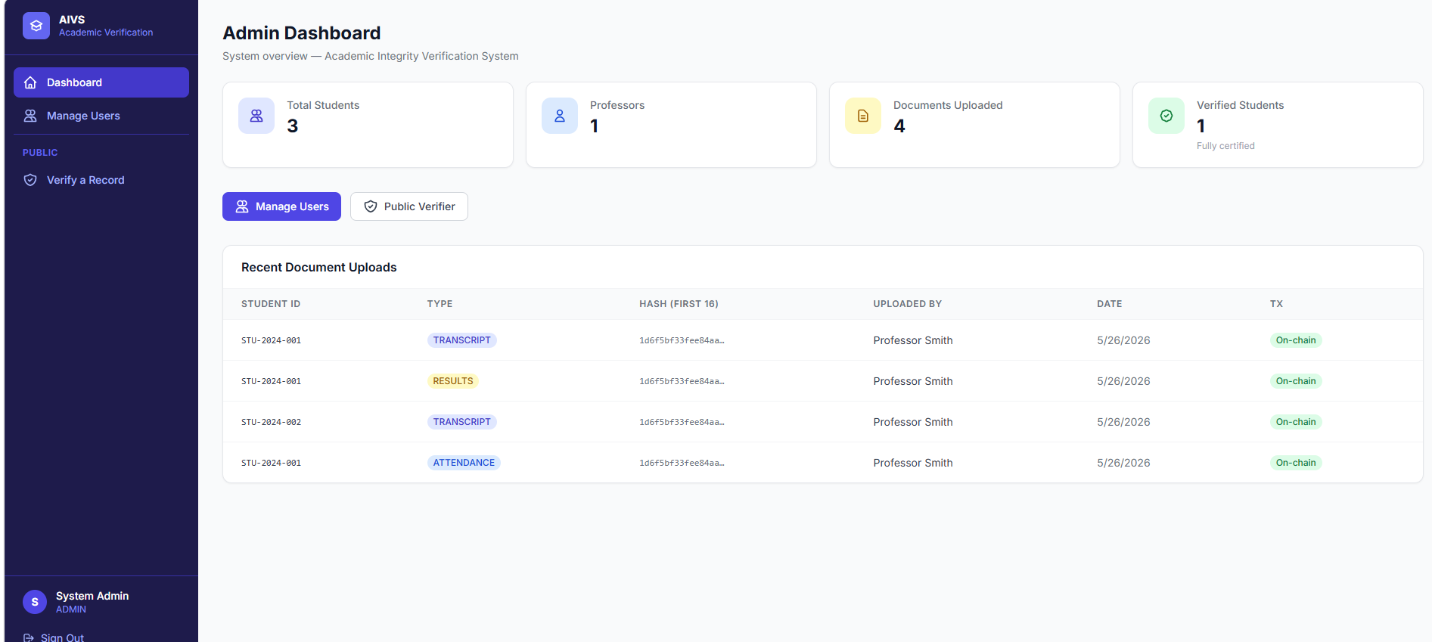
OUR SOLUTION
Introducing AIVS
[Screenshot —
Dashboard Overview]
AIVS is a web-based system that uses
blockchain technology to store and
verify student academic records.
Every document uploaded is hashed
using SHA-256 and permanently
recorded on the Ethereum
blockchain — making it impossible to tamper with.
When all three records are verified,
the system automatically issues
a signed digital certificate anyone can check.

Slide 5
THE PROCESS
How The System Works
1
2
3
4
Professor/Admin
Uploads Document
SHA-256 Hash
Generated
Hash Stored
on Blockchain
Certificate
Issued
Any file type, up to 20 MB
Server-side, never stored
Ethereum, permanent record
QR code + TX hash included
All steps happen within seconds — the file itself is never stored, only its hash.

Slide 6
FEATURES
Key Features
Role-Based Access
Blockchain Hashing
Auto Certificate
Separate dashboards for Admin, Professor and Student with protected routes
Every document gets a SHA-256 hash permanently stored on the Ethereum chain
Certificate auto-issued the moment all 3 document types are uploaded
QR Verification
Tamper Detection
Public Verifier
Anyone can scan the QR code on the certificate to verify it instantly
Any change to a document causes a hash mismatch and verification fails
Search by Student ID or Verification ID — no login required

Slide 7
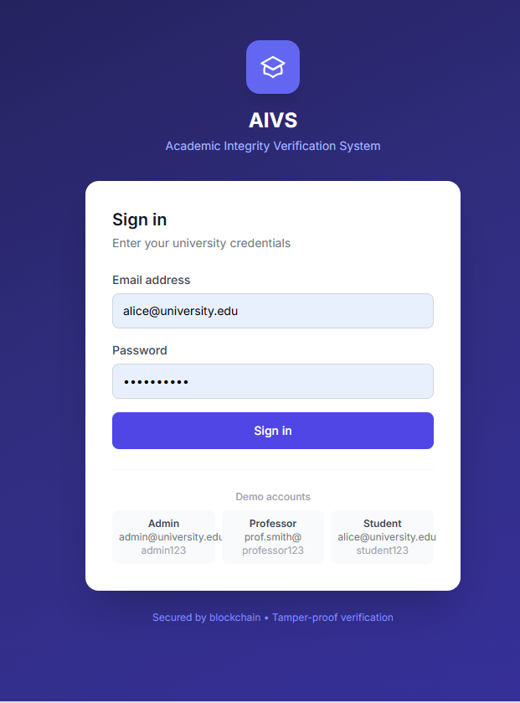
WALKTHROUGH
System Walkthrough
[Screenshot — Login Page]
[Screenshot — Admin Dashboard]
Login Page
Admin Dashboard

Slide 8
WALKTHROUGH
Professor & Student Views
[Screenshot — Upload Document Page]
[Screenshot — Student Dashboard]
Upload Document Page
Student Dashboard

Slide 9
THE OUTPUT
Verification Certificate
[Screenshot — Generated Certificate with QR Code]
The certificate contains: Student Name · Student ID · Verification ID · Issue Date · QR Code · Blockchain Transaction Hash

Slide 10
CONCLUSION
What We Built
AIVS solves a real problem that universities face today — academic record fraud.
Using Remix, Solidity, Ethers.js, and SQLite, we built a full-stack system that makes academic records verifiable by anyone, anywhere.
The blockchain guarantees that once a record is stored, it cannot be changed.
Thank You
Questions are welcome

