Slide 1
Labour market polarization in Canada: to what degree is automation responsible?
Author: Zachary Mesic
Supervisor: Miguel Cardoso

Slide 2
MOTIVATION
Automation has significantly transformed many aspects of our society, including the economy
Many are concerned about the growth of automation in society and the negative impact it may have on the economy
One of the direct outcomes of automation’s impact on the economy is the phenomenon known as labour market polarization

Slide 3
MOTIVATION
Autor, Levy, and Murnane (2003) put forth a model known as “Routine-Biased Technological Change” (RBTC) to explain labour market polarization
Much of the research has focused on the United States and little is known about the extent and causes of labour market polarization in Canada
This paper investigates the pervasiveness of the RBTC model in explaining labour market polarization in Canada

Slide 4
Figure 1: % Change in Total Income by Income Percentile

Slide 5
The data
The 2011 version of the National Occupational Classification (NOC) is used to track 27 occupational categories
Average weekly employment and wage data from Statistics Canada’s Labour Force Survey (LFS) are obtained over the period 1997-2018
The Routine Task Intensity (RTI) index constructed by Autor and Dorn (2013) is used to measure the “routineness” of occupations
The “offshorability” index constructed by Blinder and Kreuger (2013) is used to measure an occupation’s susceptibility to offshoring

Slide 6
Figure 2: RTI vs. Change in Hours Worked and Weekly Wage Rate
Figure 3: RTI vs. Change in Employment Share and Relative Wage

Slide 7
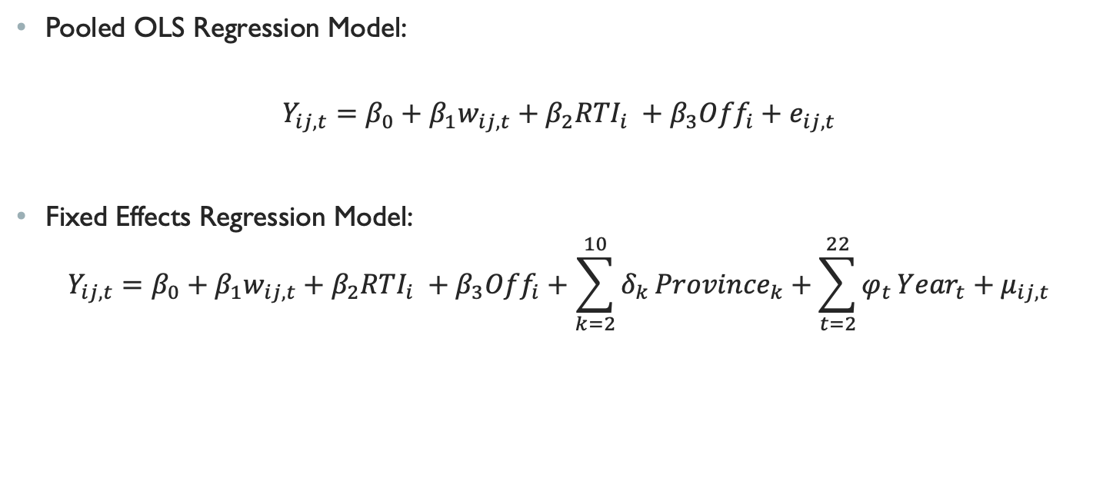
Methodology
Pooled OLS Regression Model:
$$Y_{ij,t}=β_{0}+{β_{1}w}_{ij,t}+β_{2}{RTI}_{i} +β_{3}{Off}_{i}+e_{ij,t}$$
Fixed Effects Regression Model:
$$Y_{ij,t}=β_{0}+{β_{1}w}_{ij,t}+β_{2}{RTI}_{i} +β_{3}{Off}_{i}+\sum_{k=2}^{10}{δ_{k}}{Province}_{k}+\sum_{t=2}^{22}{φ_{t}}{Year}_{t}+μ_{ij,t}$$

Slide 8
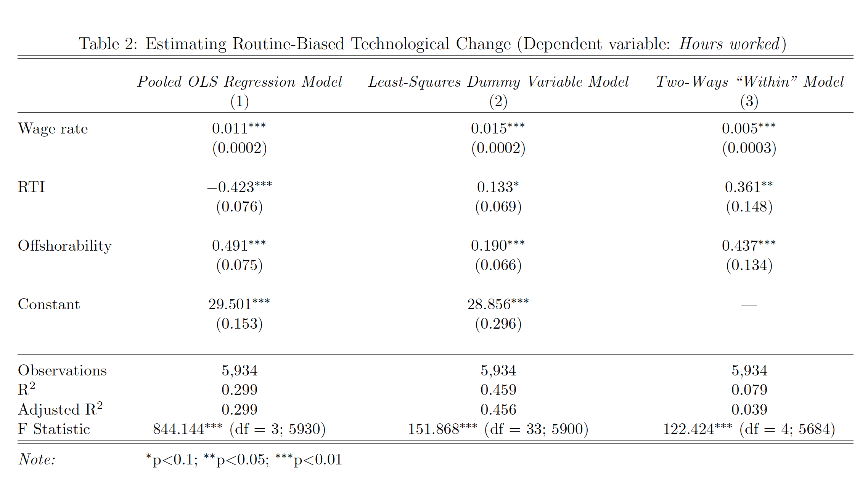
results

Slide 9
conclusion
Not enough evidence to conclude that RBTC is a primary influence of labour market polarization in Canada
It is likely that there are other causes responsible for labour market polarization in Canada
When explaining labour market polarization in Canada, explanations beyond the RBTC model should also be considered

