Slide 1
PREDICTION OF CENTRAL NERVOUS SYSTEM EMBRYONAL TUMOUR OUTCOME BASED ON GENE EXPRESSION
DATASETS
The Expression Datasets come in two different (ASCII, Tab separated) formats:
  <name>.res = Whitehead format (contains Affymetrix “calls,” rescaling factors and the numerical data)
  <name>.gct = GeneCluster format (contains only the basic numerical data)
The Sample class vectors have names:
  <name>.cls = Contains the sample class membership
The detailed formats of these files are described in the following pages.

Slide 2
Size [Bytes] File Name Dataset Type
1,798,615 Dataset_B _MD_classic_desmoplastic .res B Medulloblastoma classic and desmoplastic
1,797,291 Dataset_B _MD_classic_desmoplastic .gct B “
76 Dataset_B _MD_classic_desmoplastic .cls B “
2,297,975 Dataset_A_multiple_tumor_samples.res A Multiple Brain tumors
2,296,340 Dataset_A_multiple_tumor_samples.gct A “
95 Dataset_A_multiple_tumor_samples.cls A “
2,205,001 Dataset_A1_multiple_tumor_samples.res A1 “
2,203,444 Dataset_A1_multiple_tumor_samples.gct A1 “
91 Dataset_A1_multiple_tumor_samples.cls A1 “
4,312,574 Dataset_A2_multiple_tumor_samples.res A2 “
4,309,065 Dataset_A2_multiple_tumor_samples.gct A2 “
187 Dataset_A2_multiple_tumor_samples.cls A2 “
2,995,689 Dataset_C_MD_outcome.res C Medulloblastoma treatment outcome
2,993,350 Dataset_C_MD_outcome.gct C “
129 Dataset_C_MD_outcome.cls C “
See Supplementary Information section II for more details

Slide 3
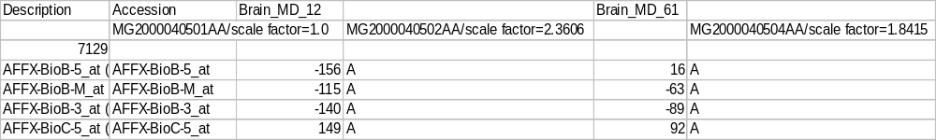
Datasets A, A1, A2, B and C “<filename>.res” file format:
Sample 1 (numerical expression values)
Sample 1 (“call”
A=gene absent
P=gene present
M=marginal
2nd column gene accession number e.g. Genbank)
Sample 2 (numerical expression values)
Sample 2 (“call”
A=gene absent
P=gene present
M=marginal
First column: gene description
…
Header with Sample names
…
Genes
(7129)
…
Number of genes (rows)
A list of Chip numbers and Re-scaling factors in the same order as the header (for the first sample the re-scaling factor is always 1.0). Each column (sample) was multiplied by 1/slope of a least squares linear fit of the experiment vs. the baseline (I.e.first column). As the data is already re-scaled if one wants to undo the re-scaling and obtain raw values one should divide each column by the corresponding re-scaling factor shown in the second row.
The numerical expression values are trimmed average differences between the perfect match (PM) and mismatch (MM) probe cells for each gene. The calls are: A=gene absent, P=gene present, M=marginal, and are helpful to assess the absence or presence of a gene (or its degree of consistency across the probe cells). These values are assigned by Affymetrix’s GeneChip software. For more details see:
Lipschutz, R. J., Fodor, S. P., Gingeras, T. R. & Lockhart, D. J. (1999). High-density synthetic oligonucleotide arrays. Nat. Gen., 21, 20--24.
www.affymetrix.com

Slide 4
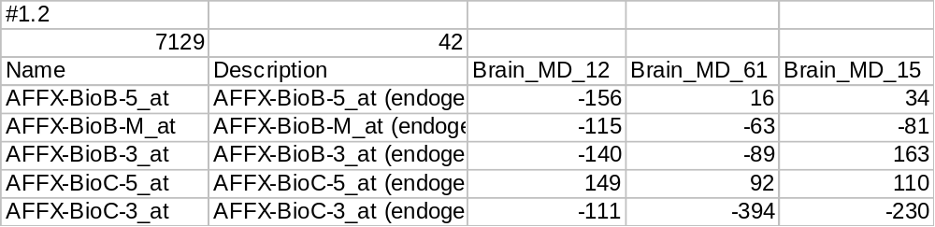
Datasets A, A1, A2, B and C “<filename>.gct” file format:
First column Affymetrix gene accession number (e.g. Genbank)
Sample 1 (numerical expression values)
Sample 2 (numerical expression values)
2nd column: gene description
Sample 3 (numerical expression values)
…
Header with Sample names
…
Genes
(7129)
Number of Samples (columns)
…
Number of genes (rows)

