Slide 1
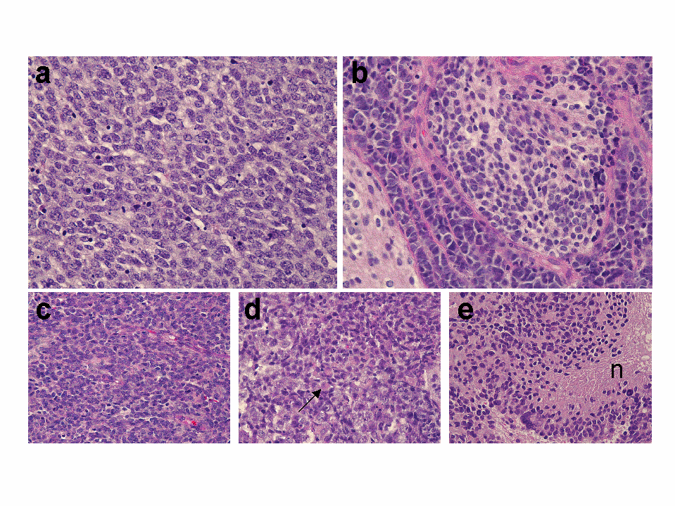
1A

Slide 2
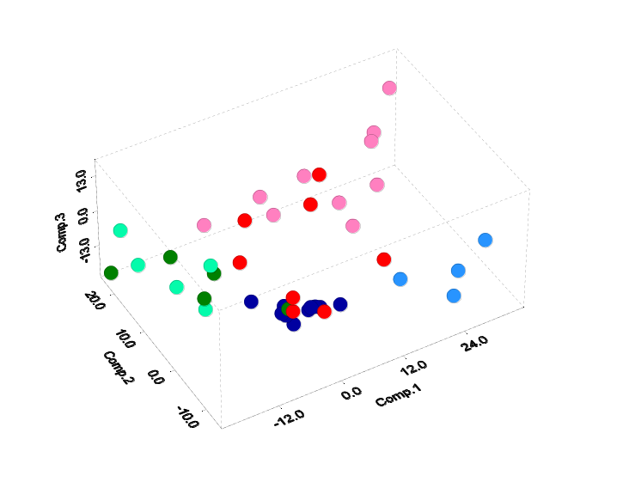
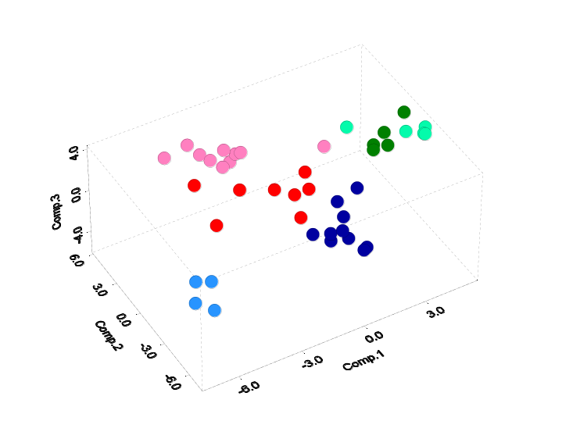
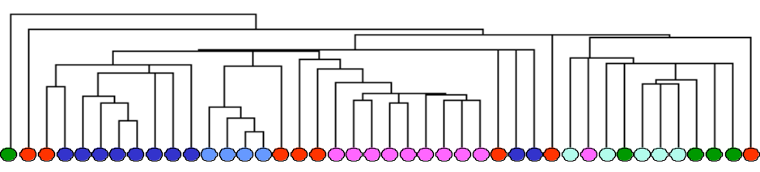
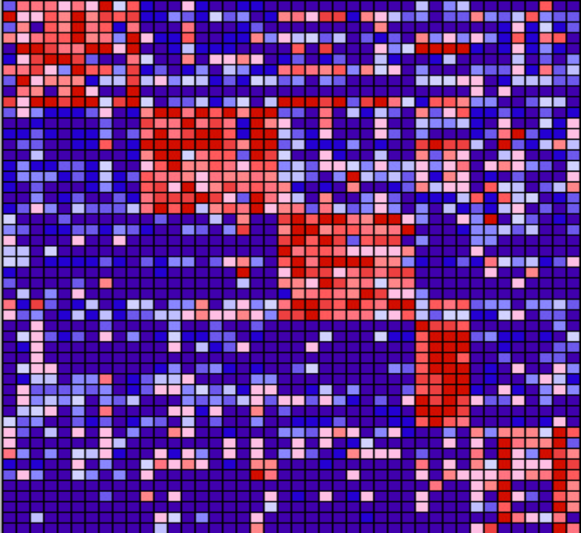
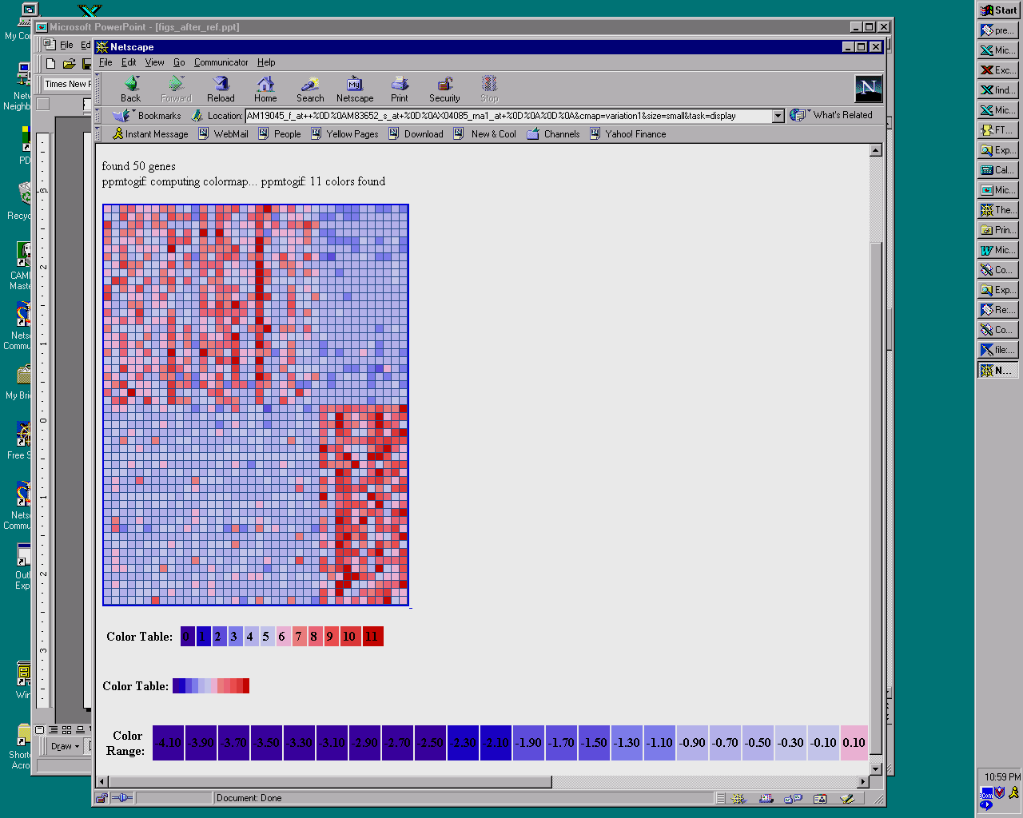
1B
1C
MD
MGlio
AT/RT CNS
AT/RT Renal/Extrarenal
Ncer
PNET
1D
1E
MD Mglio Rhab Ncer PNET
M93119 INSM1 Insulinoma-associated 1
M30448 Casein kinase II beta subunit
S82240 RhoE
D80004 KIAA0182 gene
D76435 Zic protein
X83543 APXL Apical protein
X62534 HMG2 High-mobility group
M96739 NSCL-1
U26726 11 beta-hydroxysteroid dehydrogenase type II
HG311-HT311 Ribosomal Protein L30
X86693 High endothelial venule
M93426 PTPRZ Protein tyrosine phosphatase
U48705 DDR gene
X86809 Major astrocytic phosphoprotein PEA-15
U45955 Neuronal membrane glycoprotein M6b
U53204 Plectin (PLEC1)
X13916 LDL-receptor related protein
D87258 Serin protease with IGF-binding motif
Z31560 SOX2 SRY (sex determining region Y)-box 2
M32886 SRI Sorcin
J04164 RPS3 Ribosomal protein S3
M12125 Skeletal beta-tropomyosin
D29958 KIAA0116 gene
D17400 PTS 6-pyruvoyltetrahydropterin synthase
D83174 CBP1 Collagen-binding protein 1
D83735 Adult heart mRNA for neutral calponin
D84454 UDP-galactose translocator
L38969 Thrombospondin 3 (THBS3)
U12465 RPS11 Ribosomal protein S11
D80005 KIAA0183 gene
D87463 KIAA0273 gene
U90902 Clone 23612 mRNA sequence
D26070 Type 1 inositol 1,4,5-trisphosphate receptor
X63578 Parvalbumin
Z15108 PRKCZ Protein kinase C, zeta
L35592 Germline mRNA sequence
L10338 SCN1B Sodium channel
L33243 PKD1 Polycystic kidney disease protein 1
L77864 Stat-like protein (Fe65)
J04469 Mitochondrial creatine kinase (CKMT)
M80397 POLD1 Polymerase (DNA directed), delta 1
X14830 CHRNB1 Cholinergic receptor, nicotinic, beta polypeptide 1
U97018 Echinoderm microtubule-associated protein homolog HuEMAP
HG4178-HT4448 Af-17
K02882 IGHD gene
X52228 MUC1 Mucin 1, transmembrane
U22314 Neural-restrictive silencer factor
D29675 Inducible nitric oxide synthase gene
S82471 SSX3
M54951 Human atrial natriuretic factor gene
-3σ
-2σ
-1σ
0
+1σ
+2σ
+3σ
σ = standard deviation from mean

Slide 3
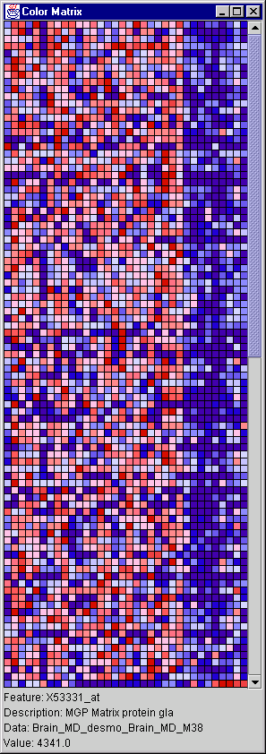
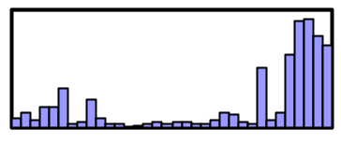
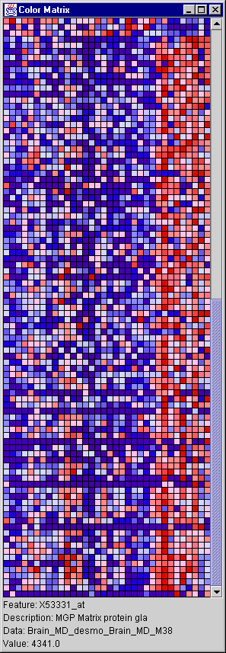
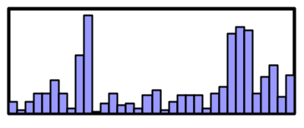
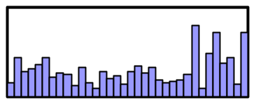
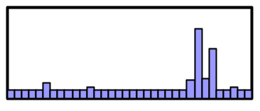
2A
Classic Desmoplastic
HG1980-HT2023 Tubulin, Beta 2
U63842 NeuroD3 gene
X67951 PAGA Proliferation-associated gene A
X64330 ATP-citrate lyase
J03241 TGFB3 Transforming growth factor, beta 3
U44839 Putative ubiquitin C-terminal hydrolase (UHX1)
Z27113 H.Sapiens gene for RNA polymerase II subunit
X12447 ALDOA Aldolase A
U73328 DLX7 Distal-less homeobox 7
U59913 SMAD5
Z75190 Apolipoprotein E receptor 2
X15183 Human mRNA for 90-kDa heat-shock protein
U61263 Acetolactate synthase homolog
L07515 Human heterochromatin protein homologue (HP1)
M34677 Human nested gene protein gene (coag. factorVIII)
U40391 Serotonin N-acetyltransferase gene
D16611 CPO Coproporphyrinogen oxidase
L37127 RNA polymerase II
U33839 No description available
X81817 BAP31
X51804 Human PMI gene for a putative receptor protein
Y09305 Protein kinase, Dyrk4
X14885 Transforming growth factor-beta 3 (TGF-beta 3)
X57398 NME1 Non-metastatic cells 1 (NM23A)
X02152 LDHA Lactate dehydrogenase A
X64364 BSG Basigin
U04806 FLT3/FLK2 ligand mRNA
U52191 SMCY (H-Y) mRNA
M35296 Tyrosine kinase arg gene
D50840 Ceramide glucosyltransferase
S69189 Peroxisomal acyl-coenzyme A oxidase
L03785 MYL5 Myosin, light polypeptide 5
M82919 GABRB3 Gamma-aminobutyric acid (GABA) A receptor, beta 3
U65092 Melanocyte-specific gene 1 (msg1)
S49592 Transcription factor E2F like protein
D79994 KIAA0172 gene
X95586 PSMB5 Proteasome subunit, beta type, 5
U79299 Human neuronal olfactomedin-related ER localized protein
X71973 GPX4 Phospholipid hydroperoxide glutathione peroxidase
U31342 Human nucleobindin gene
U48437 Amyloid precursor-like protein 1
D86957 KIAA0202 gene
HG2279-HT2375 Triosephosphate Isomerase
Z19585 THBS4 Thrombospondin 4
M16405 Human m4 muscarinic acetylcholine receptor gene
U32315 Syntaxin 3
U11701 LIM-homeobox domain protein (hLH-2)
Y11251 Novel member of serine-arginine domain protein, SRrp129
U68018 Mad protein homolog (hMAD-2)
M81181 ATP1B2 ATPase, Na+/K+ transporting, beta 2 polypeptide
U58334 Bcl2, p53 binding protein Bbp/53BP2
L38490 ARF4L ADP-ribosylation factor 4-like
M31328 GNB3 Guanine nucleotide binding protein
M60626 FPR1 Formyl peptide receptor 1
M97815 CRABP2 Cellular retinoic acid-binding protein 2
J00116 COL2A1 Collagen, type II, alpha 1
U01824 Glutamate transporter
Y00282 RPN2 Ribophorin II
M65254 PPP2R1B Protein phosphatase 2
X64877 HFL1 H factor (complement)-like 1
D31885 KIAA0069 gene
D87434 KIAA0247 gene
Z35093 SURF1 Surfeit 1
Y08374 GP-39 cartilage protein gene
Z54367 Plectin
Z46632 PDE4C Phosphodiesterase 4C
HG3517-HT3711 Alpha-1-Antitrypsin
L42354 Clone 48ES4 mRNA fragment
X15376 GABRG2 Gamma-aminobutyric acid (GABA) A receptor, gamma 2
X89059 Unknown protein expressed in macrophages
Classic Desmoplastic
IGF2
HG3543-HT3739 Insulin-Like Growth Factor 2
X53331 MGP Matrix protein gla
X65724 NDP Norrie disease protein
D14530 40S Ribosomal protein S23
Y00757 SGNE1 Secretory granule, neuroendocrine protein 1
U25789 Ribosomal protein L21
L27560 Insulin-like growth factor binding protein 5 (IGFBP5)
X83543 APXL Apical protein (Xenopus laevis-like)
X52966 RPL35A Ribosomal protein L35a
L06797 Human (clone L5) orphan G protein-coupled receptor
M14745 BCL2 B
HG3431-HT3616 Decorin
D79205 Ribosomal protein L39
D82345 NB thymosin beta
D38549 KIAA0068 gene
U14972 Ribosomal protein S10
X59841 PBX3
J03242 IGF2 Insulin-like growth factor 2 (somatomedin A)
HG3214-HT3391 Metallopanstimulin 1
X06617 RPS11 Ribosomal protein S11
J02611 APOD Apolipoprotein D
X16064 Human mRNA for translationally controlled tumor protein
Z74616 COL1A2 Collagen, type I, alpha-2
L40386 DP2 (Humdp2)
X04741 Human mRNA for protein gene product (PGP)
M55210 LAMC1 Laminin, gamma 1
M96739 NSCL-1
U73304 CB1 cannabinoid receptor (CNR1) gene
M65292 HFL1 H factor (complement)-like 1
HG311-HT311 Ribosomal Protein L30
M83233 TCF12 Transcription factor 12
U07919 ALDH6 Aldehyde dehydrogenase 6
X57959 RPL17 Ribosomal protein L7
J04080 C1S Complement component 1, s subcomponent
X76029 Neuromedin U
U14973 40S ribosomal protein S29
U24576 Breast tumor autoantigen
L41066 NF-AT3
X60489 Elongation factor-1-beta
M62843 Paraneoplastic encephalomyelitis antigen HUD
HG662-HT662 Epstein-Barr Virus Small Rna-Associated Protein
HG613-HT613 Ribosomal Protein S12
L42379 Quiescin (Q6) mRNA
M13241 N-MYC
U12404 HSPB1 Heat shock 27kD protein 1
M55998 Alpha-1 collagen type I gene
S82240 RhoE
U78027 L44L gene
X06700 COL3A1 Alpha-1 type 3 collagen
D13413 Tumor-associated 120 kDa nuclear protein p120
M74719 SEF2-1A protein (SEF2-1A)
M93119 INSM1 Insulinoma-associated 1
M92287 CCND3 Cyclin D3
HG33-HT33 Ribosomal Protein S4
U16306 CSPG2 Chondroitin sulfate proteoglycan 2
Z37976 LTBP2 Latent transforming growth factor beta binding protein 2
X69150 Ribosomal protein S18
HG4542-HT4947 Ribosomal Protein L10
L41607 GCNT2 Glucosaminyl (N-acetyl) transferase 2
U43148 PTCH Patched homolog
M30269 NID Nidogen (enactin)
X07384 GLI Glioma-associated oncogene homolog
L38941 RPL37 Ribosomal protein L37
U09953 RPL9 Ribosomal protein L9
D87464 KIAA0274 gene
M18000 40S ribosomal protein S17
M91196 ICSBP1 Interferon consensus sequence binding protein 1
L27559 IGFBP5 Insulin-like growth factor binding protein 5
S76475 NTRK3 Neurotrophic tyrosine kinase, receptor, type 3 (TrkC)
L41067 Transcription factor NFATx
N-MYC
PTCH
GLI
-3σ
-2σ
-1σ
0
+1σ
+2σ
+3σ
σ = standard deviation from mean

Slide 4
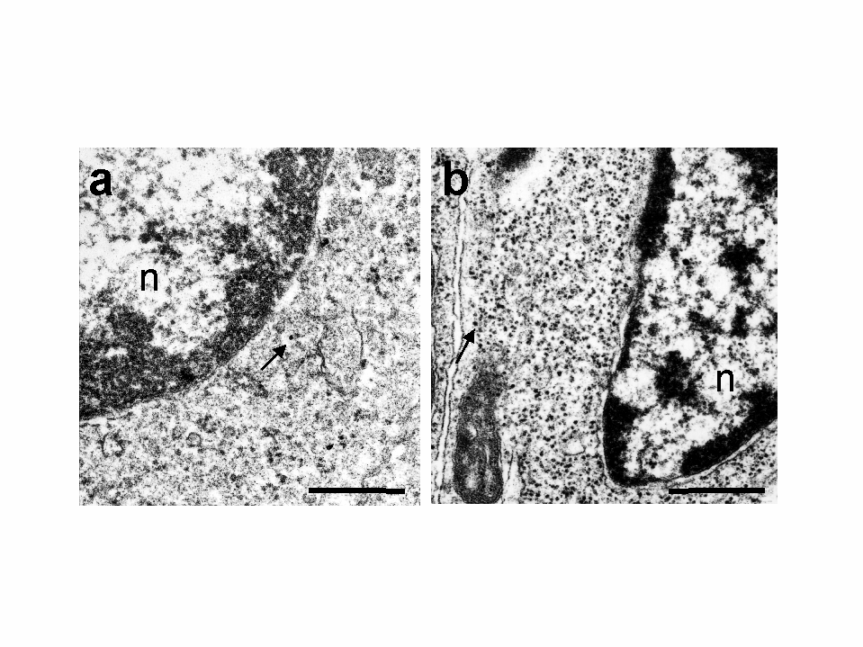
2B

Slide 5
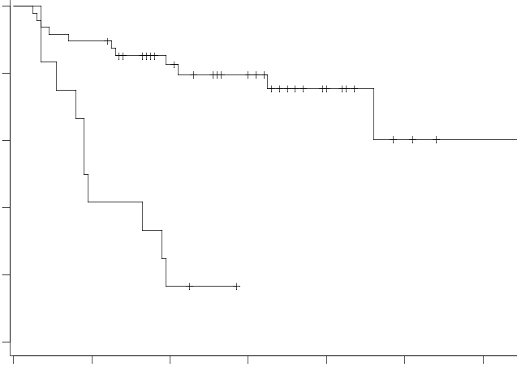
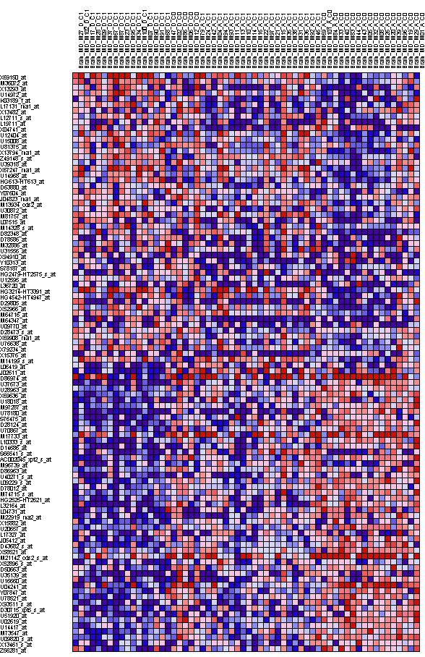
3A
Overall Survival
0 .2 .4 .6 .8 1
3B
p-val=0.0000033
Failures Survivors
0 20 40 60 80 100 120
Months
C1 C0 C1 C0
Markers of Survival
L06419 PLOD Lysyl hydroxylase
J02611 APOD Apolipoprotein D
D86974 KIAA0220 gene
U37673 Beta-NAP
U28963 Gps2 (GPS2)
X69636 H.sapiens mRNA sequence (15q11-13)
U18018 ETV4 Ets variant gene 4 (E1A enhancer-binding protein, E1AF)
M97287 SATB1 Special AT-rich sequence binding protein 1
U78180 Sodium channel 2 (hBNaC2) mRNA, alternatively spliced
S76475 NTRK3 Neurotrophic tyrosine kinase, receptor, type 3 (TrkC)
D28124 Unknown product
U70867 Prostaglandin transporter hPGT
M17733 Thymosin beta-4
L10333 Neuroendocrine-specific protein A (NSP)
D14686 AMT Glycine cleavage system protein T (aminomethyltransferase)
S66541 B-50 neural phosphoprotein
AC002045 A-589H1.2 from Homo sapiens Chromosome 16 BAC clone CIT987-SKA-589H1
M96739 NSCL-1
D86963 PTB Ribosomal protein L26
U40271 PTK7 Protein-tyrosine kinase 7
L09229 FACL1 Long chain fatty acid acyl-coA ligase
D78012 CRMP1 Collapsin response mediator protein 1
M74715 IDUA Iduronidase, alpha-L-
HG2525-HT2621 Helix-Loop-Helix Protein Delta Max, Alt. Splice 1
L32164 Zinc finger protein
L04731 Translocation T(4:11) of ALL-1 gene to chromosome 4
M22919 MLC gene (non-muscle myosin light chain)
X15882 COL6A2 Collagen, type VI, alpha 2
U20657 Ubiquitin protease (Unph) proto-oncogene
L17327 Pre-T/NK cell associated protein (3B3)
J05412 REG1A Regenerating islet-derived 1 alpha (pancreatic stone protein)
D43682 Very-long-chain acyl-CoA dehydrogenase (VLCAD)
X58521 Nuclear pore glycoprotein P62
M21142 Guanine nucleotide-binding protein G-s-alpha-3 gene
X52896 RNA for dermal fibroblast elastin
D50663 CW-1
U35139 NECDIN related protein
U16660 Peroxisomal enoyl-CoA hydratase-like protein (HPXEL)
U04241 Homolog of Drosophila enhancer of split m9/m10
Y07847 RRP22 protein
U78521 Immunophilin homolog ARA9
X93511 Telomeric repeat binding factor (TRF1)
D30715 Exon2a from Human PAP (pancreatitis-associated protein) gene
U51920 SRP54 Signal recognition particle 54 kD protein
U02619 TFIIIC Box B-binding subunit
U14417 Ral guanine nucleotide dissociation stimulator
M73547 Human polyposis locus (DP1 gene)
U09820 Helicase II (RAD54L)
X13461 Calmodulin-related protein NB-1
Z56281 Interferon regulatory factor 3
Markers of Treatment Failure
X69150 Ribosomal protein S18
M36072 RPL7A Ribosomal protein L7a
X13293 MYBL2 V-myb avian myeloblastosis viral oncogene homolog-like 2
U14972 Ribosomal protein S10
K03189 Chorionic gonadotropin (hcg) beta subunit
L17131 High mobility group protein (HMG-I(Y))
X13482 Human mRNA for U2 snRNP-specific A' protein
L12711 TKT Transketolase
L19711 Dystroglycan (DAG1)
X04741 U2 small nuclear ribonucleoprotein A’
U12404 HSPB1 Heat shock 27kD protein 1
U15008 SnRNP core protein Sm D2
U81375 Placental equilibrative nucleoside transporter 1 (hENT1)
X13794 Lactate dehydrogenase B gene
Z49148 Enhancer of rudimentary homolog
U39318 AF-4
X67247 RpS8 gene for ribosomal protein S8
U14968 Ribosomal protein L27a
HG613-HT613 Ribosomal Protein S12
D63880 KIAA0159 gene
Y07604 Nucleoside-diphosphate kinase
J04823 Cytochrome c oxidase subunit VIII (COX8)
M13934 RPS14 gene
U30872 CENP-F kinetochore protein
M81757 40S ribosomal protein S19
L07515 Human heterochromatin protein homologue (HP1)
M14328 ENO1 Enolase 1, (alpha)
D82348 5-aminoimidazole-4-carboxamide-1-beta-D-ribonucleoti de transformylase/inosinicase
D78586 Human CAD mRNA for multifunctional protein CAD
M32886 SRI Sorcin
U31556 E2F5 E2F transcription factor 5, p130-binding
X94910 ERp31 protein
Y10313 Nerve growth factor-inducible PC4 homologue
S78187 M-phase inducer phosphatase 2
HG2479-HT2575 Helix-Loop-Helix Protein Sef2-1d
U12595 Tumor necrosis factor type 1 receptor associated protein (TRAP1)
L36720 Bystin
HG3214-HT3391 Metallopanstimulin 1
HG4542-HT4947 Ribosomal Protein L10
D29805 GGTB2 Glycoprotein-4-beta-galactosyltransferase 2
X52966 RPL35A Ribosomal protein L35a
M64716 RPS25 Ribosomal protein S25
M64347 FGFR3 Fibroblast growth factor receptor 3
U09770 Cysteine-rich heart protein (hCRHP)
D28473 IARS Isoleucine-tRNA synthetase
X69908 P2 gene for c subunit of mitochondrial ATP synthase gene
U76638 BRCA1-associated RING domain protein (BARD1)
X79234 Ribosomal protein L11
X15376 GABRG2 Gamma-aminobutyric acid (GABA) A receptor, gamma 2
M14199 LAMR1 Laminin receptor (2H5 epitope)
-3σ
-2σ
-1σ
0
+1σ
+2σ
+3σ
σ = standard deviation from mean

