Slide 1
A Practical Scalable Distributed BTree
Marcos K. Aguilera, Wojciech Golab, Mehul A. Shah
PVLDB '08
Presentation by Mojtaba Eslahi-Kelorazi
Feb 2017

Slide 2
Background
Problem
Btree
Sinfonia
Distributed Btree Implementation
Assumptions
Design of the Btree
BTree Operations Efficiency
Migration
Transaction Interface
Extensions
Experimental Results
Experimental Setup
Workload
Scalability Experiments
Migration Experiments
Algorithm in Practice
Search
Insert

Slide 3
Background
Problem
Btree
Sinfonia
Distributed Btree Implementation
Assumptions
Design of the Btree
BTree Operations Efficiency
Migration
Transaction Interface
Extensions
Experimental Results
Experimental Setup
Workload
Scalability Experiments
Migration Experiments
Algorithm in Practice
Search
Insert

Slide 4
Problem
The back-end of a multi-player game
Multiplayer games need to store data for thousands of players while ensuring low latency and strong data consistency
Keeping metadata in a cluster file system
Metadata access is often a bottleneck in cluster file systems Our B-tree could hold the metadata and alleviate this bottleneck. Metadata changes, like rename, need to be atomic
Secondary indices
Many applications need to keep more than one index on data to provide fast access to data. Each index can be stored in a separate B-tree while ensure strong consistency between Btrees.

Slide 5
B-Tree
B-tree is a tree data structure that stores values sorted by key and allows updates and lookups in amortized logarithmic time
B+tree is a form of B-tree where inner nodes of the tree store keys and pointers, and leaf nodes store key-value pairs

Slide 6
Sinfonia
Sinfonia is a distributed data storage service that provides ACID properties for the application data
Sinfonia provides a data manipulation primitive, a minitransaction...
Consists of three (Possibly empty) sets: Read, Write, Compare
Reads and Writes are performed only if all of the comparisons succeed
Is performed as part of a two-phase commit
Some varieties can be performed in a single phase

Slide 7
Background
Problem
Btree
Sinfonia
Distributed Btree Implementation
Assumptions
Design of the Btree
BTree Operations Efficiency
Migration
Transaction Interface
Extensions
Experimental Results
Experimental Setup
Workload
Scalability Experiments
Migration Experiments
Algorithm in Practice
Search
Insert

Slide 8
Assumptions
The B-tree operate within a data center environment. This guarantees high bandwidth, low latencies, and small latency variations
Individual machines can fail without causing the system to stall, but network partitions will stall the system
B-tree is not going to grow or shrink rapidly.

Slide 9
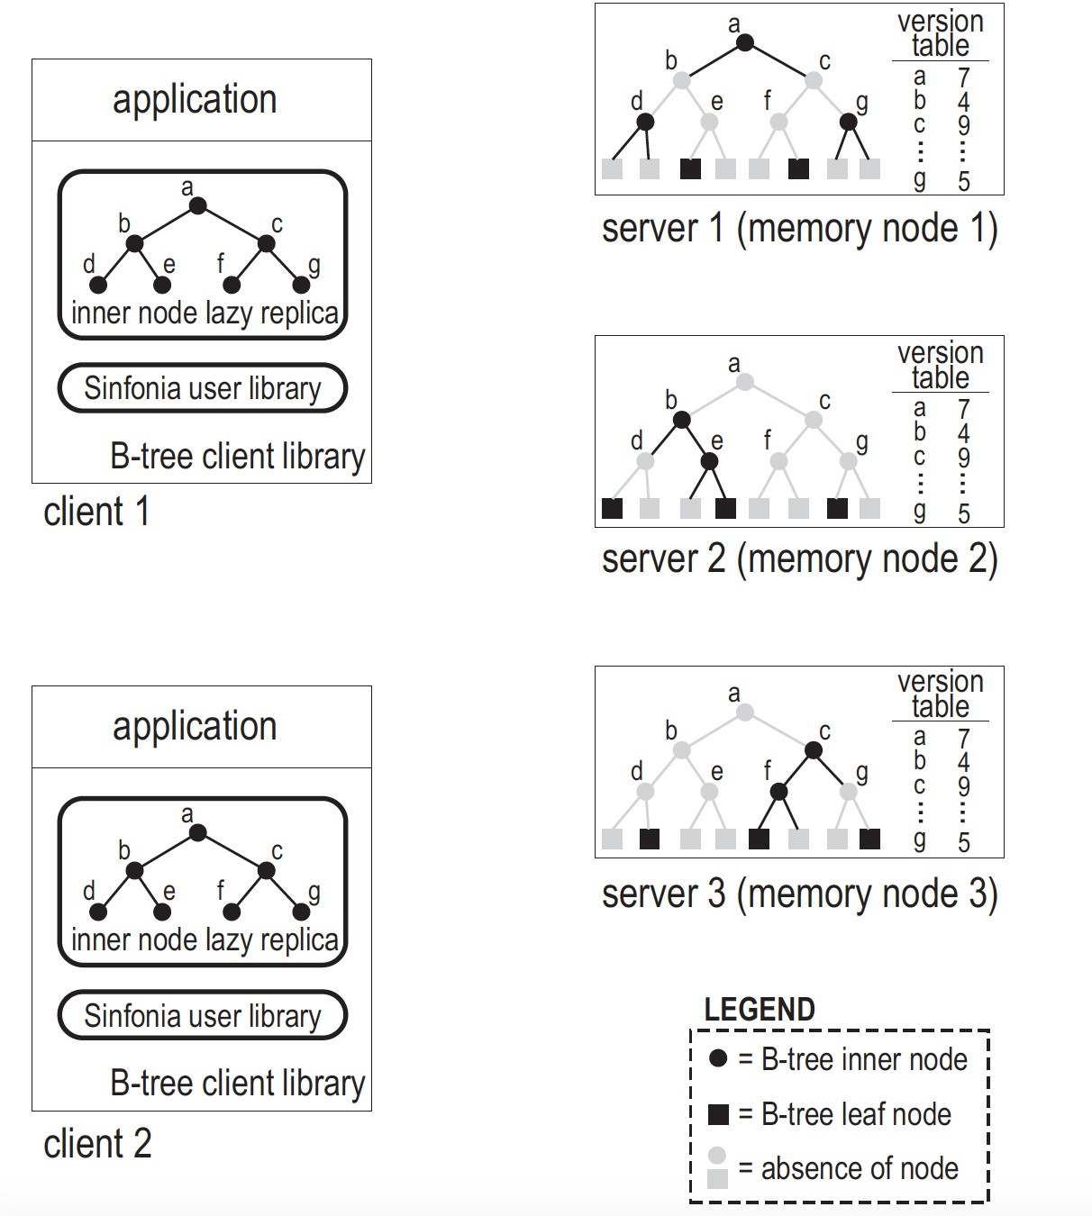
Schema

Slide 10
Design of the BTree
A distributed B-tree has its nodes spread over multiple servers
Each B-tree node is stored on a single server
Each server contains a number of inner and leaf nodes
Each server in the system stores version numbers of all inner nodes
Each client cache inner nodes of Btree and use this cache while executing a transaction
During a transaction, a client composes a set of Read and Write operations
At commit, a minitransaction is used to to perform Btree operations at servers
Comparisons are added by the BTree client library to guarantee data consistency

Slide 11
Btree Operation Efficiency
Optimistic Concurrency Control
Works well unless the B-tree is rapidly shrinking or growing
Lazy replication of objects at clients
Nodes that a particular client does not access may be stale or not present on the client
Eager replication of version numbers at servers
inner node versions can be checked at any server in the system

Slide 12
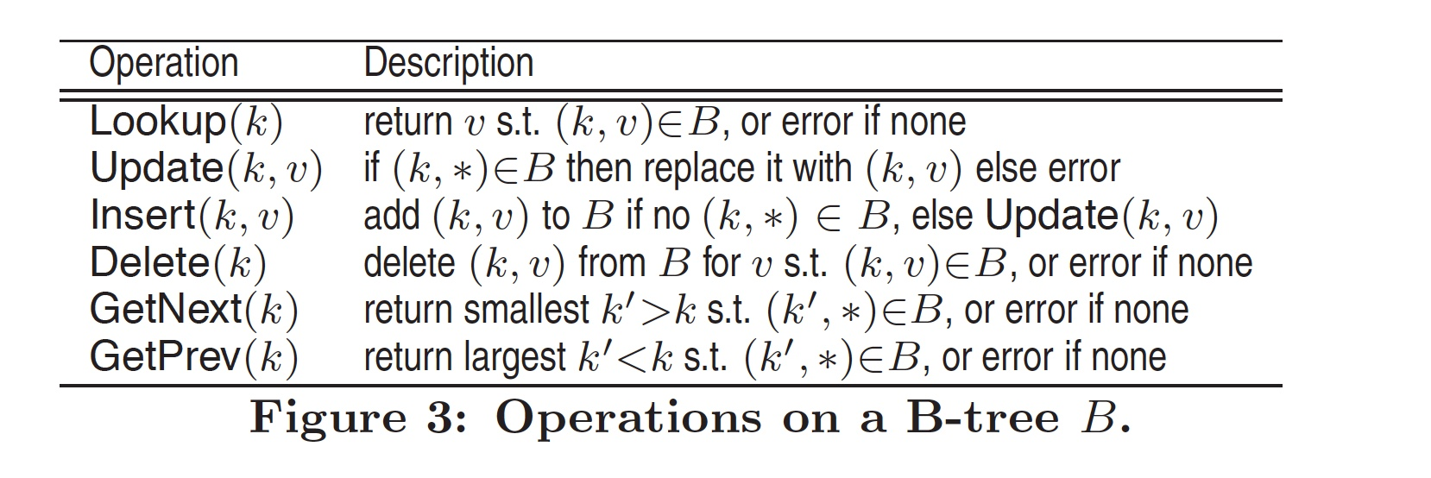
Standard Btree Operations

Slide 13
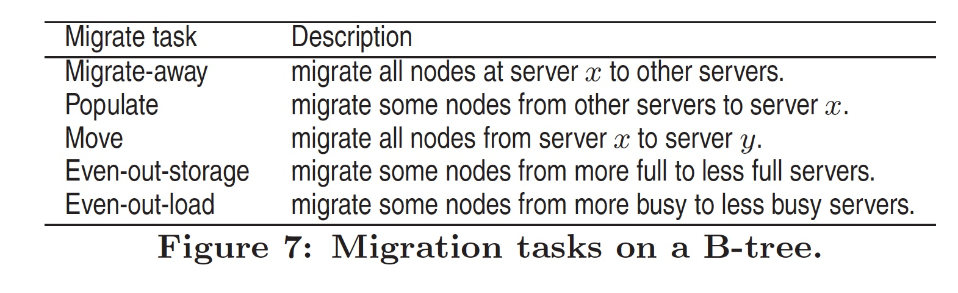
Migration Operations
Migrate(x, s) which migrates B-tree node x to server s
These operations are provided for higher level migrations:

Slide 14
Transaction Interface
In order to guarantee data consistency, each data manipulation on the B-tree has to be performed atomically, for example, renaming of a file in the cluster system or transferring an item and payment for the item between characters in the computer game
Transaction interface is provided to define all the necessary Read and Write operations within a transaction, while adding necessary comparisons to guarantee data consistency

Slide 15
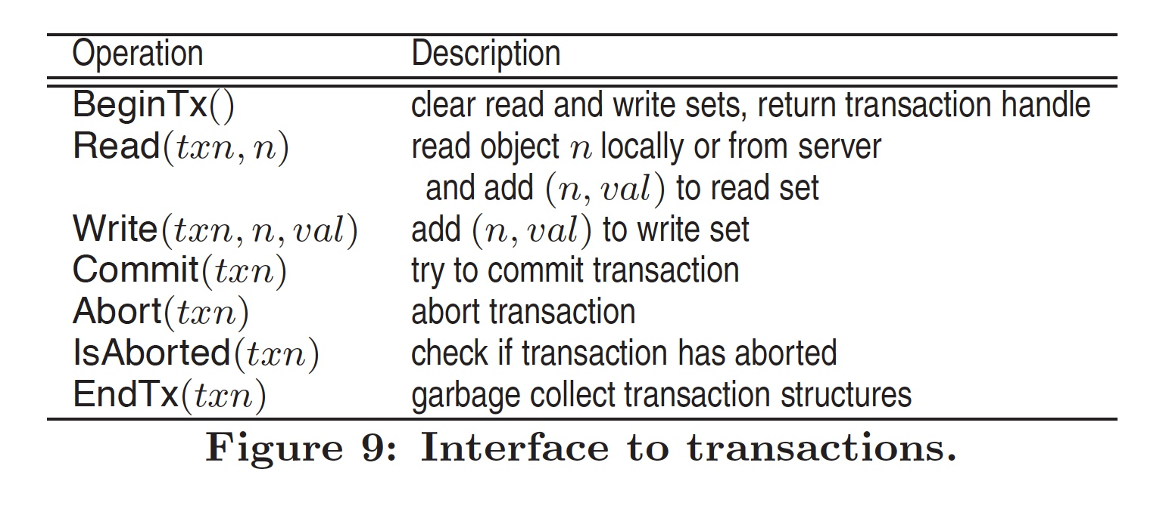
Transaction Interface

Slide 16
Extensions
Enhanced migration tasks
Dealing with hot-spots
Varying the replication factor of inner nodes
Finer-grained concurrency control to avoid false sharing

Slide 17
Background
Problem
Btree
Sinfonia
Distributed Btree Implementation
Assumptions
Design of the Btree
BTree Operations Efficiency
Migration
Transaction Interface
Extensions
Experimental Results
Experimental Setup
Workload
Scalability Experiments
Migration Experiments
Algorithm in Practice
Search
Insert

Slide 18
Results - Setup
10-byte keys
8-byte values
Leaf nodes hold 220 key-value pairs
Inner nodes hold 180 key-pointer pairs
Each pointer has 12 bytes
4 bytes specify a server
8 bytes specify an offset within the server

Slide 19
Results - Workloads
Insert: New keys are generated uniformly at random from a space of 10⁹ elements and inserted into the B-tree.
Lookup: The previously inserted keys are looked up, in the same random order in which they were inserted.
Update: The values for previously inserted keys are modified.
Mixed: This is a mixture of 60% lookups and 40% updates randomly interspersed, for randomly chosen keys that were previously inserted.
Before the insert workload, the B-tree was pre-populated with 40,000 elements rather than starting with an empty B-tree.

Slide 20
Results – Scalability Experiments
For the centralized system, we use the open-source B-tree of BerkeleyDB 4.5.
The graphs show the aggregate throughput as we increased the number of servers from 1 to 92.
For our distributed B-tree, we used the same number of clients as servers for each experiment, thus growing the workload as we increased the number of servers.
For the BerkeleyDB experiment, the x-axis indicates the number of clients, each with 4 threads issuing requests.

Slide 21
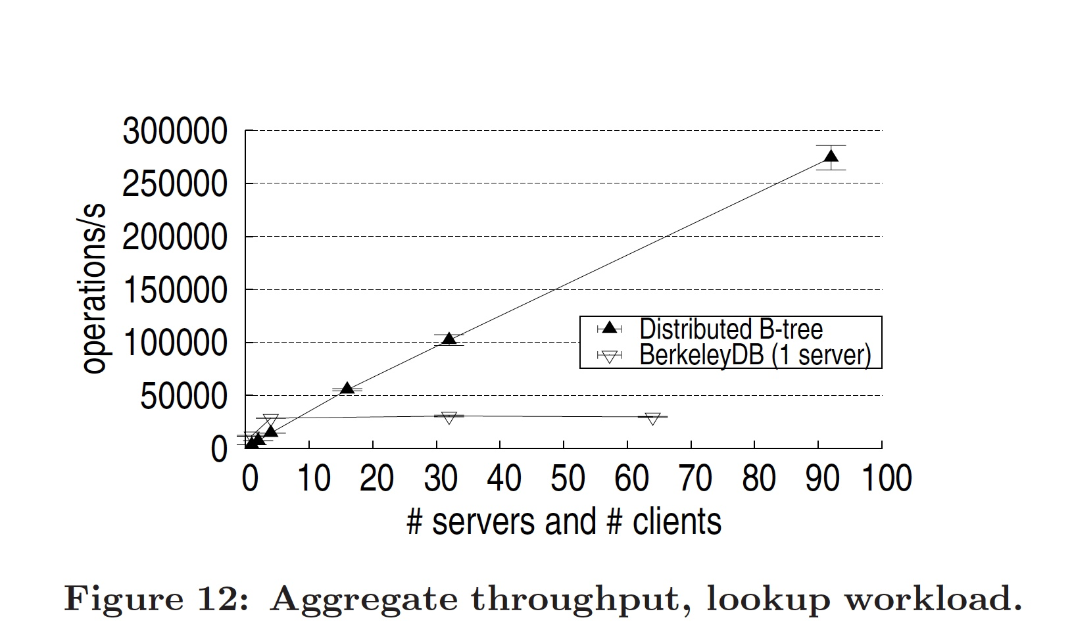
Results - Lookup

Slide 22
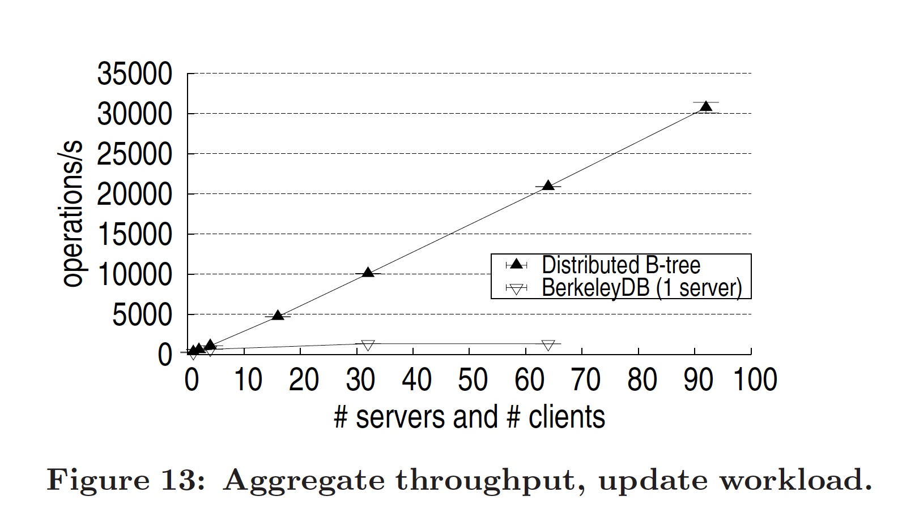
Results - Update

Slide 23
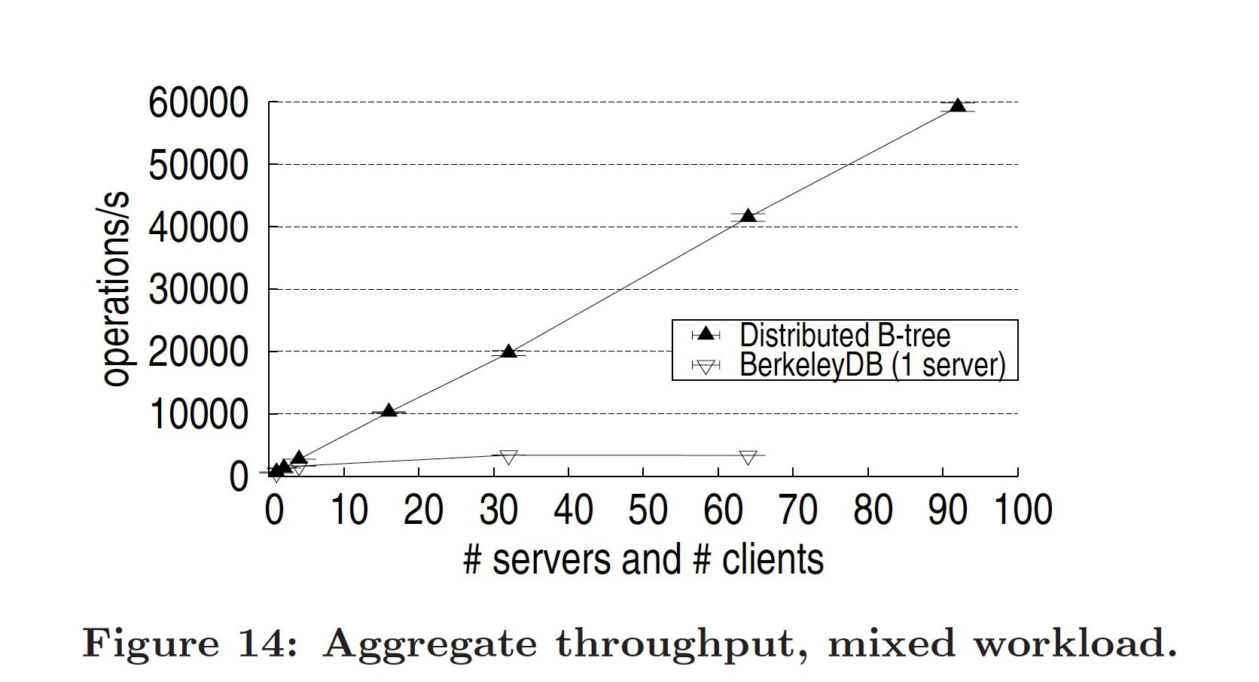
Results - Mixed

Slide 24
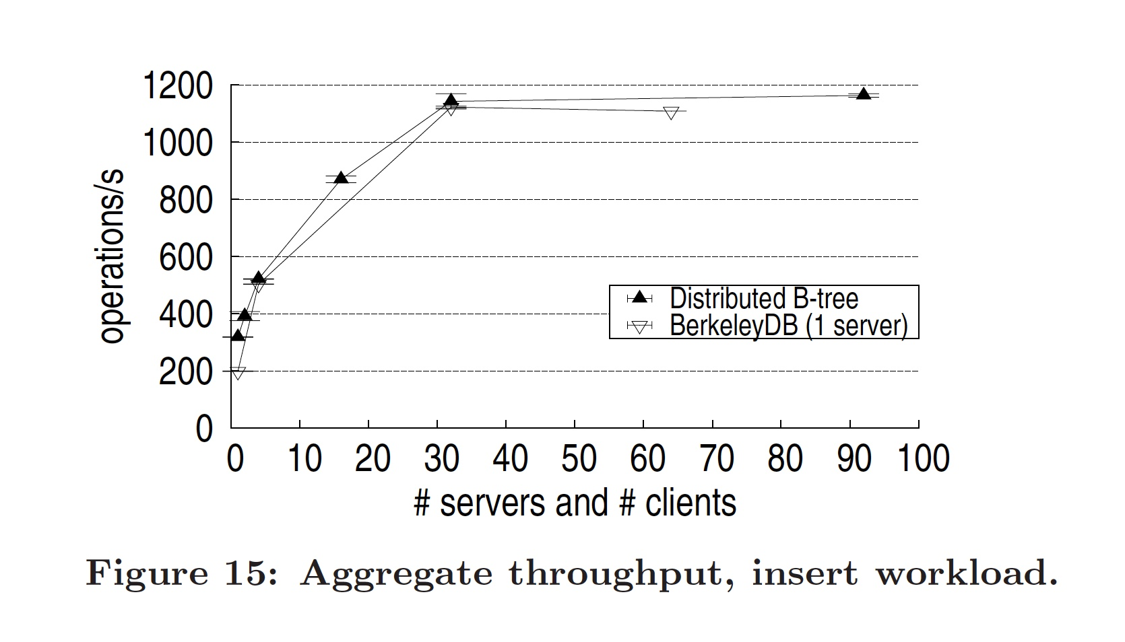
Results - Insert

Slide 25
Results - Migration
Migration was performed by a migration client separate from other clients.
The Figure shows aggregate throughput for a system with 16 clients and 16 servers, with and without migration running in the background.
We used the Move migration task which migrates all nodes from a given server to another server.
The rate of migration in a completely idle system was 55.3 ± 2.7 nodes/s (around 10000 key-value pairs/s) on an idle system and less than 5 nodes/s when executed with other tasks

Slide 26
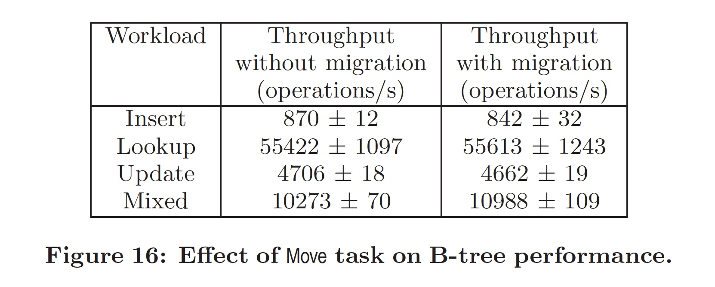
Results - Migration

Slide 27
Background
Problem
Btree
Sinfonia
Distributed Btree Implementation
Assumptions
Design of the Btree
BTree Operations Efficiency
Migration
Transaction Interface
Extensions
Experimental Results
Workload
Results
Algorithm in Practice
Search
Insert

Slide 28
Search– Cont.
Application
Sinfonia lib

Slide 29
Search– Cont.
Application
1
2
3
Sinfonia lib
Application
Sinfonia lib

Slide 30
Distributed Btree
S1
Version number
Application
a
a 2
a
b
b 3
b
c
… …
c
g 1
d
e
f
g
S2
Version number
Sinfonia lib
d
a 2
e
b 3
Application
… …
a
h
g 1
b
c
S3
Version number
d
e
f
g
f
a 2
Sinfonia lib
g
b 3
… …
i
g 1

Slide 31
Search

Slide 32
Search

Slide 33
Search

Slide 34
Search

Slide 35
Search

Slide 36
Search

Slide 37
Search

Slide 38
Search
S1
Version number
a
a 2
b
b 3
… …
c
g 1
S2
Version number
d
a 2
Read
e
b 3
… …
h
g 1
S3
Version number
f
…
a 2
g
b 3
… …
i
g 1

Slide 39
Search – Invalid Node
S1
Version number
a
a 2
b
b 3
… …
c
g 1
S2
Version number
d
a 2
Read
e
b 3
… …
h
g 1
S3
Version number
f
…
a 2
g
b 3
… …
i
g 1

Slide 40
Search – Invalid Node
S1
Version number
a
a 2
b
b 3
… …
c
g 1
S2
Version number
d
a 2
e
b 3
… …
h
g 1
S3
Version number
f
a 2
g
b 3
… …
i
g 1

Slide 41
Search – Invalid Node
S1
Version number
a
a 2
b
b 3
… …
c
g 1
S2
Version number
d
a 2
e
b 3
… …
h
g 1
S3
Version number
f
a 2
g
b 3
… …
i
g 1

Slide 42
Search – Invalid Node
S1
Version number
a
a 2
b
b 3
… …
c
g 1
S2
Version number
d
a 2
e
b 3
… …
h
g 1
S3
Version number
f
a 2
g
b 3
… …
i
g 1

Slide 43
Search – Invalid Node
S1
Version number
a
a 2
b
b 3
… …
c
g 1
S2
Version number
d
a 2
e
b 3
… …
h
g 1
S3
Version number
f
a 2
g
b 3
… …
i
g 1

Slide 44
Search – Invalid Node
S1
Version number
a
a 2
b
b 3
… …
c
g 1
S2
Version number
d
a 2
e
b 3
… …
h
g 1
S3
Version number
f
…
a 2
g
b 3
… …
i
g 1

Slide 45
Insert
S1
Version number
a
a 2
b
b 3
… …
c
g 1
S2
Version number
d
a 2
Read, Write
e
b 3
… …
h
g 1
S3
Version number
…
f
a 2
g
b 3
… …
i
g 1

Slide 46
Insert and Split
…
…
…
T/2
T/2
T > max

Slide 47
Insert and Split
…
…
…
T/2
T/2

Slide 48
Insert and Split
…
…
…
T/2
T/2

Slide 49
Insert and Split
…
…
…
T/2
T/2

Slide 50
Insert
Suppose after adding the new key, there are splits in node’s parents
…

Slide 51
Insert
S1
Version number
a
a 2
b
b 3
… …
c
g 1
S2
Version number
d
a 2
e
b 3
… …
h
g 1
S3
Version number
…
f
a 2
g
b 3
… …
i
g 1

Slide 52
Insert
S1
Version number
a
a 2
b
b 3
… …
c
g 1
S2
Version number
d
a 2
e
b 3
… …
h
g 1
S3
Version number
…
Version numbers are not valid!
f
a 2
g
b 3
… …
i
g 1

Slide 53
Insert
S1
Version number
a
a 2
b
b 3
… …
c
g 1
S2
Version number
d
a 2
e
b 3
… …
h
g 1
S3
Version number
f
a 2
g
b 3
… …
i
g 1

Slide 54
Insert
S1
Version number
a
a 2
b
b 3
Read
… …
c
g 1
S2
Version number
d
a 2
e
b 3
New version of the nodes
… …
h
g 1
S3
Version number
f
a 2
g
b 3
… …
i
g 1

Slide 55
Insert
S1
Version number
a
a 2
b
b 3
Read
… …
c
g 1
S2
Version number
d
a 2
e
b 3
New version of the nodes
… …
h
g 1
S3
Version number
f
Do the Insertion again!
a 2
g
b 3
… …
i
g 1

Slide 56
Insert
“Replicas are updated lazily: when a transaction aborts because it used out-of-date objects, the client discards any local copies of such objects, and fetches fresh copies the next time the objects are accessed. The use of lazy replicas may cause a transaction to abort even without any overlap with other transactions, in case a replica is out-of-date when the transaction begins. We did not find this to be a problem for B-trees since the objects we replicate lazily (e.g., inner nodes of the B-tree) change relatively rarely.”

Slide 57
Delete
…
T > min

Slide 58
Delete
…
…
…
T/2
T/2
T

