Slide 1
Python Packaging
Managing packages and sharing code

Slide 2
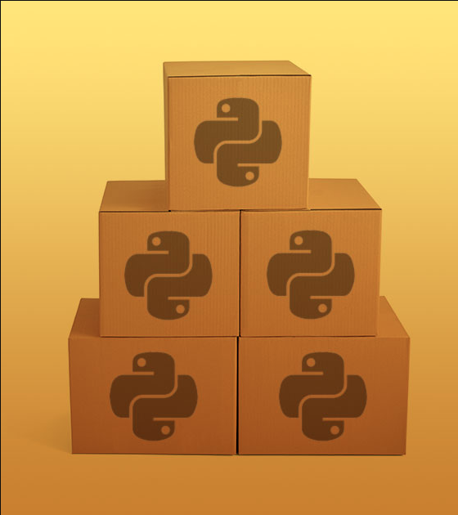
Agenda
Way
History
What is a package?
Doing!

Slide 3
Why package management?

Slide 4
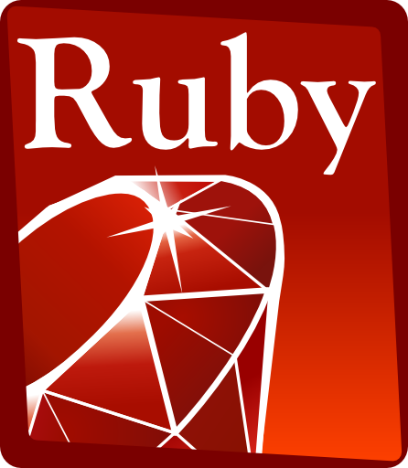

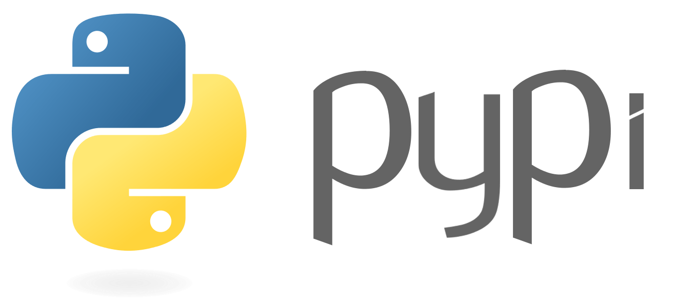
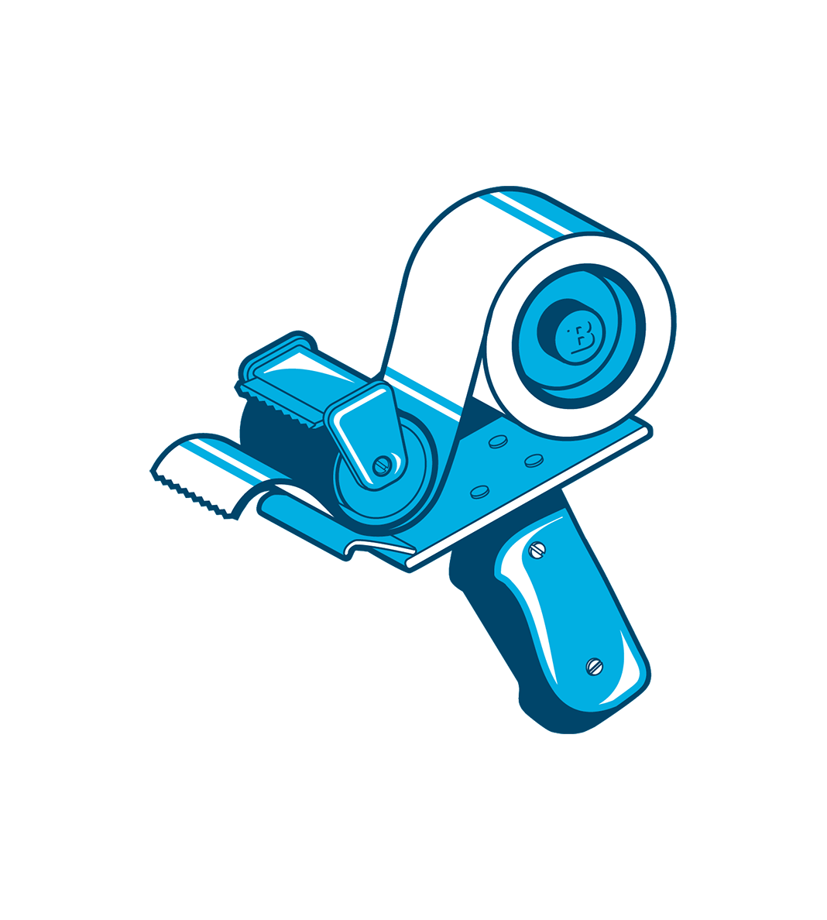

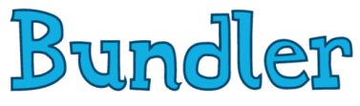
Why?

Slide 5
Why?
Share code (temas, projects, community)
Define a version of each package for all requirements.
Works to operating system constraints.
Ensures a perfectly replicable dependency tree
Notes:
1- Version > 1.0.0 < 2.0.3
2- Windows path name restrictions, EOF

Slide 6
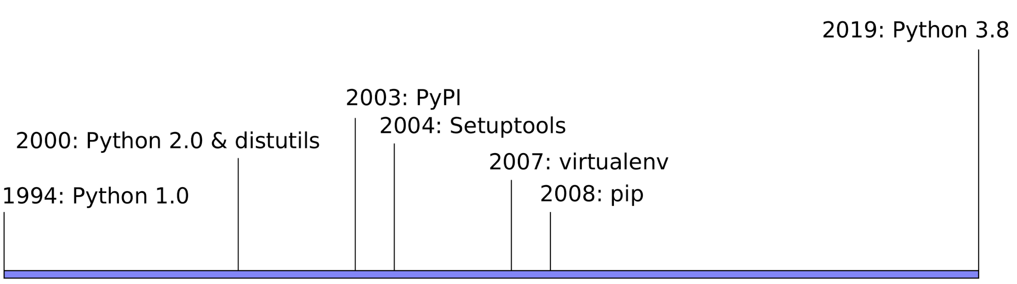
History
Notes:
1- Version > 1.0.0 < 2.0.3
2- Windows path name restrictions, EOF

Slide 7
History
● distutils no dependency management problems between cross-platforms no consistent way to reproduce an installation not all metadata was handled
● setuptools: built on top of distutils
introduces easy_install
no way to uninstall installed packages
provides dependencies management
introduced eggs (similar to zip files)
● distribute: fork of setuptools
fork of setuptools
● distutils2 (discontinued?)
standard versioning (major.minor.micro) setup.cfg: pulls metadata from setup.py file, without needing to run setup.py which operating system requires which dependency
Notes:
distutils is the original build and distribution system first added to the Python standard library in 1998. While direct use of distutils is being phased out, it still laid the foundation for the current packaging and distribution infrastructure, and it not only remains part of the standard library, but its name lives on in other ways (such as the name of the mailing list used to coordinate Python packaging standards development).
setuptools is a (largely) drop-in replacement for distutils first published in 2004. Its most notable addition over the unmodified distutils tools was the ability to declare dependencies on other packages. It is currently recommended as a more regularly updated alternative to distutils that offers consistent support for more recent packaging standards across a wide range of Python versions.
wheel (in this context) is a project that adds the bdist_wheel command to distutils/setuptools. This produces a cross platform binary packaging format (called “wheels” or “wheel files” and defined in PEP 427) that allows Python libraries, even those including binary extensions, to be installed on a system without needing to be built locally.

Slide 8
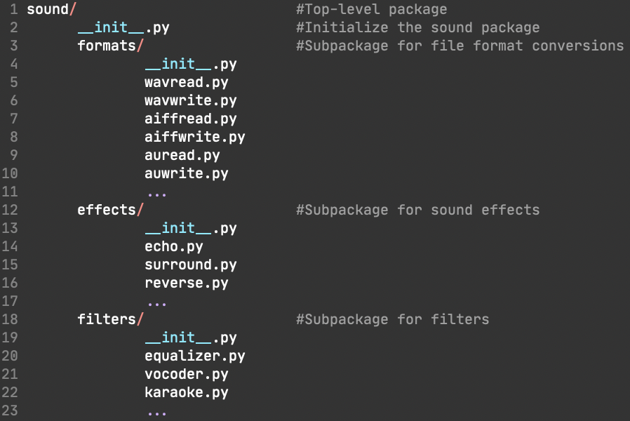
What is python package?
Packages are a way of structuring Python’s module namespace by using “dotted module names”.
Notes:
When importing the package, Python searches through the directories on sys.path looking for the package subdirectory.
The __init__.py files are required to make Python treat directories containing the file as packages. (avoid nameclassh - string)
If __all__ is not defined, the statement from sound.effects import * does not import all submodules from the package.

Slide 9
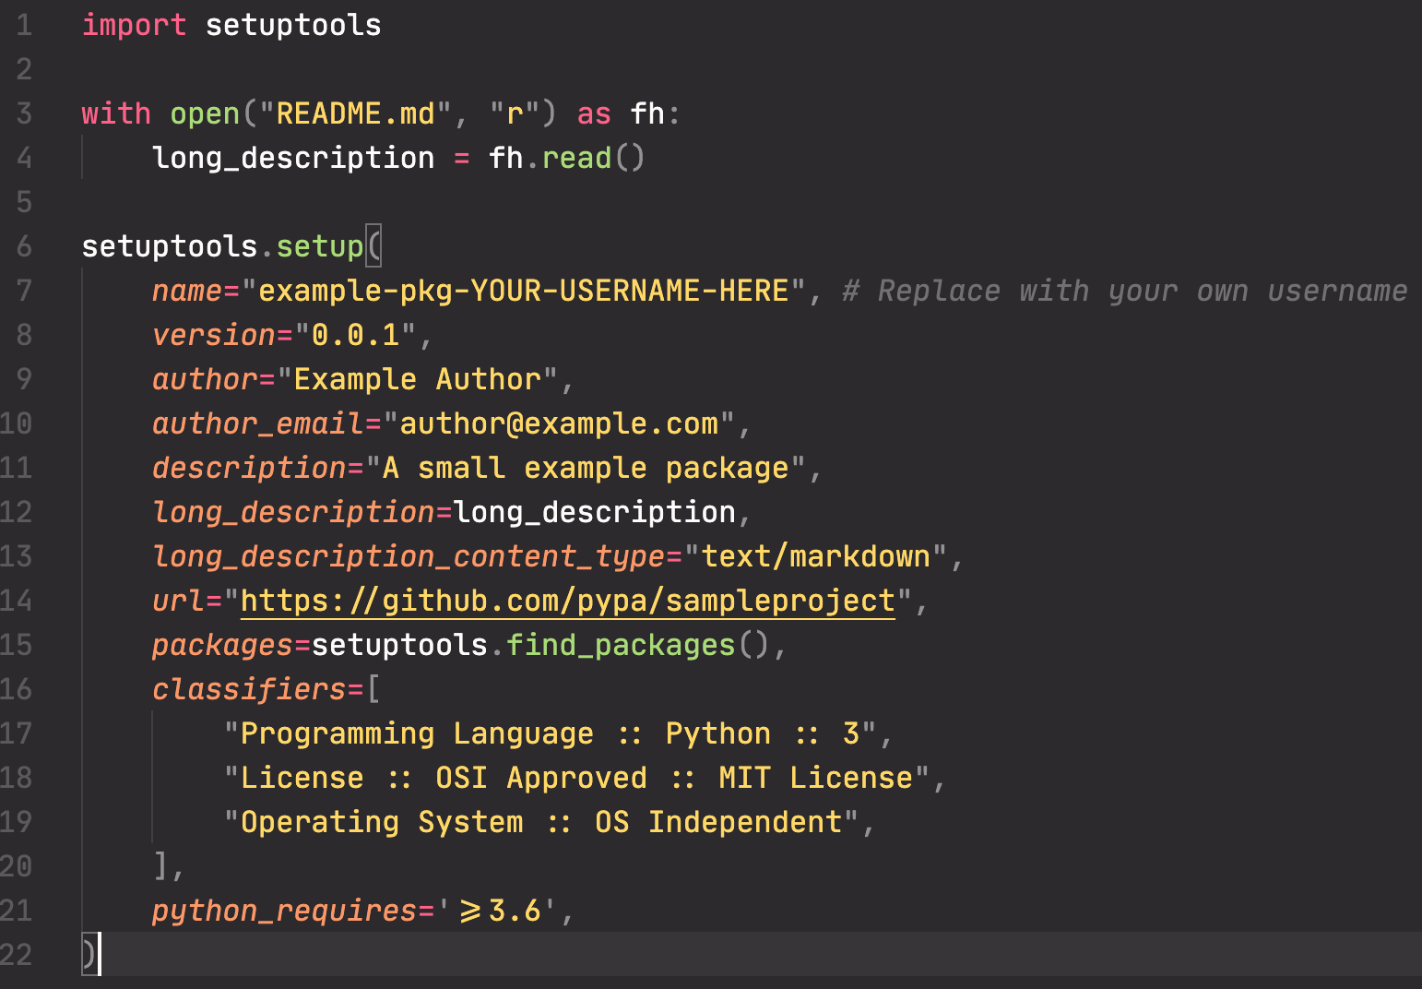
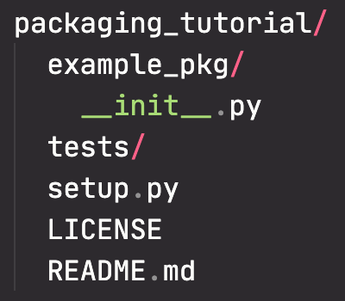
PyPi & Setuptools

Slide 10
PyPi & Setuptools
#install wheel and setuptools
python -m pip install --user --upgrade setuptools wheel
#generate the dist
python setup.py sdist bdist_wheel
#out
dist/
example_pkg_YOUR_USERNAME_HERE-0.0.1-py3-none-any.whl
example_pkg_YOUR_USERNAME_HERE-0.0.1.tar.gz
Notes:
The tar.gz file is a source archive whereas the .whl file is a built distribution.

Slide 11
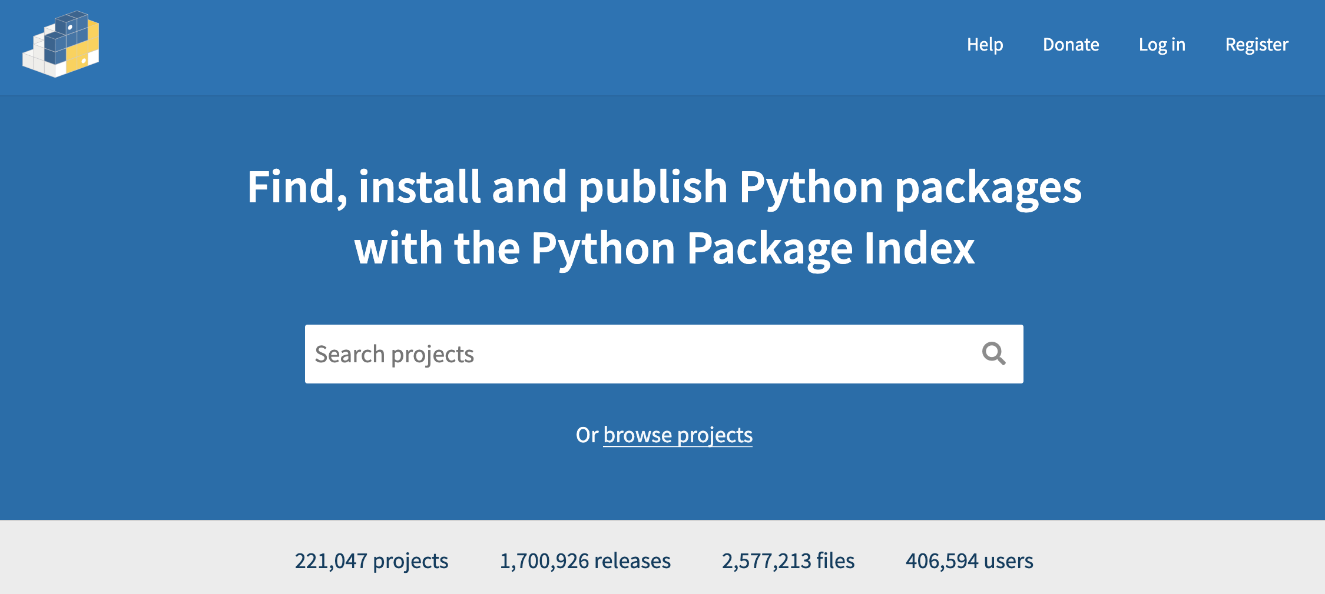
PyPi & Setuptools
#install twine
python -m pip install --user --upgrade twine
#upload to PyPi
python -m twine upload dist/*
Notes:
The tar.gz file is a source archive whereas the .whl file is a built distribution.

Slide 12
PyPi & Setuptools
Choose a memorable and unique name for your package.
Register an account on https://pypi.org
Use twine upload dist/* to upload your package and enter your credentials for the account you registered on the real PyPI.
Install your package from the real PyPI using pip install [your-package].
Notes:
The tar.gz file is a source archive whereas the .whl file is a built distribution.

Slide 13
Thanks!

