Slide 1
RNA-Seq study of mRNA metabolism in operons : role of BIME in Escherichia coli.

Slide 2

REP features
Repeated Extragenic Palindrome.
1
Notes:
20 - 40 nucleotides.
Stem-loop secondary structure with a bulge.
3 classes : Y, Z¹ and Z²
Numerous bacterial genomes, ≈ 1% for E. coli.

Slide 3
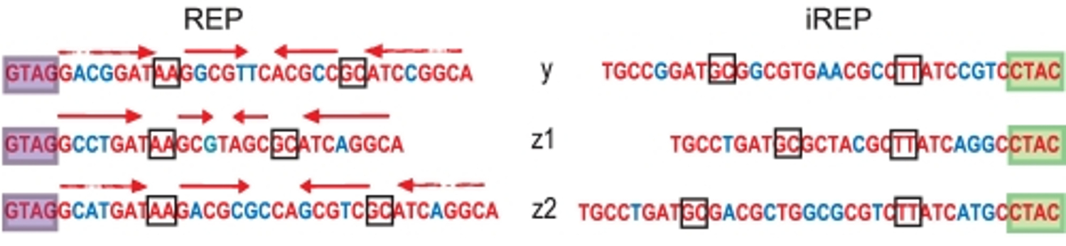
REP features
Repeated Extragenic Palindrome.
Ton-Hoang et al. 2012
1
Notes:
20 - 40 nucleotides.
Stem-loop secondary structure with a bulge.
3 classes : Y, Z¹ and Z²
Numerous bacterial genomes, ≈ 1% for E. coli.

Slide 4
REP features
Repeated Extragenic Palindrome.
BIME set-up
Ton-Hoang et al. 2012
1

Slide 5
BIME features
Bacterial Interspesed Mosaic Element.
3 classes depending on REP composition :
Bime-1, Bime-2, atypical
2

Slide 6
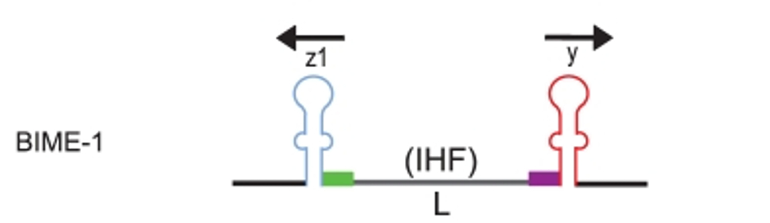
BIME features
Bacterial Interspesed Mosaic Element.
3 classes depending on REP composition :
Bime-1, Bime-2, atypical
Ton-Hoang et al. 2012
2

Slide 7
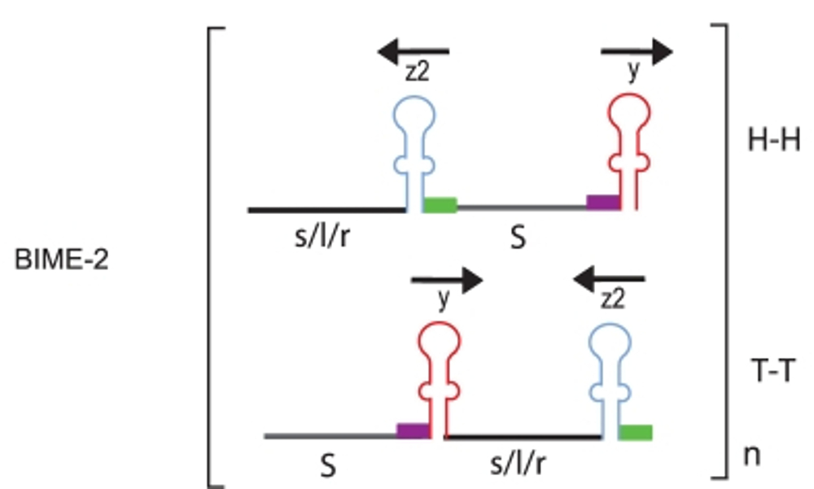
BIME features
Bacterial Interspesed Mosaic Element.
3 classes depending on REP composition :
Bime-1, Bime-2, atypical
Ton-Hoang et al. 2012
2

Slide 8
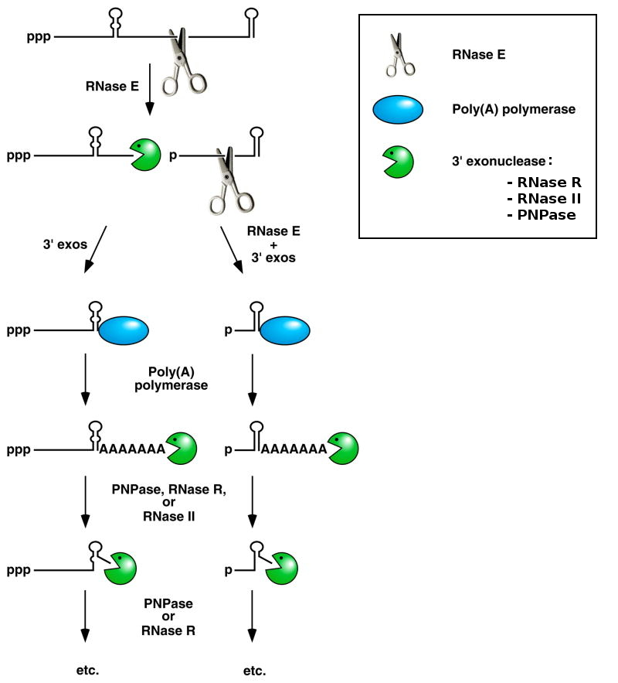
mRNA degradosome
Belasco 2010
3

Slide 9

Operons & BIME
Transcriptional Unit :
  Promotor
  1 or more genes
  Transcription terminator
4

Slide 10
Operons & BIME
Transcriptional Unit :
  Promotor
  1 or more genes
  Transcription terminator
E. coli K12 MG1655 genome :
  4605 genes
  848 operons > 1 gene
  36 operons with BIME
  39 BIME in operons
4

Slide 11
malEFG operon
malE
malF
malG
5

Slide 12
malEFG operon
malE
malF
malG
5

Slide 13
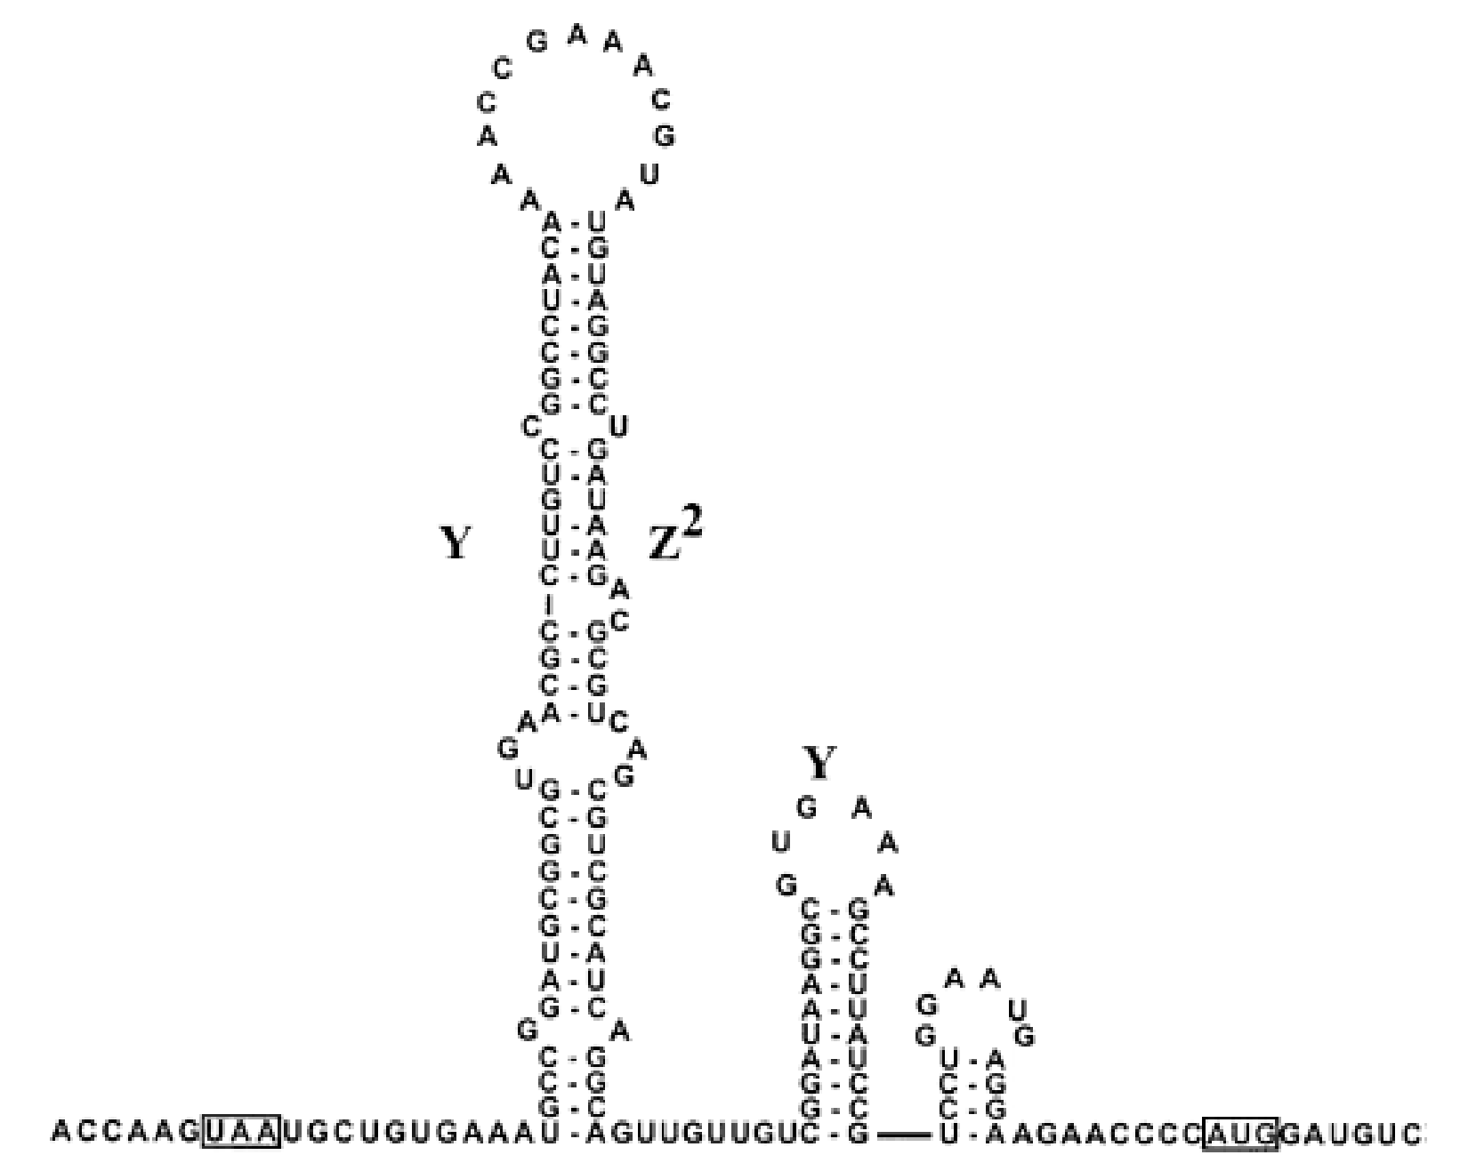
malEFG operon
malE
malF
malG
Khemici and Carpousis 2004
Y
Z²
Y
malE
malF
5'
stop
start
3'
5

Slide 14
Objectives
Does BIME are involved in the mRNA metabolism in operons for E. coli genome :
as transcription terminator ?
as stabiliser of 5' end of transcript ?
6

Slide 15
RNA-Seq data & normalisation
RNA-Seq →snapshot of transcription & degradation
7

Slide 16


RNA-Seq data & normalisation
RNA-Seq →snapshot of transcription & degradation
Keep in mind :
Not looking for gene DE in different conditions
7

Slide 17
RNA-Seq data & normalisation
RNA-Seq →snapshot of transcription & degradation
Detect Differential Expression (DE) between genes flanking a BIME in an operon.
Keep in mind :
Not looking for gene DE in different conditions
7

Slide 18
RNA-Seq data & normalisation
RNA-Seq →snapshot of transcription & degradation
Detect Differential Expression (DE) between genes flanking a BIME in an operon.
RPKM normalisation
Keep in mind :
Not looking for gene DE in different conditions
7

Slide 19
RNA-Seq data & normalisation
RNA-Seq →snapshot of transcription & degradation
Detect Differential Expression (DE) between genes flanking a BIME in an operon.
RPKM normalisation
Normalised count table (genes expression > 10)
Keep in mind :
Not looking for gene DE in different conditions
7

Slide 20
Analysis pipeline
Normalised
count table
Genes in operons
Global BIME effect
in operons
Genes DE
8

Slide 21
Global BIME effect in operons
gene 1
gene 2
-1
0
1
I_{expr}
9

Slide 22
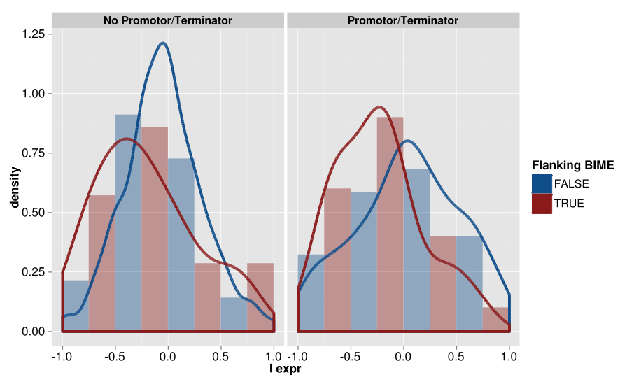
Global BIME effect in operons
Distributions of Iexpr w/o promotors and terminators
p-value :
0.094
p-value :
0.011
10

Slide 23
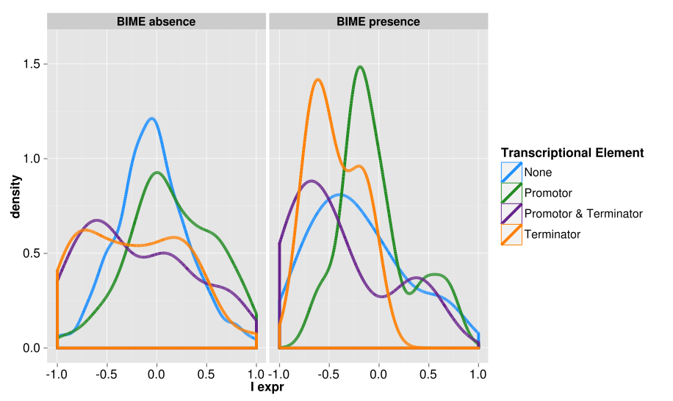
Global BIME effect in operons
Distributions of Iexpr depending on Transcriptional Elements
11

Slide 24
Analysis pipeline
Normalised
count table
Genes in operons
Global BIME effect
in operons
Genes in operons
flanking BIME
DE between
genes
Genes DE
12

Slide 25
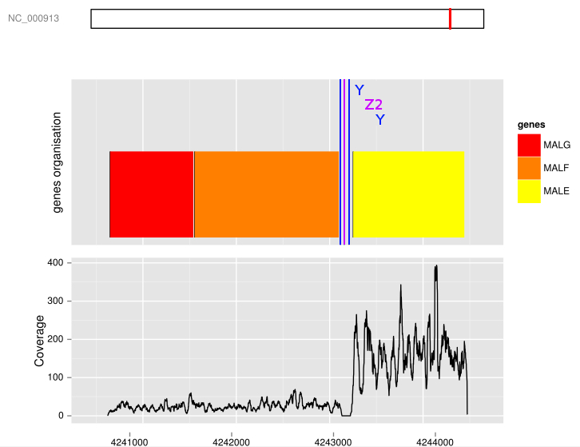
BIME impact on genes pairs
Wilcoxon rank test for DE (p-value threshold : 0.01)
malEFG operon coverage
13

Slide 26
Analysis pipeline
Normalised
count table
Genes in operons
Global BIME effect
in operons
Genes in operons
flanking BIME
DE between
genes
Local approach :
Expression profile
correlation
Global approach :
Segmentation
Genes DE
Break-points search
14

Slide 27
Coverage break-points search
Region of interest :
gene 1
gene 2
15

Slide 28
Coverage break-points search
Region of interest :
gene 1
gene 2
15

Slide 29

Coverage break-points search
Region of interest :
Breakpoints on BIME :
  Wilcoxon rank test for DE (p-value threshold : 0.01)
  2 methods :
    Correlation of expression profiles (Local approach)
    Segmentation (Global approach)
gene 1
gene 2
15

Slide 30
Local approach
Expression profile correlation
Window size : 300 bp
2 fold change of expression
Correlation > 0.5 & p-value threshold < 10⁻⁷
16

Slide 31
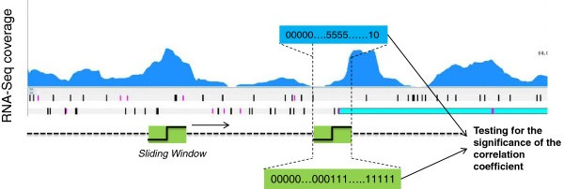
Local approach
Expression profile correlation
Window size : 300 bp
2 fold change of expression
Correlation > 0.5 & p-value threshold < 10⁻⁷
Fortino et al. 2014
16

Slide 32
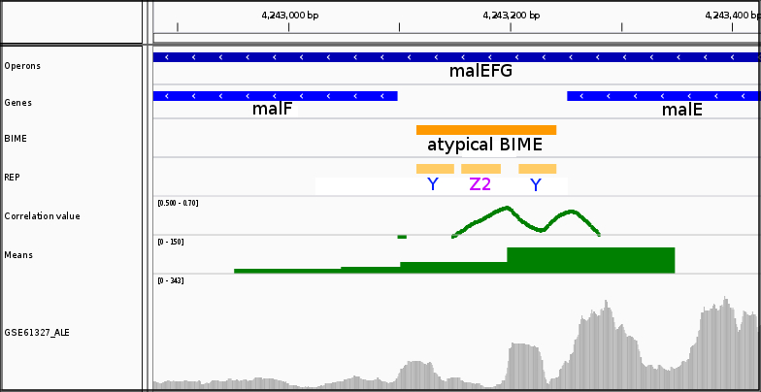
Local approach
Expression profile correlation on malE-malF BIME
17

Slide 33
Local approach
Expression profile correlation on malE-malF BIME
17

Slide 34
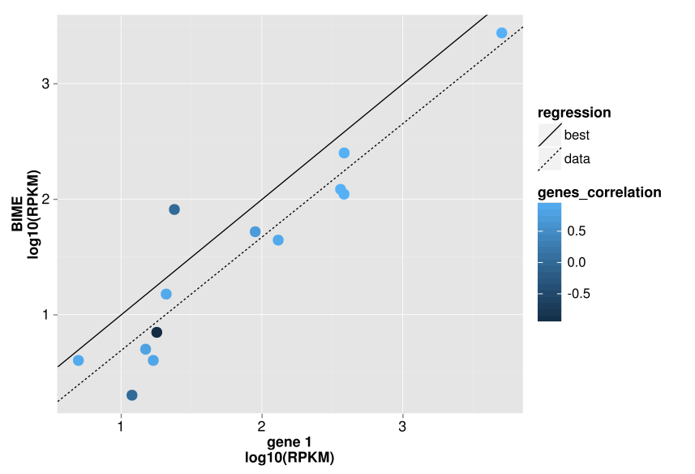
REP sequencing bias
No DE in operons, no promotors or terminators
18

Slide 35
Global approach
Segmentation
No profile
Poisson model → segments partitions of whole region
Cost function for each partition
Minimisation of cost function for set of partitions (PDP)
K = 4 segments
19

Slide 36
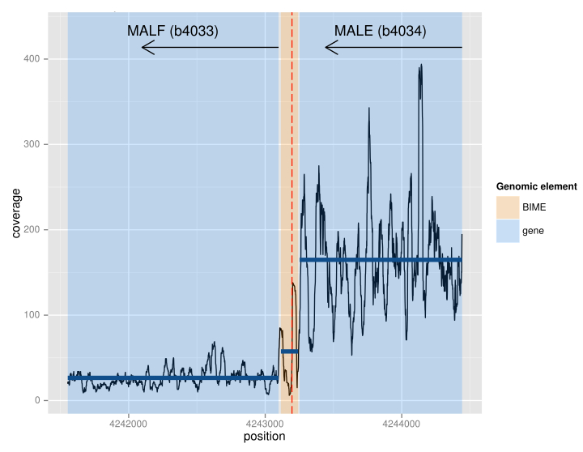
Global approach
Segmentation on malE-malF BIME
20

Slide 37
Analysis pipeline
Normalised
count table
Genes in operons
Global BIME effect
in operons
Genes in operons
flanking BIME
DE between
genes
Local approach :
Expression profile
correlation
Global approach :
Segmentation
Shared detection
Genes DE
Break-points search
Ancestral BIME
sequences and
secondary structures
Evolution
21

Slide 38
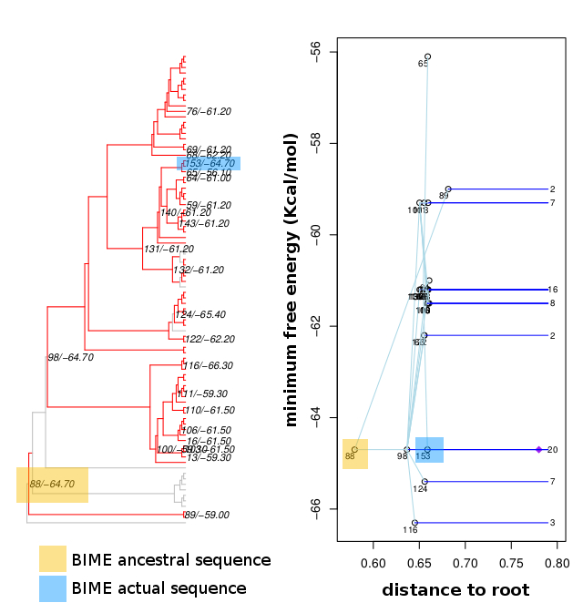
Ancestral sequences and secondary structures
malE-malF BIME 2nd structure energy evolution
22

Slide 39
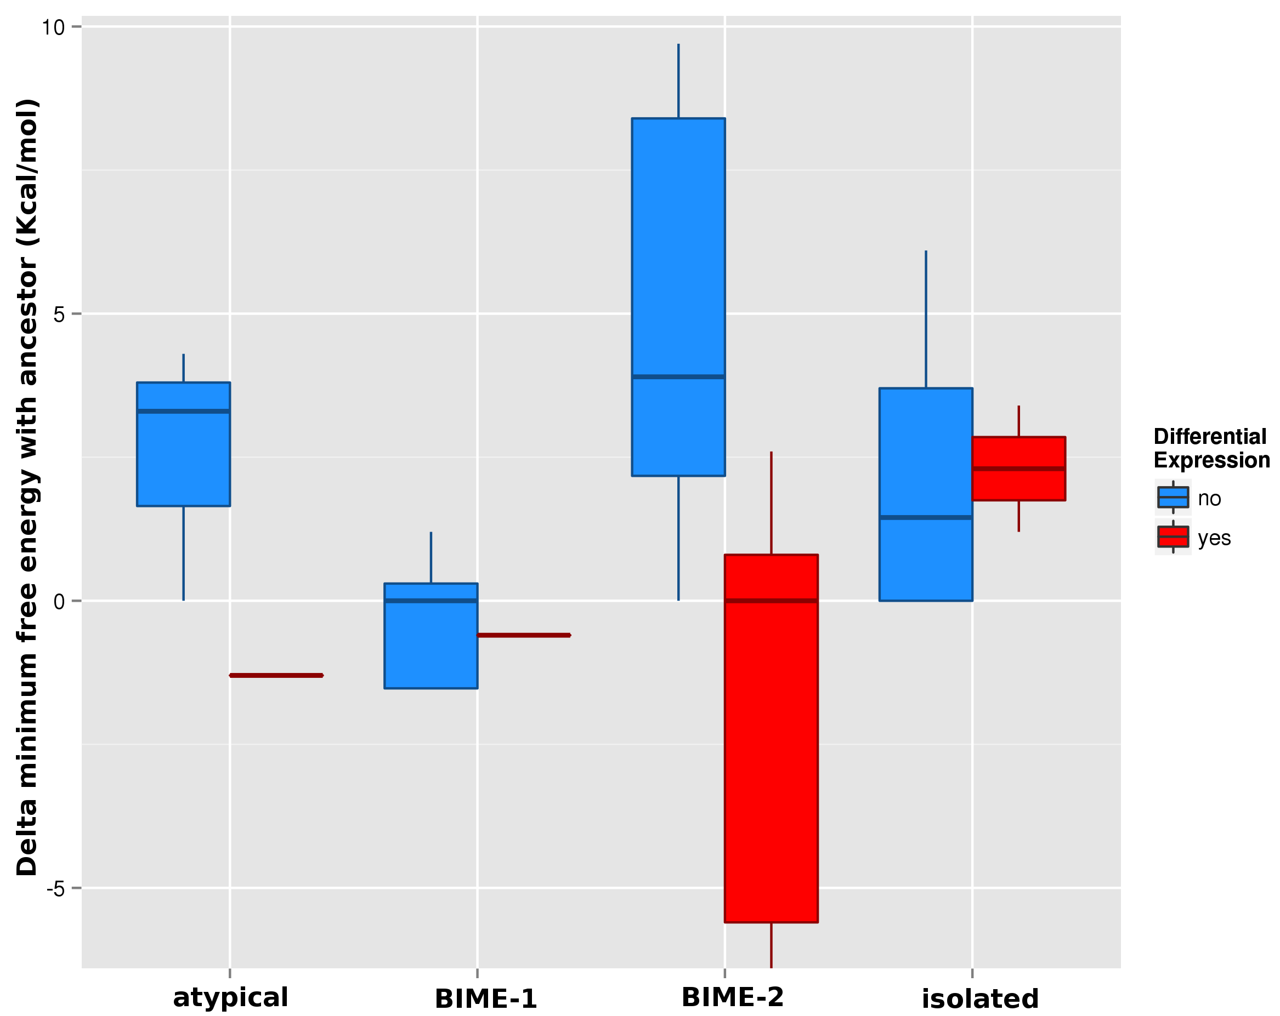
Ancestral sequences and secondary structures
Delta of energy between ancestor & actual BIME
23

Slide 40
Question
Does BIME are involved in the mRNA metabolism in operons for E. coli genome :
as transcription terminator ?
as stabiliser of 5' end of transcript ?
24

Slide 41
Conclusions
25 DE for BIME flanking genes
21 breakpoints detections (Local or Global approach)
25

Slide 42
Conclusions
25 DE for BIME flanking genes
21 breakpoints detections (Local or Global approach)
 | Terminator overlaping a BIME | Terminator not overlaping a BIME | No terminator
In operons | 9/39 | 5/39 | 25/39
Data results : Break-point on BIME | 4/21 | 4/21 | 15/21
25

Slide 43
Conclusions
25 DE for BIME flanking genes
21 breakpoints detections (Local or Global approach)
 | Terminator overlaping a BIME | Terminator not overlaping a BIME | No terminator
In operons | 9/39 | 5/39 | 25/39
Data results : Break-point on BIME | 4/21 | 4/21 | 15/21
25

Slide 44
Conclusions
25 DE for BIME flanking genes
21 breakpoints detections (Local or Global approach)
BIME effect on the upstream gene
Which function ?
 | Terminator overlaping a BIME | Terminator not overlaping a BIME | No terminator
In operons | 9/39 | 5/39 | 25/39
Data results : Break-point on BIME | 4/21 | 4/21 | 15/21
25

Slide 45
Perspectives
RNA-Seq experiments designs
Test transcription termination function :
  WT & alteration of degradosome genes
  Upstream genes still DE →Termination function
26

Slide 46
Perspectives
RNA-Seq experiments designs
Test transcription termination function :
  WT & alteration of degradosome genes
  Upstream genes still DE →Termination function
Test transcript 5' end stabiliser function :
  Transcription blocking
  Time sampling for monitoring of the transcripts degradation
26

Slide 47



Acknowledgments
LMGM : Genomics of integrated systems
Gwennaele Fichant
Yves Quentin
Roland Barriot
Petra Langendijk-Genevaux
Mathias Weyder
Arnaud Frèche
INRA : Applied Mathematics and Informatics
Christine Gaspin

