Slide 1
REP involved in
transcription regulation?

Slide 2
REP features
Repeated Extragenic Palindrome.
20 - 40 nucleotides.
3 classes depending on length and secondary structure : Y, Z¹ and Z².

Slide 3
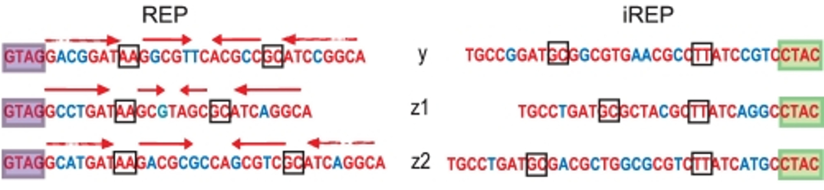
REP features
Repeated Extragenic Palindrome.
20 - 40 nucleotides.
3 classes depending on length and secondary structure : Y, Z¹ and Z².

Slide 4
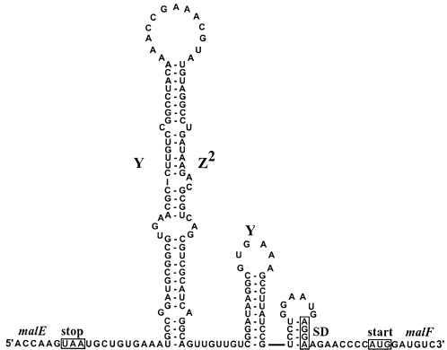
REP features
Repeated Extragenic Palindrome.
20 - 40 nucleotides.
3 classes depending on length and secondary structure : Y, Z¹ and Z².
Stem-loop secondary structure with a bulge.

Slide 5
REP features
Repeated Extragenic Palindrome.
20 - 40 nucleotides.
3 classes depending on length and secondary structure : Y, Z¹ and Z².
Stem-loop secondary structure with a bulge.
Numerous bacterial genomes, ≈ 1% for E. coli.
BIME organization.

Slide 6
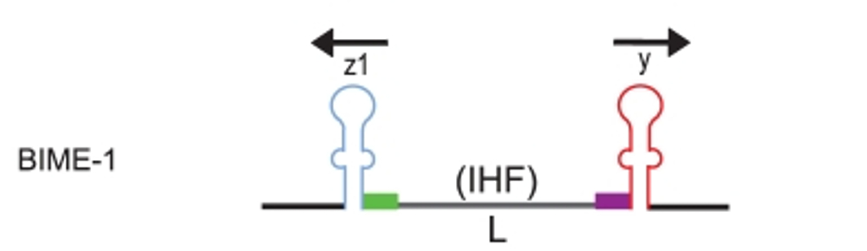
BIME features
Bacterial Interspesed Mosaic Element.
3 classes depending on REP composition :
Bime-1, Bime-2, atypical.

Slide 7
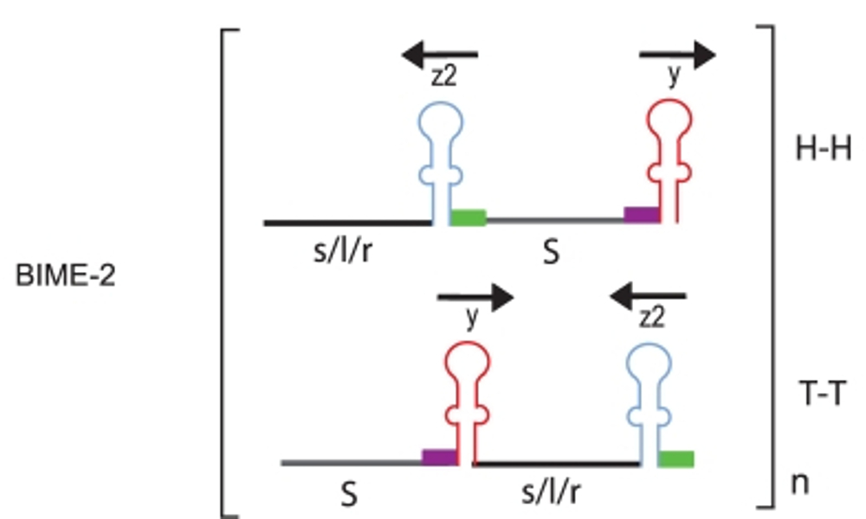
BIME features
Bacterial Interspesed Mosaic Element.
3 classes depending on REP composition :
Bime-1, Bime-2, atypical.

Slide 8
Objectives
Does REP are involved in the transcription regulation in E. coli genome :
as protection from RNA degradosome ?
as transcription terminator ?
as recognition site for proteic factors ?

Slide 9
Data choice
Escherichia coli K-12 MG1655 on Glucose Minimal Medium (LaCroix et al. 2014).
Why ?
  RNA-Seq experiment.
  Large number of replicates :
    9 for Glucose minimal medium (ALE)
    2 for the wild type (WT)
  Paired-end and specific strand library preparation.
Quality control with fastqc.

Slide 10
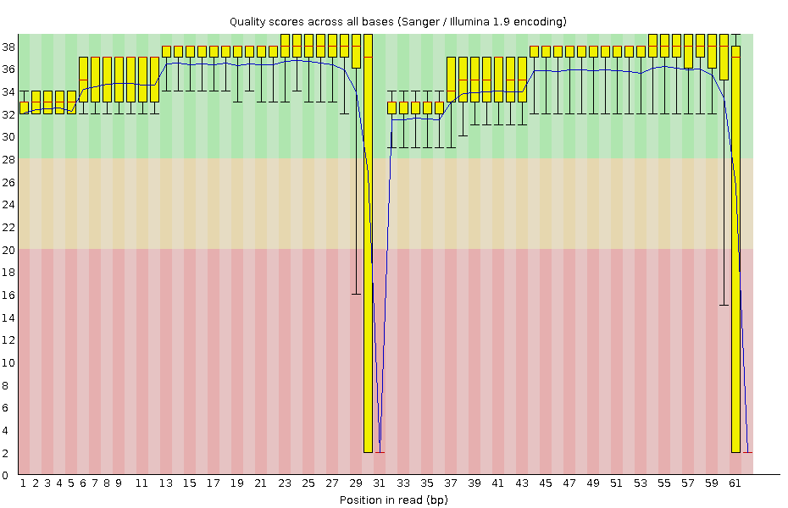
Data choice
Measure | Value
Total sequences | 7 772 244
Sequences flagged as poor quality | 0
Sequence length | 62
% GC | 53

Slide 11
Data choice
Escherichia coli K-12 MG1655 on Glucose Minimal Medium (LaCroix et al. 2014).
Why ?
  RNA-Seq experiment.
  Large number of replicates :
    9 for Glucose minimal medium (ALE)
    2 for the wild type (WT)
  Paired-end and specific strand library preparation.
Quality control with fastqc.
1 ALE sample rejected.

Slide 12
Alignments
Alignment on NC_000913.2 E.coli genome (BWA) :
  Index of the reference genome
  Alignment (SAM file)

Slide 13
Alignments
Alignment on NC_000913.2 E.coli genome (BWA) :
  Index of the reference genome
  Alignment (SAM file)
Post-alignment process (Samtools) :
  Convert to binaries (BAM file)
  Sort the reads by genomic position
  Remove PCR duplicates
  Merge files
  Index alignment merged file

Slide 14
Genomic informations
From GFF, laboratory database, RegulonDB and DOOR design of reference files (Bedtools, Python scripts)
  Operons
  REP in operons
  Genes surrounding REP in operon
  Terminators...

Slide 15
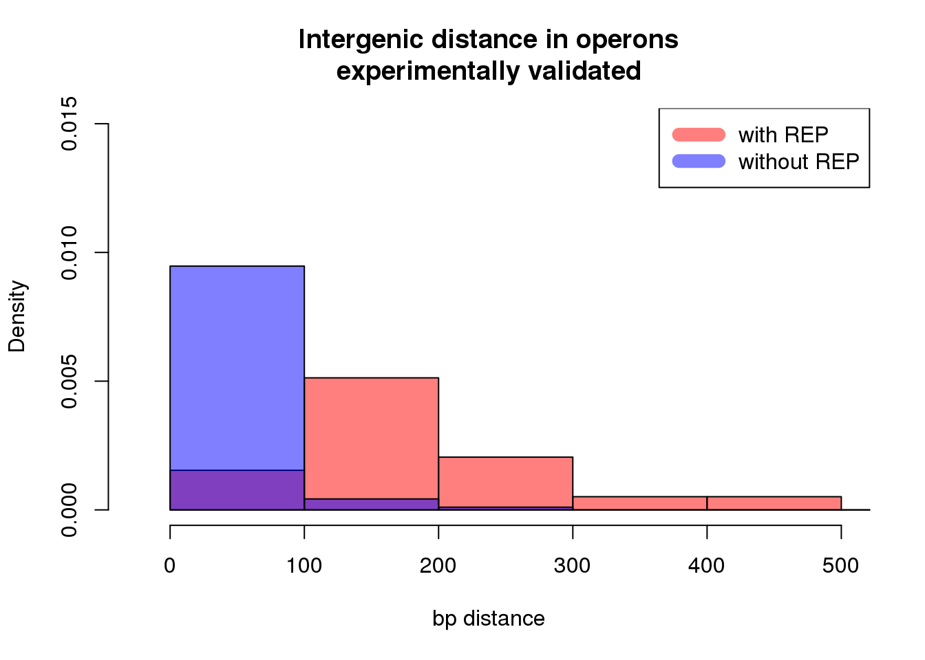
Genomic informations
For operons from RegulonDB :

Slide 16
Differential expression in operon with REP
Detect Differential Expression (DE) between genes surrounding a REP in an operon.

Slide 17

Differential expression in operon with REP
Detect Differential Expression (DE) between genes surrounding a REP in an operon.
Keep in mind :
Not looking for genes DE in different conditions.
Focus on minimal Glucose medium condition (ALE).
Not focus on mRNA, transform the GFF to get the expression of tRNA, rRNA and ncRNA.

Slide 18
Differential expression in operon with REP
Reads count table for expressed features (R package EasyRnaSeq)

Slide 19
Differential expression in operon with REP
Reads count table for expressed features (R package EasyRnaSeq)
Correct reads count with RPKM (Reads Per Kilobase Per Millions mapped reads) :

Slide 20
Differential expression in operon with REP
Reads count table for expressed features (R package EasyRnaSeq)
Correct reads count with RPKM (Reads Per Kilobase Per Millions mapped reads) :
Molar concentration of a transcript :
  RNA length
  Total number of reads in the measurement
Facilitates transparent comparison of transcript levels within and between.

Slide 21
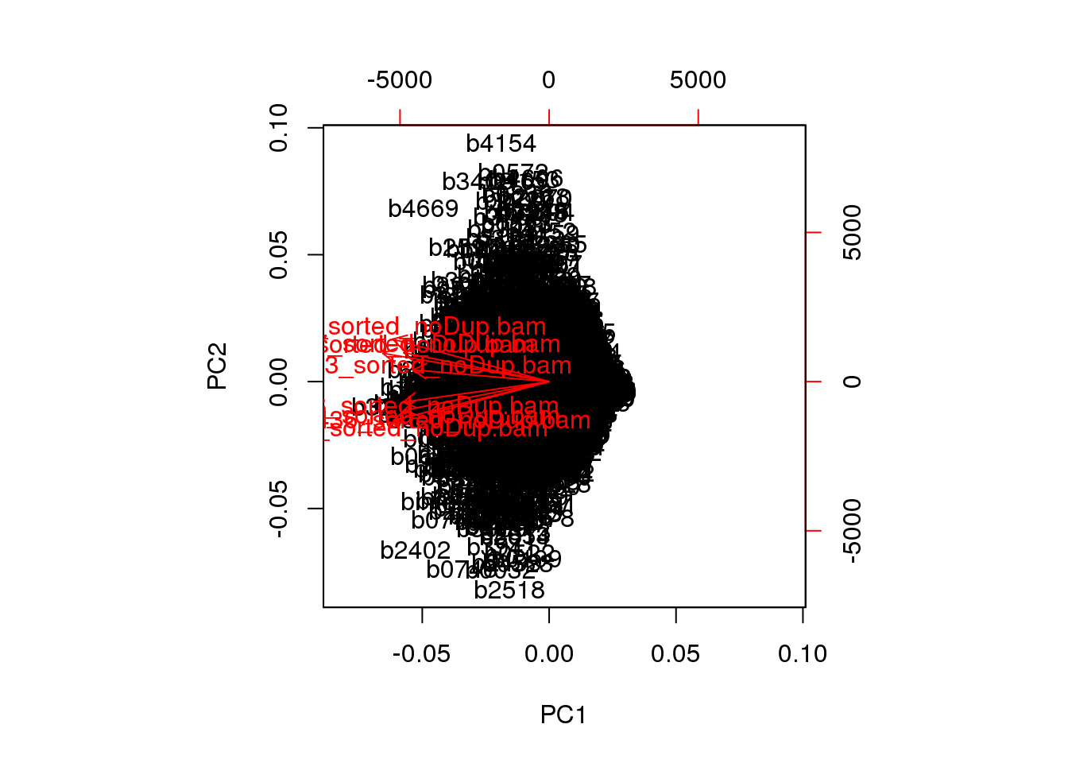
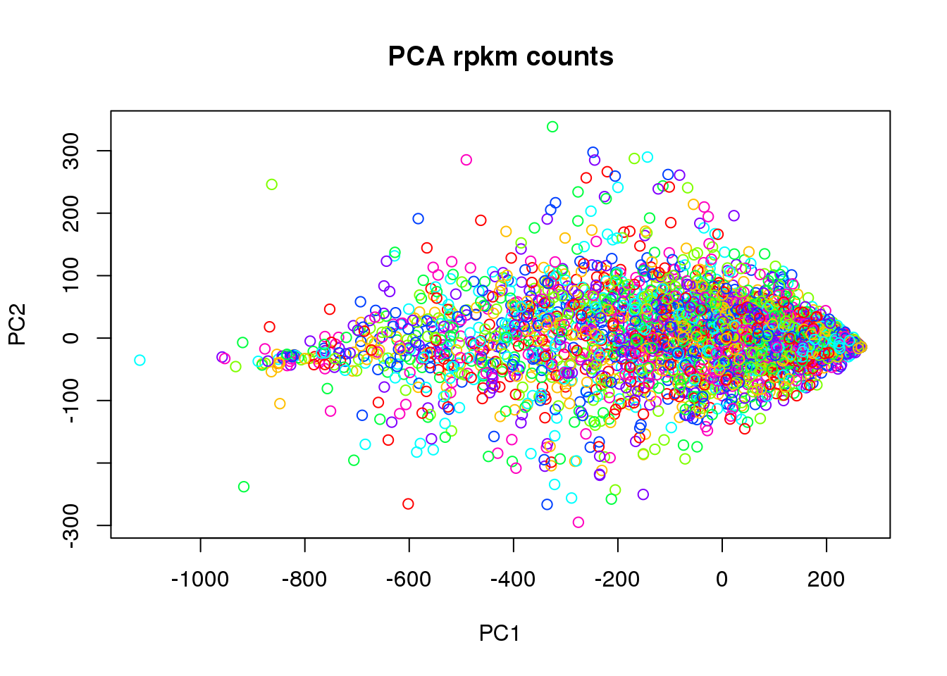
Differential expression in operon with REP
PCA check for RPKM corrected data :

Slide 22
Differential expression in operon with REP
For genes surrounding a REP, Wilcoxon test to detect DE :
  P-value : < 0.01
  RPKM counts > 10 for at least one gene

Slide 23
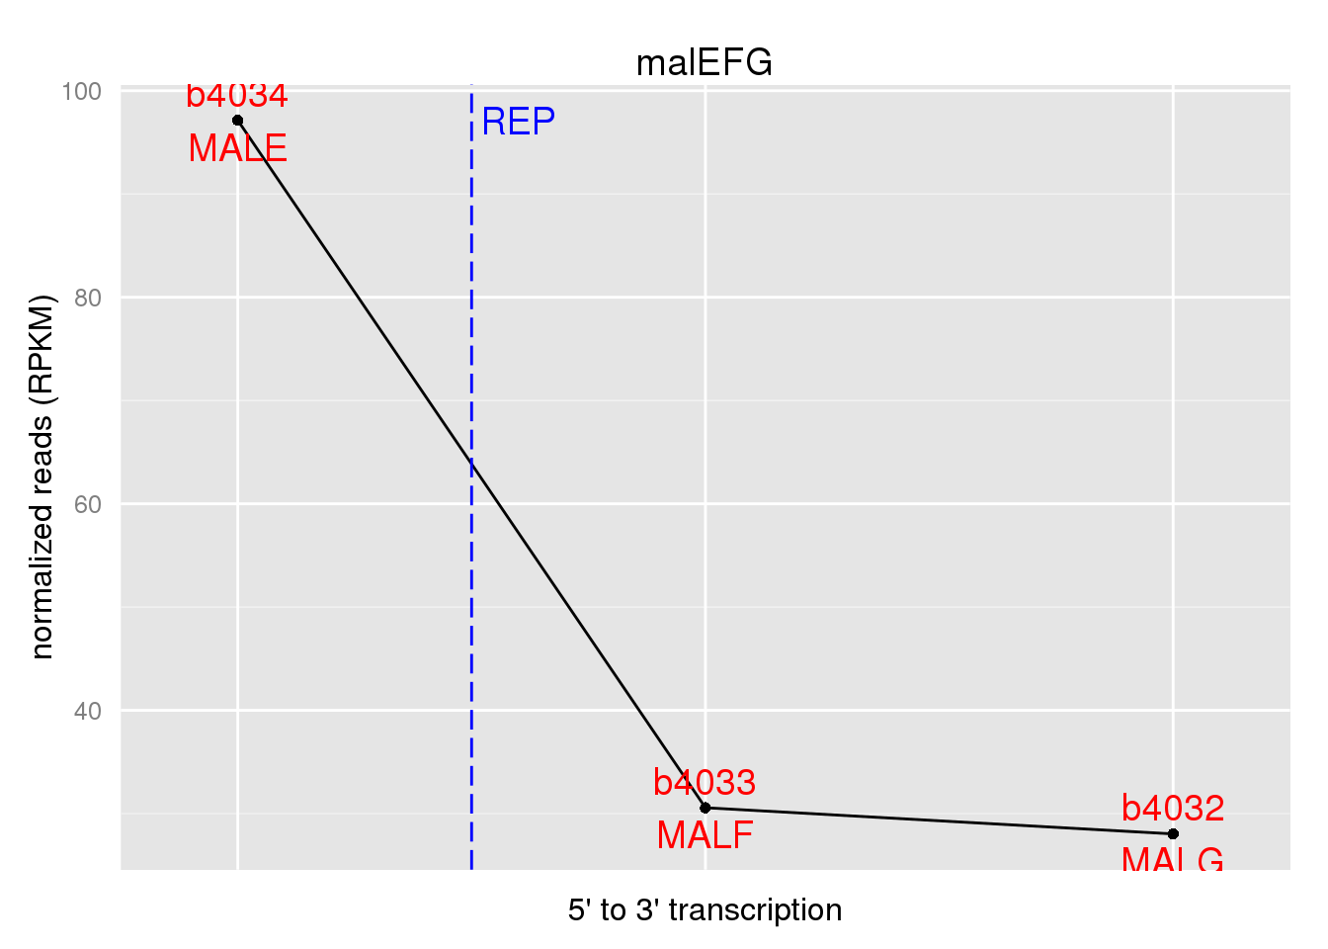
Differential expression in operon with REP
For genes surrounding a REP, Wilcoxon test to detect DE :
  P-value : < 0.01
  RPKM counts > 10 for at least one gene

Slide 24
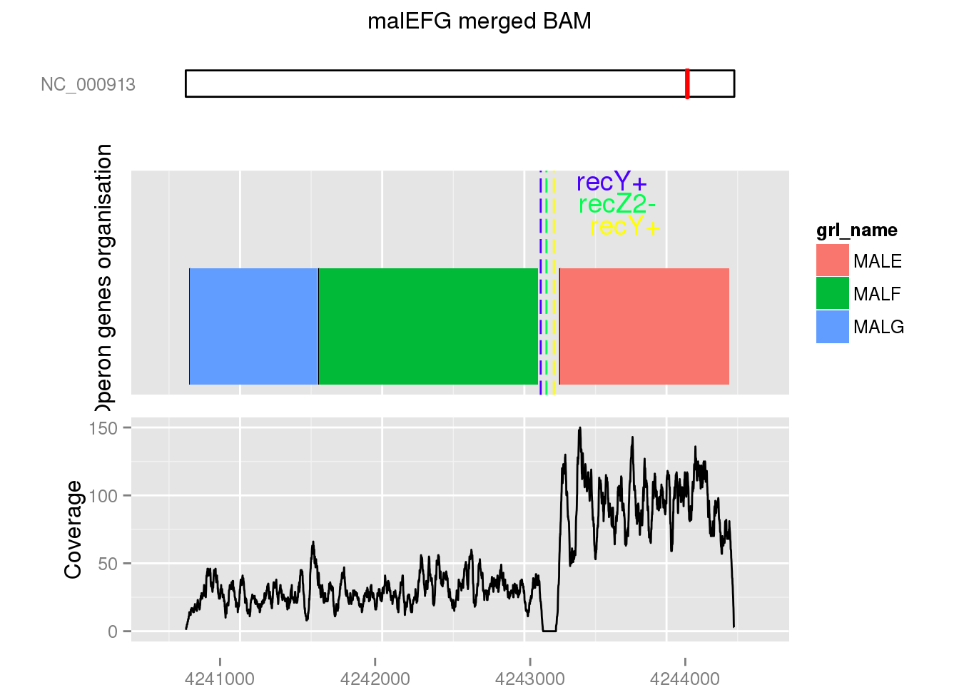
Differential expression in operon with REP
For genes surrounding a REP, Wilcoxon test to detect DE :
  P-value : < 0.01
  RPKM counts > 10 for at least one gene

Slide 25
Differential expression in operon with REP
17 over 36 operons with DE around the REP.
Function | Number of operons | DE change feature
ABC transporter | 7 | 
 | 2 | 
Multipurpose conversions 4-aminobutyrate aminotransferase, PLP-dependent | 1 | 
IF2 : membrane protein/conserved protein | 1 | 
Amino acid biosynthesis : Glutamine synthetase | 1 | 
Inner membrane protein, DUF485 family | 1 | 
Anaerobic respiration carbamoyl phosphate phosphatase and maturation protein for [NiFe] hydrogenases | 1 | 
Degradation of small molecules: Carbon compounds mannitol-1-phosphate dehydrogenase, NAD-dependent | 1 | 
Central intermediary metabolism : Pool, multipurpose conversions glycerol kinase | 1 | 

Slide 26
Differential expression in operon with REP
9 ABC transporter operons (abcDB source) :
Number of ABC transporter operons | DE change feature | More expressed gene function
7 |  | SBP
2 |  | NBD

Slide 27
Search for transcription change events on BIME
GFF modifications to convert BIME regions as mRNA.
Extraction of genomic positions for genes bounded regions with BIME like :
  {Gene} {IntraGenic-BIME-IntraGenic} … {Gene}
Coverage per base calculation on these regions (Bedtools)
RPKM correction.

Slide 28
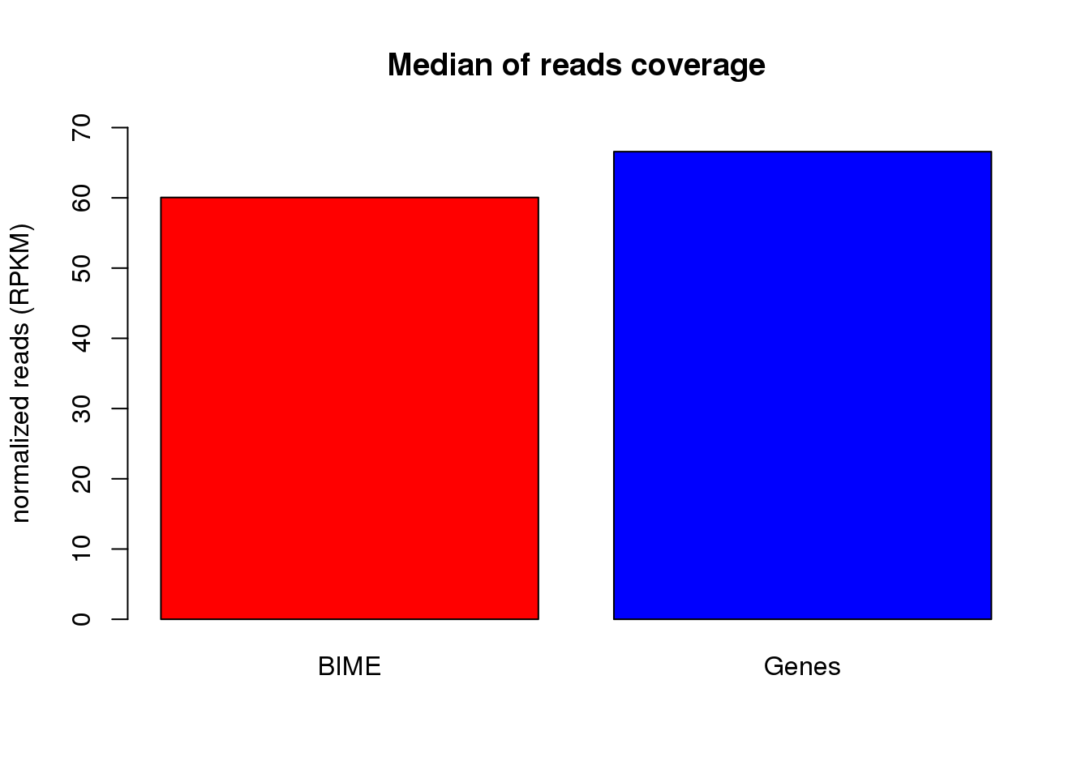
Search for transcription change events on BIME
GFF modifications to convert BIME regions as mRNA.
Extraction of genomic positions for genes bounded regions with BIME like :
  {Gene} {IntraGenic-BIME-IntraGenic} … {Gene}
Coverage per base calculation on these regions (Bedtools)
RPKM correction.

Slide 29
Search for transcription change events on BIME
Looking for correlation between :
  ___|^^^ or ^^^|___ profiles and coverage.
Profiles simulated with 0 or 1.
Sliding window (100 bp) on the BIME region.

Slide 30
Search for transcription change events on BIME
Looking for correlation between :
  ___|^^^ or ^^^|___ profiles and coverage.
Profiles simulated with 0 or 1.
Sliding window (100 bp) on the BIME region.
Correlation test :
  same strand : Wilcoxon test for DE
  one gene with RPKM count > 10
  2 fold change
  Correlation test P-value < 10⁻⁷
  Correlation coefficient > 0.7

Slide 31
Search for transcription change events on BIME
Results overview :
Number of regions | Number of regions without unique REP | Event | on BIME region
29 | 25 | ___|^^^ | YES
316 |  | ___|^^^ | NO
43 | 29 | ^^^|___ | YES
308 |  | ^^^|___ | NO

Slide 32
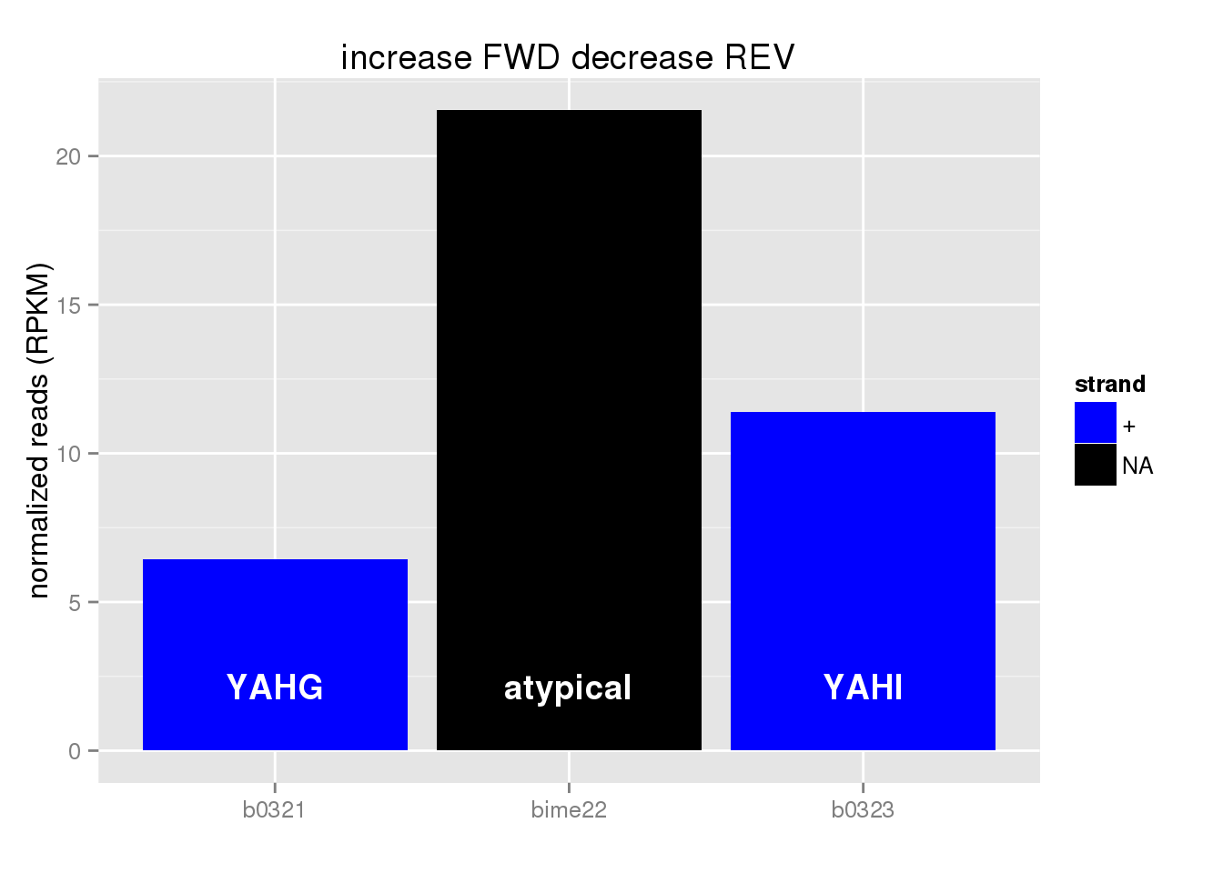
On BIME ___|^^^ : stabilisation
BIME-1 | BIME-2 | atypical BIME | unique REP
0 | 0 | 1 | 0
1 case :

Slide 33
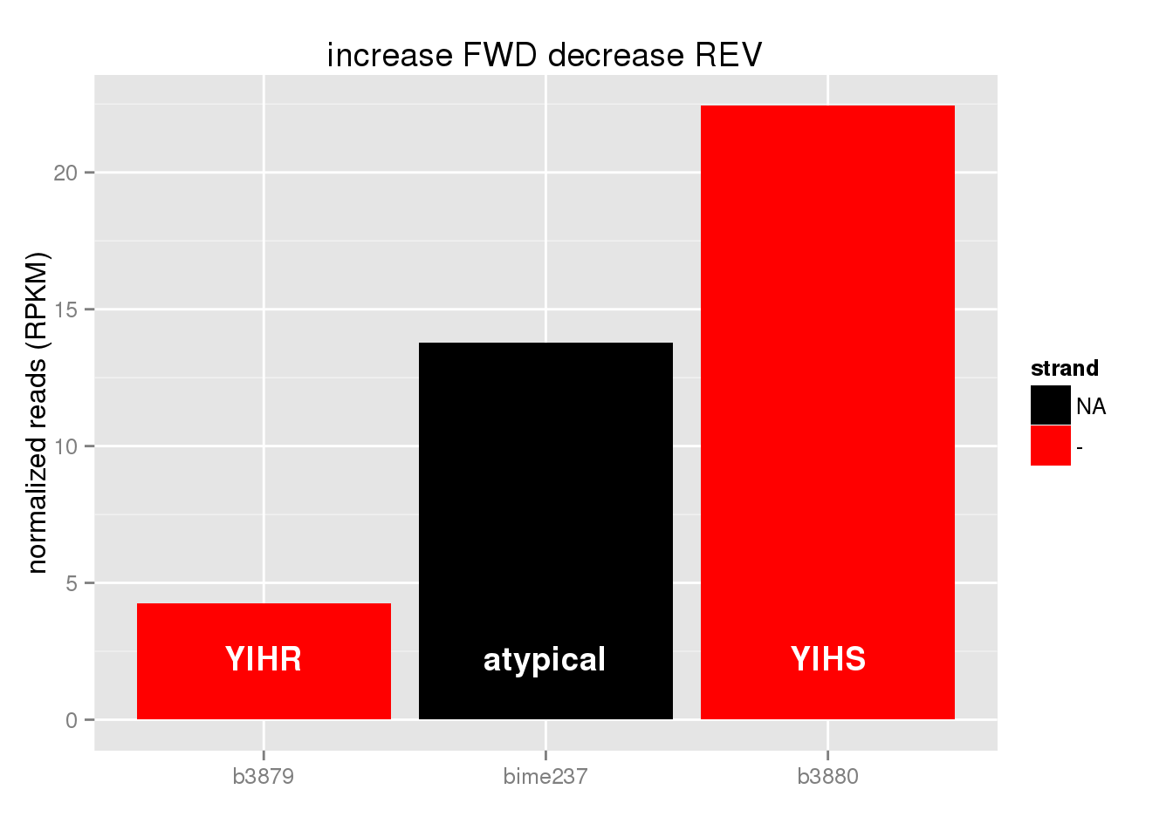
On BIME ___|^^^ : stabilisation
BIME-1 | BIME-2 | atypical BIME | unique REP
3 | 0 | 1 | 1
5 cases :

Slide 34
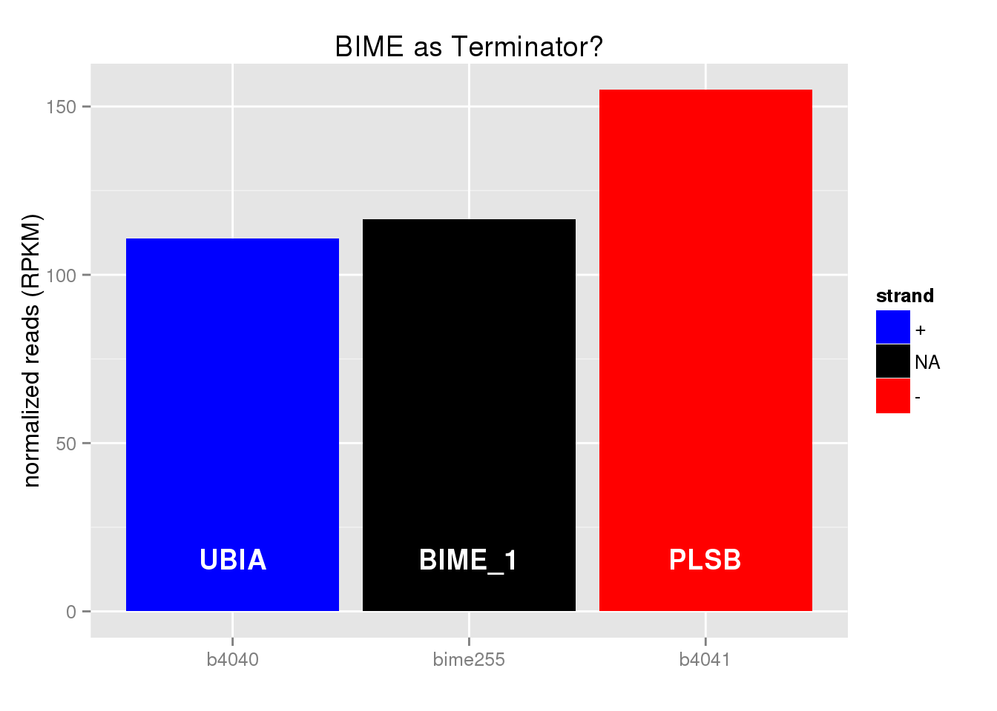
On BIME ___|^^^ : terminator
BIME-1 | BIME-2 | atypical BIME | unique REP
11 | 2 | 3 | 7
23 cases :

Slide 35
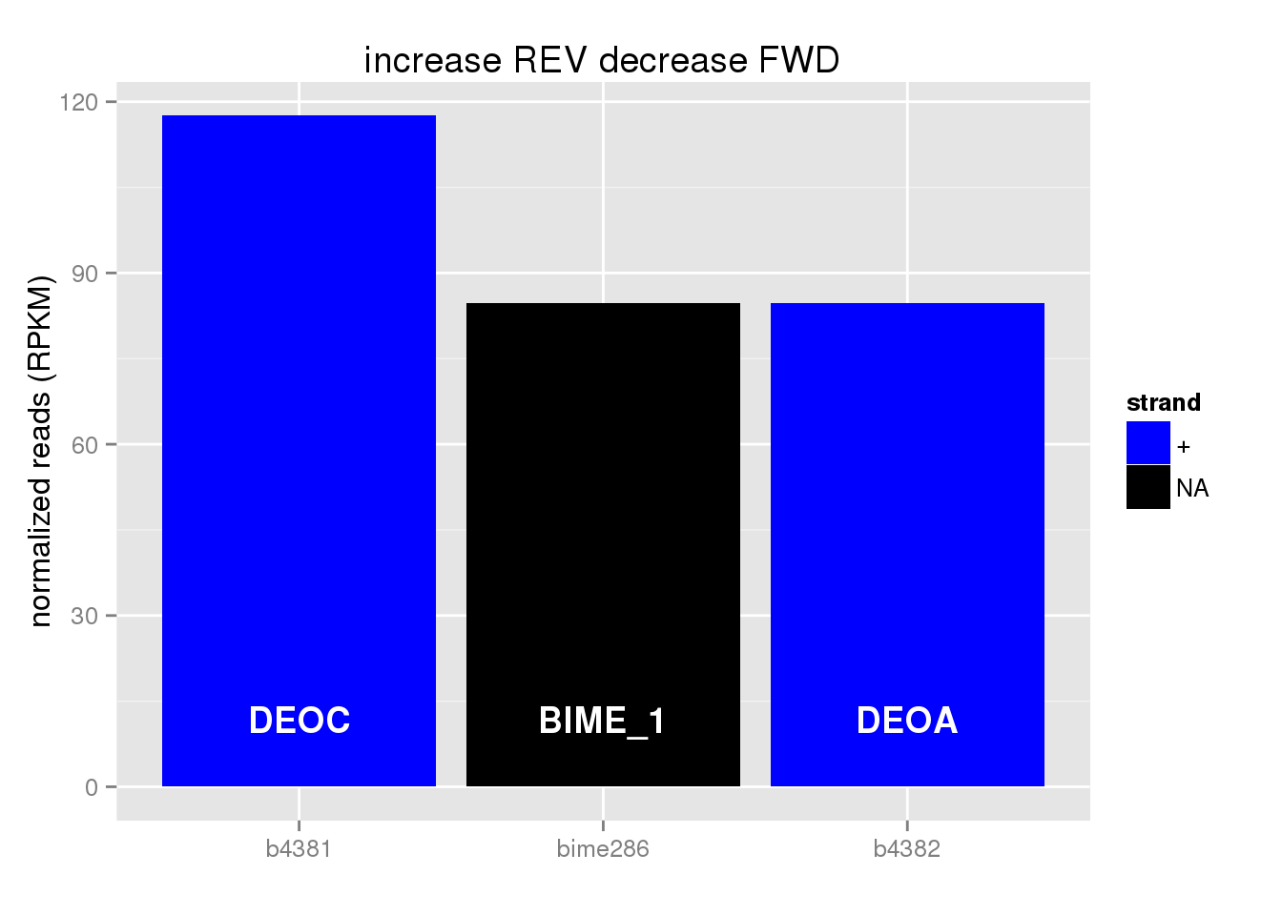
On BIME ^^^|___ : stabilisation
BIME-1 | BIME-2 | atypical BIME | unique REP
5 | 2 | 1 | 1
9 cases :

Slide 36
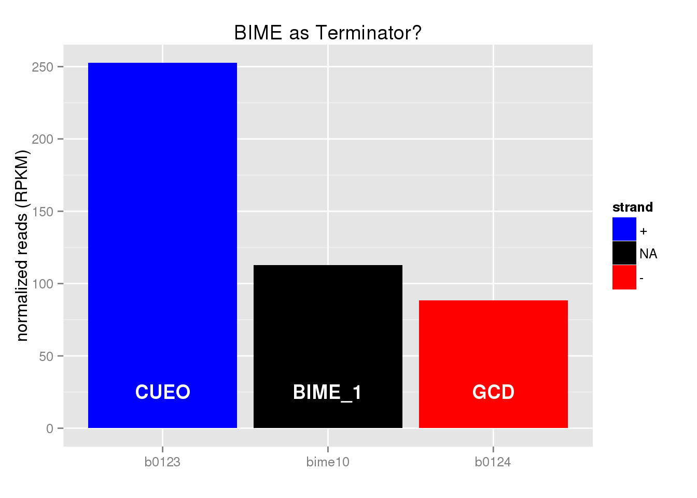
On BIME ^^^|___ : terminator
BIME-1 | BIME-2 | atypical BIME | unique REP
10 | 8 | 3 | 13
34 cases :

Slide 37
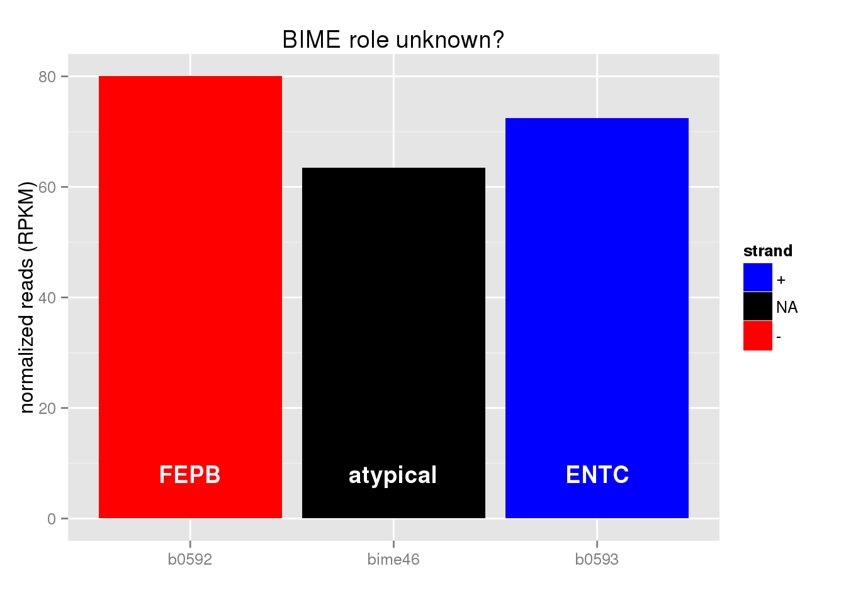
On BIME ^^^|___ : enhancing
BIME-1 | BIME-2 | atypical BIME | unique REP
0 | 0 | 1 | 0
1 case :

Slide 38
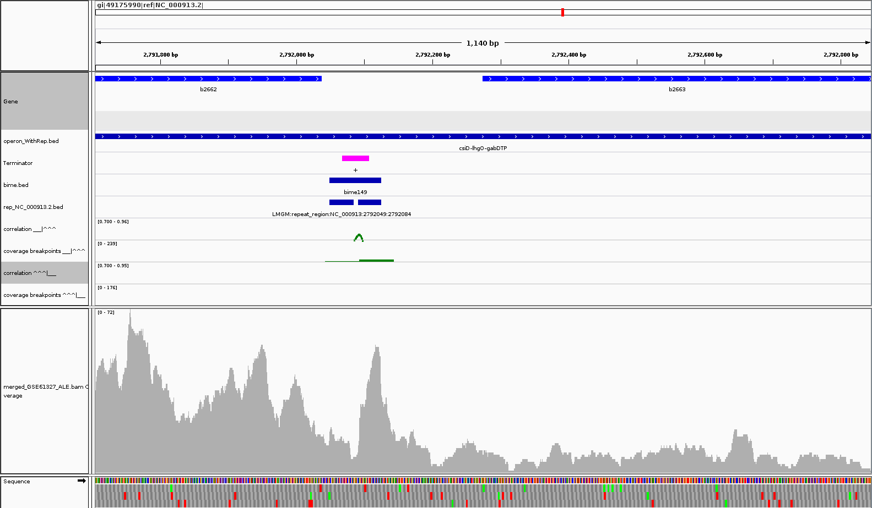
Links with REP results
Operon csiD-lhgO-gabDTP (Multipurpose conversions 4-aminobutyrate aminotransferase, PLP-dependent)

Slide 39
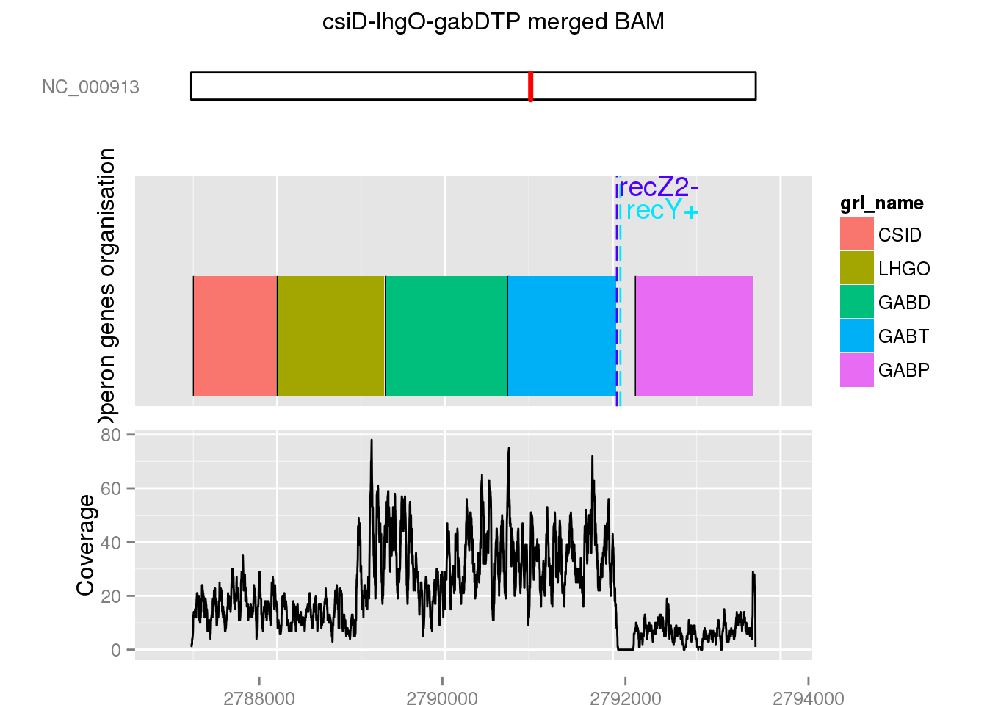
Links with REP results
Operon csiD-lhgO-gabDTP (Multipurpose conversions 4-aminobutyrate aminotransferase, PLP-dependent)

Slide 40
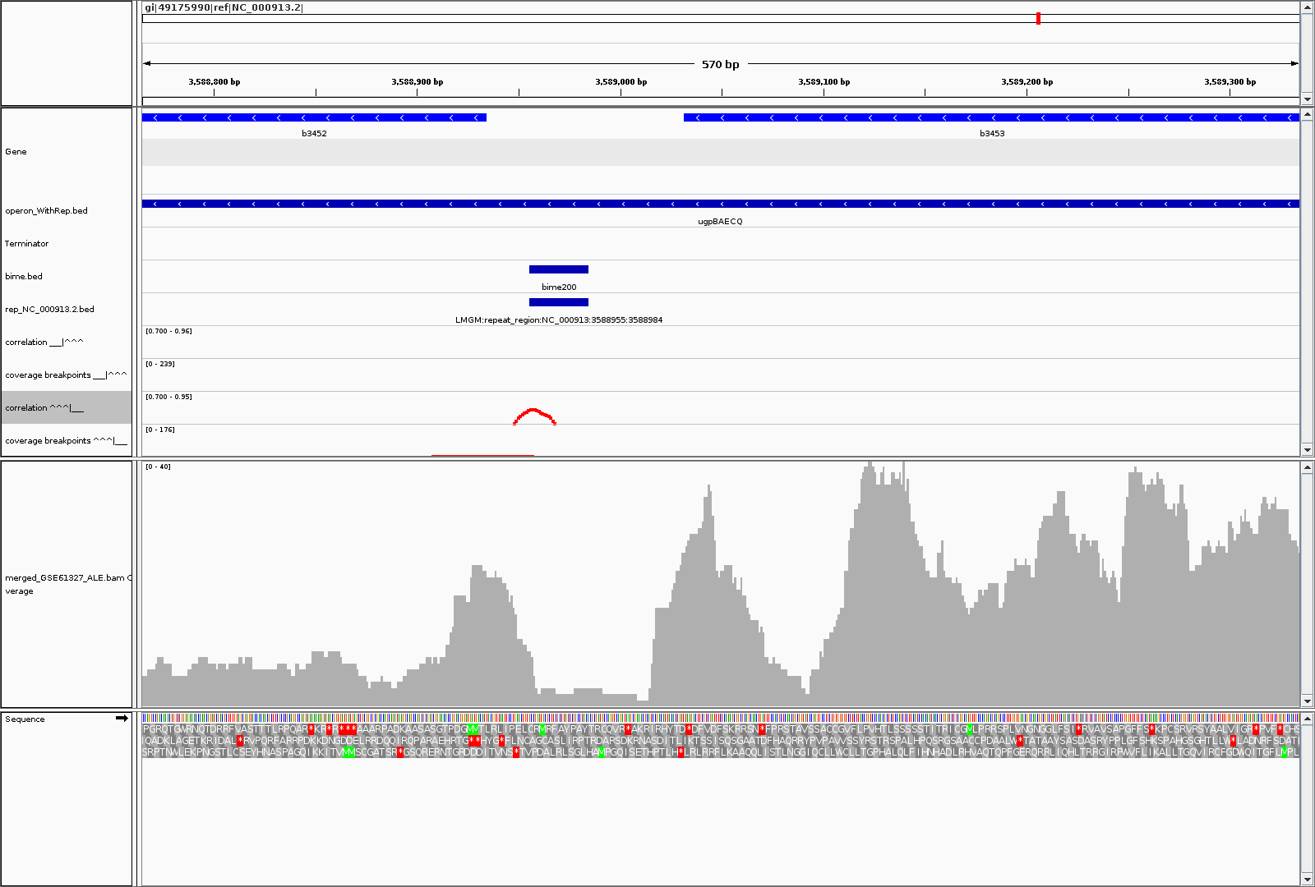
Links with REP results
Operon upgBAECQ (ABC transporter)

Slide 41
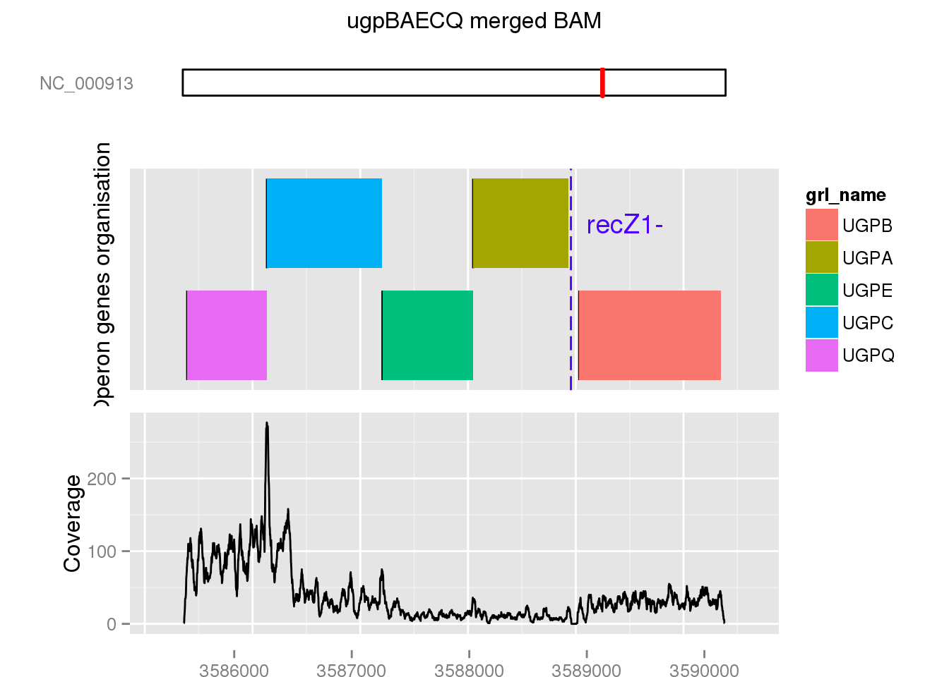
Links with REP results
Operon upgBAECQ (ABC transporter)

Slide 42
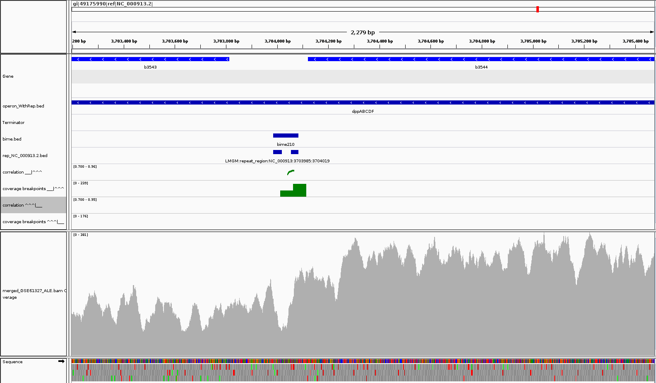
Links with REP results
Operon dppABCDF (ABC transporter)

Slide 43
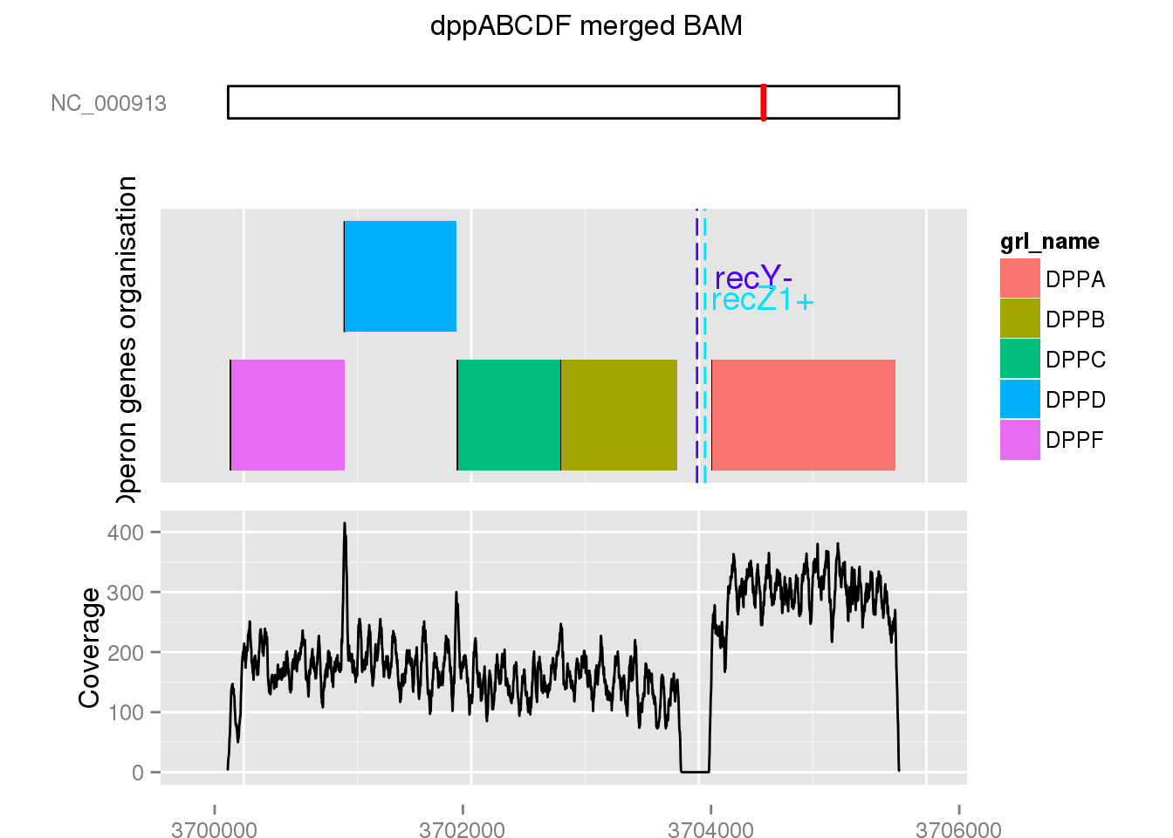
Links with REP results
Operon dppABCDF (ABC transporter)

Slide 44
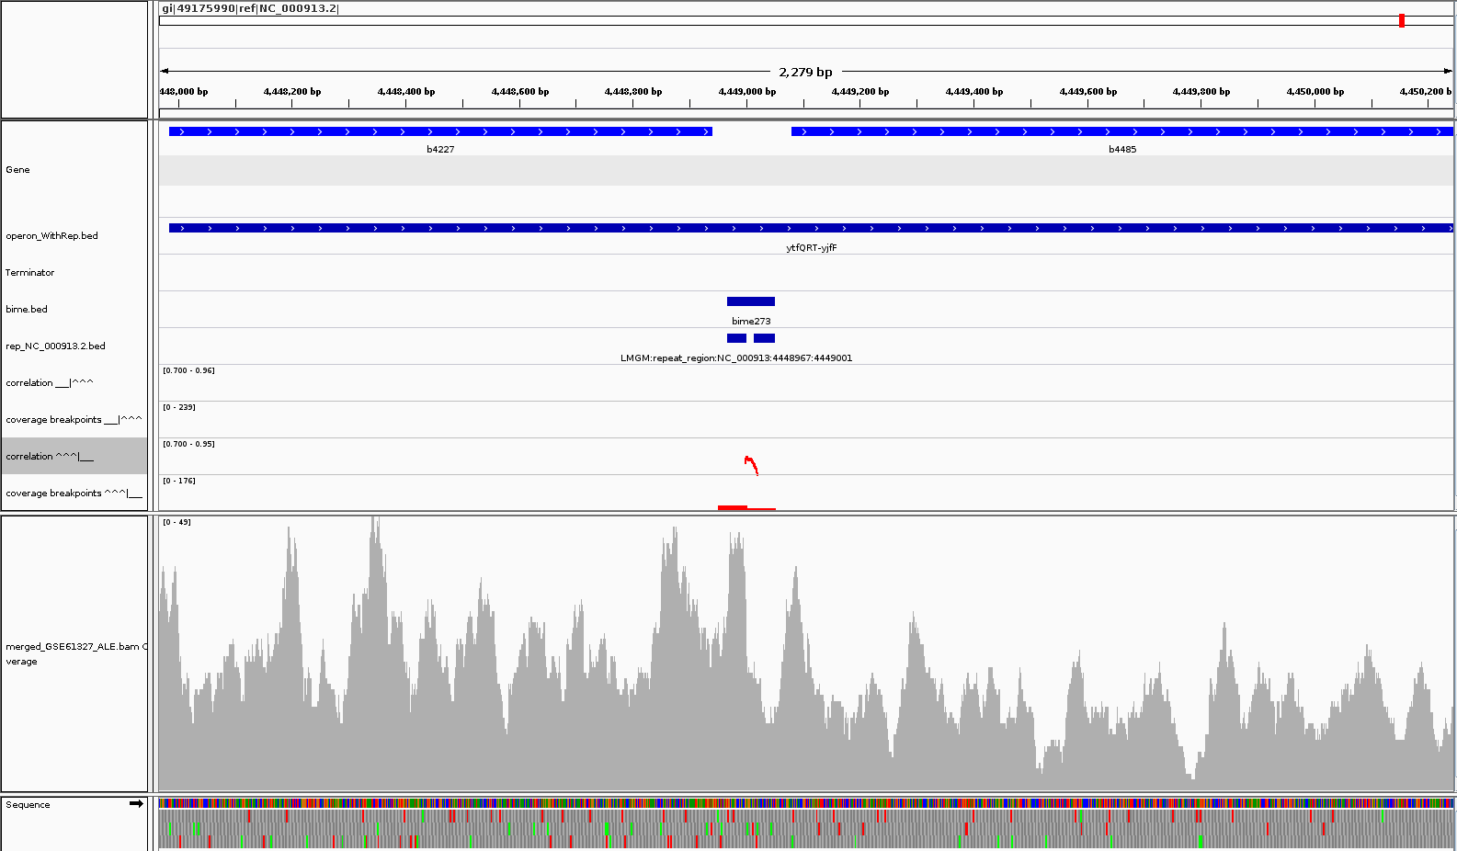
Links with REP results
Operon ytfQRT-yjfF (ABC transporter)

Slide 45
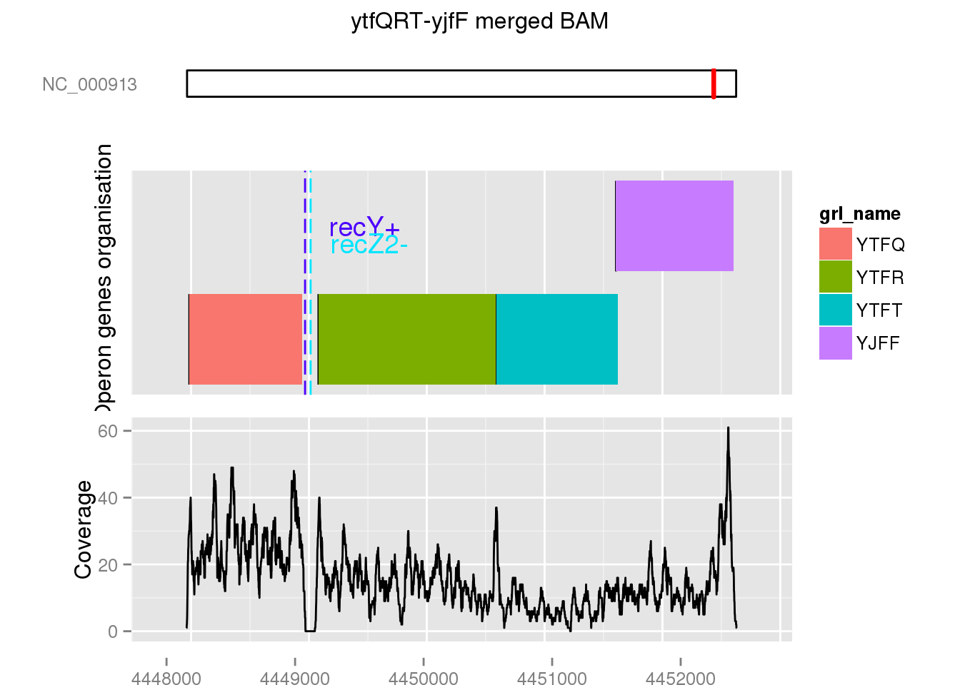
Links with REP results
Operon ytfQRT-yjfF (ABC transporter)

