Slide 1
REP involved in
transcription regulation?
19 / 03 /2015

Slide 2
REP features
Repeated Extragenic Palindrome.
20 - 40 nucleotides.
3 classes depending on length and secondary structure : Y, Z¹ and Z².

Slide 3
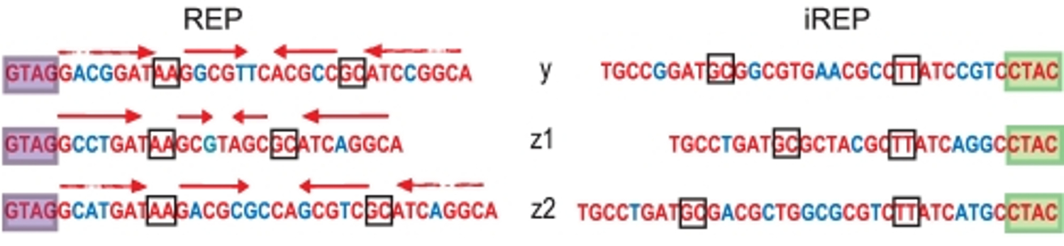
REP features
Repeated Extragenic Palindrome.
20 - 40 nucleotides.
3 classes depending on length and secondary structure : Y, Z¹ and Z².
Ton-Hoang et al. 2012

Slide 4
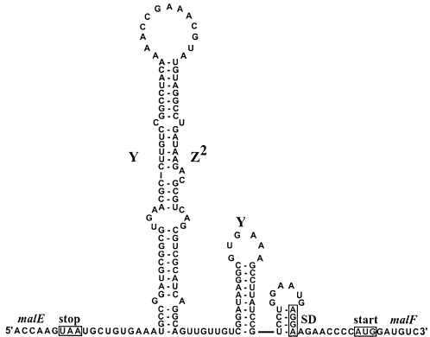
REP features
Repeated Extragenic Palindrome.
20 - 40 nucleotides.
3 classes depending on length and secondary structure : Y, Z¹ and Z².
Stem-loop secondary structure with a bulge.
Khemici and Carpousis 2004

Slide 5
REP features
Repeated Extragenic Palindrome.
20 - 40 nucleotides.
3 classes depending on length and secondary structure : Y, Z¹ and Z².
Stem-loop secondary structure with a bulge.
Numerous bacterial genomes, ≈ 1% for E. coli.
BIME organization.

Slide 6
BIME features
Bacterial Interspesed Mosaic Element.
3 classes depending on REP composition :
Bime-1, Bime-2, atypical.

Slide 7
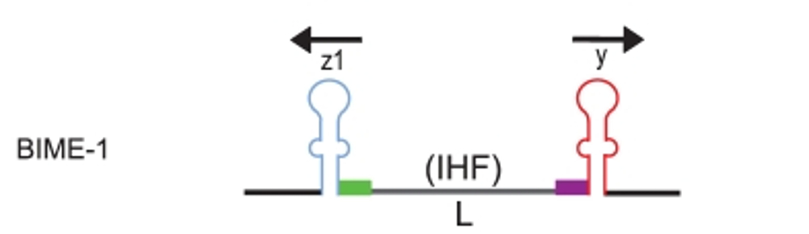
BIME features
Bacterial Interspesed Mosaic Element.
3 classes depending on REP composition :
Bime-1, Bime-2, atypical.
Ton-Hoang et al. 2012

Slide 8
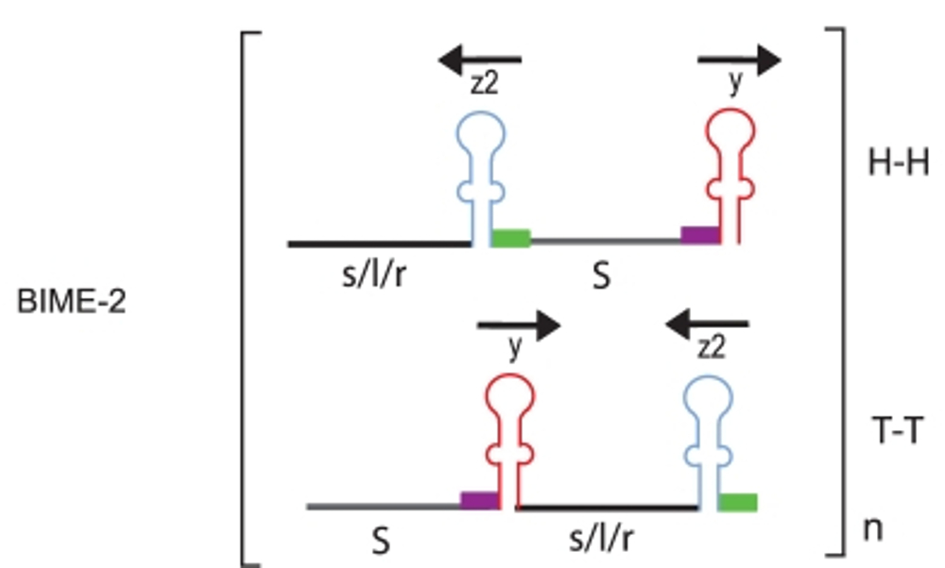
BIME features
Bacterial Interspesed Mosaic Element.
3 classes depending on REP composition :
Bime-1, Bime-2, atypical.
Ton-Hoang et al. 2012

Slide 9
Objectives
Does REP are involved in the transcription regulation in E. coli genome :
as protection from RNA degradosome ?
as transcription terminator ?
as recognition site for proteic factors ?

Slide 10
Data choice
Escherichia coli K-12 MG1655 on Glucose Minimal Medium (LaCroix et al. 2014).
Why ?
  RNA-Seq experiment.
  Large number of replicates :
    9 for Glucose minimal medium (ALE)
    2 for the wild type (WT)
  Paired-end and specific strand library preparation.

Slide 11
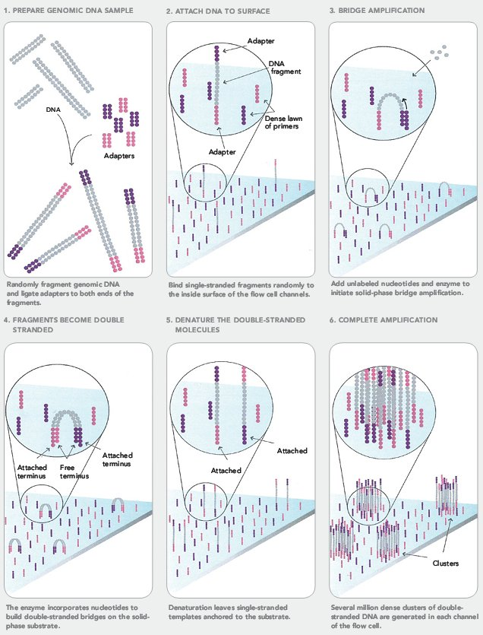
Illumina technology

Slide 12
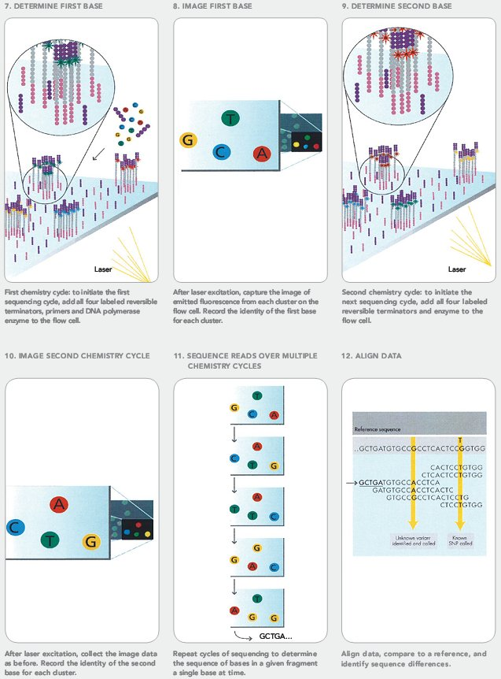
Illumina technology

Slide 13
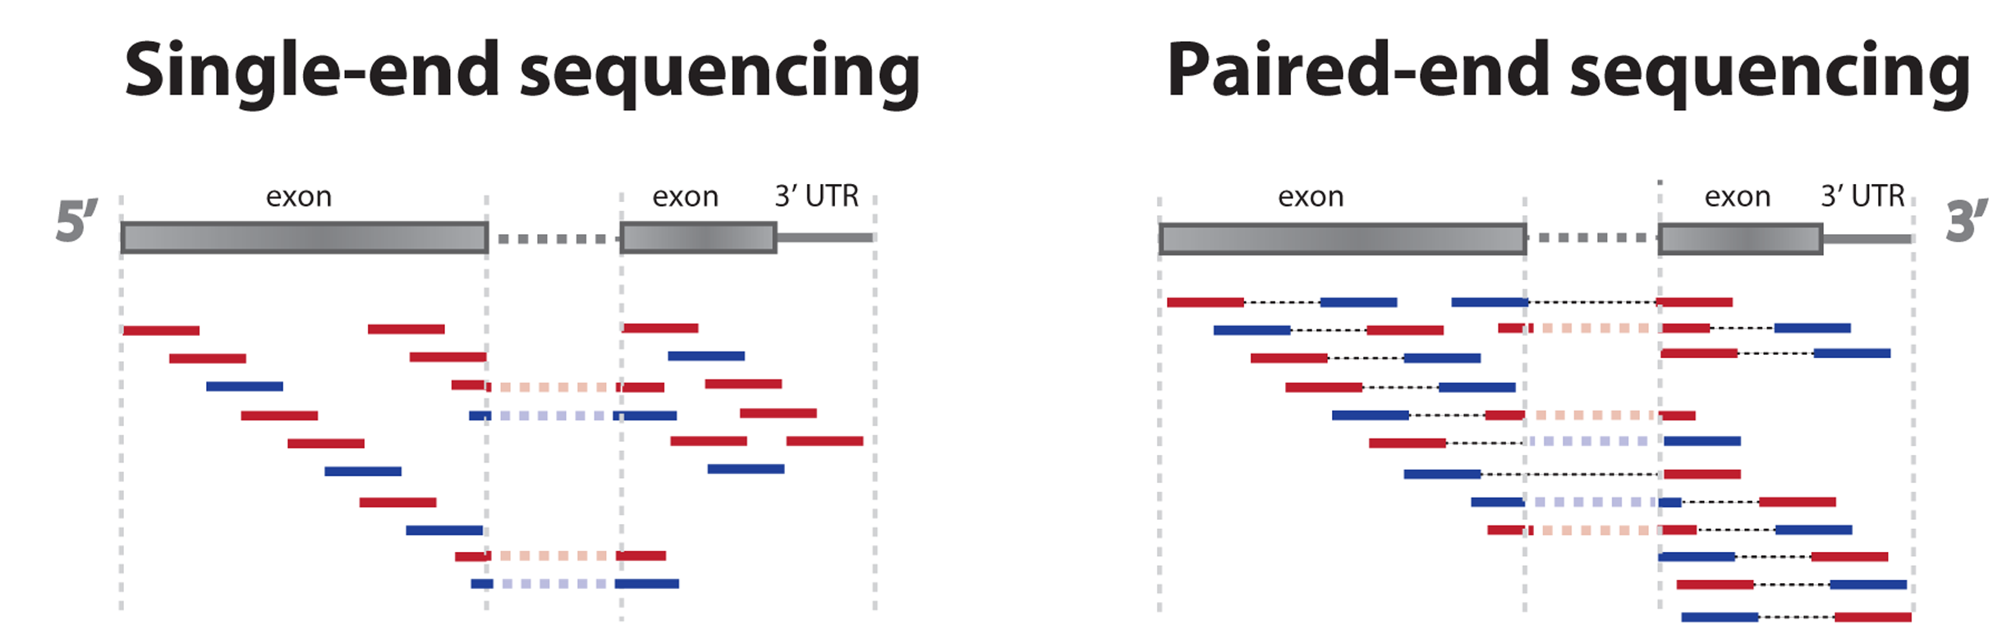
Paired-End vs. Single-End
Paired-End :
    Tag1 for 5' end, Tag2 for 3' end
    Distance fixed and known between tags (< 0 to 500 bp)
    Mapping easier even if inner sequence unknown.
Zhernakova et al. 2013

Slide 14
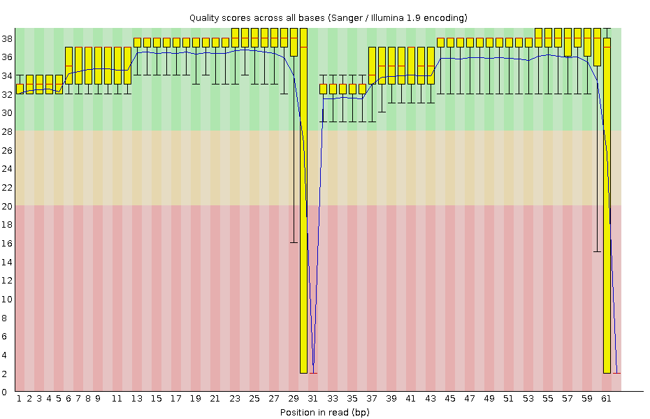
Quality control
Measure | Value
Total sequences | 7 772 244
Sequences flagged as poor quality | 0
Sequence length | 62
% GC | 53
Quality control with fastqc on ALE samples :

Slide 15
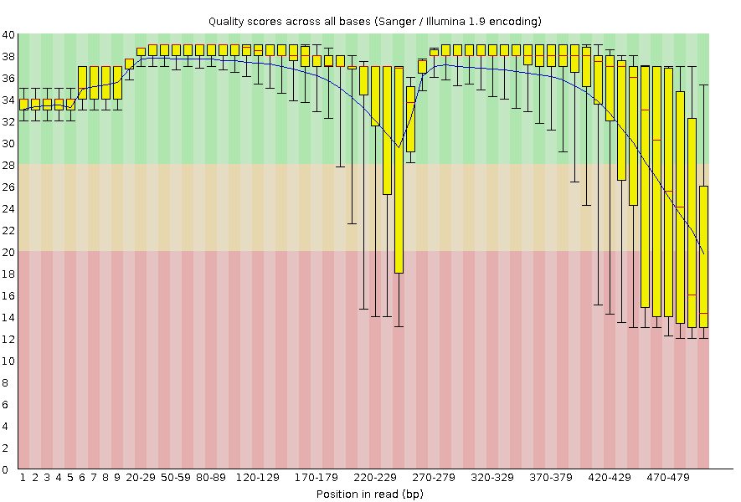
Quality control
Quality control with fastqc on ALE samples :
1 ALE sample rejected (35-502 bp)
SRR1573441

Slide 16
Alignments
Alignment on NC_000913.2 E.coli genome (BWA) :
  Index of the reference genome
  Alignment (SAM file)

Slide 17
Alignments
Alignment on NC_000913.2 E.coli genome (BWA) :
  Index of the reference genome
  Alignment (SAM file)
Post-alignment process (Samtools) :
  Convert to binaries (BAM file)
  Sort the reads by genomic position
  Remove PCR duplicates
  Merge files
  Index alignment merged file

Slide 18
Genomic informations
GFF, laboratory database, RegulonDB and DOOR design of reference files (Bedtools, Python scripts)
  Operons
  REP in operons
  Genes surrounding REP in operon
  Terminators...

Slide 19
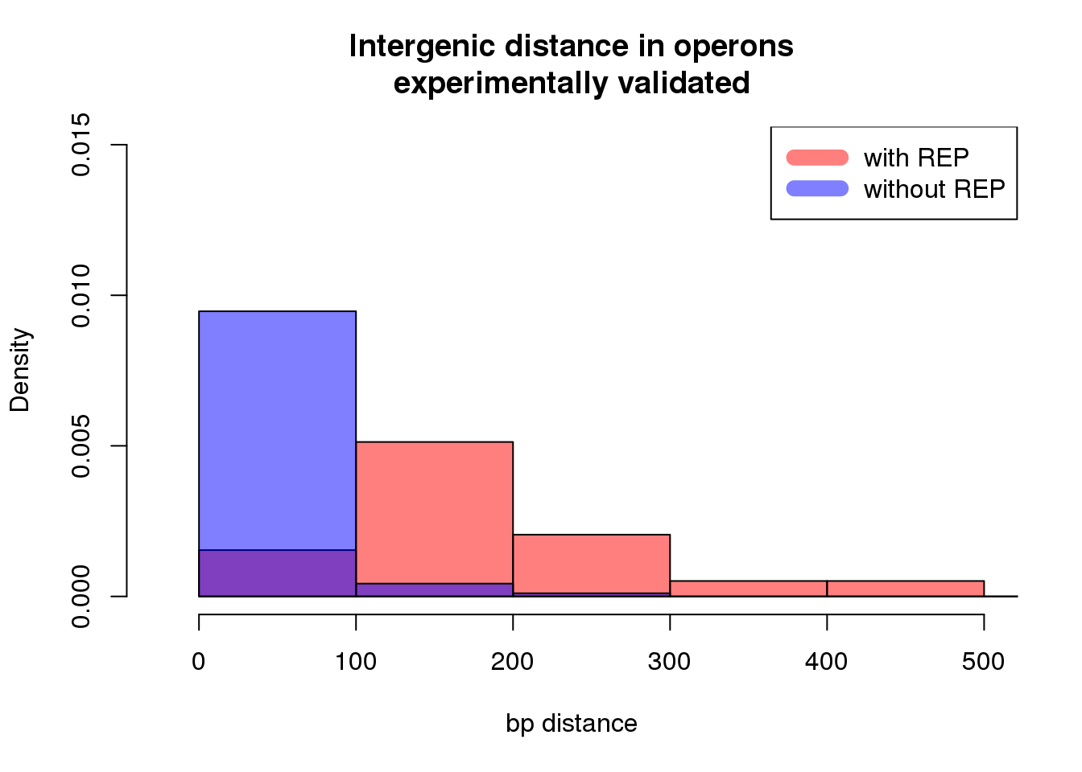
Genomic informations
For operons from RegulonDB :

Slide 20
Differential expression in operon with REP
Detect Differential Expression (DE) between genes surrounding a REP in an operon.

Slide 21

Differential expression in operon with REP
Detect Differential Expression (DE) between genes surrounding a REP in an operon.
Keep in mind :
Not looking for a gene DE in different conditions.
Focus on minimal Glucose medium condition (ALE).
Not focus on mRNA, transform the GFF to get the expression of tRNA, rRNA and ncRNA.

Slide 22
Differential expression in operon with REP
Reads count table for expressed features
(Bioconductor package easyRnaSeq)

Slide 23
Differential expression in operon with REP
Reads count table for expressed features
(Bioconductor package easyRnaSeq)
Correct reads count with RPKM (Reads Per Kilobase Per Millions mapped reads) :

Slide 24
Differential expression in operon with REP
Reads count table for expressed features
(Bioconductor package easyRnaSeq)
Correct reads count with RPKM (Reads Per Kilobase Per Millions mapped reads) :
Molar concentration of a transcript :
  RNA length
  Total number of reads in the measurement
Facilitates transparent comparison of transcript levels within and between.

Slide 25
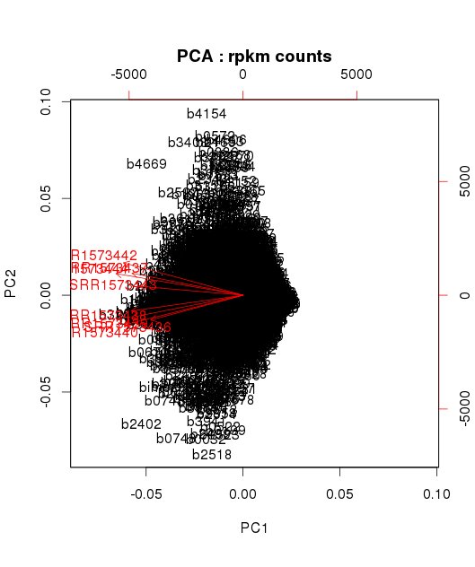
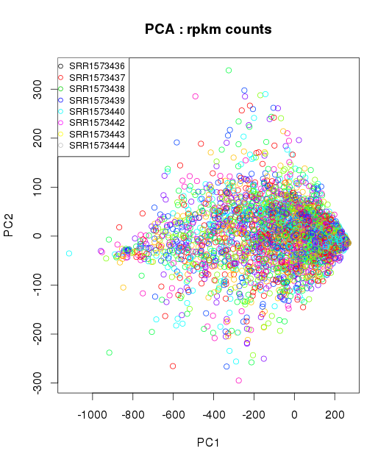
Differential expression in operon with REP
PCA check for RPKM corrected data on 8 ALE replicates :

Slide 26
Differential expression in operon with REP
For genes surrounding a REP, Wilcoxon test to detect DE :
  P-value : < 0.01
  RPKM counts > 10 for at least one gene

Slide 27
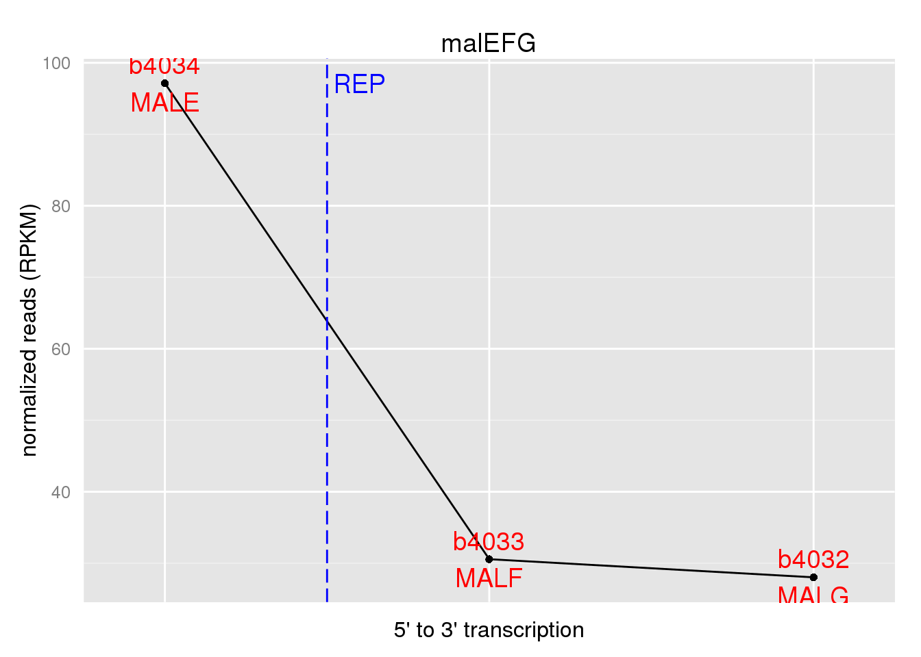
Differential expression in operon with REP
For genes surrounding a REP, Wilcoxon test to detect DE :
  P-value : < 0.01
  RPKM counts > 10 for at least one gene

Slide 28
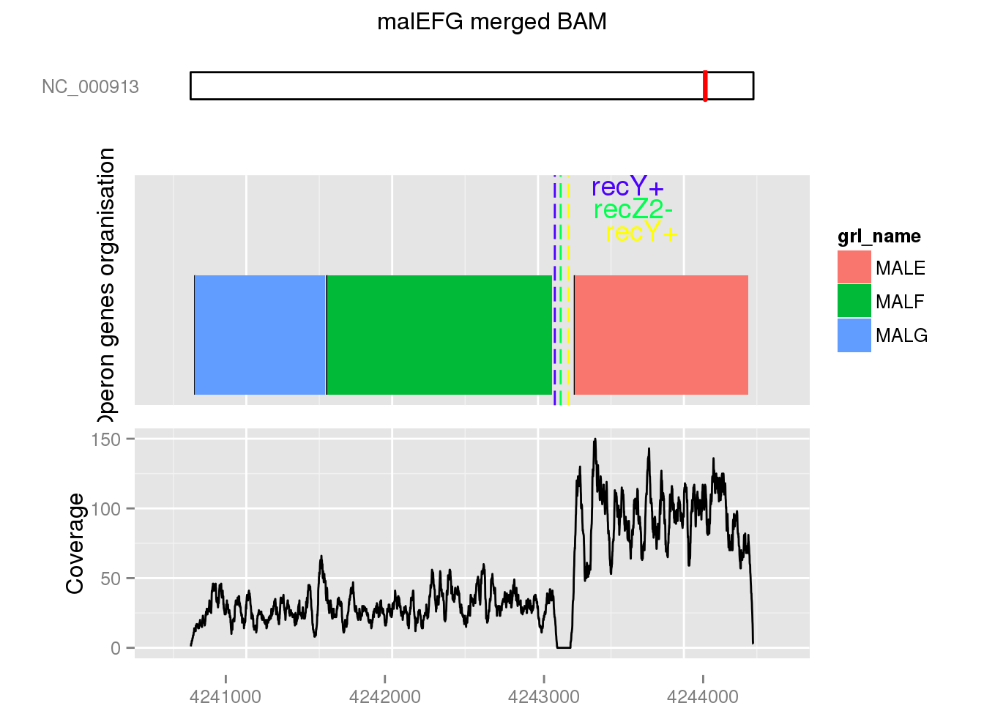
Differential expression in operon with REP
For genes surrounding a REP, Wilcoxon test to detect DE :
  P-value : < 0.01
  RPKM counts > 10 for at least one gene

Slide 29
Differential expression in operon with REP
17 over 36 operons with DE around the REP (abcDB source) :
Function | Number of operons | 5' to 3' DE change feature
ABC transporter | 7 | 
 | 2 | 
Multipurpose conversions 4-aminobutyrate aminotransferase, PLP-dependent | 1 | 
IF2 : membrane protein/conserved protein | 1 | 
Amino acid biosynthesis : Glutamine synthetase | 1 | 
Glyoxylate bypass isocitrate dehydrogenase kinase/phosphatase | 1 | 
Inner membrane protein, DUF485 family | 1 | 
Anaerobic respiration carbamoyl phosphate phosphatase and maturation protein for [NiFe] hydrogenases | 1 | 
Degradation of small molecules: Carbon compounds mannitol-1-phosphate dehydrogenase, NAD-dependent | 1 | 
Central intermediary metabolism : Pool, multipurpose conversions glycerol kinase | 1 | 

Slide 30
Differential expression in operon with REP
9 ABC transporter operons (abcDB source) :
DE for genes surrounding a REP in ABC transporter :
Number of ABC transporter operons | 5' to 3' DE change feature | More expressed gene function
7 |  | Solute Binding Protein
2 |  | Nucleotide Binding Domain

Slide 31
Search for transcription change events on BIME
GFF modifications to convert BIME as mRNA.
Extraction of genomic positions for genes bounded regions with BIME (Bedtools) called BIME regions :
  {Gene} {IntraGenic-BIME-IntraGenic} … {Gene}
Coverage per base calculation on these regions (Bedtools).
RPKM correction.

Slide 32
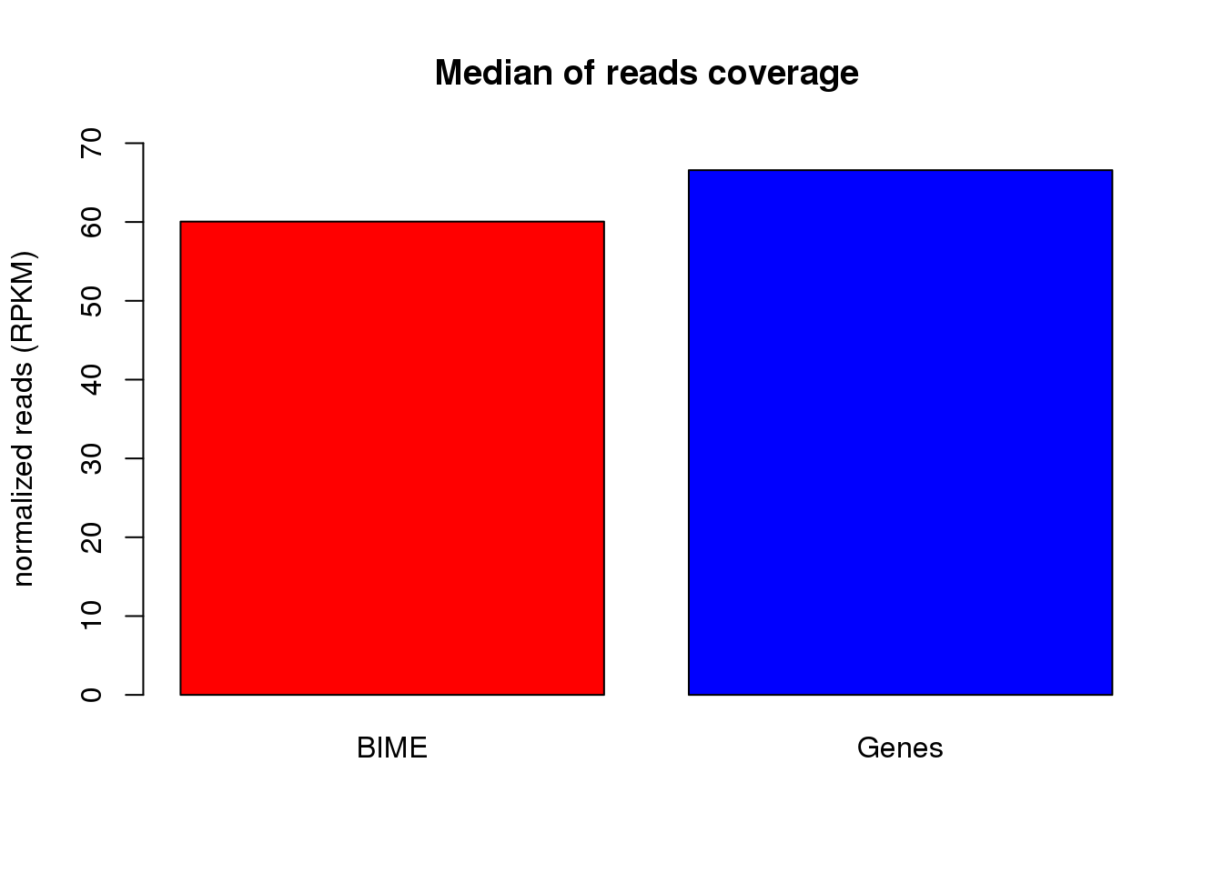
Search for transcription change events on BIME
GFF modifications to convert BIME as mRNA.
Extraction of genomic positions for genes bounded regions with BIME (Bedtools) called BIME regions :
  {Gene} {IntraGenic-BIME-IntraGenic} … {Gene}
Coverage per base calculation on these regions (Bedtools).
RPKM correction.

Slide 33
Search for transcription change events on BIME
Looking for correlation between (Fortino et al. 2014) :
  ___|^^^ or ^^^|___ profiles and coverage.
Profiles simulated with 0 and 1 vectors.
Sliding window (100 bp) on the BIME region.

Slide 34
Search for transcription change events on BIME
Looking for correlation between (Fortino et al. 2014) :
  ___|^^^ or ^^^|___ profiles and coverage.
Profiles simulated with 0 and 1 vectors.
Sliding window (100 bp) on the BIME region.
Correlation test :
  same strand :
    Wilcoxon test for DE
    one gene with RPKM count > 10
  2 fold change
  Correlation test P-value < 10⁻⁷
  Correlation coefficient > 0.7

Slide 35
Search for transcription change events on BIME
Results overview :
Number of regions | Number of regions without unique REP | Event | on BIME region
29 | 25 | ___|^^^ | YES
316 |  | ___|^^^ | NO
43 | 29 | ^^^|___ | YES
308 |  | ^^^|___ | NO

Slide 36
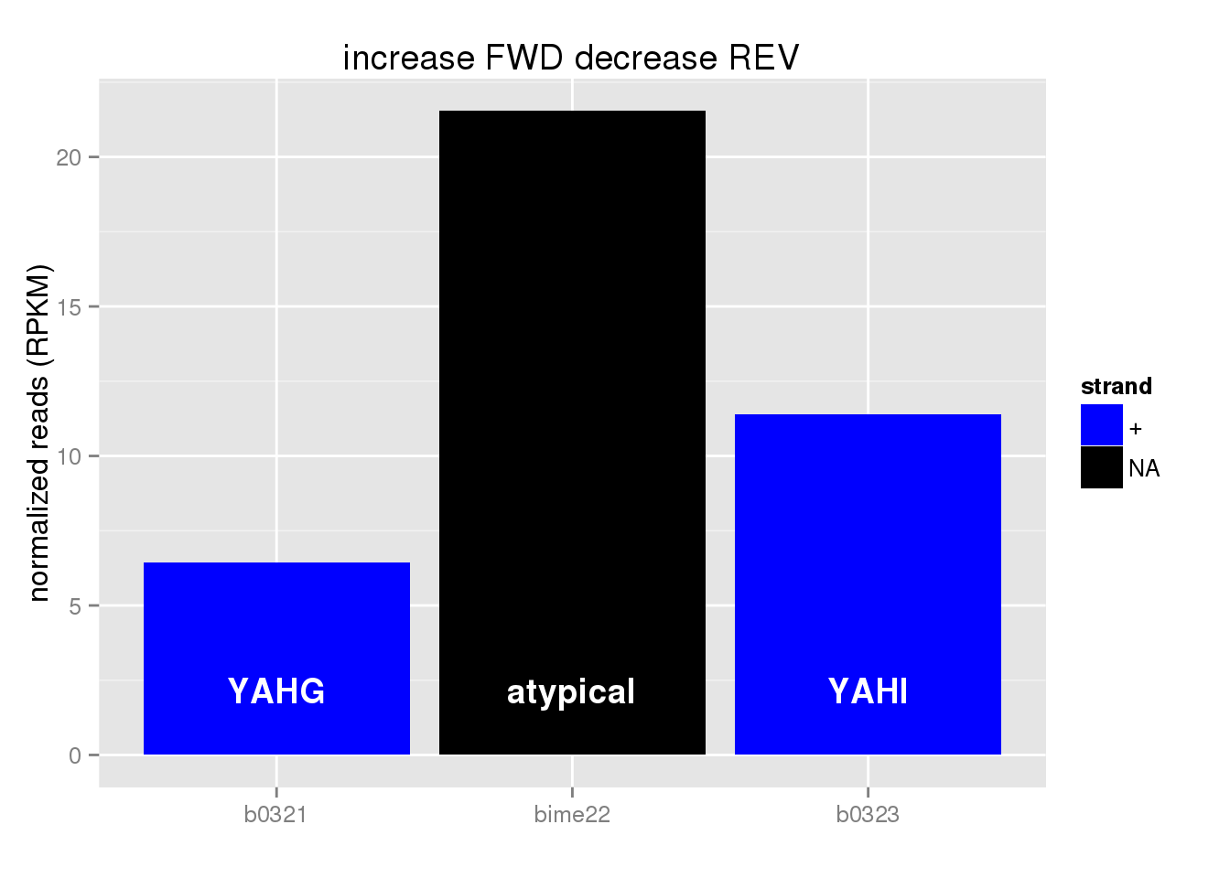
On BIME ___|^^^ : stabilisation
BIME-1 | BIME-2 | atypical BIME | unique REP
0 | 0 | 1 | 0
1 case :

Slide 37
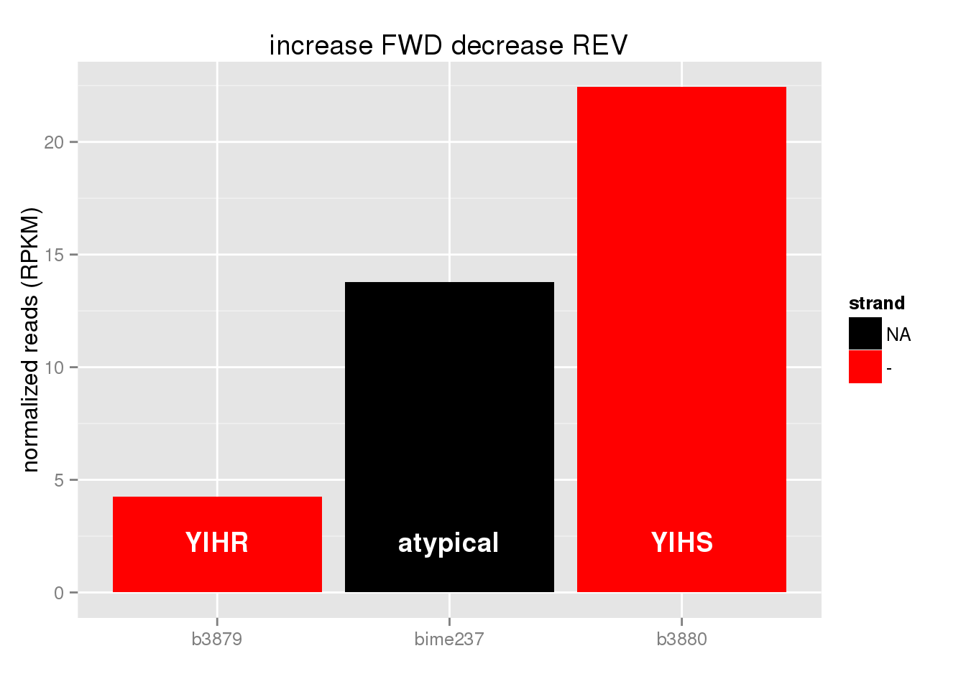
On BIME ___|^^^ : stabilisation
BIME-1 | BIME-2 | atypical BIME | unique REP
3 | 0 | 1 | 1
5 cases :

Slide 38
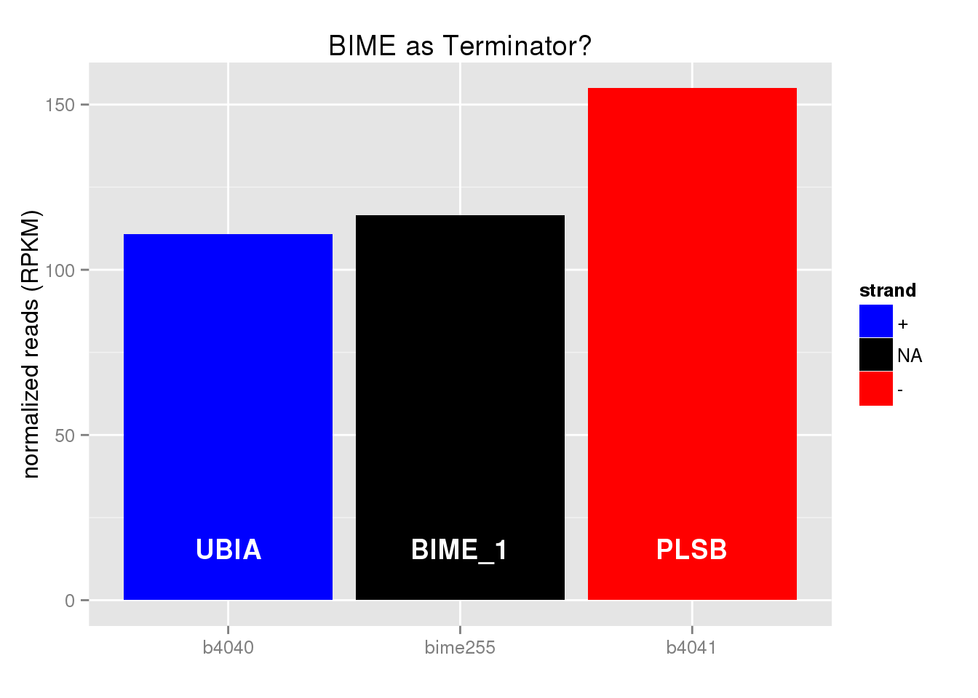
On BIME ___|^^^ : terminator
BIME-1 | BIME-2 | atypical BIME | unique REP
11 | 2 | 3 | 7
23 cases :

Slide 39
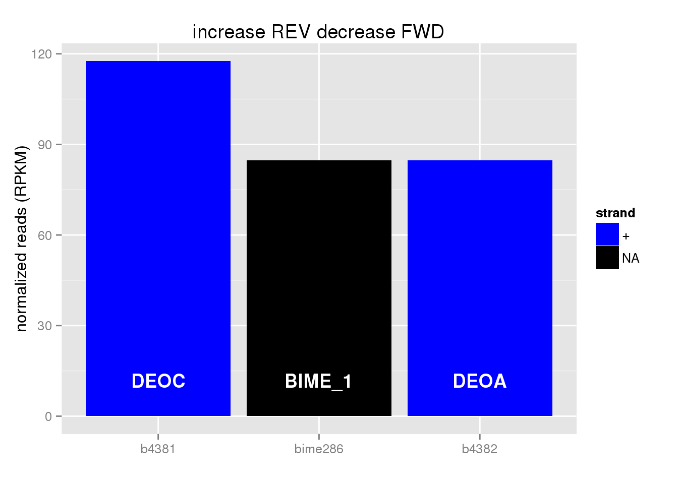
On BIME ^^^|___ : stabilisation
BIME-1 | BIME-2 | atypical BIME | unique REP
5 | 2 | 1 | 1
9 cases :

Slide 40
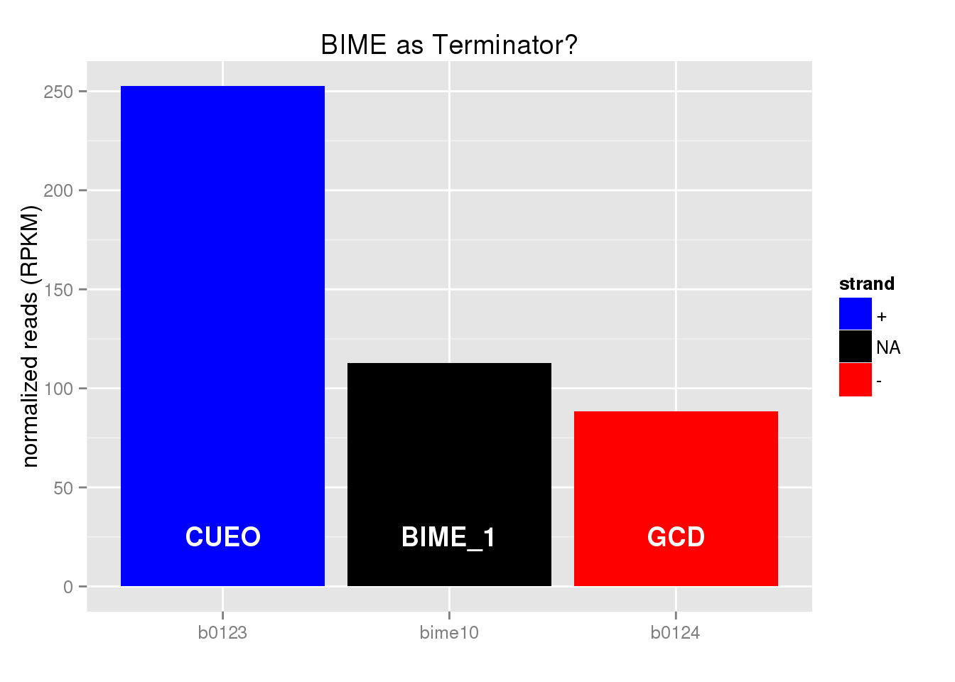
On BIME ^^^|___ : terminator
BIME-1 | BIME-2 | atypical BIME | unique REP
10 | 8 | 3 | 13
34 cases :

Slide 41
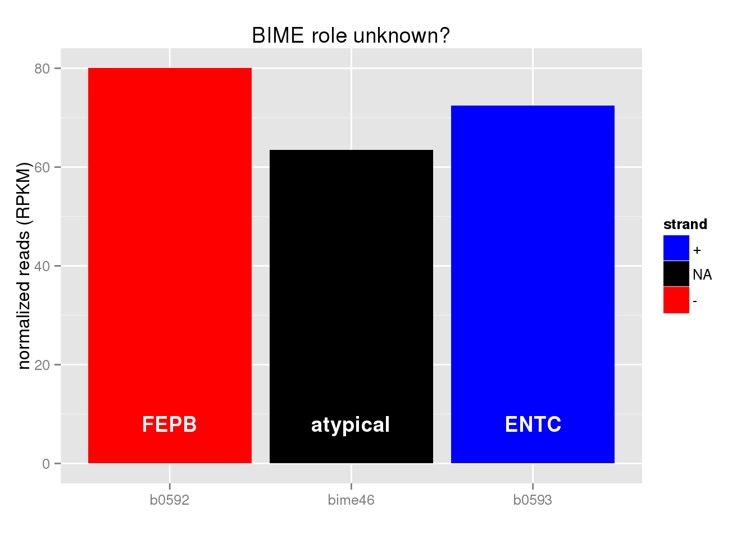
On BIME ^^^|___ : enhancing
BIME-1 | BIME-2 | atypical BIME | unique REP
0 | 0 | 1 | 0
1 case :

Slide 42
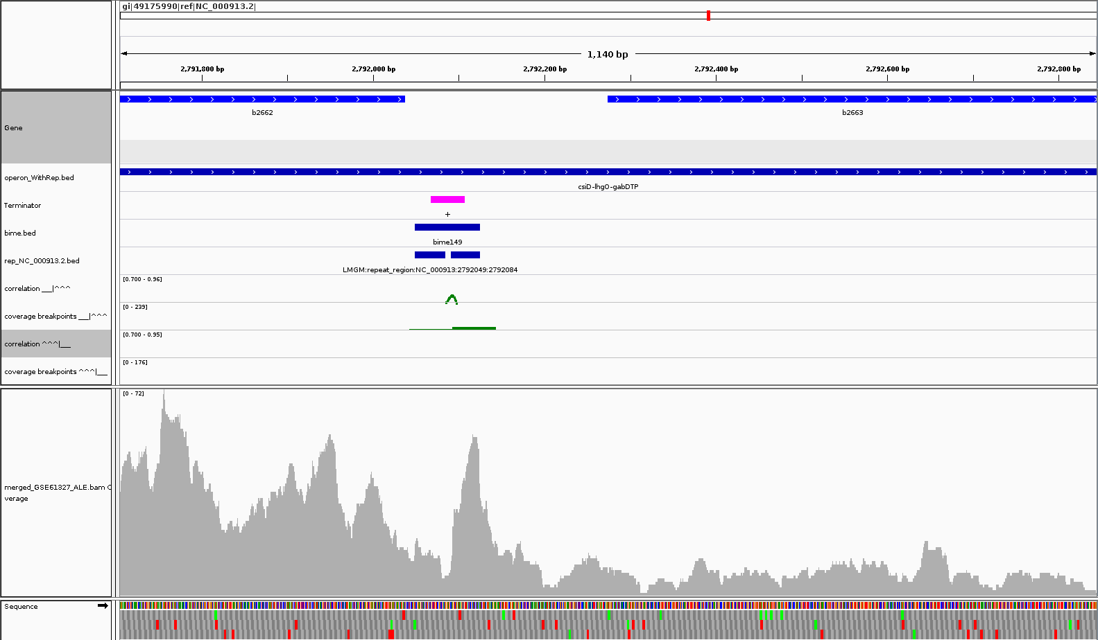
Links with REP results
Operon csiD-lhgO-gabDTP (Multipurpose conversions 4-aminobutyrate aminotransferase, PLP-dependent)

Slide 43
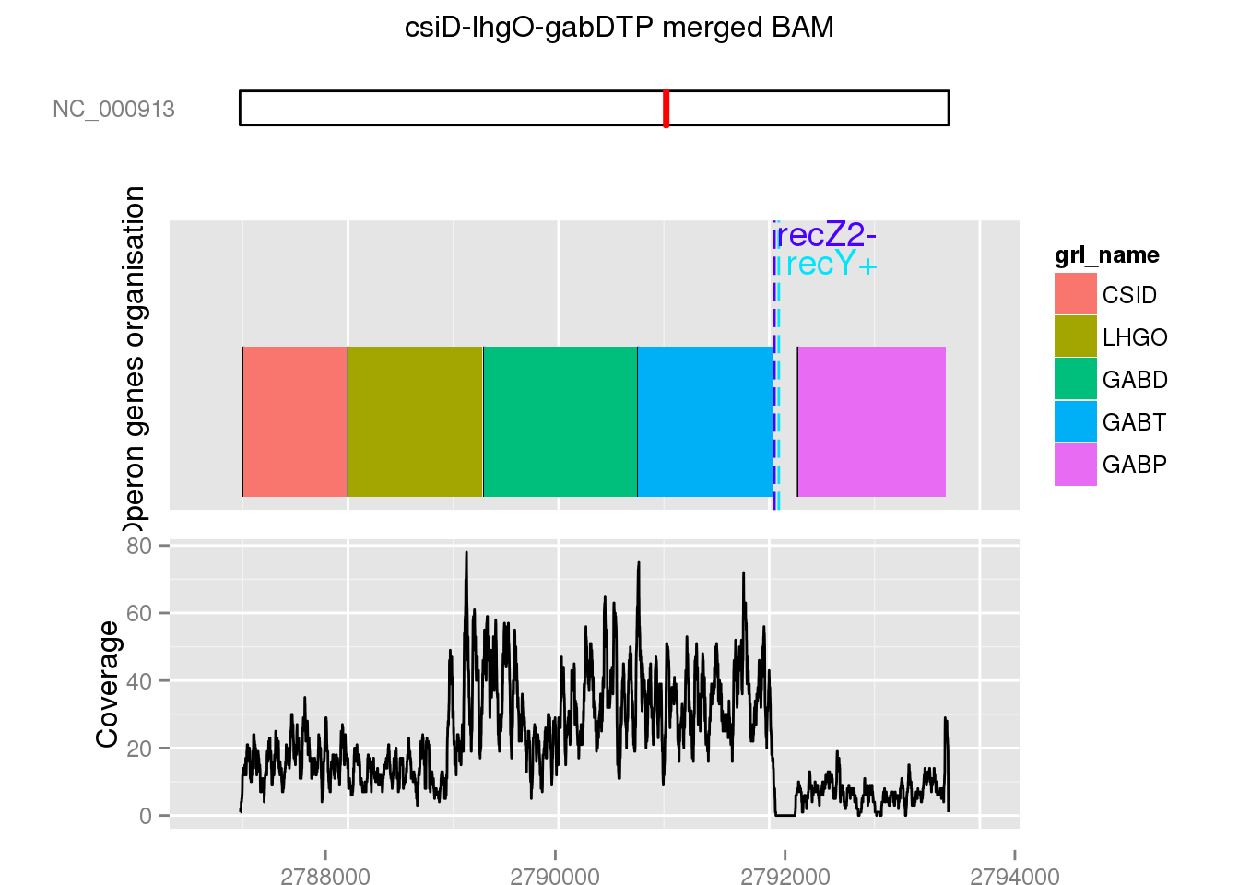
Links with REP results
Operon csiD-lhgO-gabDTP (Multipurpose conversions 4-aminobutyrate aminotransferase, PLP-dependent)

Slide 44
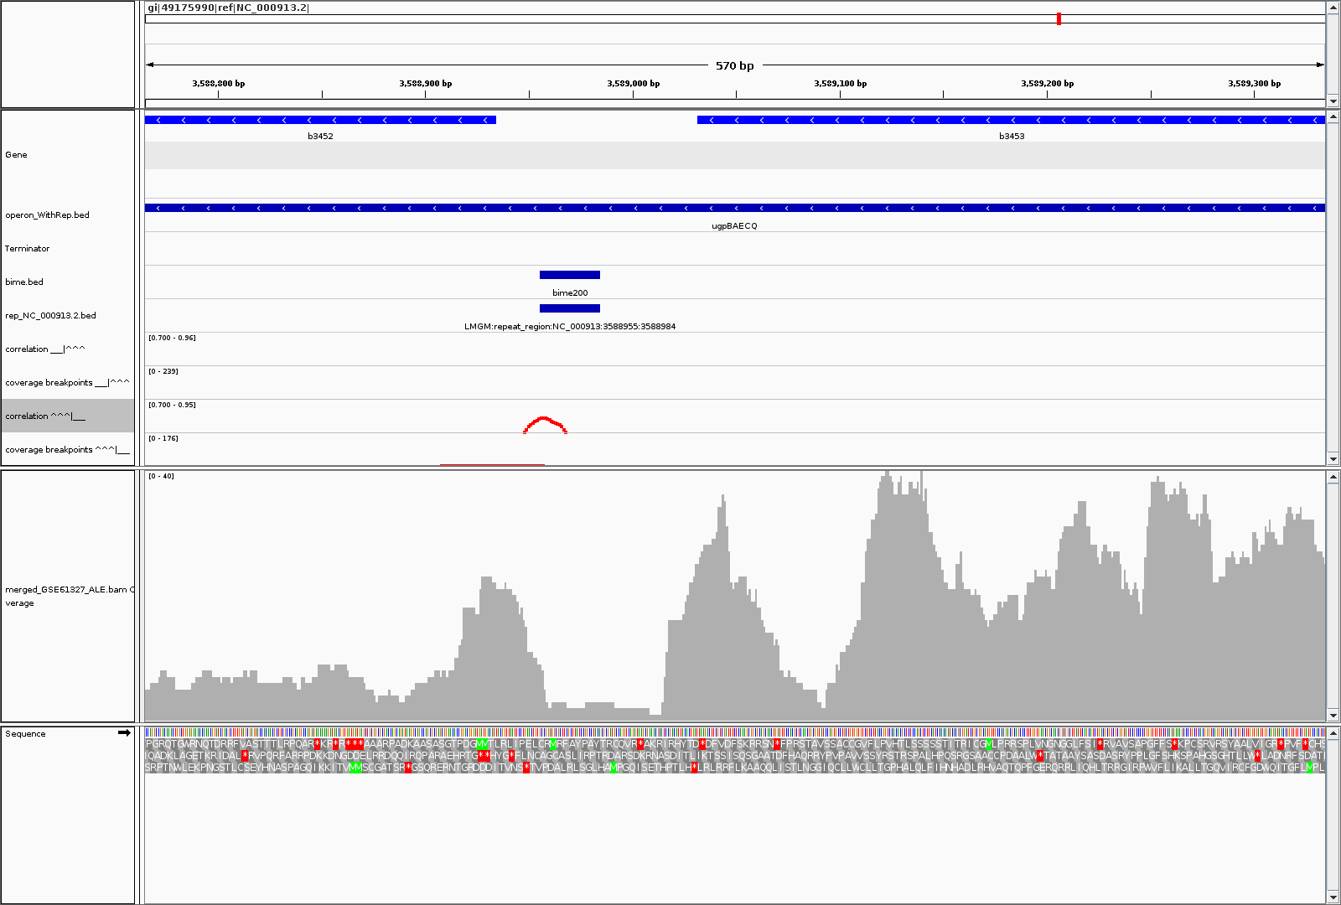
Links with REP results
Operon upgBAECQ (ABC transporter)

Slide 45
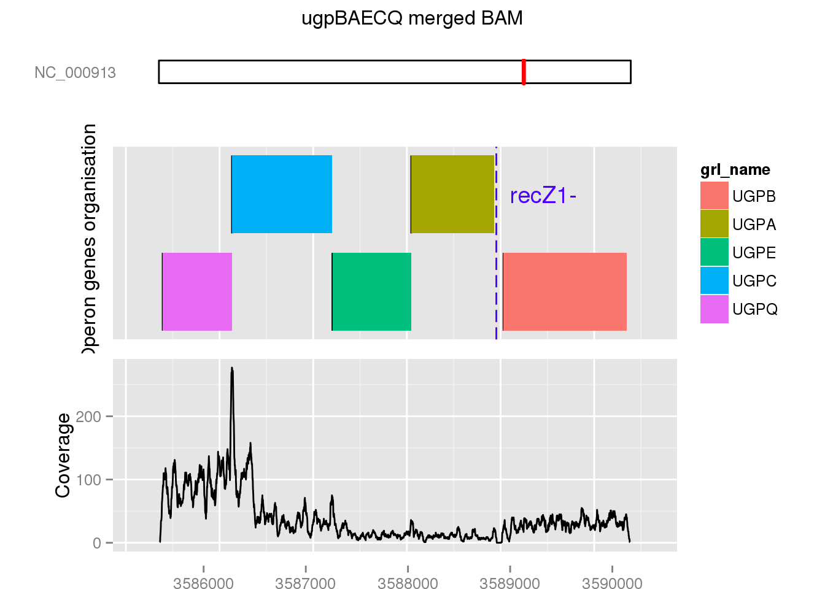
Links with REP results
Operon upgBAECQ (ABC transporter)

Slide 46
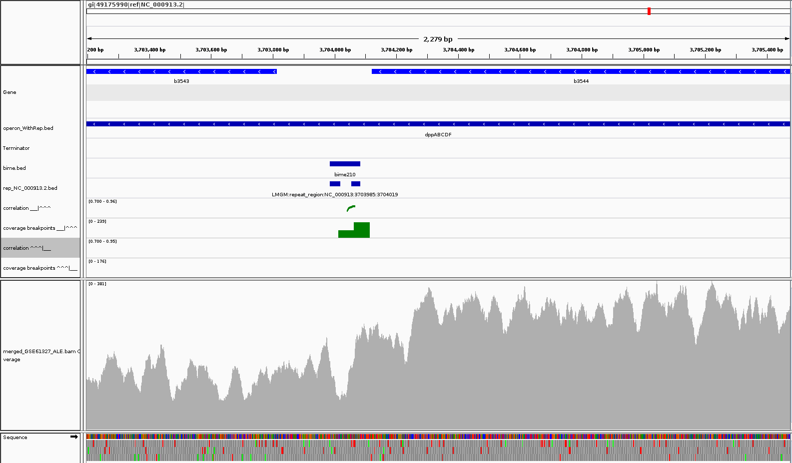
Links with REP results
Operon dppABCDF (ABC transporter)

Slide 47
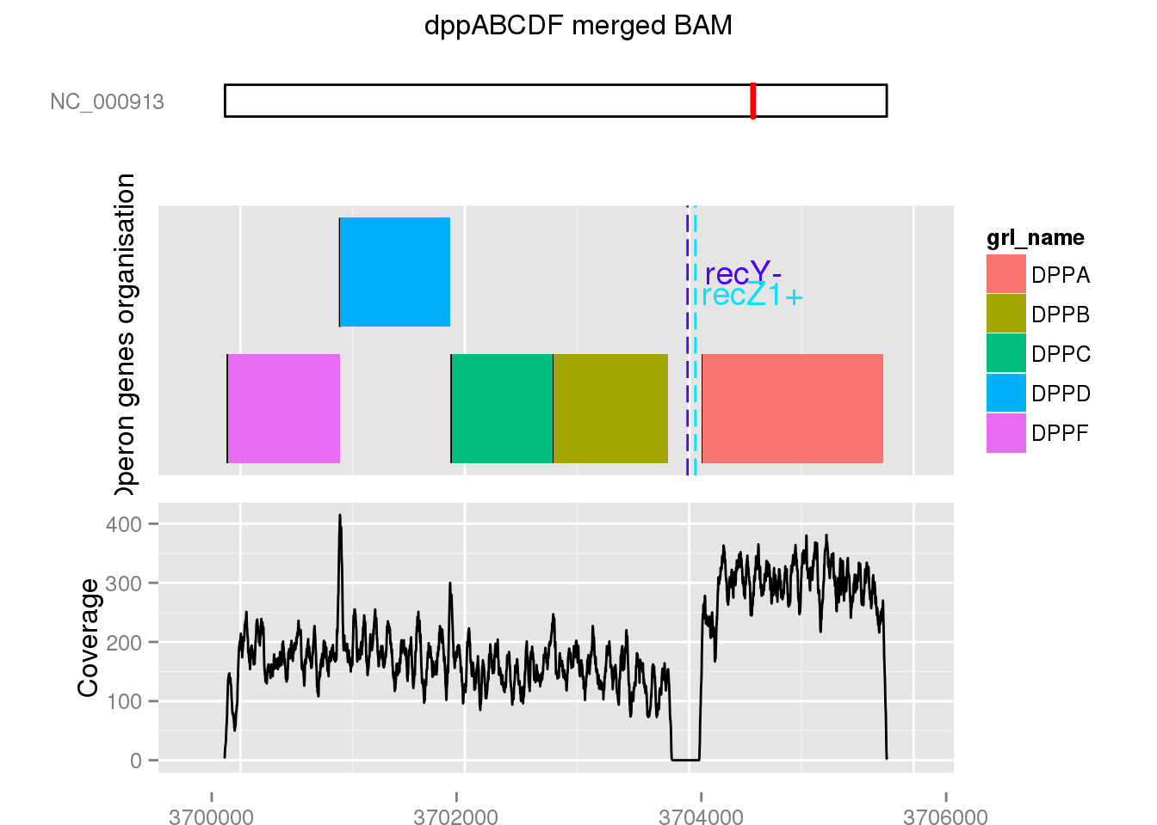
Links with REP results
Operon dppABCDF (ABC transporter)

Slide 48
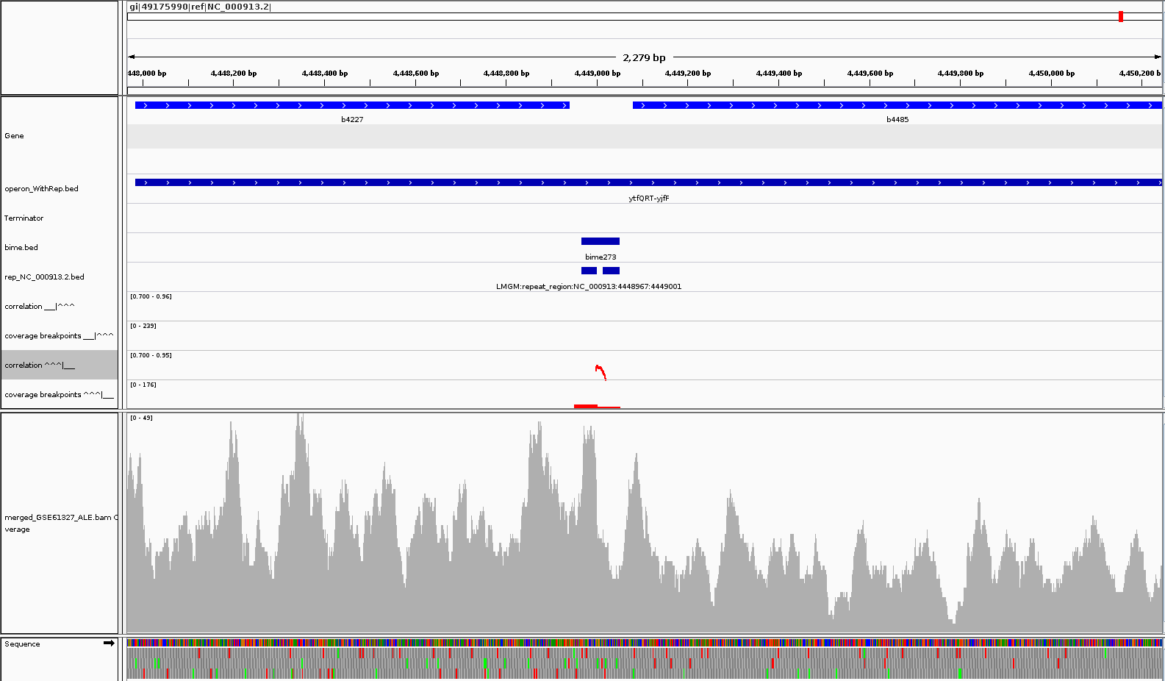
Links with REP results
Operon ytfQRT-yjfF (ABC transporter)

Slide 49
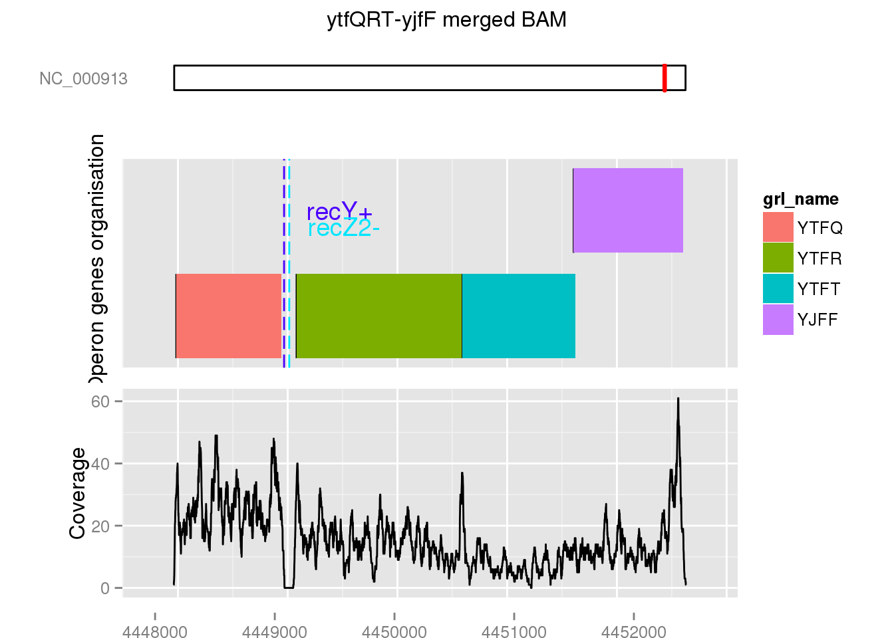
Links with REP results
Operon ytfQRT-yjfF (ABC transporter)

Slide 50
Perspectives
Improve transcription change discovery ?
Alignment of REP or BIME expression profiles to look for a pattern.
Kolmogorov test on expression profiles for BIME classes to search differences.
RIP-Seq or RIP-Chip analysis to check interactions RNA-proteins (data?, methodology?)

