Slide 1
RNA-Seq study of mRNA metabolism in operons: role of BIME in Escherichia coli.

Slide 2
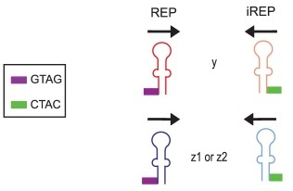

REP & BIME features
Repeated Extragenic Palindrome.
Ton-Hoang et al. 2012
1

Slide 3
REP & BIME features
Repeated Extragenic Palindrome.
BIME set-up (Bacterial Interspesed Mosaic Element)
Ton-Hoang et al. 2012
1

Slide 4

BIME properties?
Structural roles:
  Homologous recombination
  Mobile DNA sequence insertion sites
DNA level:
  Protein binding sites
  Transcription initiation
  Site specific recombination sites
RNA level:
  Control of translation
  Transcription termination
  5' end transcript stabilisation
2

Slide 5
BIME properties?
Structural roles:
  Homologous recombination
  Mobile DNA sequence insertion sites
DNA level:
  Protein binding sites
  Transcription initiation
  Site specific recombination sites
RNA level:
  Control of translation
  Transcription termination?
  5' end transcript stabilisation?
2

Slide 6
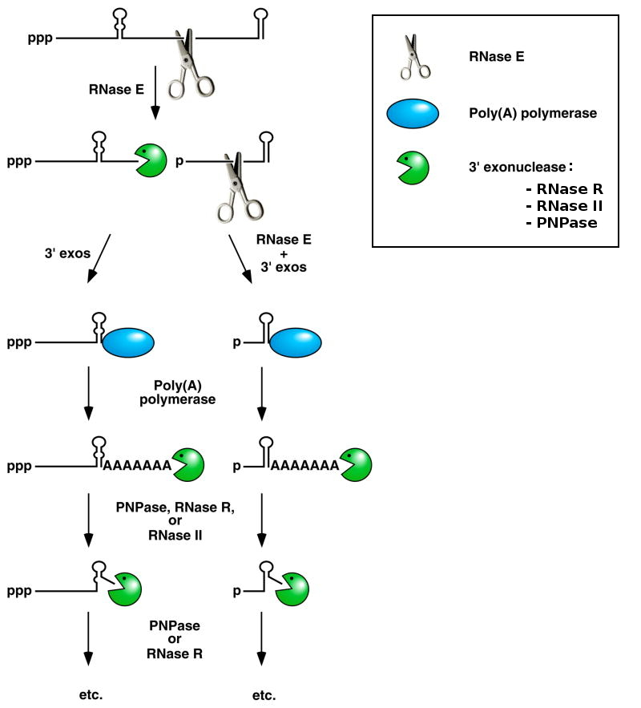
mRNA degradosome
Belasco 2010
3

Slide 7
mRNA degradosome
BIME secondary structures?
Belasco 2010
3

Slide 8
malEFG operon
ABC transporter
malG
malF
malE
3'
5'
malE
substrate
periplasm
Substrate
Binding
Protein
malF
malG
cytoplasmic
membrane
Membrane
Spanning
Domain
cytoplasm
4

Slide 9
malEFG operon
ABC transporter
malG
malF
malE
3'
5'
malE
substrate
periplasm
Substrate
Binding
Protein
malF
malG
cytoplasmic
membrane
Membrane
Spanning
Domain
cytoplasm
4

Slide 10
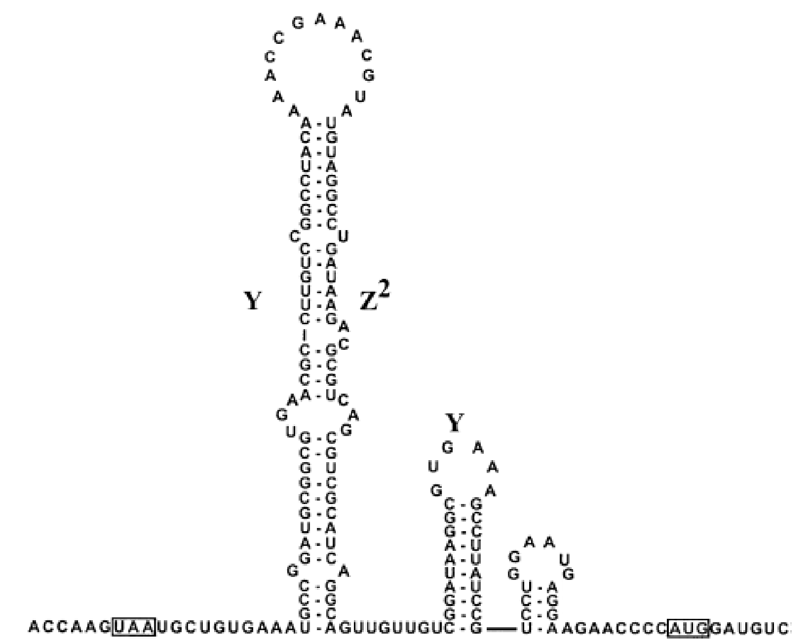
malEFG operon
ABC transporter
malG
malF
malE
3'
5'
Khemici and Carpousis 2004
Y
Z²
Y
malE
malF
5'
stop
start
3'
4

Slide 11

malEFG operon
ABC transporter
malG
malF
malE
3'
5'
Khemici and Carpousis 2004
Y
Z²
Y
malE
malF
5'
stop
start
3'
Rnase E
4

Slide 12
malEFG operon
ABC transporter
malG
malF
malE
3'
5'
Substrate Binding Protein
Expression
4

Slide 13
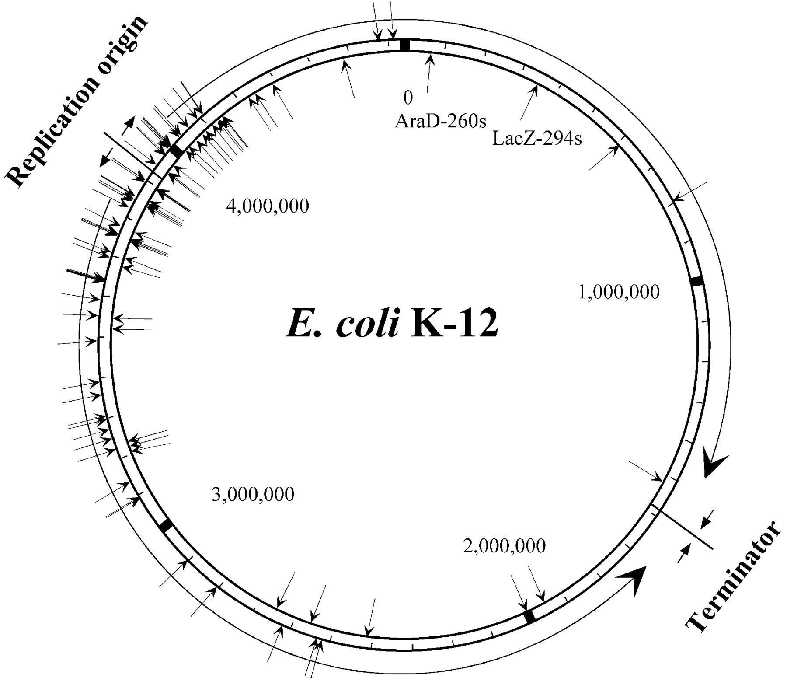

BIME effect study in whole genome
E. coli K12 MG1655 genome:
  4605 genes (NCBI : NC_000913_2)
  848 operons > 1 gene (RegulonDB)
  36 operons with 39 BIMEs (Team, Mathias Weyder 2013)
  Promotors (RegulonDB), Transcription terminators (Door²DB)
5

Slide 14
BIME effect study in whole genome
E. coli K12 MG1655 genome:
  4605 genes (NCBI : NC_000913_2)
  848 operons > 1 gene (RegulonDB)
  36 operons with 39 BIMEs (Team, Mathias Weyder 2013)
  Promotors (RegulonDB), Transcription terminators (Door²DB)
RNA-Seq:
  Whole transcriptome study
  Snapshot of transcription & degradation
  3 data sets from 2 experiments (GEO database)
  8, 3 and 3 replicates
5

Slide 15
Possible expression patterns
Without BIME
gene 1
gene 2
Expression
profiles
Promotor
Trancription
terminator
6

Slide 16
Possible expression patterns
Without BIME
gene 1
gene 2
Expression
profiles
Promotor
Transcription
Trancription
terminator
6

Slide 17
Possible expression patterns
With BIME
gene 1
gene 2
Expression
profiles
Promotor
Transcription
Trancription
terminator
Transcription
6

Slide 18
Possible expression patterns
With BIME
gene 1
gene 2
Expression
profiles
Promotor
Transcription
Trancription
terminator
Transcription
Degradation
6

Slide 19
Analysis pipeline
RNA-Seq
raw reads
Alignment
(BWA)
Filtering
(SAMtools)
Count table
(R easyRnaSeq)
Normalised
count table
RPKM normalisation
(R easyRnaSeq)
Data pre-processing
7

Slide 20

RNA-Seq normalisation
Keep in mind:
gene 1
Expression
gene 1
Condition 1
Condition 2
8

Slide 21
RNA-Seq normalisation
Keep in mind:
gene 1
Expression
gene 1
Condition 1
Condition 2
gene 1
Expression
gene 2
Condition 1
8

Slide 22
RNA-Seq normalisation
Keep in mind:
RPKM normalisation:
  Transcript size
  Library size
gene 1
Expression
gene 1
Condition 1
Condition 2
gene 1
Expression
gene 2
Condition 1
7

Slide 23
Analysis pipeline
RNA-Seq
raw reads
Alignment
(BWA)
Filtering
(SAMtools)
Count table
(R easyRnaSeq)
Genes in operons
Normalised
count table
RPKM normalisation
(R easyRnaSeq)
Global BIME effect
in operons
Data pre-processing
Genes Differentially Expressed
9

Slide 24
Global BIME effect in operons
gene 1
gene 2
-1
0
1
I_{expr}
10

Slide 25
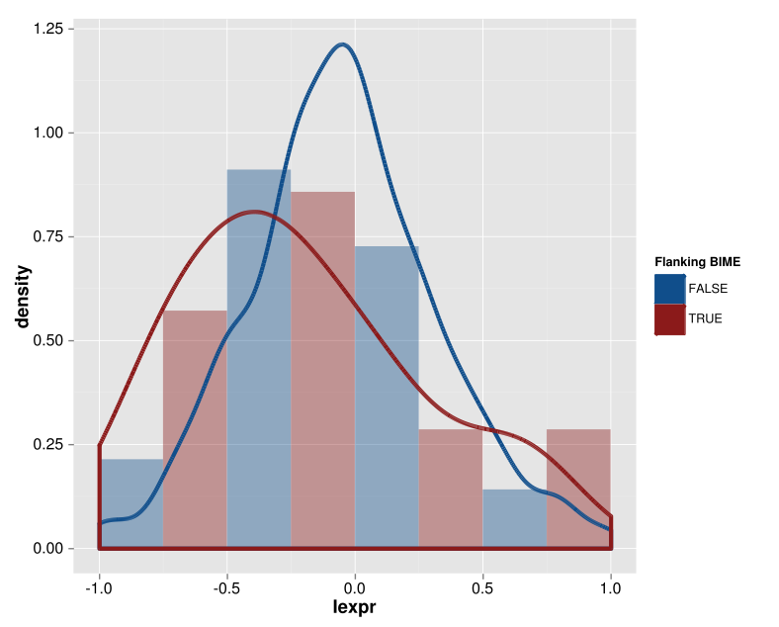
Global BIME effect in operons
Distributions of I_{expr} without promotor and terminator
Without BIME
With BIME
11

Slide 26
Analysis pipeline
RNA-Seq
raw reads
Alignment
(BWA)
Filtering
(SAMtools)
Count table
(R easyRnaSeq)
Genes in operons
Normalised
count table
RPKM normalisation
(R easyRnaSeq)
Global BIME effect
in operons
Data pre-processing
Genes in operons
flanking BIME
Genes Differentially Expressed
DE between
genes
12

Slide 27
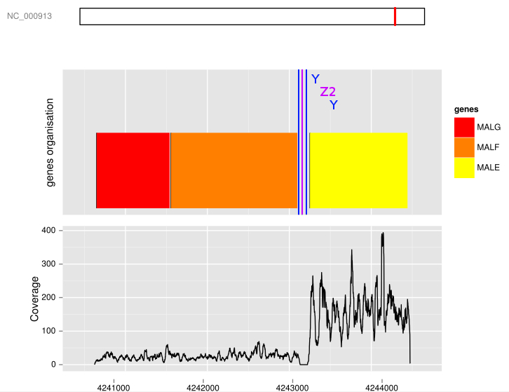

Genes flanking BIME
Differential Expression?
Wilcoxon rank sum test for DE (p-value threshold : 0.01)
malEFG operon coverage
3'
5'
13

Slide 28
Genes flanking BIME
Differential Expression?
Wilcoxon rank sum test for DE (p-value threshold : 0.01)
25 DE on 39 pairs of gene flanking a BIME (3 data sets)
malEFG operon coverage
3'
5'
13

Slide 29
Genes difference of expression linked to the BIME?
Coverage break-point on BIME?
gene 1
gene 2
Expression
14

Slide 30
Analysis pipeline
RNA-Seq
raw reads
Alignment
(BWA)
Filtering
(SAMtools)
Count table
(R easyRnaSeq)
Genes in operons
Normalised
count table
RPKM normalisation
(R easyRnaSeq)
Global BIME effect
in operons
Data pre-processing
Genes in operons
flanking BIME
Genes Differentially Expressed
Break-point search
DE between
genes
Local approach :
Expression profile
correlation
15

Slide 31
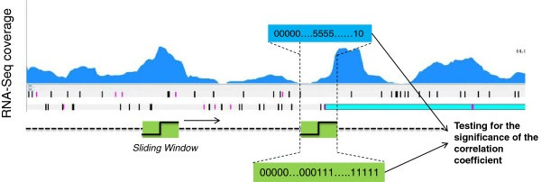
Adaptation of operon detection method
(Local approach)
Expression profile correlation
Window size: 300 bp
2 fold change of expression
Correlation > 0.5 & p-value threshold < 10⁻⁷
Fortino et al. 2014
16

Slide 32
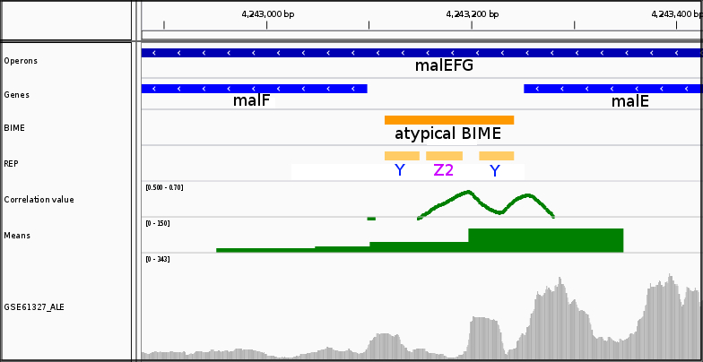
Adaptation of operon detection method
(Local approach)
Expression profile correlation on malE-malF BIME
17

Slide 33
Local approach results
18 break-points on BIMEs for 25 DE
Terminator in intergenic region | Overlaping a BIME | Not overlaping a BIME | Absence
Coverage break-points on BIME | 4/18 | 3/18 | 13/18
18

Slide 34


Local approach results
18 break-points on BIMEs for 25 DE
Weakness:
    RNA-Seq coverage not uniform
    False positive detection
Terminator in intergenic region | Overlaping a BIME | Not overlaping a BIME | Absence
Coverage break-points on BIME | 4/18 | 3/18 | 13/18
18

Slide 35
Local approach results
18 break-points on BIMEs for 25 DE
Weakness:
    RNA-Seq coverage not uniform
    False positive detection
Other approach?
Terminator in intergenic region | Overlaping a BIME | Not overlaping a BIME | Absence
Coverage break-points on BIME | 4/18 | 3/18 | 13/18
18

Slide 36
Analysis pipeline
RNA-Seq
raw reads
Alignment
(BWA)
Filtering
(SAMtools)
Count table
(R easyRnaSeq)
Genes in operons
Normalised
count table
RPKM normalisation
(R easyRnaSeq)
Global BIME effect
in operons
Data pre-processing
Genes in operons
flanking BIME
Genes Differentially Expressed
Break-point search
DE between
genes
Local approach :
Expression profile
correlation
Global approach :
Segmentation
19

Slide 37
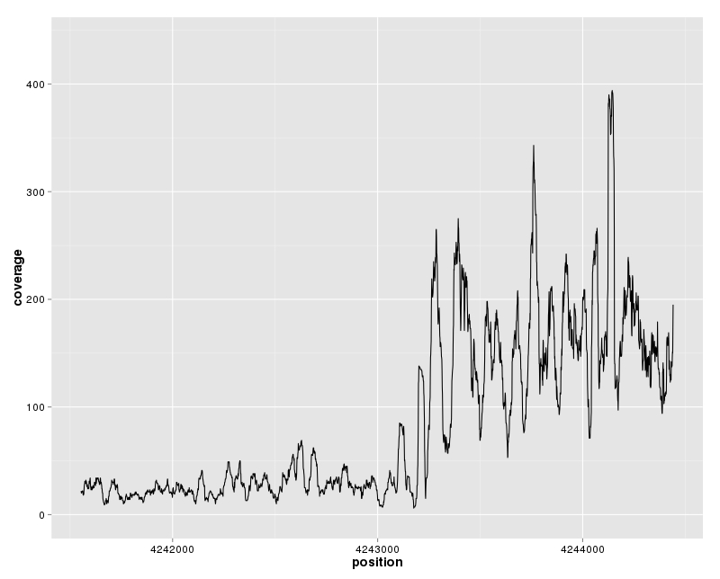
Segmentation
(Global approach)
Segmentation on malE-malF BIME
20
Notes:
Segmentation
No profile
Poisson model → segments partitions of whole region
Cost function for each partition
Minimisation of cost function for set of partitions (PDP)
K = 4 segments

Slide 38
Segmentation
(Global approach)
Statistical model :
Possible
segmentations
Cleynen et al. 2014
20
Notes:
Yt : couverture de la région
t : signal de n points
θr : moyenne du segment r
r : segments

Slide 39
Segmentation
(Global approach)
Optimal cost :
0,2
0,5
Possible
segmentations
0,9
0,5
0,6
0,3
0,2
0,4
0,7
Cleynen et al. 2014
20
Notes:
Yt : couverture de la région
t : signal de n points
θr : moyenne du segment r
r : segment
γ : perte minimal (négative log-likelihood)

Slide 40
Segmentation
(Global approach)
Pruning Dynamic Programming :
Best
segmentation
0,2
0,5
0,9
0,5
0,6
0,3
0,2
0,4
0,7
Cleynen et al. 2014
20
Notes:
Comparaison des candidats par point de cassure par permutation des segments qui suivent ce point

Slide 41
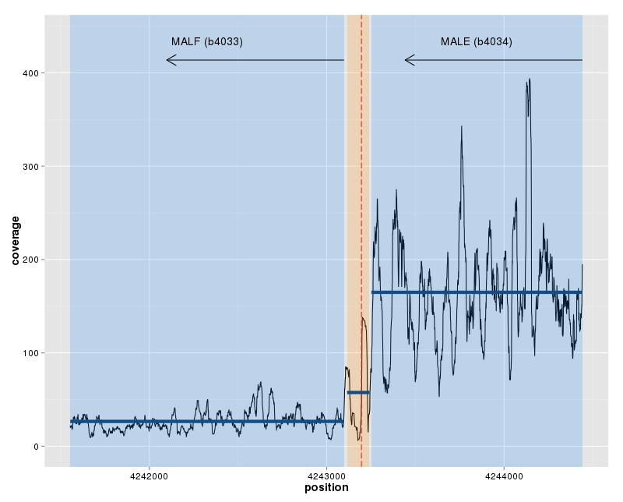
Segmentation
(Global approach)
Segmentation on malE-malF BIME
Gene
BIME
20
Notes:
Segmentation
No profile
Poisson model → segments partitions of whole region
Cost function for each partition
Minimisation of cost function for set of partitions (PDP)
K = 4 segments

Slide 42
Global approach results
17 break-points on BIMEs for 25 DE
Terminator in intergenic region | Overlaping a BIME | Not overlaping a BIME | Absence
Coverage break-points on BIME | 3/17 | 3/17 | 12/17
21

Slide 43
Global approach results
17 break-points on BIMEs for 25 DE
Weakness?
    Sensitive to number of replicates?
Terminator in intergenic region | Overlaping a BIME | Not overlaping a BIME | Absence
Coverage break-points on BIME | 3/17 | 3/17 | 12/17
21

Slide 44
Question
Are BIMEs involved in the mRNA metabolism in operons for E. coli genome :
as transcription terminator ?
as stabiliser of 5' end of transcript ?
22

Slide 45
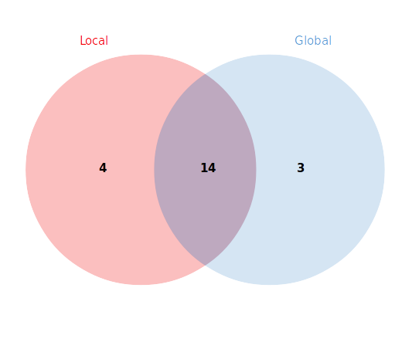
Break-point search result synthesis
Method intersect:
14 common detections on 21
3 data sets
23

Slide 46
Break-point search result synthesis
All data sets results:
Terminator in intergenic region | Overlaping a BIME | Not overlaping a BIME | Absence
Coverage break-points on BIME | 4/21 | 4/21 | 15/21
24

Slide 47
Break-point search result synthesis
All data sets results:
Transcription terminator function
Terminator in intergenic region | Overlaping a BIME | Not overlaping a BIME | Absence
Coverage break-points on BIME | 4/21 | 4/21 | 15/21
24

Slide 48
Break-point search result synthesis
All data sets results:
Transcription terminator function
Stabiliser of 5' end transcript
Terminator in intergenic region | Overlaping a BIME | Not overlaping a BIME | Absence
Coverage break-points on BIME | 4/21 | 4/21 | 15/21
24

Slide 49
Biological synthesis
malEFG model validated
malE
substrate
periplasm
Substrate
Binding
Protein
malF
malG
cytoplasmic
membrane
Membrane
Spanning
Domain
cytoplasm
25

Slide 50
Biological synthesis
malEFG model validated
28 ABC transporters in E.coli K12
malE
substrate
periplasm
Substrate
Binding
Protein
malF
malG
cytoplasmic
membrane
Membrane
Spanning
Domain
cytoplasm
25

Slide 51
Biological synthesis
malEFG model validated
28 ABC transporters in E.coli K12
7 ABC transporters with 8 BIMEs on 21 detections
malE
substrate
periplasm
Substrate
Binding
Protein
malF
malG
cytoplasmic
membrane
Membrane
Spanning
Domain
cytoplasm
25

Slide 52
Biological synthesis
malEFG model validated
28 ABC transporters in E.coli K12
7 ABC transporters with 8 BIMEs on 21 detections
6 without terminator
malE
substrate
periplasm
Substrate
Binding
Protein
malF
malG
cytoplasmic
membrane
Membrane
Spanning
Domain
cytoplasm
25

Slide 53
Biological synthesis
malEFG model validated
28 ABC transporters in E.coli K12
7 ABC transporters with 8 BIMEs on 21 detections
6 without terminator →Substrate Binding Proteins
malE
substrate
periplasm
Substrate
Binding
Protein
malF
malG
Expression
cytoplasmic
membrane
Membrane
Spanning
Domain
cytoplasm
25

Slide 54
Conclusions
RNA-Seq data fine for those studies
BIME effect on upstream gene
Segmentation method suited (Global)
Easy to use with other data sets
Annotation quality?
Predominance of 5' end transcript stabiliser function
26

Slide 55
Perspectives
RNA-Seq experiment designs
  Test transcription termination function:
    WT & alteration of degradosome genes
  Test transcript 5' end stabiliser function:
    Transcription blocking & time sampling for monitoring of the transcript degradation
Benchmark with segmentation
  reduce the number of replicates (same experiment)
Generalisation to other species
27

Slide 56



Acknowledgments
LMGM: Genomics of integrated systems
Gwennaele Fichant
Yves Quentin
Roland Barriot
Petra Langendijk-Genevaux
Mathias Weyder
Arnaud Frèche
INRA: Applied Mathematics and Informatics
Christine Gaspin

Slide 57
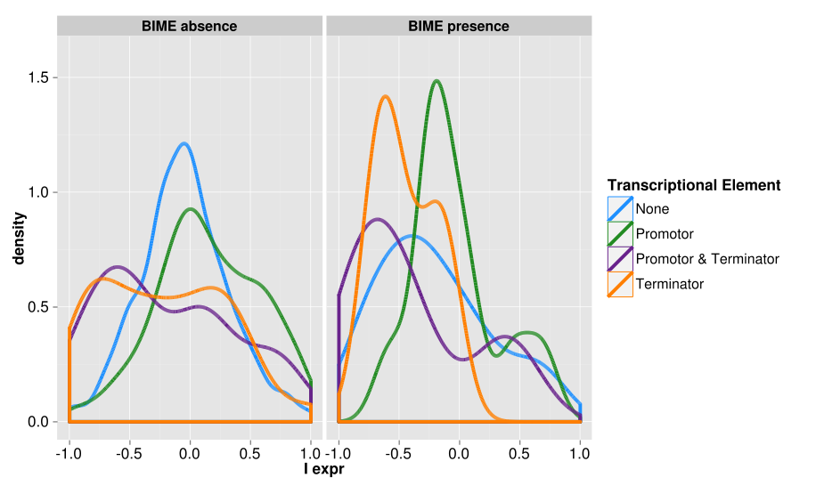
Global BIME effect in operons
Distributions of I_{expr} depending on Transcriptional Elements

Slide 58
Adaptation of operon detection method
(Local approach)
Expression profile correlation on malE-malF BIME
17

Slide 59
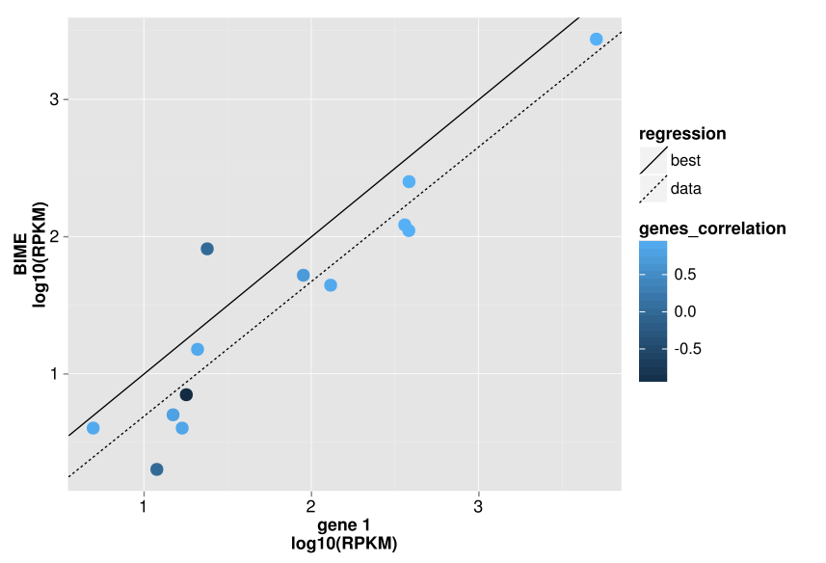
BIME sequencing bias
No DE in operons, no promotor or terminator

Slide 60
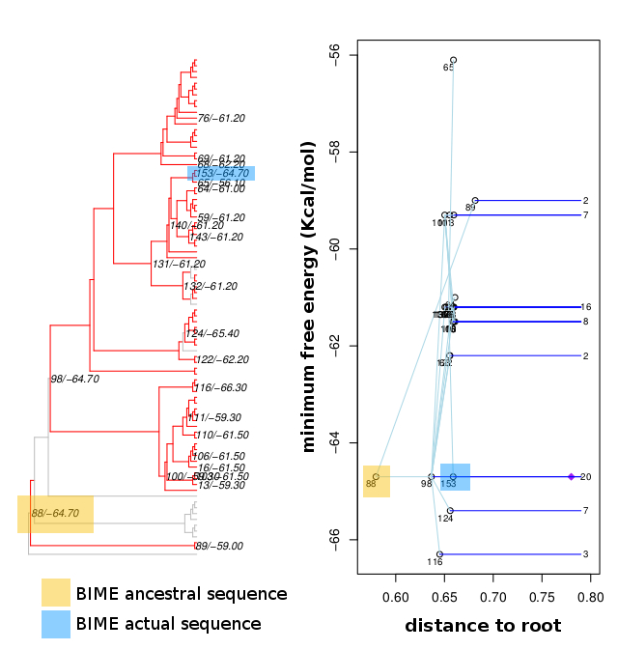
Ancestral sequences and secondary structures
malE-malF BIME 2nd structure energy evolution

Slide 61
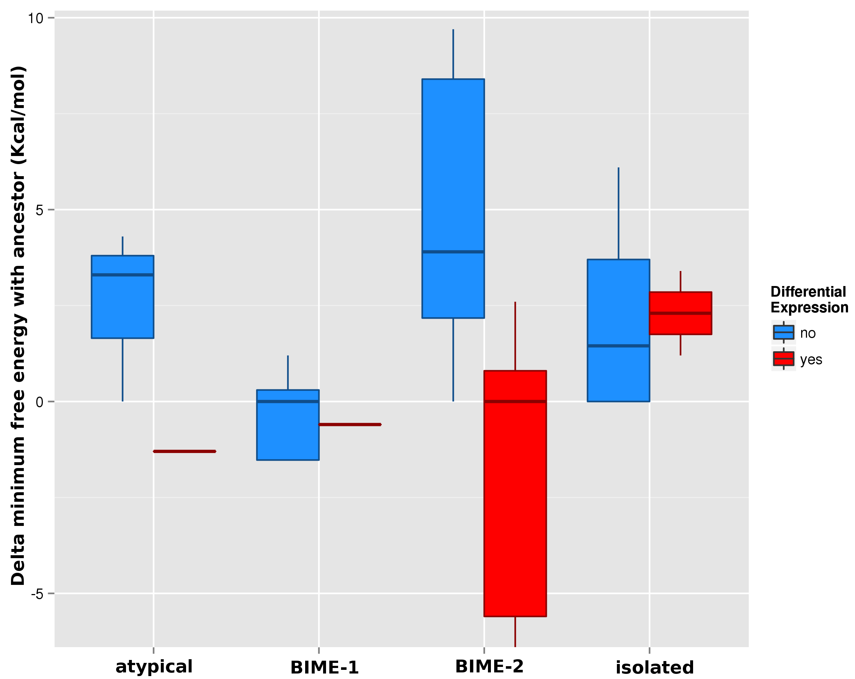
Ancestral sequences and secondary structures
Delta of energy between ancestor & actual BIME

Slide 62
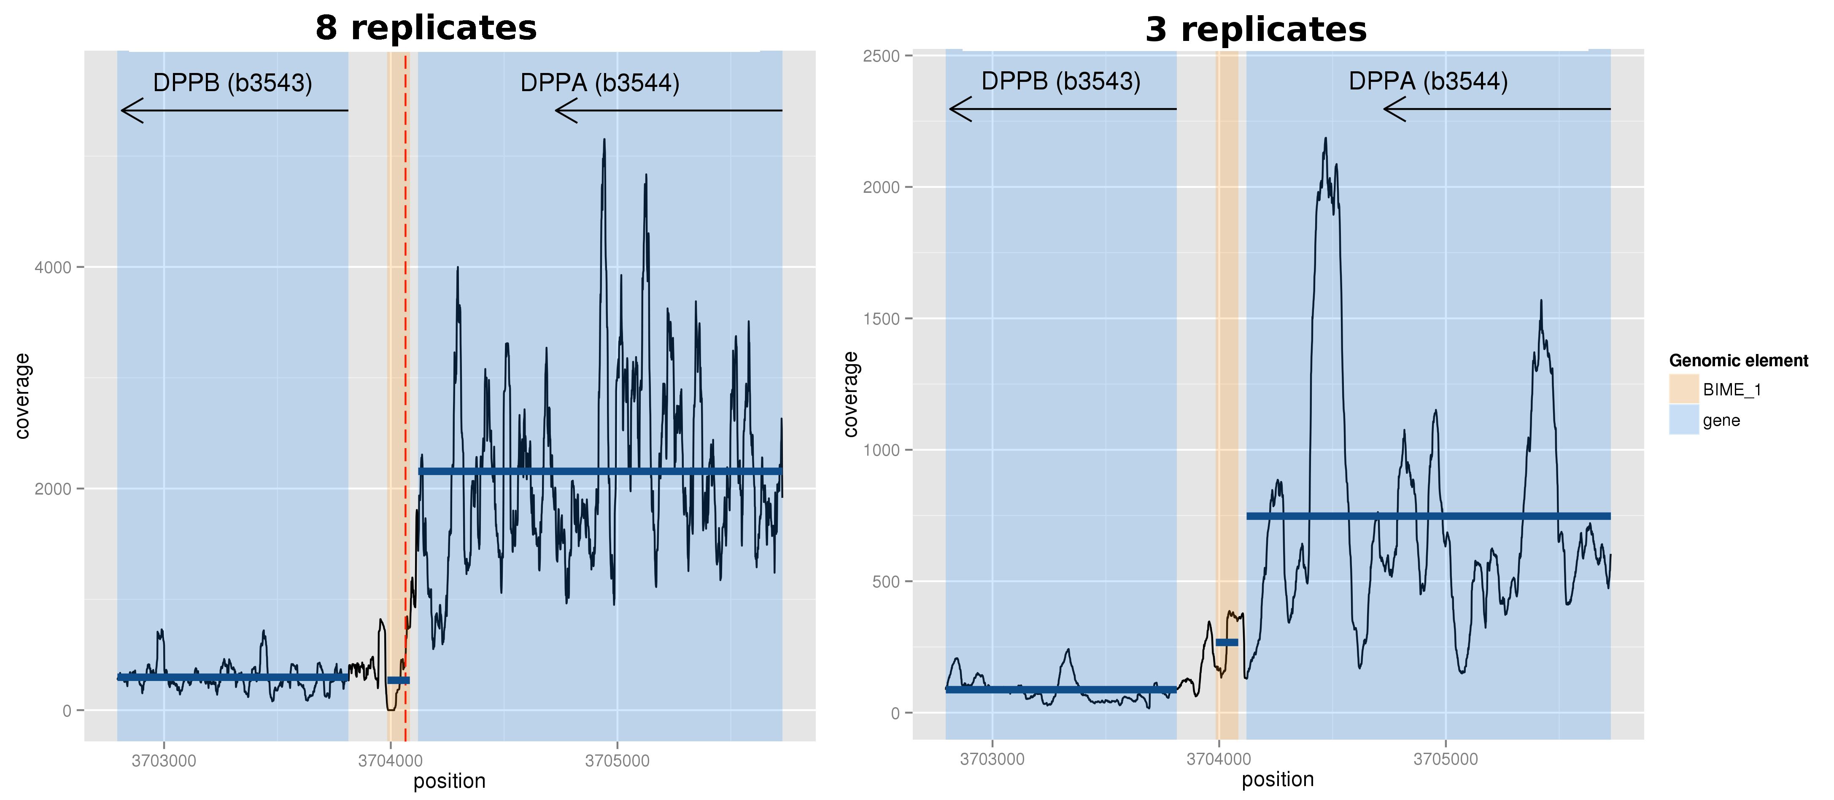
Segmentation efficiency & replicates

