Slide 1
RNA-Seq study of mRNA metabolism in operons: role of BIME in Escherichia coli.

Slide 2
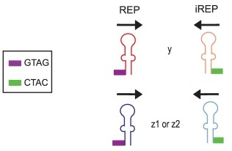

REP & BIME features
Repeated Extragenic Palindrome
Ton-Hoang et al. 2012
1

Slide 3
REP & BIME features
Repeated Extragenic Palindrome
BIME set-up (Bacterial Interspesed Mosaic Element)
Ton-Hoang et al. 2012
1

Slide 4

BIME properties?
Structural roles:
  Homologous recombination
  Mobile DNA sequence insertion sites
DNA level:
  Protein binding sites
  Transcription initiation
  Site specific recombination sites
RNA level:
  Control of translation
  Transcription termination
  5' end transcript stabilisation
2

Slide 5
BIME properties?
Structural roles:
  Homologous recombination
  Mobile DNA sequence insertion sites
DNA level:
  Protein binding sites
  Transcription initiation
  Site specific recombination sites
RNA level:
  Control of translation
  Transcription termination?
  5' end transcript stabilisation?
2

Slide 6
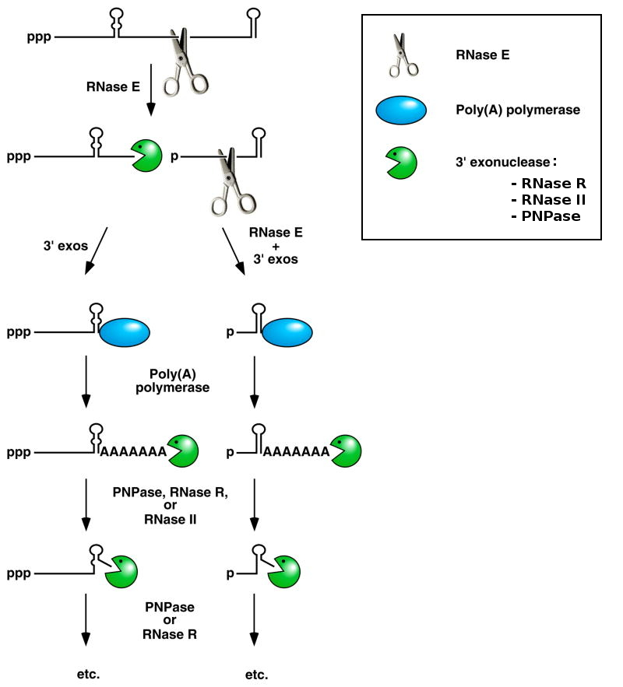
mRNA degradosome
Belasco 2010
3

Slide 7
mRNA degradosome
BIME secondary structures?
Belasco 2010
3

Slide 8
malEFG operon
ABC transporter
malG
malF
malE
3'
5'
malE
substrate
periplasm
Substrate
Binding
Protein
malF
malG
cytoplasmic
membrane
Membrane
Spanning
Domain
cytoplasm
4

Slide 9
malEFG operon
ABC transporter
malG
malF
malE
3'
5'
malE
substrate
periplasm
Substrate
Binding
Protein
malF
malG
cytoplasmic
membrane
Membrane
Spanning
Domain
cytoplasm
4

Slide 10
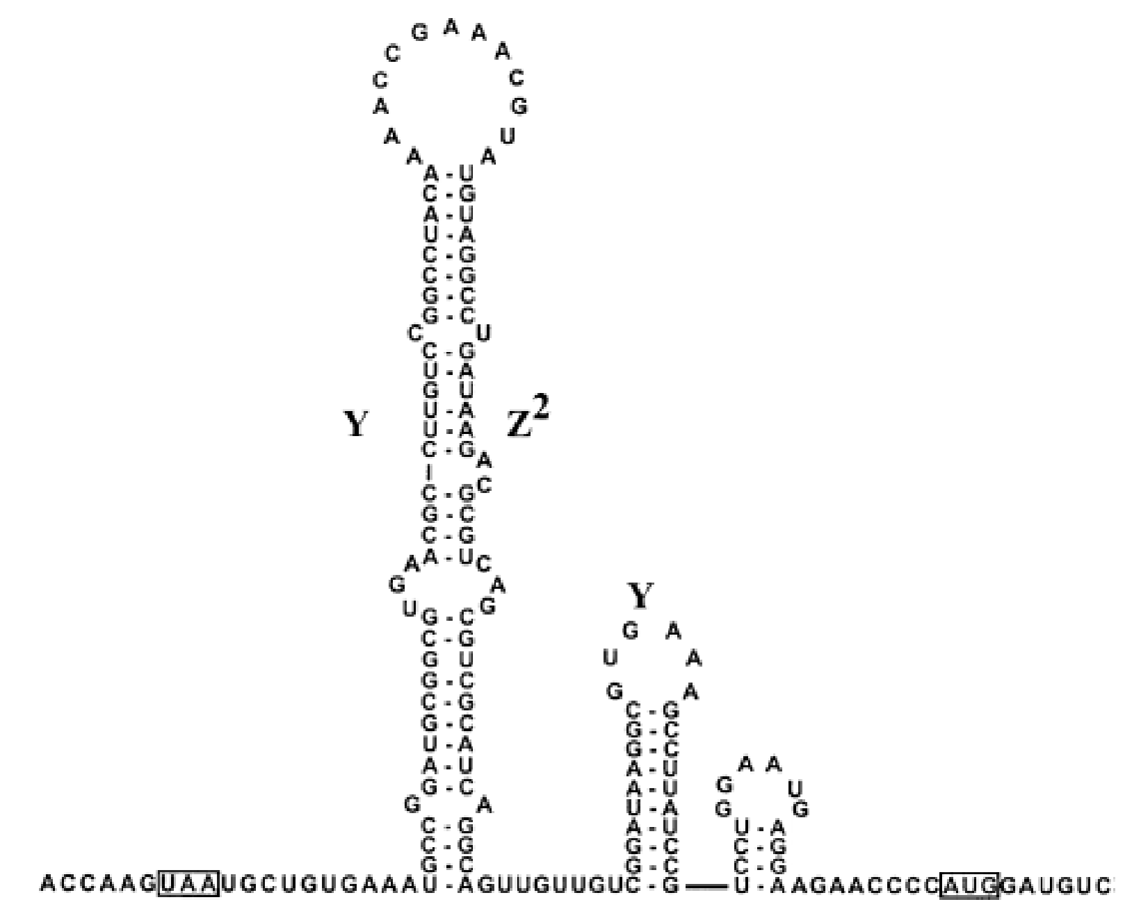
malEFG operon
ABC transporter
malG
malF
malE
3'
5'
Khemici and Carpousis 2004
Y
Z²
Y
malE
malF
5'
stop
start
3'
4

Slide 11

malEFG operon
ABC transporter
malG
malF
malE
3'
5'
Khemici and Carpousis 2004
Y
Z²
Y
malE
malF
5'
stop
start
3'
Rnase E
4

Slide 12
malEFG operon
ABC transporter
malG
malF
malE
3'
5'
Substrate Binding Protein
Expression
Transmembrane Domain
4

Slide 13
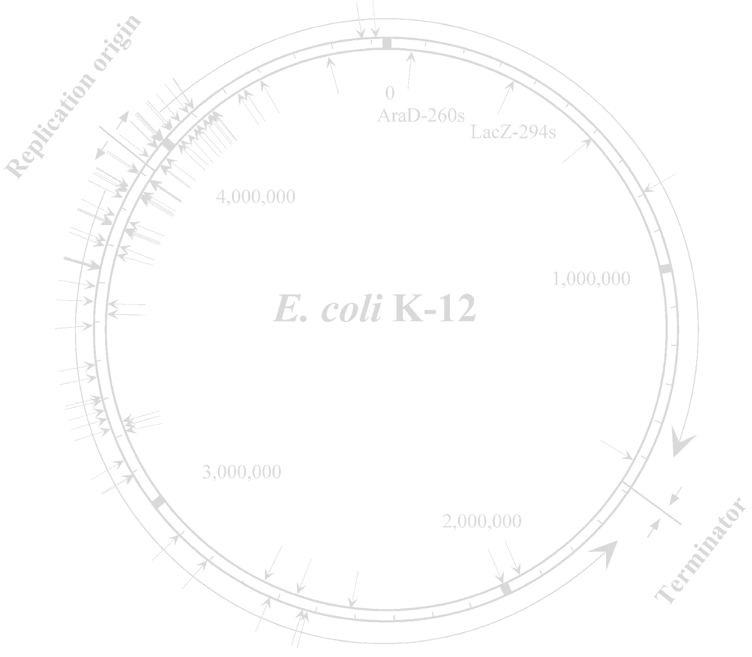

BIME effect study in whole genome
E. coli K12 MG1655 genome:
  4605 genes (NCBI : NC_000913_2)
  848 operons > 1 gene (RegulonDB)
  605 REPs, 287 BIMEs (Team, Mathias Weyder 2013)
  36 operons with 39 BIMEs
  Promotors (RegulonDB), Transcription terminators (Door²DB)
5

Slide 14
BIME effect study in whole genome
E. coli K12 MG1655 genome:
  4605 genes (NCBI : NC_000913_2)
  848 operons > 1 gene (RegulonDB)
  605 REPs, 287 BIMEs (Team, Mathias Weyder 2013)
  36 operons with 39 BIMEs
  Promotors (RegulonDB), Transcription terminators (Door²DB)
RNA-Seq:
  Whole transcriptome study
  Snapshot of transcription & degradation
  3 data sets from 2 experiments (GEO database)
  8, 3 and 3 replicates
5

Slide 15
Possible expression patterns
gene 1
gene 2
Promotor
Degradation
Trancription
terminator /
attenuator
BIME
Expression
0
6

Slide 16
Possible expression patterns
gene 1
gene 2
Promotor
Transcription
Trancription
terminator /
attenuator
BIME
Expression
0
6

Slide 17
Possible expression patterns
gene 1
gene 2
Promotor
Transcription
Trancription
terminator /
attenuator
Expression
0
6

Slide 18
Possible expression patterns
gene 1
gene 2
Promotor
Transcription
Trancription
terminator /
attenuator
Expression
0
6

Slide 19
Possible expression patterns
gene 1
gene 2
Promotor
Trancription
terminator /
attenuator
Possible
transcripts
BIME
Expression
Expression pattern of interest
0
6

Slide 20
Analysis pipeline
RNA-Seq
raw reads
Alignment
(BWA)
Filtering
(SAMtools)
Count table
(R easyRnaSeq)
Normalised
count table
RPKM normalisation
(R easyRnaSeq)
Data pre-processing
7

Slide 21

RNA-Seq normalisation
Keep in mind:
gene 1
Expression
gene 1
Condition 1
Condition 2
8

Slide 22
RNA-Seq normalisation
Keep in mind:
gene 1
Expression
gene 1
Condition 1
Condition 2
gene 1
Expression
gene 2
Condition 1
8

Slide 23
RNA-Seq normalisation
Keep in mind:
RPKM normalisation:
  Transcript size
  Library size
gene 1
Expression
gene 1
Condition 1
Condition 2
gene 1
Expression
gene 2
Condition 1
8

Slide 24
Analysis pipeline
RNA-Seq
raw reads
Alignment
(BWA)
Filtering
(SAMtools)
Count table
(R easyRnaSeq)
Genes in operons
Normalised
count table
RPKM normalisation
(R easyRnaSeq)
Global BIME effect
in operons
Data pre-processing
Genes Differentially Expressed (DE)
9

Slide 25
Global BIME effect in operons
gene 1
gene 2
-1
0
1
I_{expr}
10

Slide 26
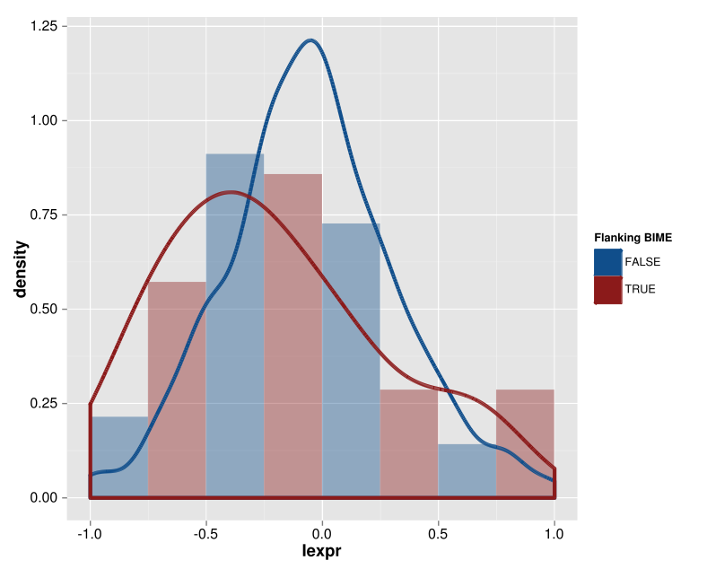
Global BIME effect in operons
Distributions of I_{expr} without annoted promotor and terminator in intergenic region
Without BIME
With BIME
11

Slide 27
Analysis pipeline
RNA-Seq
raw reads
Alignment
(BWA)
Filtering
(SAMtools)
Count table
(R easyRnaSeq)
Genes in operons
Normalised
count table
RPKM normalisation
(R easyRnaSeq)
Global BIME effect
in operons
Data pre-processing
Genes in operons
flanking BIME
Genes Differentially Expressed
DE between
genes
12

Slide 28
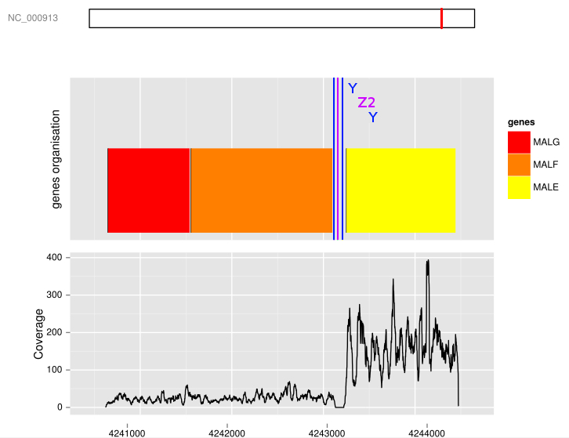

Genes flanking BIME
Differential Expression?
Wilcoxon rank sum test for DE (p-value threshold : 0.01)
malEFG operon coverage
3'
5'
13

Slide 29
Genes flanking BIME
Differential Expression?
Wilcoxon rank sum test for DE (p-value threshold : 0.01)
25 DE on 39 pairs of gene flanking a BIME (3 data sets)
malEFG operon coverage
3'
5'
13

Slide 30
Genes difference of expression linked to the BIME?
Coverage break-point on BIME?
gene 1
gene 2
Expression
14

Slide 31
Analysis pipeline
RNA-Seq
raw reads
Alignment
(BWA)
Filtering
(SAMtools)
Count table
(R easyRnaSeq)
Genes in operons
Normalised
count table
RPKM normalisation
(R easyRnaSeq)
Global BIME effect
in operons
Data pre-processing
Genes in operons
flanking BIME
Genes Differentially Expressed (DE)
Break-point search
DE between
genes
Local approach :
Expression profile
correlation
15

Slide 32
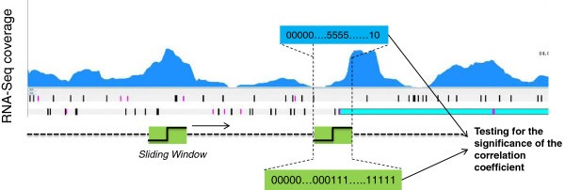
Adaptation of operon detection method
(Local approach)
Expression profile correlation
Window size: 300 bp
2 fold change of expression
Correlation > 0.5 & p-value threshold < 10⁻⁷
Fortino et al. 2014
16

Slide 33
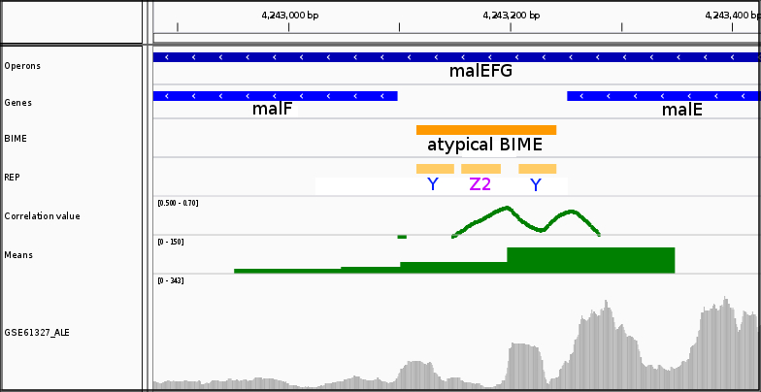
Adaptation of operon detection method
(Local approach)
Expression profile correlation on malE-malF BIME
17

Slide 34
Adaptation of operon detection method
(Local approach)
Expression profile correlation on malE-malF BIME
17

Slide 35
Local approach results
18 break-points on BIMEs for 25 DE
Coverage break-points on BIME | 3/18 | 4/18 | 13/18
1
2
1
2
1
2
18

Slide 36


Local approach results
18 break-points on BIMEs for 25 DE
Weakness:
    RNA-Seq coverage not uniform
    False positive detection
Coverage break-points on BIME | 3/18 | 4/18 | 13/18
1
2
1
2
1
2
18

Slide 37
Local approach results
18 break-points on BIMEs for 25 DE
Weakness:
    RNA-Seq coverage not uniform
    False positive detection
Other approach?
Coverage break-points on BIME | 3/18 | 4/18 | 13/18
1
2
1
2
1
2
18

Slide 38
Analysis pipeline
RNA-Seq
raw reads
Alignment
(BWA)
Filtering
(SAMtools)
Count table
(R easyRnaSeq)
Genes in operons
Normalised
count table
RPKM normalisation
(R easyRnaSeq)
Global BIME effect
in operons
Data pre-processing
Genes in operons
flanking BIME
Genes Differentially Expressed (DE)
Break-point search
DE between
genes
Local approach :
Expression profile
correlation
Global approach :
Segmentation
19

Slide 39
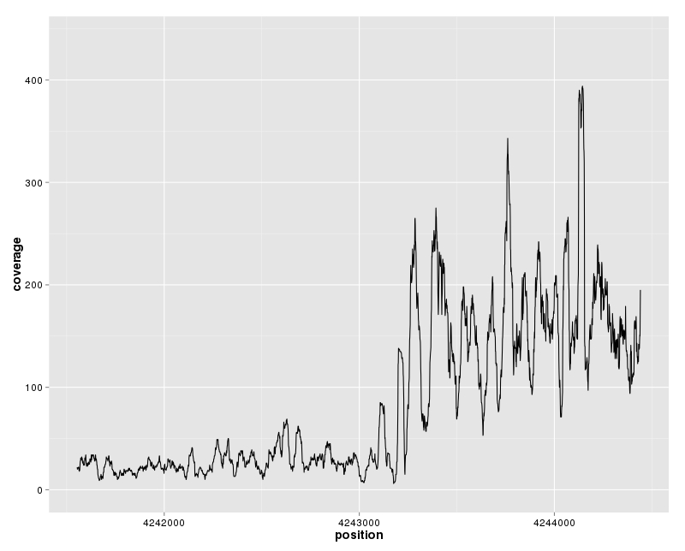
Segmentation
(Global approach)
Segmentation on malE-malF BIME
20
Notes:
Segmentation
No profile
Poisson model → segments partitions of whole region
Cost function for each partition
Minimisation of cost function for set of partitions (PDP)
K = 4 segments

Slide 40
Segmentation
(Global approach)
Statistical model :
Possible
segmentations
Cleynen et al. 2014
20
Notes:
Yt : couverture de la région
t : signal de n points
θr : moyenne du segment r
r : segments

Slide 41
Segmentation
(Global approach)
Optimal cost :
0,2
0,5
Possible
segmentations
0,9
0,5
0,6
0,3
0,2
0,4
0,7
Cleynen et al. 2014
20
Notes:
Yt : couverture de la région
t : signal de n points
θr : moyenne du segment r
r : segment
γ : perte minimal (négative log-likelihood)

Slide 42
Segmentation
(Global approach)
Pruned Dynamic Programming :
Best
segmentation
0,2
0,5
0,9
0,5
0,6
0,3
0,2
0,4
0,7
Cleynen et al. 2014
20
Notes:
Comparaison des candidats par point de cassure par permutation des segments qui suivent ce point

Slide 43
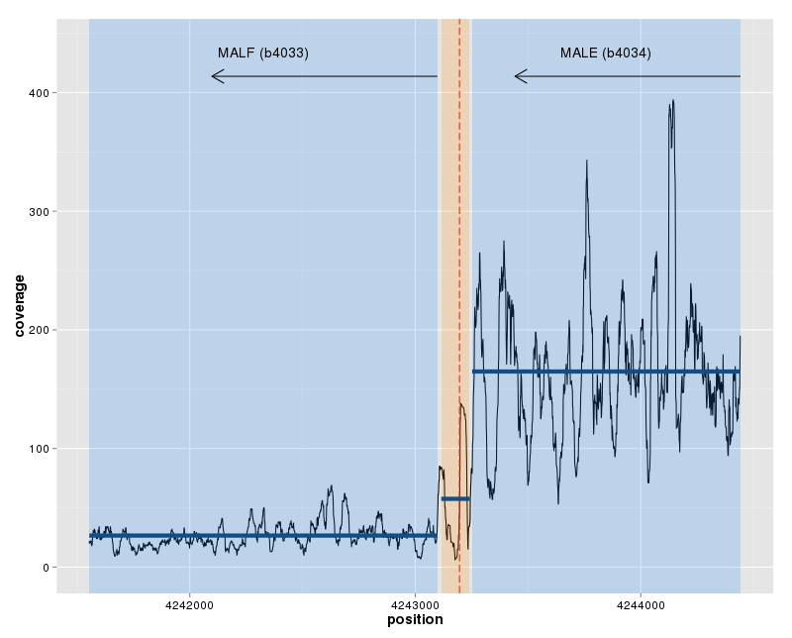
Segmentation
(Global approach)
Segmentation on malE-malF BIME
Gene
BIME
20
Notes:
Segmentation
No profile
Poisson model → segments partitions of whole region
Cost function for each partition
Minimisation of cost function for set of partitions (PDP)
K = 4 segments

Slide 44
Global approach results
17 break-points on BIMEs for 25 DE
Coverage break-points on BIME | 3/17 | 3/17 | 12/17
1
2
1
2
1
2
21

Slide 45
Global approach results
17 break-points on BIMEs for 25 DE
Weakness?
    Sensitive to the number of replicates?
Coverage break-points on BIME | 3/17 | 3/17 | 12/17
1
2
1
2
1
2
21

Slide 46
Question
Are BIMEs involved in the mRNA metabolism in operons for E. coli genome:
as transcription terminator?
as stabiliser of 5' end of transcript?
22

Slide 47
Break-point search result synthesis
Two methods: 21 break-points
Local Approach
Global Approach
4
14
3
3 RNA-Seq experiments
23

Slide 48
Break-point search result synthesis
Two methods: 21 break-points
14 common detections
Local Approach
Global Approach
4
14
3
3 RNA-Seq experiments
23

Slide 49
Break-point search result synthesis
Intergenic region structure with respect to BIME coverage break-point:
Coverage break-points on BIME | 4/21 | 4/21 | 15/21
1
2
1
2
1
2
24

Slide 50
Break-point search result synthesis
Intergenic region structure with respect to BIME coverage break-point:
Transcription terminator function
Coverage break-points on BIME | 4/21 | 4/21 | 15/21
1
2
1
2
1
2
24

Slide 51
Break-point search result synthesis
Intergenic region structure with respect to BIME coverage break-point:
Transcription terminator function
Stabiliser of 5' end transcript
Coverage break-points on BIME | 4/21 | 4/21 | 15/21
1
2
1
2
1
2
24

Slide 52
Biological synthesis
malEFG model validated
malE
substrate
periplasm
Substrate
Binding
Protein
malF
malG
cytoplasmic
membrane
Membrane
Spanning
Domain
cytoplasm
25

Slide 53
Biological synthesis
malEFG model validated
28 ABC transporters in E.coli K12
malE
substrate
periplasm
Substrate
Binding
Protein
malF
malG
cytoplasmic
membrane
Membrane
Spanning
Domain
cytoplasm
25

Slide 54
Biological synthesis
malEFG model validated
28 ABC transporters in E.coli K12
7 ABC transporters with 8 BIMEs on 21 detections
malE
substrate
periplasm
Substrate
Binding
Protein
malF
malG
cytoplasmic
membrane
Membrane
Spanning
Domain
cytoplasm
25

Slide 55
Biological synthesis
malEFG model validated
28 ABC transporters in E.coli K12
7 ABC transporters with 8 BIMEs on 21 detections
6 without terminator
malE
substrate
periplasm
Substrate
Binding
Protein
malF
malG
cytoplasmic
membrane
Membrane
Spanning
Domain
cytoplasm
25

Slide 56
Biological synthesis
malEFG model validated
28 ABC transporters in E.coli K12
7 ABC transporters with 8 BIMEs on 21 detections
6 without terminator →Substrate Binding Proteins
malE
substrate
periplasm
Substrate
Binding
Protein
malF
malG
Expression
cytoplasmic
membrane
Membrane
Spanning
Domain
cytoplasm
25

Slide 57
Conclusions
DE →Segmentation method suited (Global search for coverage break-points)
Ready to use with other data sets
Annotation quality?
For now RNA-Seq data most appropriate for those studies (coverage not uniform)
BIME effect on upstream gene
Predominance of 5' end transcript stabiliser function
26

Slide 58
Perspectives
RNA-Seq experiment designs
  Test transcription termination function:
    WT & alteration of degradosome genes
  Test transcript 5' end stabiliser function:
    Transcription blocking & time sampling for monitoring of the transcript degradation
Benchmark with segmentation
  reduce the number of replicates (same experiment)
Generalisation to other species
27

Slide 59



Acknowledgments
LMGM: Genomics of integrated systems
Gwennaele Fichant
Yves Quentin
Roland Barriot
Petra Langendijk-Genevaux
Mathias Weyder
Arnaud Frèche
INRA: Applied Mathematics and Informatics
Christine Gaspin

Slide 60
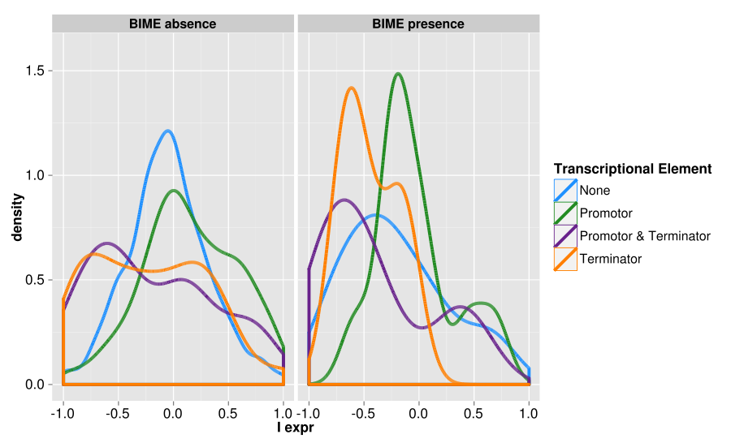
Global BIME effect in operons
Distributions of I_{expr} depending on Transcriptional Elements

Slide 61
Adaptation of operon detection method
(Local approach)
Expression profile correlation on malE-malF BIME
17

Slide 62
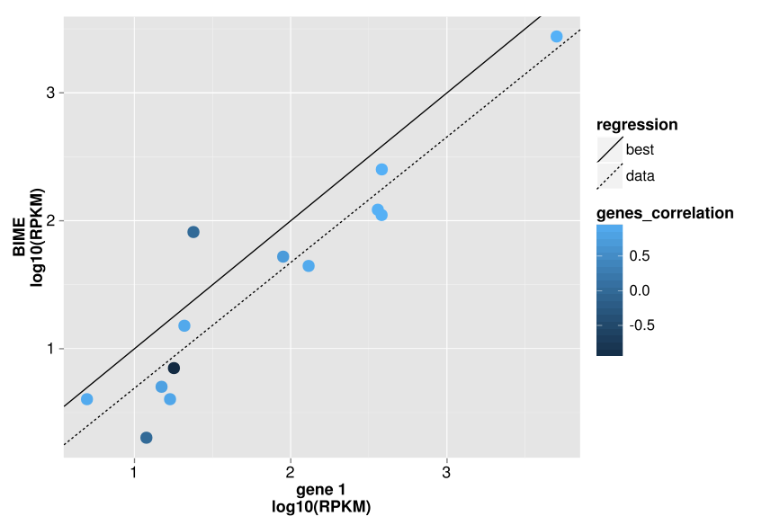
BIME sequencing bias
No DE in operons, no promotor or terminator

Slide 63
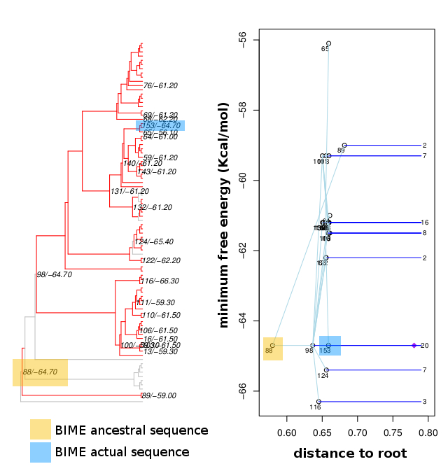
Ancestral sequences and secondary structures
malE-malF BIME 2nd structure energy evolution

Slide 64
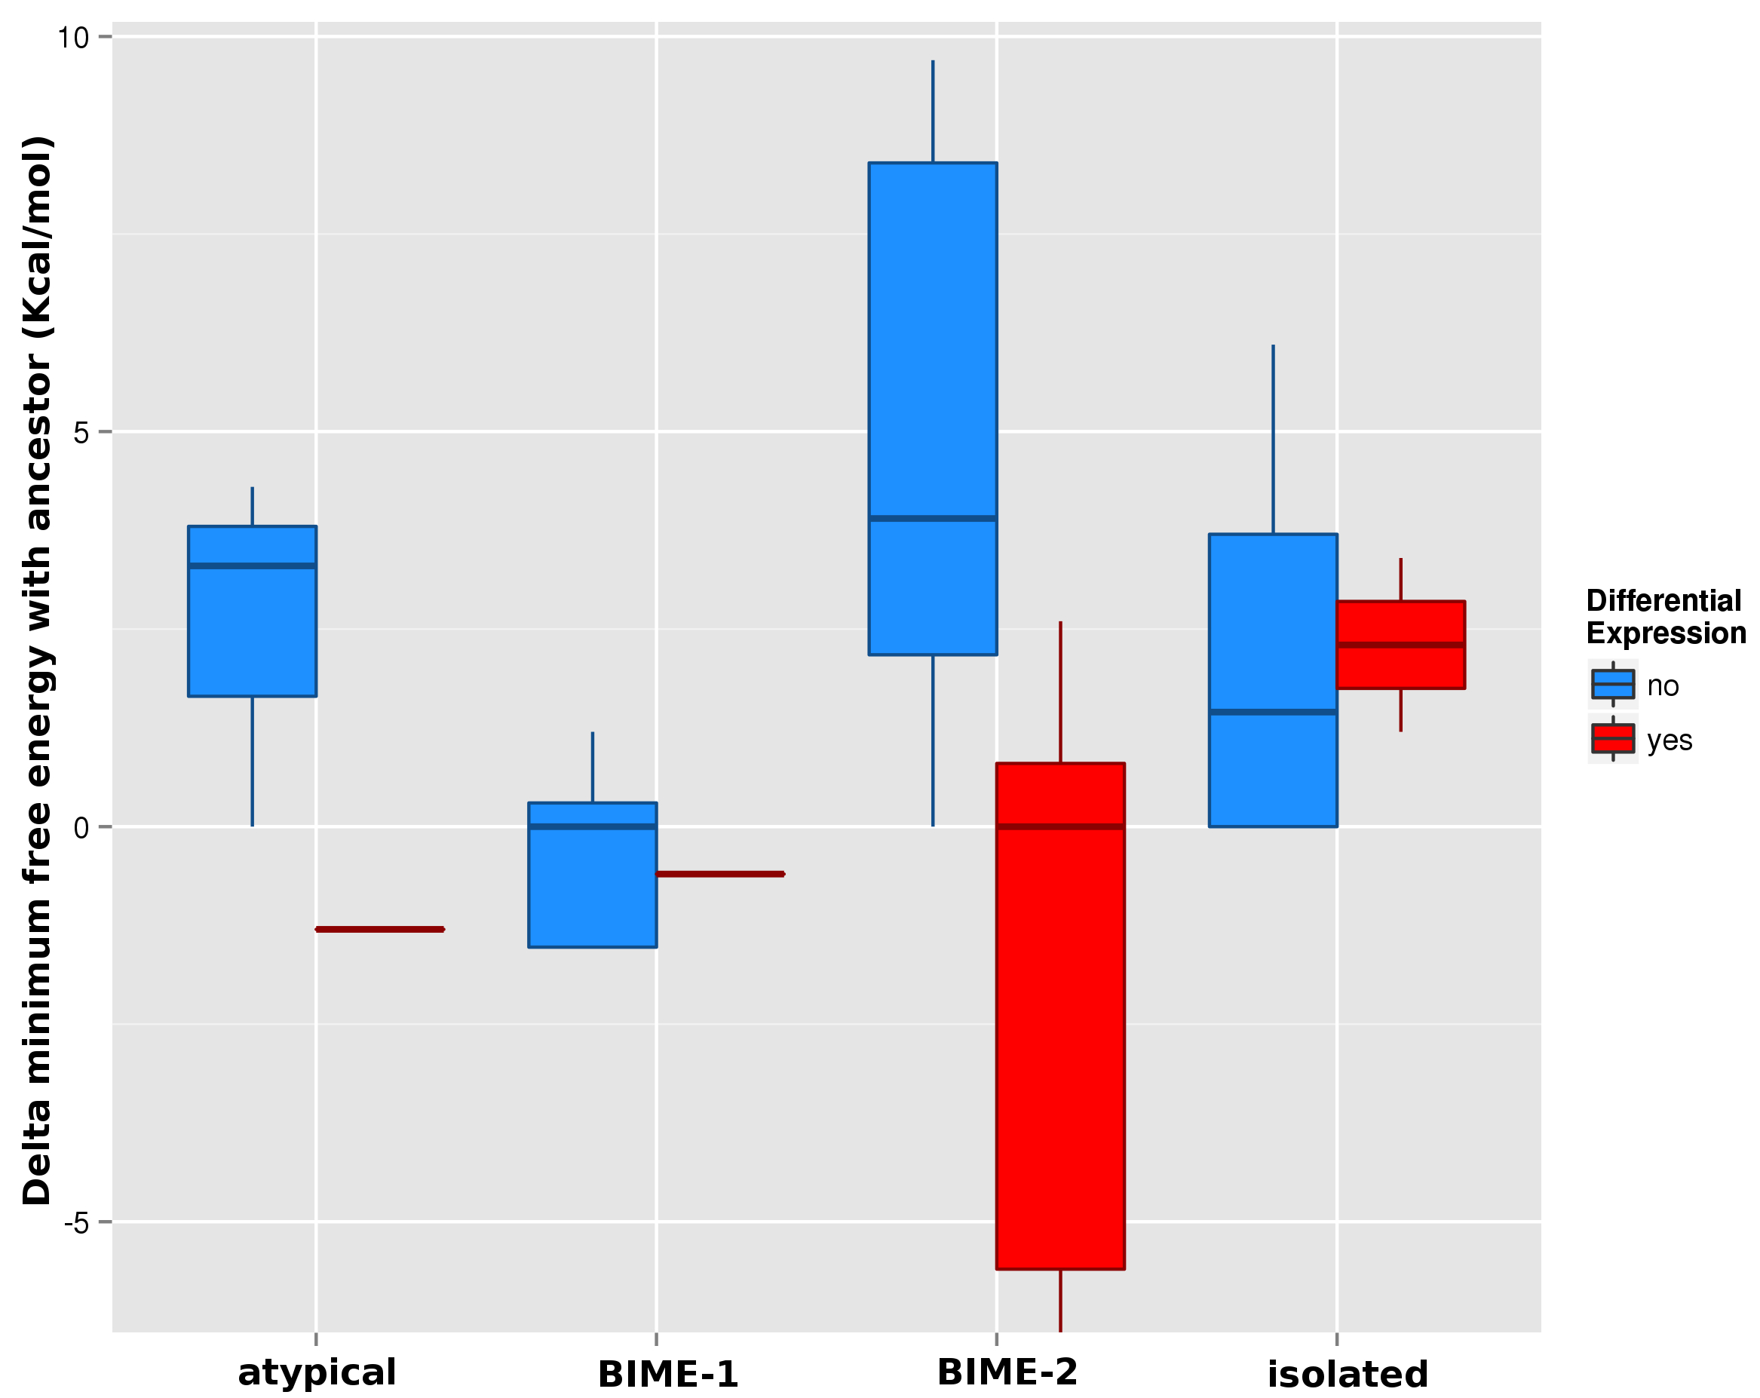
Ancestral sequences and secondary structures
Delta of energy between ancestor & actual BIME

Slide 65
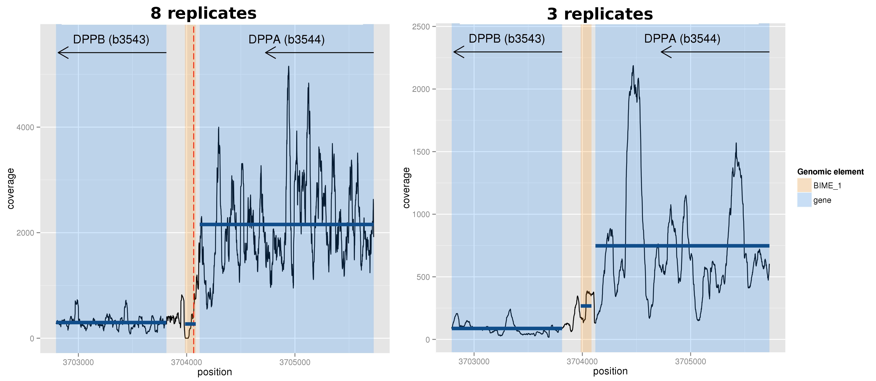
Segmentation efficiency & replicates

