Slide 1




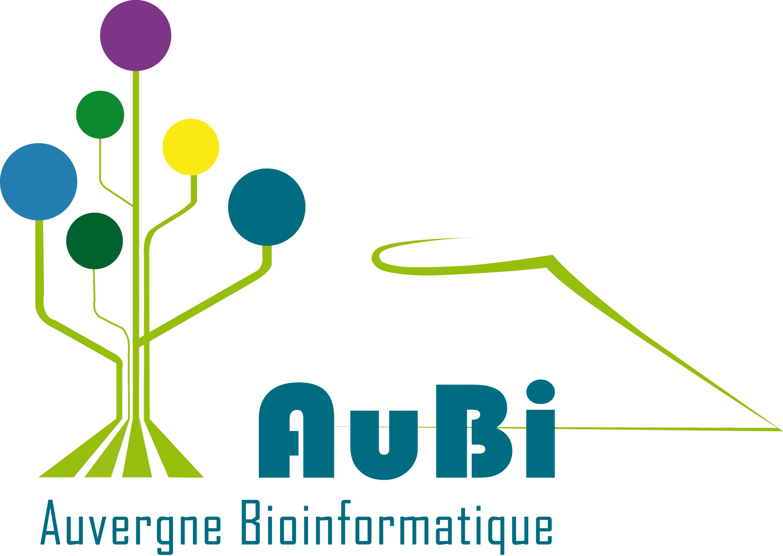

FAIR Bioinfo 2023
Introduction to workflow language with Snakemake
P. Marin, M. Hiriart, P. Ruiz, Nadia Goué
aubi@uca.fr
Université Clermont Auvergne, AuBi, Mésocentre
Du 10 au 13 & 14 juillet 2023

Slide 2
Contents
Workflow introduction
Snakemake introduction
A little more on snakefile and configuration files

Slide 3
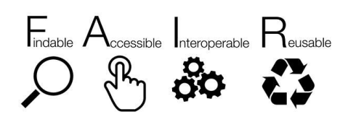
Workflow introduction
Interest in workflow management
The standardization, portability, and reproducibility of analysis pipelines is a
renowned problem within the bioinformatics community.
It had struggled with issues of reproducibility and data provenance.
Being able to reproduce scientific results is the central tenet of the scientific method.
Moving towards FAIR research methods in data-driven science is complex

Slide 4
Workflow introduction
What is a workflow ?
A pool of commands, progressively linked by the treatments,
from the input data towards the results
In case of data parallelization, several data flows can be processed in parallel:
with a multi-cores PC or a computational cluster (ex. ~ 3 100 cores)
one (or more) core can be attributed to one workflow

Slide 5
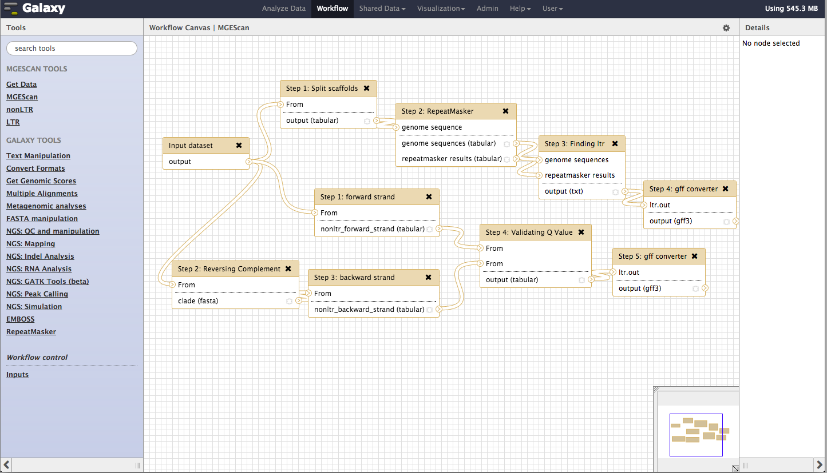
Workflow introduction
What is a workflow ?
From informatics point of view : Group of programs executed in series
so that the output of 1 program is used as input
for the next one.
From a bioinformatics point of view : a workflow is a set of pipelines

Slide 6
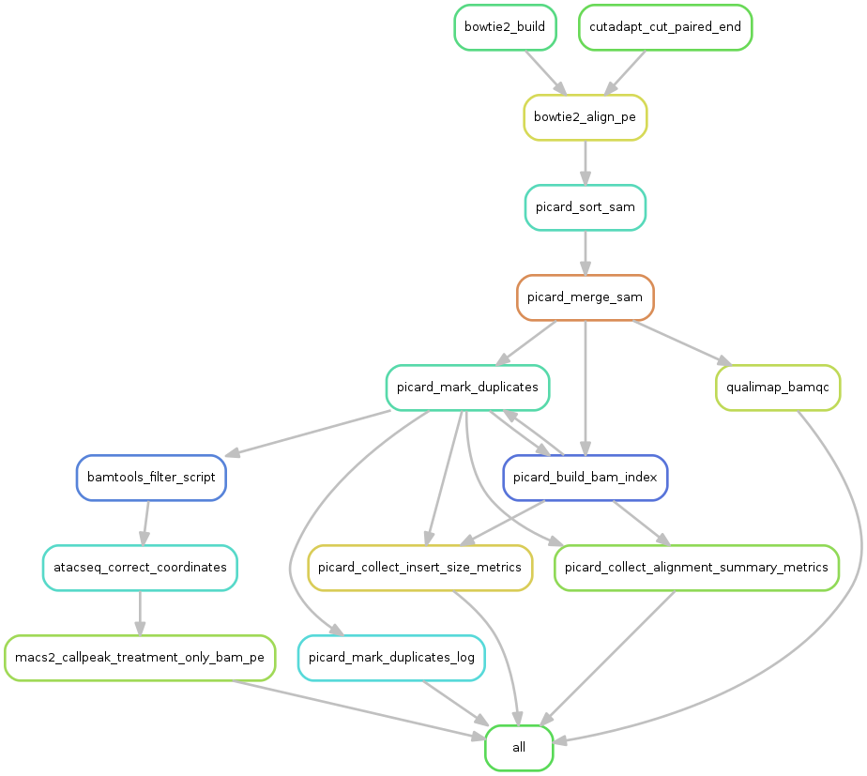
Workflow introduction
What is a workflow ?
From informatics point of view : Group of programs executed in series
so that the output of 1 program is used as input
for the next one.
From a bioinformatics point of view : a workflow is a set of pipelines

Slide 7
Workflow introduction
What are workflow management systems ?
Many workflow management systems, many forms
https://github.com/common-workflow-language/common-workflow-language/wiki/Existing-Workflow-systems
command line: shell (needs competences into scripting)
rule: snakemake, c-make, nextflow, …
graphic interface: Galaxy, Taverna, Keppler, ...
Reproducibility Learning effort
Manage parallelization

Slide 8
Snakemake Introduction
What is Snakemake ?
Workflow manager
Supports for dependencies
  Refers to upstream files (or tasks) that downstream transformation steps require as input.
  When a dependency is updated, associated downstream files should be updated as well.
Support for reentrancy
  Reentrancy is the ability of a program to continue where it left off if interrupted.
  It’s obviating the need to restart from the beginning of a process.
Köster and Rahmann, 2012. https://doi.org/10.1093/bioinformatics/bts480
Köster and Rahmann, 2018. https://doi.org/10.1093/bioinformatics/bty350

Slide 9
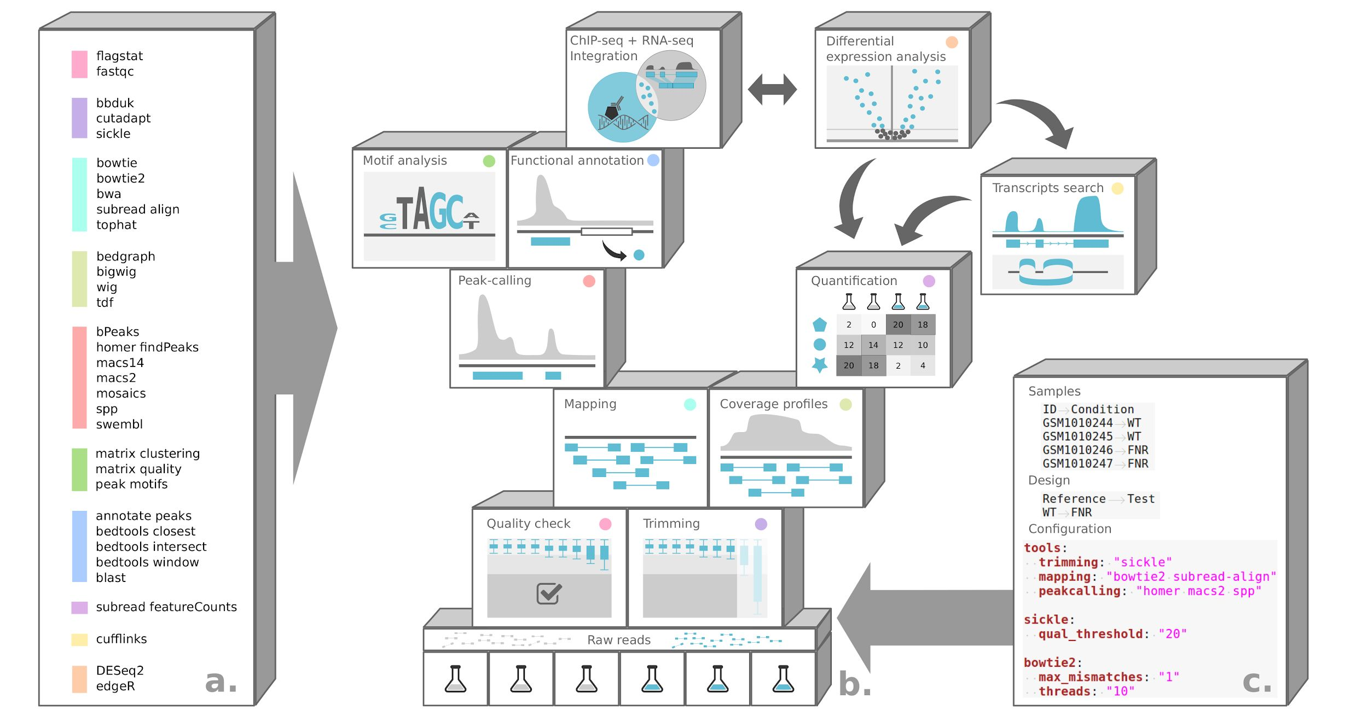
Snakemake Introduction
What is Snakemake ?
Reproducible and scalable analysis
Rioualen et al. 2017, https://doi.org/10.1101/165191, Rioualen et al. 2019 https://doi.org/10.1002/cpbi.72

Slide 10
Snakemake Introduction
The Snakemake rule
Hybrid between
  Python (Snake)
  GNU Make, a rule-based automation tool
Understanding the Rule concept. It has:
  understandable name
  input, list one or more filenames
  output, list one or more filenames
  command ( run: for python ; shell: for shell, R, …)
  optional directives: params: , message: , log: , threads: , ...
rule NAME:
input:
"path/to/inputfile",
"path/to/other/inputfile"
output:
"path/to/outputfile",
"path/to/another/outputfile"
shell: "some_command {input} {output}"

Slide 11
Snakemake Introduction
The data flow linkage and rules order
Snakemake workflow links rules thanks to input and output filenames
  Until v6.15.0: the first rule (all, target, …) need to specify the result files and the next rules describe how to achieve them
  From v6.15.0: any rule can be the default target rule
rule all:
input: "P10415.fasta"
rule get_prot:
output: "P10415.fasta"
shell: "wget https://www.uniprot.org/uniprot/P10415.fasta"

Slide 12
Snakemake Introduction
The data flow linkage and rules order
Snakemake automatically checks that everything is up-to-date:
  Create a directed acyclic graph (DAG), linking rules with inputs and outputs
  Starts with the last output result files of the DAG
  Since output files do not exits or have to be re-created, snakemake goes back through the worlflow
  Output files have to be re-created when the input file timestamp is newer than the output file one
  And from this point, Snakemake goes on through the workflow and apply rules

Slide 13
Snakemake Introduction
Generalization with wildcards
Snakemake use wildards to replace parts of filename:
  Reduce hardcoding: more flexible, work with new data without modification
  Are automatically resolved
  Are written into {}
  Are specific to a rule
Examples
Rule read_firstlines:
input:
“101/file.A.txt”
output:
‘‘{set}1/{file}.{grp}.txt”
shell:
‘‘head -n 10 {input} > {output}’’
=> set = 10, grp = A
Rule read_firstlines:
input:
“101/file.A.txt”
output:
‘‘{set}/{file}.A.{ext}”
shell:
‘‘head -n 10 {input} > {output}’’
=> set = 101, ext = txt

Slide 14
Snakemake Introduction
Input / output specifications
Enumerated
Python list & wildcard
expand() & wildcards
rule all:
input:
"P10415.fasta","P01308.fasta"
DATASETS=["P10415","P01308"]
rule all:
input:
["{dataset}.fasta" for dataset in DATASETS]
DATASETS=["P10415","P01308"]
rule all:
input: expand("{dataset}.fasta",dataset=DATASETS)

Slide 15
Snakefile and configuration files
Snakemake Options
Using a conda environment
Snakemake supports using explicit conda environments on a per-rule basis:
  directive in the rule definition:
  Run Snakemake with the --use-conda option
  The specified environment will be created and activated on the fly by Snakemake and the rule will then be run in the conda environment.
rule NAME:
input:
output:
conda: my_rule_env.yml
shell:

Slide 16
Snakefile and configuration files
Snakemake Options
Configuration file
  contains all hard-coding values of the snakefile (paths to files, core numbers, parameter values, etc)
  Is a yml or json file and call the defined items with config["myItem"]
  Run with the --configfile myConfig.yml Snakemake option
  Or add the directive configfile: myConfig.yml at the beginning of the snakefile
    config.yaml snakefile
samples:
A: data/samples/A.fastq
B: data/samples/A.fastq
configfile: ”config.yaml”
rule NAME:
input:
expand(“{sample}.fastq”, sample=config[samples])
output:
shell:

Slide 17
Snakefile and configuration files
Snakemake Options
Some other useful options
  dry-run, no workflow execution, display only what would be done: -n –dryrun
  print the shell command: -p –printshellcmds
  print a summary and status of rule: -D –summary
  limit the number of jobs in parallel: -j 1 (cores: -c 1)
  automatically create HTML reports (--report report.html) containing runtime statistics, a visualization of the workflow topology, used software and data provenance information (need to add the jinja2 package as a dependency)
  DAG visualization with `dot` tool (graphviz package), to create diagrams of the complete workflow --dag or the rules dependencies --rulegraph

Slide 18
Conclusions
References
Amstutz P., et al. 2022. Existing Workflow systems. Common Workflow Language wiki, GitHub. https://s.apache.org/existing-workflow-systems updated 2022-08-30, accessed 2022-08-30.
Leipzig 2017. A review of bioinformatic pipeline frameworks. doi: 10.1093/bib/bbw020
Köster and Rahmann, 2012. Snakemake—a scalable bioinformatics workflow engine. https://doi.org/10.1093/bioinformatics/bts480
Köster and Rahmann, 2018. Snakemake—a scalable bioinformatics workflow engine. https://doi.org/10.1093/bioinformatics/bty350
LeipzigStallma and McGrath 1991. The GNU Make Reference Manual. ISBN-10:168092155X
Rioualen et al. 2017. SnakeChunks : modular blocks to build Snakemake workflows for reproducible NGS analyses. https://doi.org/10.1101/165191
Rioualen et al. 2019. Integrating Bacterial ChIP-seq and RNA-seq Data With SnakeChunks. https://doi.org/10.1002/cpbi.72

Slide 19
Next step
Workflow PRACTICE
Snakemake for a 2-steps workflow on Biosphere BioPipes VM

