Slide 1






FAIR Bioinfo 2022
Introduction to Git, GitHub/Gitlab
P. Marin, Mateo Hiriart, P. Ruiz, N. Goué
aubi@uca.fr
Université Clermont Auvergne, AuBi, Mésocentre
du 28 novembre au 02 décembre 2022
Hiriart Mateo

Slide 2



Version control system
Online hosting service for software base on git
Git, GitHub, Gitlab
Hiriart Mateo

Slide 3

Sharing code
V1.0
V1.0
V1.1
V1.1
Send by mail
V1.1
V1.1
Modify manualy
Send back
Hiriart Mateo

Slide 4
Git a version control system
Commit v1.0
File1.txt
Commit
V1.0.1
File2.md
Commit
V1.0.2
File1.py
Commit
V1.0.3
Project
Repository
history
Hiriart Mateo

Slide 5
Centralized version control
Centralized project
Working copy
Working copy
One central repository and developers can only commit on it.
Hiriart Mateo

Slide 6
Distributed version control
local
local
public
All repository are interconnected and can be edited at same time.
Hiriart Mateo

Slide 7
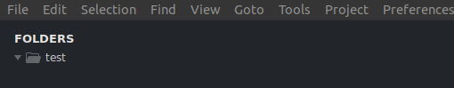
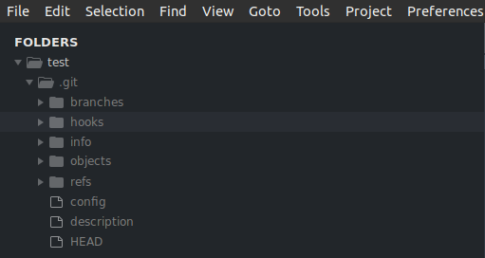
Git: Initialisation
“Git init “ to initialize a git repository in any folder
“Git clone” can also be used to import an existing repository
Hiriart Mateo

Slide 8
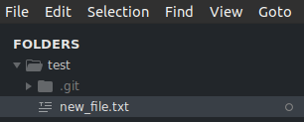
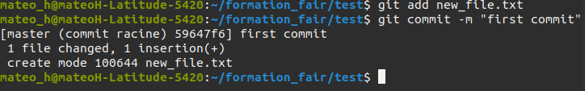
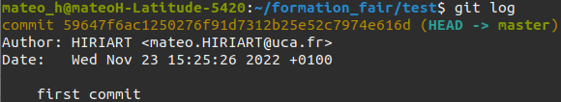
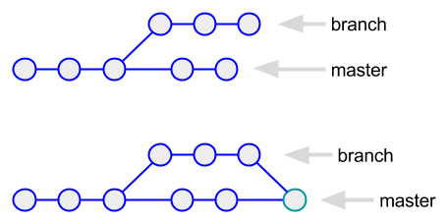
Git: Commit
Commit are snapshot of your files (code)
They all have a unique id
And are linked to their parent
Can always go back to previous commit
Hiriart Mateo

Slide 9
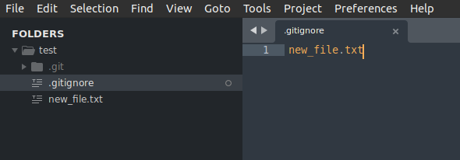
Git: .gitignore
Specific file that tell git to untrack any file listed inside.
Very usefull especially with project that required other packages or if you have any file that store sensitive data.
Hiriart Mateo

Slide 10
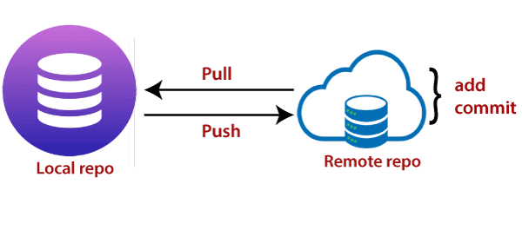
Git: Push and Pull
Git pull import modification form another repository if it have same origin.
Git push export modification to another repository if it have same origin.
Hiriart Mateo

Slide 11
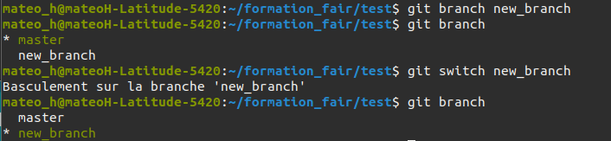
Git: branches
Git branch allow parallel development
And still apply it latter with code control
Hiriart Mateo

Slide 12
Git: Usefull command
Git help: display multiple git command with a description
Git log: display commit history of the current branch
Git status: display current state off your local repository
Git reset: reset repository back to the specified HEAD
Git diff: display code difference between current local repo and HEAD
Git restore: reset all modification of specified file.
Hiriart Mateo

Slide 13
Github and Gitlab
Public repository hosting server. Both free version
Released in 2008
Fast, more popular
Released in 2014
Open source
Hiriart Mateo

Slide 14
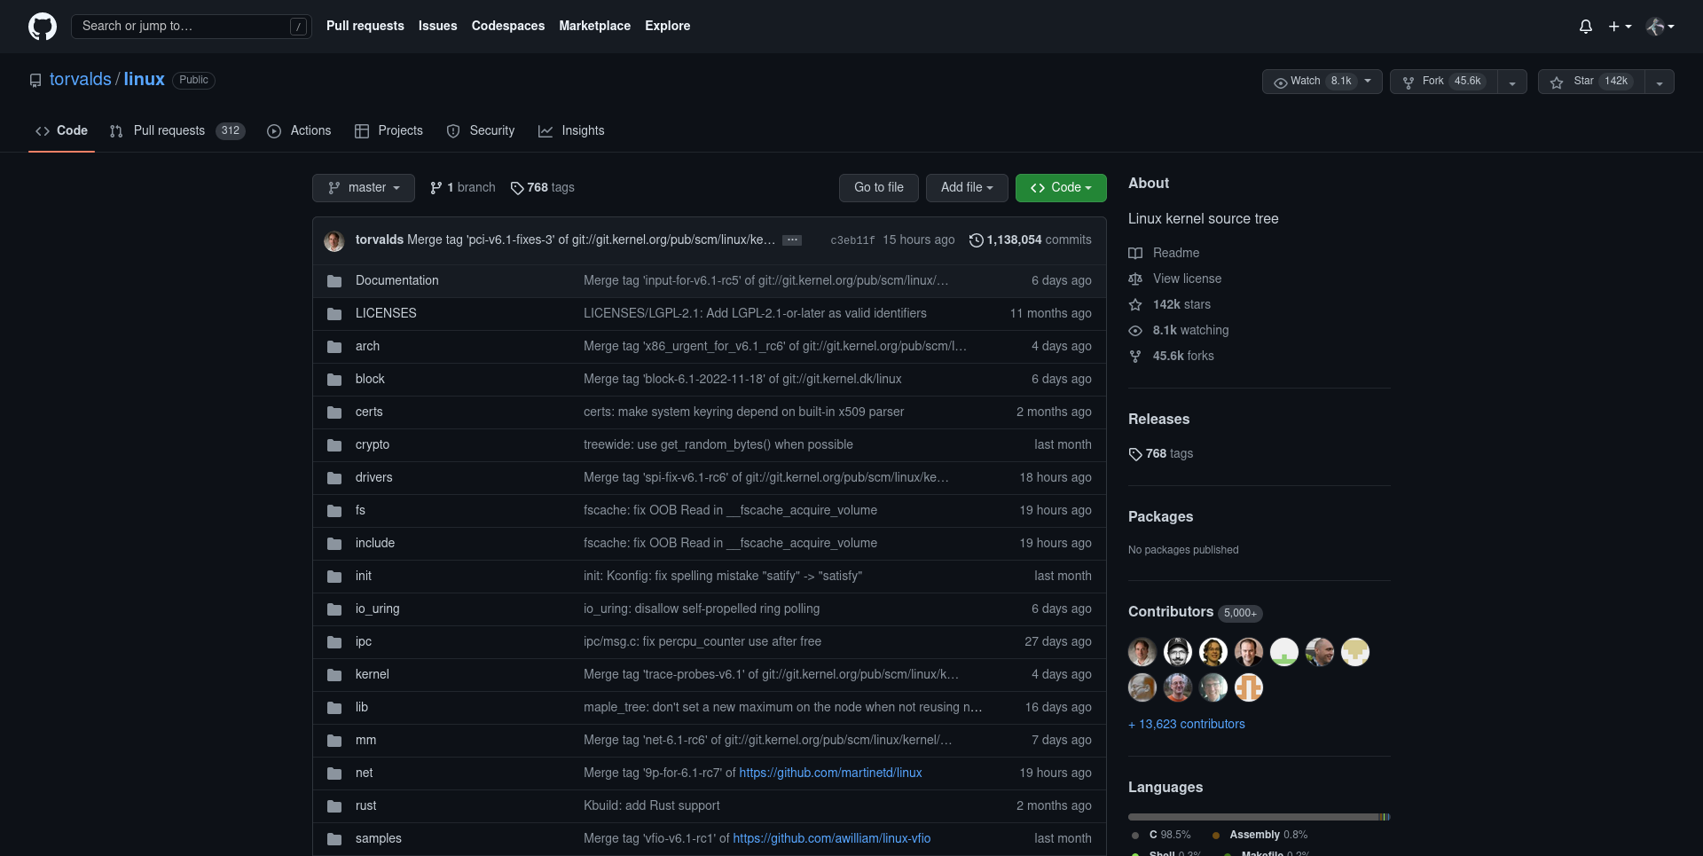
Github/Gitlab
GitHub repository example.
Linux kernel source code.
Hiriart Mateo

Slide 15
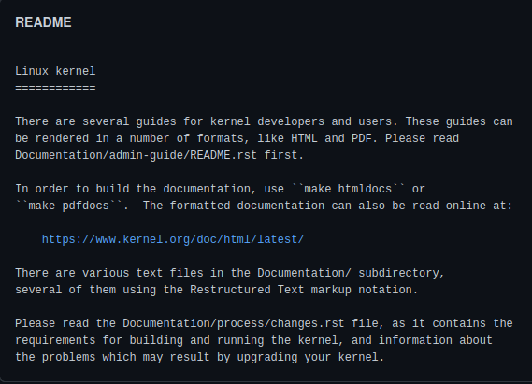
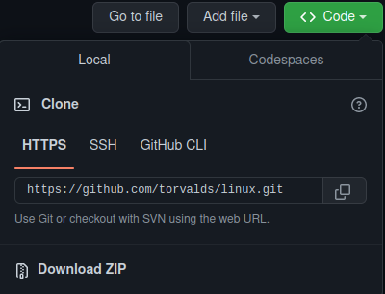
github/gitlab: Main usage
Find open source project, Publish yours under free licenses
Worldwide interactive development, with specific feature like “issues”
Readme
Clone or download link
Hiriart Mateo

Slide 16
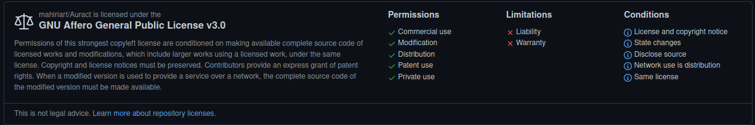
Github/Gitlab: Licenses
Key element for public repository, allow then to truly be open source.
Allow others to freely use, change and distribute your code.
Hiriart Mateo

Slide 17
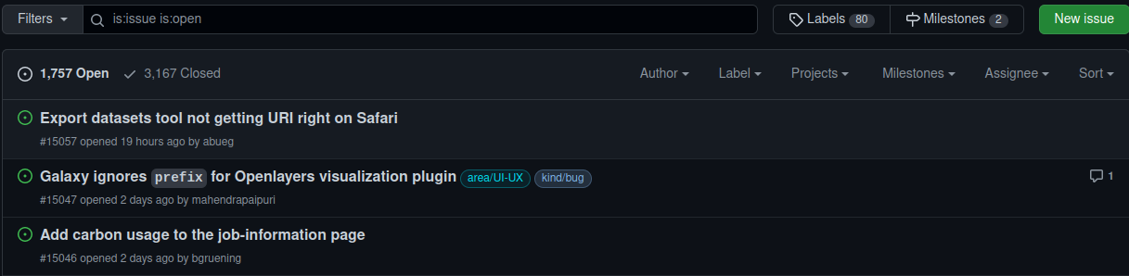
Github/Gitlab: Issues and pull request
Issues are features to point out problem in code or possible enhancement.
Usually solved in a pull request.
Pull request are code contribution in a review state, waiting to be merged in the master branch.
Hiriart Mateo

Slide 18
Github/Gitlab: Pipeline
Hiriart Mateo

Slide 19
Github/Gitlab: Pages
Hiriart Mateo

