Slide 1
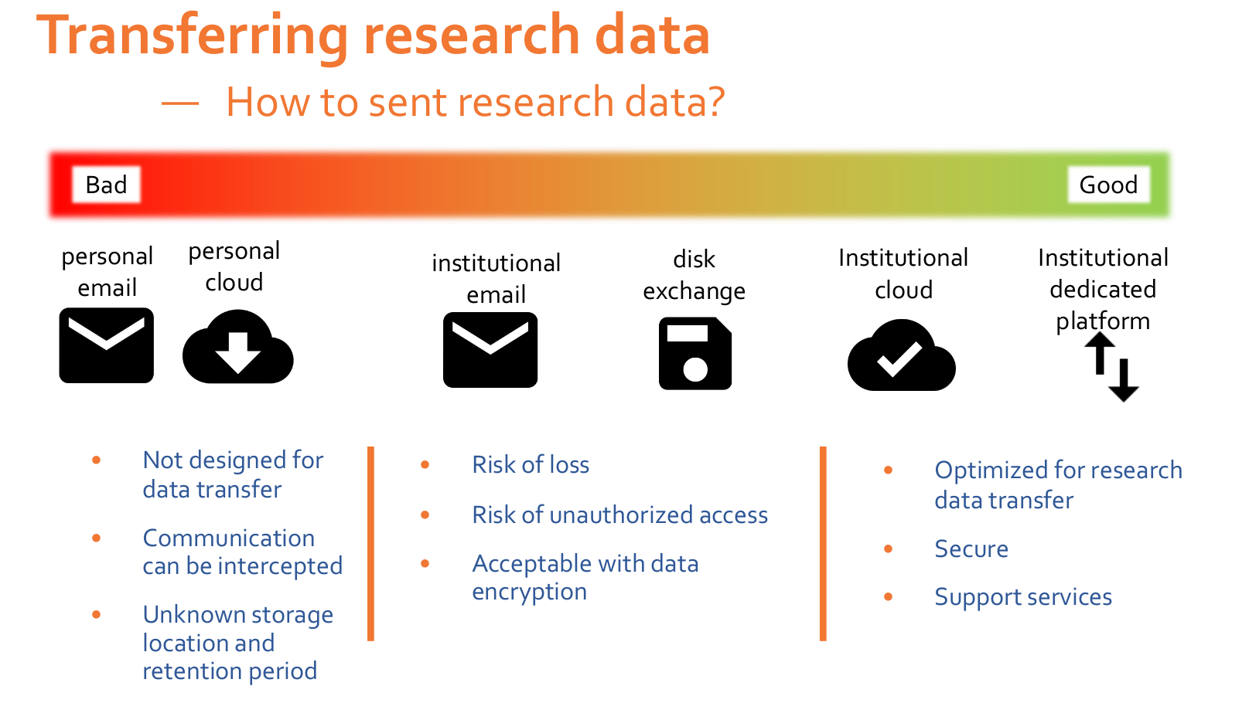

Good practices
Bad and Good practices ...
From ELIXIR DMP training 05-08oct2020

Slide 2
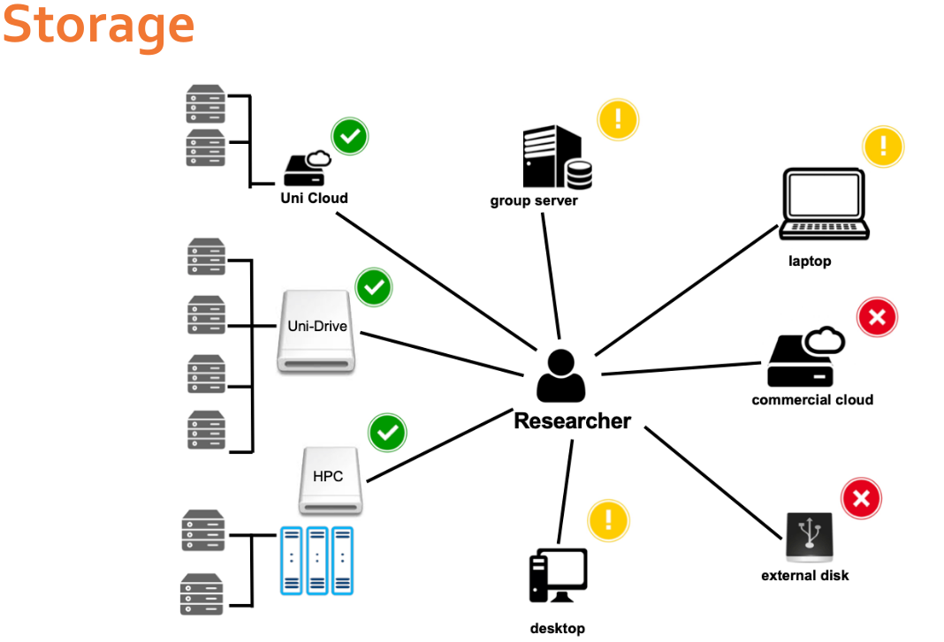
Good practices
Bad and Good practices ...
From ELIXIR DMP training 05-08oct2020

Slide 3
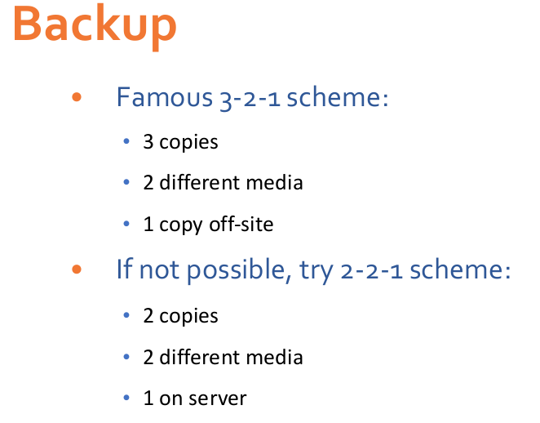
Good practices
Good practices ...
From ELIXIR DMP training 05-08oct2020

Slide 4
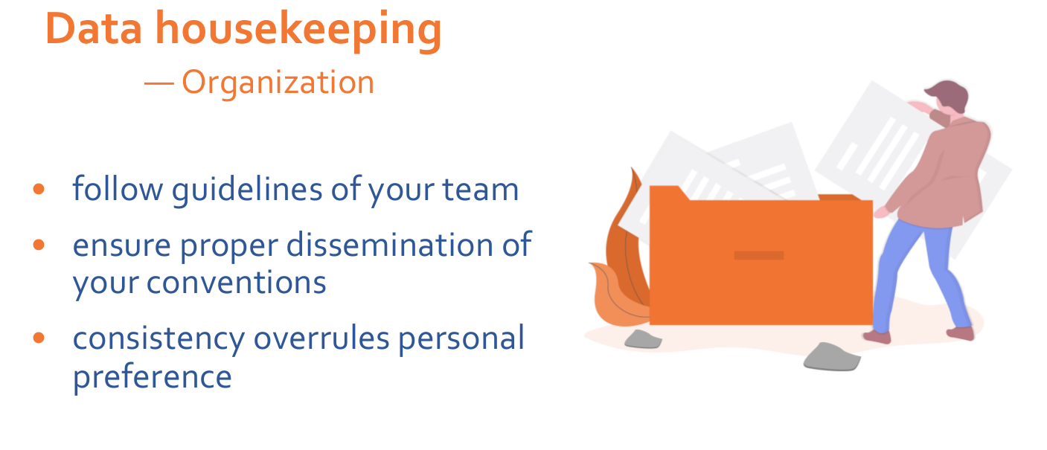
Good practices
Good practices ...
From ELIXIR DMP training 05-08oct2020

Slide 5
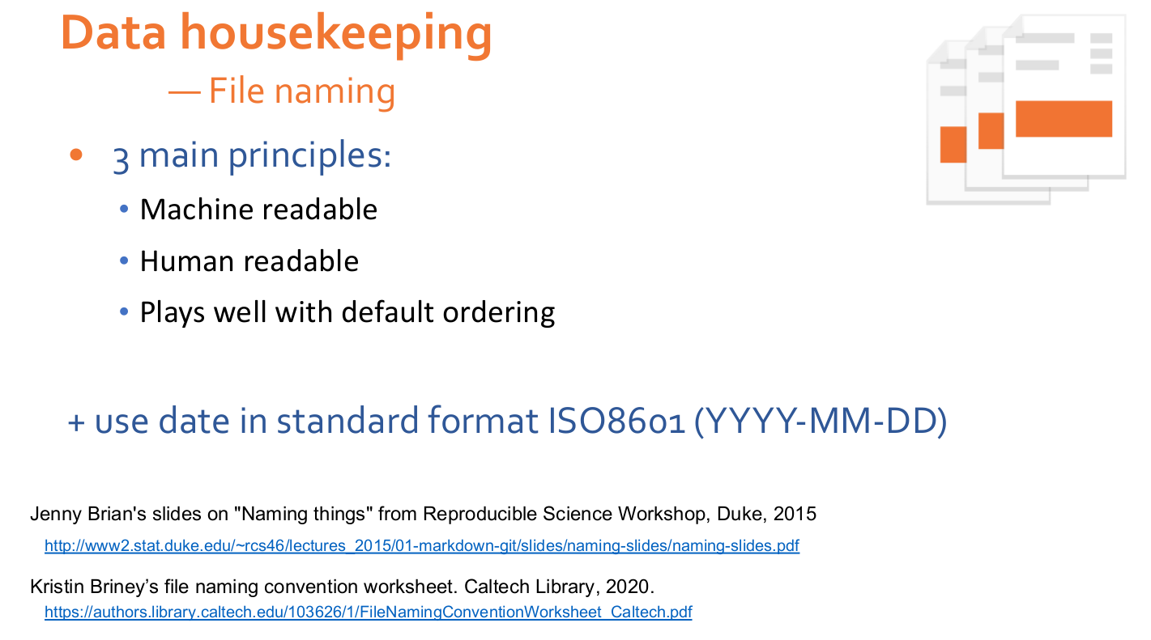
Good practices
Good practices ...
From ELIXIR DMP training 05-08oct2020

Slide 6
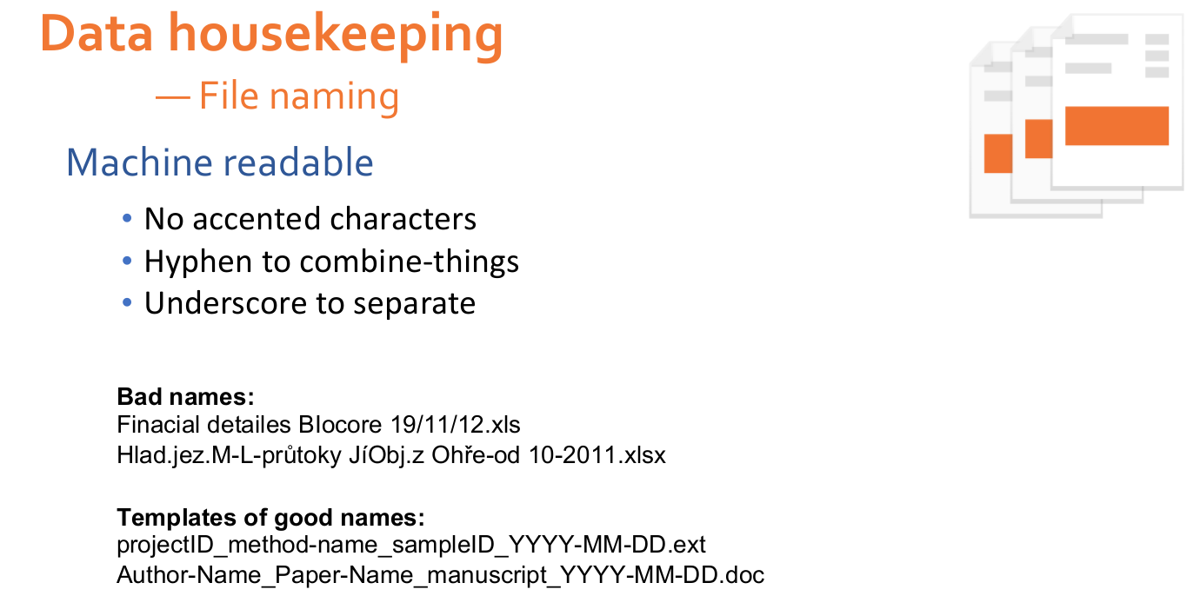
Good practices
Good practices ...
From ELIXIR DMP training 05-08oct2020

Slide 7
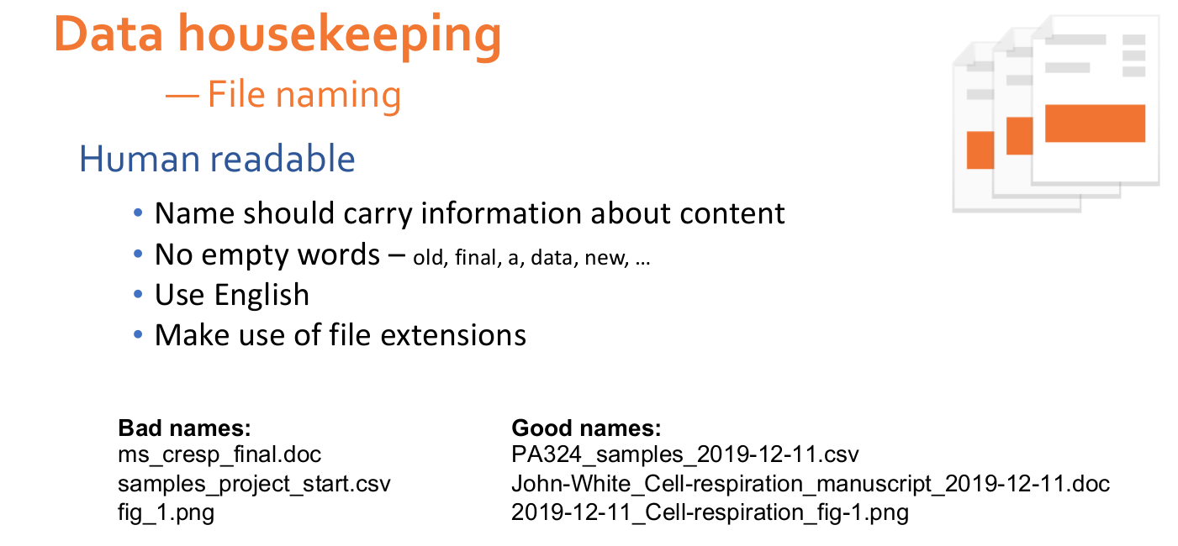
Good practices
Good practices ...
From ELIXIR DMP training 05-08oct2020

Slide 8
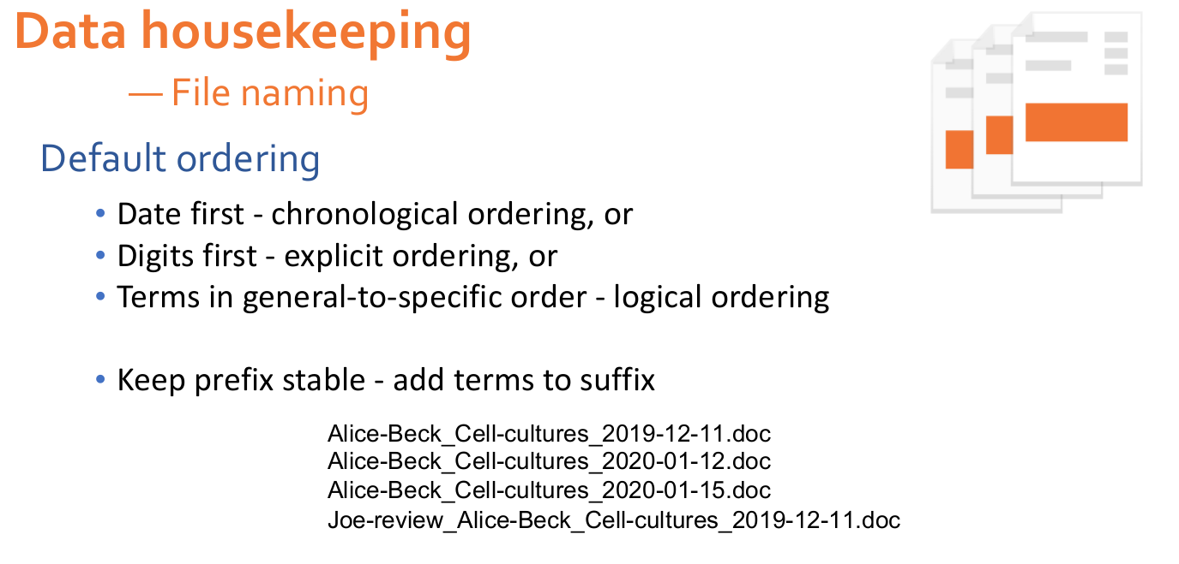
Good practices
Good practices ...
From ELIXIR DMP training 05-08oct2020

Slide 9
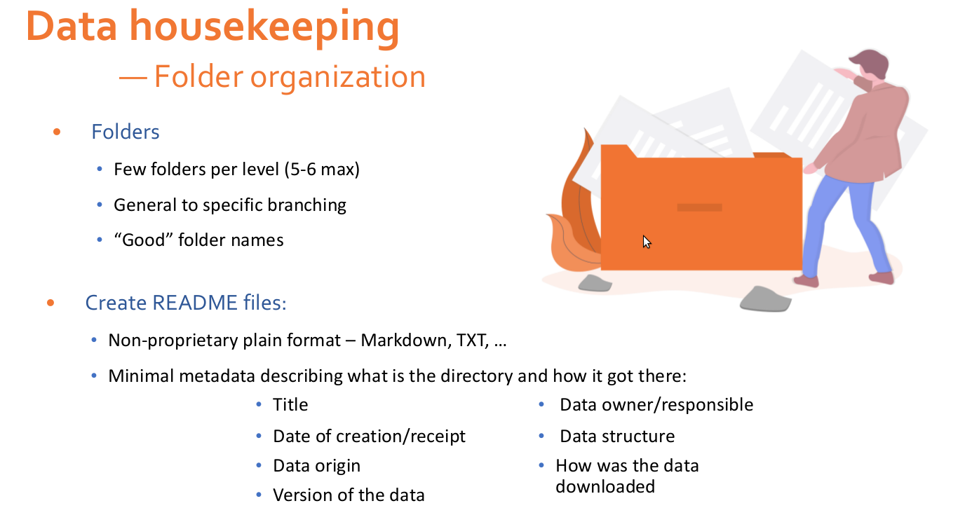
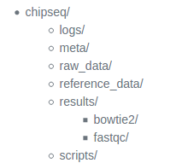
Good practices
Good practices ...
From ELIXIR DMP training 05-08oct2020
Notes:
meta: for any information that describes the samples you are using, which we refer to as metadata.
raw_data: for any unmodified (raw) data obtained prior to computational analysis here, e.g. FASTQ files from the sequencing center. We strongly recommend leaving this directory unmodified through the analysis.
reference_data: for known information related to the reference genome that will be used in the analysis, e.g. genome sequence (FASTA), gene annotation file (GTF) associated with the genome.
results: for output from the different tools you implement in your workflow. Create sub-folders specific to each tool/step of the workflow within this folder.
scripts: for scripts that you write and use to run analyses/workflow.

Slide 10
Good practices
Good practices ...
From ELIXIR DMP training 05-08oct2020

