Slide 1






FAIR Bioinfo 2023
Introduction to Git, GitHub/Gitlab
N. Goué, Mateo Hiriart, P. Marin, P. Ruiz
aubi@uca.fr
Université Clermont Auvergne, AuBi, Mésocentre
du 10 juillet au 17 juillet 2023
Hiriart Mateo

Slide 2

Sharing code
Hiriart Mateo

Slide 3



Version control system
Online hosting service for software base on git
Git, GitHub, Gitlab
Hiriart Mateo

Slide 4
Git
Git is a free and open source distributed version control system.
Handle any type of project, fast and efficiency.
Created in 2005 by Linus Torvalds
Hiriart Mateo

Slide 5
Git a version control system
Working Directory
Stage
History
Local files
Git file modification mechanism
Modification save through list of commit
Hiriart Mateo

Slide 6




Centralized version control
One central repository and developers can only commit on it.
Example: Subversion, Team Foundation Server
Local Working copy
Local Working copy
Public repository
Hiriart Mateo

Slide 7

Distributed version control
All repositories are interconnected and can be edited at the same time.
Example: Git, Mercurial
Local Working copy
Local Working copy
Public repository
Hiriart Mateo

Slide 8
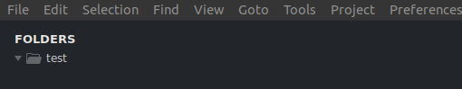
Git: Initialization
Hiriart Mateo

Slide 9
Git: Initialization
“Git init “ to initialize a git repository in any folder
“Git clone” can also be used to import an existing repository
Hiriart Mateo

Slide 10
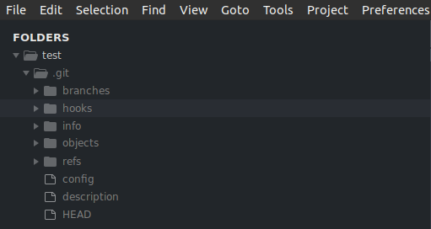
Git: Initialization
“Git init “ to initialize a git repository in any folder
“Git clone” can also be used to import an existing repository
Hiriart Mateo

Slide 11
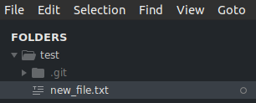
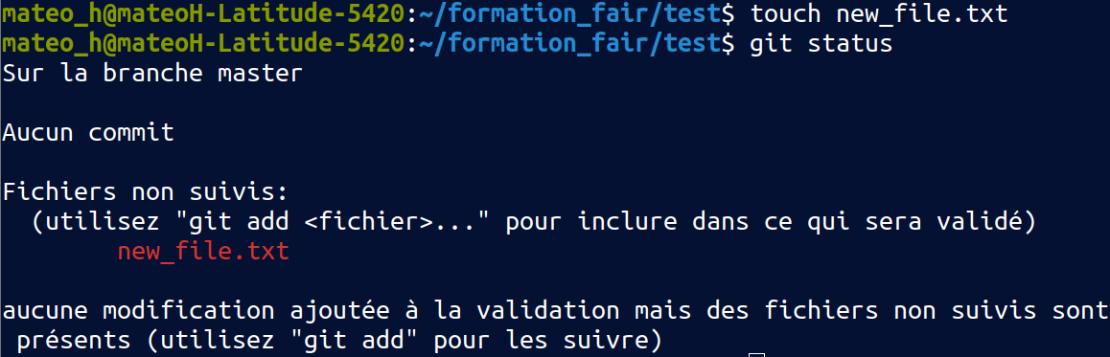
Git: Commit
Create new file in project
Hiriart Mateo

Slide 12
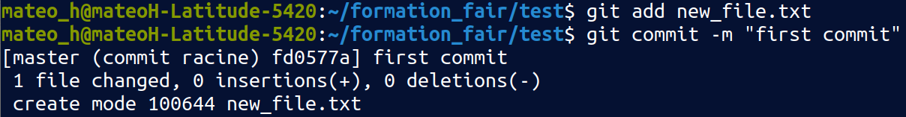
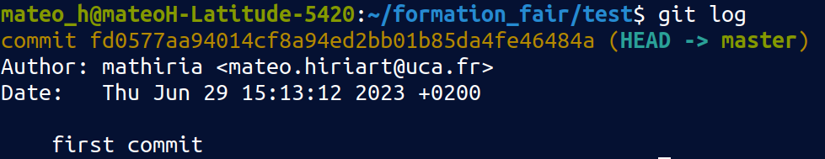
Git: Commit
Start adding file to the stage
Commit the modification and add a nice message to the comment
You can add more commentary by adding other -m “”.
Commits are snapshots of your files (code)
They all have an unique id and are linked to their parents
Can always go back to previous commit.
Hiriart Mateo

Slide 13
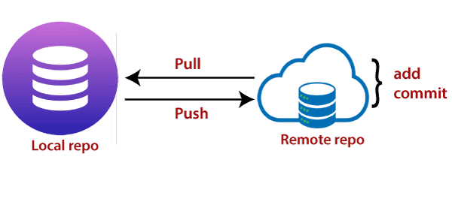
Git: Push and Pull
Git pull imports modifications from another repository if it has the same origin.
Git push exports modifications to another repository if it has same origin.
Hiriart Mateo

Slide 14
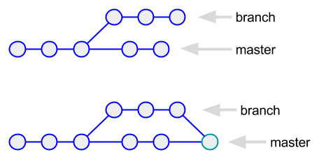
Git: branches
Git branch allows parallel development
And still applies it latter with code control
Hiriart Mateo

Slide 15
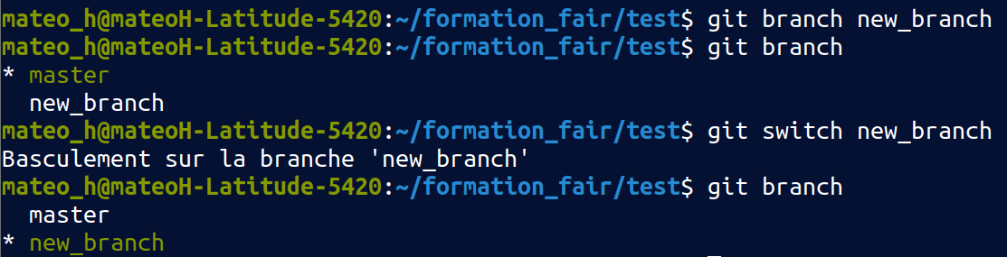
Git: branches
Git branch allows parallel development
And still applies it latter with code control
Hiriart Mateo

Slide 16
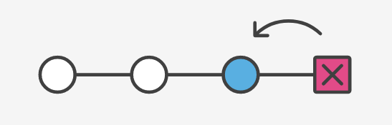
Git: Revert
Git reset: reset repository back to the specified commit
Git restore: reset current modification
Hiriart Mateo

Slide 17
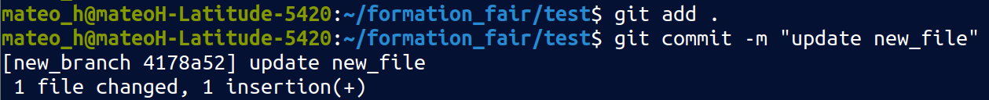
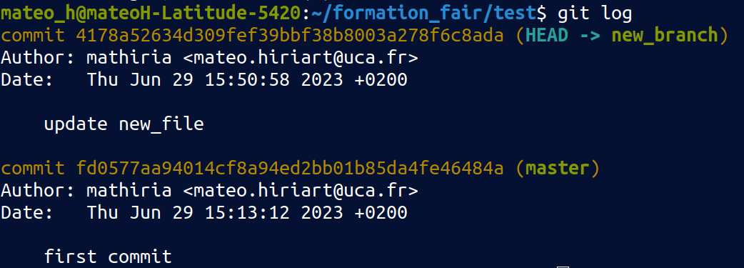
Git: Revert
Git reset: reset repository back to the specified commit
Git restore: reset current modification
Hiriart Mateo

Slide 18
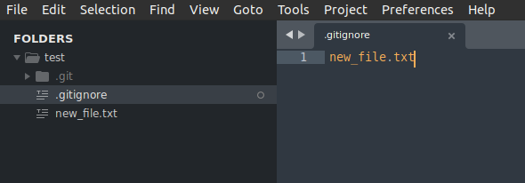
Git: .gitignore
Specific file that tells git to untrack any files listed inside.
Very useful especially with project that required other packages or if you have any file that stores sensitive data.
Hiriart Mateo

Slide 19
Git: Useful command
Git help: display multiple git command with a description
Git log: display commit history of the current branch
Git status: display current state off your local repository
Git diff: display code difference between current local repository and HEAD
Documentation link for git command:
https://git-scm.com/doc
https://docs.github.com/fr
Hiriart Mateo

Slide 20
Github and Gitlab
Public repository hosting server.
Both free version with pricing for enhance features.
Released in 2008
Owned by microsoft
Fast, more popular
Released in 2014
Open source
Built-in CI/CD,
Less restriction in free version
Hiriart Mateo

Slide 21
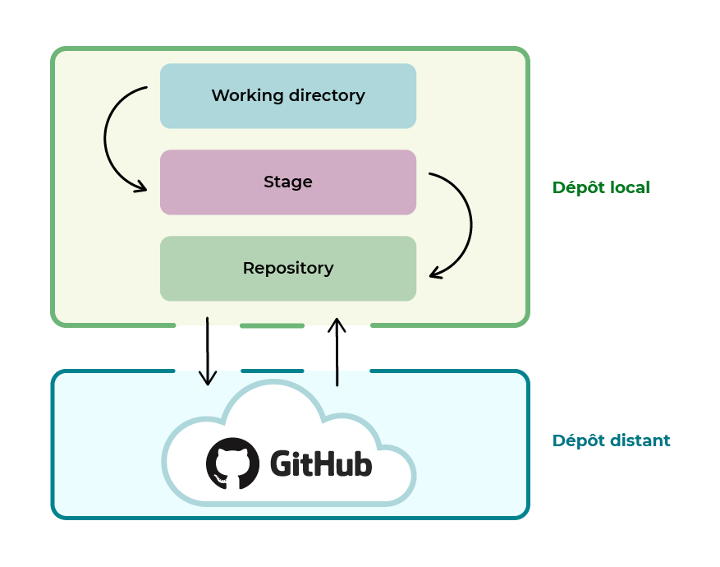
Github and Gitlab
Hiriart Mateo

Slide 22
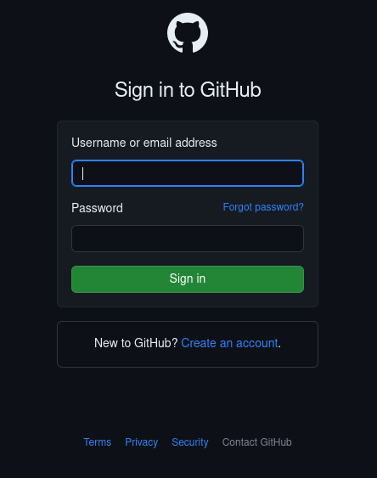
Github/Gitlab: Basics

Slide 23
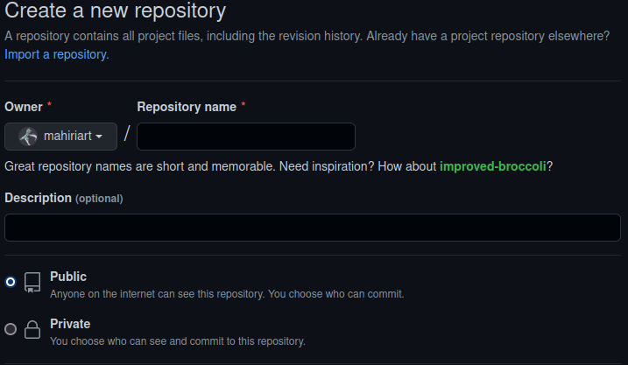
Github/Gitlab: Basics
Create your own repository
Hiriart Mateo

Slide 24
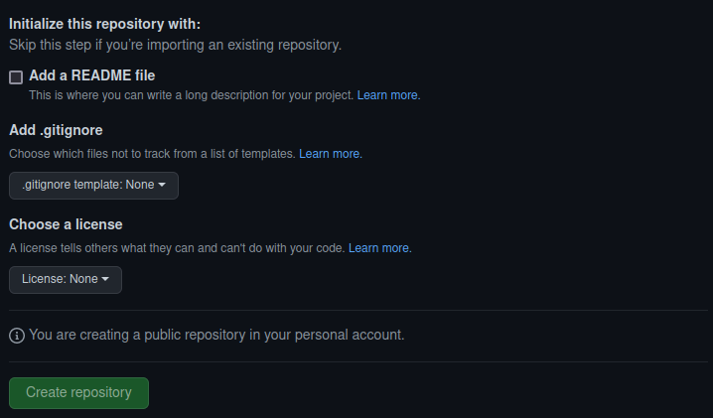
Github/Gitlab: Basics
Create your own repository, with base features
Hiriart Mateo

Slide 25
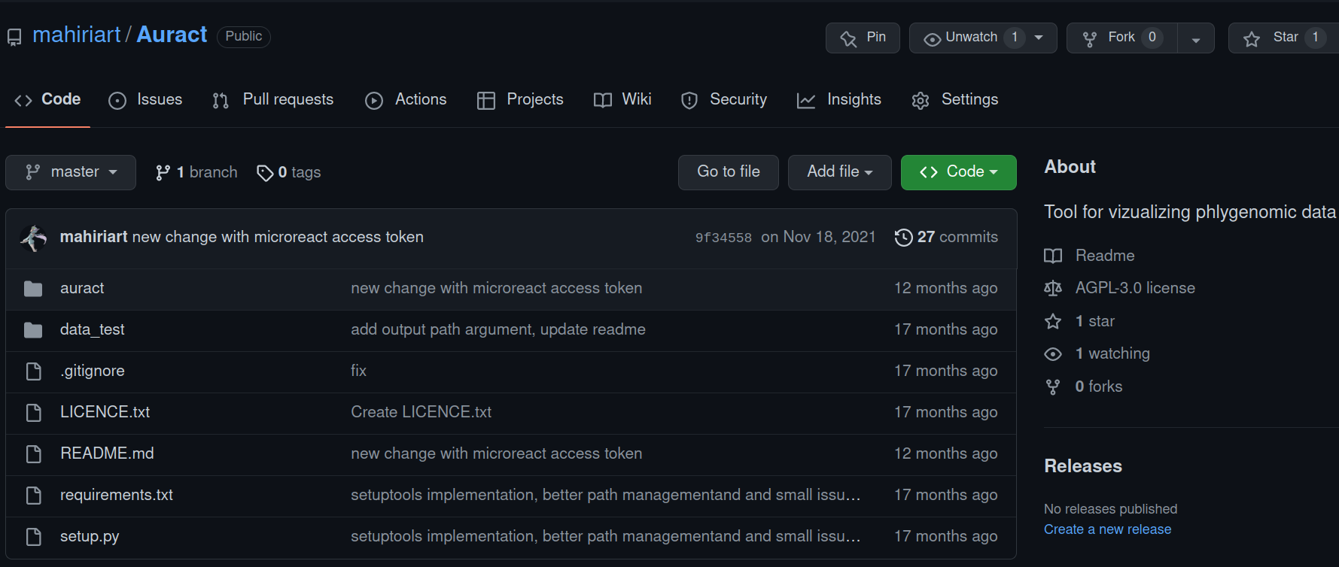
Github/Gitlab: Basics
Main page of a repository
Hiriart Mateo

Slide 26
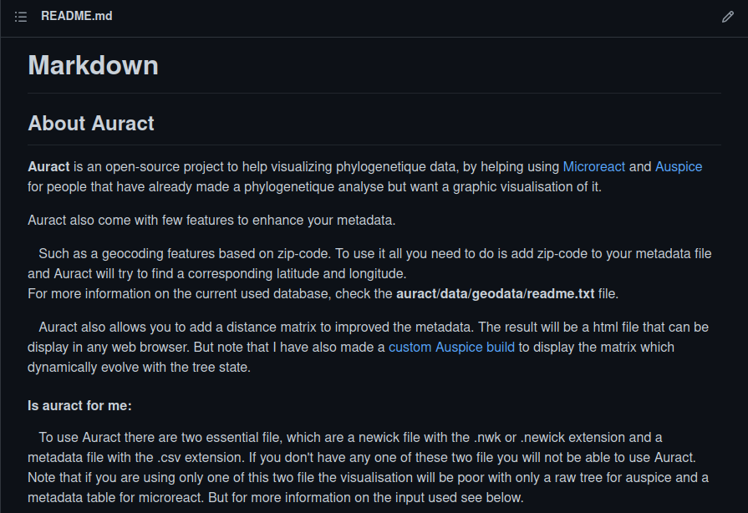
Github/Gitlab: Improvement
Readme usually presents the repository and also has documentation or guide on installation and usage.
Hiriart Mateo

Slide 27
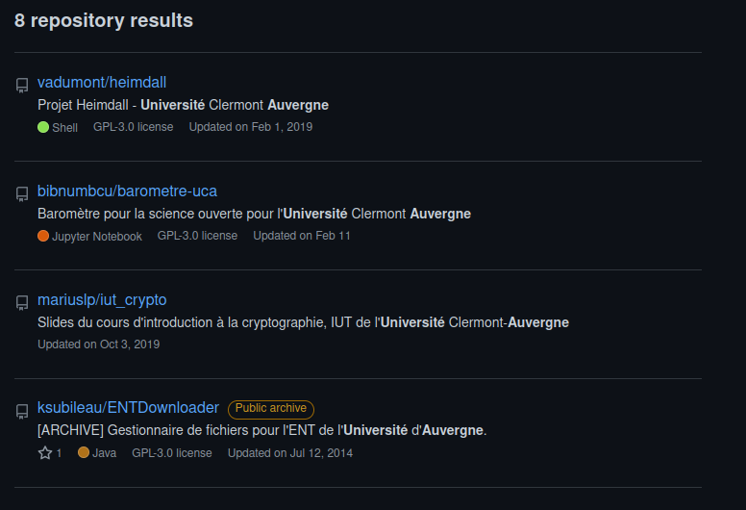
Github/Gitlab: Open source project
Find open source project and publish yours
Worldwide interactive development
Hiriart Mateo

Slide 28
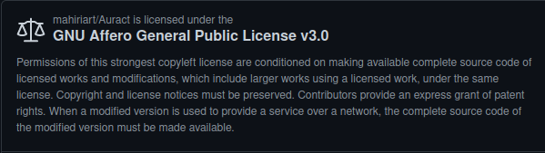
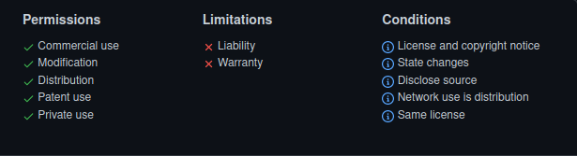
Github/Gitlab: Licenses
Key element for public repository, allow then to truly be open source.
Allow others to freely use, change and distribute your code.
Hiriart Mateo

Slide 29
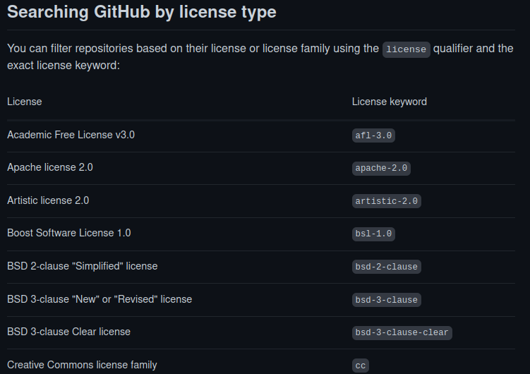
Github/Gitlab: Licenses
Many licences available
Hiriart Mateo

Slide 30
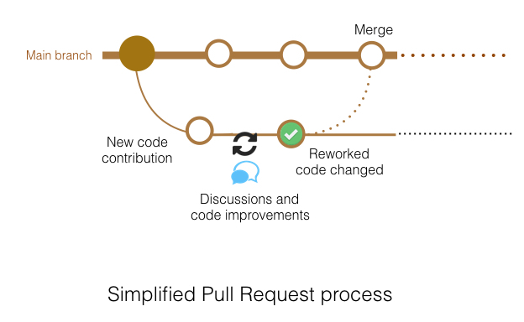
Github/Gitlab: Issues and merge request
Issues are features to point out problem in code or possible enhancement.
Usually solved in a pull request.
Pull requests are code contributions in a review state.
Hiriart Mateo

Slide 31
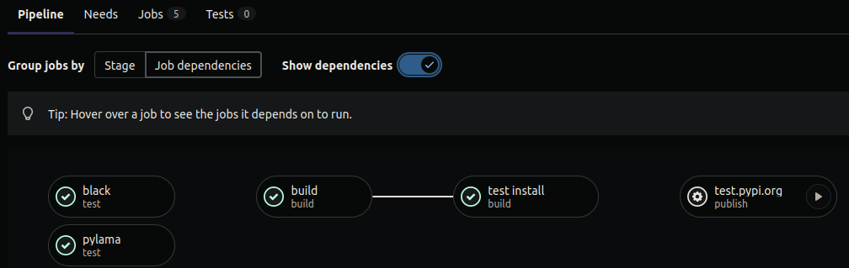
Github/Gitlab: Pipeline CI/CD
Continuous Integration (CI)
Continuous Delivery (CD)
Can automatically build, test, deploy, and monitor your applications
Example of CI pipeline
Hiriart Mateo

Slide 32
Github/Gitlab: Pages
Easily build own web site for your project. To highlight your work.
Hosted by Github or Gitlab.
Multiple templates can be found. https://git.mesocentre.uca.fr
Hiriart Mateo

Slide 33
https://github.com/mesocentre-clermont-auvergne/formation_fair_2022/tree/main/fair_git
https://git.mesocentre.uca.fr
Hiriart Mateo

