Slide 1
Exploring the uncharted ocean of data: experience with multi-institutional databank for radiotherapy-treated lung cancer patients
Sangkyu Lee
McGill MPU Friday morning talk
Oct 31st, 2014

Slide 2
Common side effects from thoracic RT
 | Radiation Pneumonitis | Fibrosis | Esophagitis
Clinical manifestation | Shortness of breath | Radiographic changes | Dysphagia
Time of emergence | Acute (<6 months) | Late (>6 months) | Acute (<6 months)
Organs at risk | Lung parenchyma, heart (?) | Lung parenchyma | Lung (upper), esophagus

Slide 3
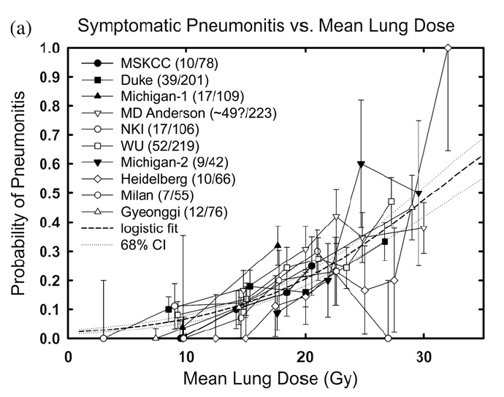
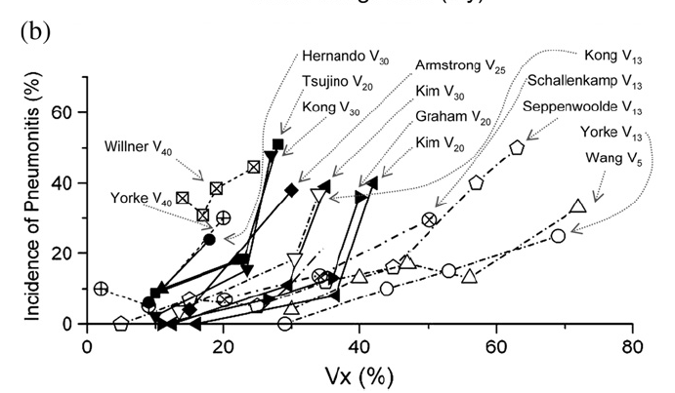
Pneumonitis: explaining heterogenity
No clear threshold behaviours in dose-volume parameters -> indication of patient heterogeneity
“…adjusting for biological and patient-related factors will lead to stronger dose-volume effect relationships.” (Bentzen et al., QUANTEC vision paper)

Slide 4
Prospective biophysical data collection (2011~)
Eligibility | Stage 1-3 non small cell lung cancer (NSCLC) Curative radiotherapy Decent performance status (< 2 ECOG) No previous lung irradiation
Collected Data | Electronic treatment plans Health reports: Consultation/ Follow-up/ imaging reports Blood samples and CT imaging Conventional 60/30: pre-RT, mid-RT, end-RT, 3 months, 6 months post SBRT: pre-RT, end-RT, 3 months, 6 months post

Slide 5
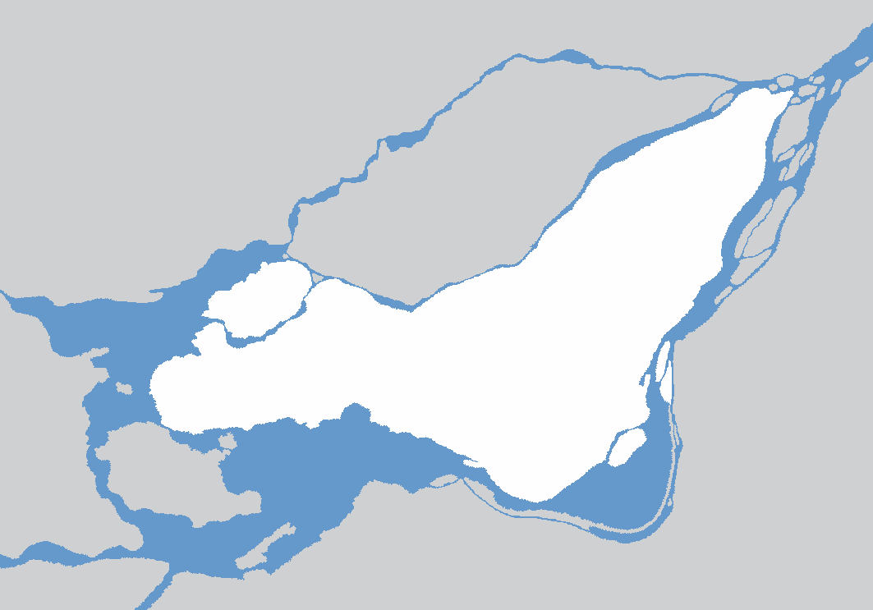
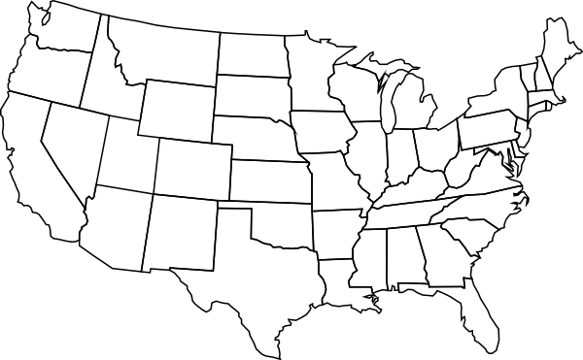
Participating institutions
Montreal General Hospital
(MGH)
Hopital Notre-Dame
(CHUM)
Washington University in St. Louis
(WashU)
* map not to scale

Slide 6
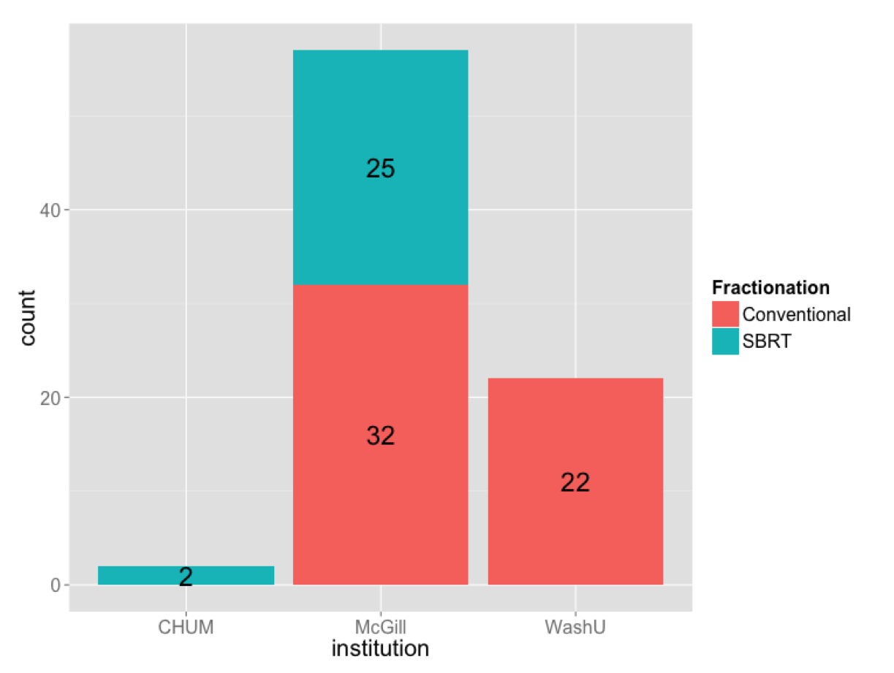
Accrual status (as of Oct. 2014)

Slide 7
Data sources and attributes (McGill)
Blood samples
Patient reports
RT plan
Imaging
Biological variables
Proteins:
OPN
ACE
IL-6
IL-8
a2M
TGFb
DNA CNV: APEX, XRCC1
Clinical variables
Demographics
Habits
Tumor info
Chemo
Comorbodities
Tumour outcomes
RP grade
Dosimetric variables
MLD (avg. lung dose)
MHD (avg.heart dose)
V_{D} (volume receiving >D Gy)
PTVCOMSI (dose to lower lung)
Texture analysis
Baseline CT
CBCT
midRT CT
Follow-up CT
Follow-up PET

Slide 8
WashU data (2007~2009)
WashU dataset
Biological variables
Protein biomarkers (pre, midRT):
ACE
IL-6
a2M
TGFb
Clinical variables
Age
Tumour outcomes
RP grade
Dosimetric variables
MLD (avg. lung dose)
MHD (avg.heart dose)
V_{D} (volume receiving >D Gy)
PTVCOMSI (dose to lower lung)

Slide 9
Biological variables (8)
Protein biomarkers:
ACE (pre, midRT/pre)
IL-6 (pre, midRT/pre)
a2M (pre, midRT/pre)
TGFb (pre, midRT/pre)
Dosimetric variables (6)
MLD, MHD
V_{20,} V₃₀
PTVCOMSI (dose to lower lung)
PTV volume
Data visualization/compression
Multivariate modeling
P (RP)

Slide 10
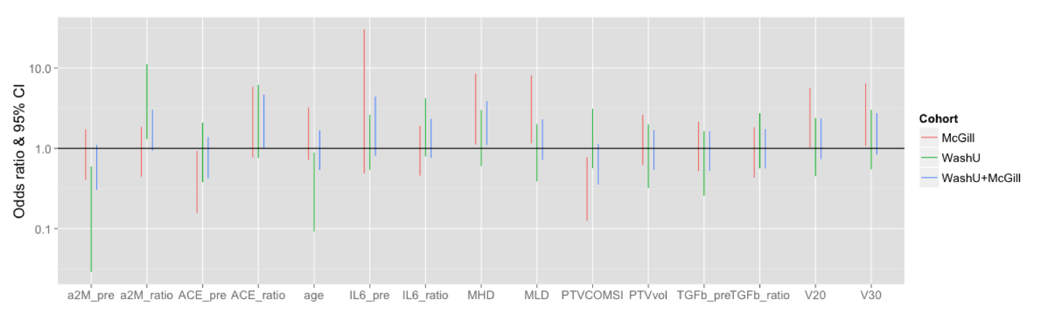
Univariate correlation
Odds ratio =
Variables with significant impact: ACE midRT/pre (ratio) (2.17),
MHD (2.06)

Slide 11

Data Visualization
N-dimensional input data
2D space
Notes:
Data is multidimensional, but you perceive information mostly in a 2D space. So the best way to visualize your data is somehow project it to a 2D space and then apply multiple layers of colors or marks to add more dimensions.
Circos: Visualization scheme to visualize gene expression data
human genes arranged in a circular orientation and also grouped by a choromosome they are located. The genes that are related through the same biochemical pathways are connected via the links within the ring
It is a descriptive/qualitative step to discover characteristics in data which will help us design strategies for more quantitative analysis

Slide 12
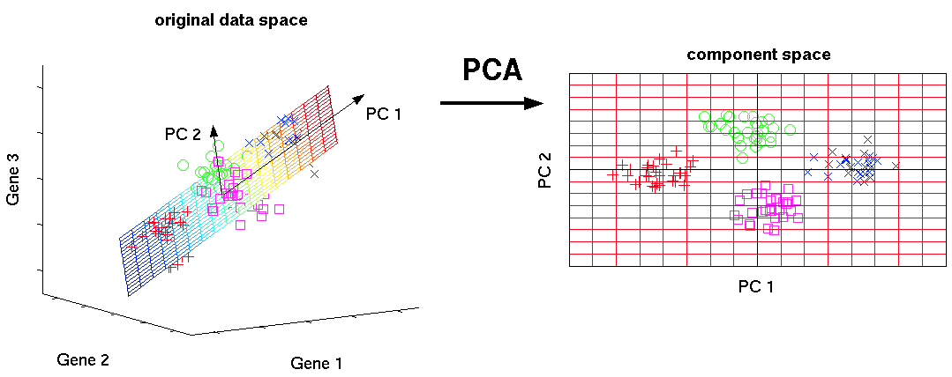
Principle Component Analysis (PCA)
PC1 = w11*Gene1 + w12*Gene2+w13*Gene3
PC2 = w21*Gene1 + w22*Gene2+w23*Gene3
…

Slide 13
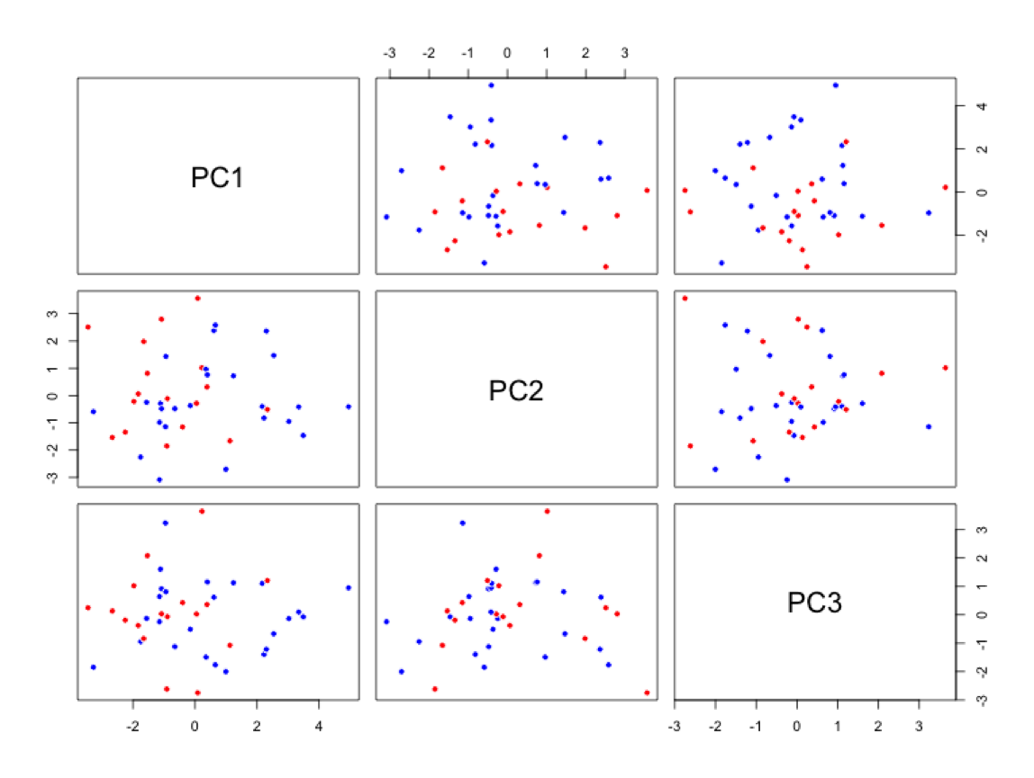
PCA on a entire variable set (l=14)
RP
No RP
Separating RP is a multivariate/nonlinear problem!!!
Notes:
For the sake of demonstration, the top 3 principal components are taken. In other words the data was compressed into a 3D dimension and the scatterplots show the 2D projections of the 3D space

Slide 14
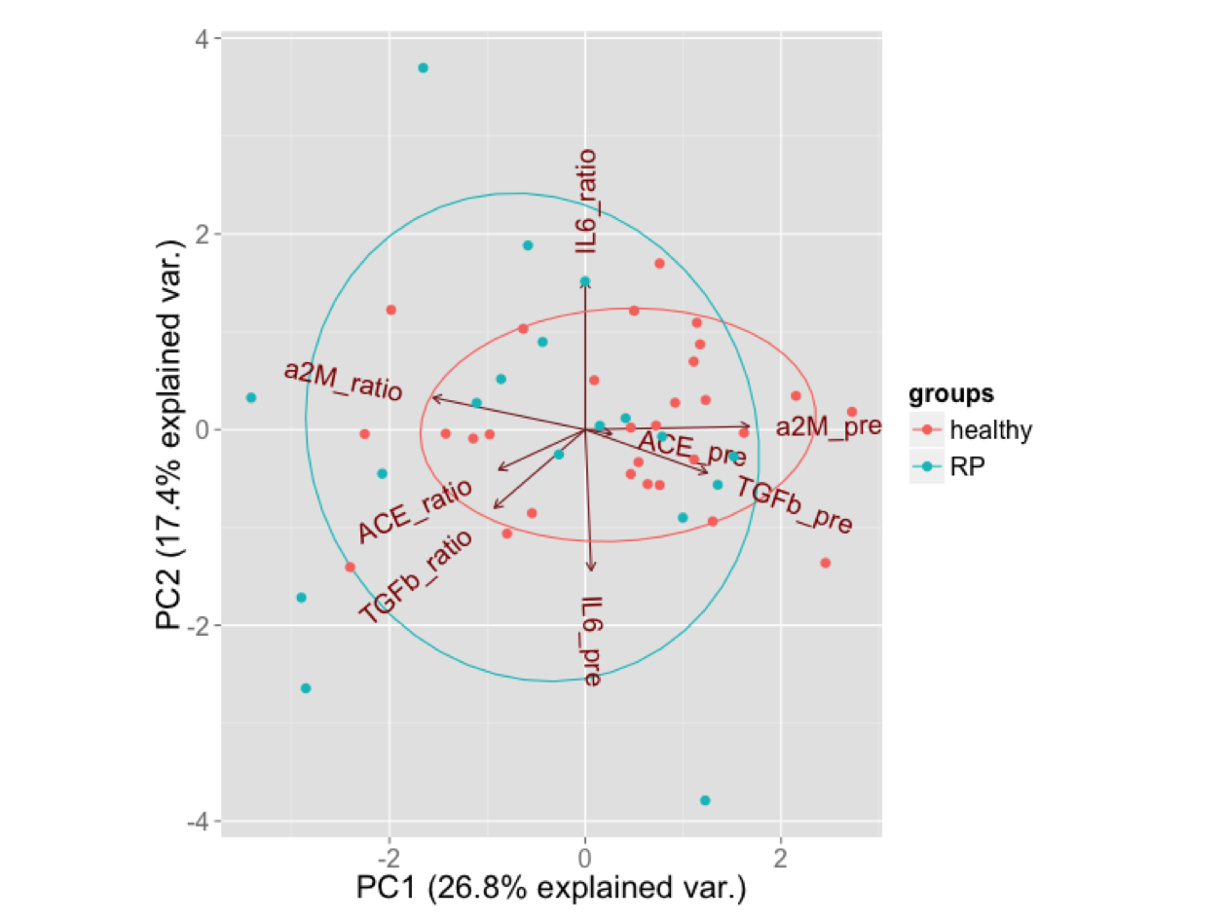
PCA on biological variables (l=8)
Conventional Fx only
Notes:
The data is so multidimensional that decided to take a look on the biology first. Blue markers for RP patients and red for healthy. An ellipse is drawn so that it comprises 68% of the samples that belong to that group. The ellipse for the RP group is much larger meaning that the protein expression from RP patients tend to go more extreme than the normal

Slide 15
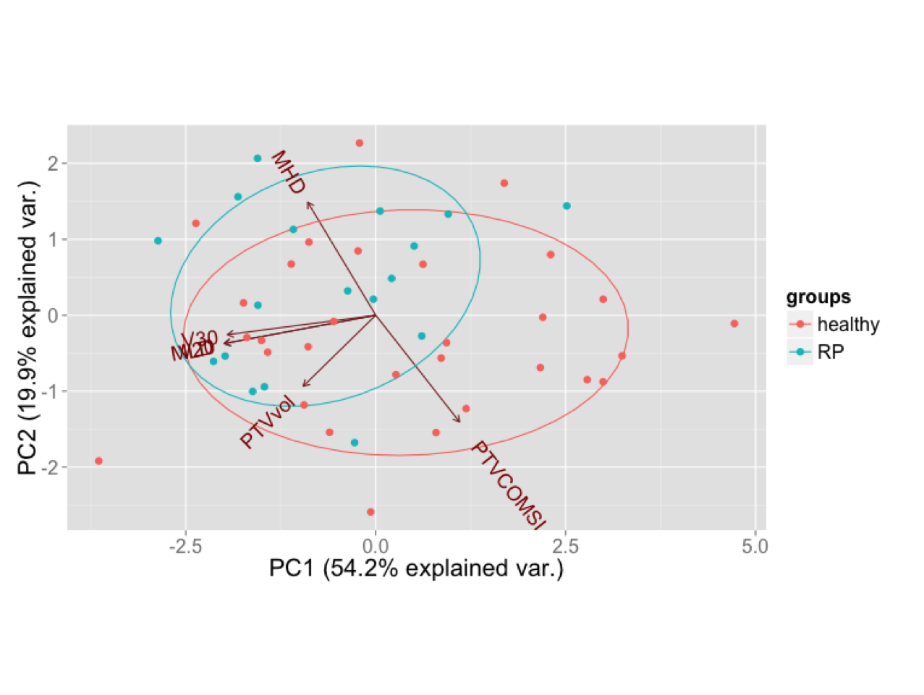
PCA on dosimetric variables (l=6)
Conventional Fx only
Notes:
The RP group is a bit off from the healthy group in the direction of heart dose

Slide 16
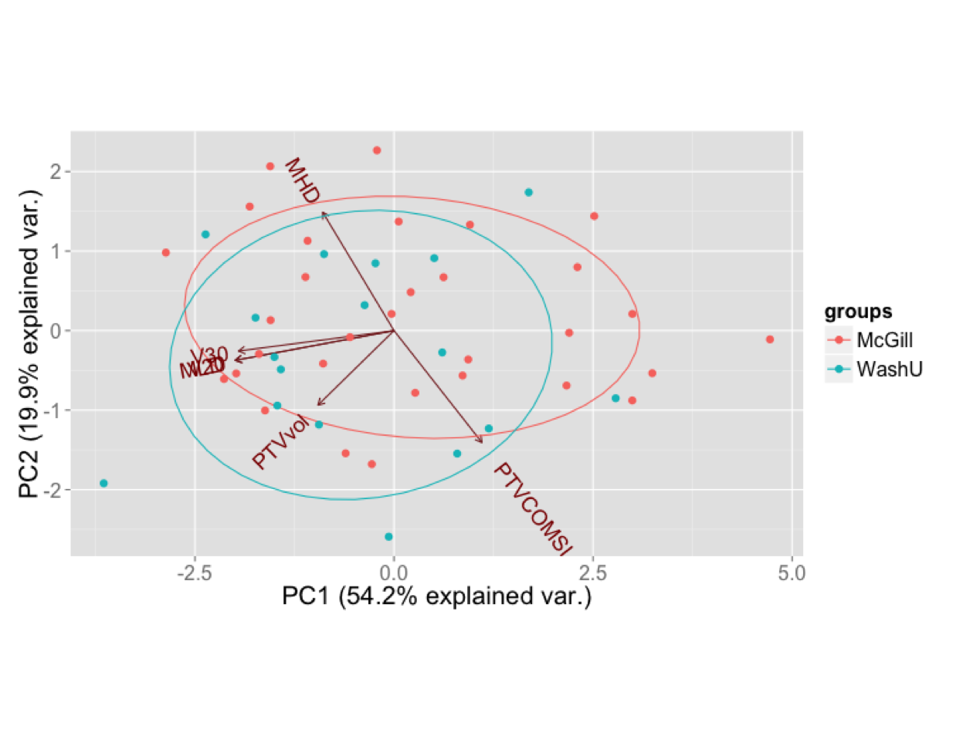
PCA on dosimetric variables (l=6)
Conventional Fx only
Notes:
Any planning differences between the two institutions. From the WashU group is shifted a little bit to the left wrt to the McGill circle which is in the direction of dose to lung

Slide 17
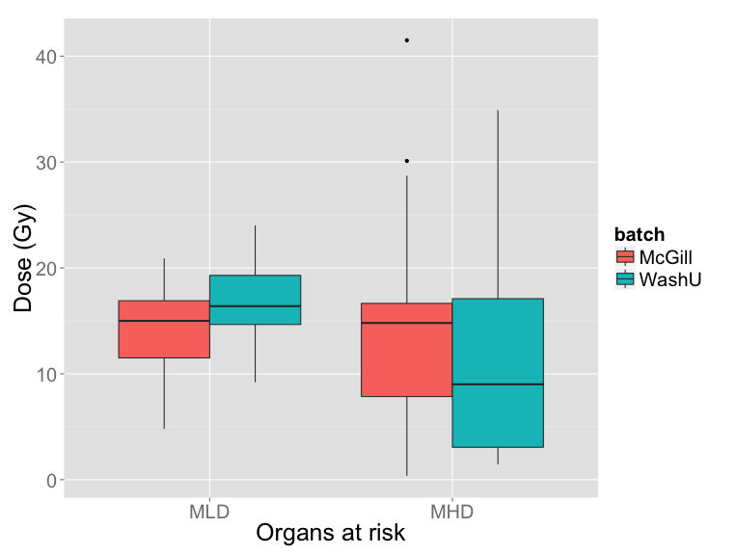
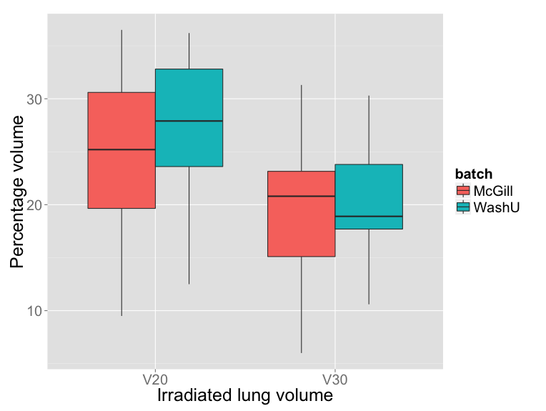
RT plan: WashU vs. McGill
outliers
Median Tx for conventional patients: 60 Gy (McGill), 68 Gy (WashU)
Notes:
Box plot. Whiskers extend to 1.5 * interquartile interval (statistically robust max. min)
Seen from MLD and V20, WashU plans were hotter (because Tx = 68 Gy, has to be less conservative to OARs)
Wide range of dose to heart, because it’s not regulated as much as lung, mention there were outliers with very high heart dose

Slide 18
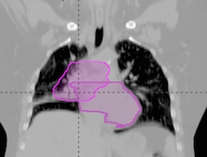
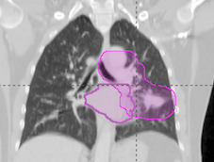
Heart dose as a risk factor?
MLD = 15.6 Gy
MHD = 30.1 Gy
RP grade 2
MLD = 16.4 Gy
MHD = 41.5 Gy
RP grade 2

Slide 19
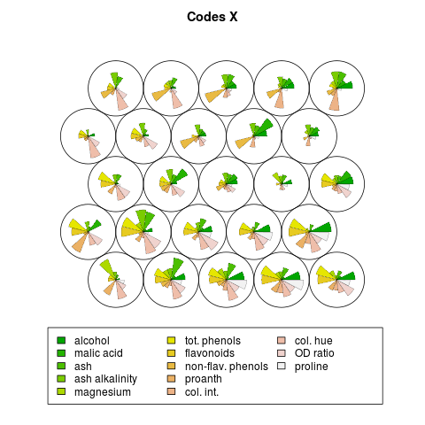

Self Organizing Map (SOM)
Notes:
SOM: another way to visualize the data. The input data space is clustered into a finite number of patterns called a node
Example: concentrations of chemical compounds contained in several wine varieties. Each cell (or node) represent distinct patterns of compound concentration, and could possibly correspond to a specific wine type
And these nodes are typically arranged in a 2-dimensional grid. What makes this a powerful tool is that these nodes are topologically ordered (it puts the nodes with similar patterns adjacent to each other) so we see a gradual transition of patterns
SOM can be used as a classifier. (example: wine tasting)

Slide 20
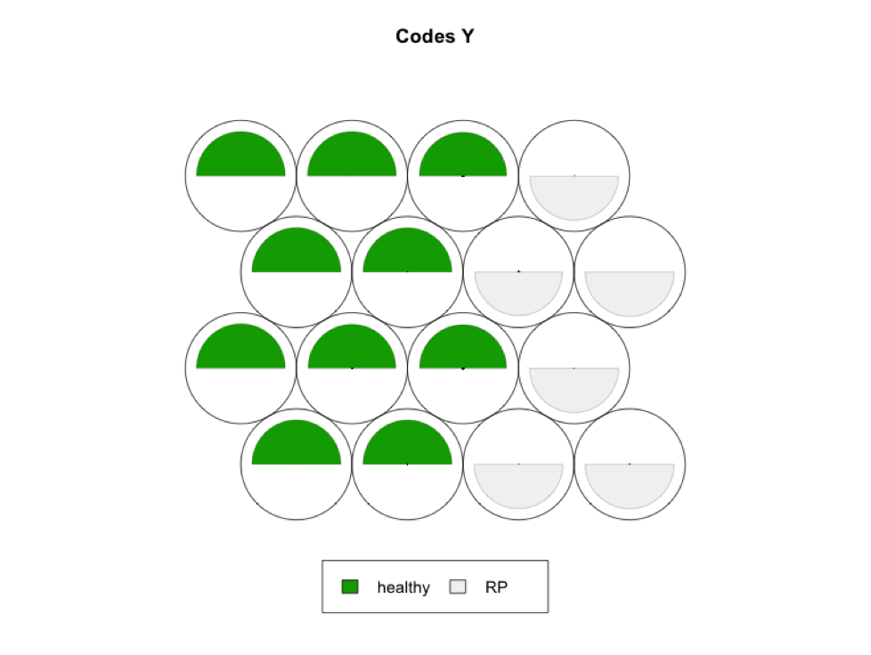
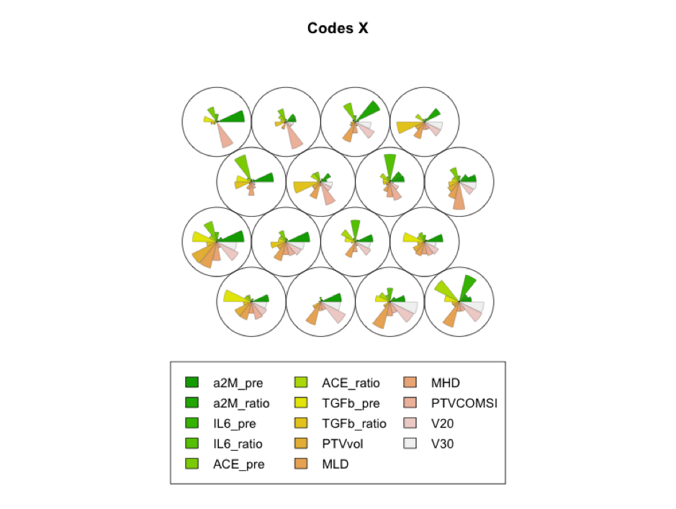
Self Organizing Map (SOM)

Slide 21
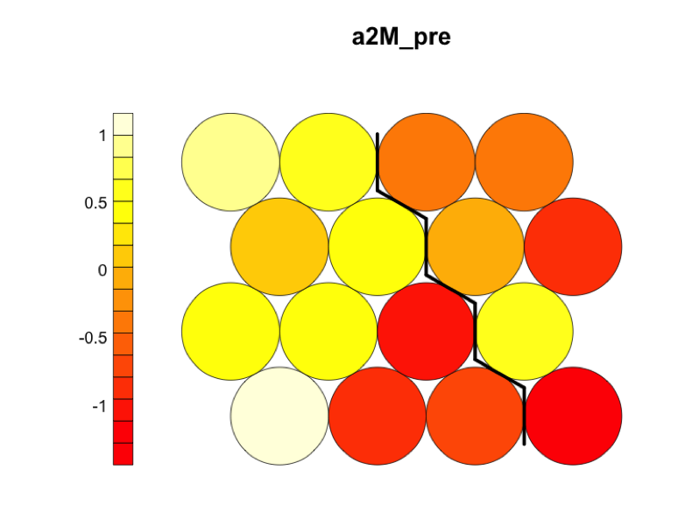
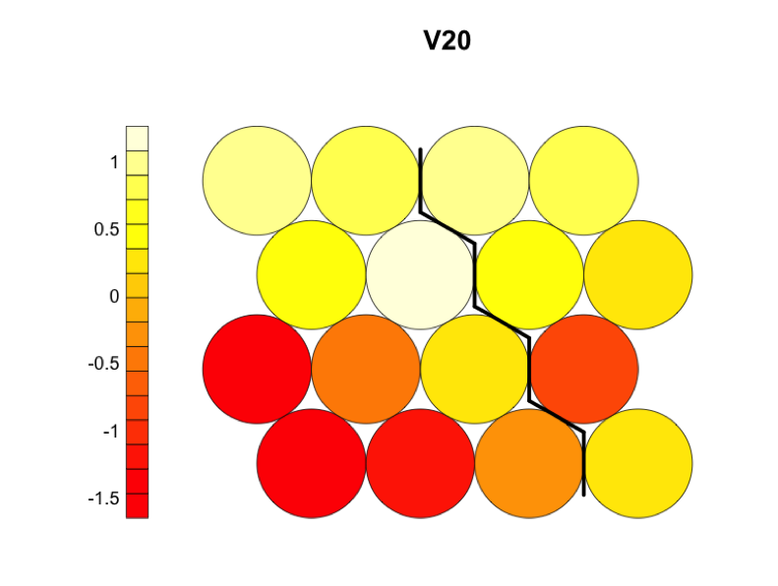
Patterns of input variables in a SOM
Healthy
RP

Slide 22
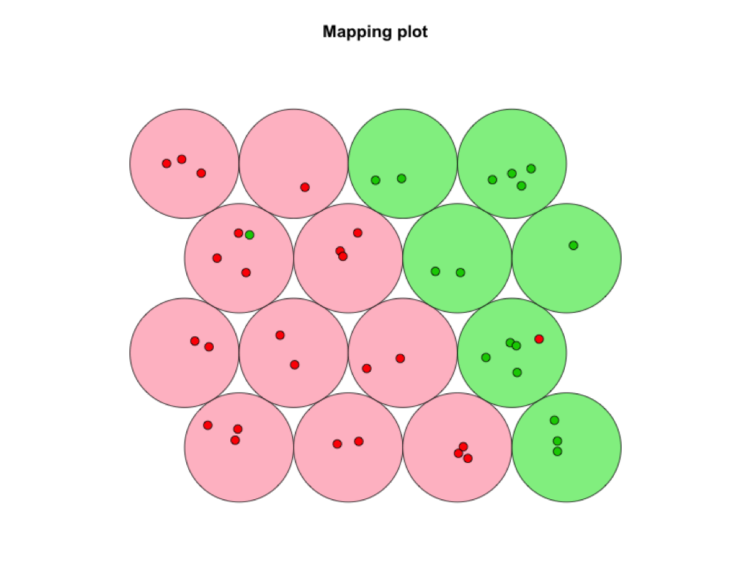
SOM as a RP classifier
RP noRP
95% accuracy (training set)
Notes:
Generated 1 false positive/ 1 false negative

Slide 23
Summary
2D visualization of data is an important step before multivariate modeling, allowing us to:
see the nature of class distribution (linear/nonlinear)
know which variables are more important than others
detect outliers
Data can be linearly projected (PCA) or clustered into a number of patterns (SOM)

Slide 24


Acknowledgments
Issam El Naqa (McGill)
Krishinima Jeyaseelan (McGill)
Norma Ybarra (McGill)
Neil Kopek (MUHC)
Sergio Faria (MUHC)
Jan Seuntjens (McGill)
Jeff Bradley (WashU)
Clifford Robinson (WashU)
Toni Vu (CHUM)
Edith Filion (CHUM)
Marie-Pierre Campeau (CHUM)
Louise Lambert (CHUM)
Pierre Delvecchio (CHUM)
Jean Francois Carrier (CHUM)
Natalie Japkowicz (UOttawa)
Pascale Brisebois (MUHC)
Diane Trudel (CHUM)
Chantal Lafleur (CHUM)
Nidale El-Sokhn (CHUM)
….and the McGill MPU crew!

