Slide 1
On-Premises to Azure Cloud Migration Strategy A Secure, Scalable, and Compliant Hybrid Cloud Solution
Srikanth Bollampally
Role: Senior DevOps/SRE/Cloud/MLOps Consultant
Prepared for Client: M&T Bank

Slide 2

Introduction & Objective
Introduction and Role:
I’m Srikanth Bollampally, a DevOps, Site Reliability, and MLOps Engineer with over 12 years of experience driving cloud transformation and infrastructure automation projects. My expertise spans infrastructure as code (IaC), continuous integration and deployment (CI/CD), and secure hybrid cloud solutions, specifically with tools like Terraform, Ansible, GitLab, and Jenkins. I specialize in designing scalable and resilient architectures, seamlessly migrating on-premises systems to cloud platforms, and implementing MLOps practices to support real-time data insights and model performance monitoring. In this role, I deliver secure, cost-effective, automated solutions that align with business objectives and ensure long-term operational success.
Objective:
I aim to lead a secure, scalable, and efficient migration from on-premises to Azure by leveraging automation and cloud best practices. Through infrastructure as code (IaC) with Terraform, configuration management with Ansible, and CI/CD pipelines using GitLab and Jenkins, I aim to streamline the migration process, ensure data integrity, and establish a hybrid architecture that meets high security and compliance standards. This approach will provide a robust foundation for scalable cloud operations while maintaining essential on-premises capabilities.

Slide 3
Key Migration Goals
Scalability:
Seamlessly scale applications using Azure cloud resources while retaining essential on-prem infrastructure.
Security and Compliance:
Emphasize security practices that meet industry standards and data privacy regulations.
Automation and Efficiency:
Ensure a repeatable, efficient migration process with IaC, Ansible, and CI/CD.

Slide 4
Migration Approach
Phase 1: Discovery and Assessment
Evaluate current on-prem assets and align with Azure architecture best practices.
Phase 2: Design and Architecture
Implement a cloud-agnostic, hybrid architecture using Terraform and Ansible to ensure flexibility and data protection critical to banking operations. This hybrid setup combines Azure cloud resources with essential on-premises infrastructure, allowing sensitive data to remain securely on-prem while leveraging cloud scalability for non-sensitive workloads. By avoiding dependency on proprietary Azure services, this architecture mitigates vendor lock-in risks and upholds robust data privacy standards, ensuring compliance and operational resilience for the bank.
Phase 3: Migration Execution
Execute an incremental migration within a Kubernetes environment using automated CI/CD pipelines with GitLab and Jenkins, incorporating code coverage checks, artifact storage, and version control. Deployments will leverage ArgoCD for continuous delivery and Helm charts for Kubernetes resource management, ensuring high-quality releases, efficient artifact handling, and seamless transitions with minimal downtime.
Phase 4: Optimization and Monitoring
Optimize resources and reduce costs by fine-tuning configurations and implementing robust monitoring using cloud-native Azure Monitor Application Insights or platforms like Grafana, Datadog, or New Relic to detect and respond to real-time anomalies.

Slide 5
Automation Tools and Technologies
Infrastructure as Code (IaC):
Terraform for consistent, scalable Azure deployments with minimal manual intervention.
The reusable Modules Concept can reduce the effort with a backend State file in Azure Blob Storage.
Configuration Management: Ansible to configure and manage resources securely and repeatedly across Azure and on-prem.
Reusable, simple configuration management and multi-machine deployment system, one that is well suited to deploying complex applications.
CI/CD Pipelines: GitLab and Jenkins for pipeline automation, ensuring quick, consistent updates with built-in testing.
Secret Management: Securely manage sensitive data using Azure Key Vault, Hashicorp Vault, or other secret management solutions.

Slide 6
Security and Compliance Strategy
For a bank, security, and compliance are paramount to customer trust and regulatory integrity. As banks handle highly sensitive financial data, ensuring the privacy and security of this information is crucial for preventing fraud, safeguarding assets, and maintaining customer confidence. Compliance with industry standards (like PCI-DSS, SOC 2) and government regulations (such as GDPR) is essential to meet legal obligations and mitigate financial and reputational risks associated with data breaches or misuse. This strategy involves rigorous data encryption in transit and at rest, robust secret management to protect credentials and sensitive information, and comprehensive Identity and Access Management (IAM) policies with role-based access controls and multi-factor authentication (MFA) to prevent unauthorized access. A bank’s commitment to these practices ensures that every transaction, user interaction, and data asset is secured to the highest standard, sustaining trust and operational resilience in a regulated environment.
Data Encryption:
Use encryption in transit and at rest to protect customer and business data.
Secret Management:
Highlight your strategy for securely handling credentials, API keys, and sensitive data with Vault solutions.
Identity and Access Management (IAM):
Implement IAM policies with Azure AD, ensuring role-based access control and multi-factor authentication (MFA).

Slide 7
Monitoring and Observability
Monitoring Tools:
Use Azure Monitor, Prometheus, and Grafana for real-time performance monitoring across environments.
Alerting:
Set up automated alerts and performance dashboards to quickly address issues and maintain high uptime.
ML Observability:
Integrate monitoring for ML models to track accuracy, drift, and performance, ensuring models remain reliable.

Slide 8
Migration Timeline and Milestones
Phase-wise Timeline:
Key dates and milestones for each migration phase (e.g., Discovery, Pilot Migration, Full Migration).
Duration Estimates:
Estimated weeks or months for each phase to provide a clear roadmap for the client.

Slide 9
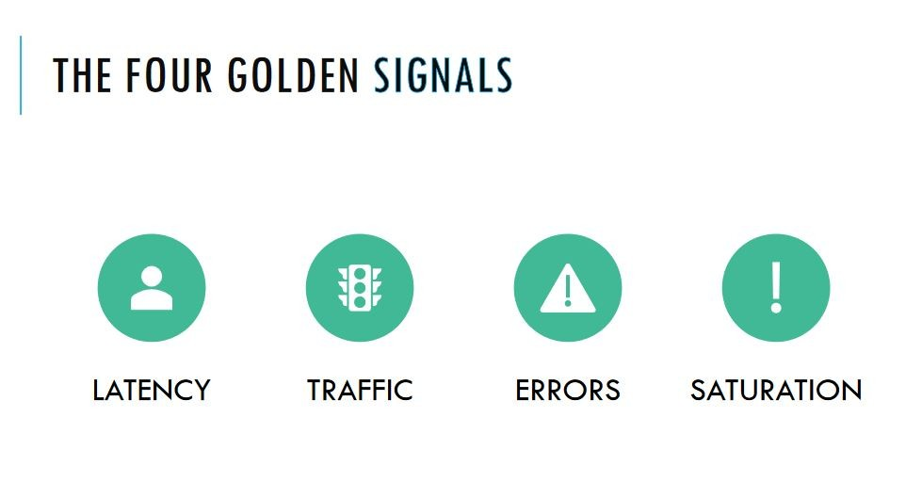
Success Metrics
Key Metrics:
Define success metrics such as reduced downtime, deployment frequency, cost savings, and SLA adherence.
Reporting: Use real-time dashboards and periodic reports to track migration progress and post-migration performance.

Slide 10

Contact: GitHub LinkedIn
Thank You

