Slide 1
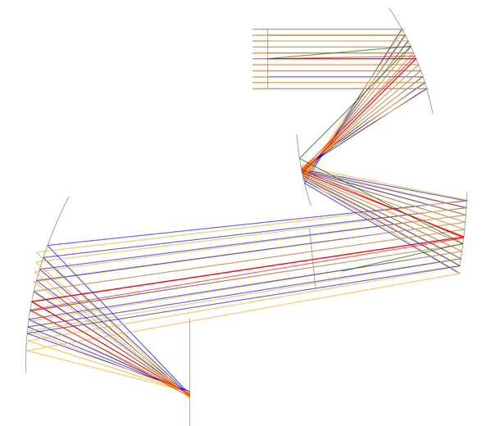
Pyrate
Optical Raytracing Based on Python
J. Hartung, M. Esslinger, T. Heinze, U. Lippmann
https://github.com/mess42/pyrate

Slide 2
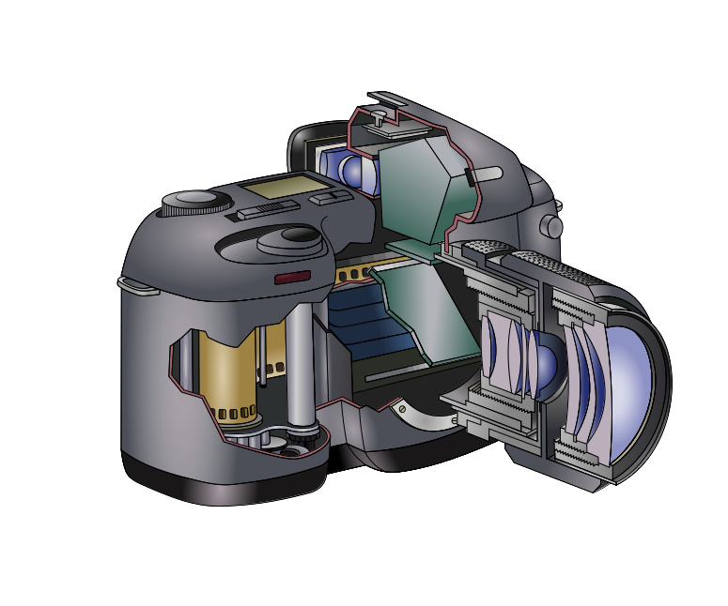
Goals
Design Optics for photography, microscopes, telescopes, …
Learn about optics
Figure:
https://upload.wikimedia.org/wikipedia/commons/e/ef/Reflex_camera_%28description%29.svg
(C) [[::User:Anuskafm|Anuskafm]] CC-BY-SA 3.0

Slide 3

Optical Design
Optimize Lens geometries so that the objective focuses light to a sharp spot
Perform a ray trace
Define a merit function
Use scipy.minimize() to optimize
merit function value

Slide 4
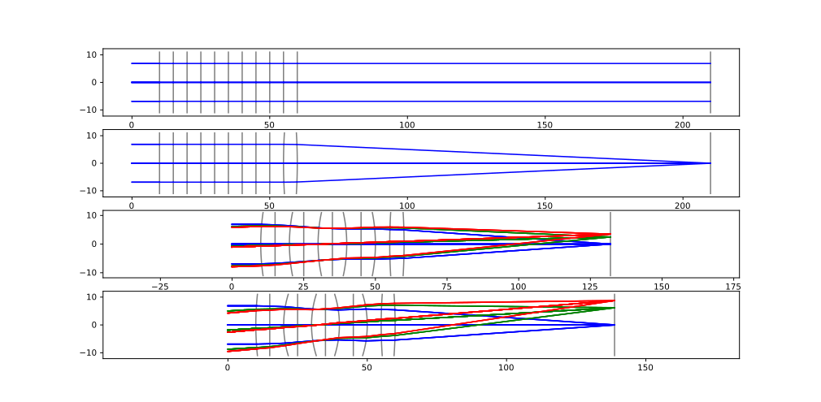
Design Process
Start with few variables and few requirements
Change the set of variables and merit function often

Slide 5
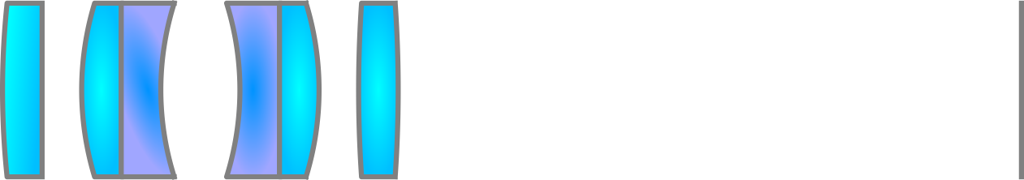


Hierarchical Structure
Optical System
+ Optical Element
+ Optical Element
Optical Element
Surface
Radius
...

Slide 6
Class structure
class optimizableVariable():
self.name
self.value
self.status (fixed, variable, Lagrange constraint, ...)
self.constraints
self.boundaries
class classWithOptimizableVariables():
self.foo = optimizableVariable()
self.bar = optimizableVariable()
def getAllVariables():
searches self.__dict__
for instances of optimizableVariable
and classWithOptimizableVariables

Slide 7
Class structure
class optimizableVariable():
self.name
self.value
self.status (fixed, variable, Lagrange constraint, ...)
self.constraints
self.boundaries
class classWithOptimizableVariables():
self.foo = optimizableVariable()
self.bar = optimizableVariable()
def getAllVariables():
searches self.__dict__
for instances of optimizableVariable
and classWithOptimizableVariables

Slide 8

Element Structure
Optical System
s = OpticalSystem()
v = s.getAllVariables()
+ Optical Element
+ Optical Element
Optical Element
Surface
Radius

Slide 9
Optimization Algorithm
User input
Optical System
def meritfunction(opticalSystem):
perform raytrace
return spot size
getAllVariables()
Pick optimizableVariables
with status == “variable“
def meritFunctionWrapper( variableValues ):
opticalSystem.set( variableValues )
return meritfunction( opticalSystem )
Wrapper
Scipy.optimize
Backend
Result
Modified Optical System

Slide 10
Thank you for your attention
https://github.com/mess42/pyrate

