Slide 1
Cislunar Solar Sailing for DARPA Cattle Run
Simulation study results: transit, launch geometry, cislunar transfers, pole-sitting, 'in-irons' limits, field of view, hybrid agility and the demonstration orbit
Proposal-team briefing | DARPA-SN-27-03 Proposers Day 10 Nov 2026 | 1 November 2026
Notes:
Purpose: brief the proposal team on what the mission simulator says about solar-sail and hybrid sail/SEP concepts for DARPA Cattle Run. Companion to the PDF results report, which contains methods, tables and references.

Slide 2
Bottom line
A hybrid sail flown first at ~1,000 km, then launched toward the lunar plane, meets every Cattle Run objective
1.3 yr
GEO to lunar distance with a
Solar Cruiser-class sail (CR-S)
34.5 deg
sunward cone where a sail
produces no thrust at all
2.2x
7-day reach of the hybrid
vs the sail (from a DRO)
~1,000 km
lowest robust demo orbit
(drag < 25 % of sail thrust)
Baseline a hybrid: Solar Cruiser-class sail + 20 mN two-axis gimballed SEP (CR-H) removes the in-irons region and decouples pointing and power from thrust for 20 kg.
Demonstrate below GEO at ~1,000 km dawn-dusk SSO (no eclipses, ~20 % faster raising); from a 550 km rideshare, climb with the sail stowed (18 days, 2 kg).
Launch cislunar elements toward the lunar plane (Cape Canaveral 28.5 deg / 27 deg GTO); DRO, NRHO and L1/L2 halos are weeks apart, L4/L5 two months.
Do not baseline a lunar pole-sitter: it needs 1.2-1.8 mm/s^2 continuously - an SEP mission. Use paired NRHO spacecraft for polar coverage.
Notes:
Four numbers carry the story: transit takes years from Earth orbit with near-term sails; physics forbids sunward thrust over a 35 deg cone; a small gimballed SEP more than doubles agility; and drag sets the demo floor near 1,000 km for a robust test.

Slide 3








Eight questions, one simulator
Each study question maps to an analysis module, a results file and figures in this deck
Q1 Transit time from GTO, GEO, TLI, LEO
Q5 'In irons': sail vs hybrid
Q2 Optimal launch inclination
Q6 Field of view, fixed vs gimballed bus
Q3 Transfers among DRO, LLO, EML1/2/4/5
Q7 Hybrid manoeuvrability & acceleration
Q4 Lunar pole-sitter requirements
Q8 Lowest acceptable demo orbit
Notes:
The objectives document asked for an inclusive simulator from Earth to and within cislunar space, transit times, conventional vs hybrid comparison, GPU use through PyTorch, pre-processed mission profiles and 2-D/3-D plots. All eight questions are answered with it.

Slide 4
Simulator: GPU-batched, validated against flight data
NumPy or PyTorch (CUDA) backend - thousands of trajectories propagated in lock-step
sail optical force model, materials, optimal steering, hybrid allocation
Benchmark | Reference | Simulator
Orbit-averaged thrust fraction | 0.4393 (McInnes) | 0.4393
ACS3 SMA rise, 900 km, 180 d | +340 km (Dono) | +353 km
Min. ACS3 raising altitude | ~691 km (Wilkie) | 647 km
Averaged vs Cowell (Sun+Moon), 60 d | - | 0.1 % in apogee
9:2 NRHO period / perilune | 6.56 d / ~3,250 km | 6.56 d / 3,249 km
Lunar pole hover at 60,000 km | Ozimek contours | 1.77 mm/s^2
environment Sun/Moon ephemerides, shadows, NRLMSIS drag tables
earth_orbit orbit-averaged spirals (MEE), J2, eclipses, drag, SEP
cr3bp Earth-Moon CR3BP + rotating Sun line, halos, NRHO, DRO
designs mass model calibrated on ACS3 and Solar Cruiser
analyses q1-q8 + design trades; run_all.py rebuilds everything
Notes:
Validation: the steering tables reproduce McInnes exactly; the averaged LEO model matches the ACS3 flight-dynamics predictions within 4-30 % depending on the solar-activity assumption; averaged vs full Cowell differs by 0.1 % in apogee after 60 days; the NRHO matches Gateway's reference orbit.

Slide 5
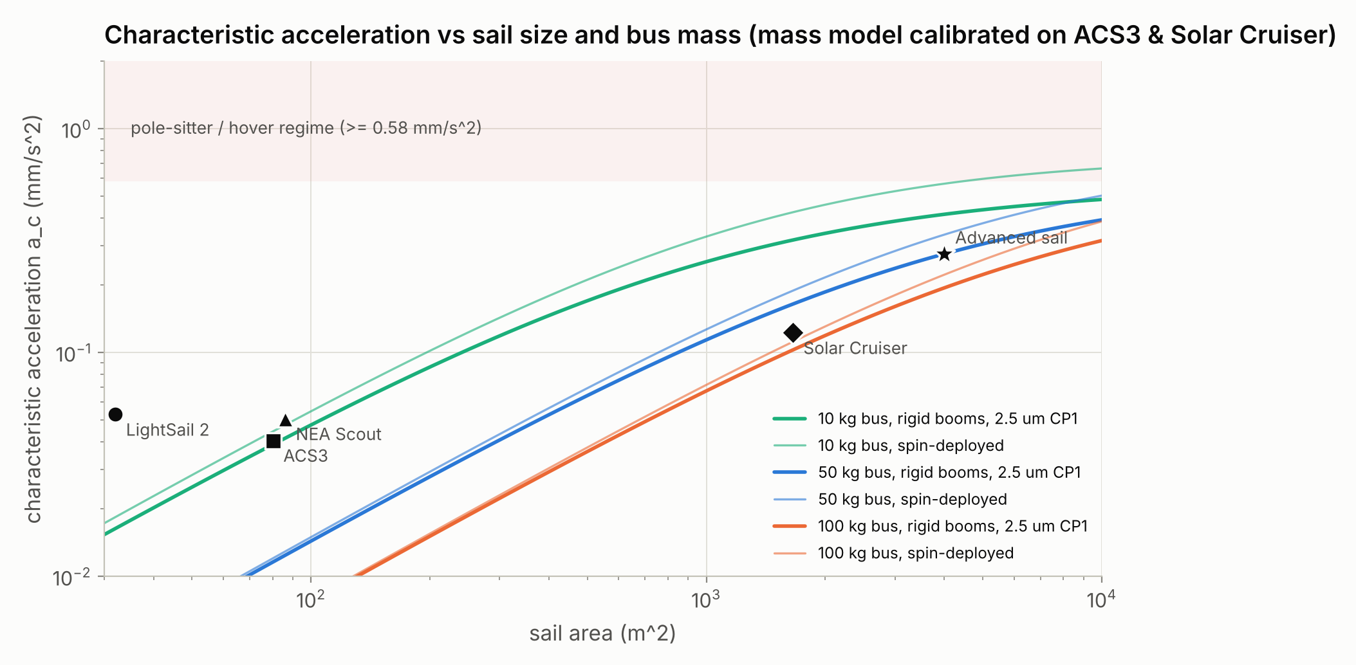
Design points
Heritage sails anchor the range; the study uses a Solar Cruiser-derived sail (CR-S), its hybrid (CR-H) and a far-term sail (CR-A)
Design | Mass (kg) | Area (m^2) | a_c (mm/s^2) | SEP
LightSail 2 (2019) | 5 | 32 | 0.053 | -
ACS3 (2024) | 16 | 80 | 0.041 | -
NEA Scout (2022) | 14 | 86 | 0.051 | -
Solar Cruiser (TRL-6 sail) | 111 | 1,653 | 0.123 | -
CR conventional sail | 111 | 1,653 | 0.123 | -
CR hybrid | 131 | 1,653 | 0.104 | 20 mN, 1500 s, +/-30 deg
Advanced sail (DCB-II, 1 um CP1) | 120 | 4,000 | 0.275 | -
Notes:
a_c is quoted for the real film (about 9 % below the ideal 2PA/m formula). CR-H trades 18 % more mass for SEP agility; CR-A shows what 1 um film and 45 m booms buy.

Slide 6
Getting there
Q1 transit time | Q2 launch inclination | Q3 transfers between cislunar orbits

Slide 7
Q1 Transit time scales as 1 / a_c
Near-term sails need 1.3-5.5 years to climb from Earth orbit to lunar distance - start high
490 d
GEO to lunar distance (CR-S)
819 d
raised GTO (1,000 x 35,786 km)
1,991 d
1,000 km LEO, 28.5 deg
TLI: lunar distance in 2.6 d, then ~89 d sail capture (~27 d hybrid).
Notes:
Medians over six launch seasons; arrival = osculating apogee at 326,000 km. CR-H with 6 kg of propellant: 395 d from GEO; with unlimited SEP 122 d but 14 kg of propellant. A standard 250 km-perigee GTO is survivable only with edge-on perigee passes; a 75 m/s perigee raise is the robust choice.

Slide 8
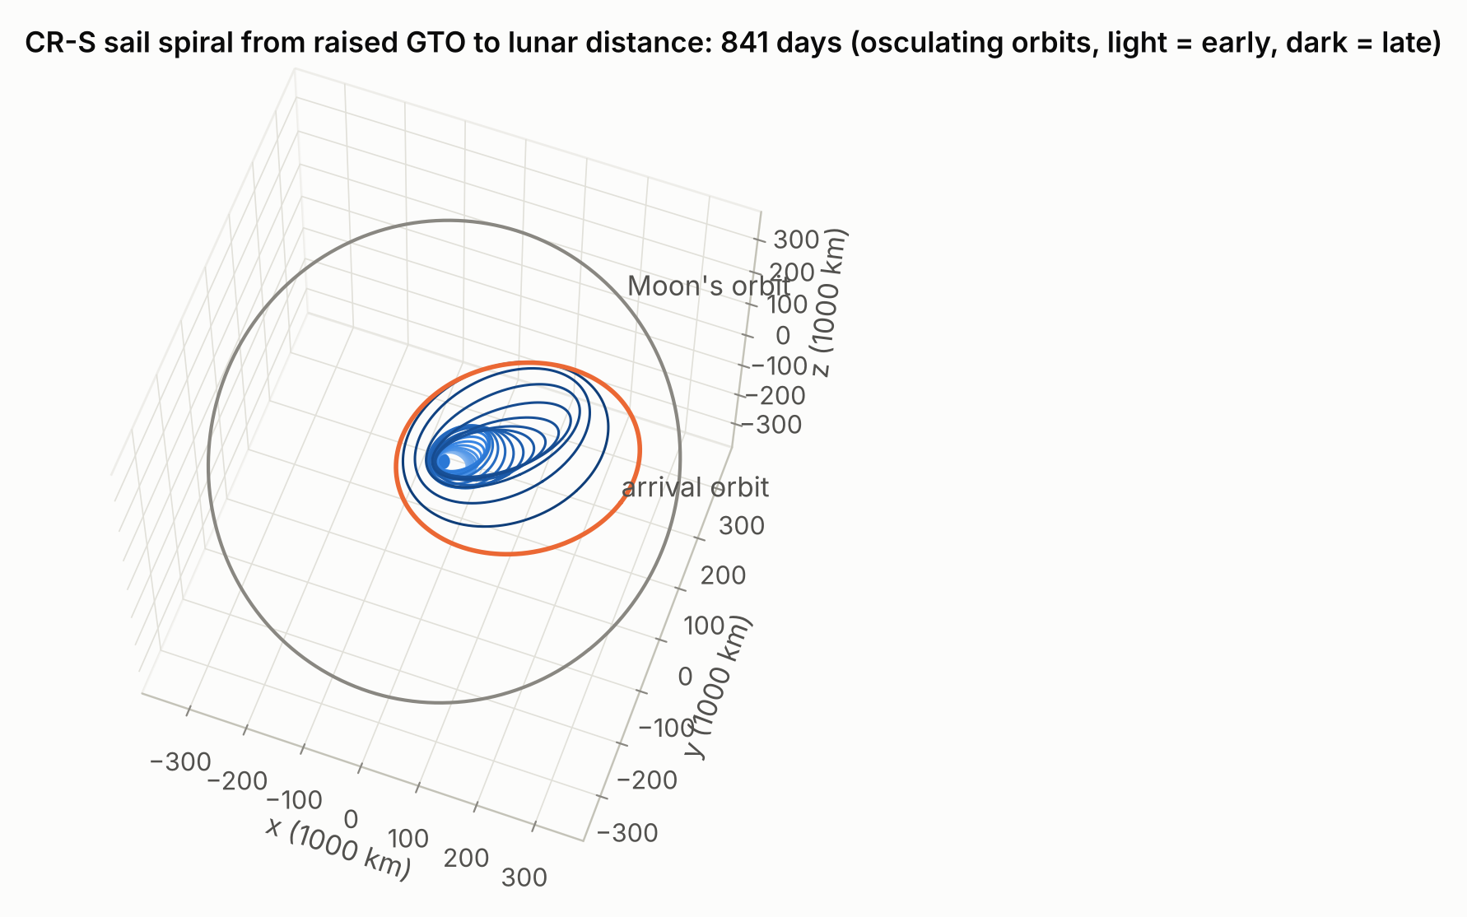
Q1 Spiralling out from GTO
Apogee grows ~1 % per day; the arrival orbit reaches the Moon's distance after ~2.3 years
Sail deployment in a standard 250 km-perigee GTO is survivable only if the sail stays edge-on through every 10 km/s perigee pass; then sunlight lifts perigee to ~3,450 km in 120 days.
Robust option: raise perigee to 1,000 km first (75 m/s from the upper stage, a kick motor or SEP).
Hybrid SEP is least valuable here: with unlimited propellant CR-H cuts GTO transit to 207 d but burns 23 kg.
Model check: averaged vs full Cowell with Sun and Moon gravity agree within 0.1 % in apogee after 60 days.
Notes:
The figure shows osculating orbits light (early) to dark (late), with the arrival orbit highlighted in orange and the Moon's orbit in grey.

Slide 9
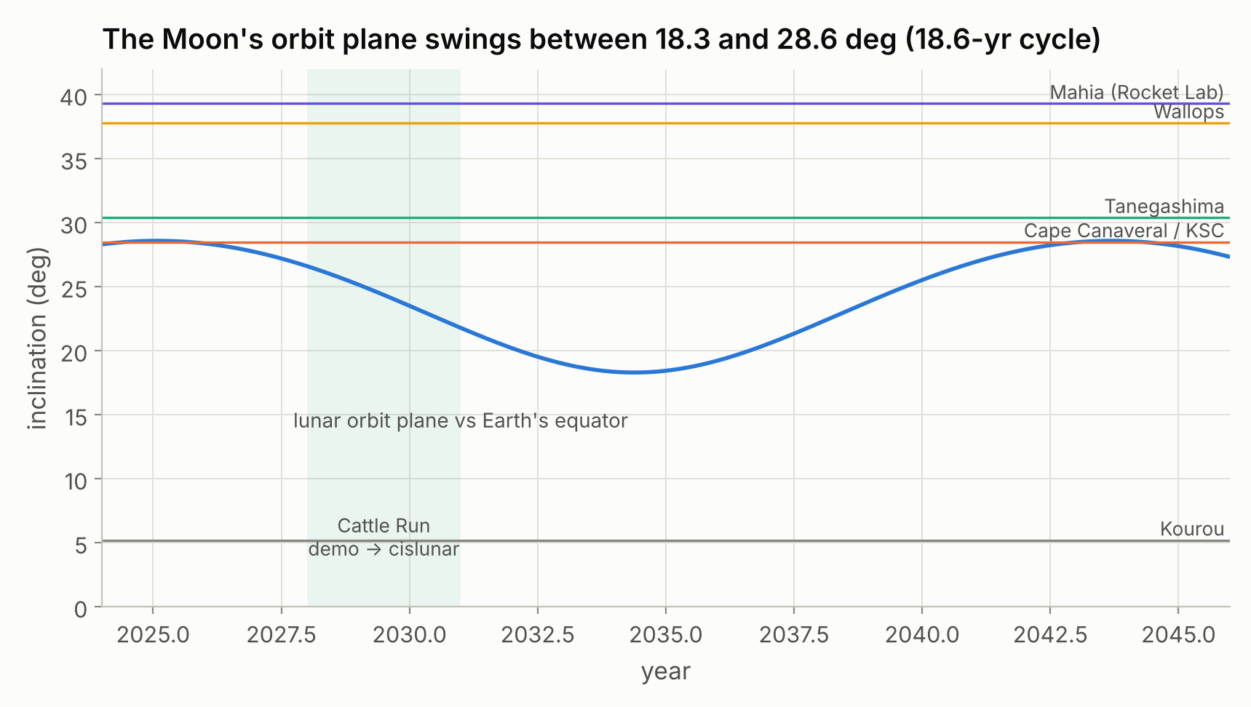
Q2 Launch toward the lunar plane: ~28.5 deg
Spiral time is insensitive to inclination (+/-3 %); the cost is the plane mismatch at arrival
Lunar plane: 26.6 deg (2028) -> 23.5 deg (2030) -> 18.3 deg (2034).
Optimum 23.4-28.5 deg; SSO launches add ~139 d.
The sail itself drifts the plane toward the ecliptic: a 28.5 deg launch arrives near 21 deg.
LEO demo: dawn-dusk SSO is ~20 % better than noon-midnight (no eclipses).
Notes:
Plane change near apogee costs ~1.6 d/deg when apsides align with the node line, ~38 d/deg when perpendicular. RAAN can be phased by J2 (~0.3 deg/day in GTO).

Slide 10
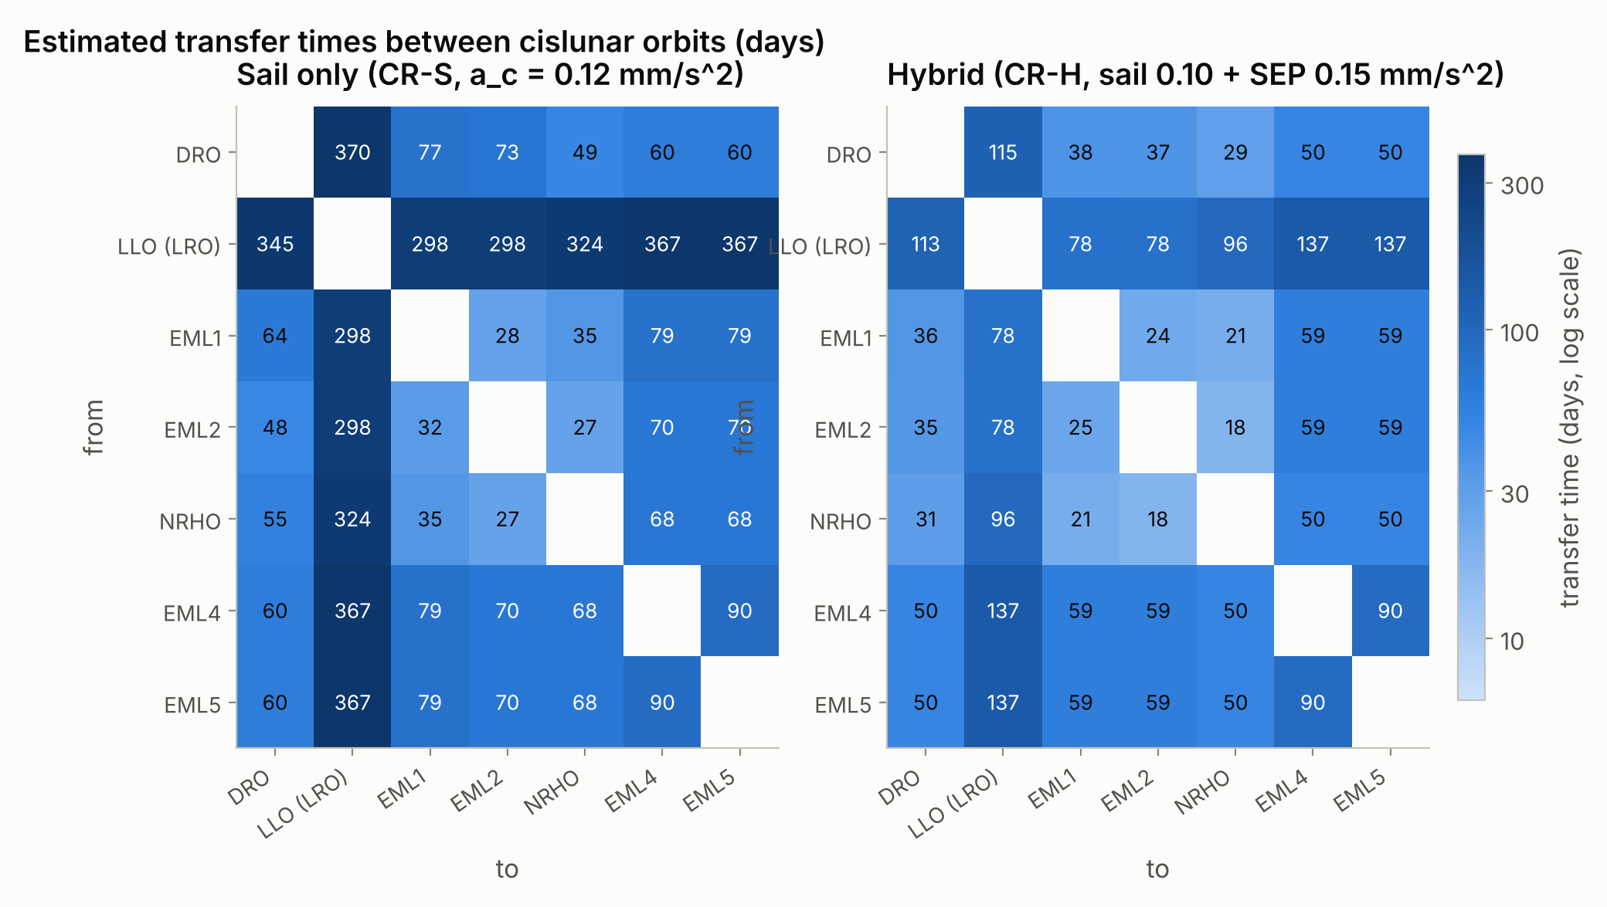
Q3 Cislunar slots are weeks apart; LLO is a year away
Energy-change ensembles (12 start x 8 Sun phases) + natural coasts, CR3BP with rotating Sun line
27-77 d
halo / NRHO / DRO legs (sail)
hybrid 18-38 d
60-79 d
to L4 / L5 sentinel slots
(drift-dominated)
298-367 d
any leg touching 100 km LLO
hybrid 78-137 d
Notes:
Energy-change rates near these orbits: ~0.003-0.008 per day in Jacobi constant for a 0.12 mm/s^2 sail. L1-L2 coast computed along the halo unstable manifold (21 d). Lowering energy from the NRHO drives perilune into the Moon; those legs use the reverse transfer. LLO legs: 293 d lunar spiral for the sail, 73 d hybrid (needs ~0.6 km/s of SEP).

Slide 11
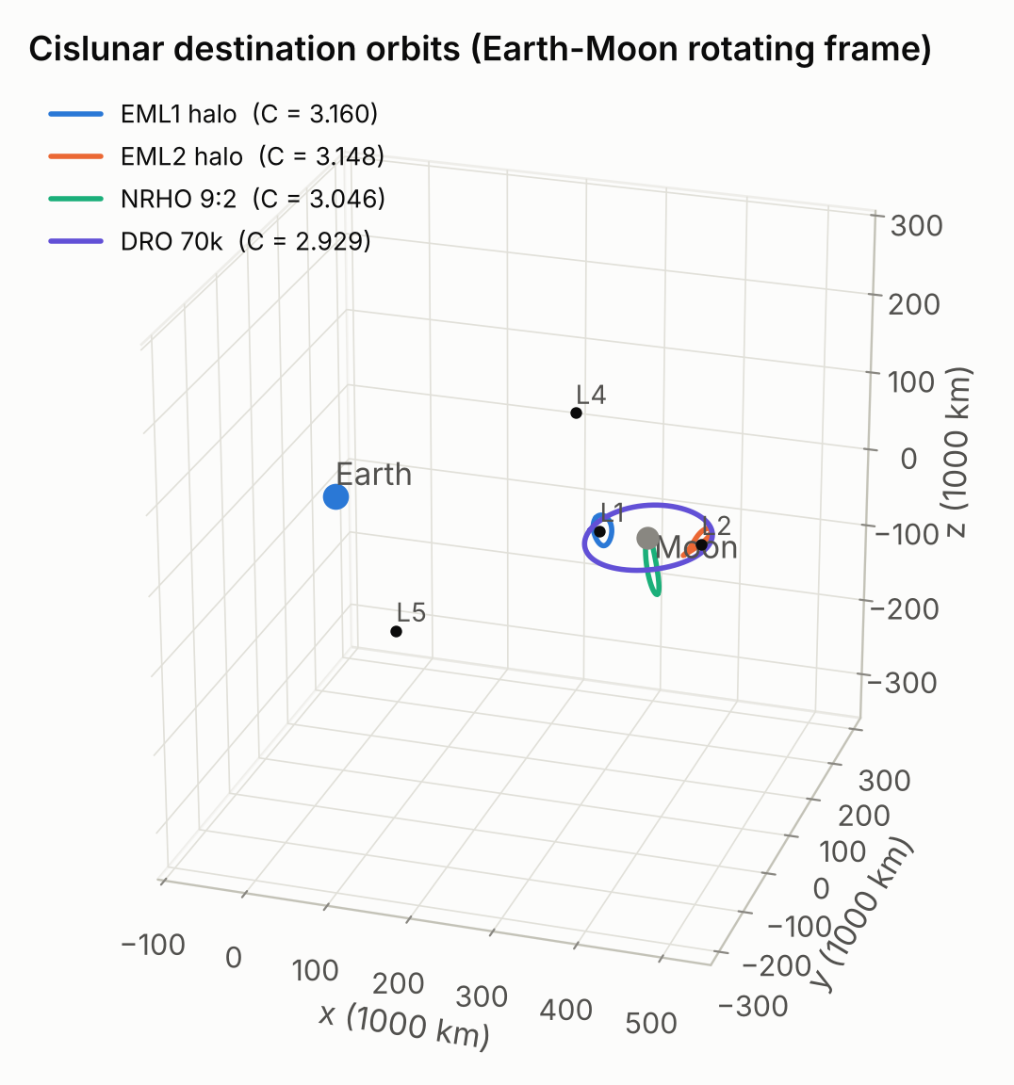
Q3 Destination orbits for a cislunar constellation
Computed by differential correction and continuation; the 9:2 NRHO matches Gateway's reference orbit
Orbit | Jacobi C | Period (d) | Stability
EML1 halo | 3.1596 | 12.0 | 911.9
EML2 halo | 3.1477 | 14.8 | 561.5
NRHO 9:2 | 3.0465 | 6.6 | 1.3
DRO 70k | 2.9285 | 13.9 | 1.0
EML4 | 2.9880 | - | 1.0
LLO 100 km polar | 5.4935 | 0.1 | 1.0
Lower C = higher energy. The DRO is neutrally stable (index 1.0) - an ideal parking slot needing almost no station keeping.
Notes:
Halo orbits are strongly unstable (stability index in the hundreds) and need regular small corrections - a natural job for the sail; the NRHO is mildly unstable (1.3) and the DRO neutrally stable. LLO here is a 100 km polar orbit representing LRO.

Slide 12
Operating there
Q4 lunar pole-sitter | Q5 in-irons limits | Q6 field of view | Q7 hybrid manoeuvrability

Slide 13
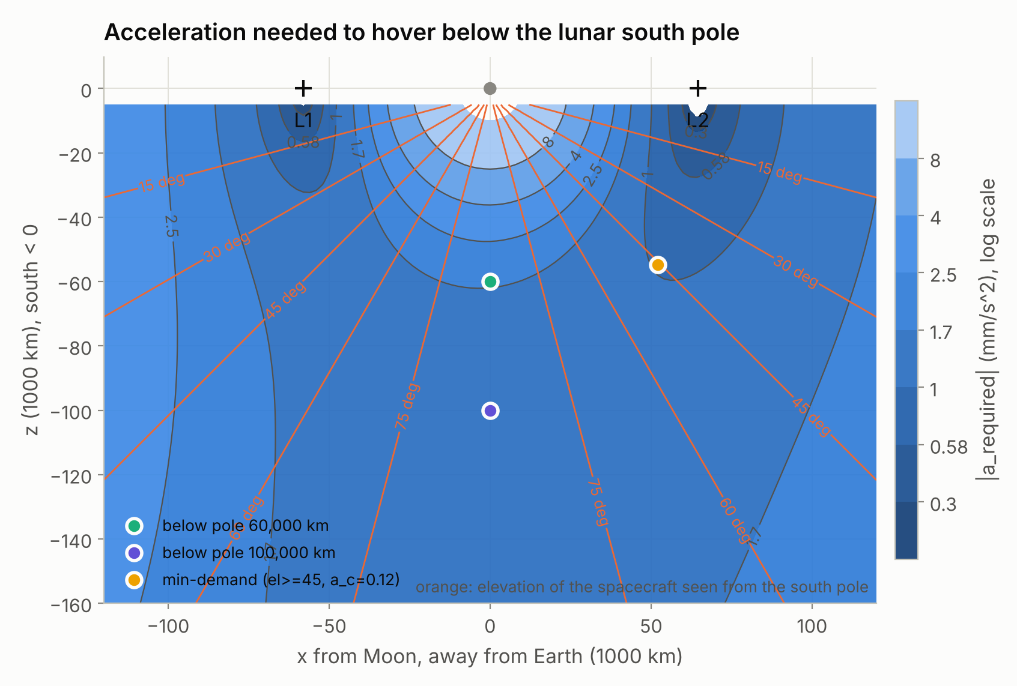
Q4 A lunar pole-sitter is an SEP mission
Hovering below the south pole needs 1.2-1.8 mm/s^2 continuously; the sail pushes the wrong way
1.15-1.77
mm/s^2 required, 100,000-60,000 km
below the pole (10-14x CR-S a_c)
36-56 km/s
SEP delta-v per year (71 %-85 %
of mass per year at Isp 3,000 s)
A sail alone never holds a static hover (0 % of the month); even a 1.7 mm/s^2 sail removes only 10-40 % of the SEP demand.
Sail-only coverage orbits need 0.58-1.7 mm/s^2 (Ozimek, Wawrzyniak): 5-14x CR-S.
Recommendation: polar coverage from two NRHO / L2-halo spacecraft.
Notes:
The requirement is dominated by lunar gravity along the polar axis, while sail thrust lies near the Earth-Moon plane. Grebow et al. needed a 500 kg spacecraft with 450 kg of propellant for 387-554 days of pole-sitting, consistent with these numbers.

Slide 14
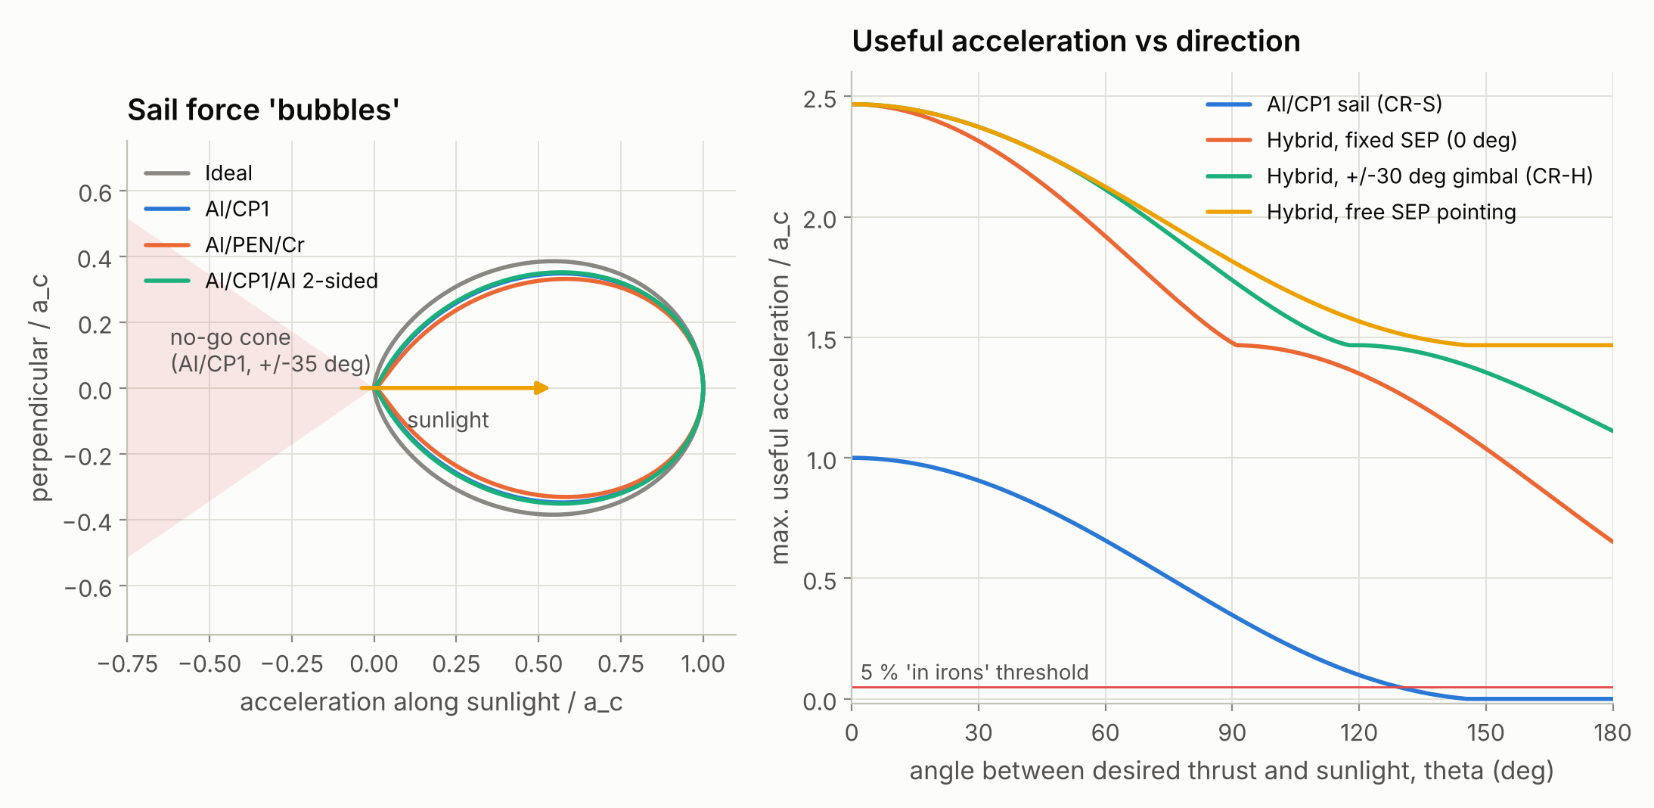
Q5 Sails are 'in irons' within ~35 deg of the Sun
A real film can tilt its force at most 50-56 deg from sunlight; any hybrid removes the dead zone
34.5 deg
no-thrust cone (Al/CP1);
50.8 deg below 5 % of a_c
1.11 a_c
sunward thrust of CR-H
(+/-30 deg gimbal)
All hybrid variants: 0 % in irons. Even a fixed SEP thruster gives 0.65 a_c toward the Sun.
Notes:
Left: force bubbles of ideal and real films and the Al/CP1 no-go cone; right panel of the figure: useful acceleration vs direction. In operations the sail is in irons 28 % of the time during Earth-orbit raising and 18 % for arbitrary station-keeping corrections.

Slide 15
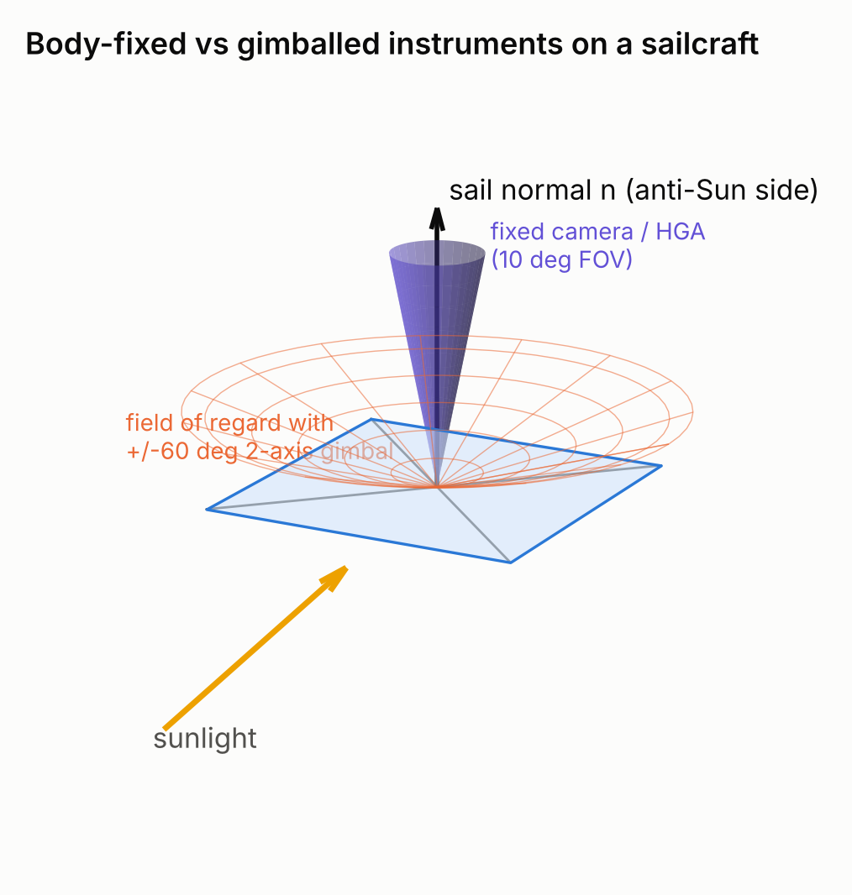
Q6 Gimbal the bus: Earth access 3 % -> 39 %
Propulsion owns the sail attitude, so body-fixed instruments point wherever thrust demands
Fixed arrays average 75 % of peak power and fall to zero when the sail feathers; +/-30 deg recovers 94 %.
The sail blocks half the sky: carry antennas on both faces.
Notes:
Four months of DRO operations with random manoeuvre demands every 12 hours; free roll about the sail normal assumed; membrane blocks +/-5 deg about its plane.

Slide 16
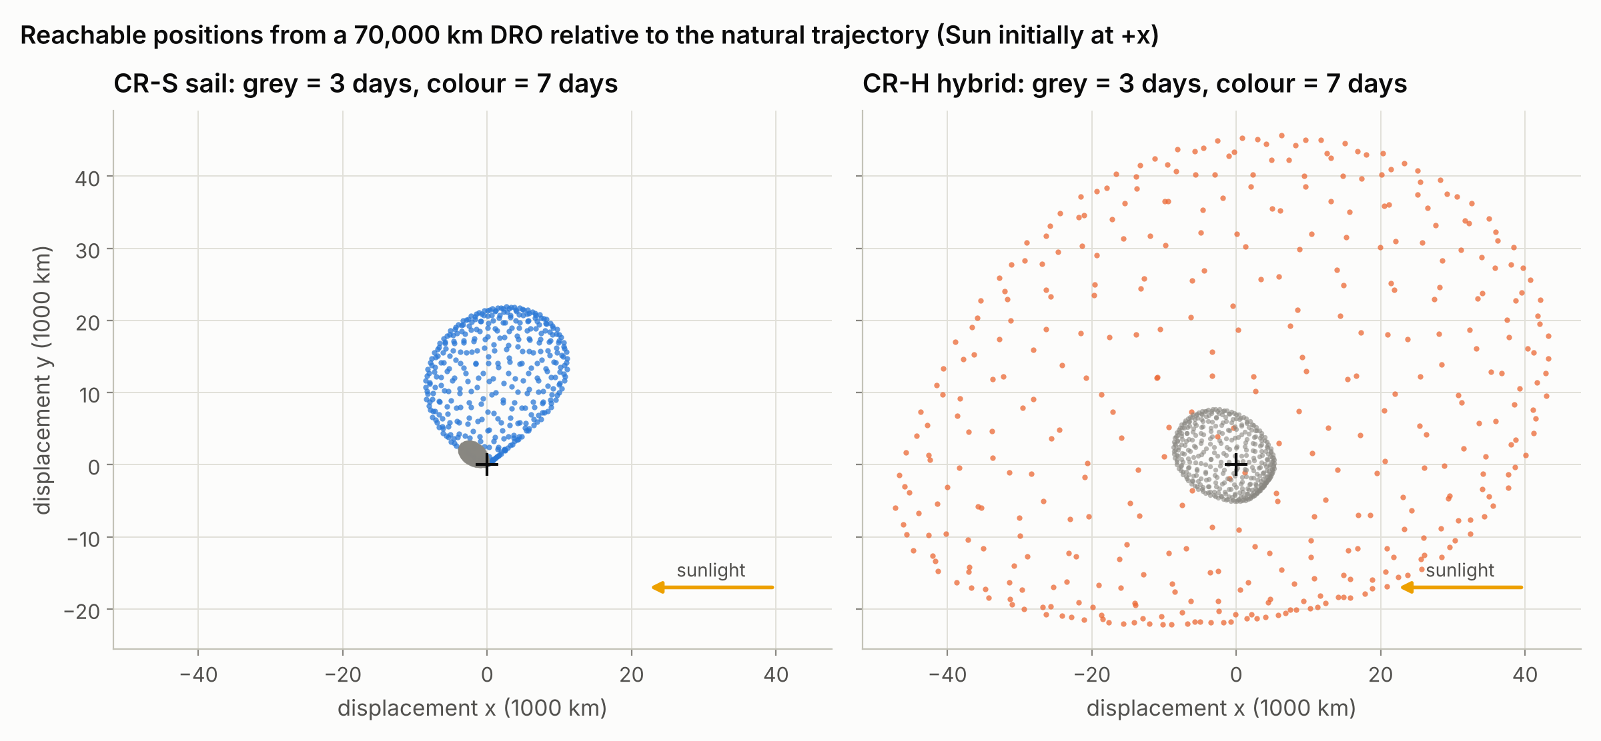
Q7 The hybrid reaches every direction
Constant-direction steering ensembles from a 70,000 km DRO (Sun initially at +x)
49k km
7-day reach, hybrid
(sail 22k km, lopsided)
0.45-1.00 d
10 m/s in any direction (hybrid)
sail 0.94-2.71 d, never sunward
0.187
mm/s^2 mean in all directions
(sail 0.048)
Hybrid acceleration: 0.257 away from the Sun, 0.181 perpendicular, 0.116 toward it (mm/s^2).
Notes:
Each dot is the end point of a constant-direction steering command (400 directions on a sphere). The sail cannot push toward the Sun at all in the first days; Coriolis effects and the rotating Sun line open some sunward displacement after a week. The hybrid's SEP closes the gap immediately.

Slide 17
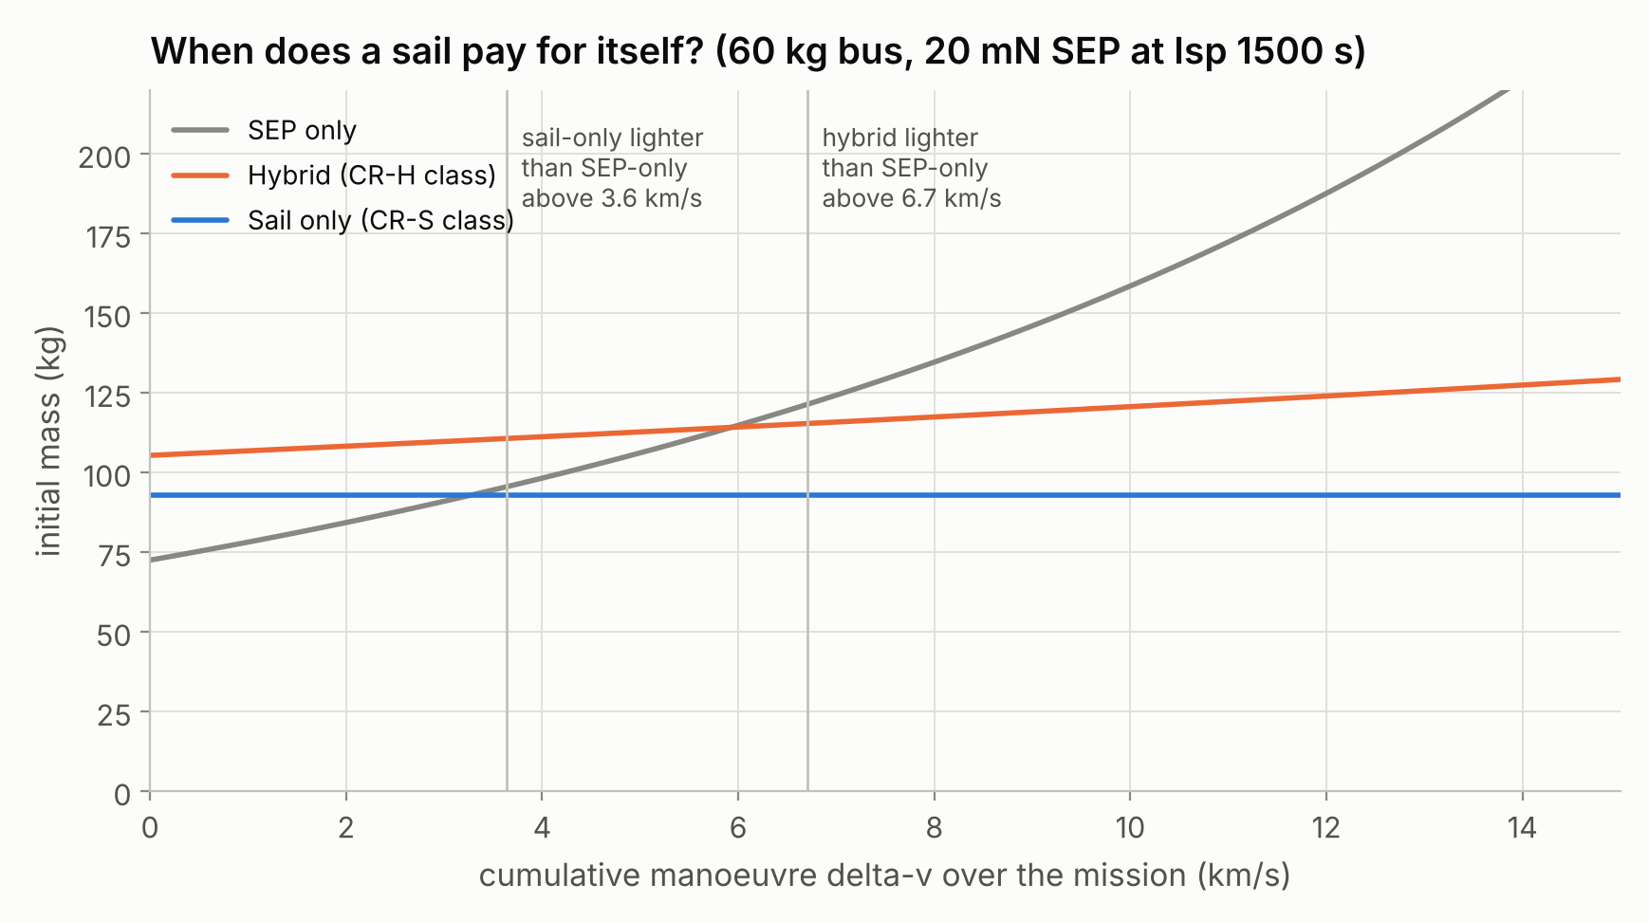
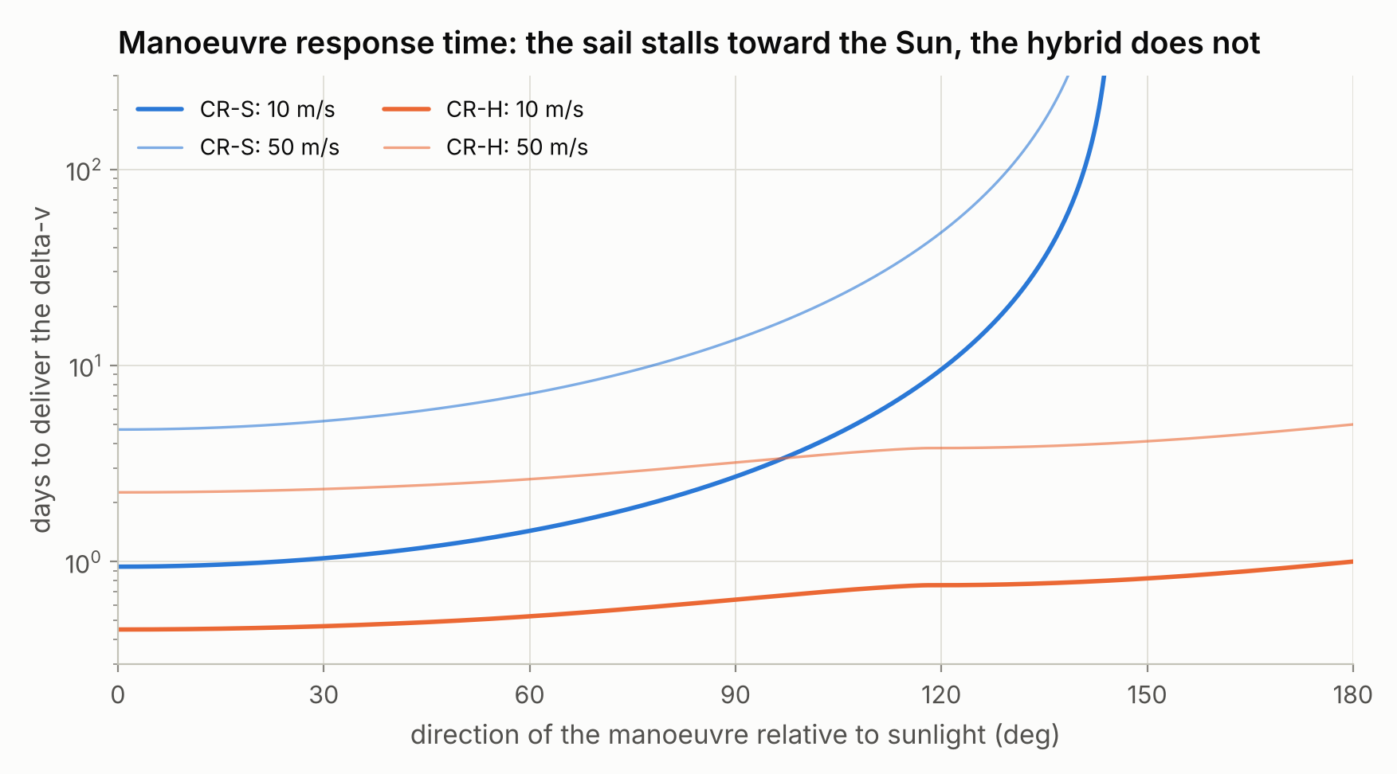
Q7 When does a sail pay for itself?
Sails win for long, manoeuvre-intensive missions - the Cattle Run constellation use case
Sail system ~33 kg: sail-only beats SEP-only after ~3.6 km/s of cumulative manoeuvring, the hybrid after ~6.7 km/s.
Use SEP tactically (in-irons gaps, fast response, fine station keeping) and let the sail supply the bulk delta-v: CR-H's 6 kg then lasts for years.
Notes:
Mass trade: 60 kg bus; 1,653 m^2 sail system ~33 kg; SEP dry ~12.5 kg (20 mN, Isp 1,500 s); hybrid SEP supplies only the in-irons share (18 %) of the delta-v. Right: days to deliver 10 or 50 m/s versus manoeuvre direction.

Slide 18
Demonstrating it
Q8 lowest acceptable orbit for the below-GEO demonstrator

Slide 19
Q8 Drag sets the floor at 650-800 km
Drag and sail thrust both scale with area/mass: no sail is big enough to fly below the break-even altitude
Criterion (km) | Min | Mod. | Max
Drag = thrust (orbit mean) | 505 | 655 | 785
Break-even, dawn-dusk | 500 | 632 | 744
Break-even, noon-midnight | 506 | 646 | 754
Drag <= 25 %, dawn-dusk | 550 | 750 | 900
Drag <= 25 %, noon-midnight | 650 | 800 | 1,000
Cycle 25 is declining in 2028: plan for F10.7 ~ 150 with excursions above 200.
Notes:
Mengali-Quarta criterion f = rho v^2 / P_ideal <= 2/C_D gives the orbit-mean altitudes; the simulated break-even uses drag-aware locally optimal steering with NRLMSIS densities and a 1 % edge-on residual area.

Slide 20
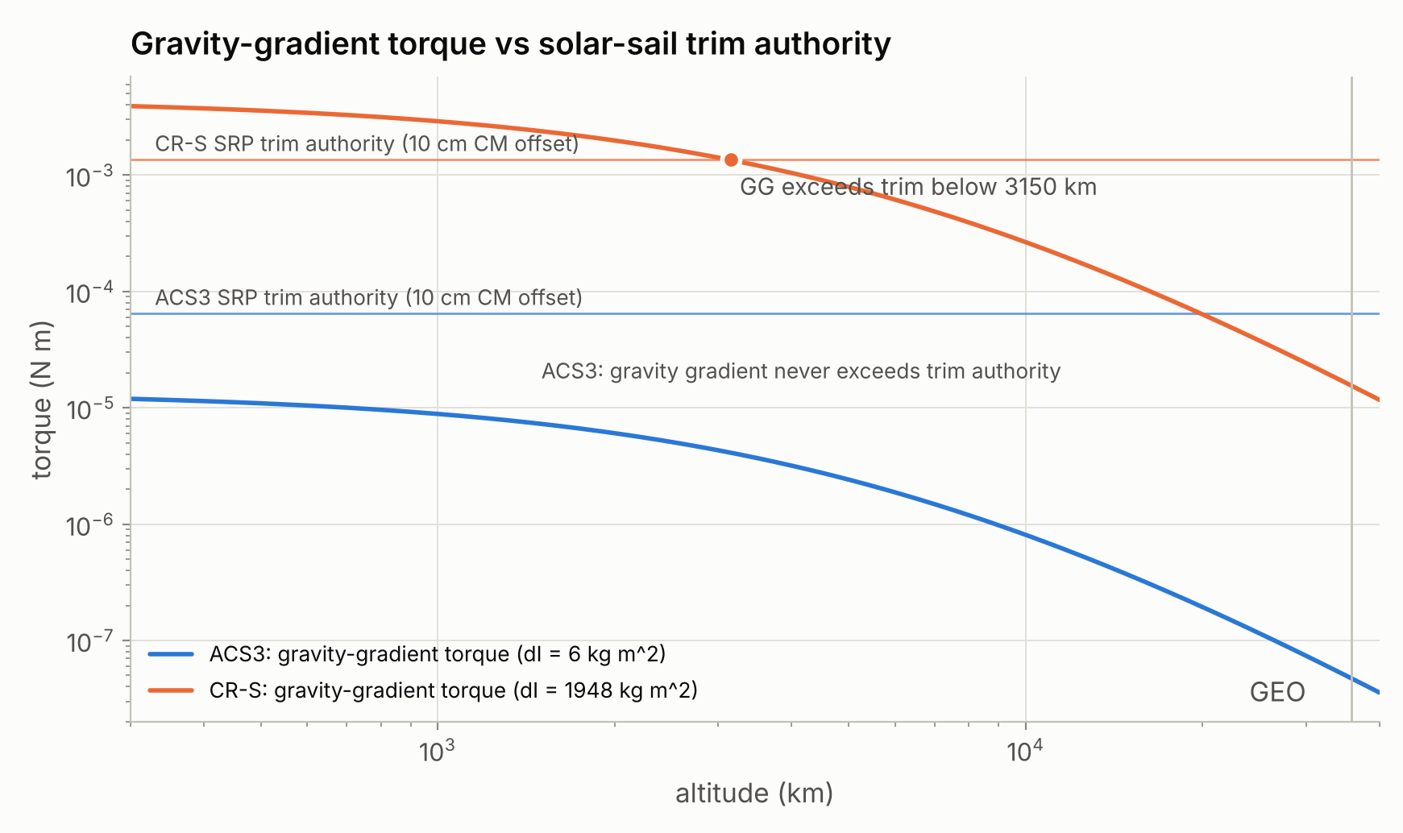
Q8 Lowest acceptable orbit: ~1,000 km dawn-dusk SSO
Robust at solar maximum, 400x less atomic oxygen than 550 km, ~220 km of raising per month for CR-S
Altitude (km) | AO erosion, ram face (um/yr) | Passive decay, CR-S
550 | 12.2 | 10 d
700 | 1.5 | 25 d
800 | 0.4 | 65 d
900 | 0.11 | 165 d
1000 | 0.03 | 365 d
Full-size 1,653 m^2 sail: gravity gradient exceeds 10 cm CM-trim authority below ~3,150 km - size wheels/magnetorquers or demo a 100-500 m^2 sail.
550 km rideshare: CR-H climbs to 1,000 km with the sail stowed in 18 days using 2.1 kg.
Left: gravity-gradient torque (worst-case attitude) vs sail trim authority.
Notes:
AO erosion assumes a ram-facing polyimide surface at 3e-24 cm^3/atom with moderate solar activity. Passive decay assumes the sail deployed, 50 % average projected area, F10.7 = 150. A large sail is also an excellent de-orbit device.

Slide 21

Design options scorecard
Every option in the outline was simulated; recommendations in the right-hand column
Option | Quantified benefit | Cost / risk | Call
Hybrid sail + SEP | No in-irons; 2-4x agility; SEP climb from low rideshare | +20 kg (18 %), propellant | Adopt
Gimballed SEP (+/-30 deg) | Sunward 1.11 vs 0.65 a_c; CM trim 4e-3 N m | Gimbal mass, plume limits | Adopt
Retractable sail | Throttle: 11 % vs 2 % of demands met exactly; drag/debris avoidance | +30 % deployer mass, wear | Ground-mature, fly on demo
Electrochromic RCD (2 % area) | 5.1e-4 N m pitch/yaw, wheel-free roll | Authority nulls near 60 deg incidence | Adopt for roll
Double-sided film | Efficiency 0.934 vs 0.908 | Runs 139 C at normal incidence | Keep single-sided
Spin / yo-yo deployment | ~11 kg lighter sail system | Too slow for LEO steering (needs ~0.06 deg/s) | Rigid booms
Notes:
A 5 cm CM-CP offset on the 1,653 m^2 sail accumulates 59 N m s per day, so continuous propellant-free trim (mass shift, RCDs) is mandatory.

Slide 22
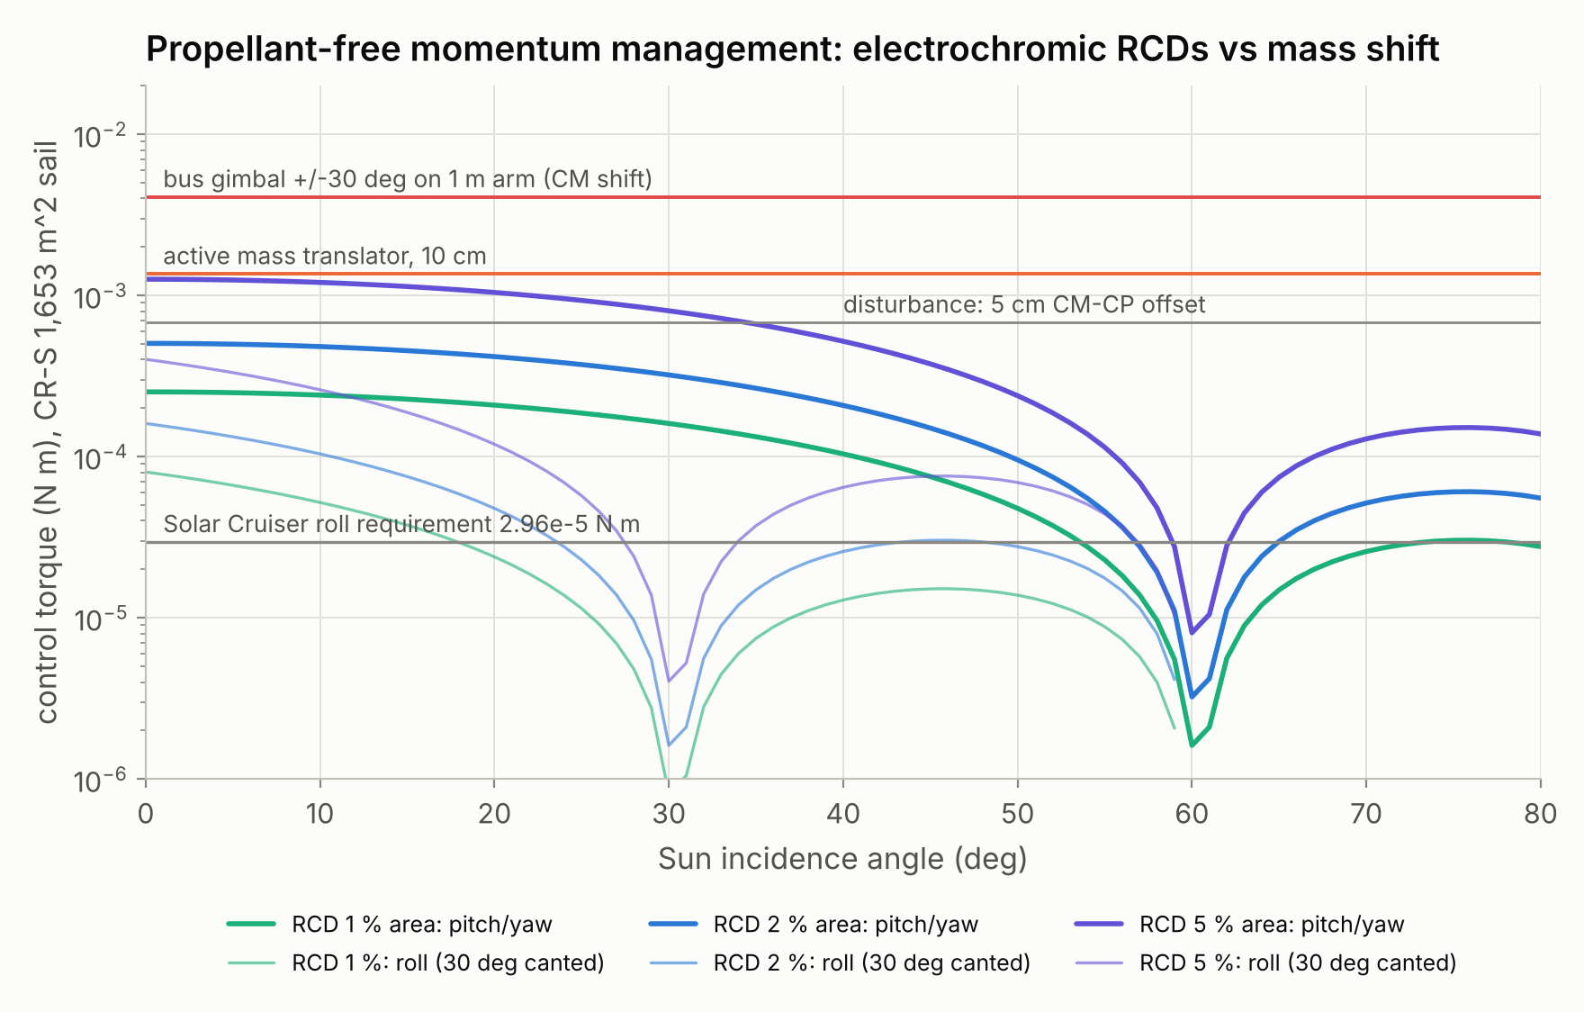
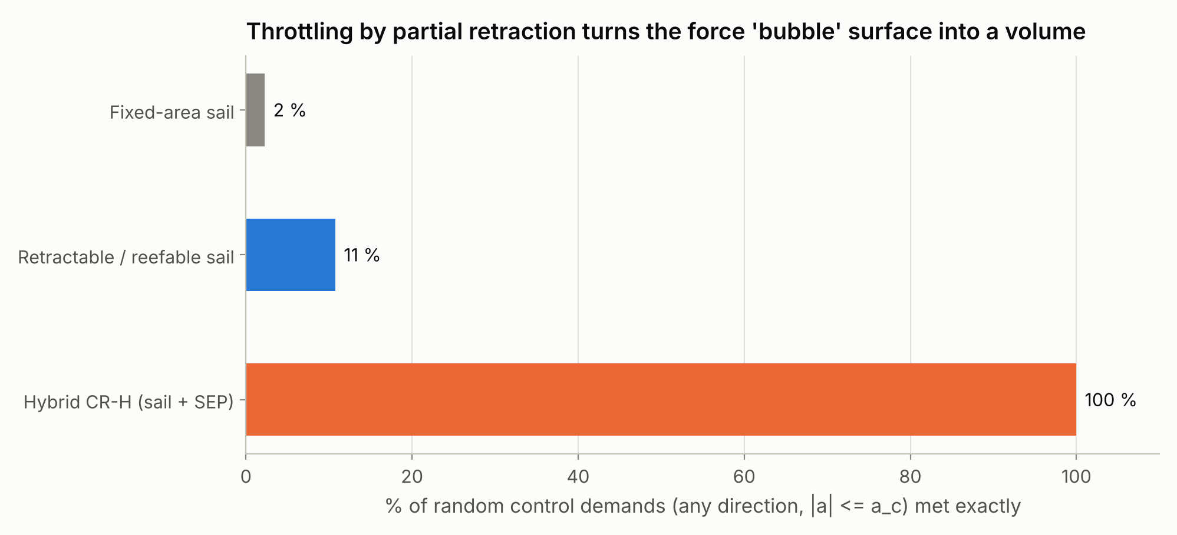
Propellant-free attitude and momentum control
A 5 cm CM-CP offset builds 59 N m s of momentum per day on the full-size sail - trim continuously
Bus gimbal (+/-30 deg, 1 m arm) gives ~3x the authority of a 10 cm mass translator.
RCD panels at 2-5 % of area match the disturbance at low incidence and meet Solar Cruiser's roll requirement.
Partial retraction throttles the sail: 5x more control demands met exactly.
Notes:
RCD = reflectivity-control device (electrochromic / PDLC film). Differential switching of tip panels gives pitch/yaw torque; canted panels give roll torque. Authority nulls near 60 deg incidence for the assumed optical states, matching Heaton's 'loss of control authority at high SIA'.

Slide 23

Questions the proposal should also answer
Surfaced by the analyses; ordered by priority for the Cattle Run proposal
A. Film and coating life at the demo altitude and through the radiation belts
B. Collision and conjunction risk of a 1,653 m^2 sail at ~1,000 km; screening with continuous thrust
C. Orbit determination with attitude-dependent SRP; force-model calibration in flight
D. Autonomy architecture: safe feathering, momentum management, fault recovery
E. LEO gravity-gradient and aerodynamic torques for a large sail
F. Sail billow, wrinkles and boom thermal deflection effects on force and torque
G. Survival of lunar and Earth eclipses (thermal snap, boom contraction loads)
H. Constellation deployment and phasing from a single launch
I. Antenna placement when the sail blocks half the sky
J. SEP plume impingement on the film and resulting gimbal limits
K. Station-keeping cost in the full ephemeris model with solar gravity
L. End of life: drag-sail disposal in LEO, heliocentric escape from cislunar space
Notes:
The objectives document asked the study to 'find other questions that should be addressed'. These twelve came out of the analyses; A, B and E bear directly on the Phase 1 demonstrator.

Slide 24

Recommended concept and next steps
A hybrid sailcraft, demonstrated at ~1,000 km and deployed to DRO, NRHO, L1/L2 and L4/L5 slots
Architecture (CR-H class)
Solar Cruiser-heritage 1,653 m^2 single-sided CP1 sail on rigid booms; RCD roll control; two-axis gimballed bus (+/-30-60 deg) with a 15-25 mN Hall thruster, arrays and instruments; antennas on both faces.
Phase 1 demonstrator
~1,000 km dawn-dusk SSO (or 550 km rideshare + 18-day SEP climb). Success: measured a_c within 10 %, ~5-7 km/day raising, autonomous steering and momentum management, safe feathering.
Phase 2 cislunar operations
Launch toward the lunar plane (28.5 deg) to GTO/GEO or TLI; slots in DRO, NRHO and L1/L2 halos with L4/L5 sentinels; polar coverage by paired NRHO spacecraft.
Simulator next steps
Trajectory optimisation for transfers, full-ephemeris / BCR4BP station keeping with a sail-aware controller, slew-limited attitude dynamics, sail-shape uncertainty, GPU Monte Carlo of autonomy faults.
Notes:
The concept follows directly from the eight answers: hybrid for omnidirectional agility, ~1,000 km for a convincing demo, 28.5 deg launches for the lunar plane, and NRHO pairs rather than a pole-sitter.

Slide 25
Backup: assumptions and reproduction
All results are reproducible from the repository
Flat sail, nominal optics, no degradation (real performance typically 5-15 % lower)
Instantaneous attitude changes in trajectory runs; agility treated separately
Averaged Earth-orbit dynamics without lunisolar perturbations (0.1 % after 60 days)
CR3BP with rotating Sun line; transfer times = energy change + natural coast (+/-30 %)
NRLMSIS 2.x equatorial densities, C_D 2.2, 1 % edge-on residual area
Mass model calibrated on ACS3 and Solar Cruiser; SEP sizing after Ceriotti & McInnes
Command | Effect
python simulator/run_all.py | All analyses -> results/*.json, figures/*.png
CISLUNAR_BACKEND=torch python simulator/run_all.py | Same on PyTorch (CUDA GPU when present)
python reports/build_report.py | Rebuild the PDF report
node reports/build_deck.js | Rebuild this deck

