Slide 1
VaultX Password Manager
STANDALONE WEB APPLICATION
A local password vault for organising account credentials behind a master-password login.
MEMBER 1
Ronak Singh
Roll No. ADTU/1/2025-29/BTCS/039
Python logic, interface and testing
PROJECT AUTHOR
Roll No. ADTU/1/2025-29/BTCS/039
COURSE FACULTY
Mr. Priya Raj Chanda
Assistant Professor
Programme of CSE
Programming with Python (BTCS2101) · Mini Project · B.Tech CSE, 3rd Semester · 27 October 2026
Notes:
Introduce VaultX Password Manager, Ronak Singh, Programming with Python (BTCS2101).

Slide 2

Problem and motivation
Many accounts
No single organised vault
Project motivation; no external statistic claimed
THE PROBLEM
People managing many online accounts may reuse weak passwords or keep credentials in unprotected notes.
Credential safety
VaultX encrypts saved credential values before local storage.
Based on project design; not an independent security audit
WHY IT MATTERS
Students and everyday users with multiple online accounts.
Forgotten passwords, repeated passwords and time spent searching for credentials.
Notes:
Explain motivation without fabricated statistics. Emphasise password reuse and unprotected notes as the design problem.

Slide 3



Objectives and scope
Objectives
In scope
O1
Provide master-password setup and login.
Local credential management
Single user on a trusted computer
Browser-based interface and password generator
O2
Add, search, view, edit and delete saved entries.
Generate random passwords for new accounts.
Out of scope
O3
No cloud sync, multi-user access or browser extension
Educational prototype; no independent security audit
O4
Store credential data locally with encryption.
Notes:
Explain scope: local single-user application; cloud sync, multi-user accounts and formal security audit are excluded.

Slide 4






Tools and technologies
Python
Version: 3.15 (shown in terminal path; verify with python --version)
Programming language
Flask
Version: 3.1.3
Local web routing and request handling
Cryptography
Version: 50.0.2 (terminal output)
Fernet encryption; Scrypt key derivation per report
SQLite
Local database
Stores application credential records
PowerShell / IDE
Windows development environment
Running and debugging the app
GitHub repository
messi847383-source/vaultx-Password-Manager
Source sharing and version control
Notes:
Versions shown are from terminal evidence where available; verify Python and package versions before final submission.

Slide 5




Architecture or workflow
User input
Master password and credential form
Browser UI
Flask HTML templates
Python logic
Authentication, validation and CRUD
SQLite + encryption
Local database stores encrypted secrets
Dashboard
Updated list and status messages
HOW IT WORKS
The user interacts with the local browser interface. Flask routes handle setup/login and credential actions, apply validation and security logic, and read or write the local SQLite database. Sensitive credential fields are encrypted before storage and decrypted only in the authenticated reveal flow.
Notes:
Explain the browser → Flask routes → validation/security logic → SQLite → dashboard workflow.

Slide 6

Features and modules
FOR APPLICATIONS
1
Credential vault
2
Search & manage
Modules (files)
Save service, username and password details.
Search, reveal/hide, copy, edit and delete entries.
app.py — Flask routes, authentication and credential actions
templates/setup.html, login.html, dashboard.html — user screens
static/style.css — interface styling
SQLite — local credential records
app.py
app.py
3
Password generator
4
Protected storage
Generate a random password for account setup.
Hash the master password and encrypt saved secrets.
app.py
app.py
Notes:
Features listed are documented in the project report. Confirm each in the actual app during the live demo.

Slide 7
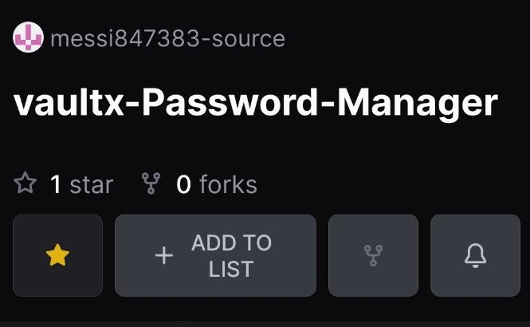
User interface
FOR APPLICATIONS
GitHub repository screenshot
The repository is public; the application UI screenshot should be captured from the running app.
1
Search and manage saved account records.
2
Show/hide, copy, edit or delete an entry.
3
Add a credential or generate a new password.
Notes:
Image is a repository screenshot, not the app UI. If you have time, replace it with a browser screenshot of the real dashboard.

Slide 8
Python concepts used
Flask routes and request handling | app.py — Connect browser forms to Python handlers.
Input validation and conditionals | Setup/login and credential routes — Check submitted fields and choose the correct action.
Password hashing and key derivation | Authentication / encryption helpers — Verify the master password and derive encryption key material.
Fernet encryption/decryption | Credential storage and reveal flow — Encrypt secret values before persistence; decrypt for authenticated viewing.
SQLite operations | Database helper / route logic — Create, read, update and delete local credential records.
Templates and static files | templates/ and static/style.css — Separate HTML pages and visual styling from Python logic.
Concept | Where in our code (file, function or class) | What it does there
Functions | [file.py: function_or_class] | [ ]
Classes and objects | [file.py: function_or_class] | [ ]
Lists, tuples, sets and dictionaries | [file.py: function_or_class] | [ ]
File handling (text, CSV or JSON) | [file.py: function_or_class] | [ ]
Exception handling | [file.py: function_or_class] | [ ]
Modules and packages | [file.py: function_or_class] | [ ]
Notes:
Explain each concept and point to its actual location in app.py/templates during viva.

Slide 9
Key code
What it does
Security workflow (conceptual)
SECURITY WORKFLOW — CONCEPTUAL SUMMARY
validate submitted fields
derive key from configured secret material
ciphertext = Fernet(key).encrypt(secret)
store ciphertext in local SQLite
decrypt only inside authenticated reveal flow
This is a workflow summary, not a verbatim code excerpt.
1
Encrypt before database write.
2
Fernet handles authenticated symmetric encryption.
3
Confirm exact function names against app.py before viva.
Notes:
This slide is a conceptual security workflow, not a verbatim source-code excerpt. If faculty requires code, paste exact lines from app.py.

Slide 10


Live demonstration
What we will show
1
Start VaultX and log in.
2
Add a fictional credential.
3
Search, reveal and copy the saved entry.
Approx. 4-minute walkthrough
4
Try invalid login or missing input.
Backup: use a short screen recording if available.
Notes:
Demo login, add a fictional record, search, reveal/copy, edit/delete and password generation. Do not use real passwords.

Slide 11
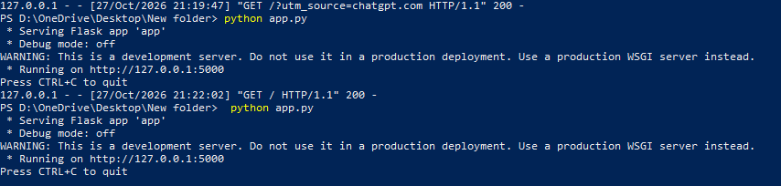
Results and testing
FOR APPLICATIONS
Observed terminal output: Flask development server starts at 127.0.0.1:5000 and returns HTTP 200 for GET requests.
Core flows described in project report
setup/login, CRUD, search and generator
Functional checks discussed; exact test count not recorded
No formal bug count recorded
Notes:
Terminal evidence shows Flask starts locally and HTTP GET requests return 200. Do not claim an exact test pass count.

Slide 12


Challenges and what we learnt
Challenges
What we learnt
Project startup and dependencies
→ Installed Flask/cryptography and launched the app from the project folder.
Flask routes connect browser forms to Python handlers.
Protecting saved credentials
→ Project design uses master-password hashing, Fernet encryption and Scrypt key derivation.
Templates and CSS separate interface design from application logic.
Checking browser requests
→ Forms use configured CSRF protection; full independent security testing remains future work.
Automated tests and a security review should be added next.
Notes:
Discuss the actual setup and security considerations. Do not claim independent audit or production readiness.

Slide 13

Conclusion and future scope
CONCLUSION
VaultX is a local Python/Flask password-manager prototype with master-password access, credential management, a random password generator, SQLite persistence and encryption-related safeguards. The available evidence confirms the Flask server runs locally; full functional and security testing remains unquantified.
Future scope
1
Add automated unit and integration tests.
2
Review key storage, session settings and threat model.
O1 Master-password access: described as implemented
O2 Credential management: described as implemented
3
Add encrypted backup and recovery design.
O3 Password generation: described as implemented
O4 Encrypted local storage: described as implemented
Notes:
Summarise documented features and clearly state that formal security testing was not performed.

Slide 14
References
[1] Python Documentation — https://docs.python.org/3/
[2] Flask Documentation — https://flask.palletsprojects.com/
[3] SQLite Documentation — https://docs.python.org/3/library/sqlite3.html
[4] Cryptography Documentation — https://cryptography.io/
Notes:
References for the technologies used; cite any additional tutorials or code adapted.

Slide 15
Thank you
Questions?
Ronak Singh
Code: github.com/messi847383-source/vaultx-Password-Manager
Notes:
Thank the audience and invite questions. Repository URL shown from the supplied GitHub screenshot.

