Slide 1
Servos

Slide 2
Controlling Rotation
Continuous Servo | Standard Servo | Stepper | Direct Motor
Pros: PWM speed control | Pros: PWM angle control | Pros: Precise angle control and Continuous rotation | Pros: Fast
Cons: No fine angle control | Cons: Upper limit on Turning | Cons: SLOWEST | Cons: No precision speed control (ON or OFF)
It is possible to directly connect a motor to the arduino. I DO NOT recommend doing this. http://www.instructables.com/id/Simple-2-way-motor-control-for-the-arduino/?ALLSTEPS
We’re taking the Continuous Servo as the best compromise.

Slide 3
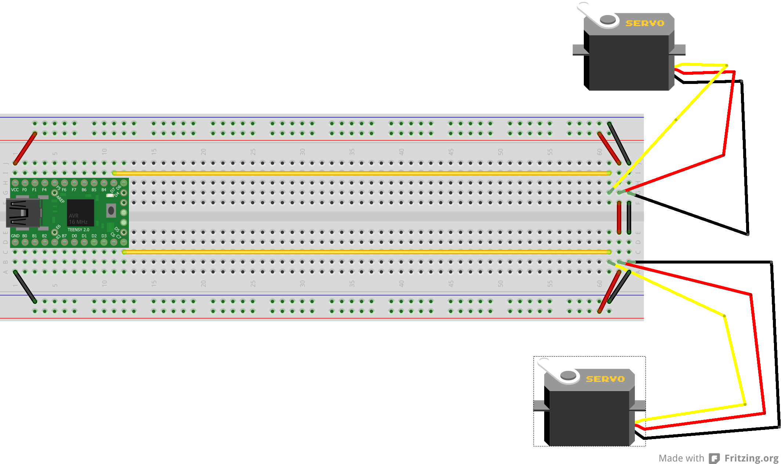
Servo Wiring

Slide 4
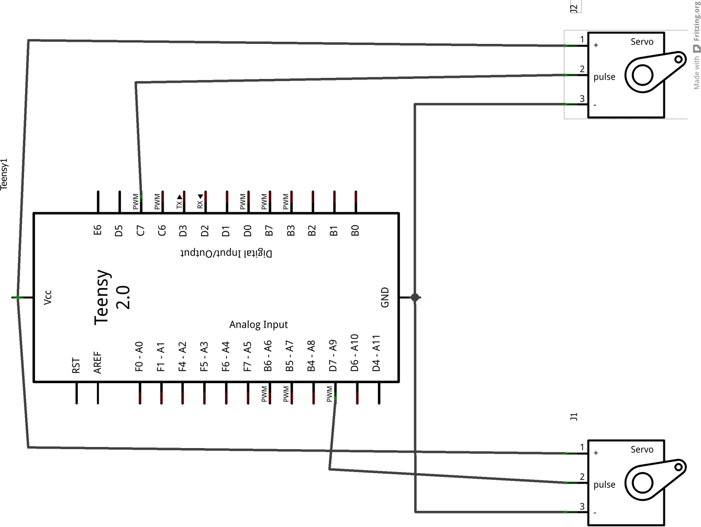
Servo Circuit

Slide 5
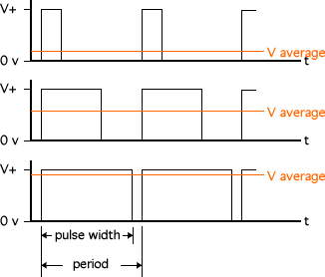
PWM

Slide 6
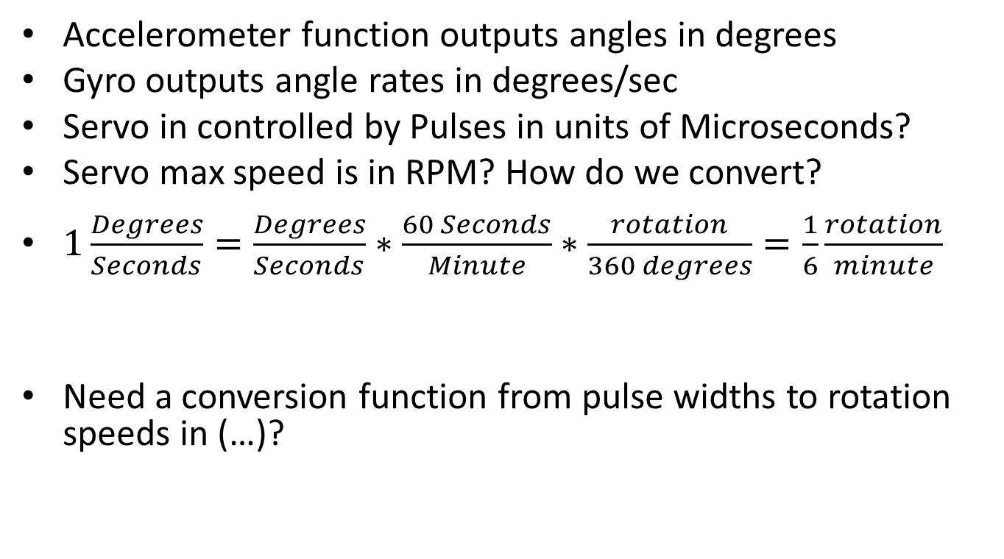
Units
Accelerometer function outputs angles in degrees
Gyro outputs angle rates in degrees/sec
Servo in controlled by Pulses in units of Microseconds?
Servo max speed is in RPM? How do we convert?
$1\frac{Degrees}{Seconds}=\frac{Degrees}{Seconds}∗\frac{60 Seconds}{Minute}∗\frac{rotation}{360 degrees}=\frac{1}{6}\frac{rotation}{minute}$
Need a conversion function from pulse widths to rotation speeds in (…)?

Slide 7
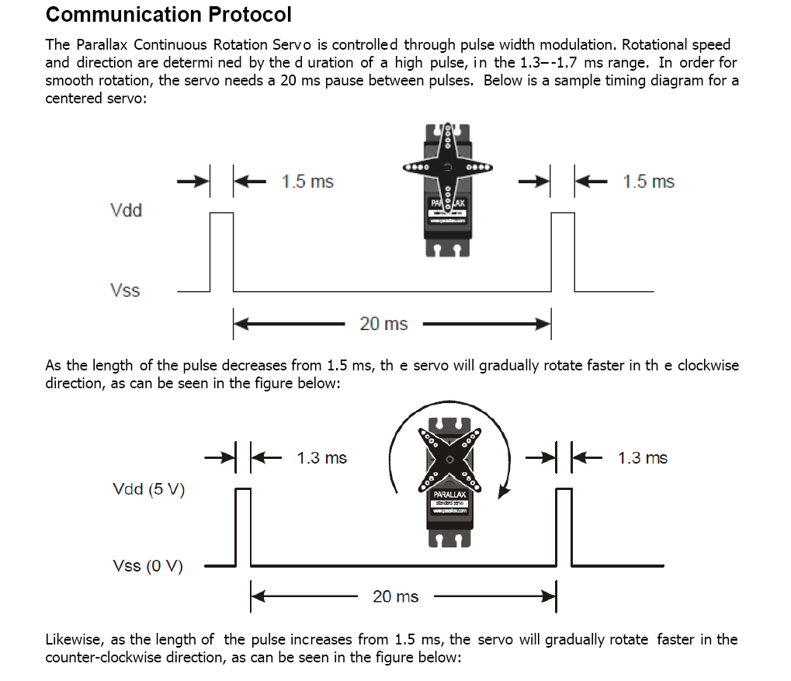
Controlling the Servo

Slide 8
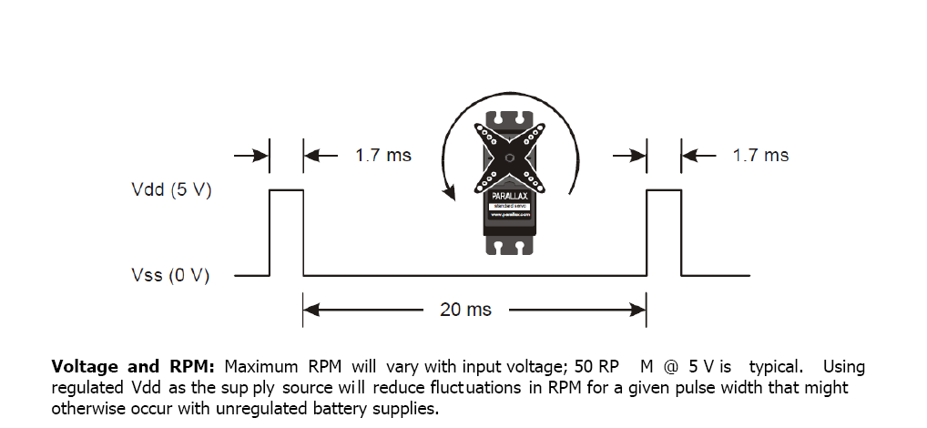
Controlling the Servo cont.

Slide 9
Servo Setup Code
#include <Servo.h>
#define SERVO1_PIN 10
#define SERVO2_PIN 12
#define LED_PIN 11
#define SERVO_ZERO 1500
char buff[5];
int ii = 0;
Servo servo1;
Servo servo2;
int ledState = 0;
void setup() {
servo1.attach(SERVO1_PIN );
servo2.attach(SERVO2_PIN );
pinMode(LED_PIN, OUTPUT);
Serial.begin(9600);
}

Slide 10
Servo Loop Code
void loop() {
ii=0;
while (Serial.available() > 0) {
buff[ii] = Serial.read();
Serial.print(buff[ii]);
if (buff[ii] == 0x0d ) {
pos = atoi(buff);
break;
}
ii++;
}

Slide 11
Servo Loop Code cont.
ledState += 1; if ((ledState % 2) == 0){
digitalWrite(LED_PIN, HIGH); servo1.writeMicroseconds(pos);
rpos = map(pos, 1300, 1700, 1700, 1300);
servo2.writeMicroseconds(rpos);
}
else {
digitalWrite(LED_PIN, LOW);
servo1.writeMicroseconds(SERVO_ZERO); servo2.writeMicroseconds(SERVO_ZERO);
}

Slide 12
Build a “calibration curve”
Find the pulse widths that made the servo rotate at (each servo is a little different, don’t blindly copy):
300 deg/sec
270 deg / sec
180 deg / sec
90 deg/ sec
45 deg / sec
Negative counterparts.

