Slide 1
IMU and Servo Setup

Slide 2
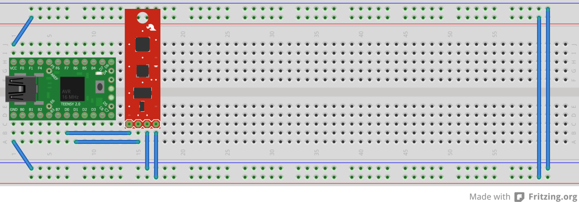
Wiring the IMU
The IMU Pins
VCC (+5 Volts) -> VCC
GND(Common) -> GND
SDA -> D1
SCL -> D0

Slide 3
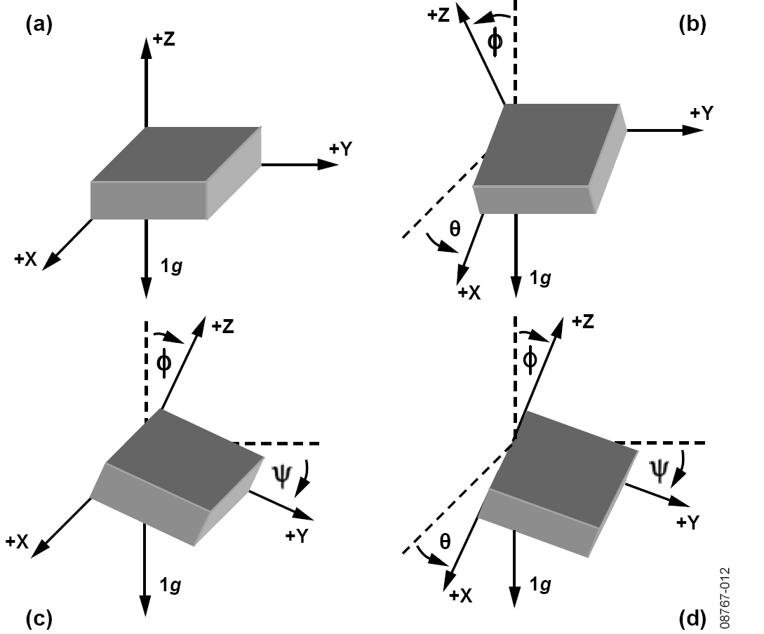
Accelerometer: What are we reading?
Acceleration due to gravity
We are intrested in:
Theta
Psi

Slide 4
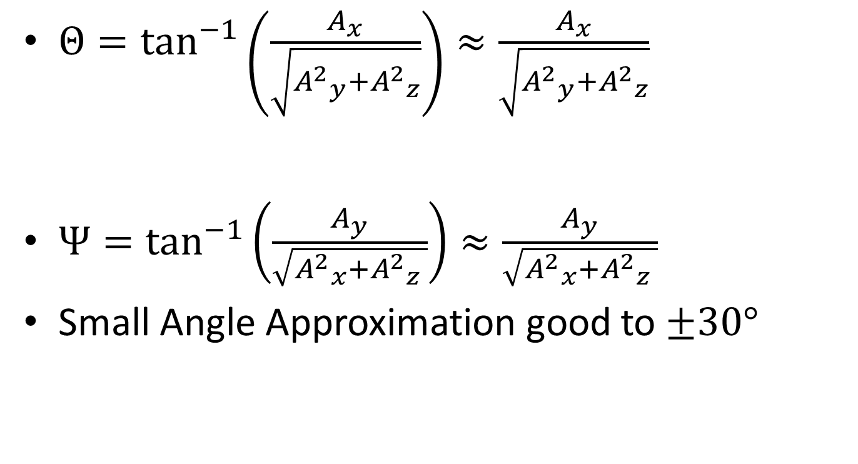
Small Angle Approximation
$Θ=\tan^{−1}\left(\frac{A_{x}}{\sqrt{{A^{2}}_{y}^{}+{A^{2}}_{z}^{}}}\right)≈\frac{A_{x}}{\sqrt{{A^{2}}_{y}^{}+{A^{2}}_{z}^{}}}$
$Ψ=\tan^{−1}\left(\frac{A_{y}}{\sqrt{{A^{2}}_{x}^{}+{A^{2}}_{z}^{} }}\right)≈\frac{A_{y}}{\sqrt{{A^{2}}_{x}^{}+{A^{2}}_{z}^{} }}$
Small Angle Approximation good to $±30°$

Slide 5
Reading the Accelerometer
Use the FREE IMU library to get the raw Acceleration measurements out of the Accelerometer
Compute Theta and Psi

Slide 6
Setup
void accBegin(){
Accel.init(ADXL345_ADDR_ALT_LOW); Accel.set_bw(ADXL345_BW_12);
}
void setup(){
accBegin();
Serial.begin(115200);
}

Slide 7
Angle Calculation
void getAccAngle(){
float acc_data[3];
Accel.get_Gxyz(acc_data);
theta = (acc_data[0]/sqrt(acc_data[1]*acc_data[1] + acc_data[2]*acc_data[2]))*180/PI;
psi = (acc_data[1]/sqrt(acc_data[0]*acc_data[0] + acc_data[2]*acc_data[2]))*180/PI;
}
void loop() {
getAccAngle();
Serial.print(millis());
Serial.print(" , ");
Serial.print(theta);
Serial.print(" , ");
Serial.println(psi);
}

Slide 8
Sample Data

