Slide 1



Git, GitHub & GitLab

Slide 2
Instructions for use
EDIT IN GOOGLE SLIDES……
Click on the button under the presentation preview that says "Use as Google Slides Theme".
You will get a copy of this document on your Google Drive and will be able to edit, add or delete slides.
You have to be signed in to your Google account.
EDIT IN POWERPOINT®
Click on the button under the presentation preview that says "Download as PowerPoint template". You will get a .pptx file that you can edit in PowerPoint.
Remember to download and install the fonts used in this presentation (you’ll find the links to the font files needed in the Presentation design slide)
More info on how to use this template at www.slidescarnival.com/help-use-presentation-template
This template is free to use under Creative Commons Attribution license. You can keep the Credits slide or mention SlidesCarnival and other resources used in a slide footer.

Slide 4
Transition headline
1
Let’s start with the first set of slides

Slide 5
Quotations are commonly printed as a means of inspiration and to invoke philosophical thoughts from the reader.

Slide 6
This is a slide title
Here you have a list of items
And some text
But remember not to overload your slides with content
Your audience will listen to you or read the content, but won’t do both.

Slide 7
89,526,124$
185,244 users
100%
That’s a lot of money
And a lot of users
Total success!

Slide 8
Let’s review some concepts
Yellow
Is the color of gold, butter and ripe lemons. In the spectrum of visible light, yellow is found between green and orange.
Blue
Is the colour of the clear sky and the deep sea. It is located between violet and green on the optical spectrum.
Red
Is the color of blood, and because of this it has historically been associated with sacrifice, danger and courage.
Yellow
Is the color of gold, butter and ripe lemons. In the spectrum of visible light, yellow is found between green and orange.
Blue
Is the colour of the clear sky and the deep sea. It is located between violet and green on the optical spectrum.
Red
Is the color of blood, and because of this it has historically been associated with sacrifice, danger and courage.

Slide 10
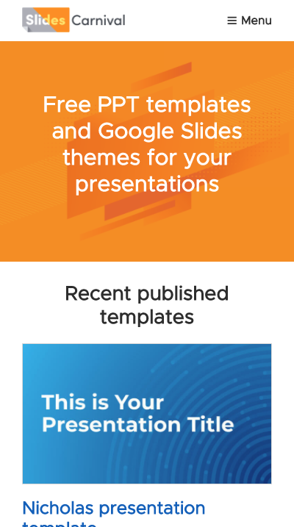
Mobile project
Show and explain your web, app or software projects using these gadget templates.

Slide 11
THANKS!
Any questions?
You can find me at:
@username
user@mail.me

