Slide 1

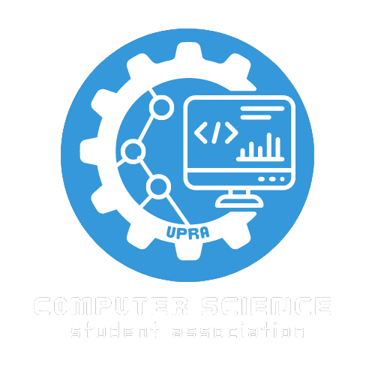

Git, GitHub & GitLab
Change Logo
Poner Nombres

Slide 2
QR Code de asistencia

Slide 3
Introduccion de quienes somos
EDIT IN GOOGLE SLIDES
Click on the button under the presentation preview that says "Use as Google Slides Theme".
You will get a copy of this document on your Google Drive and will be able to edit, add or delete slides.
You have to be signed in to your Google account.
EDIT IN POWERPOINT®
Click on the button under the presentation preview that says "Download as PowerPoint template". You will get a .pptx file that you can edit in PowerPoint.
Remember to download and install the fonts used in this presentation (you’ll find the links to the font files needed in the Presentation design slide)
More info on how to use this template at www.slidescarnival.com/help-use-presentation-template
This template is free to use under Creative Commons Attribution license. You can keep the Credits slide or mention SlidesCarnival and other resources used in a slide footer.

Slide 4
Version Control Softwre
1
Find Version Control Software Logos
What if Version Control Software?

Slide 5
Why is Version Control Software important?
Talk about how Git is a standard in the tech industry

Slide 6
What are Git Workflows?
Talk about importance of git workflows
Examples: Gitflow, Feature Branches, Pull Request Workflow, etc...

Slide 7
GitHub
What is GitHub?
How is Git & GitHub related?
Talk about repos (local and remote)
And some text
But remember not to overload your slides with content
Your audience will listen to you or read the content, but won’t do both.
Find GitHub Logo

Slide 8
Why should I create a GitHub Account?
Company Name
Company Logo
Blue
Is the colour of the clear sky and the deep sea. It is located between violet and green on the optical spectrum.
Red
Is the color of blood, and because of this it has historically been associated with sacrifice, danger and courage.
Yellow
Is the color of gold, butter and ripe lemons. In the spectrum of visible light, yellow is found between green and orange.
Blue
Is the colour of the clear sky and the deep sea. It is located between violet and green on the optical spectrum.
Red
Is the color of blood, and because of this it has historically been associated with sacrifice, danger and courage.

Slide 9
GitLab
What is GitLab?
What's the difference between GitHub and GitLab?
Here you have a list of items
And some text
But remember not to overload your slides with content
Your audience will listen to you or read the content, but won’t do both.
Find GitLab Logo

Slide 10
Open Source Software
2
Find related picture
What is Open Source Software?
How can I contribute to Open Source Software?

Slide 11
Popular Open Source Software
Company Name
Company Logo
Blue
Is the colour of the clear sky and the deep sea. It is located between violet and green on the optical spectrum.
Red
Is the color of blood, and because of this it has historically been associated with sacrifice, danger and courage.
Yellow
Is the color of gold, butter and ripe lemons. In the spectrum of visible light, yellow is found between green and orange.
Blue
Is the colour of the clear sky and the deep sea. It is located between violet and green on the optical spectrum.
Red
Is the color of blood, and because of this it has historically been associated with sacrifice, danger and courage.

Slide 12
Live Demonstration
2
Find related picture
Set up a repository
Create a Profile README

Slide 13
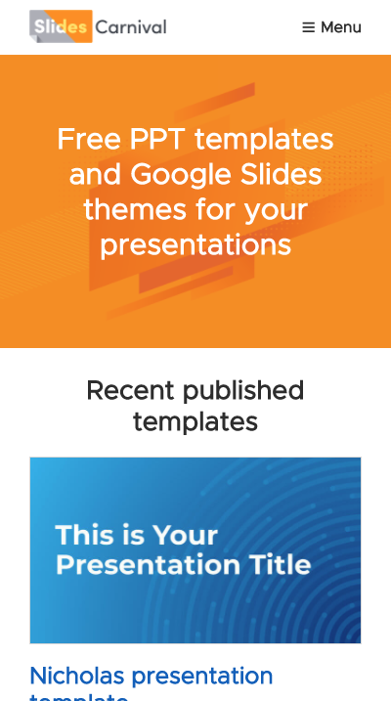
Mobile project
Show and explain your web, app or software projects using these gadget templates.

Slide 14
QR Code de redes sociales

Slide 15
THANKS!
Any questions?
You can find me at:
@username
user@mail.me

