Slide 1
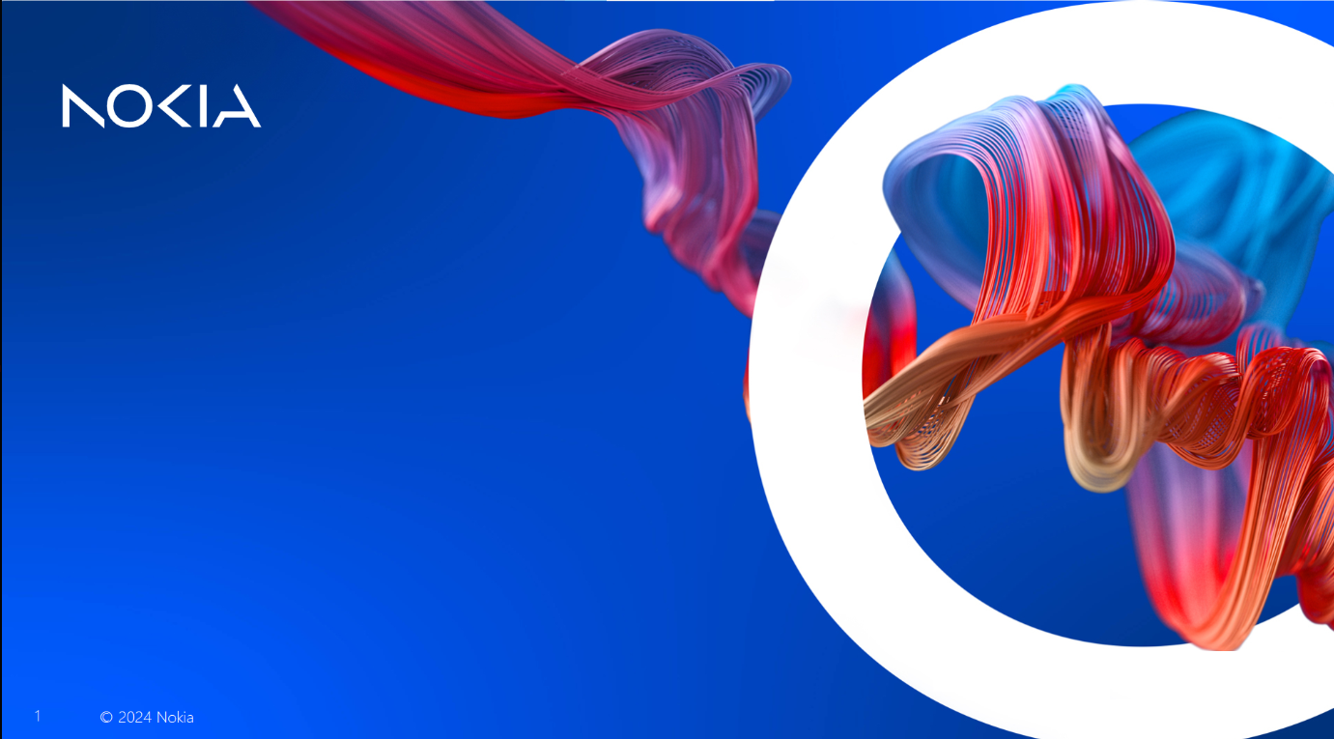
BTOR Training
Phase 3 – Composite intent v2
1

Slide 2


Supported Device Type and Supported Release
Supported Device Type | LS-FX, LS-MF
Supported Device Release | 25.3
NBI Impact | No
Migration | No
Intent Up Version | No
2

Slide 3
Requirements
Create HSI-Service composite intent with child intents: ONT, L2infra and L2user.
3

Slide 4
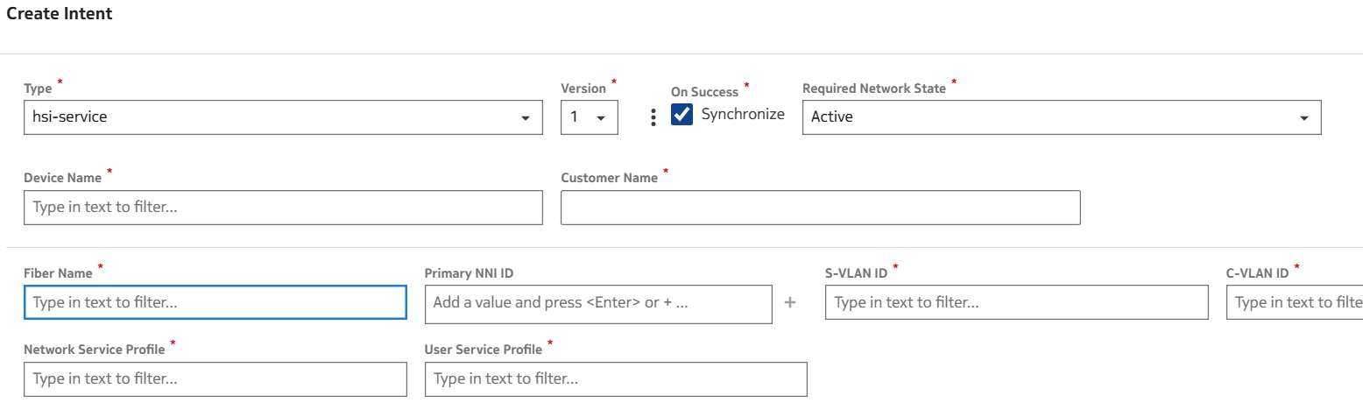
Requirements
Inputs:
4

Slide 5
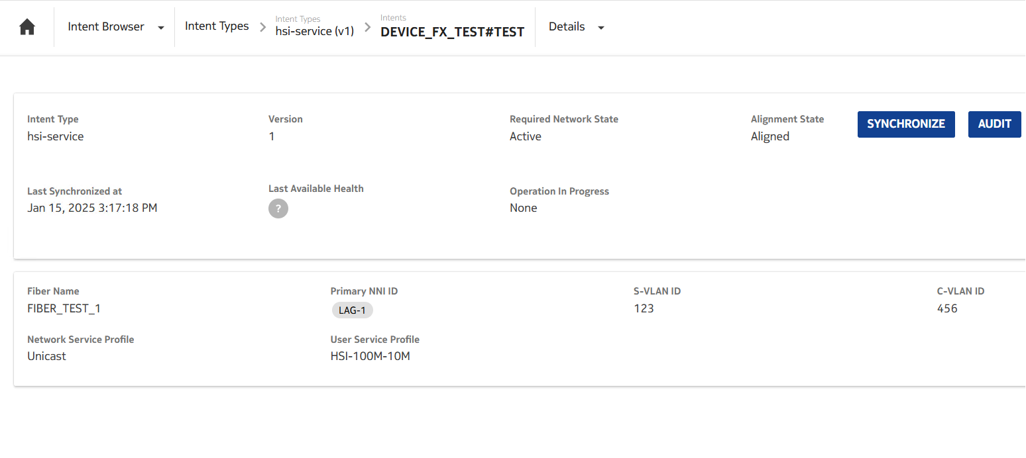
HSI-Service Configuration
5

Slide 6
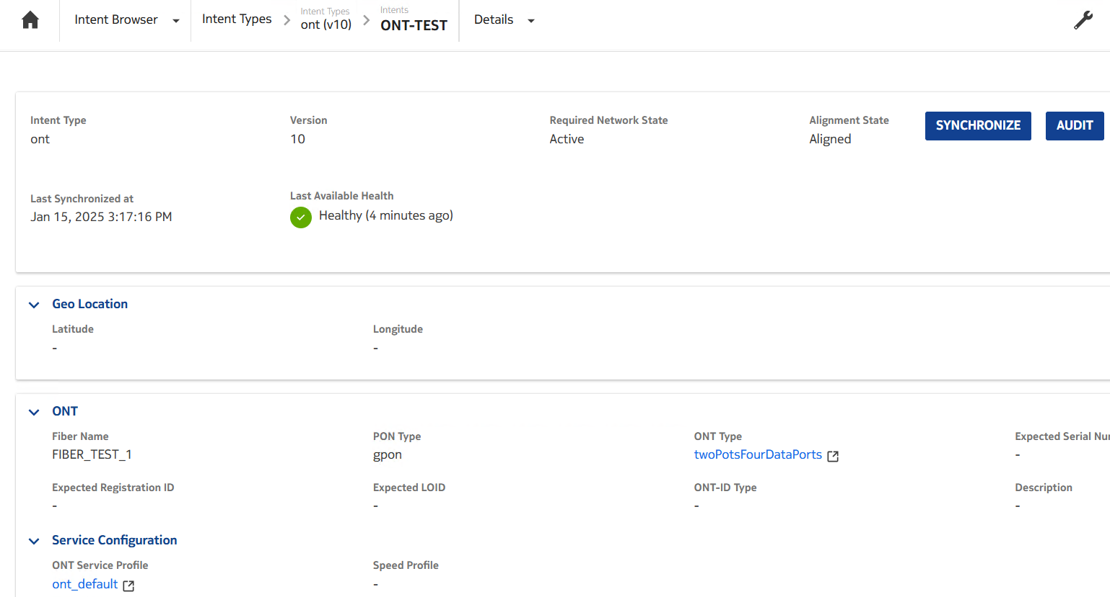
Expected Results - ONT
6

Slide 7
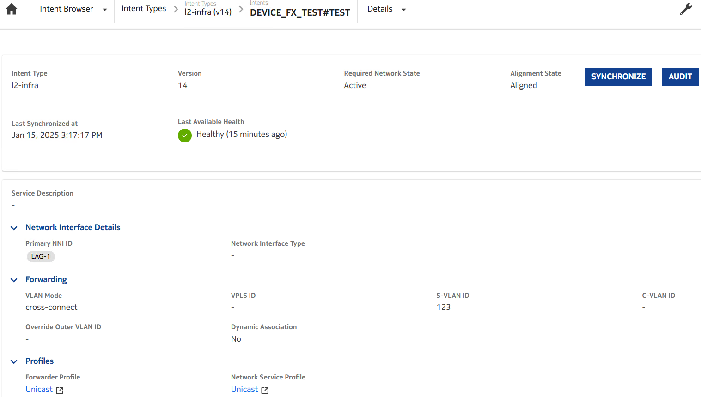
Expected Results - L2Infra
7

Slide 8
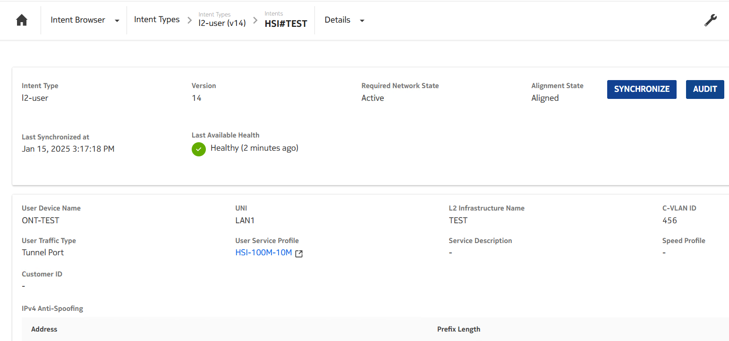
Expected Results - L2User
8

Slide 9


