Slide 1





PICTURE PUZZLE
Animal Theme

Slide 2

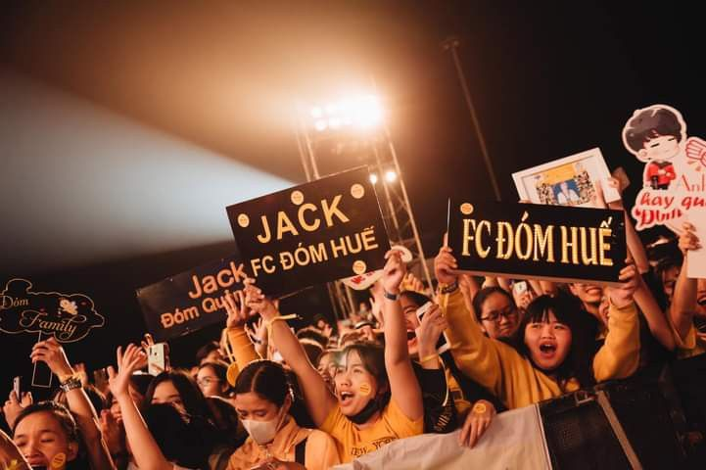


Firefly
1

Slide 3
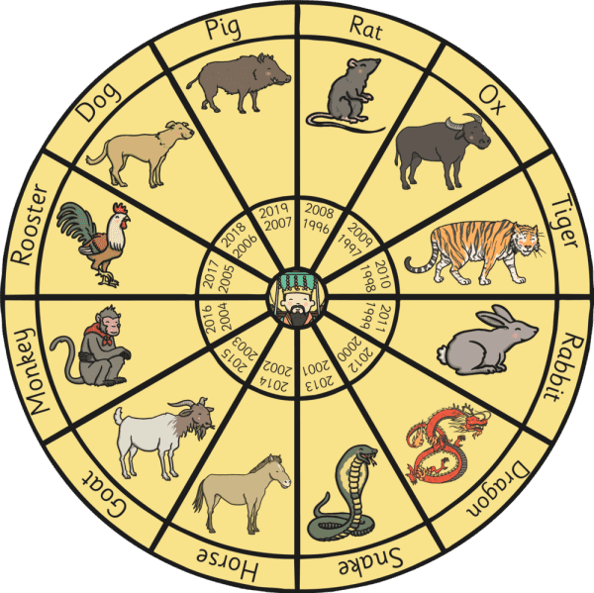


Snake
2

Slide 4

Tiger
3

Slide 5


Penguin
4

Slide 6
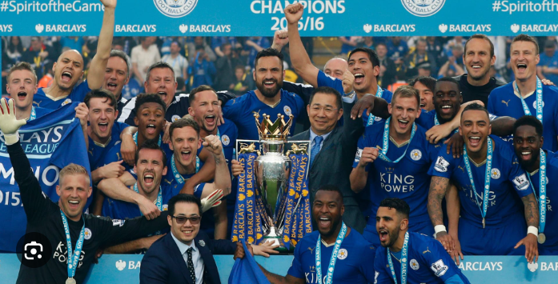
Fox
5

Slide 7


Kangaroo
6

Slide 8

270 °
Owl
7

Slide 9

Elephant
8

Slide 10
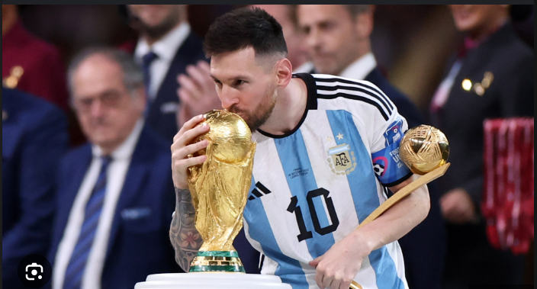
Goat
9

Slide 11







GAME OVER
Thank you for playing

