Slide 1

A Credit Risk Machine Learning Classification Model

Slide 2

Problem
How to minimize default Rates on personal loans?

Slide 3
The Dataset
Lending Tree borrowers data
Conducted between 2007 and 2011
42500 rows x 52 columns
Available on lendingtree.com

Slide 4
Data Preparation Steps
Handling missing Values
Eliminating columns leaking information from the future
Synthetic Minority Oversampling (SMOT) for class imbalance

Slide 5
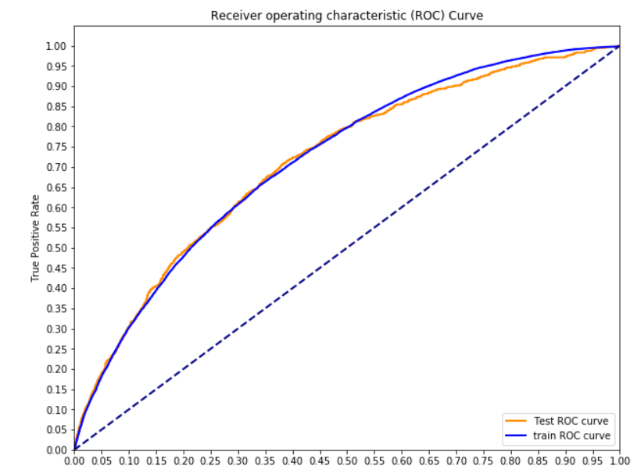
Evaluation Metric
Accuracy not a good indicator
True positive rate (recall)
False positive rate

Slide 6
Different Classification Models
Logistic Regression
Support Vector Machine
Random Forest
XGBoost

Slide 7
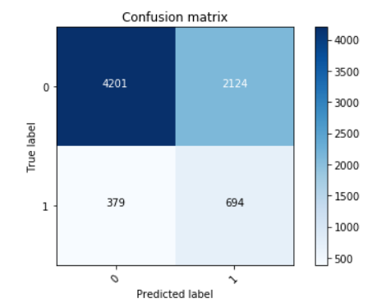
Which Model Did Best ?
Logistic regression provided the best results

Slide 8
Conclusion
We can predict 65% of the defaults that were initially approved by Lending Tree screening process
Drawback : the model still rejects a significant portion of the applicants who were not going to default

Slide 9
Next Steps
Improve gridsearch to optimize random forest and XGBoost model performance
Try different approaches to handling class imbalance
Determine levels of interest rates insuring profitability despites undetected defaults

