Slide 1
Householder Transformations: Tridiagonalization of Symmetric Matrices Kevin Mesta Sara Talebi
Collage of Arts & Science - Chemistry

Slide 2
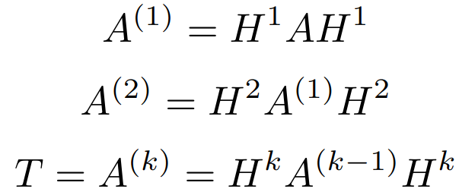
Purpose of Householder Transformation
Given a symmetric n×n matrix A, there exists n – 2 (k) Householder matrices that produce T, the tridiagonal matrix that is similar to the original matrix A
The Householder matrix is the matrix used eliminate entries below the main diagonal to diagonalize the matrix
The Householder transformation is most often used to perform QR decomposition since it provides greater numerical stability than other methods​
Collage of Arts & Science - Chemistry

Slide 3
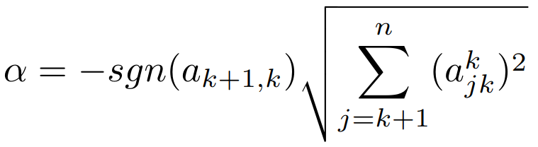

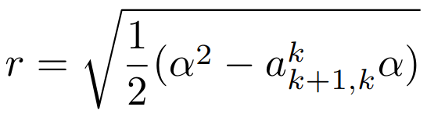
Constructing the Householder Matrix
The first step in constructing the Householder matrix is determining α and r:
Householder matrix is defined as:
where I is an identity matrix that is n×n, and v is a vector that is 1×n and has values following one of three rules
where a iterates through the original A matrix to the first, second … kth transformations
Collage of Arts & Science - Chemistry

Slide 4
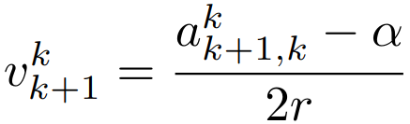

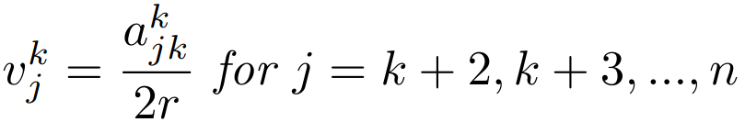
Constructing the Householder Matrix
Using the values of α and r previously calculated, v is constructed as follows:
Collage of Arts & Science - Chemistry

Slide 5
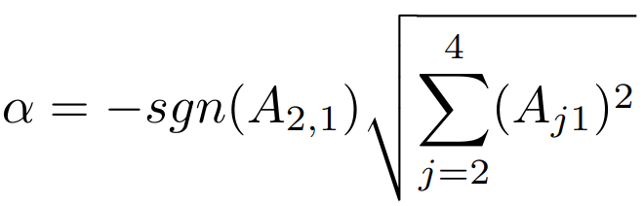
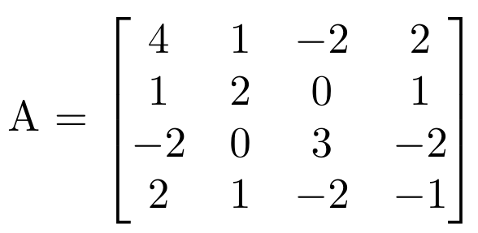
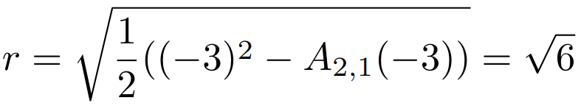
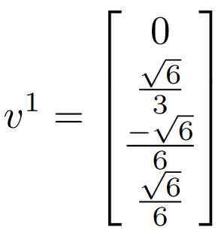
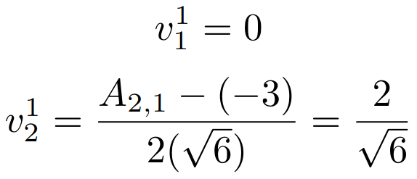
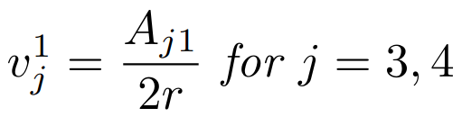
An Example: 4×4 Matrix
Collage of Arts & Science - Chemistry

Slide 6
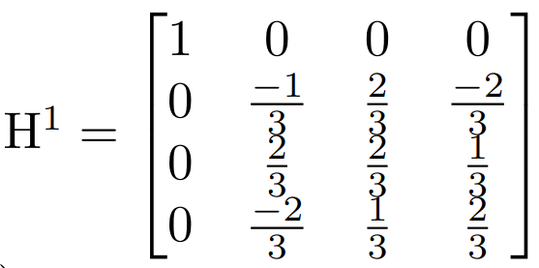
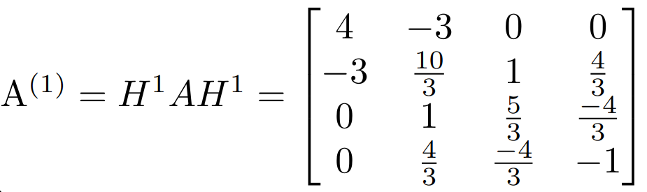
An Example: 4×4 Matrix
Collage of Arts & Science - Chemistry

Slide 7
Practice Problem
GitHub repo found at: https://github.com/mestakevin/ProjectHousehold.git
View the Householder_class_practice.py file
Householder algorithm has missing steps
Add back in missing steps
Confirm the transformed matrix has identical eigenvalues to original matrix
Collage of Arts & Science - Chemistry

Slide 8
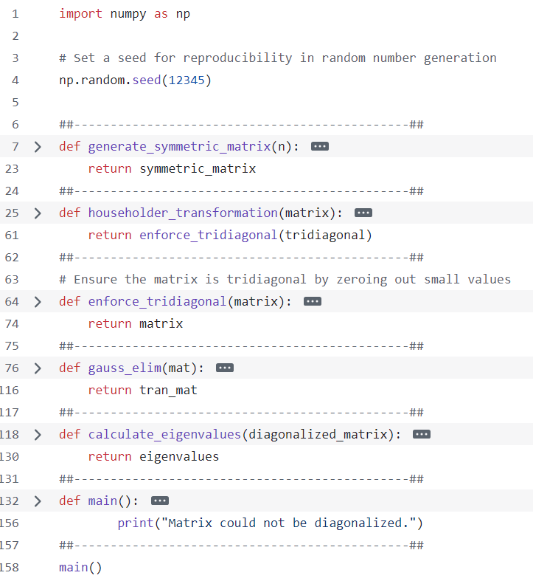
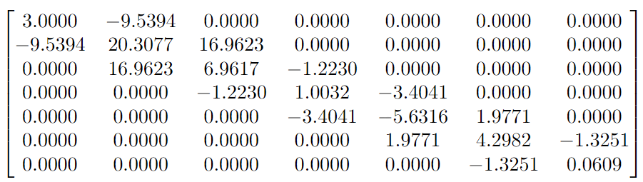
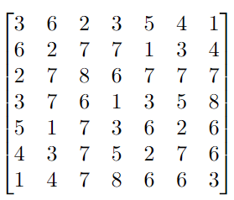
Practice Problem
Householder Tridiagonalized Symmetric Matrix
Initial Symmetric Matrix
Eigenvalues
Missing part in Householder function
Collage of Arts & Science - Chemistry

Slide 9
Equation Slide
Collage of Arts and Science - Chemistry

Slide 10
References
(1)Householder matrix. https://www.statlect.com/matrix-algebra/Householder-matrix (accessed 2024-11-20
(2)Higham, N. What Is a Householder Matrix?. Nick Higham. https://nhigham.com/2020/09/15/what-is-a-householder-matrix/ (accessed 2024-11-20).
Collage of Arts and Science - Chemistry

Slide 11
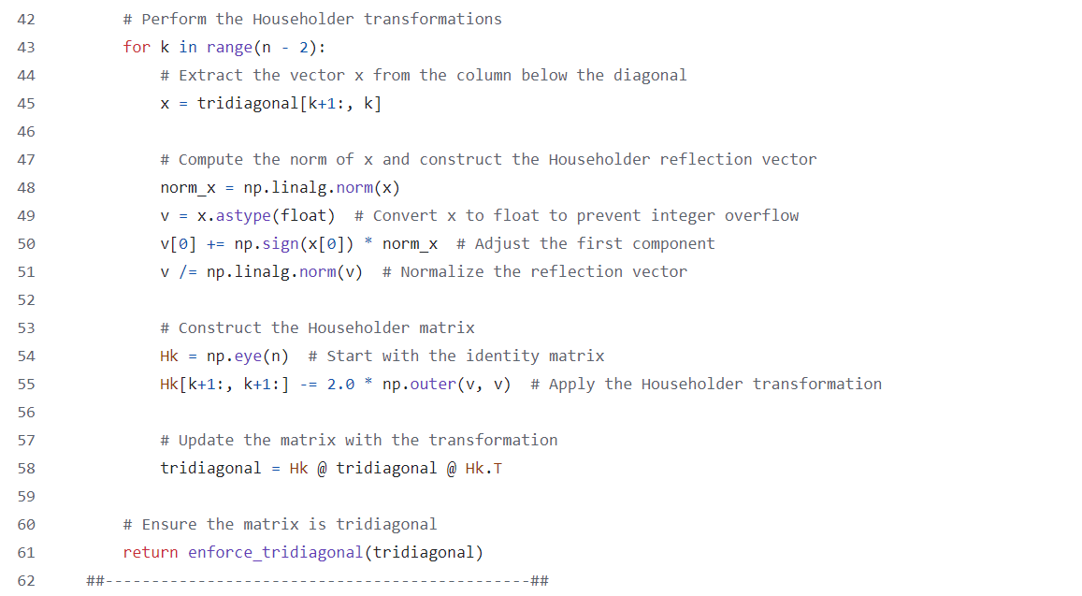
Householder Algorithm Solution
Collage of Arts and Science - Chemistry

