Slide 1



Tumour Geometric Complexity: A Proof of Concept Towards Explainable Quality Assurance in Radiotherapy Trials
Prof. Dr. Juliette Thariat
Muhammad Sufyan

Slide 2
A Bird’s Eye View
Introduction and Motivation
Methods : Formulism and matRad
Results
Discussions and Conclusions
Future Works

Slide 3
Introduction and Motivation
Radiotherapy, clinical trials, and the limits of quality assurance

Slide 4
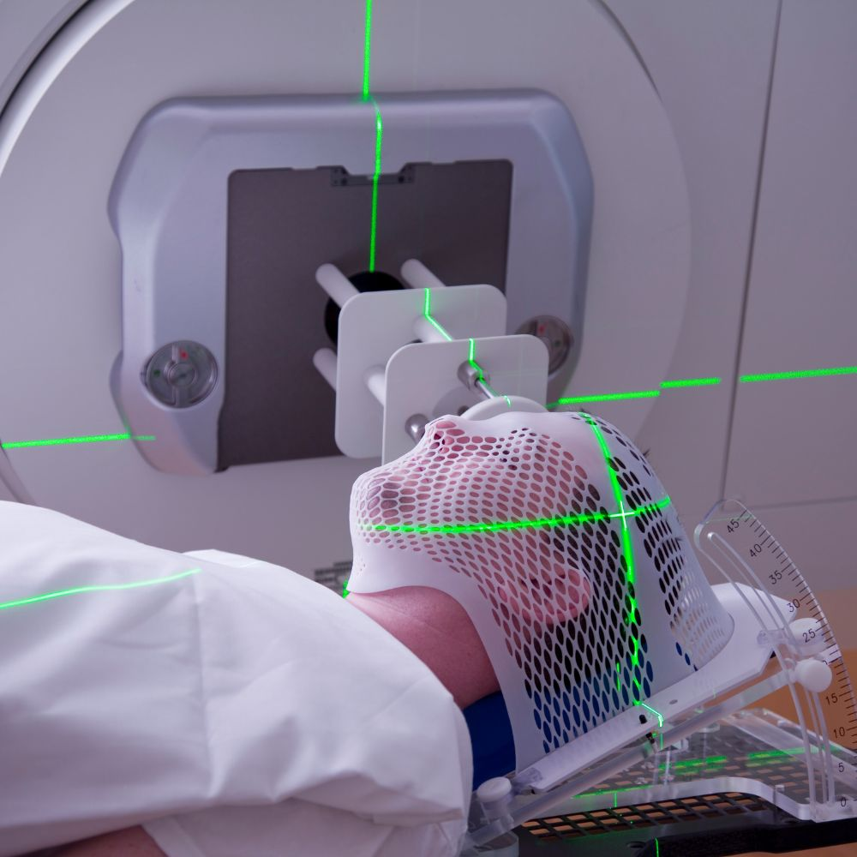
Radiotherapy and where Clinical Trials Fit
Introduction
Methods
Results
Conclusions
Future Works
Radiotherapy treats about 50% of cancer patients — a high dose to the tumour, sparing nearby healthy tissue.
New techniques reach patients through large multicentre clinical trials.
Quality assurance (QA) = the checks that each plan meets the trial protocol (centre credentialling + plan review).
It matters clinically: in the head-and-neck trial TROG 02.02, major plan deficiencies roughly halved two-year survival (≈50% vs 70%).
Peters et al., J Clin Oncol28(18):2996–3001, 2010 (TROG 02.02)

Slide 5
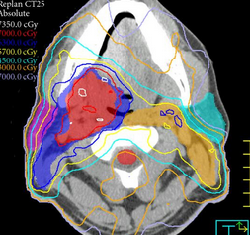
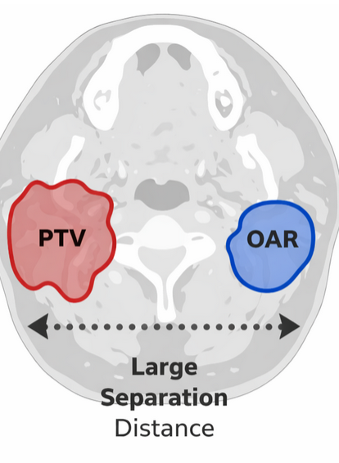
Its Limitations
Introduction
Methods
Results
Conclusions
Future Works
Current QA only gives two classes: Pass / Fail
If a plan is flagged as fail, It could be due to:
Poor or suboptimal planning
Intrinsic complexity of the patient anatomy
Manual, time consuming and expert-dependent
Inter-center variability in evaluation
Clinical history of the patient is not taken into account most of the times
Not easily scalable or manageable
FAIL
Quantify → Integrate → Automate

Slide 6
Objectives of the Thesis
Propose a contour-only geometric descriptor of tumour geometric complexity, the Geometric Volume Coefficient (GVC), so that a QA verdict can separate poor planning from intrinsic anatomical difficulty
- Formulate the descriptor from tumour and organ contours alone, with no dose input
- Test, as a proof of concept, whether it tracks delivered-dose difficulty across four modalities,
enabling a four-class verdict in place of pass/fail

Slide 7



Methods
The Geometric Volume Coefficient, and the planning study that tests it

Slide 8
Prior Work → Our Proposed Contour-Only Descriptor
Introduction
Methods
Results
Conclusions
Future Works
Prior work : the target–organ relation as a histogram (Kazhdan 2009; Zhu 2011; Yuan 2012). Özer et al. 2023 showed proximity predicts case difficulty, using non-standard planning structures.
Our step : quantify Tumour Geometric Complexity (TGC) : how hard a case is from anatomy alone, through a contour-only descriptor, the Geometric Volume Coefficient (GVC), needing no plan.
It splits each organ by distance into three zones: overlap (inside the target) · near-compression (within the dose fall-off) · separation (safe).
TGC : tumour geometric complexity: how hard a case is, from the anatomy alone
GVC : geometric volume coefficient : a contour-only score from these fractions. Higher means more of the organ sits in trouble.
Özgür et al., Radiotherapy & Oncology 2023; doi:10.1016/j.radonc.2023.109895.
Kazhdan 2009 · Zhu 2011 · Yuan 2012

Slide 9
Design Requirements for the Descriptor
Introduction
Methods
Results
Conclusions
Future Works
Intrinsic, not delivered : computed from anatomy and the prescription, independent of any realised dose or plan
Two levels : organ-level, to locate where the difficulty is; patient-level, to give one verdict per case
Volumetric : measure how much of an organ is compromised, not just whether it is close
Clinically weighted : the patient score reflects both each organ's intrinsic difficulty and its clinical importance
Interpretable : a number a clinician can read and act on, not a black box

Slide 10
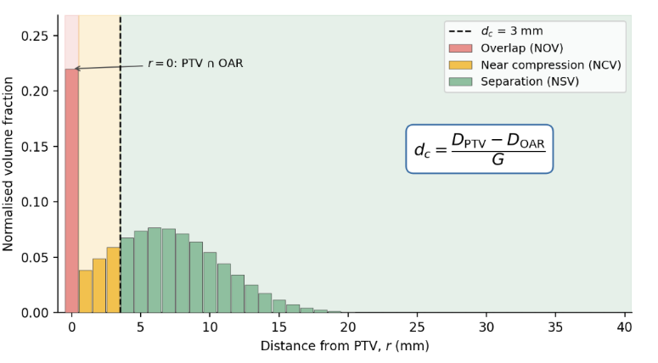


Tumour Geometric Complexity(TGC) - Quantification
Introduction
Methods
Results
Conclusions
Future Works
Overlap (NOV) intrinsic complexity — OAR inside the PTV
Near-Compression (NCV) machine-limited — too close to spare
Safe (NSV) far enough from the tumour to be spared
d_{c} = $\frac{DPTV − DOAR}{G}$
Differential Distance-to-Target Histogram of an OAR, split into three zones
Where D_{PTV} = prescribed PTV dose
D_{OAR} = OAR dose constraint (tolerance)
G = achievable dose gradient (Gy/mm)
Özgür et al., Radiotherapy & Oncology 2023; doi:10.1016/j.radonc.2023.109895.

Slide 11

Organ Level Geometric Volume Coefficient
Introduction
Methods
Results
Conclusions
Future Works
Overlap (NOV) intrinsic complexity — OAR inside the PTV
Near-Compression (NCV) machine-limited — too close to spare
Safe (NSV) far enough from the tumour to be spared
Organ Level Geometric Volume Cofficient (GVC)
$$GVC=α∙NOV+β∙NCV+γ∙NSV$$
Where $: α=1,β=0.5, γ=0$
Differential Distance-to-Target Histogram of an OAR, split into three zones
$$GVC=NOV+\frac{1}{2}NCV$$
α = 1, γ = 0 keep the score bounded (overlap full, separation ignored); β = 0.5 sets near-compression at the midpoint of partial recoverability : a PoC first hand choice.

Slide 12
Interpretation of Geometric Descriptor
Introduction
Methods
Results
Conclusions
Future Works
Engaged fraction (volume not free of risk):
E = NOV + NCV = 1 − NSV
The coefficient bounds it to within a factor of two:
GVC ≤ E ≤ min(2 GVC, 1)
Organ Level GVC | Engaged Volume % | Safe Volume %
0.0 | 0.0 | 100
0.2 | 20 - 40 | 60 - 80
0.5 | 50 - 100 | 50 - 0
1.0 | 100 | 0
Table — Interpretation of the GVC: the engaged and safe organ-volume fraction each coefficient implies (Eq. 2.6).

Slide 13

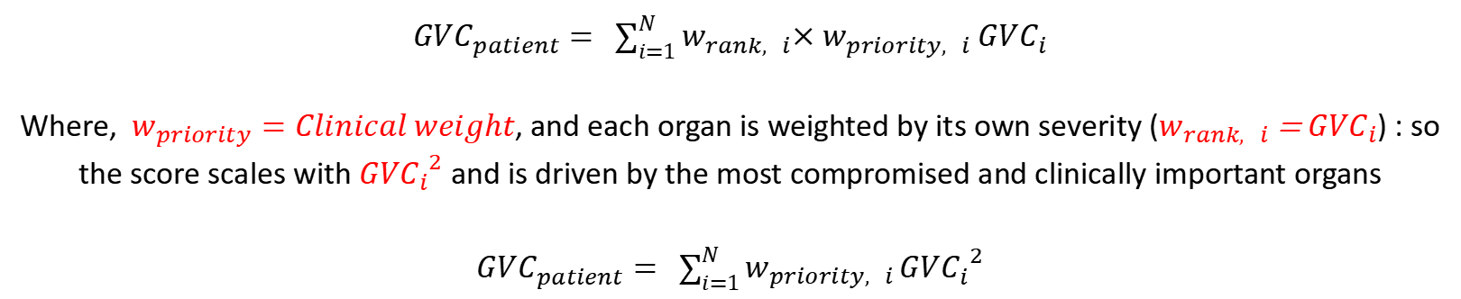
Patient Level Geometric Volume Coefficient
Introduction
Methods
Results
Conclusions
Future Works
Organ Level Geometric Volume Cofficient (GVC)
$$GVC=α∙NOV+β∙NCV+γ∙NSV$$
Where $: α=1,β=0.5, γ=0$
$$GVC=NOV+\frac{1}{2}NCV$$
Patient Level Geometric Volume Cofficient (GVC)
${GVC}_{patient}= \sum_{i=1}^{N}{w_{rank, i}{×w_{priority, i} GVC}_{i}}$
Where, $w_{priority}=Clinical weight$, and each organ is weighted by its own severity ($w_{rank, i}$ = ${GVC}_{i}$) : so the score scales with ${{GVC}_{i}}^{2}$ and is driven by the most compromised and clinically important organs
${GVC}_{patient}= \sum_{i=1}^{N}{w_{priority, i}}{{GVC}_{i}}^{2}$

Slide 14
Planning Study — matRad + Parameters
Introduction
Methods
Results
Conclusions
Future Works
Open-source planning toolkit : our dosimetric reference, not a clinical plan.
Inverse planning : optimises backwards from the prescribed dose, the paradigm our descriptor targets
Four modalities, one framework : photon, proton, helium, carbon; the modality is the only variable
Real patient CT : DICOM head-region anatomy, not phantoms
Open-source and scriptable : free, MATLAB-based, reproducible; lets us reach into the dose maps to extract the gradient G.
No OAR objectives applied : only the PTV is optimised, keeping the geometry–dose test unbiased.
Parameter | Value
Beams | 2
Prescribed dose | 30 Gy / 30 fx
Bixel width | 2.5 mm
Grid | 2.5³ mm
Gantry | 350°, 190°
Iso-centre | (0, 3.90, −7.40)
PTV objective | sq. dev. (w=300)
Three head-region patients; bi-institutional, IRB-approved (CFB INT-24-016; CLERS 5496). 30 Gy/30 fx is a normalisation, not a clinical schedule.

Slide 15
Results
Geometric complexity, delivered dose, and their agreement

Slide 16
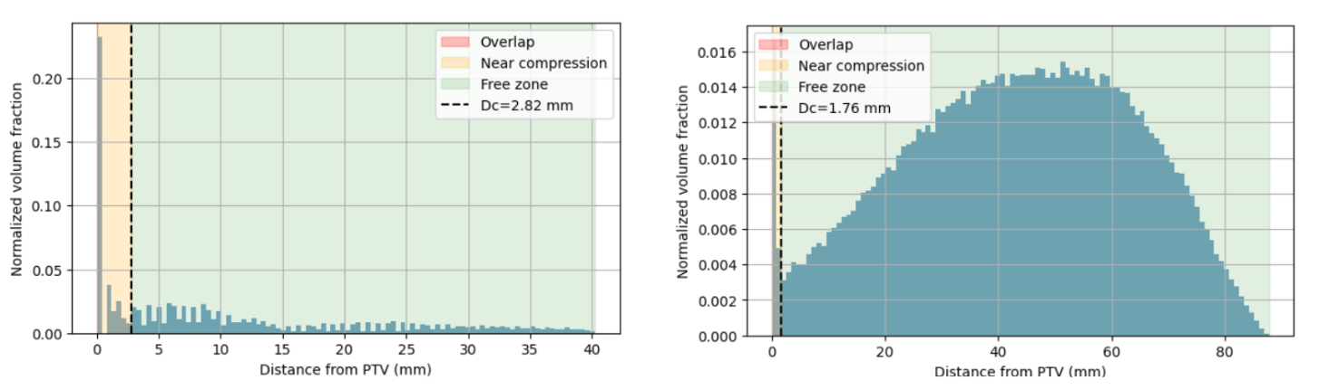
Distance to Target Histograms
Introduction
Methods
Results
Conclusions
Future Works
Fig 01 : Distance-to-target histograms relative to the planning target volume for two
organs at risk of the representative patient: the optic pathways (dc = 2.82 mm, left) and
the brain (dc = 1.76 mm, right).
G = 5.67 Gy/mm — 95th percentile of the dose gradient across the PTV boundary (matRad)

Slide 17
Organ-Level GVC — Representative Patient
Introduction
Methods
Results
Conclusions
Future Works
Organ | NOV | NCV | NSV | GVC
Chiasma (optic chiasm) | 0.4167 | 0.4063 | 0.1771 | 0.6198
Hippocampe G (hippocampus, L) | 0.0038 | 0.7664 | 0.2298 | 0.3870
Voies Optiques (optic pathways) | 0.2321 | 0.0991 | 0.6689 | 0.2816
Tronc (brainstem) | 0.0638 | 0.0782 | 0.8580 | 0.1029
Encéphale (brain) | 0.0166 | 0.0049 | 0.9784 | 0.0191
Hippocampe D (hippocampus, R) | 0.0000 | 0.0000 | 1.0000 | 0.0000
Rétine G (retina, L) | 0.0000 | 0.0000 | 1.0000 | 0.0000
Rétine D (retina, R) | 0.0000 | 0.0000 | 1.0000 | 0.0000
Parotide G (parotid, L) | 0.0000 | 0.0000 | 1.0000 | 0.0000
Parotide D (parotid, R) | 0.0000 | 0.0000 | 1.0000 | 0.0000
Representative patient, relative to the PTV. GVC = NOV + ½·NCV. Chiasm is overlap-driven; left hippocampus is near-compression-driven; five OARs return exactly zero.

Slide 18
Patient-Level GVC — Representative Patient
Introduction
Methods
Results
Conclusions
Future Works
Organ | GVC | w_{priority} | GVC² | w·GVC² | Contribution %
Chiasma | 0.6198 | 0.90 | 0.3841 | 0.3457 | 65.88
Hippocampe G | 0.3870 | 0.65 | 0.1498 | 0.0974 | 18.55
Voies Optiques | 0.2816 | 0.90 | 0.0793 | 0.0714 | 13.60
Tronc | 0.1029 | 0.95 | 0.0106 | 0.0101 | 1.92
Encéphale | 0.0191 | 0.75 | 0.0004 | 0.0003 | 0.05
Patient-level GVC |  |  |  | 0.5248 | 100
More than 98% of the patient-level GVC is carried by the three most entangled structures; the least-engaged organs still contribute rather than being averaged away.
GVC_patient = Σ w_priority·GVC² (quadratic aggregation)
Priority weights from Marks 2010 / Mayo 2010 / Lambrecht 2018.

Slide 19
Organ-Level GVC Across Three Patients
Introduction
Methods
Results
Conclusions
Future Works
Organ | Patient 1 | Patient 2 | Patient 3
Chiasma (optic chiasm) | 0.6198 | 0.9938 | 0.1395
Voies Optiques (optic pathways) | 0.2816 | 0.5237 | 0.0938
Hippocampe G (hippocampus, L) | 0.3870 | 0.1441 | 0.0099
Hippocampe D (hippocampus, R) | 0.0000 | 0.0272 | 0.0970
Tronc (brainstem) | 0.1029 | 0.0319 | 0.0913
Encéphale (brain) | 0.0191 | 0.0187 | 0.0375
Rétine G (retina, L) | 0.0000 | 0.0000 | 0.0000
Rétine D (retina, R) | 0.0000 | 0.0000 | 0.0000
Parotide G (parotid, L) | 0.0000 | 0.0000 | 0.0000
Parotide D (parotid, R) | 0.0000 | 0.0000 | 0.0000
Patient-level GVC | 0.5248 | 1.1509 | 0.0406
0.9938
Patient-level GVC spans 0.04–1.15. The second-ranked organ changes per patient; Patient 2 exceeds unity, as the unbounded severity score permits.

Slide 20
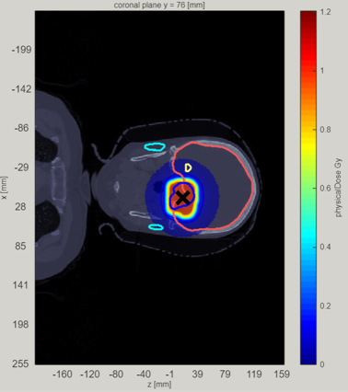
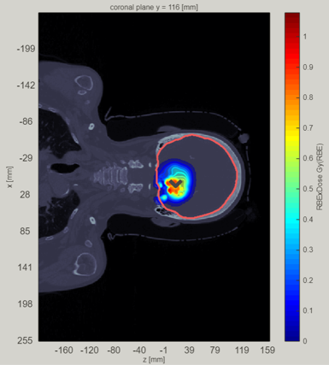


matRad - Dose Distributions
Introduction
Methods
Results
Conclusions
Future Works
Photon
Proton
Helium
Carbon
Figure — Dose distributions (A–D): photons spread widest, ions confine tightest. matRad Cleve v3.1.0 (Wieser 2017).

Slide 21
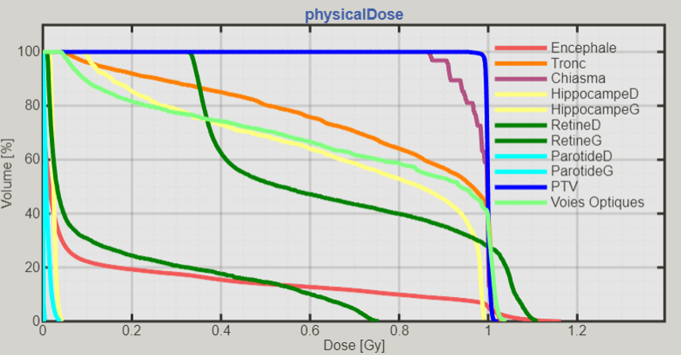
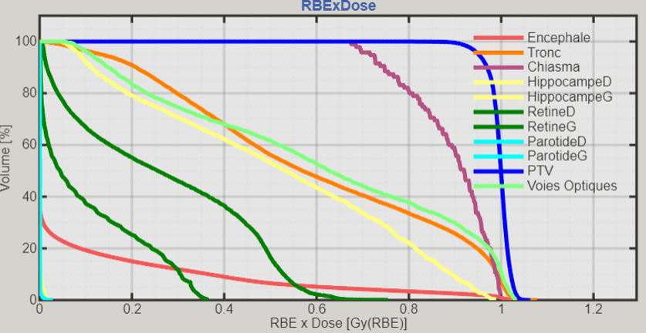
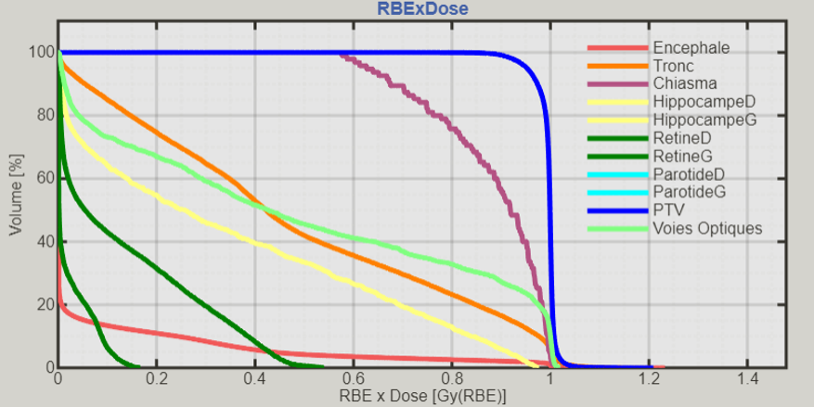
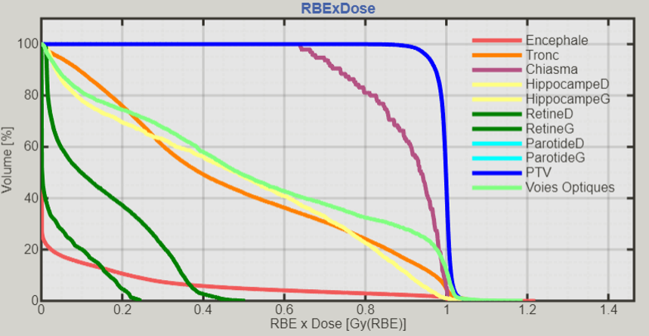
matRad - Dose Volume Histograms
Introduction
Methods
Results
Conclusions
Future Works
Photon
Proton
Helium
Carbon
Figure — DVHs (A–D): all plans cover the PTV; they separate on the OAR curves. matRad Cleve v3.1.0 (Wieser 2017).

Slide 22
Mean Doses — All Three Patients
Introduction
Methods
Results
Conclusions
Future Works
 | Patient I |  |  |  | Patient II |  |  |  | Patient III
Structure | Ph | Pr | He | Ca | Ph | Pr | He | Ca | Ph | Pr | He | Ca
PTV | .9997 | .9964 | .9943 | .9951 | .9991 | .9933 | .9907 | .9912 | .9999 | .9966 | .9784 | .9959
Chiasma | .9805 | .8914 | .8788 | .9000 | .9996 | 1.0001 | .9976 | .9975 | .8606 | .7405 | .4916 | .6372
Voies Optiques | .7104 | .6083 | .4891 | .5310 | .8904 | .7295 | .6498 | .6773 | .4494 | .3247 | .2003 | .2676
Hippocampe G | .6837 | .5168 | .3436 | .4707 | .7407 | .2977 | .1361 | .1629 | .3022 | .1108 | .0341 | .0585
Hippocampe D | .0248 | .0010 | .0001 | .0000 | .1870 | .1709 | .0490 | .0673 | .3619 | .2826 | .1339 | .1627
Tronc | .7875 | .5963 | .4780 | .4785 | .9273 | .6409 | .5519 | .5336 | .2765 | .2588 | .1650 | .2121
Encéphale | .1591 | .0917 | .0640 | .0677 | .2358 | .1171 | .0842 | .0822 | .3081 | .1657 | .1066 | .1204
Rétine G | .6624 | .2684 | .1347 | .1503 | .5065 | .1298 | .0552 | .0791 | .1036 | .0003 | .0004 | .0029
Rétine D | .1558 | .1047 | .0237 | .0428 | .4441 | .2263 | .1268 | .1146 | .0656 | .0290 | .0061 | .0083
Parotide G | .0094 | .0002 | .0000 | .0000 | .0047 | .0000 | .0000 | .0000 | .0000 | .0000 | .0000 | .0000
Parotide D | .0003 | .0000 | .0000 | .0000 | .0014 | .0000 | .0000 | .0000 | .0000 | .0000 | .0000 | .0000
.9996 | 1.0001 | .9976 | .9975
Mean dose relative to prescription. Patient 2 chiasm ≈ 1.0 across every modality — anatomy-limited, flagged in advance by the highest GVC in the study.

Slide 23
Interesting Cases
Case | GVC | Photon → Best Ion | Reading
Parotide D — P1, P3 | 0.00 | 0.00 → 0.00 | True negative : spared by all
Rétine G — P1 | 0.00 | 0.66 → 0.13 | In beam path : GVC blind
Chiasma — P2 | 0.99 | 0.99 → 0.99 | Overlap : no plan spares it
Hippocampe G — P1 | 0.39 | 0.68 → 0.34 | Near-compression : ions halve it
Chiasma — P2 vs P3 | 0.99 / 0.14 | 1.00 / 0.49 | Same organ, anatomy decides
Table — Selected cases: where geometry and dose agree (true negatives, overlap-limited) and where the radial GVC misses beam-path organs.

Slide 24
Agreement: GVC vs Delivered Dose
Introduction
Methods
Results
Conclusions
Future Works
Patient | Photon | Proton | Helium | Carbon
Patient 1 | 0.847** | 0.821** | 0.862** | 0.870**
Patient 2 | 0.769** | 0.853** | 0.828** | 0.828**
Patient 3 | 0.922** | 0.960** | 0.935** | 0.935**
Ordering the OARs by their contour-only GVC reproduces the ordering of their mean delivered doses.
Holds for every modality and every patient: ρ = 0.77–0.96 across the twelve combinations, all significant.
A purely geometric descriptor recovers the dose burden the anatomy imposes — the central result.
Spearman ρ over all ten OARs. One-tailed; ** p < 0.01.

Slide 25
Sensitivity: Non-Zero Organs Only
Introduction
Methods
Results
Conclusions
Future Works
Patient | n | Photon | Proton | Helium | Carbon
Patient 1 | 5 | 0.600 | 0.700 | 0.700 | 0.700
Patient 2 | 6 | 0.771 | 0.943** | 0.886** | 0.886**
Patient 3 | 6 | 0.771 | 0.943** | 0.829* | 0.829*
Restricted to the entangled organs, the correlation stays positive throughout (0.60–0.94).
Six of twelve combinations reach p < 0.05 — none in Patient 1, where n = 5 caps the achievable significance.
A question of statistical power, not of the relationship; ranking among entangled organs needs the full cohort.
Non-zero-GVC OARs only (n = 5 for Patient 1, n = 6 for Patients 2–3). One-tailed; * p<0.05, ** p<0.01.

Slide 26
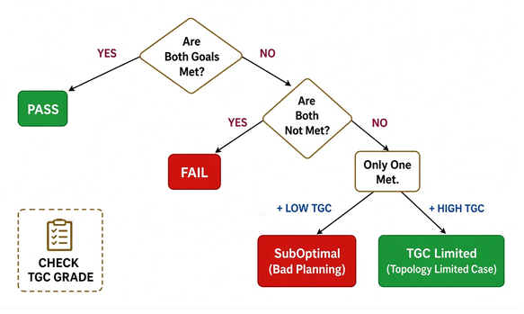
Two Classes to Four Classes
Introduction
Methods
Results
Conclusions
Future Works
TGC : Tumour Geometric Complexity

Slide 27
Discussion and Conclusions
Discussion Points - Limitations - Conclusions

Slide 28
What the Descriptor Shows — and Its Limits
Introduction
Methods
Results
Conclusions
Future Works
Not circular : GVC comes from contours, before any plan; only the PTV was optimised.
Patient 2's chiasm : fully overlapped, spared by no modality; flagged in advance as the highest GVC.
Limitations
Three patients : proof of concept; the complexity cut-off is not yet set
Proposed, not derived : the form and its fixed numbers (½ penalty, one G, organ weights) are chosen, not fitted
Blind to beam direction : a far organ in the beam path still gets dose; the retina is the case (GVC = 0, real dose)

Slide 29
Conclusions
Introduction
Methods
Results
Conclusions
Future Works
Difficulty from geometry alone : GVC grades a case from contours, at organ and patient level, no plan needed
It tracks the dose : the contour-only ordering reproduces the delivered ordering (ρ = 0.77–0.96) across all four modalities, all three patients
A verdict that explains : opens binary QA into four classes: Pass · Fail · Sub-optimal · Complexity-limited
Proof of concept : three cases; parameters and the four classes await cohort validation

Slide 30
Future Work
Integration - Automation

Slide 31
Future Work → Streamline-QART
Introduction
Methods
Results
Conclusions
Future Works
Extend the descriptor
A second, angular term : GVC sees distance, not direction. Add beam's-eye occlusion (GVC_angular) so path organs like the retina score non-zero. Final GVC = GVC_anatomy + λ·GVC_angular, λ modality-dependent.
Build the programme
Scale to cohort : GVC as distributions; optimise penalties; G per modality
Validate the four classes : against recorded QA verdicts; fix the complexity cut-off
Automate : GVC as the feature for a learned four-class model
Prognostic QA (longer term) : link complexity to control, survival, toxicity

Slide 32
Thank You!

Slide 33
Current Quality Assurance
Introduction
Methods
Results
Conclusions
Future Works
Contours : GTV/CTV/PTV and OARs delineated per protocol?
Dose–volume metrics : DVH checks against protocol constraints (target coverage D95/D98, OAR limits like Dmax, Dmean)
Plan quality indices : conformity index, homogeneity index
The human judgement layer : an expert panel reads all this and issues a verdict

Slide 34
Automation: Project Flow
Introduction
Methods
Results
Conclusions
Future Works
Objective : predict the four-class QA verdict from routinely available data; multimodal learning.
Verdict : Pass · Fail · Sub-optimal · Complexity-limited
 | Phase I | Phase II | Phase III
In | Tabular — GVC, clinical (plan-free) · DVH, dose metrics (plan-derived) | Imaging — CT, RTSTRUCT, RTDOSE | Both streams
Learn | attention on tabular | DL on RT-DICOM | multimodal fusion → verdict
Figure — Proposed multimodal pipeline (planned PhD work): reduced and spatial streams fused to predict the four QA classes.

